Slide 1
Escambia County Public Schools
Health Services
MEDICATION ADMINISTRATION
2026-2027
Annual Review
Presented by: Betty Hagans, MSN, RN School Health Coordinator

Slide 2
This module, post-test, Seizure training video, Anaphylaxis training video, and check-off of skills by an RN fulfill the annual medication training requirement for staff administering medications.
Before administering medication, the following checklist must be in the student-specific training book.
Graded test
Diabetic Skills (if applicable)
Annual Medication Administration Checklist
Emergency Seizure Medication (if applicable)
Emergency Anaphylaxis Medication (if applicable)
Anaphylaxis Certificate
Seizure Certificate
Please contact your clinic RN supervisor to schedule a time to complete your training.
Notes:
*** THIS POWERPOINT IS MEANT TO BE A BASIC OVERVIEW. THE RN SUPERVISOR WILL PROVIDE SPECIFIC TRAINING AND ANSWER ALL QUESTIONS.

Slide 3
Health Services Webpage https://www.escambiaschools.org/departments/health-services/home
All information and forms related to school health will be found on this webpage.
You will need five forms to check in medication
    Dispersion of Medication form
    Student Medication Record (SMR)
    Medication Count Form
    Parent handout
    Clinic Note

Slide 4
Dispersion of Medication/Tracking Log
D:\26-27 Forms - PDF Versions\26-27 DOM & MED TRACKING.pdf
This form is used to check all medications into the clinic.
The back side of the form is the Medication Tracking Log. This is where staff/parent will agree and sign off on the amount checked in or out.
Staff will fill out the form. A parent should not fill it out.
The label must be written EXACTLY as it is printed on the prescription label.
Time due: Must be a time. If the bottle reads to be given at lunch, the lunch time will be verified, and that time will be the time due.
Allergies- Never write N/A. If student does not have any allergies, none or NKA (no known allergies) will be written.
Parent or guardian will sign the bottom of this form as well as the staff checking in the medication.
If parent does not sign the form in front of staff, the form must be notarized.

Slide 5
Dispersion of Medication/Tracking Log
The back side of the form is the Medication Tracking Log.
Medication will be counted, and the amount received or signed out will be written on this form.
The parent/guardian and staff will sign, agreeing on the amount.
Check the expiration date of the medication before filling out paperwork.
The DOM must be uploaded into Focus the day the medication is checked in.

Slide 6
Student Medication Record (SMR)
D:\26-27 Forms - PDF Versions\26-27 Yearly SMR.pdf
This form must be filled out the same as the DOM
Medication administration must be documented immediately
Medication can be given one hour before or up to one hour after the time due
Do not leave any blank spaces on the form

Slide 7
Medication Count Form
D:\26-27 Forms - PDF Versions\26-27 MEDICATION COUNT FORM.pdf
This form is used by the RN and Health Tech to count their medications.
Clinic backups do not need to use this form.

Slide 8
Parent Handout
D:\26-27 Forms - PDF Versions\26-27 Med Protocol at School Parent Resp.pdf
This form is to be given to the parent when medication is checked in.
#4 Medication must be provided in the original container and must feature a current, recent pharmacy fill date. Older refills or expired prescriptions cannot be accepted.
#7 Morning medication doses should be administered at home.
The RN supervisor can be contacted for clarification. When in doubt, call the RN

Slide 9
Clinic Note
D:\26-27 Forms - PDF Versions\26-27 Clinic Treatment Notes- Landscape.pdf
This form is to be placed in the medication book behind the SMR
Use this form to make a note of important things such as calling a parent to let them know they are low on medications
The form will be scanned into Focus once it is full or at the end of the school year.

Slide 10
Students Carrying Medication
Students can possess and self-administer over-the-counter headache medication on school property and at school-sponsored events without a physician's note or prescription, as long as it is a (FDA)-regulated product intended for over-the-counter headache treatment. Students are responsible for using the medication solely for themselves. Medication must be in the original bottle.
Students may carry an Inhaler, Epinephrine, pancreatic enzymes, diabetes medication and Supplies only if the following is complete
    Physician must Sign part 3 of the Dispersion of Medication Form
    Physician must check the carry and self-administration box.
    Parent must sign part 4 of the Dispersion of Medication Form
    Student will be given a copy of this form to carry with the medication.
    This form will be placed in the Medication book.
    The student and medication will be added to the Tick Sheet

Slide 11
IMPORTANT
All medication must be in the original bottle.
Do not take medication if it is different colors, shapes and sizes. The bottle will tell you the shape, color, and identification of the medication.
Medication must be counted with parent/guardian.
Morning medication doses should be given at home.
Medications must be FDA-approved.
Medications cannot be expired. Emergency medications and Inhalers will have a label expiration date as well as a medication expiration date.
Do not discuss student’s medical care with other staff.
Do not use white-out. Draw a line through error, date, and initial.
When taking in a refill, if the label reads differently than the Dispersion of Medication form, you MUST fill out a new Dispersion of Medication form.
Medication must be age-appropriate.

Slide 12
Medication Label
All medications must have a label.
The label must have appropriate instructions. Contact the RN supervisor for clarification if unsure when checking a medication into the clinic.
Examples of labels that are not acceptable and require follow up:
See attached (where is the attached)
Use as needed for seizure (at onset, 3min, 5min)
Give two puffs as needed for wheezing (How often)
Use as directed (Request a faxed order from Dr. clarifying directions)
Notes:
IF YOU ARE ATTENDING THIS COURSE IN PERSON, EXPLANATIONS AND EXAMPLES WILL BE GIVEN. IF YOU ARE TAKING THIS COURSE ONLINE, THE RN SUPERVISOR WILL FURTHER EXPLAIN AND GIVE EXAMPLES

Slide 13
8 RIGHTS OF MEDICATION
EVERY STUDENT, EVERY DOSE
Right Student: Ask the student to say his or her name and compare this to the name on the medication label. If the student is unable to state his or her name, another staff member who knows the student should be asked.
Right Medication: Compare the medication name on the Authorization form with the label on the medication container.
Right Dose: Compare the dose listed on the Dispersion of Medication Form, the Student Medication Record, and the dose printed on the medication label.
Right Route: Administer the medication by the route specified on the medication label. Route may be oral, nasal, inhaled, injected, rectal, topical etc.
Right Time: The medication must be given within 1 hour of the prescribed time (no more than 1 hour before or 1 hour after the ordered administration time).
Right Documentation: Each medication administered must be documented immediately.
Right Expiration: Check the medication expiration date and the label expiration date.
Right to Refuse: Do NOT force a student to take medication. If the student refuses, contact parent, administration and RN supervisor.

Slide 14
MEDICATION ERRORS
If a medication error occurs, complete a Medication Error form and fax to Health Services @ 5346
Medication errors and adverse reactions must be documented on the Clinic Note Form or in Focus in the daily visit log.
Alert: Notify principal, RN supervisor, Health Services Coordinator, and parent of error.

Slide 15
Emergency Medications
Common Emergency Medications seen in the clinic
  Epinephrine- Used to treat Anaphylaxis (Severe allergic reaction) -Comes in auto-injector or nasal form.
  Glucagon- Used to treat severe Hypoglycemia- Comes in an injection and nasal form.
  Valtoco, Nayzilam, Diastat- Used to treat Seizure activity. Comes in rectal and nasal form.
  The student’s Emergency Action Plan will give instructions on the care the student should receive. These plans can be found under the medical tab in Focus and printed in the Care Plan Book in the clinic.
  You must have Student Specific Training completed with an RN before administering these medications. IT IS THE LAW!
  YOU MUST CALL 911 ANYTIME AN EMERGENCY MEDICATION IS GIVEN

Slide 16
MEDICAL EVENTS
  Any time 911 is called, you must notify Betty Hagans, the School Health Coordinator @ 850-469-5456, or Deidra Nimblett, the Health Services Registered Nurse @850-439-2681.
  A Medical Event Report must be filled out and faxed to 5346 within 24 hours.
  This form can be found on the district webpage as well as in the medication book.

Slide 17
DIABETES
  The RN Supervisor must be notified of all new diabetic students before care is provided.
  Do not provide care for a diabetic student if you have not had student-specific training with a registered nurse.
  All Diabetic students will have an emergency action plan and orders from a physician.
Notes:
This presentation is a brief over view of Diabetes. In depth training will be provided by the RN supervisor.

Slide 18
DIABETES
  Follow This Link To View Diabetes Basic Training Video
  Follow This Link To View Diabetes PP
Notes:
This presentation is a brief over view of Diabetes. In depth training will be provided by the RN supervisor.

Slide 19
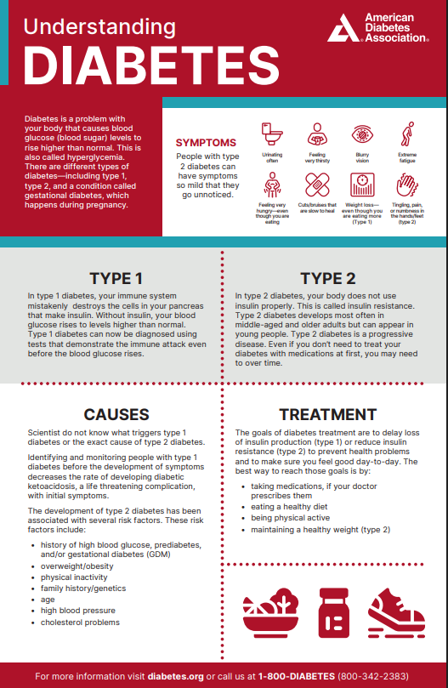
Notes:
This presentation is a brief over view of Diabetes. In depth training will be provided by the RN supervisor.

Slide 20
Diabetic Emergency Medication
If a student is not able to eat or drink, administer the emergency medication if available.
911 must be called if any emergency medication is administered.
If student does not have medication checked into the clinic, call 911.
May cause nausea and vomiting. Turn student on side if able.
Stay with student until EMS arrives
DOCUMENT
Notes:
You may use cake icing to raise blood glucose by placing on cheek. Never give juice to an unconscious student.

Slide 21
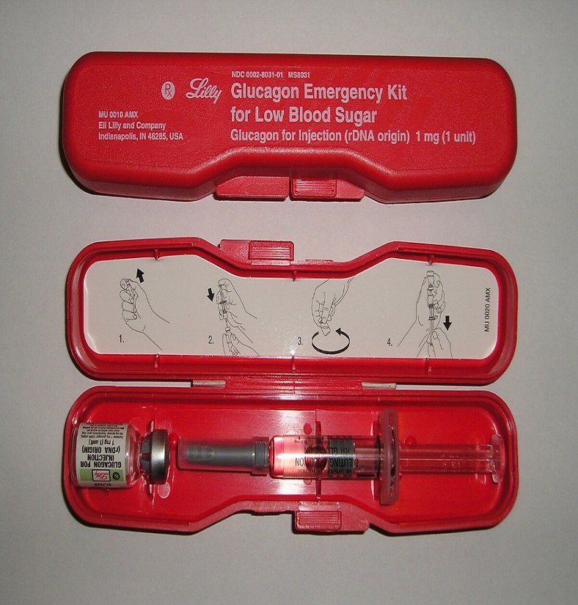
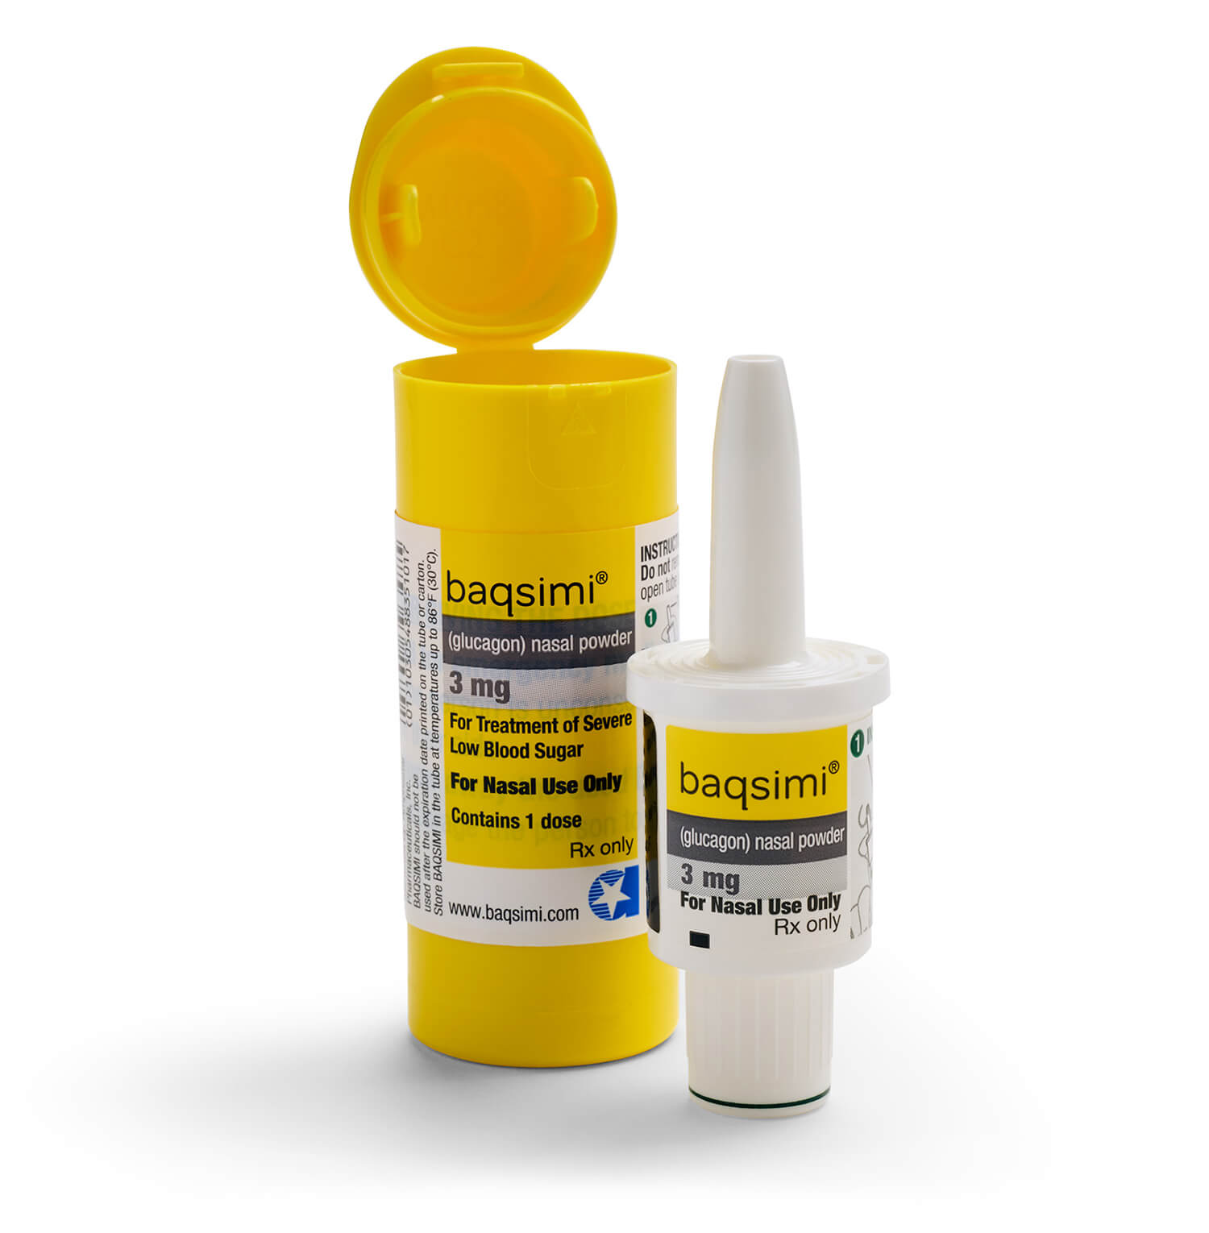
Diabetic Emergency Medication
Glucagon is the emergency medication given.
It can be in the form of an inhalant or an injection.
This Photo by Unknown Author is licensed under CC BY-SA
Notes:
Student-specific training will be done in the clinic with the RN Supervisor

Slide 22
WHAT IS ANAPHYLAXIS?
A severe, life-threatening allergic reaction that can occur when individuals are exposed to specific allergens

Slide 23
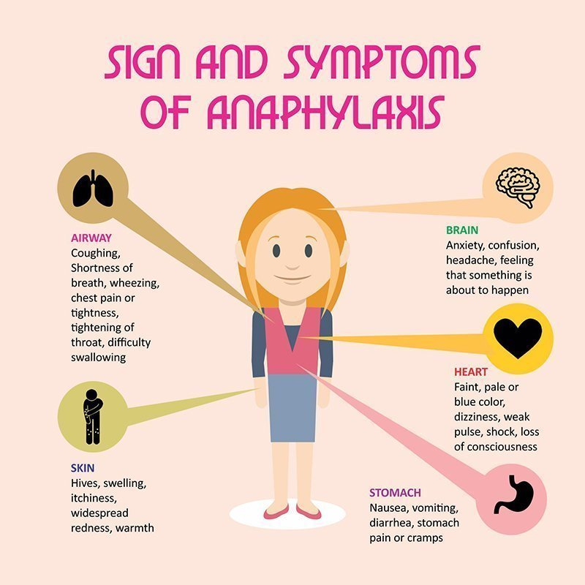

Slide 24
DID YOU KNOW?
Early signs can resemble even a mild allergic reaction
Although anaphylaxis typically results in multiple symptoms, reactions vary from person to person
Anaphylaxis usually occurs in a few minutes, but may occur several hours after exposure
Without treatment, anaphylaxis can result in complete airway obstruction, shock, and death
Epinephrine is the only treatment

Slide 25
BE PREPARED
Recognize symptoms
Be prepared to initiate the Emergency Action Plan
Administer epinephrine without delay
CALL 911
Document
Medical event form

Slide 26
Anaphylaxis
All staff who interact with students must be trained in preventing, recognizing, and responding to allergic reactions.
Click on link below to complete required training
Anaphylaxis Training
After completion, turn your certificate into the School Health Clinic
Contact the RN supervisor and request epinephrine student-specific training.

Slide 27
SEIZURES
A brief, excessive discharge of electrical activity in the brain that alters movement, sensation, behavior, and awareness
Epilepsy is a disorder of the brain characterized by repeated seizures
Common causes of seizures
  Fever-Genetic Factors-Brain Trauma-Anoxia (absence of oxygen) Brain Tumors-Infections of the brain-Brain Injury at Birth
Possible Triggers
  Missed or Late Medications-Stress-Anxiety-Lack of Sleep or Fatigue Flashing Lights-Illness-Overheating
Notes:
Always be prepared to begin cpr anytime an emergency medication is given

Slide 28
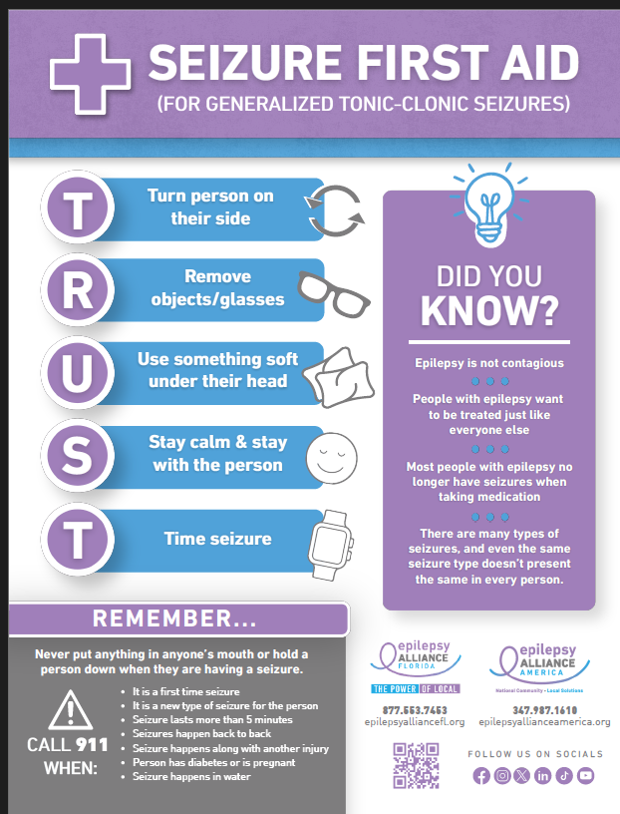

Slide 29
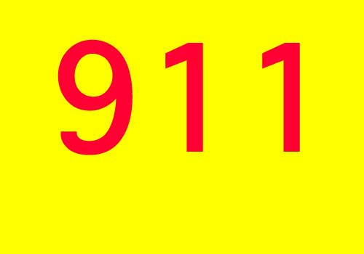
WHEN IS A SEIZURE AN EMERGENCY?
  First time seizure
  seizure lasting greater than 5 minutes or as directed by student’s Action plan.
  Normal breathing does not resume
  Repeated seizures without return to consciousness between seizures
  change in seizure pattern
  Student is injured
  Student is pregnant or a diabetic
  Emergency medication is administered

Slide 30
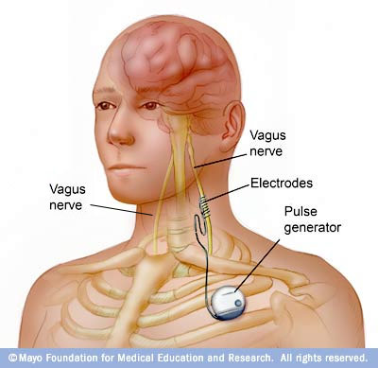
Vagus Nerve Stimulator (VNS)
Used to primarily treat partial seizures when medication is not effective
Device implanted just under the skin usually in the chest with wires that attach to the vagus nerve in the neck
Delivers intermittent electrical stimulation to the vagus nerve in the neck that relays impulses to widespread areas of the brain
Use of special magnet to activate the device, may help prevent or reduce the severity of an oncoming seizure
May still require anti-seizure medication

Slide 31
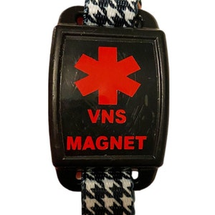
USING A VAGAL NERVE STIMULATOR
Can be used any time during seizure, most likely to work at the beginning of a seizure.
Often used when student feels a sense or warning that seizure may be coming.
Can be used by person with seizures or by another person.
Keep magnet at least 10 inches from anything affected by strong magnet fields.
Swipe magnet across the generator that is under the skin (usually on the left side of the chest) for one second.
Wait 1 to 2 minutes and if seizure is still going on, swipe the magnet again.
Don’t hold magnet over generator. Will turn it off after six seconds.
Must have Physician orders and student specific training

Slide 32
EMERGENCY MEDICATIONS
Medication can come in rectal and inhalant form.
  Diastat
  Nayzilam
  Valtoco
  You must have student specific training by the RN supervisor in order to administer these medications.
  If student does not have emergency medication in the clinic and has a known seizure disorder, 911 will be called at the 5 minute mark.
  Call 911 immediately after administering medication.

Slide 33
Seizure Training
All staff whose duties involve regular contact with
Click on the link below to complete required training
  Seizure Training
After completion, turn your certificate into the School Health Clinic
Contact the RN supervisor and request Emergency Medication student-specific training.

Slide 34
  What is Asthma?
  Click Link to Learn More about Asthma
  All students with Asthma need to have a Health Care Plan/Emergency Action Plan
  Ensure the inhaler and spacer are easily accessible
  Do you understand the label instructions?
  Does the student have a spacer?

Slide 35
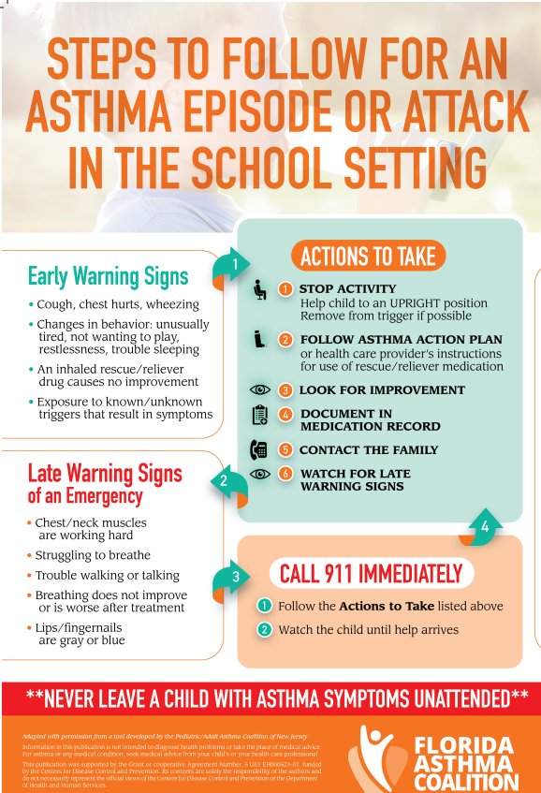

Slide 36
Completion
ECSD Staff:
Review this module.
Click link below to access test.
Medication Training Post Test
Print and complete the test.
Contact RN supervisor to review test results and complete student-specific training.
Store documentation in Student Specific Training book.
Charter or Private School Staff:
Follow steps above. Email the post test to Deidra Nimblett @ dnimblett@ecsdfl.us or fax to 5346

