Slide 1

How To Do Business
With the RCSS
Bobby A. Smith, CPA
Chief Financial Officer
2026-2027

Slide 3

PURPOSE OF PRESENTATION
Learn more about the Richmond County School System (RCSS).
Explore business opportunities and connections with RCSS.
Become connected and registered to do business with RCSS.
Gain knowledge about RCSS policies and procedures.

Slide 4

DID YOU KNOW???
With approximately 28,000 students, RCSS is the 15th largest school district in Georgia.
Our student population is highly diverse, with approximately 89% of students representing Black, Hispanic, multi-racial, Asian/Pacific Islander, American Indian/Alaskan native races/ethnicities.
RCSS currently has 53 schools and programs.
RCSS has the oldest continually operating school in the Southeast and the sixth oldest public high school in the U.S. Several schools are on the National Register of Historic Places.

Slide 5
RCSS AS AN EMPLOYER
The Richmond County School System employs almost 4,200 individuals.
The School System is the 5th largest employer in the region.
The Effective Hiring and Retention of high-quality and skilled employees is one of the main missions of the Human Resources Department.

Slide 6
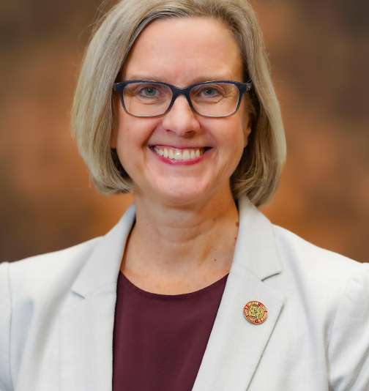
RCSS LEADERSHIP
Dr. Malinda B. Cobb
Superintendent of Schools

Slide 7
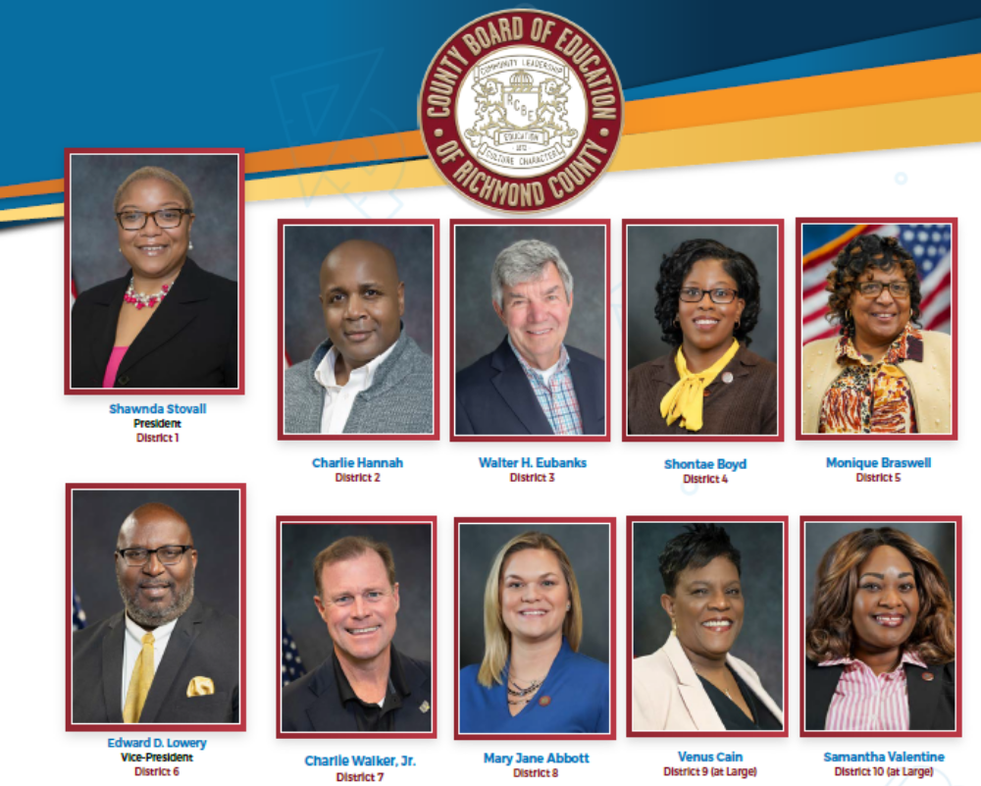
RCSS LEADERSHIP—The Board Members

Slide 8
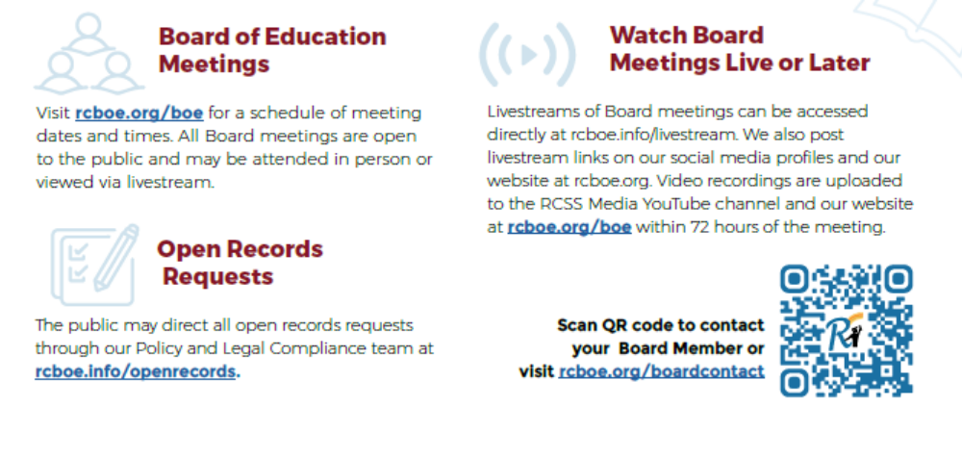
Board of Education Meetings

Slide 9

Provisions of RCBOE Charter
Related to Business Opportunity
Chartered
August 23, 1872

Slide 10
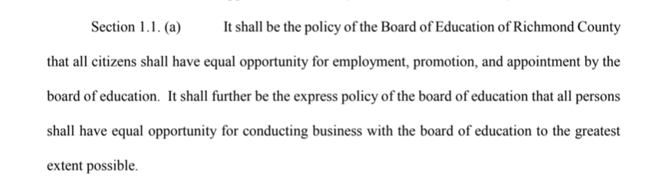
Provisions of RCBOE Charter
Related to Business Opportunity

Slide 11
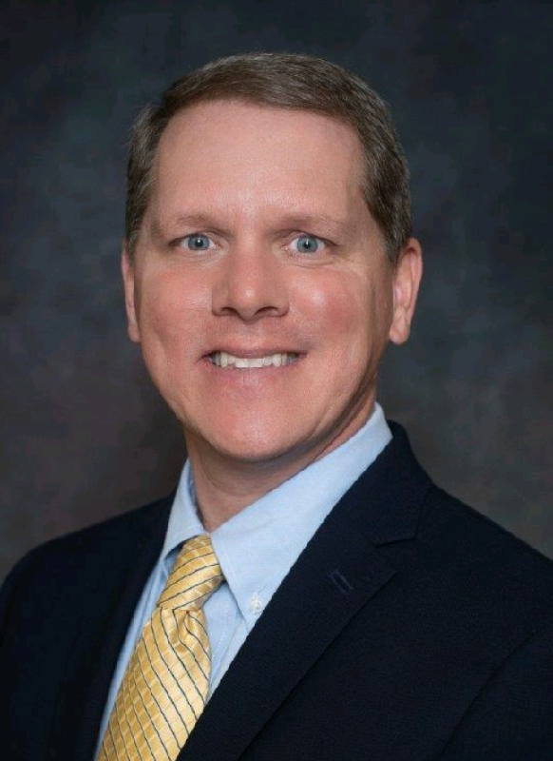
CHIEF FINANCIAL OFFICER
Bobby A. Smith, CPA
Phone: (706) 826-1114
smithbo@boe.Richmond.k12.ga.us

Slide 12
WHAT WE BUY
Items | Examples of Purchases
Food, Food Service Supplies, Equipment | Frozen Treats, Paper Products, Dairy, Eggs, Small Kitchen Wares, Large Equipment (Freezers)
Nutrition Services | Pumping & Cleaning Grease Traps, Exhaust Hood System Cleaning
Maintenance Equipment and Supplies | Playground Equipment, Chillers, Boilers, Long Leaf Pine Straw, Mulch, Intercoms
Maintenance Services | Post-Event Stadium Cleaning, Flooring Jobs, Fire Extinguisher Maintenance, Parking Garage Painting
School Safety/Athletics | Ambulance & EMT Services, Weight Room Equipment, School Safety Uniforms
Transportation | Fuel Pump Dispensers, Heavy Duty Mobile Column School Bus Lifts
Construction | New School Buildings, HVAC, Roofing, Sitework, Demolition, Classroom Additions
Information Technology | Network Infrastructure

Slide 13

WHO BUYS?
SCHOOL SITE / PRINCIPALS
DEPARTMENTS & CENTRAL OFFICE
School Site Purchasing Authority Up to $5,000
Purchases Made with Separate School Funds
District Centralized Purchasing

Slide 14
QUOTES VS. FORMAL BIDS
QUOTES
FORMAL BIDS
Less formal written estimate of the costs of the goods or services
Competitive Solicitation Process
Invitation for Bid or Request for Proposal
Formalized Process
RCSS required to take the lowest responsive and responsible bidder

Slide 15
RCSS FORMAL BID THRESHOLD
RAISED TO $50,000
In 2023, Policy DJED and the RCBOE Charter were modified to raise the formal bid threshold from $7,500 to purchases in excess of $50,000.
Purchases between $5,000 and $50,000 now follow the Procurement Manual (Quotes). Formal Bids are no longer required for purchases in this range.
This modification has the potential to benefit many small businesses.

Slide 16
QUOTES – PURCHASING THRESHOLDS
$4,999.99 OR LESS
One Quote
Discretion must be used in best interest of RCSS
$5,000 - $50,000
(Schools)
Three Quotes
RCBOE Purchasing Office must review to ensure Procurement Manual is followed
$5,000 - $50,000
(Departments)
Three Quotes
Department Head awards lowest quote
Records of quotes are attached to purchase order and retained

Slide 17
ITEMS ABOVE $50,000—REQUIRES FORMAL BID
HANDLED BY PURCHASING DEPARTMENT
Department submits specifications/requirements.
REQUIRES APPROVAL BY THE BOARD OF EDUCATION
Board Committee Meeting (Item reviewed and approved).
Purchasing creates and manages the solicitation process.
Purchasing submits the Department’s recommendation for approval.
Board Meeting (Item voted on by full Board).
Board Meeting Schedule and Agenda available on RCSS Website.

Slide 18
RICHMOND COUNTY SCHOOL SYSTEM
PROCUREMENT MANUAL
The RCSS Procurement Reference Manual is on the website and contains valuable information about doing business with the School System.
RCSS Procurement Reference Manual 2026

Slide 19

SO, NOW WHAT?
Doing Business with RCSS Is As Easy As…

Slide 20

REGISTER AS A VENDOR!

Slide 21
REGISTER AS A VENDOR
Complete the Vendor Registration Form
Complete the IRS Form W-9
Complete the Certification Regarding Debarment and Suspension
Complete the E-Verify Affidavit
Email the forms to purchasing1@boe.Richmond.k12.ga.us

Slide 22
REGISTER AS A VENDOR
Registration Forms Can Also Be Found Online:
Vendor Information and Forms
www.rcboe.org
Staff & Departments
Business Office and Bids
Vendor Information

Slide 23

MAKE CONNECTIONS AND STAY IN CONTACT!

Slide 24
MAKE CONNECTIONS AND STAY IN CONTACT!
Registering as a Vendor does NOT mean that you will receive automatic notice of opportunities. Help RCSS personnel make the connection with you!
For QUOTE items, it is important that you connect with the Department Head / School Site Principal who is likely to need your goods and services.
For FORMAL BIDS, it is important that you frequently research opportunities and follow procedures.

Slide 25
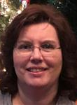
MAKE THE CONNECTION
ADMINISTRATIVE ASSISTANT TO THE BUSINESS OFFICE (BIDS)
Cecilia Perkins
Phone: (706) 826-1298
email: perkice@boe.richmond.k12.ga.us

Slide 26
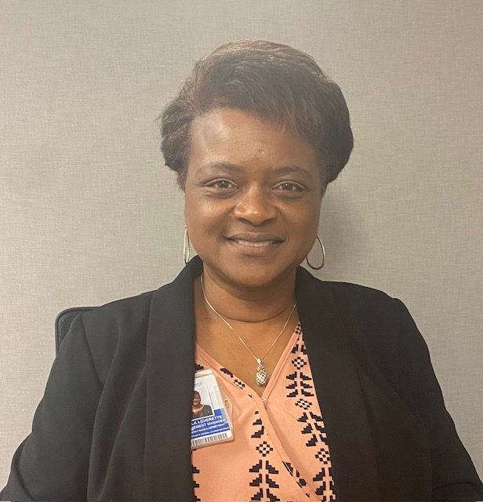
MAKE THE CONNECTION
PROCUREMENT MANAGER (QUOTES)
Pam Leverette
Phone: (706) 826-1113
email: leverpa@boe.richmond.k12.ga.us

Slide 27
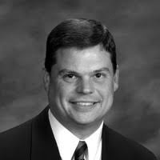
MAKE THE CONNECTION
MAINTENANCE AND FACILITIES
Director of Operations, Mr. Glenn Todd
(Ms. LaToya Tucker-Kelsey, Supply Foreman)
Phone: (706)737-7189 (MAIN LINE)
toddgl@boe.Richmond.k12.ga.us

Slide 28
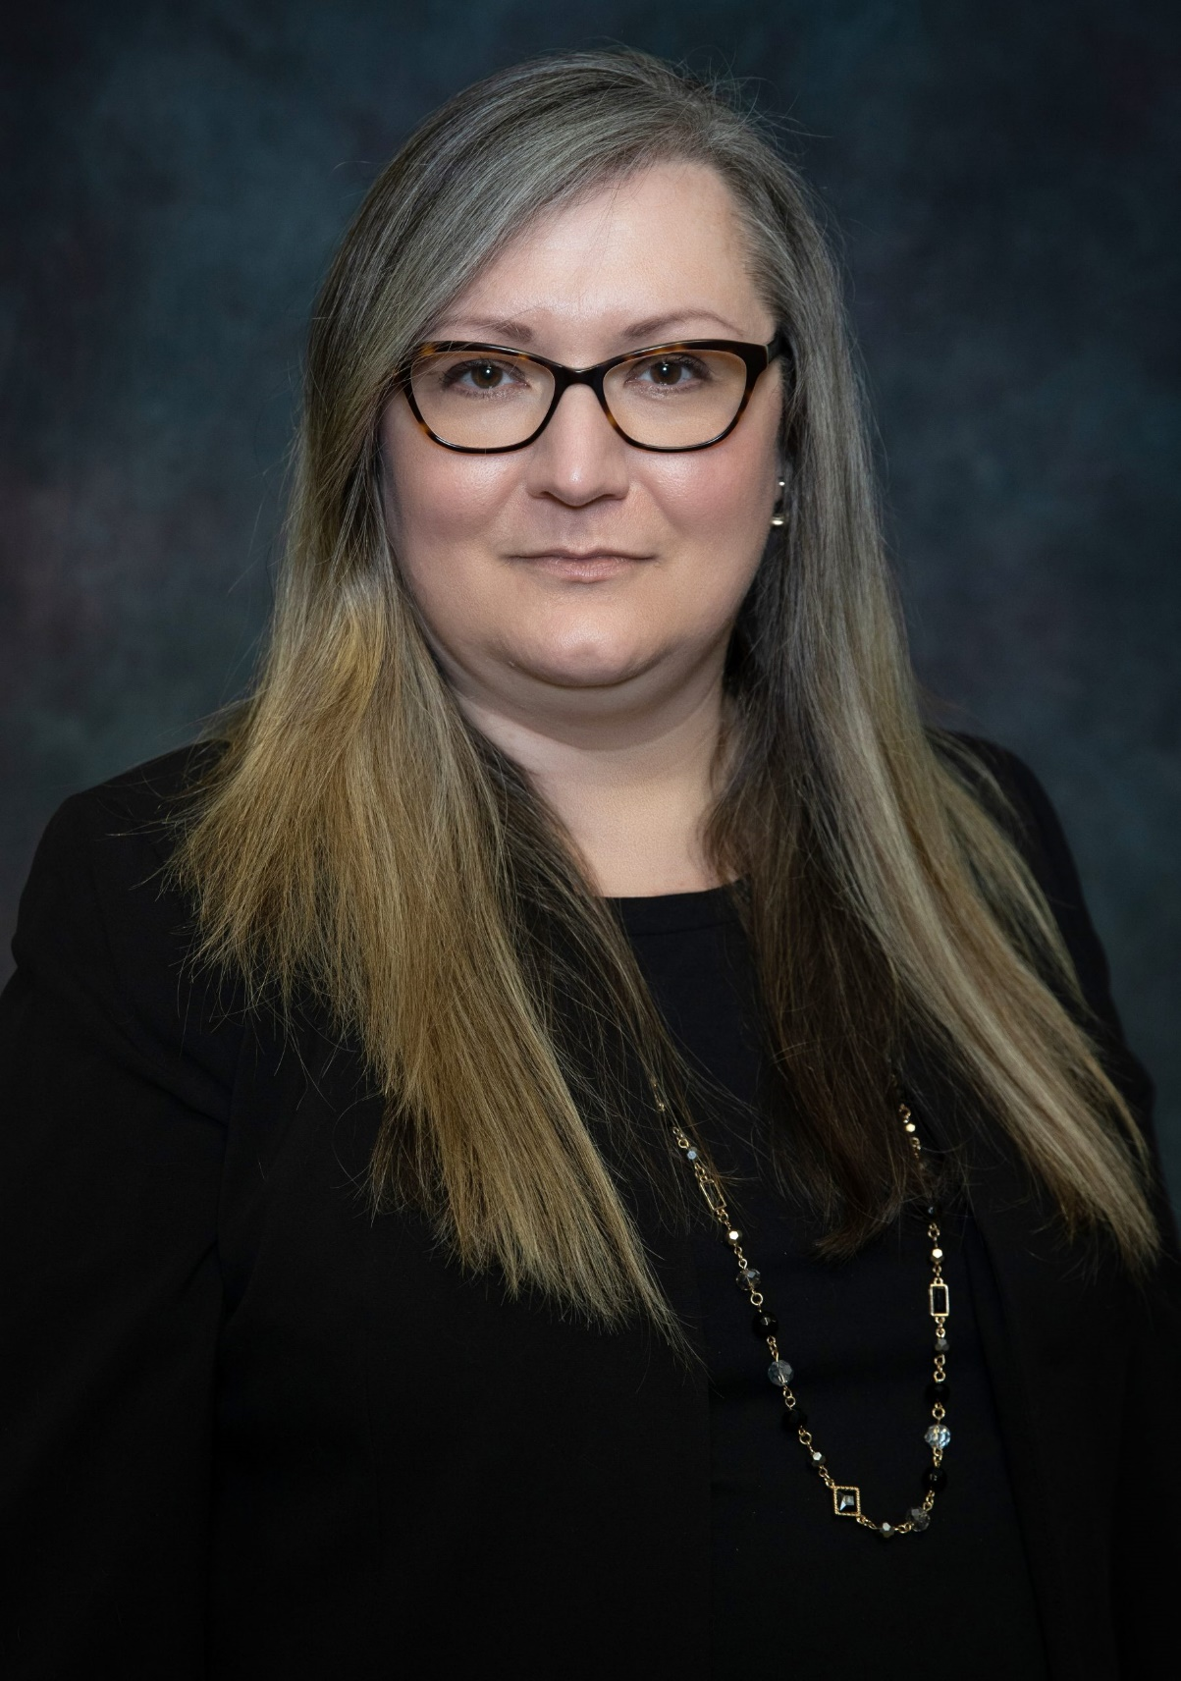
MAKE THE CONNECTION
SCHOOL NUTRITION DEPARTMENT
Director, Cathy Johnson, MBA
Phone: (706) 826-1122
johnsca@boe.Richmond.k12.ga.us

Slide 29
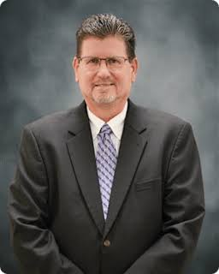
MAKE THE CONNECTION
TRANSPORTATION DEPARTMENT
Senior Director, Bill Kurts
Phone: (706) 796-4777
kurtswi@boe.Richmond.k12.ga.us

Slide 30
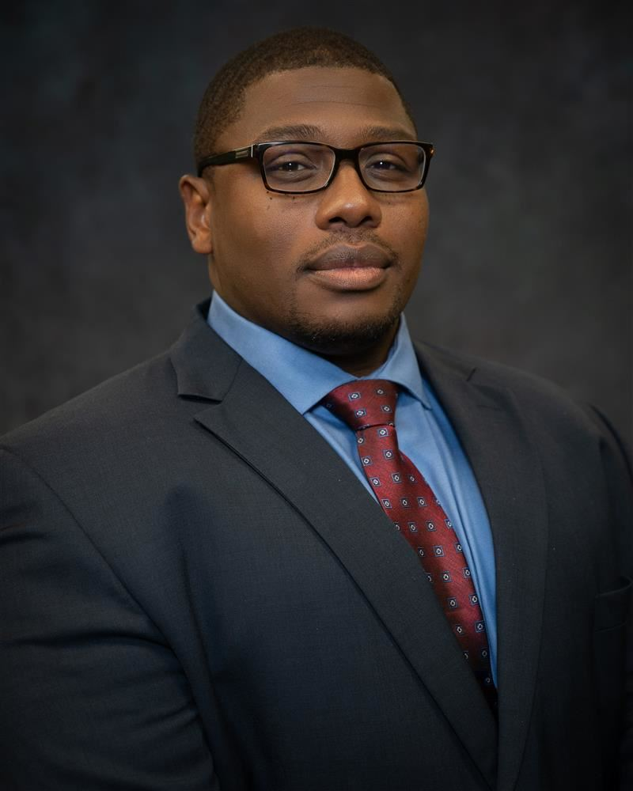
MAKE THE CONNECTION
SCHOOL SAFETY AND SECURITY DEPARTMENT
Chief Mantrell Wilson
Phone: (706) 826-1133
wilsoma1@boe.Richmond.k12.ga.us

Slide 31
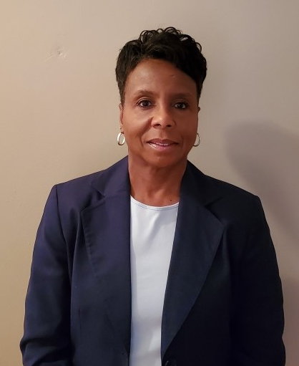
MAKE THE CONNECTION
INFORMATION TECHNOLOGY
Chief Technology Officer,
Carolyn McCord
Phone: (706) 826-1103
mccorca@boe.Richmond.k12.ga.us

Slide 32
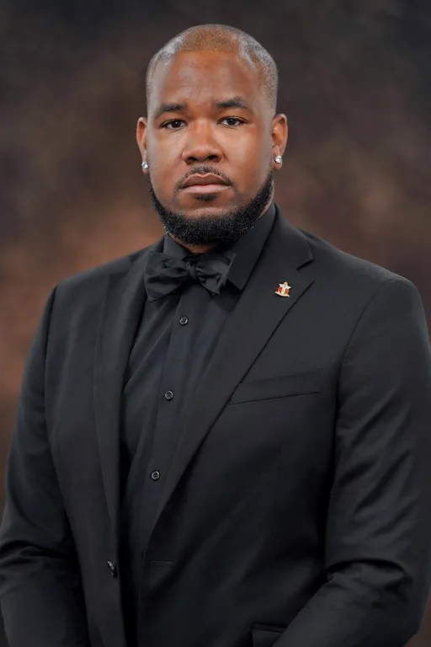
MAKE THE CONNECTION
ATHLETICS
Director, Lawrence M. Kelly
Phone: (706) 826-1126
kellyla@boe.Richmond.k12.ga.us

Slide 33
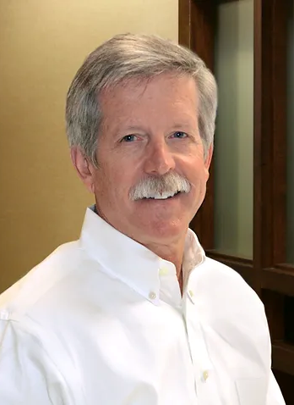
MAKE THE CONNECTION
CONSTRUCTION BIDS
Mr. Jeff Baker, GMK
Executive Program Director
Phone: 706.826.1297 (Jeanine H. Usry)
Email: jbaker@gmka.com

Slide 34

FORMAL BID OPPORTUNITIES
(DON’T SLEEP ON ‘EM)

Slide 35
Bidding Opportunities (>$50,000)
Formal Requests for Proposals and Invitations to Bid are posted on the Board’s website at www.rcboe.org/bids and advertised in The Augusta Chronicle, Urban Pro Weekly, and/or The Metro Courier, depending on the type of bid.
Bids are awarded to the lowest responsible and responsive bidder meeting specifications.

Slide 36
QUESTIONS ABOUT BIDS
Communications concerning bids must be submitted to the Business Office.
  Mrs. Cecilia Perkins
  (706) 826-1298
    perkice@boe.richmond.k12.ga.us
    ***Please always carefully review Bid Specifications***

Slide 37
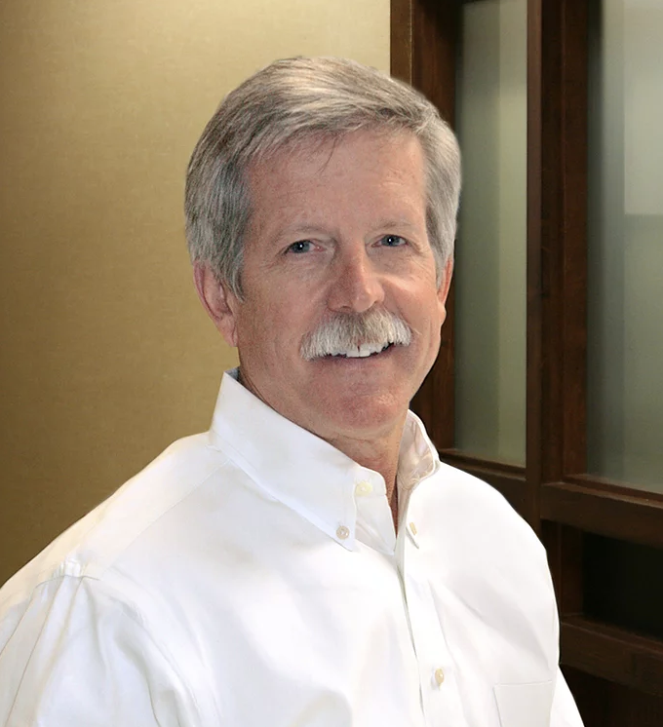

CONSTRUCTION BIDS
Mr. Jeff Baker serves as the Executive Program Director for the Richmond County Schools building program.
General contractors submit the formal bid. The general contractor obtains its own subcontractors.
Mr. Baker and his team may be able to assist making connections.

Slide 38
CONSTRUCTION BIDS
If you are a subcontractor, we encourage you to connect with Mr. Baker and his team.
Phone: 706.826.1297 (Jeanine H. Usry)
Email: usryje@boe.Richmond.k12.ga.us
Introductions and Information from the Construction Bid Team

Slide 39

Bid and Performance Bonds
Bonds may be required when it is necessary to protect the interests of the Board.
Many contracts issued by RCSS require bonds (e.g., construction and renovations).

Slide 40

Local Vendor Preference
In the event of a tie on a bid item, preference is given to
  (1) the supplier within the closest proximity to Richmond County
  (2) the supplier within the State of Georgia over an out-of-state supplier.

Slide 41
HOW TO SUBMIT A BID / SEARCH FOR BIDS
Current BID Information Can Be Found Online:
Current Bid Solicitations
Staff & Departments
Business Office and Bids
Current Bid Solicitations

Slide 42
HOW TO SUBMIT A BID
All bids and requests for proposals should be submitted to the Richmond County Board of Education to the attention of:
  Dr. Malinda B. Cobb, Superintendent
  c/o Mr. Bobby A. Smith, CFO
  864 Broad Street, 4th Floor
  Augusta, Georgia 30901

Slide 43
HOW TO REVIEW AWARDED BIDS
Past Awarded BID Information Can Be Found Online:
Awarded Bid Solicitations
Staff & Departments
Business Office and Bids
Awarded Bid Solicitations

Slide 44
PRO TIPS
Check our website regularly for upcoming events.
Read the bid documents thoroughly and follow all instructions, terms, and conditions.
Be sure the bid is submitted on or before the due date and time.
Bidders are strongly encouraged to attend all pre-bid meetings and site visits, which in some cases are mandatory. Please check the bid specifications carefully.
Please keep your information current.

Slide 45
A WORD ON CONSULTANTS
There is a separate packet and application for Consulting Services. (Requires a CONSULTANT PROPOSAL and other information.)
Keep in mind that separate departments may need the services, so it may be wise to reach out to the applicable department (e.g., literacy specialist consulting would reach out to our Teaching & Learning Department).

Slide 46
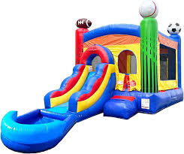
INFLATABLES INFO – JUMP TO IT!
Inflatables (“bounce houses”) have additional rules and procedures. (See Procurement Manual.)
Company must have business license and proof of liability insurance.
Company must sign an indemnity agreement.
Must be approved by appropriate school officials before contract can be signed.

Slide 47

ANOTHER SOURCE FOR BUSINESS
The Georgia Procurement Site provides information about bidding opportunities around the State.
Anyone can register as a bidder or supplier.
Georgia Procurement Site

Slide 48

CONTENTS OF THE MAGIC PACKET

Slide 49

Questions?

