Slide 1

OXNARD SCHOOL DISTRICT
Ramona Elementary School Update
Rough Order of Magnitude (ROM) Pricing, Long-Term Options,
and Interim Planning
Board of Trustees | September 16, 2026
Notes:
Sources and internal basis:
Update following prior Board report.

Slide 2
RAMONA ELEMENTARY SCHOOL
Tonight’s update: Rough Order of Magnitude (ROM) pricing and options
1. Pricing
Review the repair ROM and what it means for the long-term decision.
2. Long-term choice
Compare repair and rebuild at a high level: cost, timing, and risk.
3. Interim planning
Identify a mid-term option that can work under either long-term path.
Notes:
Sources and internal basis:
Prior Board report covered consultant findings and relocation status. Current update focuses on ROM pricing and options.

Slide 3
ROM pricing changes the decision context
Repair costs
ROM construction estimate
$10.2M
Soft costs allowance
$5M
DSA-triggered rehab / seismic
$2.8M
Repair costs are at ~90%
DSA Formula Based Replacement Value
Estimated total repair cost:
$18M
Notes:
[Sources]
- Current ROM estimate: Ramona Elementary School ROM total $10,194,353 from the Ramona Elementary ROM / Survey Report.
- DSA formula replacement value: approximately $19.0M based on NAC-provided DSA typical construction value calculation for 36,869 SF at $517/SF.
- DSA 50% threshold: approximately $9.5M. ROM alone equals approximately 54% of the DSA formula value; ROM plus soft-cost and rehabilitation/seismic allowances equals approximately 74%-81%.
- DSA-triggered rehabilitation/seismic allowance is a planning range based on rehabilitation/structural evaluation ($150K-$300K) plus project-specific seismic/structural allowance of approximately $1.7M.

Slide 4
RAMONA ELEMENTARY SCHOOL
Repair path: mandatory rehabilitation scope
50% threshold: DSA rehabilitation evaluation adds scope beyond exterior repairs.
Structural / seismic systems
Foundations and load path
Diaphragms, bracing, collectors, connections, hold-downs, gravity loads and wind resistance.
Steel sill/C-channel, anchor bolts, post bases, foundations and module-to-module connections.
Nonstructural seismic bracing
Verification and certification
Ceilings, lights, HVAC/ducts, piping, conduit, electrical, fire alarm and sprinkler supports.
Material testing, destructive verification, peer review/geotech if needed, separate DSA certification.

Slide 5
RAMONA ELEMENTARY SCHOOL
Repair path: approximate timeline
6 mo.
Design
6 mo.
DSA review
2 mo.
Bid
12 mo.
Construction
Approximate total: 26 months
Schedule risk: DSA rehabilitation scope and concealed damage could extend the timeline.
Notes:
Sources and internal basis:
NAC schedule approximations: 6 months design, 6 months DSA, 2 months bid, 12 months construction.

Slide 6
RAMONA ELEMENTARY SCHOOL
Rebuild path: approximate timeline
8–10 mo.
Design
6 mo.
DSA review
2 mo.
Bid
18–24 mo.
Construction
Approximate total: 34–42 months
Rebuild takes longer, but avoids placing a near-replacement investment into aging modular buildings.
Notes:
Sources and internal basis:
NAC schedule approximations: 8-10 months design, 6 months DSA, 2 months bid, 18-24 months construction.

Slide 7
RAMONA ELEMENTARY SCHOOL
Long-term choice: repair or rebuild
Repair*
~26 months
~$18M+
Keeps aging modular buildings
Rebuild
~34–42 months
$45M - $50M
New useful life
*Repair is unusual at this scale: major cost, DSA rehabilitation, and continued use of older modular buildings.
Notes:
Sources and internal basis:
Planning basis: repair cost approaches a major share of replacement value while retaining older modular buildings.

Slide 8
RAMONA ELEMENTARY SCHOOL
Interim planning works under either path
The District still needs a mid-term student-location strategy while repair or rebuild proceeds.
Notes:
Sources and internal basis:
Planning basis: TK/K at Ramona with portables; move Juanita 6-8 to Frank; return Ramona 1st/2nd closer to the neighborhood by placing them at Juanita. Reboundary discussion intentionally omitted.

Slide 9
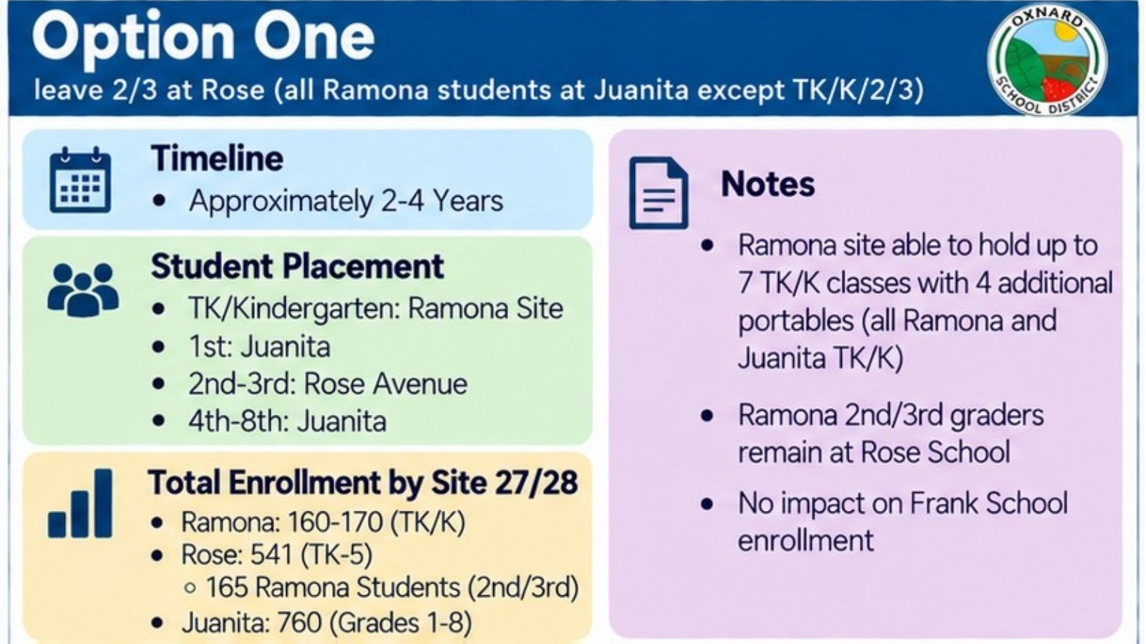
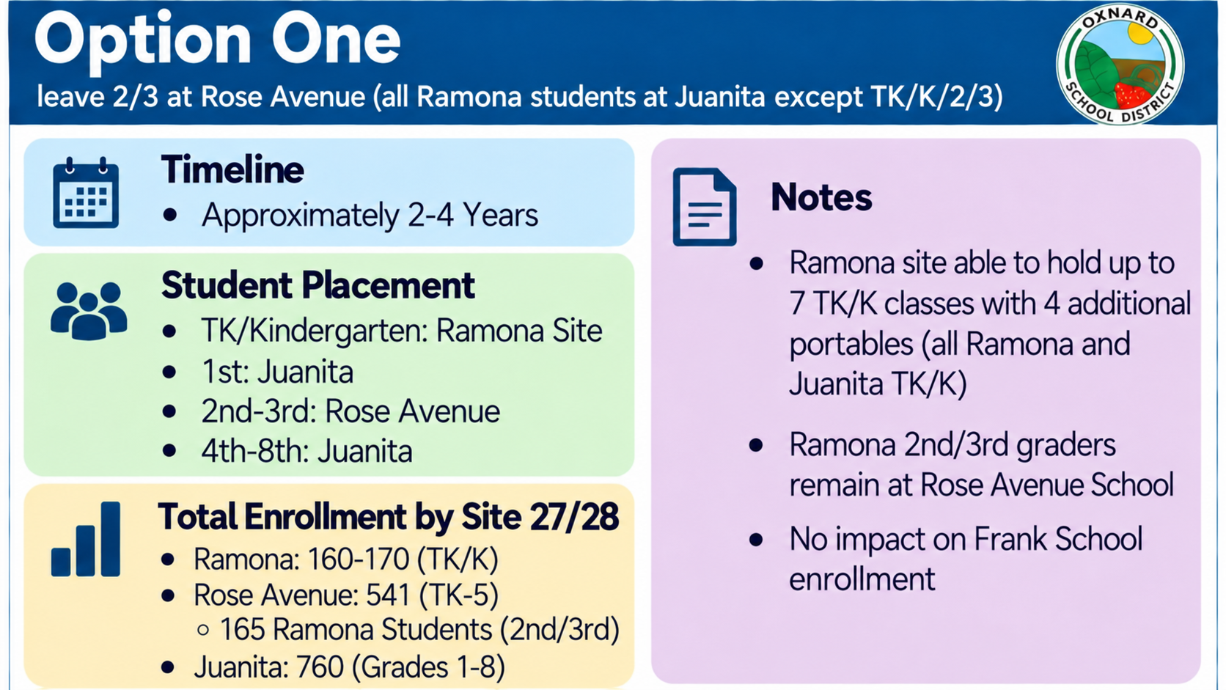

Slide 10
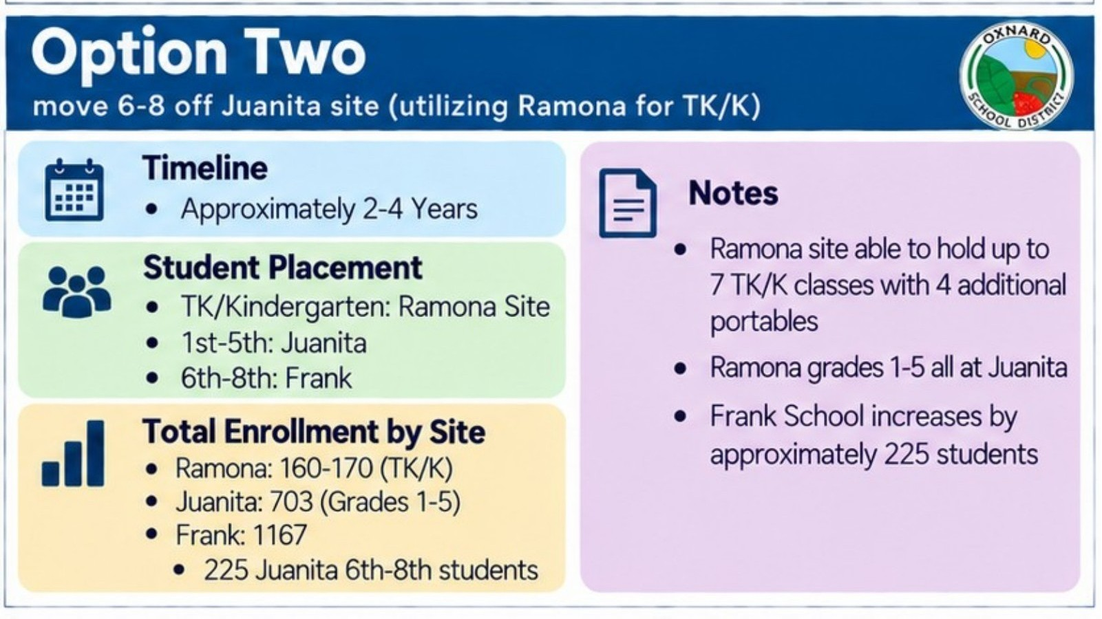

Slide 11
RAMONA ELEMENTARY SCHOOL
TK/K portable option: timing and cost range
2 mo.
Design
2 mo.
DSA
2 mo.
Bid
4 mo.
Construct
Fall 2027 feasible if the District starts now.
Lease-based planning range: ~$2.2M to ~$4.1M
Purchase-based planning range: ~$2.7M to ~$4.6M
Notes:
Sources and internal basis:
NAC schedule for portables: September 2026 decision to target August 2027, with 2 months design, 2 months DSA, 2 months bidding, and 4 months construction/CA. Lease-based cost estimate is a planning assumption pending actual quote.

Slide 12
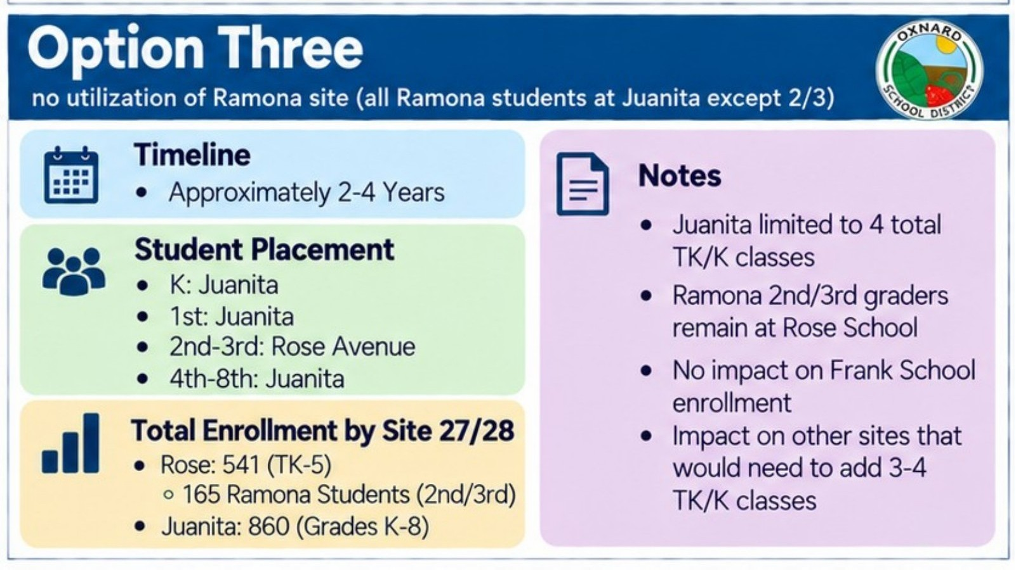
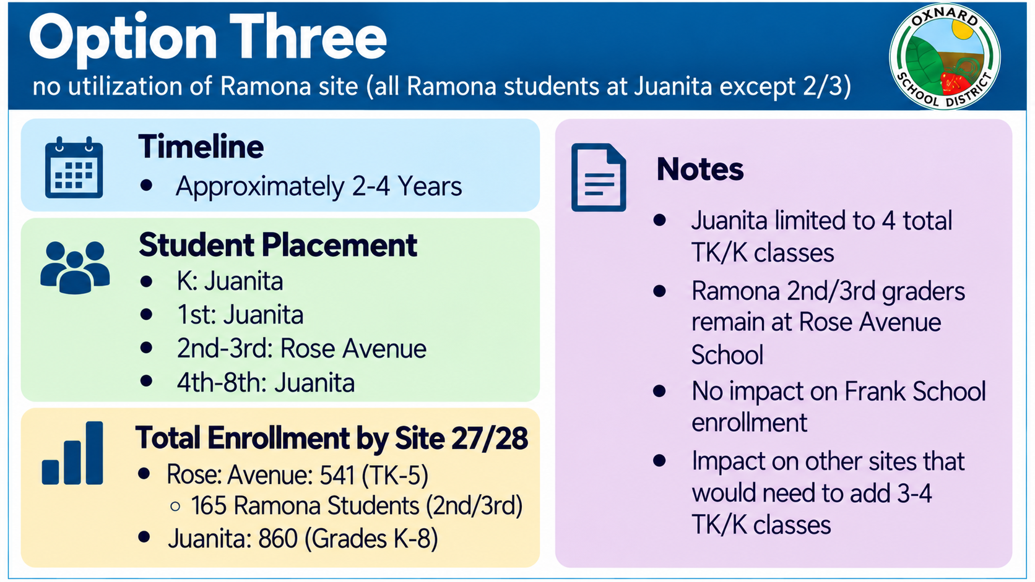

Slide 13
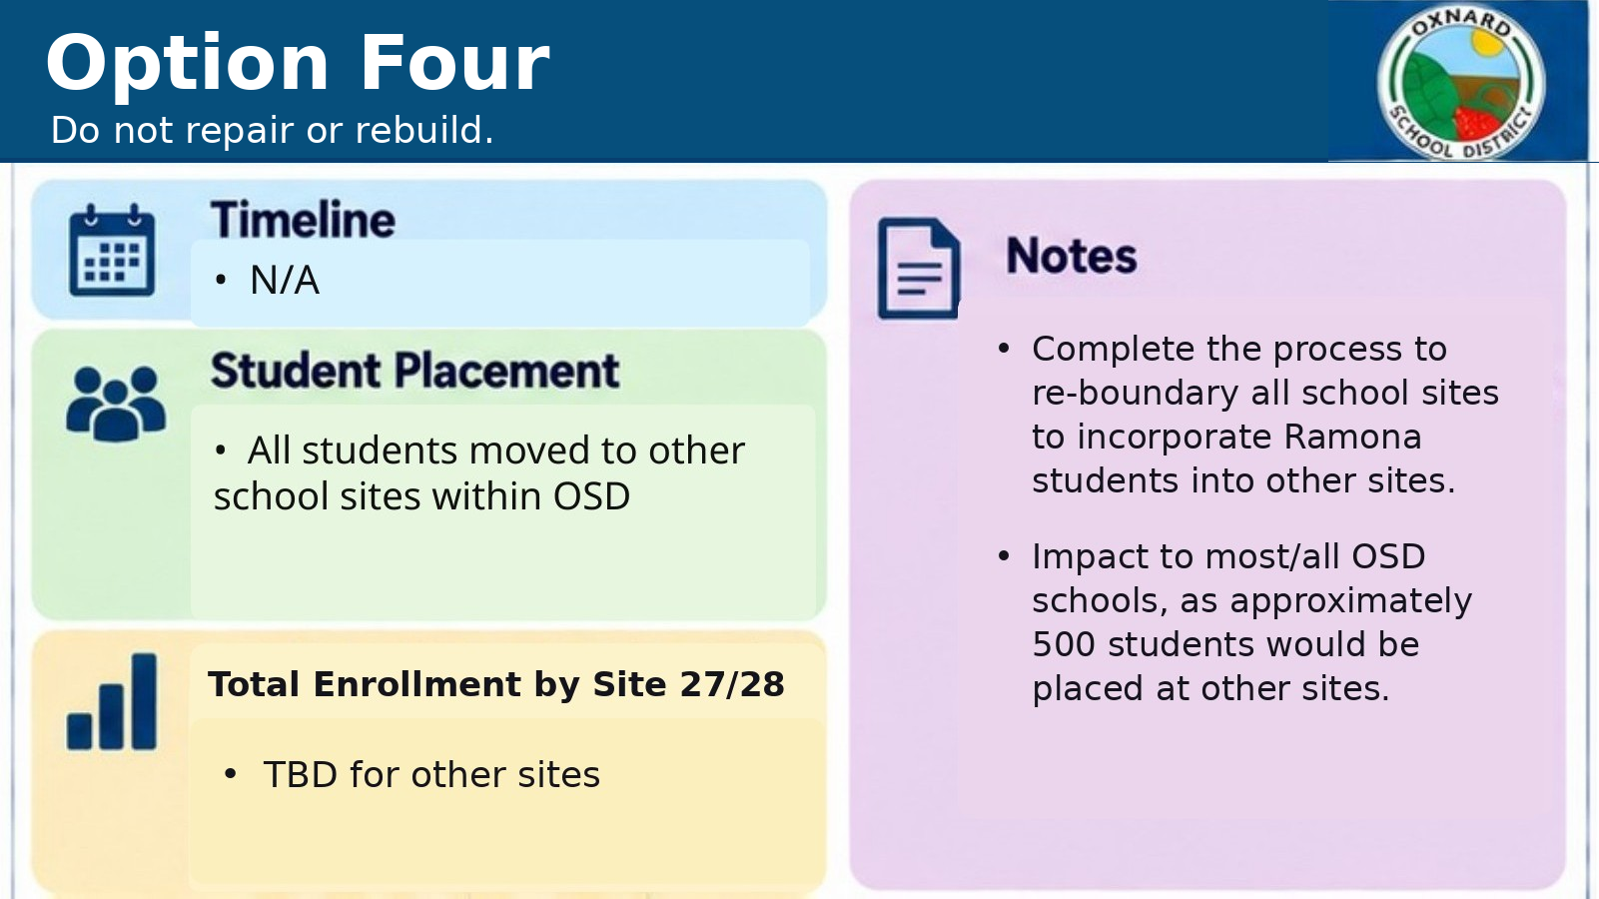

Slide 14
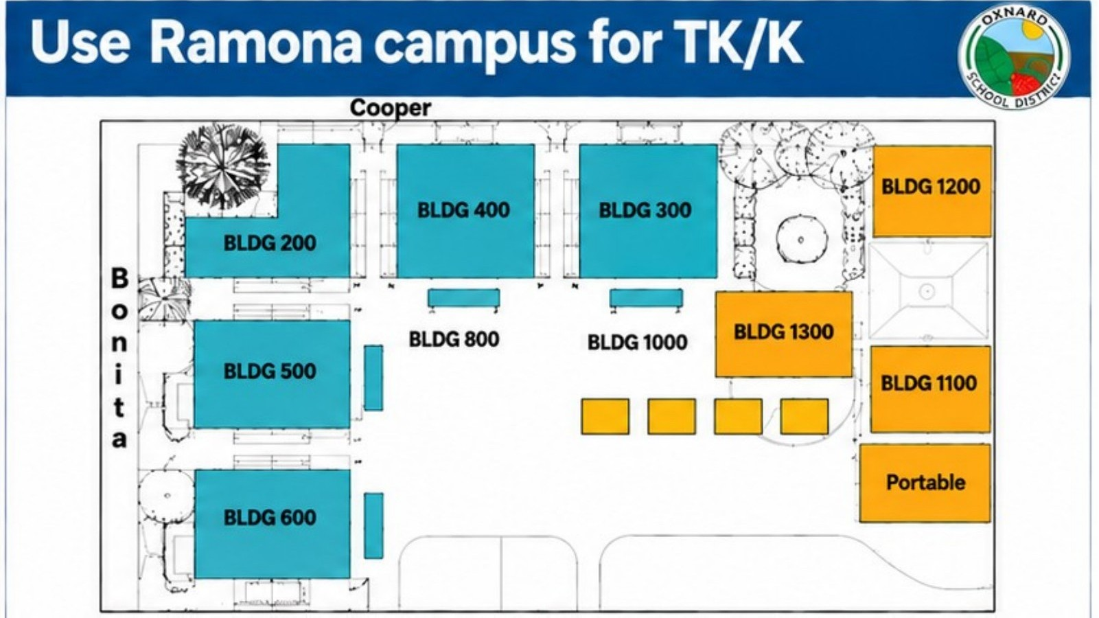

Slide 15
RAMONA ELEMENTARY SCHOOL
Decisions ahead
1. Long-term: repair or rebuild
2. Mid-term: TK/K portable concept
3. Commitments: design, procurement, DSA, funding
The TK/K option can support either repair or rebuild.
Notes:
Sources and internal basis:
Planning basis: distinguish long-term campus direction from mid-term student-location strategy and implementation commitments.

