Slide 1
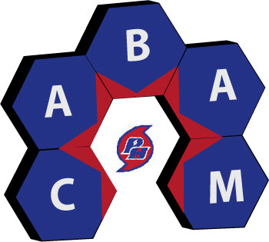
2026 Parent Summit
Career Academy of Business Administration & Management
An Academy of Distinction – with Distinguished Honors

Slide 2
Tonight’s Agenda
What is CABAM?
What do we do?
What opportunities are available for my student through their participation?
What can a parent do to help?
What should a kid be doing in each grade to be successful
A Parent’s Perspective
Bright Futures/Gold Seal

Slide 3
Newsworthy Number: 50%
Share of Americans, per a study from Preply, who think their college major did not adequately prepare them for the job market.
Top regrets include:
  Not networking more (~56.4%)
  Not completing an internship (~33%)

Slide 4
CABAM Staff
Kevin Schachter schachterk@pcsb.org | AP Business with Personal Finance, Accounting Applications I&2; Legal Aspects of Business, Introduction to Hospitality & Tourism, Technology for Hospitality & Tourism, Hospitality & Tourism Marketing Management, Hospitality & Tourism Entrepreneurship, Hospitality & Tourism Internship ***Future Business Leaders of America(FBLA), ***TEDxYouth@PHUHS, ***phuhs.org Webmaster, ***Department Chair
Dzindzi Asamoah-Wade asamoahwaded@pcsb.org | AP Cyber Security, Advanced Information Technology; Foundations of Programming, AP Computer Science Principles, Digital Design I-IV, ***National Technical Honor Society ***FBLA
Randy Homa homar@pcsb.org | Sports, Recreation & Entertainment Marketing I-III, Artificial Intelligence Program

Slide 5
What is CABAM?
A career academy offering a sequence of courses and programs that provides rigorous and relevant content aligned with challenging academic standards and technical knowledge and essential skills needed to prepare for further education and careers.
CABAM gives students a head start on Life after High School
Academy of Distinction with Distinguished Honors

Slide 6
CABAM Mission
Empowering Success

Slide 7
CABAM Vision Statement
To provide students with rigorous and relevant business concepts and skills, through education and experiences, that are vital for success in life.

Slide 8
CABAM Values
G.R.I.T.
  Growth
  Respect
  Integrity
  Tenacity

Slide 9
Career Academy of
Business Administration & Management
Text to 81010 for CABAM Reminders
Grade 9: @CABAM30
Grade 10: @CABAM29
Grade 11: @CABAM28
Grade 12:@CABAM27
Like us at facebook.com/cabamphuhs/
phuhscabam on Instagram

Slide 10
What do we do?
Work Based Learning
Career Preparation
  Job Shadow
  Professional Attire
  Career & College Fair
  Mock Interviews
  Resume Help
Community Service Project/Bright Futures Hours
Seminars/Business lecture Series
Industry Certifications
Field Trips/Business Travel
Incentives
Town Halls
Community Advisory Board/Student Advisory Committee
Clubs & Organizations

Slide 11
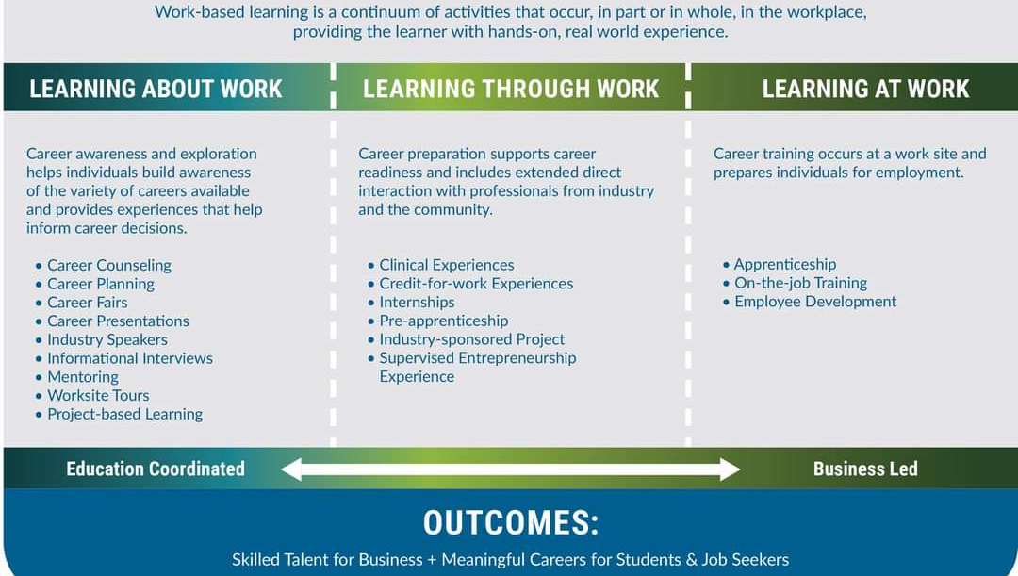
Work Based Learning

Slide 12
Florida’s Career Readiness Skills for CTE Programs
Florida’s Career Readiness Skills for Career and Technical Education (CTE) programs are designed to prepare students for more than a job after high school. They focus on the skills employers and colleges expect, including communication, critical thinking, problem-solving, teamwork, technology, professionalism, leadership, time management, and personal responsibility, while also helping students explore careers, plan for life after high school, and learn how to successfully pursue employment or postsecondary education. These skills are infused into every CTE course in Florida, not taught as a separate “employability skills” unit. That is why students may be asked to dress professionally, complete job shadows, earn industry certifications, create resumes and portfolios, work on real-world business projects, participate in FBLA, attend career fairs, practice interviews, interact with business professionals, manage projects and deadlines, and connect classroom learning to careers and college.
There is a purpose behind the things we do in CABAM: we want students to leave high school with more than a transcript. We want them to have the knowledge, skills, experiences, confidence, and professional habits to successfully navigate whatever comes next.

Slide 13
How Parents Can Help
Encourage your student to SAY YES!
  Job Shadow • Professional Dress • FBLA • Certifications • Career Fair • Mock Interviews • Community Service • Business Trips
You don't have to do everything. But students get much more from CABAM when they participate beyond the classroom.
The opportunities we create only work if students take advantage of them.

Slide 14
Professional Attire
Professional Dress days allow students to develop an awareness of the image your appearance projects, as well as to learn and practice the finer points of making great first impressions and dressing for success. You will also receive many tips for dressing professionally for special situations like job interviews, business meetings and even business trips.
This is a graded assignment, once per grading period.
  Tuesday, September 29
  Thursday, November 12

Slide 15
Job Shadow
A short-term work-based educational experience which introduces students to a particular job or career by pairing them with an employee of a business, industry or agency. By following or "shadowing" that employee for a day, students become familiar with the duties associated with that occupation, the physical setting of the occupation, and the compatibility of the occupation with their own career goals.
Thursday, November 5, 2026
Tuesday, February 2, 2027 (Tentative)

Slide 16
Business Lecture Series
Business Lecture Series
This long running event occurs regularly, where local businesspeople present practical concepts and skills, aimed at helping you prepare for College, Careers, and Life. Past topics have included; Time Management, Math in the Real World, Employer Expectations, Accountability, and Job Interviews.
Dress for Success: Tuesday, September 29, 2026
Adobe Express Workshop: 10/5 & 10/6 During School (EC)
Resume Writing Workshop: October 6 & 7 – After School
Great American Teach In: Wednesday, November 18, 2026

Slide 17
Industry Certifications
Last year More than 125 CABAM students improved their resumes by earning almost 300 globally recognized credentials with a wide variety of certifications. They also helped boost the school grade, and many earned additional college credits and scholarships and even helped earn money for CABAM (Which we spend on them!)
Certification Days will begin in October and continue through May

Slide 18
Career & College Fair/Mock Interviews
This event is an opportunity for you to meet with potential employers, and practice networking, filling out job applications, and even interviewing. Many students receive employment or arrange to complete volunteer hours through these events.
Mock Interviews: (Extra Credit)
  October 20
  October 28
  Spring Dates TBA
Career Fair: Spring 2027 Date TBA

Slide 19
Community Advisory Board
A group of business partners, business owners & managers, entrepreneurs, parents, teachers, and students who assist in adding value to what we can offer you, by organizing the programs discussed today, as well as offering job shadow opportunities, internships, mentoring and more.
Meeting Dates: (2:30-4:00 in Principal’s Conference Room)
September 14, November 2, January TBD, March TBD

Slide 20
CABAM Student Advisory Committee
Are you a passionate and driven student interested in shaping the future of our Business Program while earning valuable volunteer community service hours? Here's your chance to make a real impact and pave the way for positive change!
The Student Advisory Committee is a unique opportunity for dedicated students to have a direct say in the development and enhancement of CABAM, including the programs we offer, curriculum we utilize, the activities we participate in, and the causes we get involved in. Your insights, ideas, and feedback will help us create an even more engaging and enriching learning experience for all CABAM students.
See Mr. Schachter with questions
Next Meeting Monday, 9/28 after school in 11-201

Slide 21
Future Business Leaders of America (FBLA)
Future Business Leaders of America is a co-curricular student run organization designed to teach students about business while developing leadership, communication and team skills. All CABAM students are strongly encouraged to participate.
Information on School Website under Clubs & Activities
Next General Meeting: 9/15/2026, 2:00-3:00 p.m. 11-201

Slide 22
National Technical Honor Society (NTHS)
National Technical Honor Society is a club that recognizes students who have carried an overall 3.0 GPA or higher in their overall academic coursework as well as within their CTE pathway or major. This club has awarded millions in scholarships and comes with a host of other perks for its members. “NTHS membership is the beginning of building a life and career upon a foundation of skill, service, responsibility, citizenship, scholarship, leadership, and honesty”.
Contact either Ms. Asamoah-Wade or Ms. Webb to see if you’re eligible!
General Information Meeting: Thu. Oct. 1st in TA @ 2pm
Inductions: Friday, December 11 @ 2:00 p.m. in TA

Slide 23
Community Service Project
Designed to: Give students opportunities to earn volunteering hours for Bright Futures; teach Corporate Social Responsibility (CSR); and to foster community in the program and school.
Over the past 10 years CABAM Students have raised over $100,000 and volunteered many thousands of hours for several worthy causes.
Keep Florida Beautiful
FEAST
Suncoast Animal Shelter
PHCC

Slide 24

TEDxYouth@PHUHS
Student run TEDxYouth Event
Next Meeting: Thursday, September 24, 2:00 in 11-201
  Speakers Needed
  Student Positions Needed:
    Curators & Lead Curator
    Executive Producer
    Event Manager & Event Assistants
    Sponsorship & Budget Manager
    Communications, Editorial & Marketing Director
      Lead Designer
      Website Manager
    Video & Production Manager

Slide 25
Field Trips:
Benchmark International Arena
Florida Restaurant Show
Innisbrook Resort
Hyatt Regency Clearwater Beach
FBLA National Conferences:
  ‘27: Columbus; ’28: Anaheim; 29: Indianapolis, Indiana
Senior Trip – EPCOT– Thursday, March 25, 2027
CABAM: “Business in…New York” February 11-15, 2027
Business in Portugal: Spring Break – March 2027

Slide 26
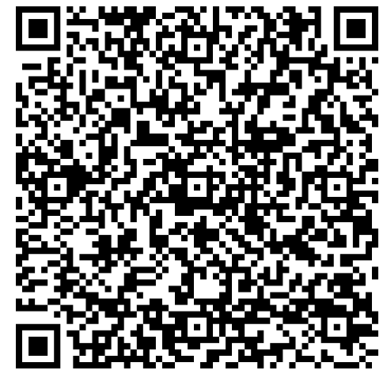
CABAM: Business in New York
-February 11-15, 2027
-Registration Deadline: November 1
-Payment Deadline: January 4

Slide 27
CABAM: Business in Portugal
-March 13-21, 2027
-Registration Deadline: 11/30

Slide 28
Program Participation Incentives
Scholarships (Gold Seal/Bright Futures)
  The Tim & Susan Bryce Scholarship $1,000
College Credit (SPC)
Reduced Cost on Field Trips
Grad Cords for Program Completers
T-Shirts
Prizes, Gift Cards/Certificates, Swag
Resume building experiences

Slide 29
CABAM Programs
Hospitality & Tourism Management
Digital Design (H)
Digital Design I (H)
Business Management & Analysis
Digital Design II (H)
Introduction to Hospitality & Tourism (C)
Technology for Hospitality & Tourism
Legal Aspects of Business (H)
Accounting I (H)
Sports, Entertainment & Recreation Marketing
Sports, Entertainment & Recreation Essentials
Sports, Entertainment & Recreation Applications
Sports, Entertainment & Recreation Management (H)
Hospitality & Tourism Management Marketing (H)
Sports, Entertainment & Recreation Internship
Digital Design III (H)
AP Business with Personal Finance
Advanced Information Technology
AP Computer Science Principles
AP Computer Science A (Online)
Digital Design IV (H)
Foundations of Programming
Hospitality & Tourism Internship
Computer Science
Digital Business Foundations
(MS)(C)
Artificial Intelligence Foundations
Artificial Intelligence in the World (H)
Applications of AI (H)
Intermediate Programming
Foundations of Machine Learning

Slide 30
CABAM Standalone Courses
Hospitality & Tourism Internship
Sports, Entertainment & Recreation Marketing Internship
AP Business with Personal Finance
AP Cyber Security
***AP Networking – Next Year***

Slide 31
Upcoming Opportunities/Events
Community Advisory Board: 9/14, 11/2
FBLA: 9/15
TEDx: 9/24
Student Advisory Committee: 9/28
Professional Dress Day: 9/29
NTHS: 10/1
Adobe Workshop: 10/5 & 10/6 (During School)
Resume Workshop: 10/6 & 10/8 (After School)
Mock Interviews 10/20 & 10/28 (In School, Extra Credit)
Job Shadow Day: 11/5 (Contracts Due by 10/22)
Great American Teach In: 11/12

Slide 32
College Application Process
GradePower Learning
Dunedin (727)475-9980
Largo (727)595-1538

Slide 33
Freshman-Junior Year
Know how GPAs are calculated
  Regular classes: A: 4.0 B: 3.0 C: 2.0 D:1.0 F: no credit
  Honors classes: A: 4.5 B: 3.5 C: 2.5 D: 1.5 F: no credit
  AP/IB/Dual Enrollment classes:
  A: 5.0 B: 4.0 C: 3.0 D: 2.0 F: no credit
  If you want the high GPAs needed for many of the state universities in Florida, you will need to take Honors/AP/IB/Dual Enrollment classes and get good grades in them!
Pick the correct classes
  Should I take honors/AP/IB/dual enrollment?
    Yes! As long as you can get an A or B, you should take the most difficult class you can. Universities care a lot about the difficulty of your class schedule – including senior year.
  Does it matter which electives I take?
    Yes and no? Most universities do not take elective classes into account when calculating their own version of your high school GPA (for admissions purposes). However, taking more academic electives or electives that show a passion for something (like band or art or business) are a huge positive on your college application.
  Do I need to take a foreign language and how many years?
    Yes! 2 years of a foreign language (both years must be the same language) are required for Bright Futures and admittance to any of the state universities in Florida (as well as many other universities). If you can get an A or B, it also looks great on a college application to take 3, 4, or even 5 years of a foreign language.
EVERY high school grade matters
  Beginning freshman year, your grades matter A LOT to college admissions. Get help if you need it. It is way harder to raise a low GPA than to keep up with a good GPA.
Notes:
Only if you’re ready. Will count toward your high school gpa. Don’t start in a hole if you don’t need to
Explain how they work with gpa. It looks better to take the harder class but only if you think you can at least get a B
Most colleges calculated gpas based on only academic classes. Therefore, band doesn’t help or hurt you – don’t worry about taking honors band for college or bright futures. However, it can help you for hs graduation.
If you want to go to college, the short answer is yes. You need at least 2 years for state universities and for bright futures. The more years you take the better it looks for college. You do not need language to graduate with a 24 credit diploma
Will need to retake to get credit for graduation. The new grade will replace the old one for graduation GPAs and Bright Futures GPAs but NOT for most college admission GPAs

Slide 34
Freshman-Junior Year
Start building your skills early – you’ll need them for later courses, SAT/ACT and college
  Math
  Reading comprehension
  Grammar
  Essay
Start thinking about potential colleges and majors – begin your research. It is never too early to visit schools, look at majors, and find universities you may want to attend in the areas you may want to live.

Slide 35
Freshman-Junior Year
Familiarize yourself with the Bright Futures Requirements. Keep in mind that the scores typically stay the same or increase every year. SAT/ACT/CLT scores are usually the most difficult part of getting Bright Futures – so start early!
Florida Academic Scholars
Pays 100% of tuition at a public college in Florida
  Around $28,000 over 4 years
Requirements (26/27 graduates)
  3.5 weighted GPA
  1330 SAT, 29 ACT, or 95 CLT (super-scored)
  100 service or work hours
  2 years of a foreign language
  27/28 graduates will have new requirements
    1350 SAT, 29 ACT, or 96 CLT
Florida Medallion Scholars
Pays 75% of tuition at a public college in Florida
  Around $19,000 over 4 years
Requirements (26/27 graduates)
  3.00 weighted GPA
  1190 SAT, 24 ACT, or 82 CLT (super-scored)
  75 service hours or 100 work hours
  2 years of a foreign language
  27/28 graduates will have new requirements
    1200 SAT, 25 ACT, or 83 CLT

Slide 36
Gold Seal Vocational Scholars
Pays
  $48/credit hour for Technical Degree Education Program
  $48/credit hour for Bachelor of Science or Bachelor of Applied Science
    Note: cannot be used for a Bachelor of Arts or Associate of Arts degree
  $39/credit hour for Career Certificate Program or Applied Technology Program
Requirements
  3.0 weighted GPA/ 3.5 unweighted GPA in career education courses
  Take 3 full credits in a single Career and Technical Education program
  Achieve minimum score on the ACT, SAT, or PERT
    SAT: Reading & Writing – 490 Math – 480
    ACT: Reading – 19 English – 17 Math – 19
    PERT: Reading – 106 Writing – 103 Math - 114
  30 service hours or 100 work hours
Limitations: can only be used to fund a maximum of 72 or 60 credit hours depending on the program
It will be best to get an Academic Scholarship or Medallion Scholarship if you can as it will pay out the most in scholarship money!

Slide 37

University Case Studies
How difficult is it to get into Florida universities these days? Here is the information for the middle 50% of freshman who started college in the 25/26 school year. It is important to know what your goals may need to be as early as possible! College admissions is competitive and you need to get ready early.
UF
USF
Mid-range GPA: 4.5-4.7
Mid-range SAT: 1390-1510
Mid-range ACT: 31-34
Application Deadline:
  Early Admission: Nov 1
  Regular Decision: Jan 15
Super-score: SAT and ACT
30 hour tuition in 2025-2026: $6,380
Mid-range GPA: 4.03-4.55
Mid-range SAT: 1260-1410
Mid-range ACT: 27-31
Application Deadline:
  Priority: Nov 1
  Rolling - March 1
Super-score: SAT and ACT
30 hour tuition in 2025-2026: $6,410
As you can see, it is getting more difficult to get into state universities. UF is the most difficult school to get into in Florida and is a top 10 Public University. USF used to be seen as a school you could always get into if you couldn’t get in anywhere else, but it is no longer that way. Its scores have increased significantly in the past 5 years.

Slide 38
Junior Year
Know each school’s admissions process
Average admissions GPA
Middle 50% SAT/ACT score
What extra information will you need to submit in your application?
Common App Essay
Application Date
Narrow down a list of colleges you’d like to attend
Safety – apply to at least 5 schools you know you can get into and wouldn’t mind attending
Reach – apply to 1 or 2 schools you’d love to go to but aren’t sure you can get in
Fit is the most important – we want you to get into college but we really want you to stay there and graduate! Do you like the location, size, programs, etc?

Slide 39
Junior Year
Start your SAT/ACT Prep*
  However, you don’t need to wait until junior year. You should begin prep near the end of Algebra 2
  The earlier the better: SAT scores are good for 5 years so there is no reason to wait
    If you take Algebra II as a freshman, begin SAT/ACT prep the summer between 9th and 10th grade
    If you take Algebra II as a sophomore, begin SAT/ACT prep the summer between 10th and 11th grade
Know what you’re getting into; be prepared!
  Take a practice test
  Become familiar with the format and content
  Get help if you need it
    Most students need an average of 20 hours of practice to raise their score 115 points

Slide 40
College Admissions Tests
SAT
Two Sections (2 modules of each)
  Reading & Writing
  Math
  No essay
Completely Digital
1600 Scale
ACT
Four Sections
  English
  Math
  Reading
  Optional Science
  Optional Essay
Option of Paper-Based or Digital
36 Scale
CLT
Three Sections
  Verbal Reasoning
  Grammar & Writing
  Quantitative Reasoning
  Optional Essay
Digital with remote proctoring available
120 Scale
Make sure to pick the best test for you! You only need to get a good score on one of the tests, so take practice tests to see which you prefer. As a note, the CLT can only be used at public Florida universities and some small liberal colleges, so it may make sense to focus on the SAT or ACT.

Slide 41
Senior Year: Apply!
Summer
  write college essays and begin online application
    Most applications open in August – turning them in earlier is better but you’re good as long as you apply by the deadline
    Common App is used by almost all school to apply
      Common app essay – one essay that will be ready by every school
October 1: Apply for FAFSA
Before November 1
  Submit applications with well written essays
    Make sure to finish applications in school portals
  Send official SAT/ACT scores
By deadlines for each school
  Submit financial aid, housing, honors, and other applications
  Make final decision about where you want to attend
Before August 31 after graduation
  Apply for Bright Futures. BUT it’s better to apply by Nov 1 of senior year if possible
  The August SAT or July ACT after you graduate is your LAST CHANCE to get your score up for Bright Futures

Slide 42

Bright Futures: Gold Seal
2026 – 2027
Pinellas County Schools
Assessment, Accountability, and Research
Jill Lord-Shelby
Research Manager

Slide 43


Bright Futures
General Information

Slide 44
The Program
The Florida Bright Futures Scholarship Program was created to establish a lottery-funded scholarship program to reward any Florida high school graduate who merits recognition of high academic achievement.
This program has helped more than 725,000 Florida students attend a postsecondary institution. Bright Futures awards include:
$ Florida Academic Scholars award (FAS) [100% tuition],
$ Florida Medallion Scholars award (FMS) [75% tuition],
$ Florida Gold Seal Vocational Scholars award (GSV) [fixed dollar amount per credit or clock hour (≈30-55% tuition)],
$ Florida Gold Seal CAPE Scholars award (GSC) [fixed dollar amount per credit or clock hour (≈30-55% tuition)]
Bright Futures
Bright Futures website: https://www.floridastudentfinancialaidsg.org/SAPBFMAIN/SAPBFMAIN

Slide 45
Academic and Medallion Scholarships
Bright Futures
Type | High School Courses | HS GPA | ACT / SAT Scores | Service / Work Hours | Award
FAS Florida Academic Scholars | 4 – English 4 – Mathematics 3 – Natural Science | 3.5 | 2025–26 Graduates: 29 / 95 / 1330 2026–27 Graduates: 29 / 95 / 1330 | 100 hours [service OR paid work] | 100%
FMS Florida Medallion Scholars | 3 – Social Science 2 – World Language | 3.0 | 2025–26 Graduates: 24 / 82 / 1190 2026–27 Graduates: 24 / 82 / 1190 | 75 service hours OR 100 paid work hours | 75%*
*FMS: Beginning in the fall 2021 semester, a Florida Medallion Scholar who is enrolled in an associate degree program at a Florida College System institution is eligible for an award equal to the amount necessary to pay 100 percent of tuition and fees established under s. 1009.23(3), (4), (7), (8), (10), and (11) to assist with the payment of educational expenses.
FAS: http://www.leg.state.fl.us/statutes/index.cfm?App_mode=Display_Statute&Search_String=&URL=1000-1099/1009/Sections/1009.534.html
FMS: http://www.leg.state.fl.us/statutes/index.cfm?App_mode=Display_Statute&Search_String=&URL=1000-1099/1009/Sections/1009.535.html
Bright Futures Course Table: https://sso.osfaffelp.org/BFIEHS/Course/ComprehensiveCourse

Slide 46
Bright Futures Gold Seal

Slide 47
Gold Seal Scholarships
The Florida Gold Seal Vocational (GSV) Scholars award and the Florida Gold Seal CAPE (GSC) Scholars award were created within the Florida Bright Futures Scholarship Program to recognize and reward academic achievement and career preparation by high school students who wish to continue their education.
Bright Futures: Gold Seal
Source: http://www.leg.state.fl.us/Statutes/index.cfm?App_mode=Display_Statute&URL=1000-1099/1009/Sections/1009.536.html

Slide 48
Vocational (GSV)
Type | High School | HS GPA | ACT / SAT Scores | Service / Work Hours
GSV Gold Seal Vocational Scholars | Earn at least 3 full credits in a single Career & Technical Education program | 3.0 GPA in the non-elective high school courses 3.5 unweighted GPA in career education courses | ACT Subtest Reading: 19, ACT Subtest English 17, ACT Subtest Math: 19 [SAT after 3/1/2024] SAT Critical Reading: 490, SAT Math: 480 [SAT prior to 3/1/2024] SAT Reading: 24, SAT Writing & Language 25, SAT Math: 24 GSV ONLY: PERT PERT Reading: 106, PERT Writing: 103, PERT Math: 114 | 30 service hours OR 100 paid work hours
Gold Seal Vocational

Slide 49
Programs at PHUHS
C.A.B.A.M. (Business)
Career Academy of Business Administration and Management
C.W.M.P.
Center for Wellness & Medical Professions
Arts, A/V Technology & Communication | Digital Design [8209600]
 | DIT [8207310]
 | Digital Design 1 [8209510]
 | Digital Design 2 [8209520]
 | Digital Design 3 [8209530]
 | Digital Design 4 [8209540]
Business Mgt & Admin | Business Management and Analysis [8301100]
 | DIT [8207310]
 | Business and Entrepreneurial Principles [8215120]
 | Accounting Applications 1 [8203310]
 | Legal Aspects of Business [8215130]
Information Technology | Computer Science Principles [9007600]
 | Advanced Information Technology [9007610]
 | Foundations of Programming [9007210]
 | AP Computer Science Principles [0200335]
 | AP Computer Science A [0200320]
Hospitality & Tourism | Hospitality and Tourism Management [8703100]
 | Introduction to Hospitality & Tourism [8850110]
 | Technology for Hospitality & Tourism [8703110]
 | Hospitality & Tourism Marketing Management [8703120]
 | Hospitality & Tourism Internship [8845130]
Marketing, Sales & Service | Sport, Recreation and Entertainment Marketing [8827400]
 | Sport, Recreation, and Entertainment Essentials [8827410]
 | Sport, Recreation, and Entertainment Applications [8827420]
 | Sport, Recreation, and Entertainment Marketing Mgt [8827430]
 | Sport, Recreation, and Entertainment Internship [8827440]
Health Science | Allied Health Assisting [8417130]
 | Health Science Foundations [8417110]
 | Health Science Anatomy & Physiology [8417100]
 | Allied Health Assisting 3 [8417131]
 | Biodmedical Sciences [8708100]
 | Principles of Biomedical Sciences [8708110]
 | Human Body Systems [8708120]
 | Medical Interventions [8708130]
 | Biomedical Innovation [8708134]
 | Electrocardiograph Technician [8427100]
 | Health Science Foundations [8417110]
 | Health Science Anatomy & Physiology [8417100]
 | Electrocardiograph Technician 3 [8417130]
 | Exercise Science [8417000]
 | Health Science Foundations [8417110]
 | Health Science Anatomy & Physiology [8417100]
 | Exercise Science [8417120]
 | Nursing Assistant [8417210]
 | Health Science Foundations [8417110]
 | Health Science Anatomy & Physiology [8417100]
 | Nursing Assistant 3 [8417211]
 | Pharmacy Technician [8418200]
 | Pharmacy Technician 1 [8418210]
 | Pharmacy Technician 2 [8418220]
 | Pharmacy Technician 3 [8418230]
 | Pharmacy Technician 4 [8418240]
 | Pharmacy Technician 5 [8418250]
 | Pharmacy Technician 6 [8418260]
 | Pharmacy Technician 7 [8418270]
Gold Seal Vocational

Slide 50
GSV Frequently Asked Questions
Gold Seal Vocational: FAQs
To be a BF GSV Program Completer, do the courses have to be taken in a specific order?
No. For GSV eligibility, the order of courses does not matter. However, schools or teachers may require students to follow a specific sequence
for instructional purposes.
If there are more than 3 courses offered in a program, is the student required to take any specific courses?
No. For GSV eligibility, students may take any three courses in a
program. However, schools or teachers may require students to take certain courses.
If a student took a program course that is part of the program sequence online or at another school, will it count for GSV eligibility?
Yes. A program course, such as D.I.T. [8207310], in which the student earned credit at any Florida school (including FLVS) will count toward GSV
eligibility.

Slide 51
CAPE (GSC)
Type | High School | HS GPA | ACT / SAT Scores | Service / Work Hours
GSC Gold Seal CAPE Scholars | Earn standard Florida high school diploma | 2.0 required for high school graduation | —NA— ACT, CLT, PERT, or SAT score not required | 30 service hours OR 100 paid work hours
 | Earn a minimum of 5 postsecondary credit hours through CAPE industry certifications that articulate* for college credit.
 | GSC recipients who earn a qualifying A.S. or A.A.S. degree may receive an award toward a qualifying B.S. or B.A.S. degree.
Gold Seal CAPE
Articulated Credit
When a high school student earns an industry certification on the statewide articulation agreement, they can receive college credit toward certain A.S. or A.A.S. degree programs at Florida College System institutions. The industry certifications with articulated credit are summarized on the Bright Futures CAPE list. For students earning these certifications, the articulated credits also count toward Bright Futures GSC.
Note: The FLDOE maintains the CAPE Industry Certification list. The Bright Futures CAPE list is a subset of this list and includes only the certifications that are eligible for articulated credit and count toward Bright Futures.
>>CAPE list ≠ Bright Futures CAPE List<<
Bright Futures CAPE Lists:
2025–2026: https://sso.osfaffelp.org/BFIEHS/Course/IndustryCertificationList
2024–2025: www.fldoe.org/core/fileparse.php/7525/urlt/active-articulation-summary.xlsx

Slide 52
Certification Articulated Credits (examples)
Gold Seal CAPE
This list includes a few of the CAPE certifications offered at PHUHS that award Bright Futures articulated credit.
FDOE Code | Certification Title | Articulated Credits
CABAM (Business)
ADOBE023 | Adobe Certified Professional in Video Design (Requires Premiere Pro and After Effects or Photoshop) | 3–4*
ADOBE024 | Adobe Certified Professional in Visual Design (Requires Photoshop and Illustrator or InDesign) | 3
CERTI010 | Information Technology Specialist (ITS) - JavaScript | 3
INTUT001 | Quickbooks Certified User | 3
INTUT002 | Entrepreneurship & Small Business | 3
PRMIN004 | PMI Project Management Ready | 3
CWMP (Medical)
CERHB001 | Biotechnician Assistant | 3
NATHA009 | Certified Clinical Medical Assistant (CCMA) | 3
NATHA010 | Certified Pharmacy Technician | 9
*Depending on the collegiate program, this certification may count for 3 or 4 articulated credit.

Slide 53
GSC Frequently Asked Questions
Gold Seal CAPE: FAQs
Do all FLDOE CAPE industry certifications count for Bright Futures articulated credit?
No. Only certifications listed on the FLDOE Bright Futures articulated credit list are eligible. This list includes the qualifying industry
certifications, the amount of articulated credit each provides, and the degree program to which the credit applies.
Do the earned BF CAPE certifications need to be from the same high school program?
No, the certifications just need to be on the FLDOE Bright Futures articulated credit list.
Does the student have to enroll in the degree program that aligns with their BF CAPE certifications?
No. Students may pursue any A.S./A.A.S. degree program. If their chosen program aligns with earned articulated credits, they should share
this information with the college so the credits can be applied toward their degree.

Slide 54
GSC Frequently Asked Questions, continued
Gold Seal CAPE: FAQs, continued
Does a BF CAPE certification count for GSC if earned in a dual enrollment course?
Yes, as long as the student is enrolled in high school when the certification is earned.
Can the CAPE certifications be earned in middle school?
Yes, as long as the CAPE certification is still on the FLDOE Bright Futures articulated credit list.

Slide 55
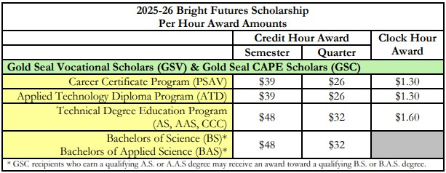
How Much?
GSV and GSC award recipients receive a fixed cost per credit hour based on award level, institution type, and credit type as specified in the BF Student Handbook, chapter 2.
Gold Seal Award
Example Costs [Gold Seal Approximate Coverage]
SPC: $111.75 – $122.70 [≈32% – 43% covered]
PTC: $2.92 per clock hour [≈45% – 55% covered]

Slide 56
GSV vs. GSC
Gold Seal Vocational (GSV)
Gold Seal Vocational (GSV)
Gold Seal CAPE (GSC)
Requirements | Gold Seal Vocational (GSV) | Gold Seal CAPE (GSC)
Courses | Yes Complete a single program | No
GPA minimum | 3.0 / 3.5 non-electives / CTE courses | 2.0  required for high school graduation
ACT/SAT/PERT minimum | Yes | No
Service hours [30] or paid work hours [100] | Yes | Yes
Bright Futures 5 Articulated Credit Hours (by earning qualifying industry certifications) | No | Yes
Funding
Recipients who earn an eligible A.S. or A.A.S. degree may also receive an award for a maximum of 60 credit hours toward an eligible B.S. or B.A.S. degree. | No | Yes
Yes
Complete a single program
No
Yes
Complete a single program
Gold Seal Summary
3.0 / 3.5
non-electives / CTE courses
2.0
✪ required for high school graduation
3.0 / 3.5
non-electives / CTE courses
Yes
No
Yes
Yes
Yes
Yes
No
No
Yes
No
Yes
No

Slide 57
Stipulations
Gold Seal awards (GSC/GSV) may only be used at postsecondary institutions that offer an applied technology diploma, technical degree education program (associate in science–A.S. or associate in applied science–A.A.S.), or a career certificate program.
Gold Seal Award
What’s the Difference?
Associate of Science (A.S.): A two-year degree that prepares students to begin a career or continue into a B.A.S. degree at SPC.
Associate of Applied Science (A.A.S.) degree programs are designed for students who want to enter the workforce immediately upon completing their program.
Associate of Arts (A.A.): A two-year degree that prepares students for a bachelor’s degrees at SPC or a state university.

Slide 58
Participating Institutions
Bright Futures Gold Seal Scholarships are accepted at Florida College System schools and District Postsecondary Institutions.
Florida College System [source: https://www.fldoe.org/schools/higher-ed/fl-college-system/]
Gold Seal Award
Broward College Chipola College College of Central Florida Daytona State College Eastern Florida State College Florida Gateway College College of the Florida Keys Florida Southwestern State College Florida State College at Jacksonville Gulf Coast State College | Hillsborough Community College Indian River State College Lake–Sumter State College Miami Dade College North Florida College Northwest Florida State College Palm Beach State College Pasco–Hernando State College Pensacola State College | Polk State College Santa Fe College Seminole State College of Florida South Florida State College St. Johns River State College St. Petersburg College State College of Florida Tallahassee Community College Valencia College
Regional District Postsecondary Institutions
Pinellas County Pinellas Technical College - Clearwater Pinellas Technical College - St. Petersburg | Pasco County Fred K. Marchman Technical College | Hillsborough County Aparicio-Levy Technical College Brewster Technical College Erwin Technical College
Statewide list of District Postsecondary Institutions: https://www.fldoe.org/academics/career-adult-edu/dist-ps-instit.stml

Slide 59
SPC: A.S. Degrees
Gold Seal Award: Degrees at SPC
Certain industry certifications earned in high school award articulated credit toward A.S./A.A.S. degrees statewide*. This table highlights SPC
A.S. programs with credit awarded for earned industry certifications.
CAPE Industry Certification Articulated Credit |  |  | Associate (AAS OR AS) Degree Options
Ind. Cert. | >> | Course Equivalent (credits)
CERHB001 | >> | BSC2420 (3) | Biotechnology Laboratory Technology A.S.
COMPT018 KNOWL001 | >> >> | CGS1309 (3) CGS1309 (3) | Computer Programming and Analysis A.S.
COMPT008 | >> | CGS1309 (3) | Data Science A.S.
NATHA009 | >> | HSC1531 (2) | Health Information Technology A.S.
NATHA009 | >> | HSC1531 (2) | Health Sciences A.S.
INTUT002 | >> | ENT1000 (3) | Production Systems Management A.S.
ADOBE025 COMPT006 | >> >> | CGS1309 (3) CNT1000 (3) | Web Development A.S.
Gold Standard Career Pathways Articulation Agreements List: https://www.fldoe.org/academics/career-adult-edu/career-technical-edu- agreements/industry-certification.stml
SPC also offers additional A.S. programs, such as:
Applied Engineering Technology A.S.
Biomedical Engineering Technology A.S.
Building Design and Construction Management A.S.
Cloud Computing Technology A.S.
Computer Information Technology A.S.
Crime Scene Technology A.S.
Digital Forensics and Computer Investigations A.S.
Emergency Medical Services A.S.
Environmental Science Technology A.S.
Fire Science Technology A.S.
Funeral Services A.S.
Homeland Security and Emergency Management A.S.
Hospitality and Tourism Management A.S.
Music Industry Recording Arts MIRA A.S.
Networking Technologies A.S.
Nursing A.S. – L.P.N. transitional
Physical Therapist Assistant A.S.
Radiography A.S.
Respiratory Care A.S.
Respiratory Care A.S. – CRT Transitional
Social and Human Services A.S.
Surgical Services A.S.
18

Slide 60
SPC: A.S. to B.A.S. Degrees
Certain industry certifications earned in high school award articulated credit toward A.S./A.A.S. degrees statewide. At SPC, these A.S. degrees provide pathways into related B.A.S. programs. This table highlights A.S. to B.A.S. programs with and without articulated credit.
Gold Seal Award: Degrees at SPC
CAPE Industry Certification Articulated Credit |  |  | Associate (AAS OR AS) Degree Options | Bachelors Degree Options
Ind. Cert. | >> | Course Equivalent (credits)
PRMIN003 | >> | MAN2582 (3) | Business Administration A.S. | Business Administration B.S.
INTUT002 | >> | ENT1000 (3)
INTUT003 | >> | ENT1000 (3)
INTUT001 | >> | ACG2450 (3)
COMPT001 | >> | CET1171C (3), CET1172C (3) | Cybersecurity A.S. | Cybersecurity B.A.S.
COMPT008 | >> | CTS1120 (3), CIS1358 (3)
COMPT001 | >> | CET1171C (3), CET1172C (3) | Public Safety A.S. | Public Safety Administration B.A.S.
COMPT008 | >> | CTS1120 (3), CIS1358 (3)
FLVMA002 | >> | ATE1741 (1), ATE1943 (1); ATE1944 (1) | Veterinary Technology A.S. | Veterinary Technology B.A.S.
 |  |  | Dental Hygiene A.S. | Dental Hygiene B.A.S.
 |  |  | Digital Media A.S. | Digital Media B.A.S.
 |  |  | Nursing A.S. | Nursing B.S.
 |  |  | Paralegal Studies A.S. | Paralegal Studies B.A.S.

Slide 61
Pinellas Technical College Programs
Pinellas Technical College offers career-focused programs that prepare students with the skills and certifications needed to enter the workforce.
Gold Seal Award: PTC
Program | CLW | SP
Arts & Audio / Visual
Stage Production | CLW
Television Production Technology |  | SP
Automotive & Transportation
Automotive Collision Technology Technician |  | SP
Master Automotive Service Technology 1 | CLW | SP
Master Automotive Service Technology 2 | CLW | SP
Diesel Maintenance Technician | CLW
Diesel Systems Technician 1 | CLW
Diesel Systems Technician 2 | CLW
Marine Service Technologies | CLW
Commercial Class B Driving |  | SP
Commercial Vehicle Driving |  | SP
Beauty
Barbering | CLW | SP
Cosmetology |  | SP
Facials Specialty |  | SP
Nails Specialty |  | SP
Business & Information Technology
Accounting Operations | CLW
Computer Systems & Information Technology | CLW | SP
Computer Systems & Information Technology (CSIT) - IET |  | CLV
Medical Administrative Specialist | CLW
Network Support Services | CLW
Web Development | CLW
Child Care
Child Care Center Operations | CLW | SP
Early Childhood Education |  | SP
School Age Professional Certificate |  | SP
Programs | CLW | SP
Construction & Design
Cabinetmaking | CLW
Computer-Aided Drawing and Modeling |  | SP
Electricity | CLW | SP
Electronic Systems Integration and Automation | CLW
Heating, Ventilation, Air-Conditioning / Refrigeration (HVAC/R)1 |  | SP
Heating, Ventilation, Air-Conditioning / Refrigeration (HVAC)1 - IET | CLW
Interior Decorating | CLW
Plumbing |  | SP
Health Science
Dental Assisting |  | SP
Emergency Medical Technician |  | SP
Medical Coder / Biller |  | SP
Phlebotomy | PHI
Phlebotomy - IET | PHI | SP
Practical Nursing | CLW | SP
Surgical Technology |  | SP
Hospitality
Baking & Pastry Arts | CLW
Fundamental Foodservice Skills | CLW
Professional Culinary Arts & Hospitality | CLW | SP
Manufacturing
Jewelry Design and Repair 1 |  | SP
Jewelry Design and Repair 2 |  | SP
Machining Technologies | CLW
Welding Technology | CLW | SP
Welding Technology - Advanced | CLW | SP
Public Works
Public Works |  | SP
Students who plan to attend PTC should meet with a PTC counselor to review which high school credits and industry certifications may count toward their program.
CLW: Clearwater Campus
PHI: Clearwater Campus–Pinellas High Innovation
SP: St. Petersburg Campus
CLV: St. Petersburg Campus–Clearview Adult Education Center

Slide 62
Next Steps
Industry Certifications (GSC)
To qualify for and take industry certifications, speak with your CTE teacher, Mr. Schachter (CABAM Department Chair), or Ms. Webb (CWMP Department Chair).
Program Completer (GSV)
When planning your schedule each school year, speak with your CTE teacher or guidance counselor about which courses will complete a CTE program.
Seniors
Complete your service / work hours
Complete the Florida Financial Aid Application* (FFAA) [available 10/1]
Contact your guidance counselor or College Career Coordinator.
Next Steps
Bright Futures:
Program | Counselor | Email | Extension
I.B. | Amber Shepherd-Thompson | shepherda@pcsb.org | 2064
C.W.M.P. | Erin Lane | laneer@pcsb.org | 2060
University: Last names A–L | Tim Papp | pappt@pcsb.org | 2061
University: Last names M–Z | TBA |  | 2063
College Career Coordinator | Sarah Lopez | lopezsar@pcsb.org
*required for Bright Futures

Slide 63
Frequently Asked Questions

Slide 64
FAQs
If a student qualifies for both the Florida Academic Scholars (FAS) and the Florida Gold Seal CAPE Scholars (GSC), will they receive both Bright Futures scholarships?
No, the student will not receive both scholarships. The Florida Department of Education awards the Bright Futures scholarship that provides the greatest financial benefit. In this case, the FAS award, which covers 100% of tuition, would be granted.
I am eligible for GSC, but plan to attend a Florida 4-year university, why should I complete the Florida Financial Aid Application (FFAA)?
GSC (and GSV) can only be used at Florida College System institutions or regional postsecondary schools. You are encouraged to complete the Florida Financial Aid Application (FFAA) in case your plans change and you decide not to attend a state university.
I’m undecided about my plans after high school. Can I wait and apply for Bright Futures later?
No. To be eligible for Bright Futures, you must submit the Florida Financial Aid Application (FFAA) by August 31 of the year you graduate from high school*.
Bright Futures: FAQs
*“Bright Futures recipients who did not receive funding immediately following high school graduation must apply within five years after high school graduation to reinstate the award.” (Bright Futures Students Handbook, Chapter 2, p3.)
23

Slide 65
Type | High School Courses | HS GPA | ACT / SAT Scores | Service / Work Hours | Award
FAS Florida Academic Scholars | 4 – English 4 – Mathematics 3 – Natural Science | 3.5 | 2025–26 Graduates: 29 / 95 / 1330 2026–27 Graduates: 29 / 95 / 1330 | 100 hours [service OR paid work] | 100%
FMS Florida Medallion Scholars | 3 – Social Science 2 – World Language | 3.0 | 2025–26 Graduates: 24 / 82 / 1190 2026–27 Graduates: 24 / 82 / 1190 | 75 service hours OR 100 paid work hours | 75%*
GSV Gold Seal Vocational Scholars | Earn at least 3 full credits in a single Career & Technical Education program | 3.0 non- electives 3.5 career ed courses | ACT Subtest Reading: 19, ACT Subtest English 17, ACT Subtest Math: 19 [SAT after 3/1/2024] SAT Critical Reading: 490, SAT Math: 480 [SAT prior to 3/1/2024] SAT Reading: 24, SAT Writing & Language 25, SAT Math: 24 | 30 service hours OR 100 paid work hours | fixed $$$ hour amount [refer to Gold Seal Award on next slide]
 |  |  | [GSV ONLY: PERT] PERT Reading: 106, PERT Writing: 103, PERT Math: 114
GSC Gold Seal CAPE Scholars | Earn standard Florida high school diploma | 2.0 required for high school graduation | —NA— ACT, CLT, PERT, or SAT score not required | 30 service hours OR 100 paid work hours | fixed $$$ hour amount [refer to Gold Seal Award on next slide]
 | Earn a minimum of 5 postsecondary credit hours through CAPE industry certifications that articulate for college credit.
Bright Futures Summary

Slide 66
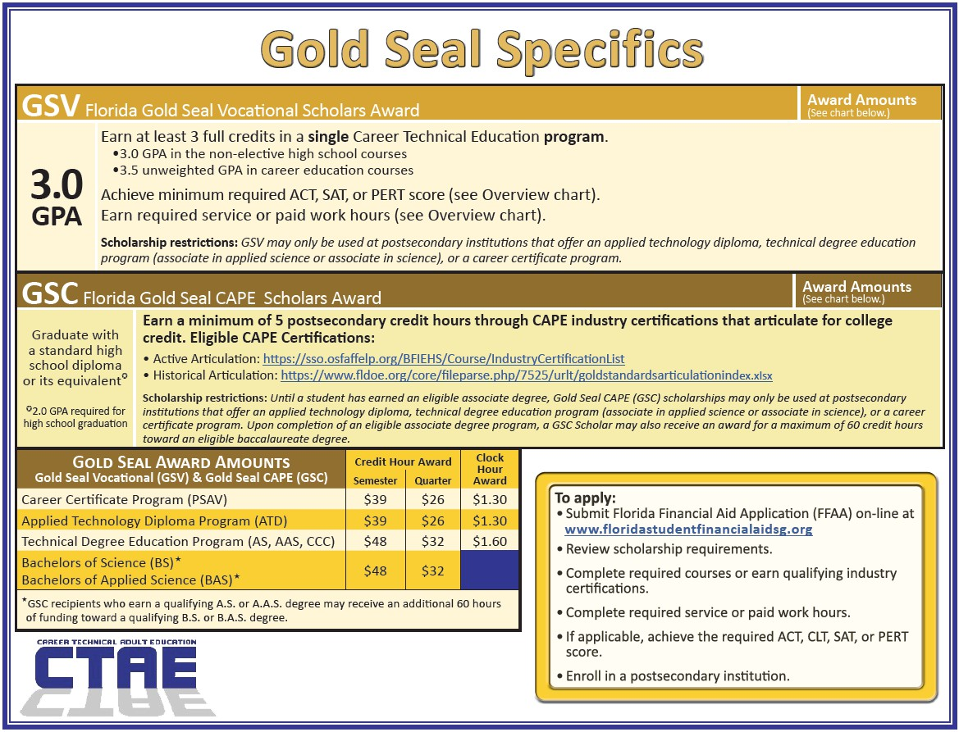
Bright Futures Gold Seal Summary

Slide 67
Questions

Slide 68
Bright Futures Gold Seal
Bright Futures: Resources
Every effort has been made to ensure the accuracy of the information in this presentation. However, statutes and related guidance may change over time, which can lead to discrepancies. In such cases, the official FL DOE resources are the authoritative source. The links below provide access to Bright Futures information.
Bright Futures Home Page:
https://www.floridastudentfinancialaidsg.org/SAPHome/SAPHome?url=home
Bright Futures Handbook:
https://www.floridastudentfinancialaidsg.org/SAPBFMAIN/SAPBFMAIN
GSV Flyer: https://www.floridastudentfinancialaidsg.org/PDF/GSV.pdf
GSC Flyer: https://www.floridastudentfinancialaidsg.org/PDF/GSC.pdf
Bright Futures CAPE Industry Certifications (2025-2026):
https://sso.osfaffelp.org/BFIEHS/Course/IndustryCertificationList
Pinellas County Schools Financial Aid
https://www.pcsb.org/financialaid

