Slide 1

4th Grade Back to School Night 2026-2027
Please grab a packet and sign up for conferences at the back table!
¡Por favor tome un paquete y regístrese para las conferencias en la mesa del fondo!

Slide 2
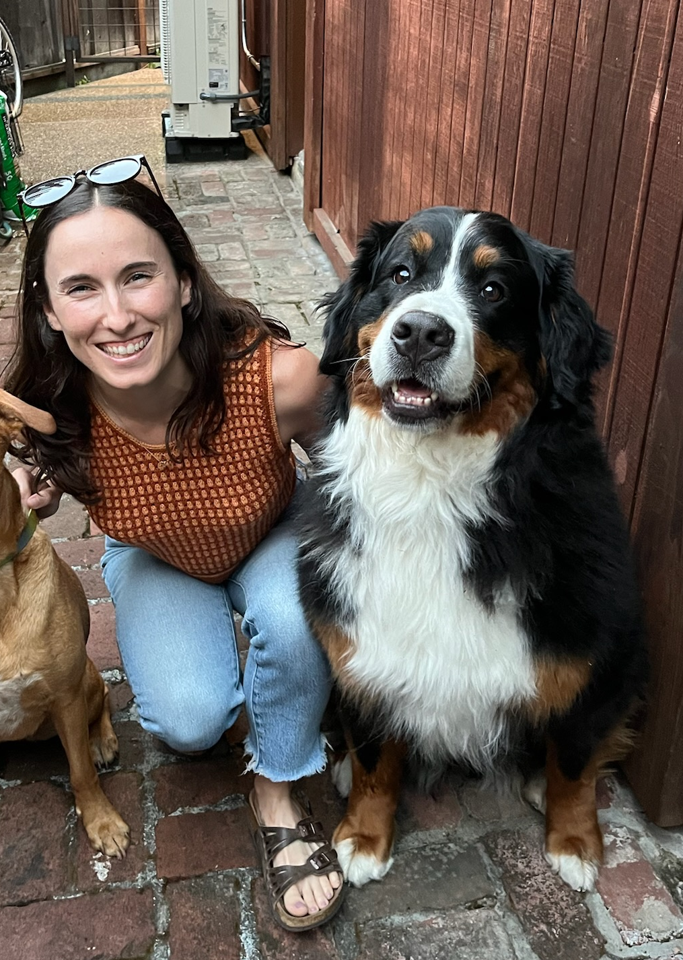
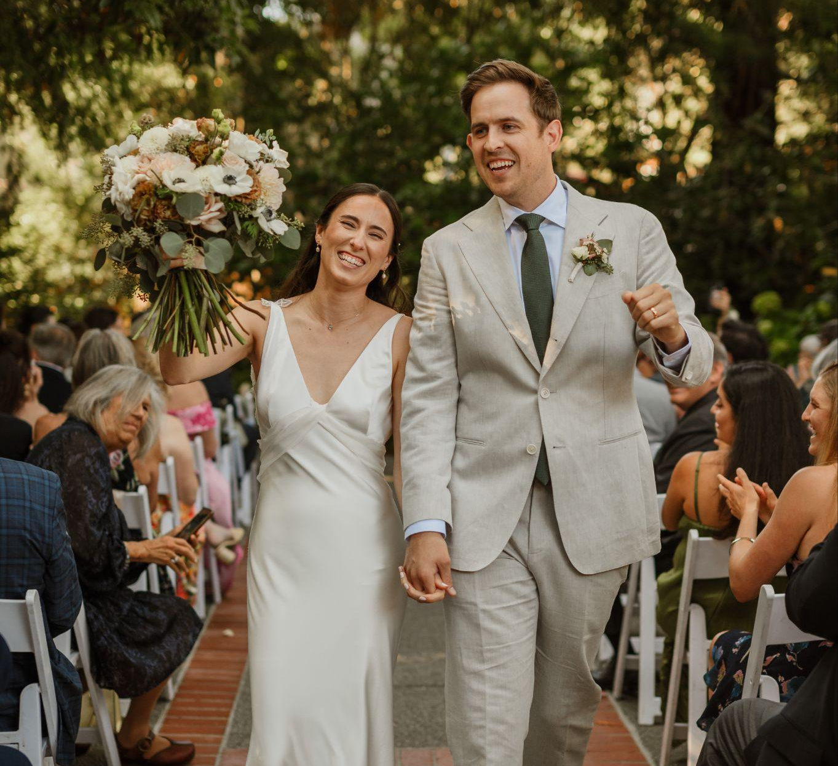
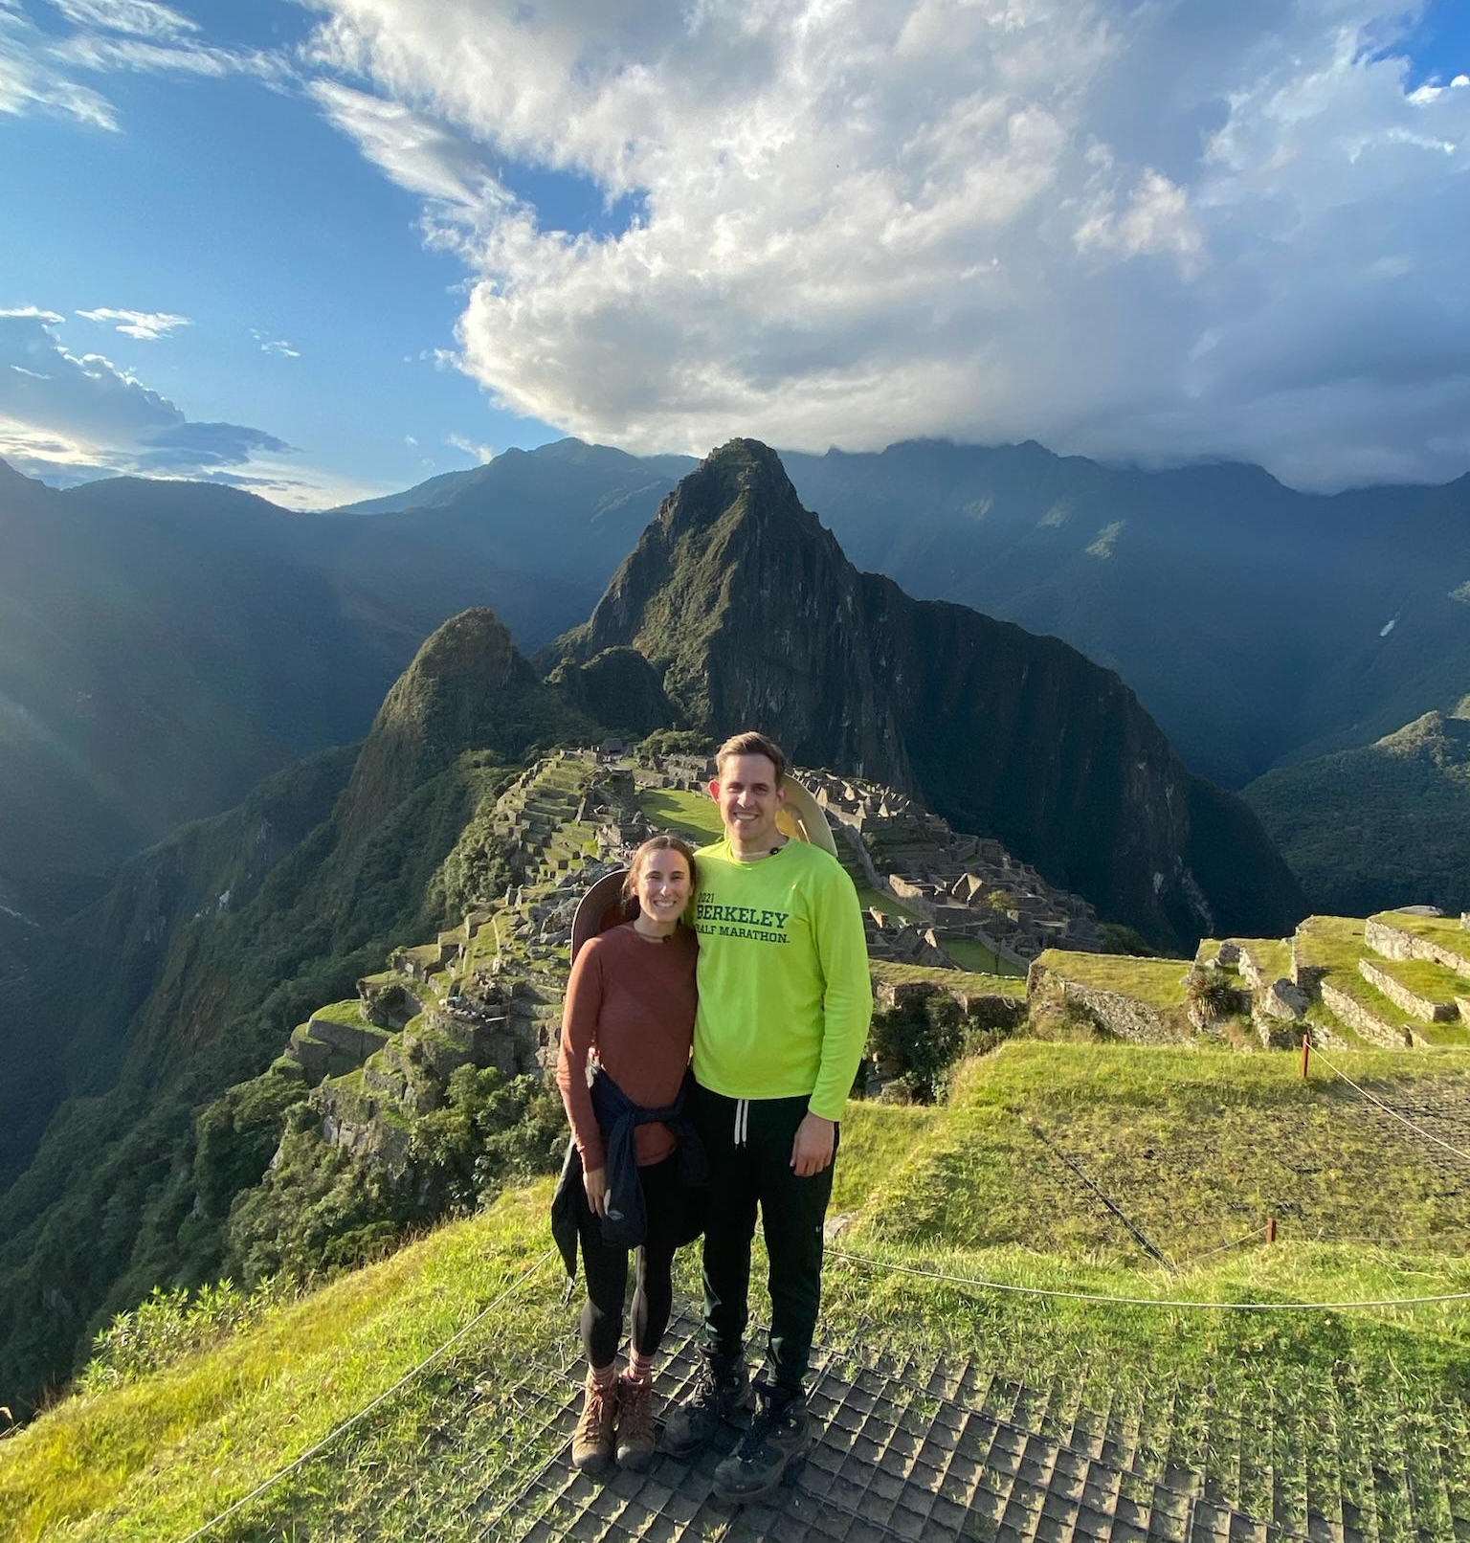

ABOUT MRS. MCCORMICK
Ninth year at Meadow Heights (4th and 5th grades)
Born and raised in San Mateo
Graduated from UC Santa Cruz, with Master of Arts in Education at UC Davis.
Recently got married last year
Enjoys adventurous hikes, running, traveling, walking my 95 lb Bernese Mountain dog and watching Spanish Netflix shows to practice the language.
Noveno año en Meadow Heights (4.º y 5.º grado).
Nacido y criado en San Mateo.
Graduado de UC Santa Cruz y con una maestría en Educación de UC Davis.
Me casé el año pasado.
Disfruto de las caminatas de aventura, correr, viajar, pasear a mi boyero de Berna de 95 libras y ver series en español en Netflix para practicar el idioma.

Slide 3
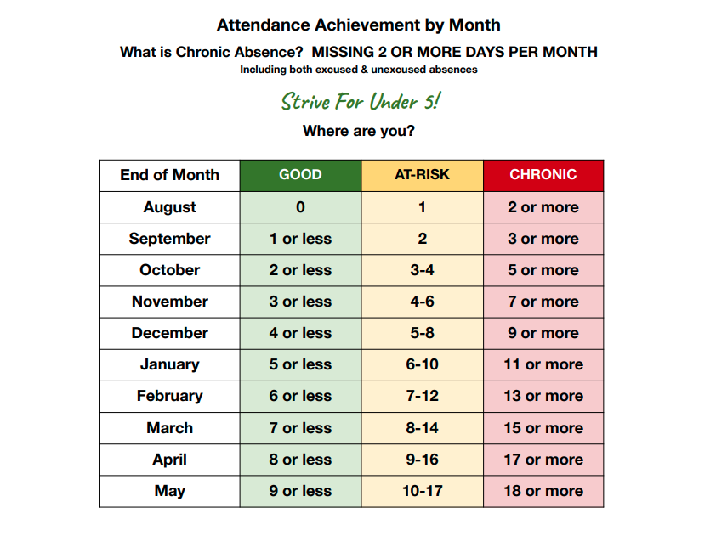

Slide 4
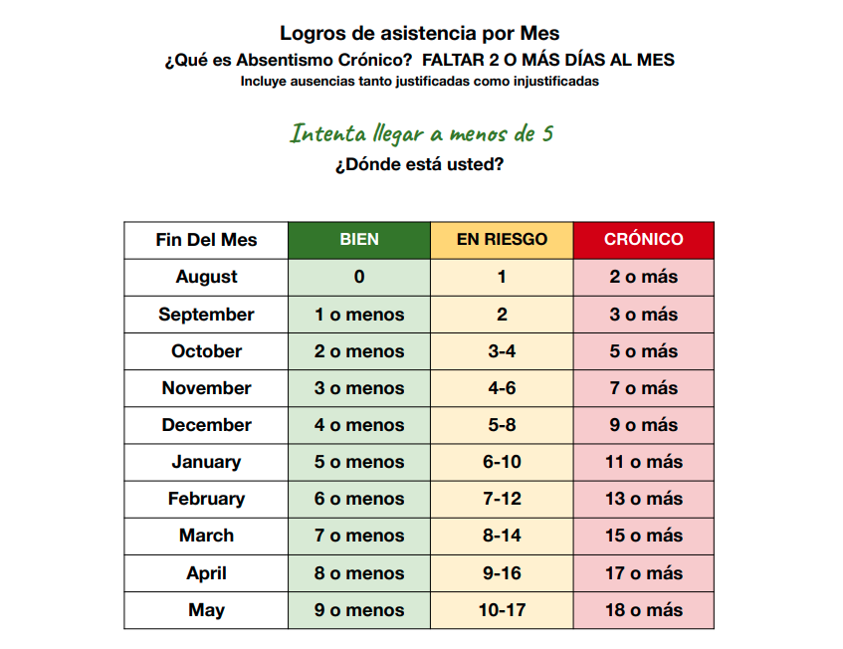

Slide 5
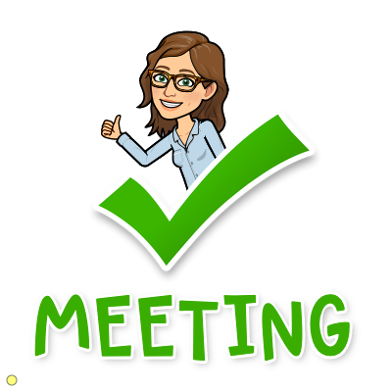
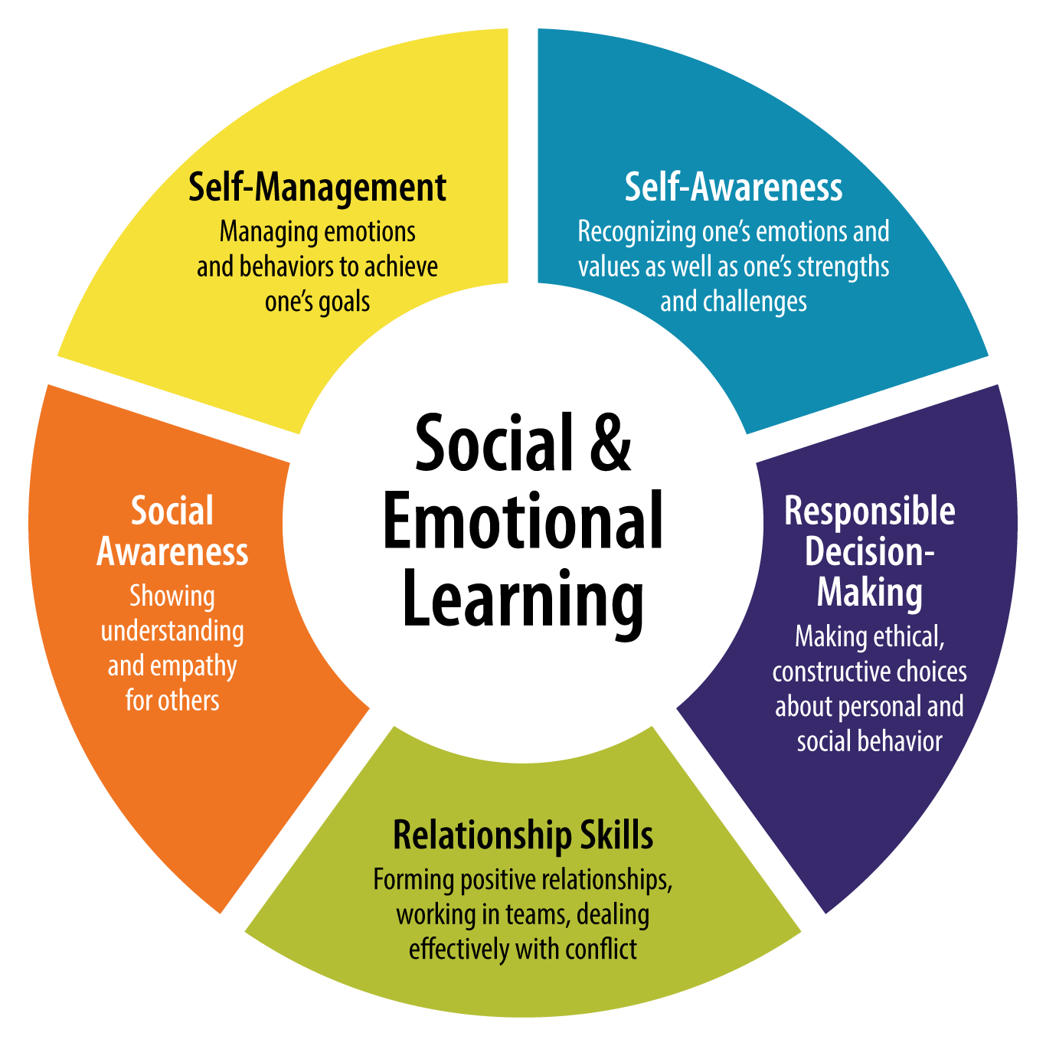
MORNING MEETINGS/REUNIONES DE LAS MAÑANAS
We start every day promptly at 8:35/ Comenzamos puntualmente todos los días a las 8:35am!
Greeting Saludo
Share Compartir
Activity Actividad
Message Mensaje
Notes:
You’ll see this on your kids schedule and for your viewing pleasure, we are going to take you through one right now
Social emotional learning, life skills- we also practice social emotional skills at Soul Shoppe Assemblies and Second Step currriculum

Slide 6

Greeting Saludo
Join me in greeting someone near you with a rainbow wave.
Únase a mí para saludar a alguien cercano a usted con una ola de arcoíris.

Slide 7

Sharing Compartir
Please share with a neighbor.
“Today I am feeling _____.”
Por favor, comparta con una personna.
“Hoy me siento _____.”

Slide 8



Activity Actividad
“Whoosha, Whoosha, Whoosha Warrior” Game
Once I say “Warrior”, one of the 3 options below should be shown with your hands. If you have the same one that I do, sit down. The last one/s standing are the “winners”.
Cobra
Crane
Fireball

Slide 9

Message/Mensaje
Dear 4th Grade Parents,
Welcome to Room 14! I feel honored to have your children in my class and know that we can all learn from each other each and every day. I love teaching and preparing your children with life skills.
I am looking forward to working with each and every one of you this year. If you ever have any questions or concerns, please feel free to contact me.
Sincerely,
Mrs. McCormick
Estimados padres de 4to grado,
¡Bienvenidos a la Sala 14! Me siento honrada de tener a sus hijos en mi clase y sé que todos podemos aprender unos de otros todos los días. Me encanta enseñar y preparar a sus hijos con habilidades para la vida.
Espero trabajar con todos y cada uno de ustedes este año. Si alguna vez tiene alguna pregunta o inquietud, no dude en ponerse en contacto conmigo.
Atentamente,
Sra. McCormick

Slide 10
What is one of my main goals? ¿Cuál es uno de nuestros objetivos principales ?
To prepare your child for
more responsibility.
Es para preparar a su hijo para asumir más responsabilidad
Communication is Key/ Comunicación es clave:
Kristen McCormick
kemccormick@smfc.k12.ca.us
Parent Squared

Slide 11
More Goals…
Otras metas…
kind, empathetic citizens
Ciudadanas amables y empáticos
problem-solvers
solucionadores de problemas
thoughtful readers
Lectoras/os pensativas/os
deep thinkers
Pensar Profundamente
risk-takers
tomen riesgos
perseverers
perseverantes

Slide 12
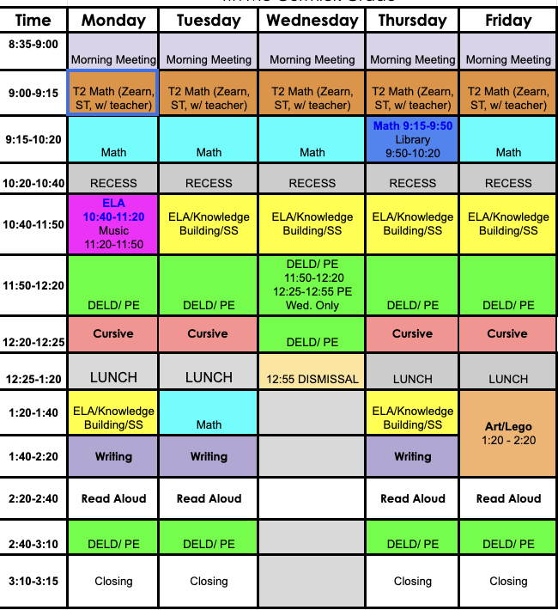




Library
8:40-9:10
Rocket Math

Slide 13

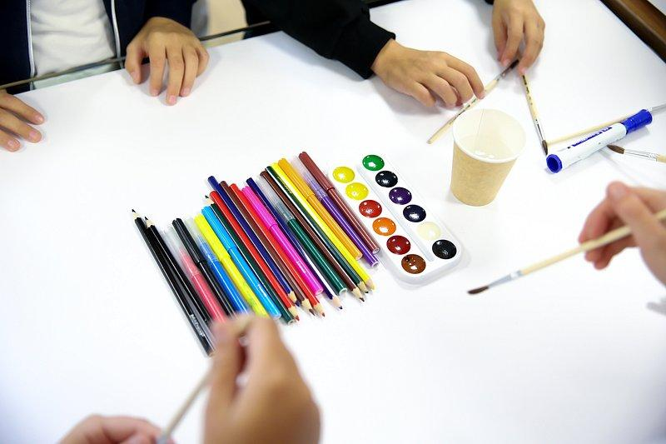

Specialist classes / Clases Especiales
art with mrs. duncan/ arte con la Sra. Duncan
Lego lab to build steam skills with mrs. harris/ la clase de lego con la Sra. Harris
music through myriad music/música a través de Myriad Music

Slide 14
Curriculum/ Currículo
Math / Matemáticas: Amplify (NEW!)
Science / Ciencias: TWIG Science
Language Arts / Artes del lenguaje: Benchmark Advance/Bookworms for novel studies
Writing / Escritura: SRSD (Self-Regulated Strategy Development)
Social Studies / Estudios Sociales: Social Studies Alive!
Notes:
Beginning of year units: City of Ember book study ( vocabulary building, analyzing descriptive text, work towards writing own narrative story)
Social Studies Basic Map Skills and California Regions

Slide 15

Bookworms - high-impact routine for building strong readers
📖 Builds Knowledge & Vocabulary
Students encounter rich, complex texts and learn new words and concepts through purposeful discussion.
🗣️ Strengthens Oral Language
Students regularly explain their thinking, respond to peers, and use academic language.
🧠 Develops Comprehension
Teachers model and guide students in making meaning from increasingly complex texts—not just decoding words.
🔤 Supports Literacy Development
Shared reading gives students opportunities to connect vocabulary, syntax, background knowledge, and reading strategies.
👥 Creates Access for All Students
Because the teacher supports the reading load, all students can engage with challenging grade-level text, including multilingual learners and students who need additional support.

Slide 16
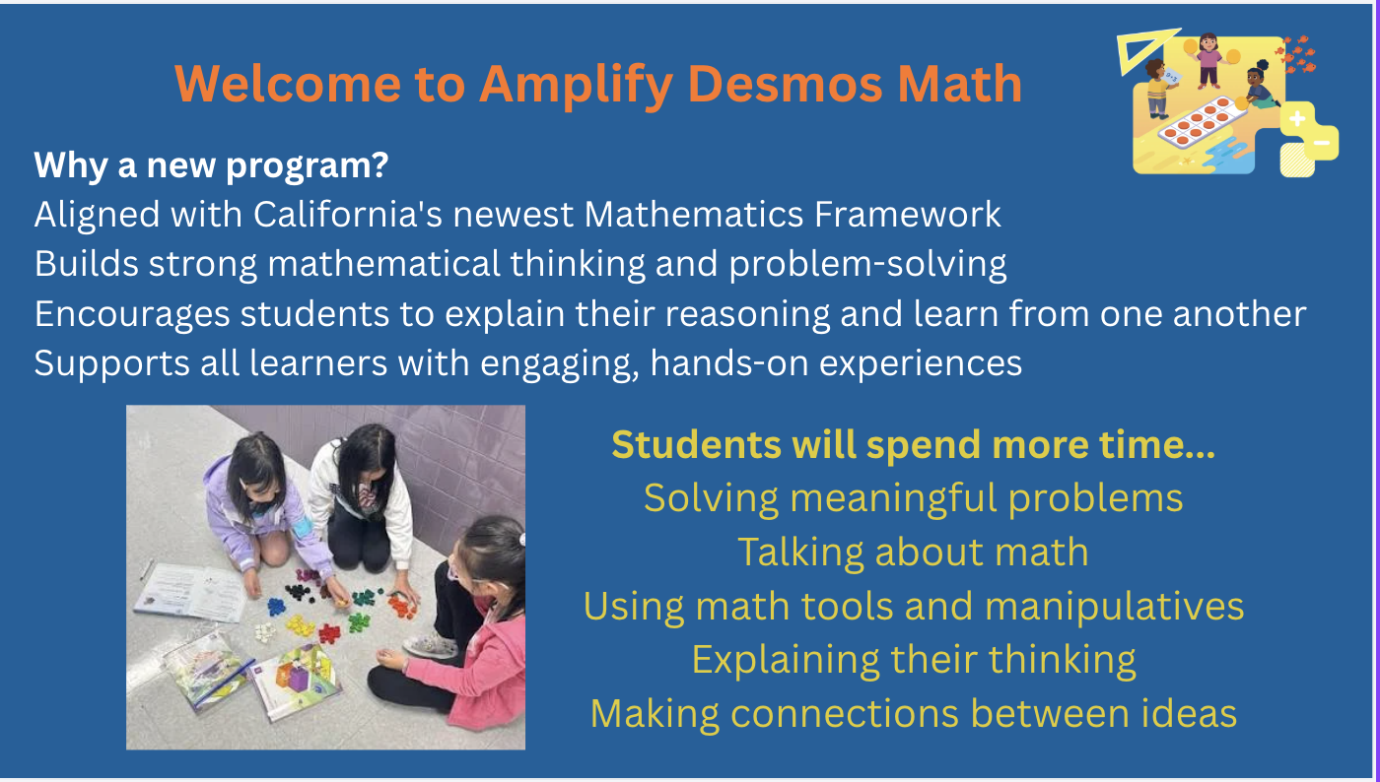

Math

Slide 17
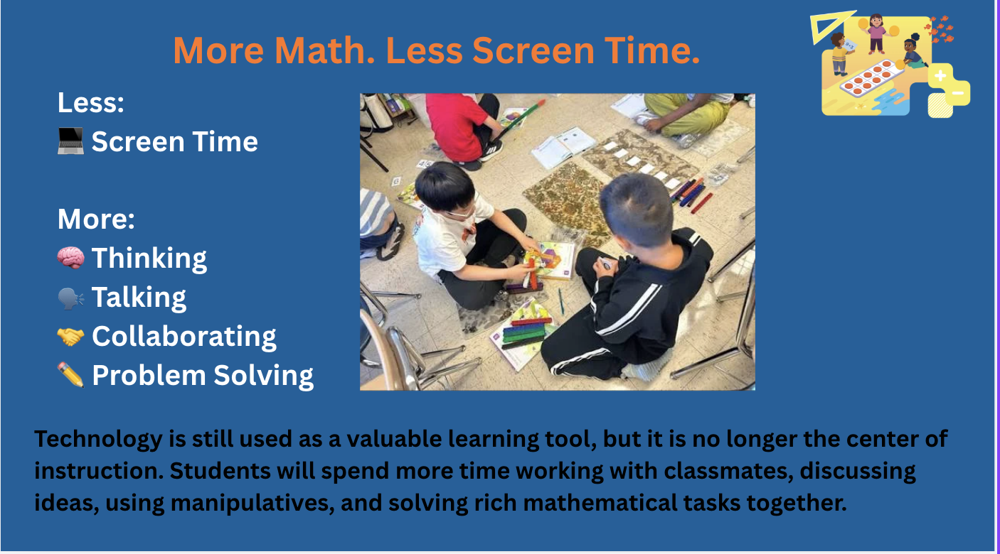

Slide 18
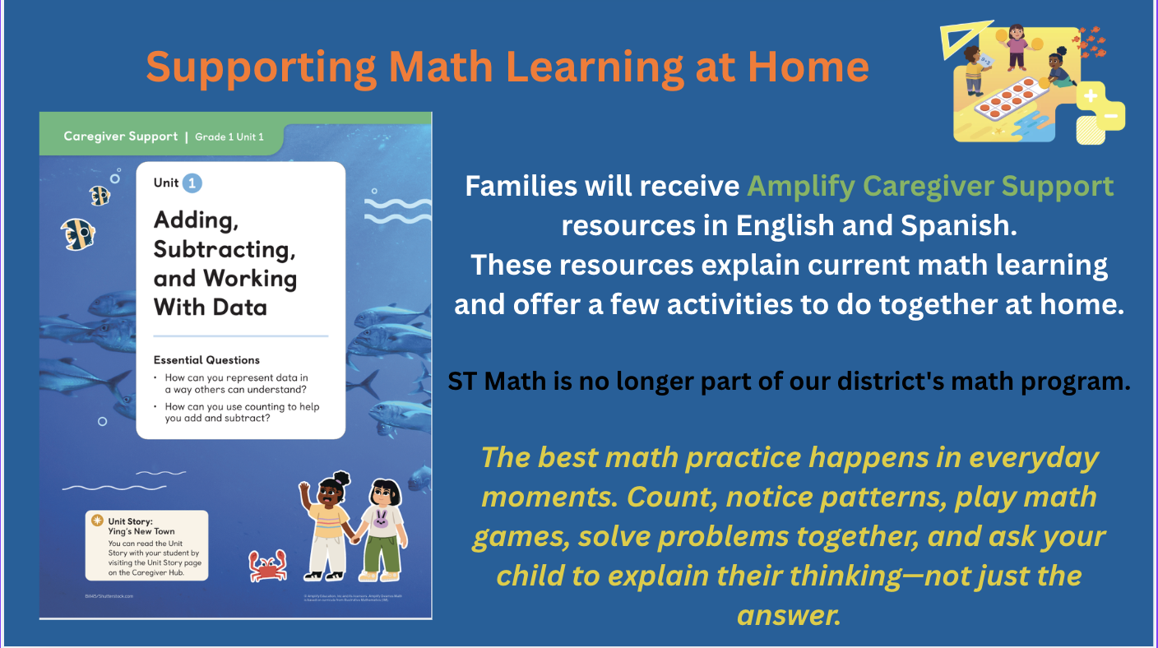

Slide 19


TWIG
inspires students with real-life phenomena through driving questions
access to online material, videos, and hand-on science demonstrations
ELA standards practiced through science content
TWIG
currículo para inspirar a los estudiantes con fenómenos de la vida real a través de preguntas
folleto de estudiante
acceso a material en línea, videos y demostraciones científicas prácticas
Notes:
building background knowledge, academic vocabulary, and levled readers to explore topic more in depth

Slide 20
Social Emotional Learning / Aprendizaje socio emocional
Soul Shoppe: Four assemblies throughout the year / Cuarto reuniones a lo
Second Step; a social emotional program that takes “A holistic approach to building supportive communities for every child through social-emotional learning.”
PBIS (Positive Behavioral Intervention Support)
Student services tosa erica gilberT

Slide 21
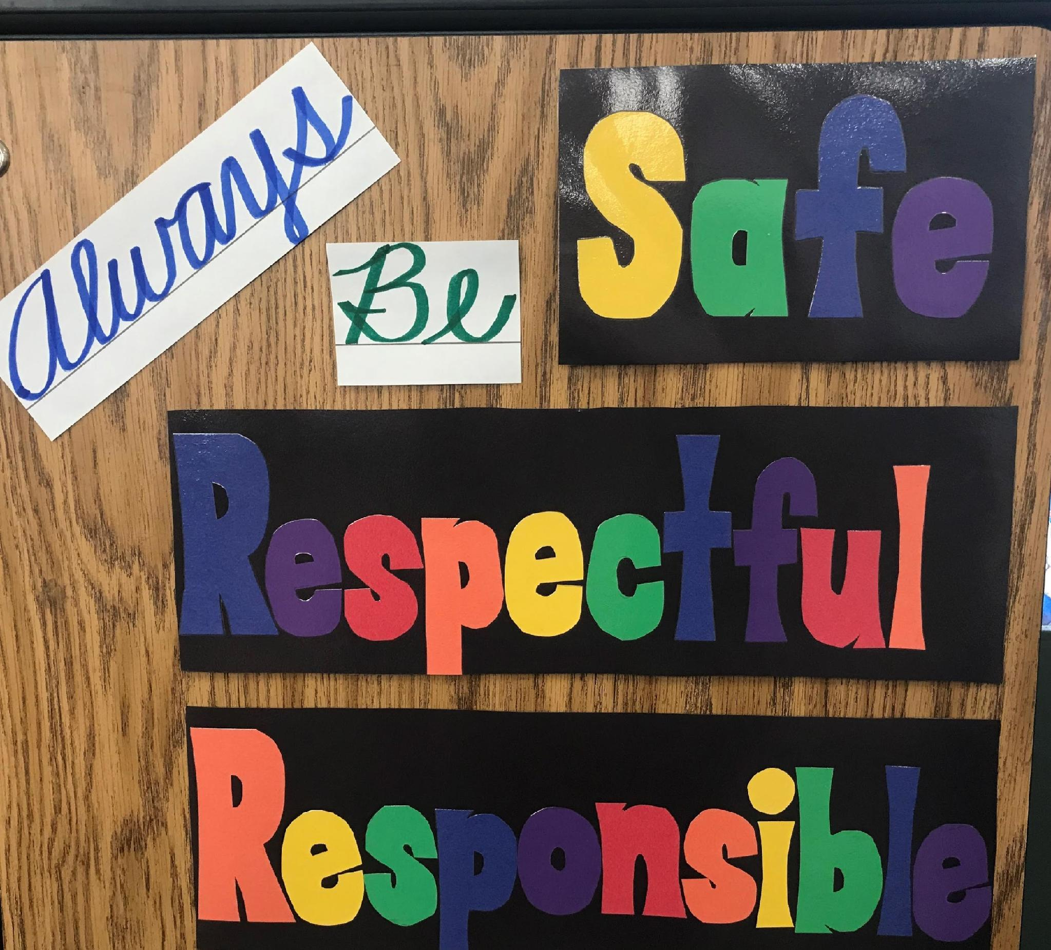

School Values
Valores escolares
EXAMPLE…
Hallway Expectations
Be Safe, Be Respectful,
Be Responsible, Be Kind
H-hands off
A-all eyes forward
L-low voice
L-low speed
S-single file on sidewalk
Estar seguro
Respetuoso
KIND
Responsable
Amable

Slide 22
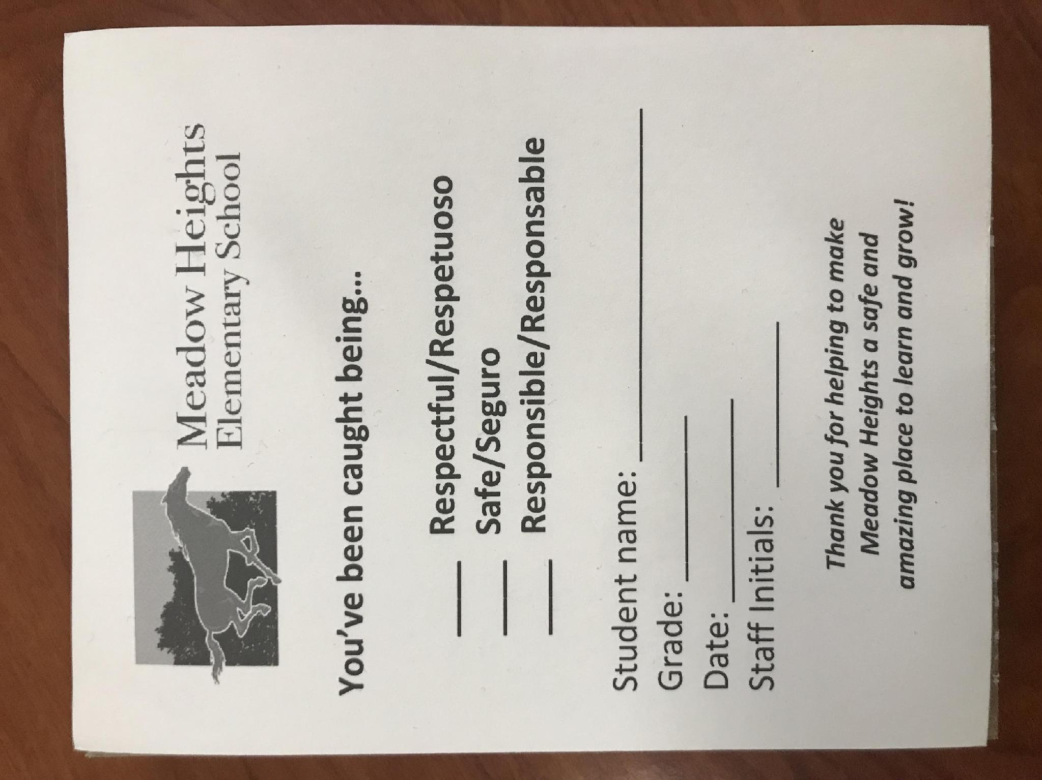

PBIS
POSITIVE BASED INTERVENTIONS & SUPPORT
Mustang Ticket!

Slide 23
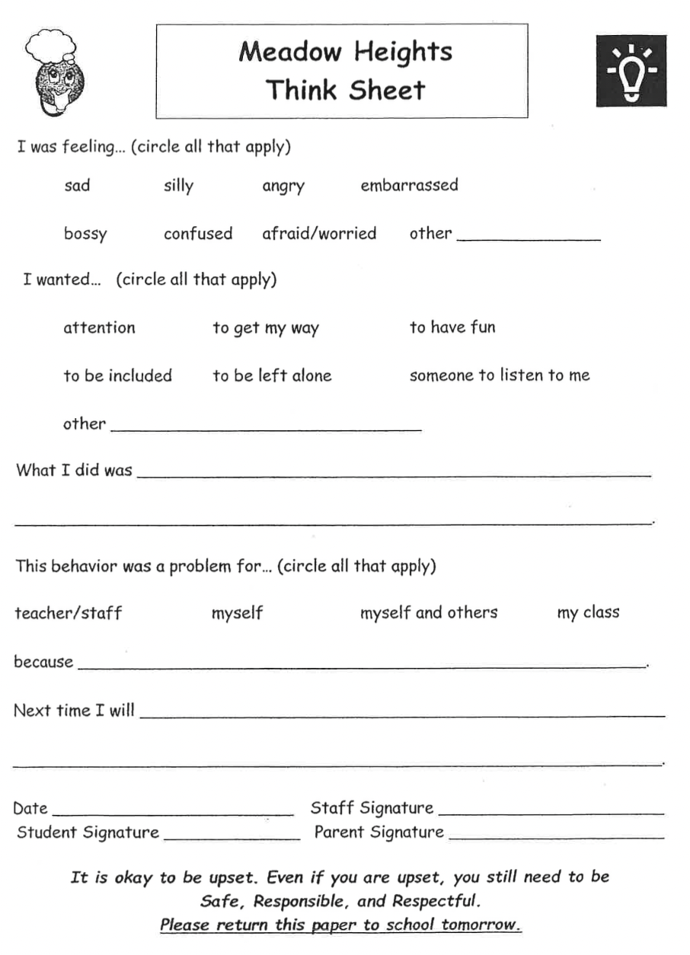
Think Sheet
Hoja de pensamiento
Think Sheet used when other options are exhausted. I will email you if one is coming home!
Think Sheet se utiliza cuando se agotan otras opciones. Te enviaré un correo electrónico si alguno va a volver a casa.

Slide 24
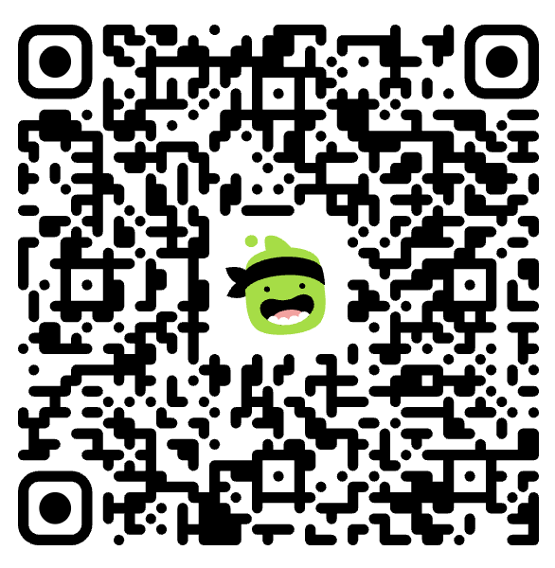
CLASS DOJO
Reward system for behaviors.
Join my class to see what your child earns points for each day!
Sistema de recompensas por comportamiento.
¡Únete a mi clase para ver por qué cosas gana puntos tu hijo cada día!

Slide 25

Homework Policy
Política de tareas
Monday through Thursday (math and reading)
Reading – 30 minutes (please sign log at end of week)
Math- Packet page
Log and math packet collected on Fridays
Extra hw time? Review Rocket Math facts in yellow envelope
Missed Homework – if child is falling behind, you will be contacted
Homework should take less than 40 minutes, give or take.
If unable to complete for personal reasons, please contact me and he/she will be excused. Make it up later.
Don’t save them, give them time to work it out.
FAILURE IS HEALTHY!
lunes a jueves (matemáticas y lectura)
Lectura – 30 (mínimo) por dia con un registro.
Paquete de matemáticas y registro de lectura deben entregarse los viernes
"Rocket Math" que están en el sobre amarillo
Tarea perdida: si el niño se está quedando atrás, lo contactaremos a través de "Think Sheet" o correo electrónico
La tarea les tomará más o menos cuarenta minutos
Si tienen una razón personal y no pueden completar las tarea, por favor de comunicarse con nosotros y se le excusara. Intenta hacerlos en otro momento.
No van a su rescate, deles tiempo de resolverlo esto los va a preparar.
Notes:
FIX SPANISH!!!!!

Slide 26
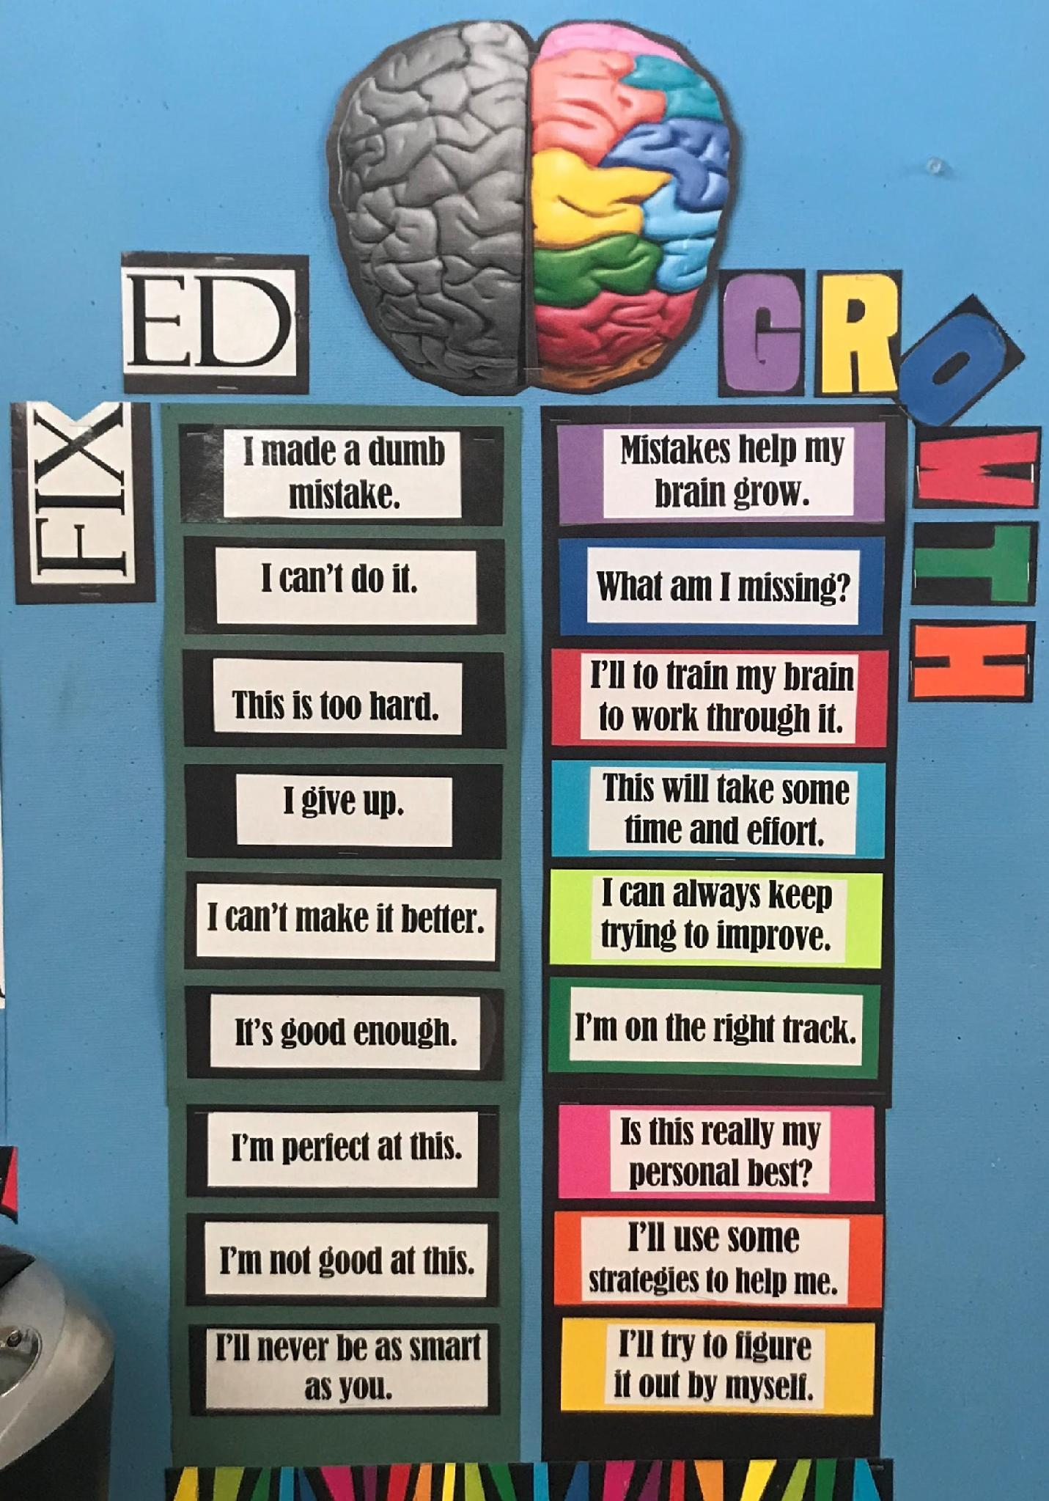
YOUR CHILD’S ABILITY TO BE OPEN TO A
GROWTH MINDSET
IS KEY!

Slide 27
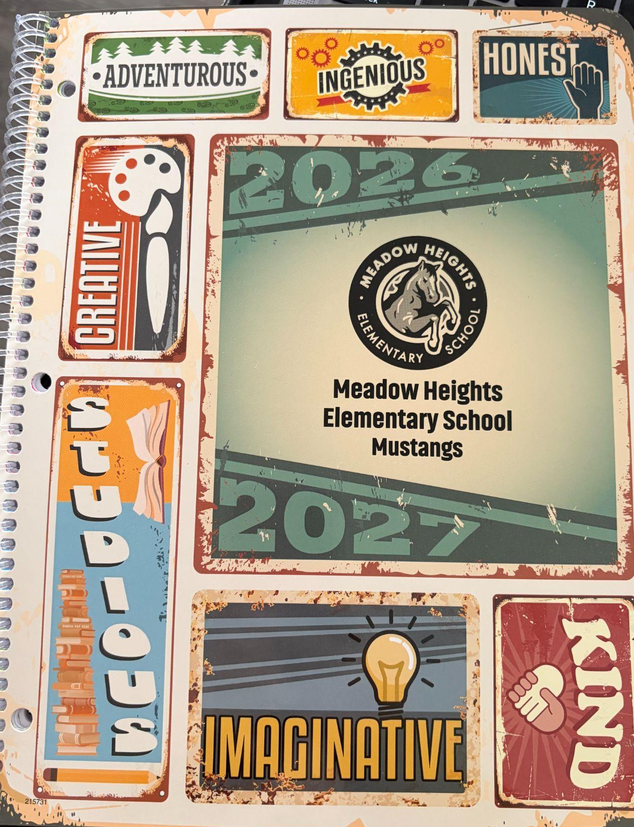

STUDENT PLANNER
Review full week on Monday, add personal events, discuss ways to be successful.
Blue Homework folder will be brought home and returned every Friday with homework inside
Revise la semana completa el lunes, agregue eventos personales, discuta formas de tener éxito.
La carpeta roja de tarea se llevará a casa y se devolverá viernes con tarea.
Notes:
Using red folder home and back every night

Slide 28

Chromebook Responsibility Responsabilidad de Chromebook
Chromebooks need to be fully charged and returned to school every single day.
Los Chromebooks deben estar completamente cargados y devueltos a la escuela todos los días.

Slide 29
HELPFUL TIPS TO ASSIST
CONSEJOS ÚTILES PARA AYUDAR
1. Make academics a top priority in your home.
2. Hold your child accountable for getting enough sleep every single night.
3. Hold your child accountable for his/her reading homework.
4. Encourage your student to use his/her planner as an organizational tool.
5. Remind your child when faced with a problem either socially or academically, if they have already tried to solve it but it’s still a big issue, we are here to help.
6. Encourage your child to advocate for him/herself.
7. Provide a quiet workstation for your child to complete homework from home.
8. Encourage your children to persevere in solving problems. Don’t save them. It’s okay to let them make mistakes & struggle.
1. Haga de lo académico una prioridad principal en su hogar.
2. Responsabilice a su hijo de dormir lo suficiente todas las noches.
3. Responsabilice a su hijo por su tarea de lectura.
4. Anime a su estudiante a usar su planificador como una herramienta de organización.
5. Recuérdele a su hijo cuando se enfrente a un problema social o académico, si ya ha tratado de resolverlo pero sigue siendo un gran problema, estamos aquí para ayudarlo.
6. Anime a su hijo a abogar por sí mismo.
7. Proporcione una estación de trabajo tranquila para que su hijo complete la tarea desde casa.
8. Anime a sus hijos a perseverar en la solución de problemas. No los guardes. Está bien dejar que cometan errores y luchen.

Slide 30
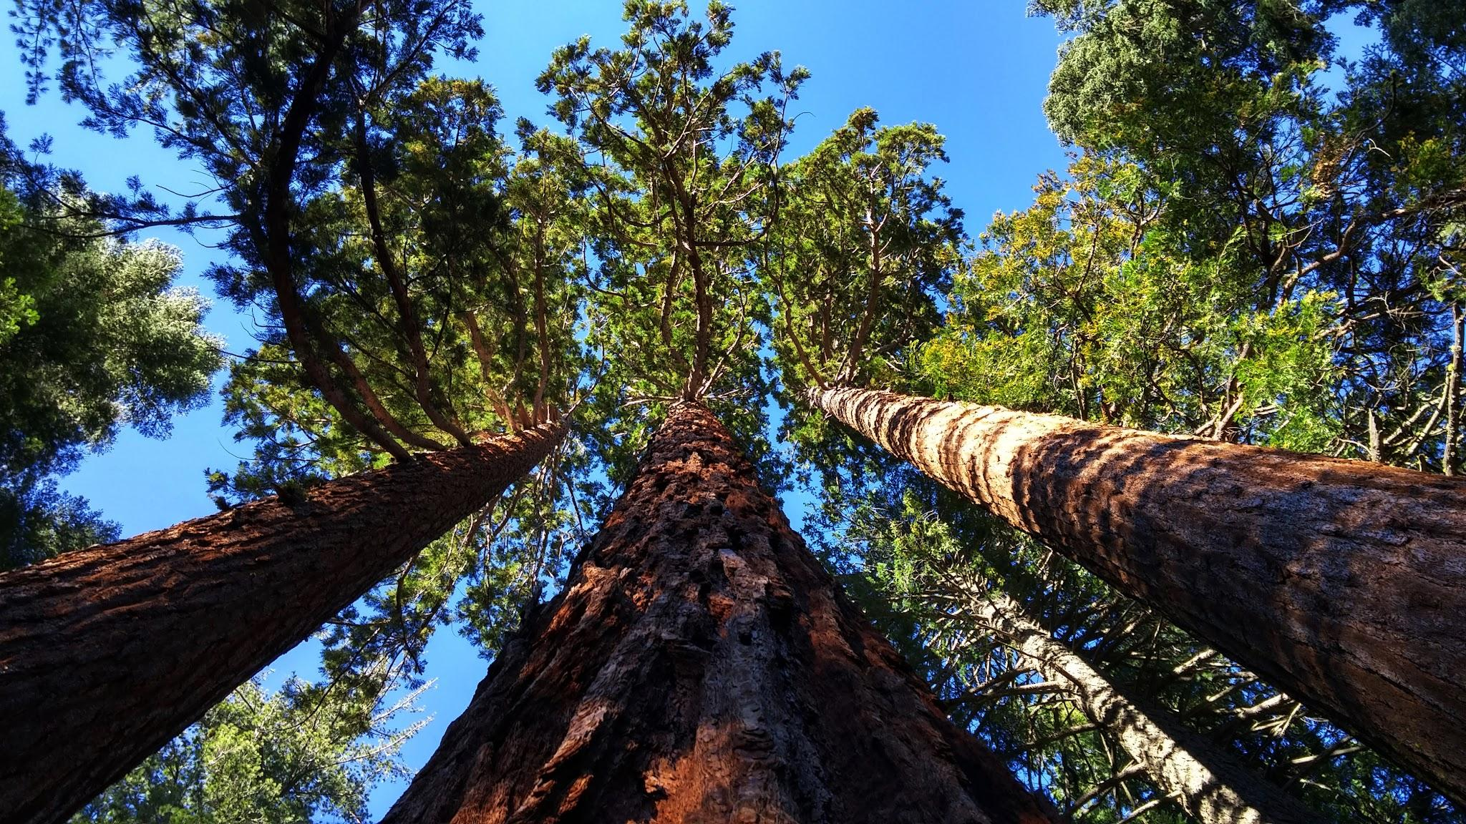
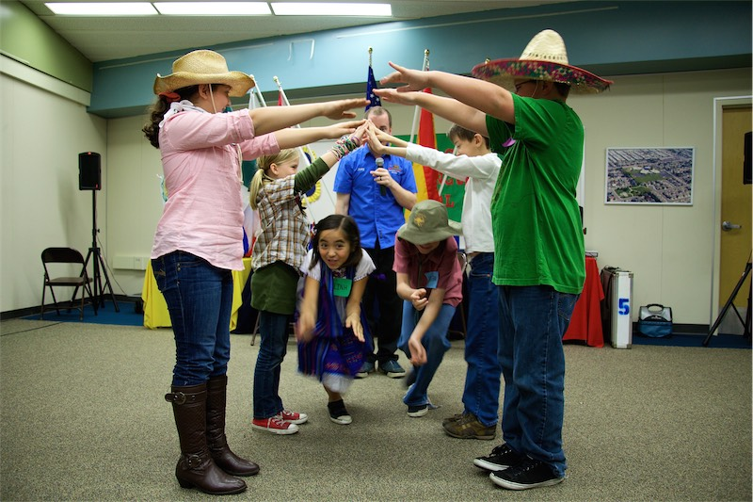
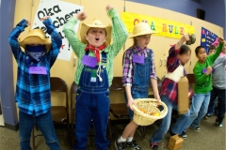
Field Trip Opportunities
Walk Through Presentations California History
Students will learn about CA history through games, re-enactments, and storytelling. Supports performance literacy, listening, and vocabulary.
Los estudiantes aprenden sobre la historia de California mediante juegos, recreaciones y narraciones. Se fomenta la lectura, la comprensión auditiva y el vocabulario.

Slide 31
Special 4th Grade Performance!
On September 4 AT OUR MUSTANG ROUNDUP, our 4th grade classes will be performing a song in SPANISH to celebrate peace and freedom. Please come join us in the MPR that morning!
El 4 de septiembre, durante nuestro evento "Mustang Roundup", los grupos de cuarto grado interpretarán una canción en español para celebrar la paz y la libertad. ¡Acompáñennos en la sala de usos múltiples (MPR) esa mañana!

Slide 32

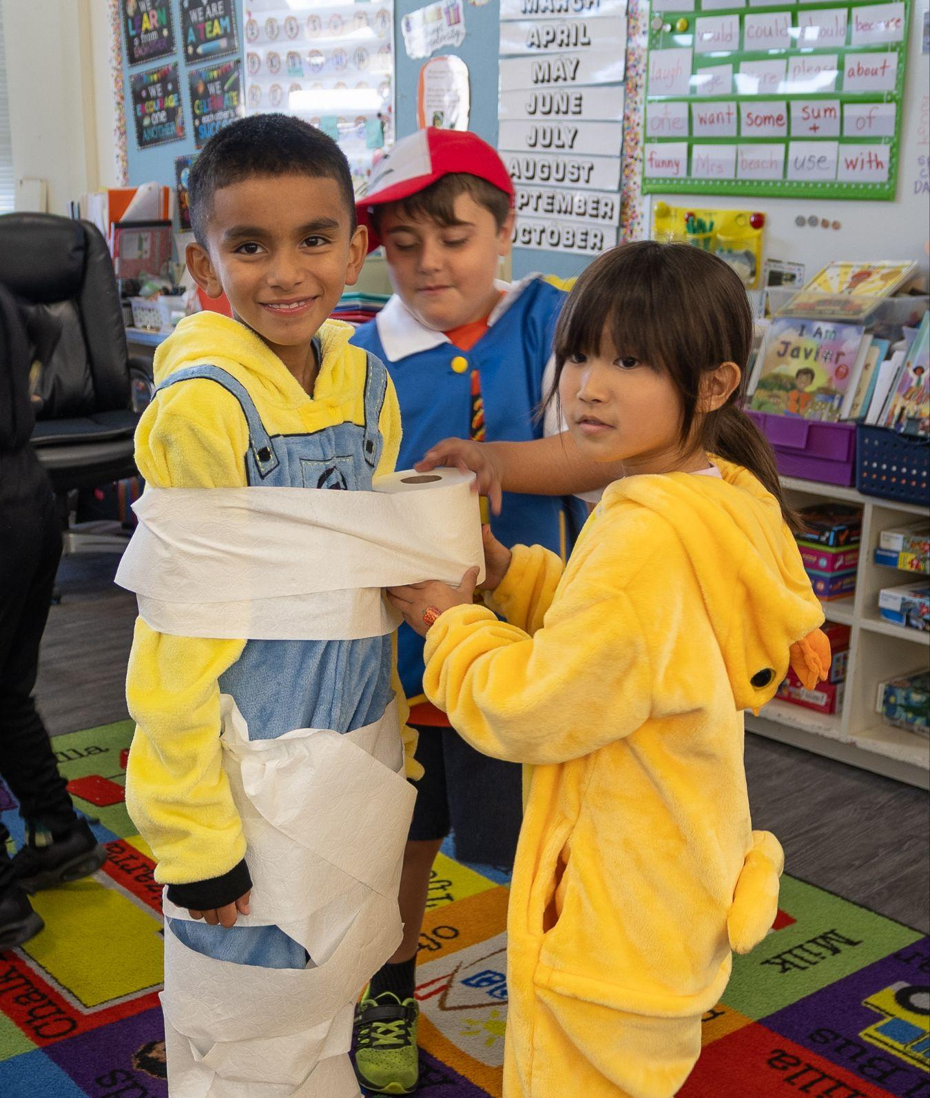
Get involved and JOIN the PTA for only $10 and 5 meetings a year. Together we make Meadow Heights the amazing community that it is.
Scan to Volunteer
Upcoming Volunteer Opportunities:
Harvest Carnival (October 30)
Room Parents
Multilingual Parent Resource
Questions? Email Carisa @ president@meadowheights.org

Slide 33
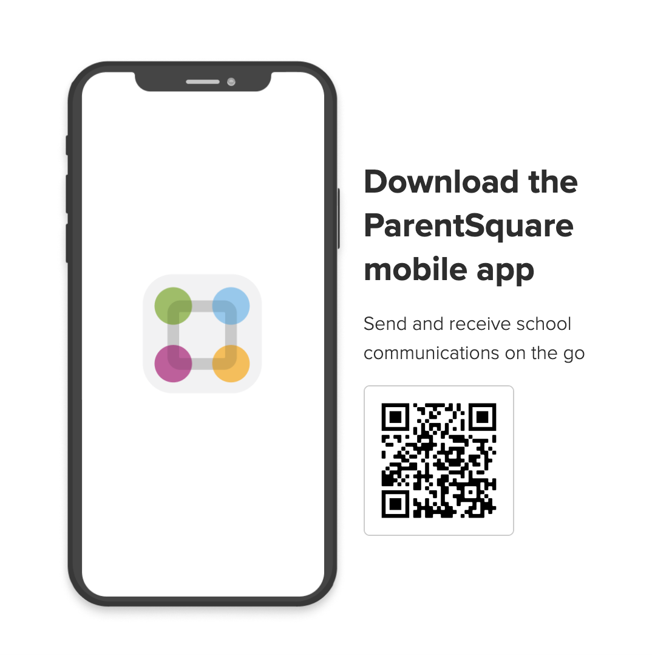
This is the best way to work as a team and communicate. If you haven’t already, PLEASE LOGIN now.
Esta es la mejor manera de trabajar en equipo y comunicarse. Si aún no lo ha hecho, INICIA SESIÓN ahora.
Notes:
Check out my 3-2-1’s every other week!

Slide 34
SIGN IN SHEET
Firmar en la hoja
CONFERENCE SIGN UP
Regístrate para la conferencia
DOJO POINTS
PTA INTEREST

