Slide 1

West Fargo United Esports
2026-2027 Season
Horace, Sheyenne, and
West Fargo High Schools
Registration and Season Expectations

Slide 2

Introductions
General Manager – Jamie Odum Thompson aka Odum – Seventh Season running program
Assistant GM/Coach – Aaron Beseler – Discord Coach Beseler – Mario Kart and Chess
Assistant Coach – Mason Powers – Discord Biskwit – Smash Bros and League of Legends; Former United Esports Athlete, Sheyenne Grad, Class of 2024
Additional Resources/Support:
Fenworks Coaching (ex. Ethan, Brad, Zac, etc., determined by game title)
We have many previous players that are still active on the server and can pop in to help coach individuals

Slide 3
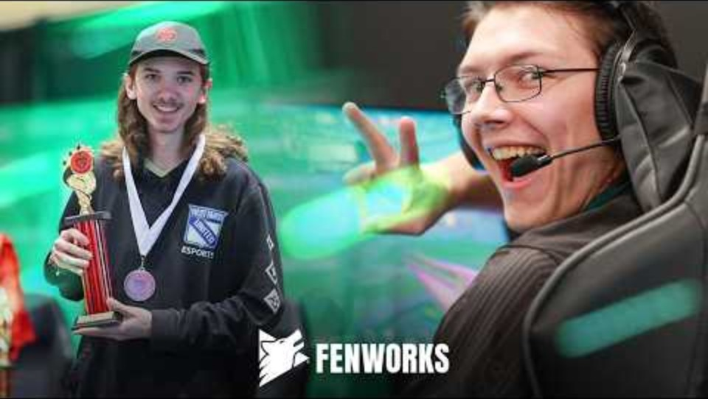
https://www.youtube.com/watch?v=yi4qKt9mL2c
Notes:
https://www.youtube.com/watch?v=yi4qKt9mL2c

Slide 4
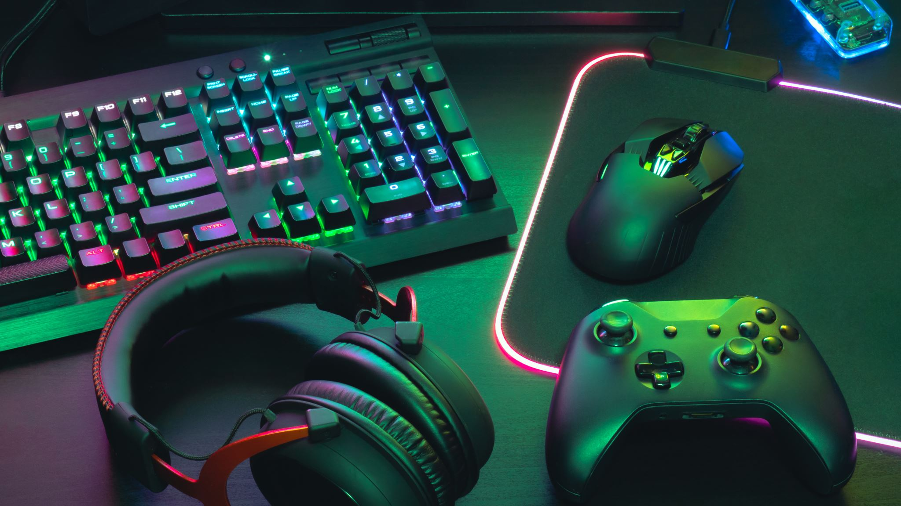
What is Esports?
Competitive Video Games including Chess, Super Smash Brothers Ultimate, Mario Kart 8, Valorant, League of Legends, Rocket League, Minecraft, and Marvel Rivals, where players are pitted against other programs across the state of North Dakota
Program includes grades 7-12, 13 and over, with players and teams from Horace, Sheyenne and West Fargo High School, all under GM Odum and her team
Comprised of a preseason, regular season, spring (casual) season, drone racing (Gravdahl at SHS), and Special Olympics hosted by our vendor Fenworks
State Tournament at University of North Dakota, Grand Forks

Slide 5
Why Esports?
Scholarship Opportunities
Profile of a Grad Application
Growing major and minors at Universities across the state
Professional outlook in a growing market
Leadership Opportunities

Slide 6
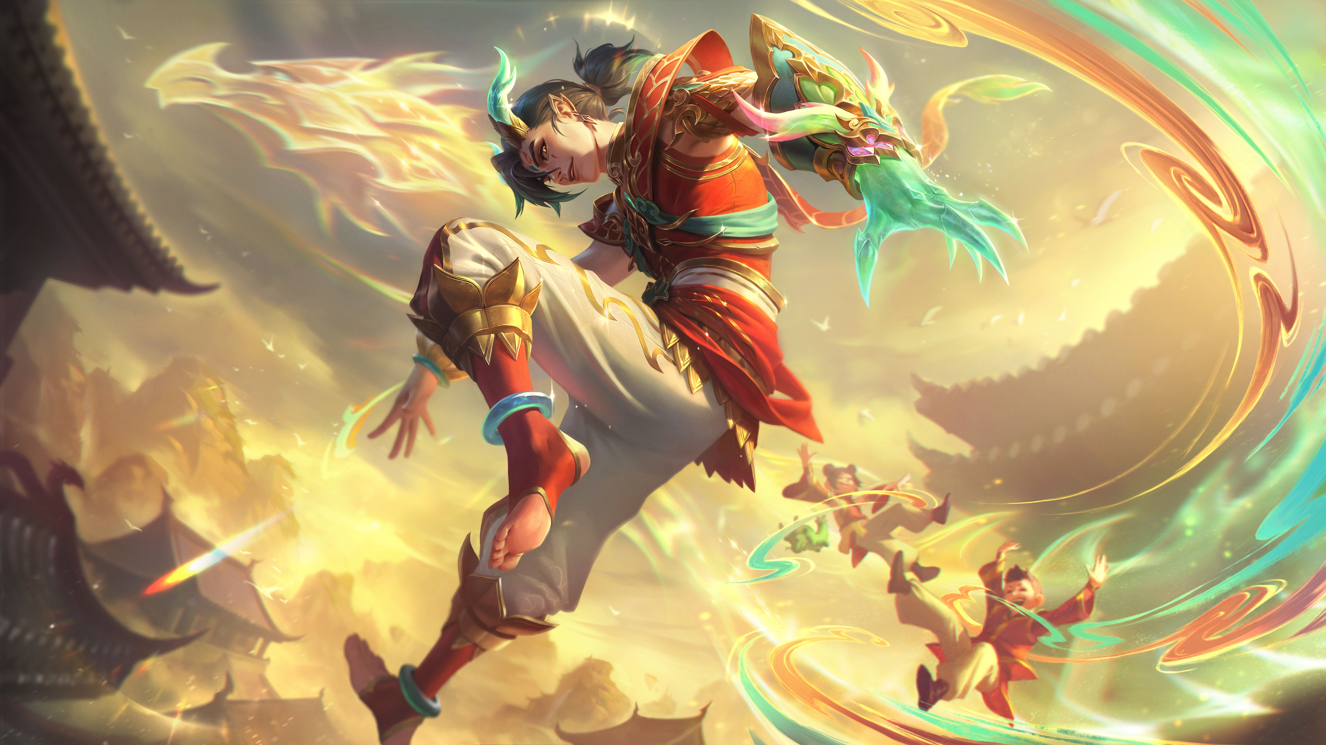
Player Impact
Esports has been a huge benefit to my high school experience. It has given me opportunities that I could never even imagined, like showing me that schools are offering scholarships for esports and given me countless friends I would have never met outside of esports.
I feel that Esports made high school so much better, and I wish I had started earlier than my senior year. Along with the fact that I enjoyed playing the games, I was in it and it gave me motivation to get better so I could try and get 1st place in the tournaments.
The Esports program was my favorite part of WFHS. It gave me a community to be a part of and a way to compete with other students in the state.
I made personal connections with the team I was a part of, as well as learning how to better communicate and work in a group setting.

Slide 7

Parent Perspective
Realities and Benefits
  How it fits your teen
  (digital track and field variety)
  Cost and Time
  (investment across multiple years lower than athletics)
  Physical and Mental Health
  (lack of physical activity and access to the digital world for good and bad)
  Helping to shape your teen's path
  (careers and involvement post-High School)
  What they get right now

Slide 8
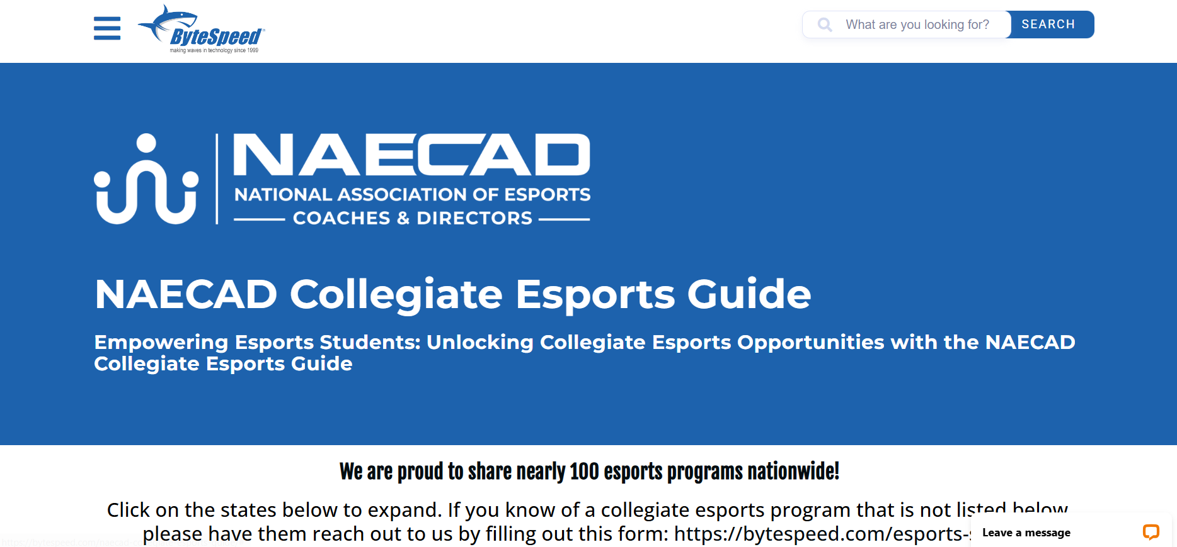
Scholarships - Naecad-Collegiate-Esports-Guide - ByteSpeed
*Link in Discord Server under Resources

Slide 9

Profile of a Grad
Compassion
Resilience
Responsibility
Communication
Critical Thinking
Reflection
Creativity
Collaboration

Slide 10
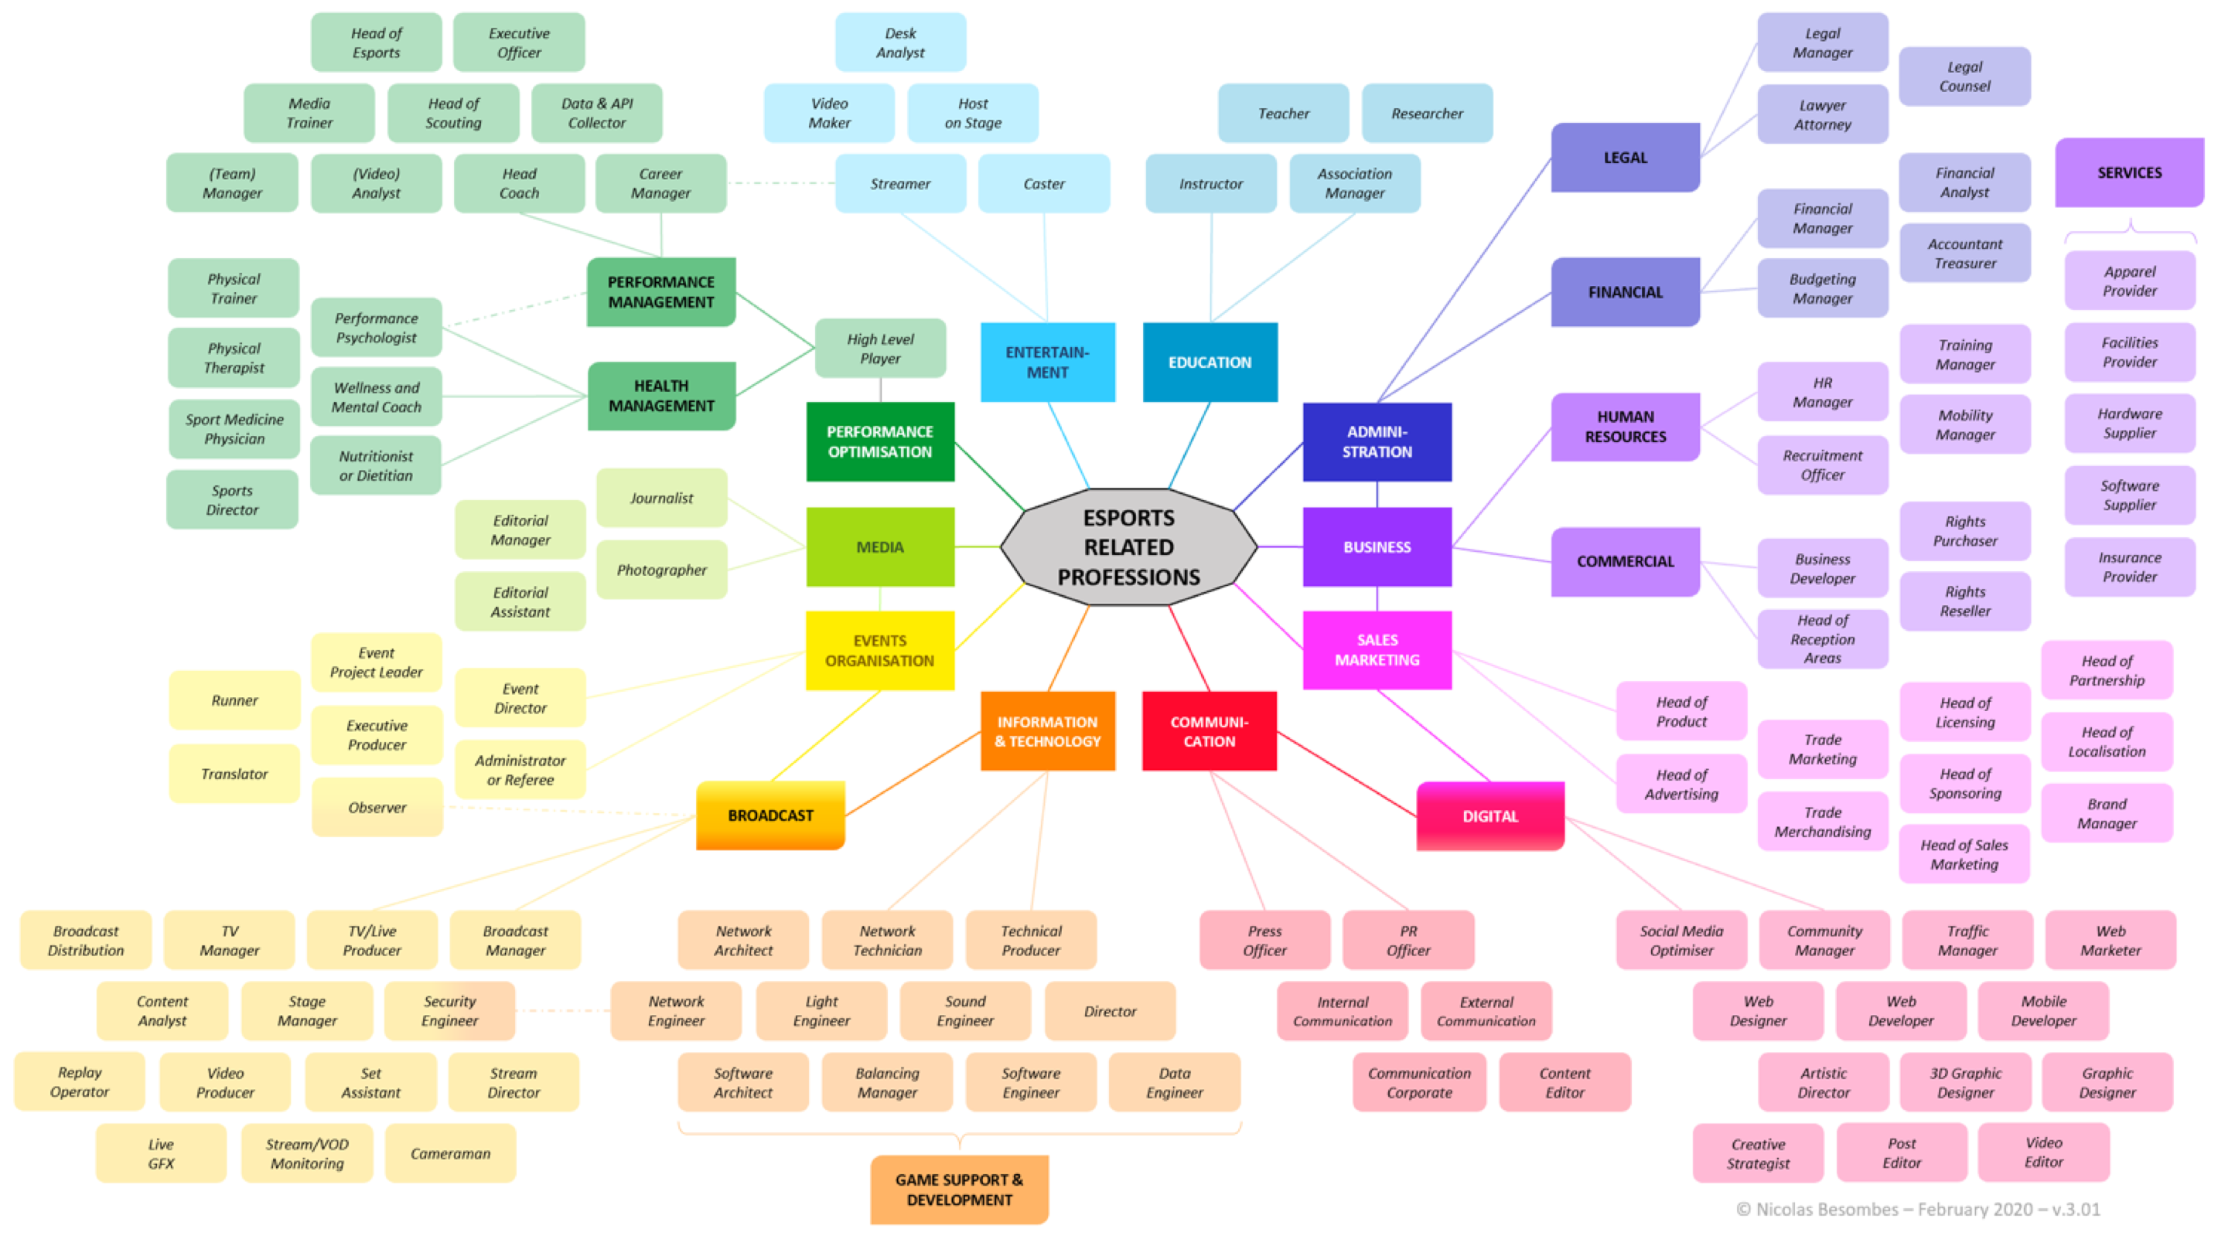

Slide 11
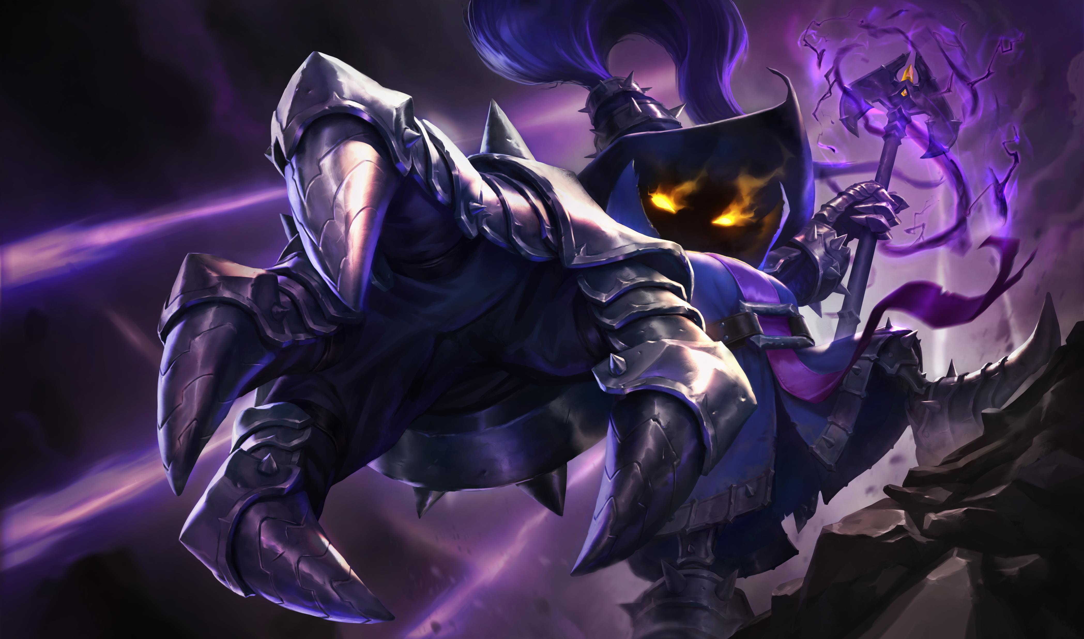
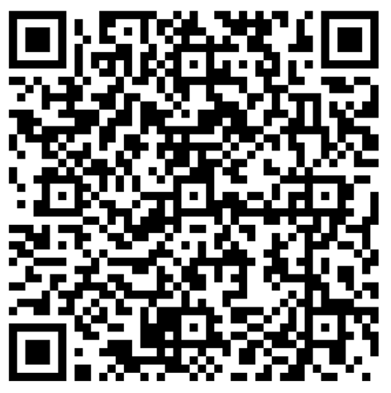
Season Registration
Registration – Fenworks, Arbiter (no physical needed), Permission Slip – Need all three to complete registration
GM/Coach Registration Form (QR Code title interests)
$100 Registration fee – Paid on Arbiter or at Activities Office
(waivers for free/reduced lunch plans, confirm with activities office)
Additional Costs – Gear, Jersey, additional travel for Tournaments (optional); Spring Club Season $50 (optional)
Player Interest Survey

Slide 12

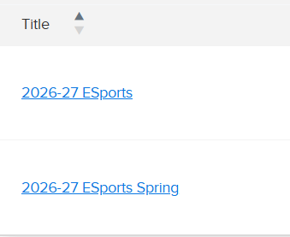
School Registration
Register through Arbiter for correct season (Winter/Spring)
No Physical Needed
Pay online through Arbiter (preferred) or bring Cash or Check (made out to West Fargo High School or West Fargo Public Schools) for activity fee
Talk to Activities Office to confirm waiver for activity fee

Slide 13
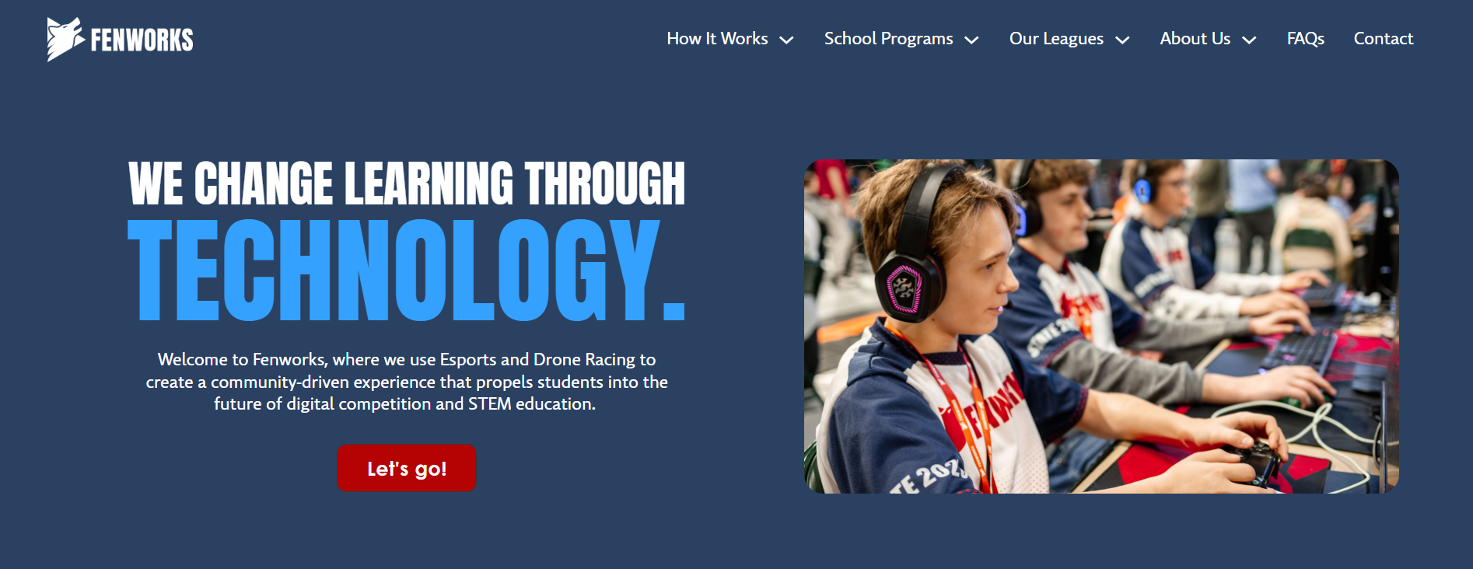
Fenworks Registration
Students will be invited to the team’s platform and will need to connect their account; Register on platform with non-WFPS email address
Parents/Guardians need to sign the Fenworks media waiver
Rules for each title are also under Our League > North Dakota > North Dakota Season Information. Players should familiarize themselves with the rules and game setup for the titles they are interested in, and update home computers.

Slide 14
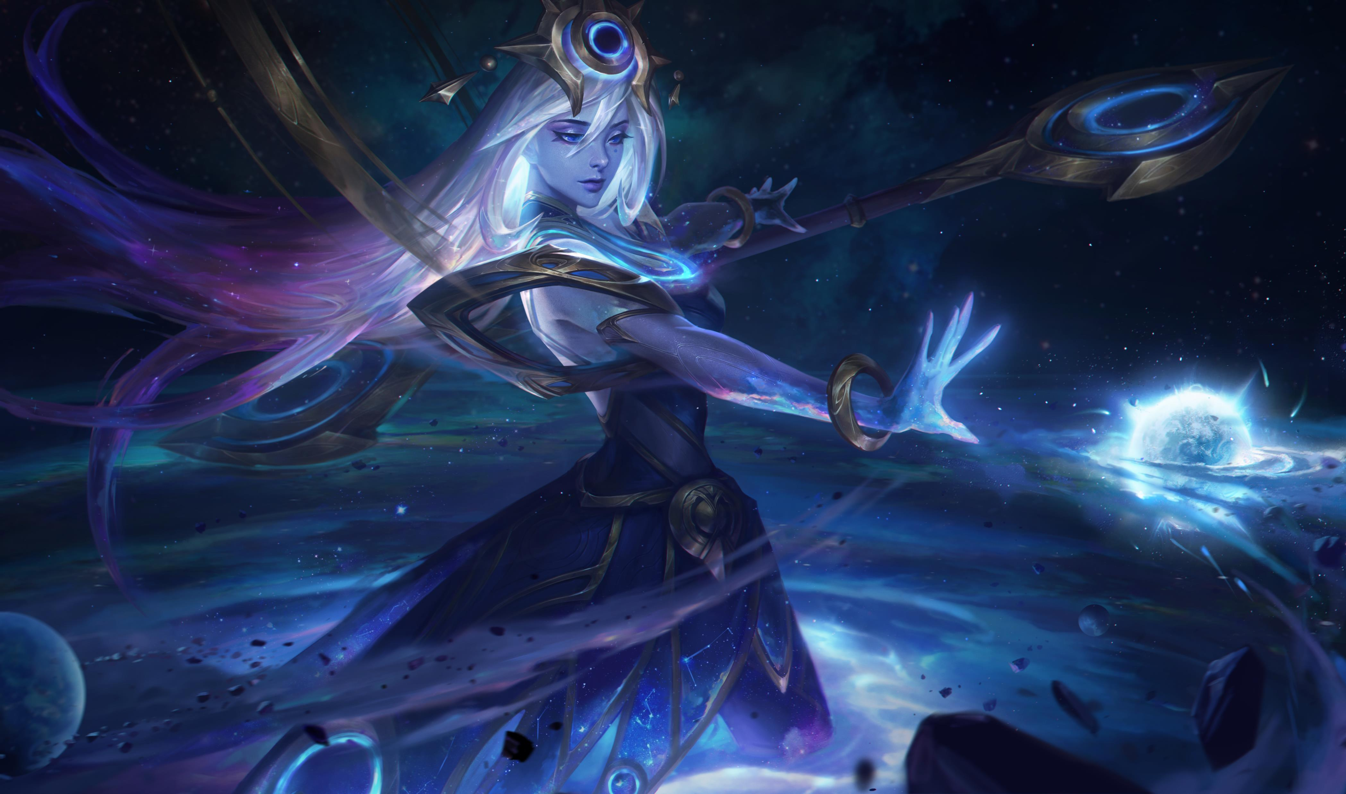
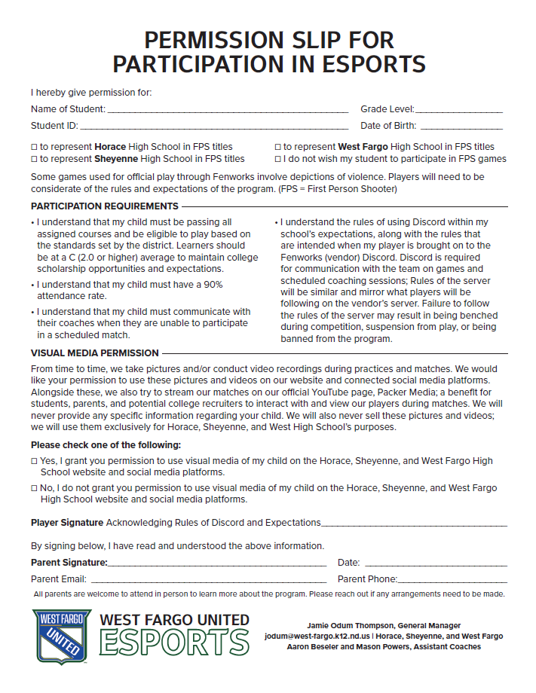
West Fargo United Registration
Sign and Return to Odum
Goes over the expectations for discord and academic performance
Parent/guardian signoff of first-person shooter titles and media release (Odum takes pictures at state and tournaments that are shared out with players and used in the yearbook)
Select your roles in the Discord channel and fill out the excel informational spreadsheet (helps coaches and teammates know who is who on the server)

Slide 15

Player Expectations
Match Game Days – Check in 15 minutes Prior – In-person for most titles
Coaching – In Voice Channel of coach 10-15 minutes prior to scheduled Fenworks sessions; those being a distraction or taking away from others will lose coaching privileges; make sure game is updated on your PC beforehand
One in-person practice a week (holidays exception)
Academic – ‘C’ average for each semester; 90% attendance; eligible; no detention (also outlined on permission slip)
Professionalism – No profanity, screaming at screen/computer, get up first and shake hands with opponent before tear down for in-person matches and events; If behavior has to be corrected three or more times, possibility of being removed from team/program or being benched for matches
Responsibility – Take care of gear; clean up after yourself; be respectful; be positive and willing to learn how you can continue to improve

Slide 16

Current Game Titles and Breakdowns
Chess – 1v1
League of Legends – 5v5
Mario Kart 8 Deluxe – 2v2
Marvel Rivals - 6v6
Minecraft (Bed Wars) – 4v4
Rocket League – 3v3
Super Smash Brothers Ultimate – 1v1
Valorant – 5v5
Special Olympics Rocket League – 2v2 (subject to change)

Slide 17
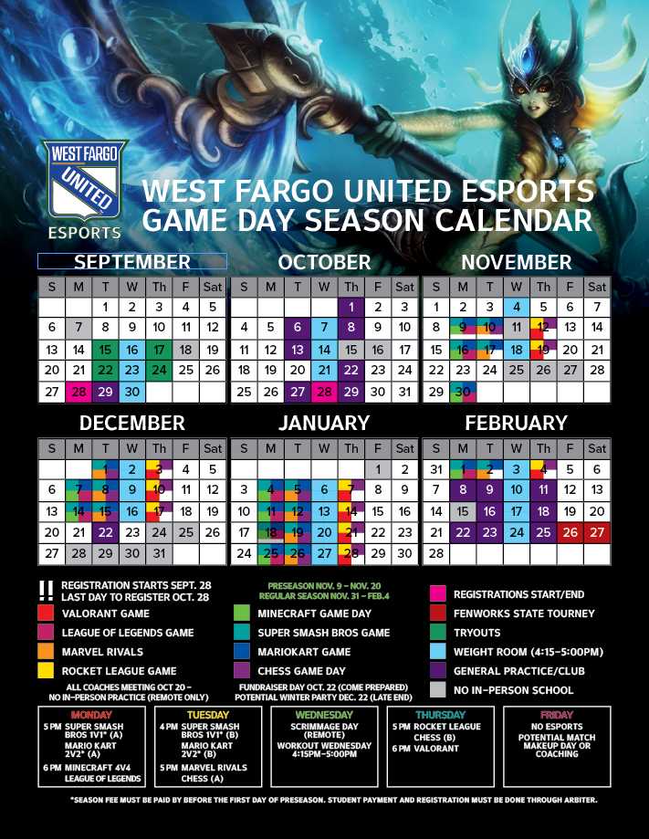
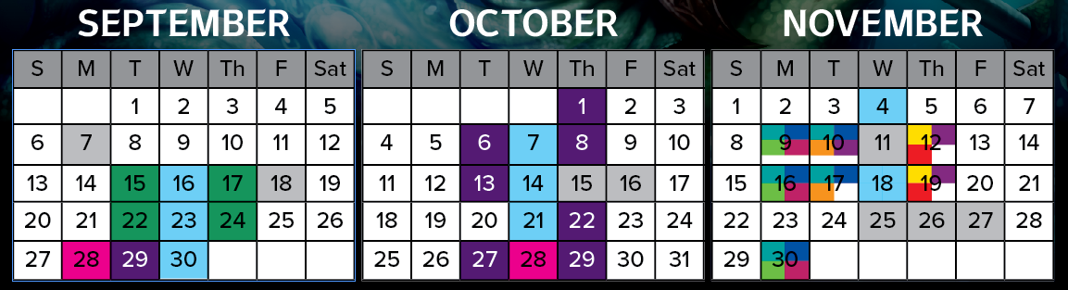
Preseason and Team Build (Try Outs)
Late September and into October we’ll be assessing what players work well together and build teams around those skills (Practices will go until 6pm)
Preseason Nov. 9-Nov. 20 – Teams may be tweaked before regular season
More complete calendar will be provided closer to season for each game title and overall

Slide 18
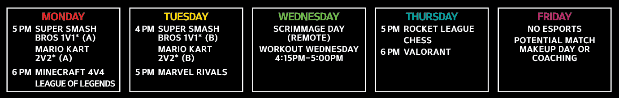
Season Schedule
Regular season starts last week of November (Nov.31)
Smash and Mario Kart are Monday or Tuesday (Play for one)
Chess is Tuesday or Thursday (Play for one)
Games Monday, Tuesdays, and Thursdays
Coaching will be decided on numbers and teams/schedules (required)
Workout Wednesday – Go Touch Grass – All year
Fenworks State Tournament February 26-27; Parents/Guardians welcome (spectator fee); location: UND in Grand Forks
Season Performance can determine if you go to State; bad behavior, you’ll get left behind; must be eligible; players will need to pick main game and what title(s) they could be a sub for (if they play more than one)

Slide 19

College Experience
We try to connect with College Coaches and have them present their opportunities to the players in person, when available – Mayville State in September 29 at 4:30/4:45pm
Parents and Guardians are welcome to attend college talks when held at WFHS
#college-connect on discord to ask College GMs questions about their program; GMs/Coaches/Recruiters can share tournaments they’re hosting
College visits and tours when available
Bytespeed/NAECAD list to search offerings in and out of state

Slide 20
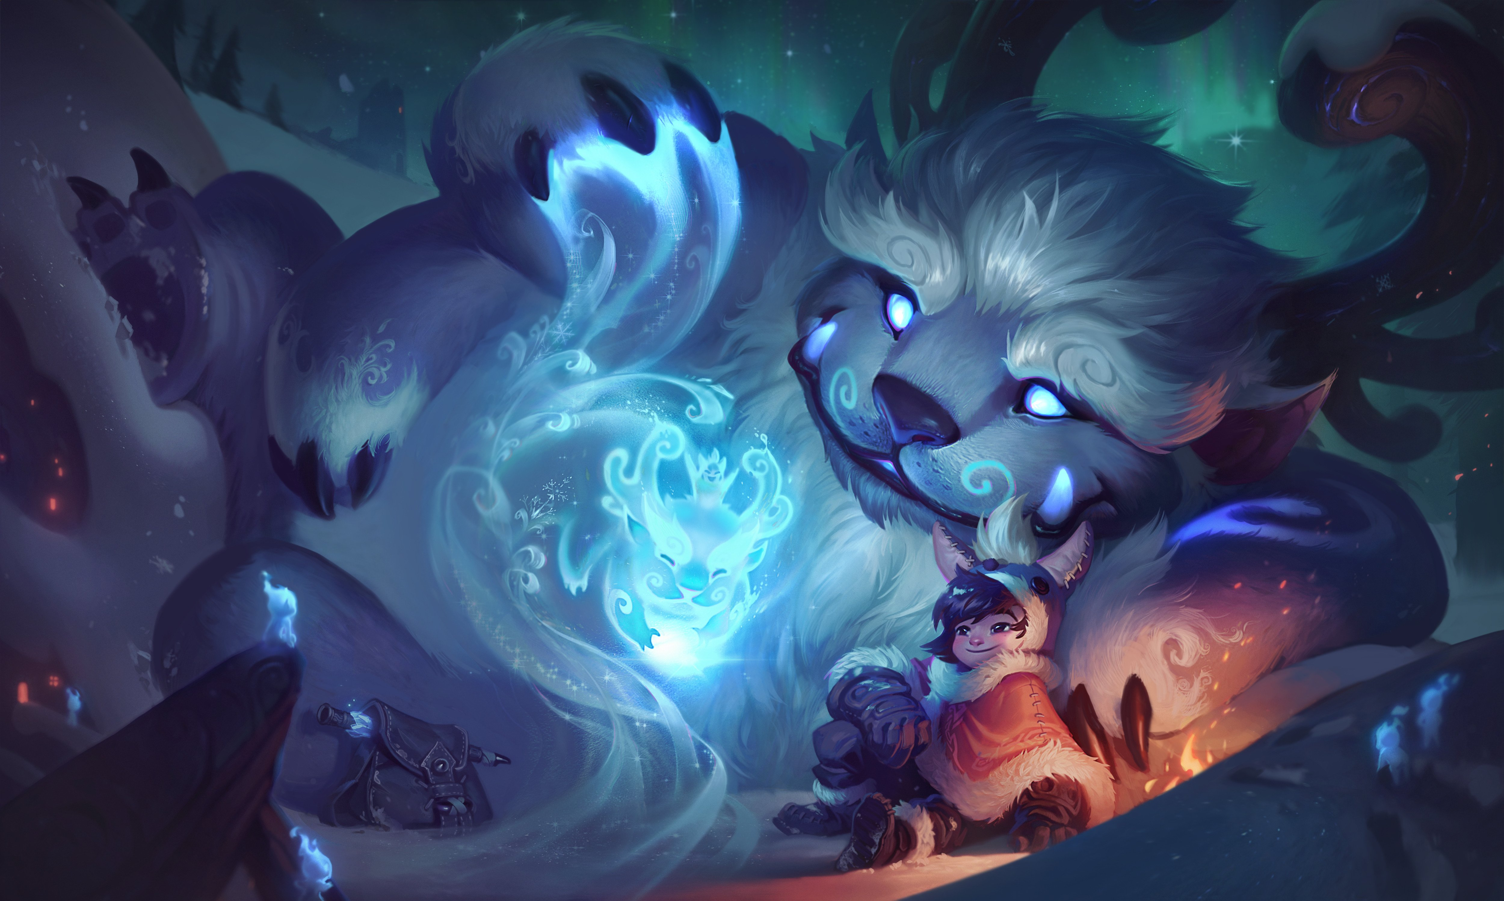
Player Wellness
20/20/20 – 20 minutes looking at the screen, break for 20 seconds, look 20 feet away from screen
Hydration/healthy food choices
Posture – Keeping spine straight, arms 90 degrees with table, we also have standing desks
Encouraging team outings where players can interact in-person (ex. Suite Shots)
Off screens 1+ hour before bed
Workout Wednesdays
  4:15 – 5:00 p.m. at WFHS
  Importance of physical activity for players

Slide 21
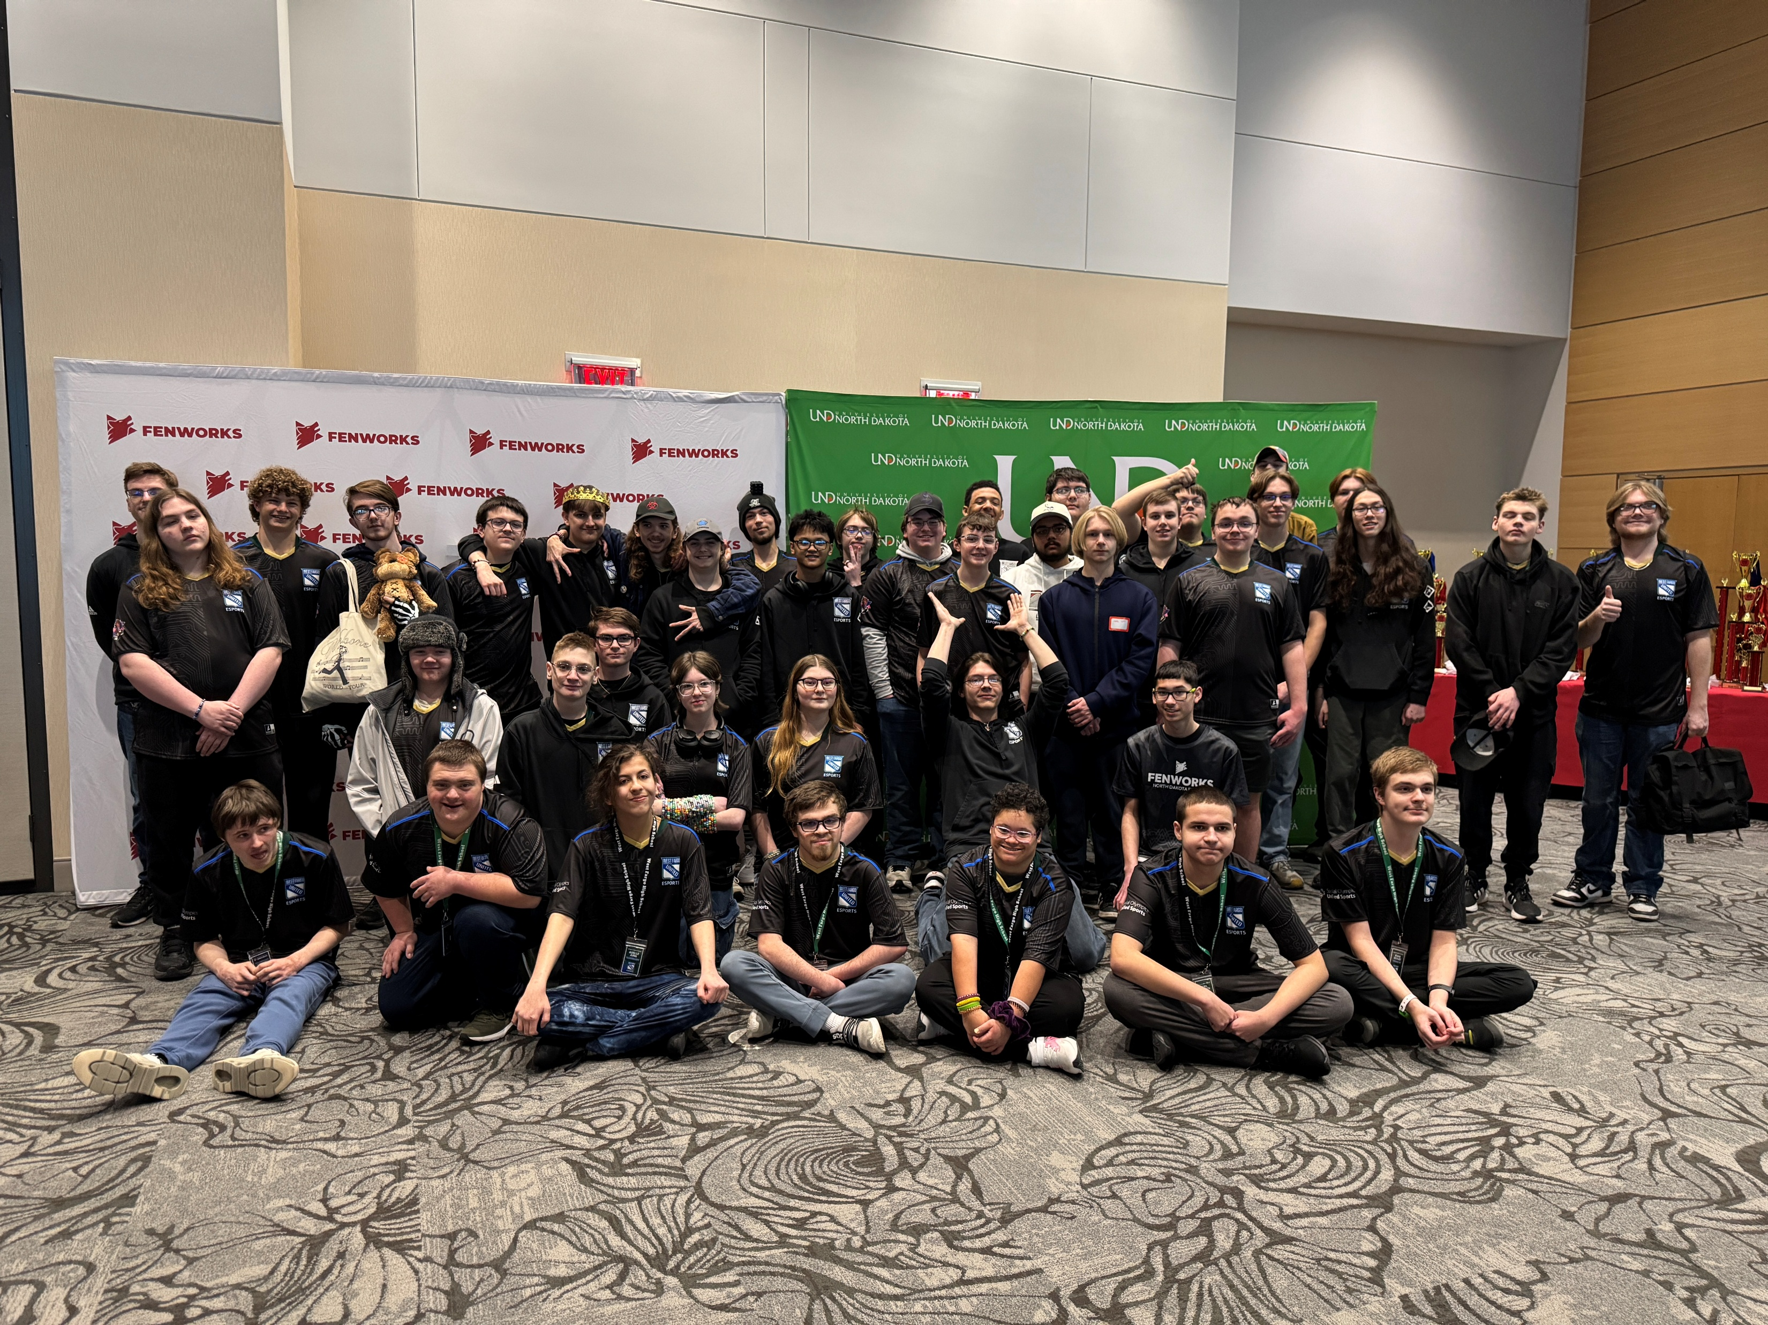
Spring Season Opportunities
Drone Racing through Mr. Gravdahl’s Aviation Course at Sheyenne High School (Spring + State tourney)
Special Olympics Season (one hour
a week for eight weeks), Starting in January; State Tourney that takes place alongside main state competition– Volunteer hours (NHS)
Spring Season and Titles will be announced closer to spring; Must register and pay activity fee

Slide 22
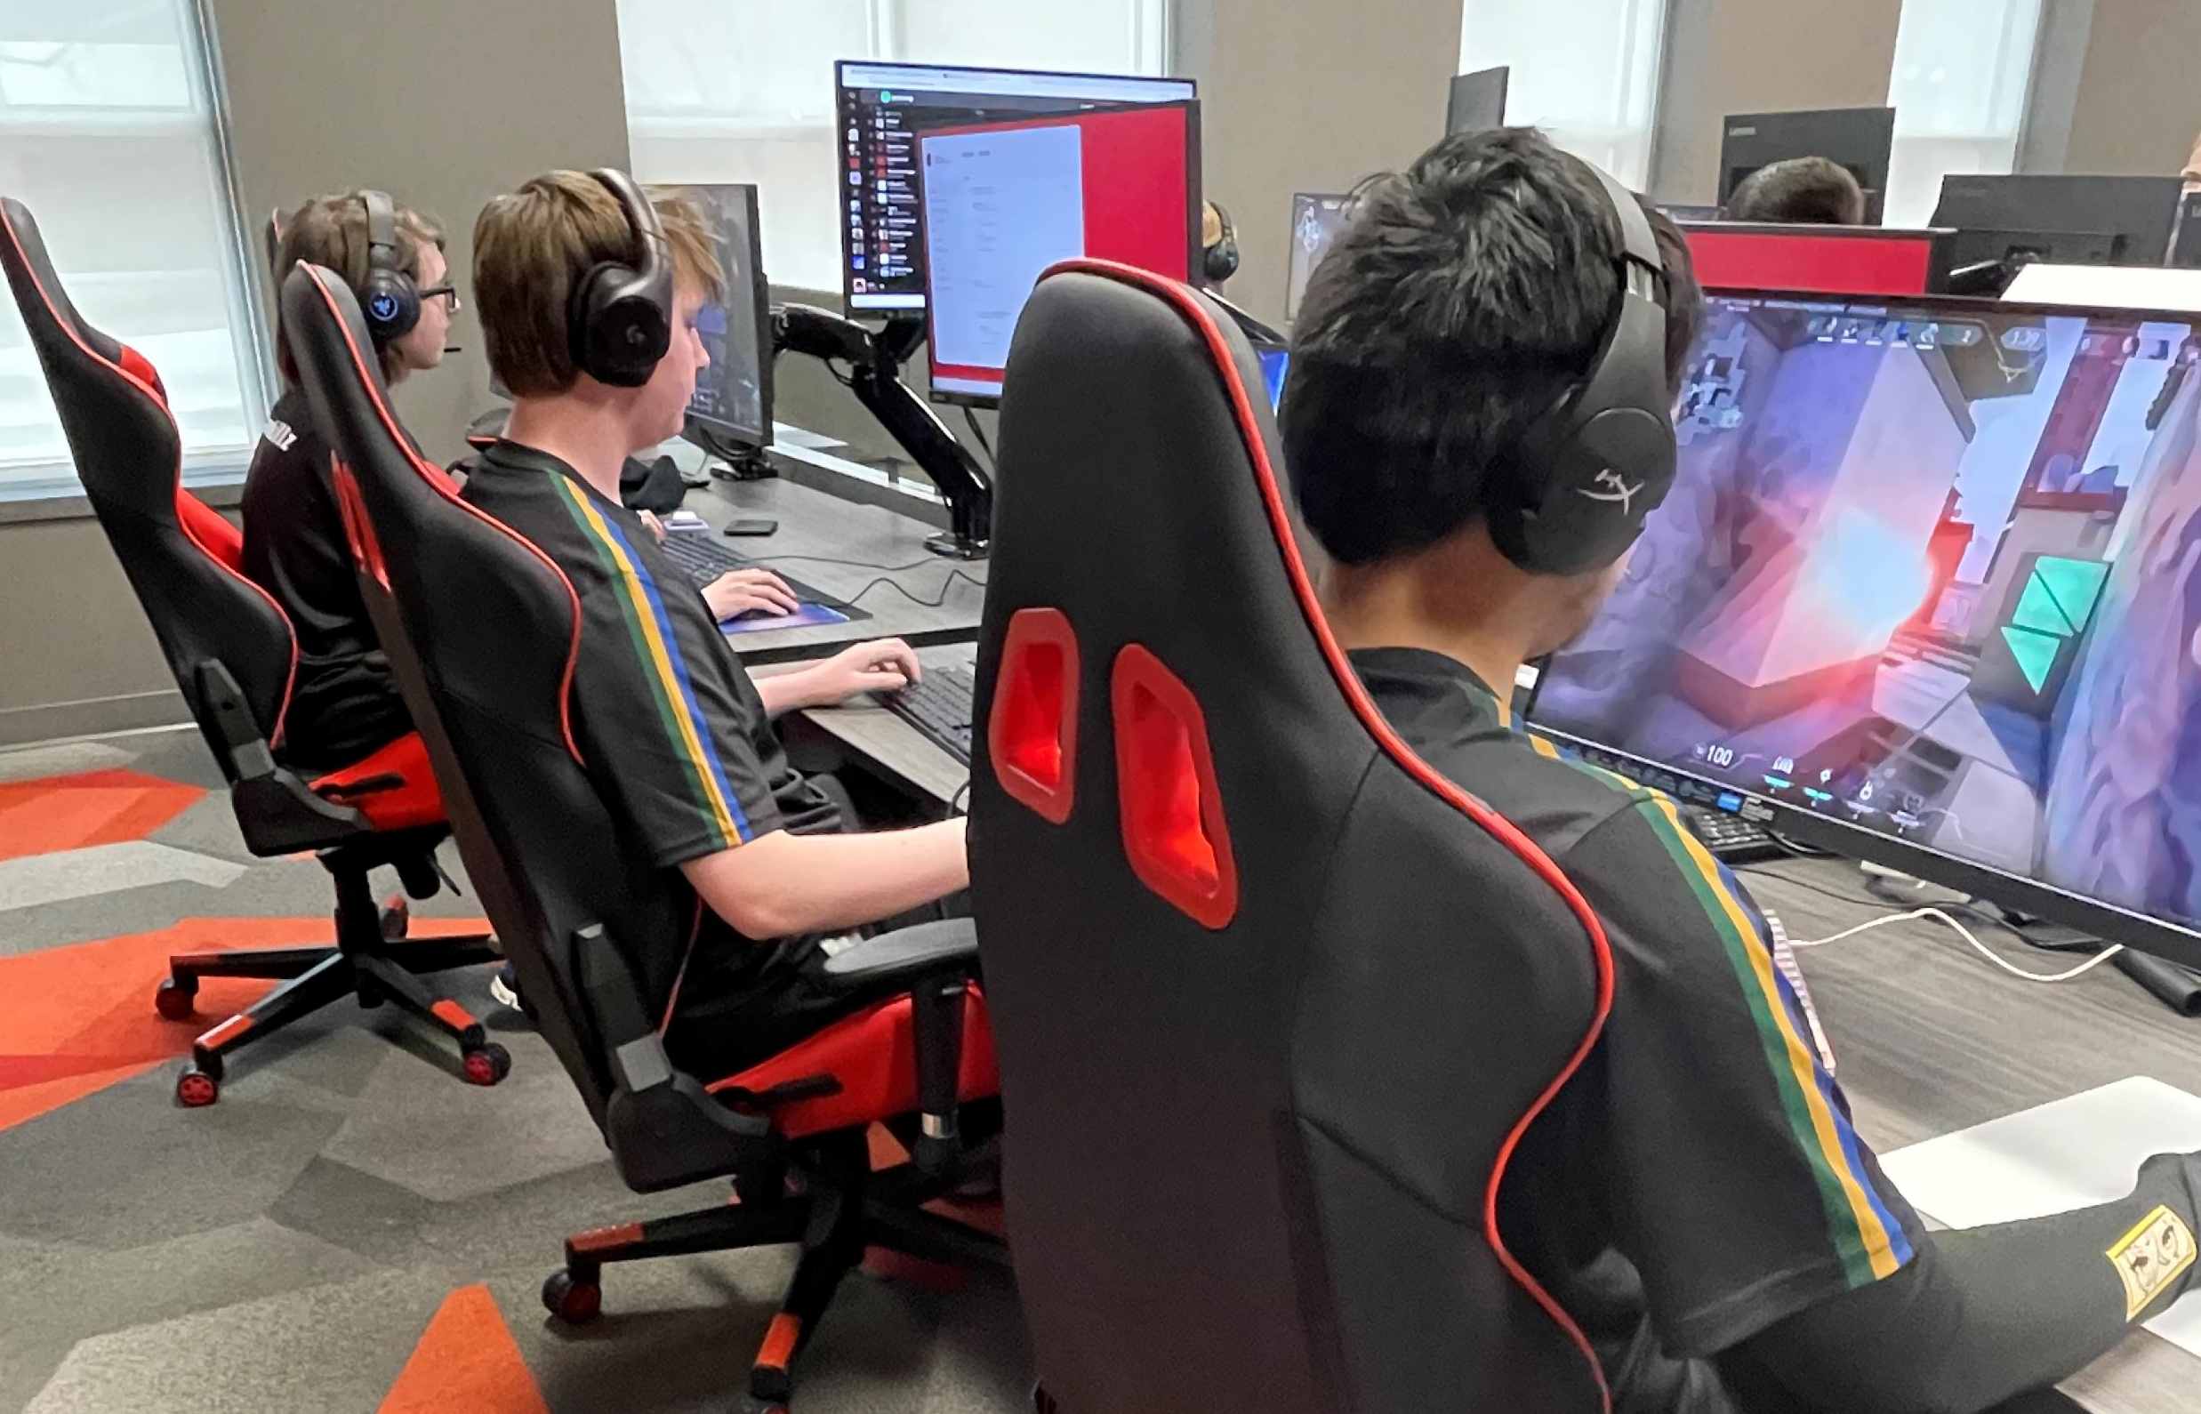
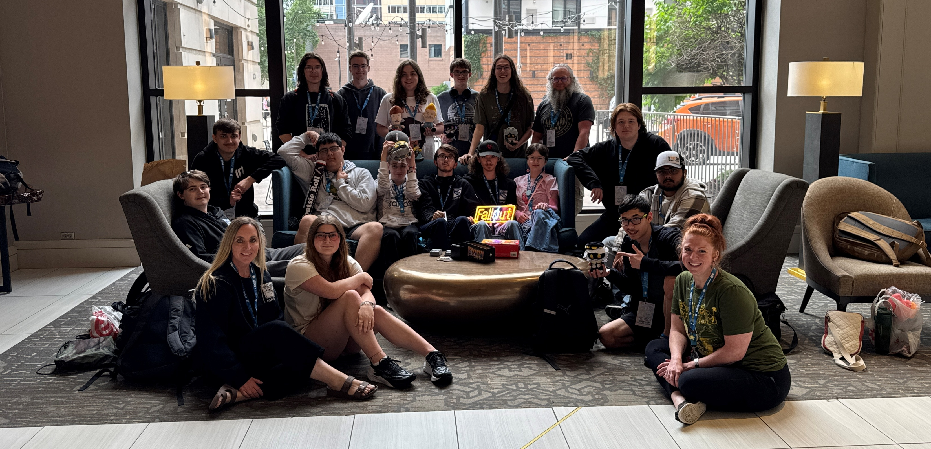
Fundraiser
Spending Options
Minot State Tournament:
Great Plains Gauntlet
Summer Games Done Quick/Minneapolis trip
College Visits to preview Esports Programs across ND and MN
New Computers/Gear
Jerseys (if not sponsored)
State Travel Expenses
This will be communicated with families, and all travel info will be sent out

Slide 23
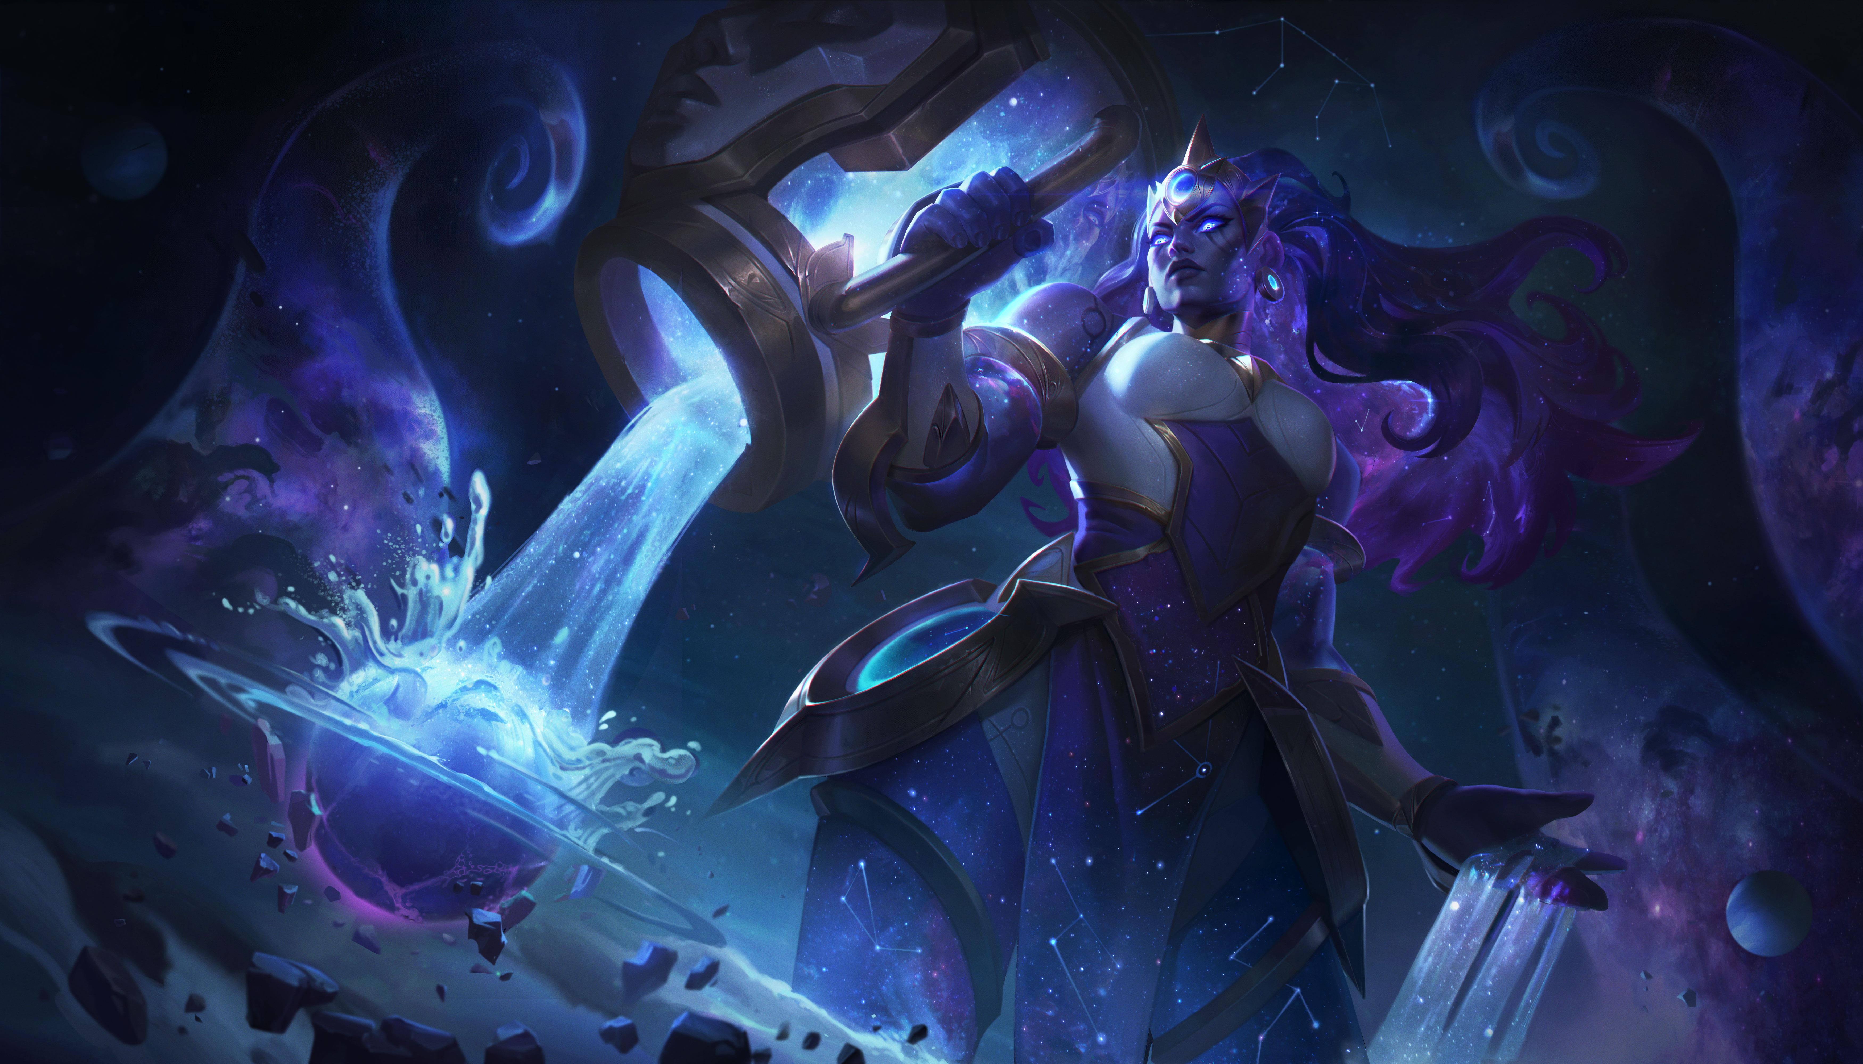
Technology
Requirements
Discord
  Active participation and use as our team's primary form of communication
Strong internet connection (wired, if possible)
Keep games up-to-date
Smash and Mario Kart require the Switch Online service – Talk to Beseler
What to do if you don’t have a Switch or computer at home – Talk to Odum

Slide 24
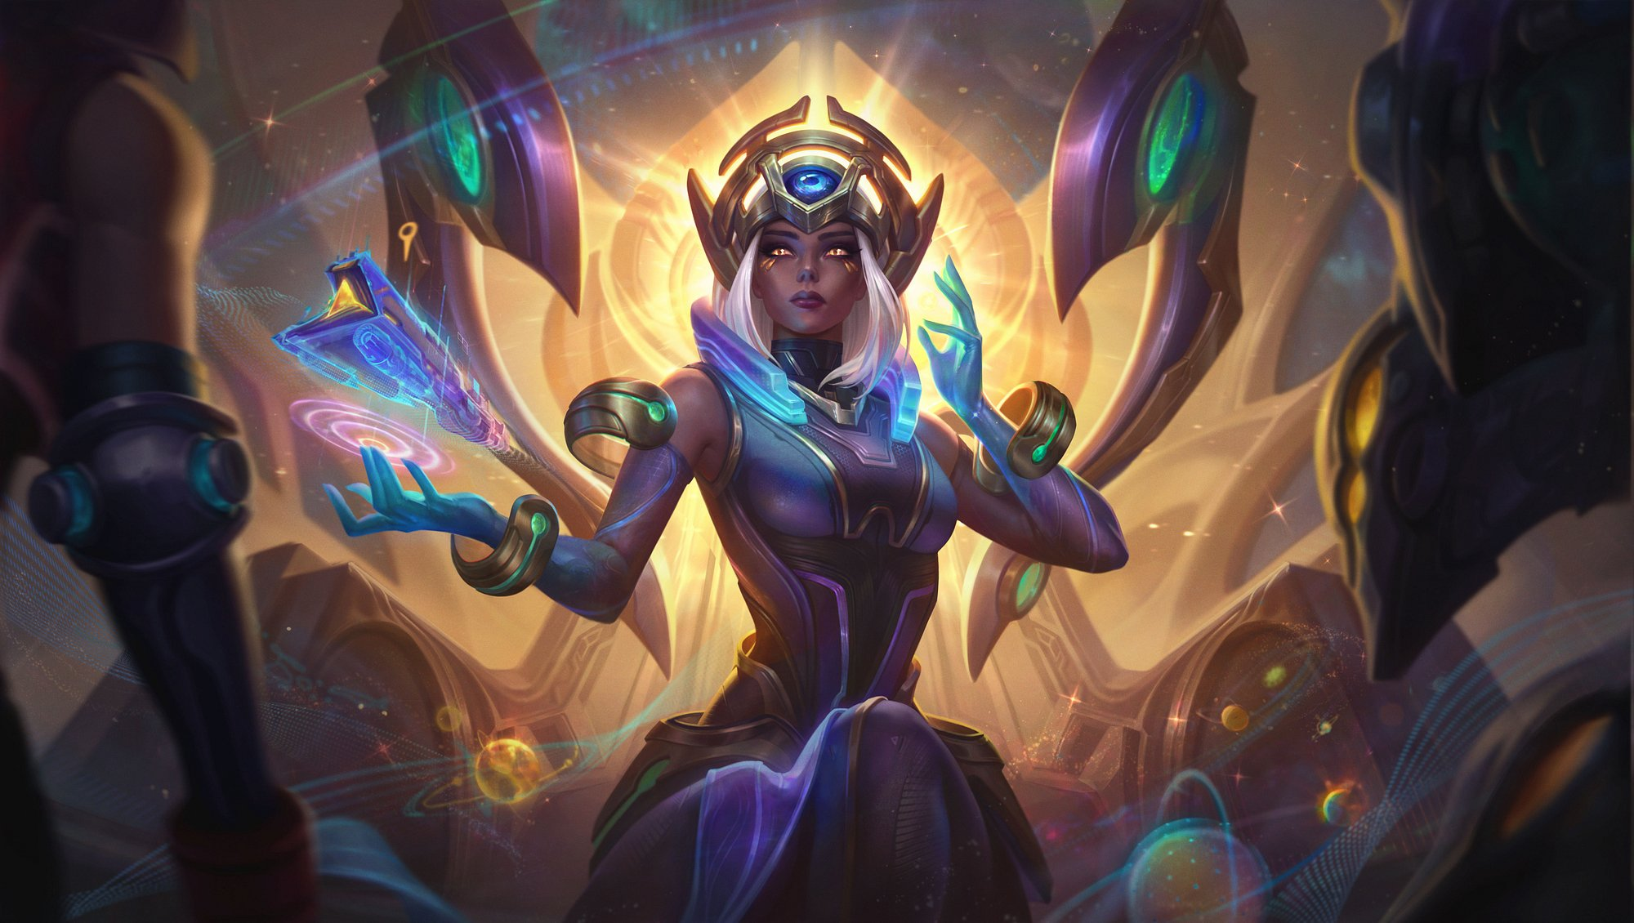
Buying a Gaming PC
Indicate on Parent form or email for more information (Beseler more helpful)

Slide 25
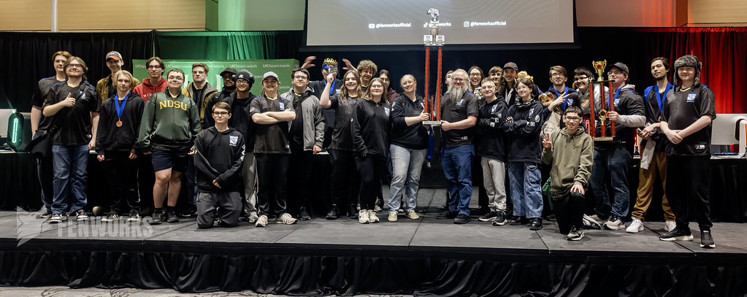
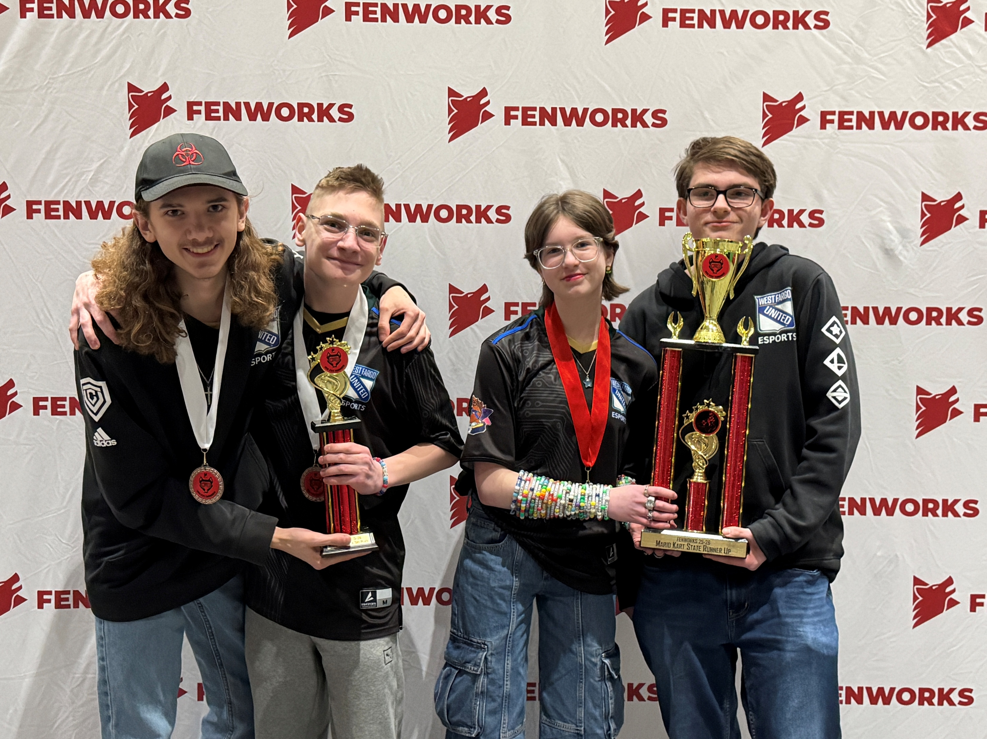
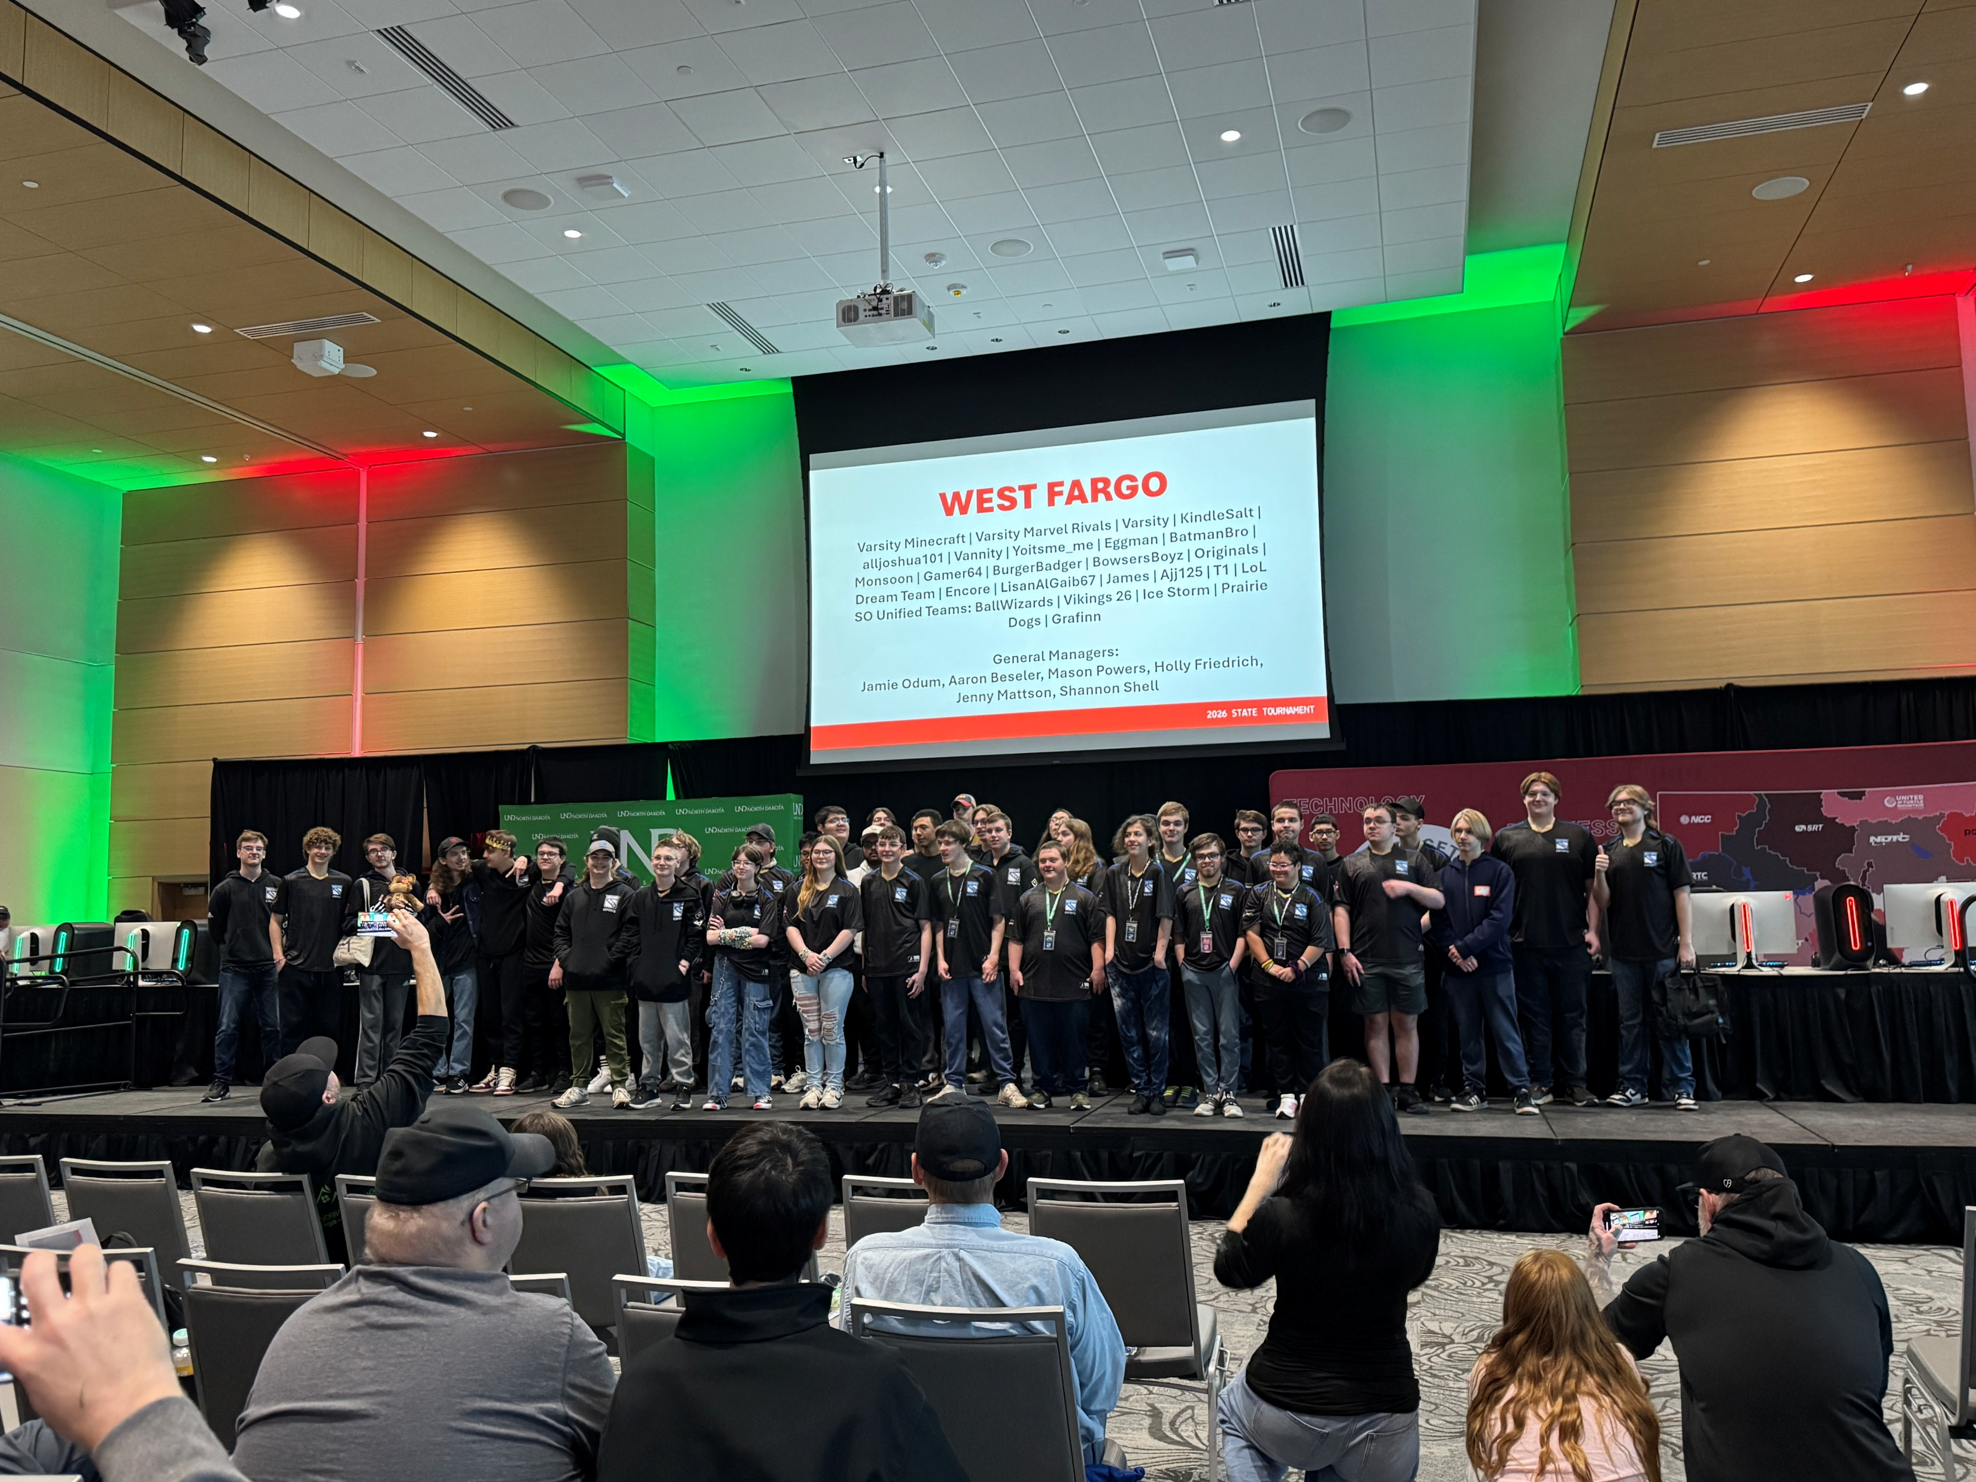
Parent/Guardian involvement
Healthy Snacks – Optional signup; helps promote healthy eating; players get something to eat before matches that can go as late as 7pm
Team Shop – Get gear for you and your player; creates visibility for community representation at State
Streaming and Content Creation – We’ll do our best, but welcome help – Fenworks is creating a Broadcast Internship program for students (additional costs, run through the school – has to be approved by district)
Concessions for fundraising – Oct. 16
License to drive a bus (CDL)

Slide 26
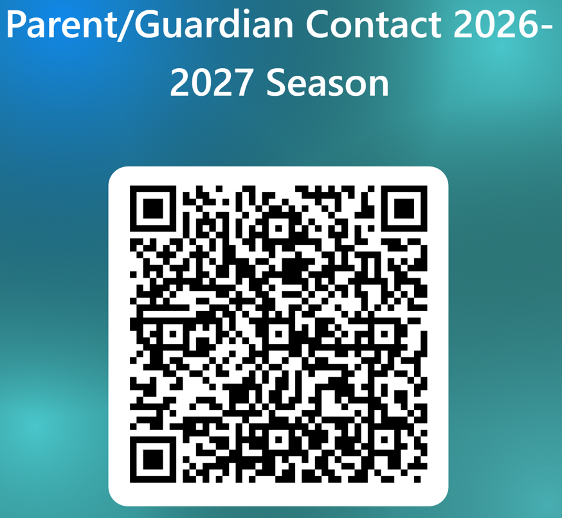
Parent Sign Up
Please scan this QR code if you are:
Interested in having information about the season sent to you directly
Need us to know anything about your player to help support them
Want us to have emergency contact info all season (we will also have access to this in Arbiter)
Wanting to get involved in the program (snacks/concession/streaming/etc.)
(this is completely optional)

Slide 27
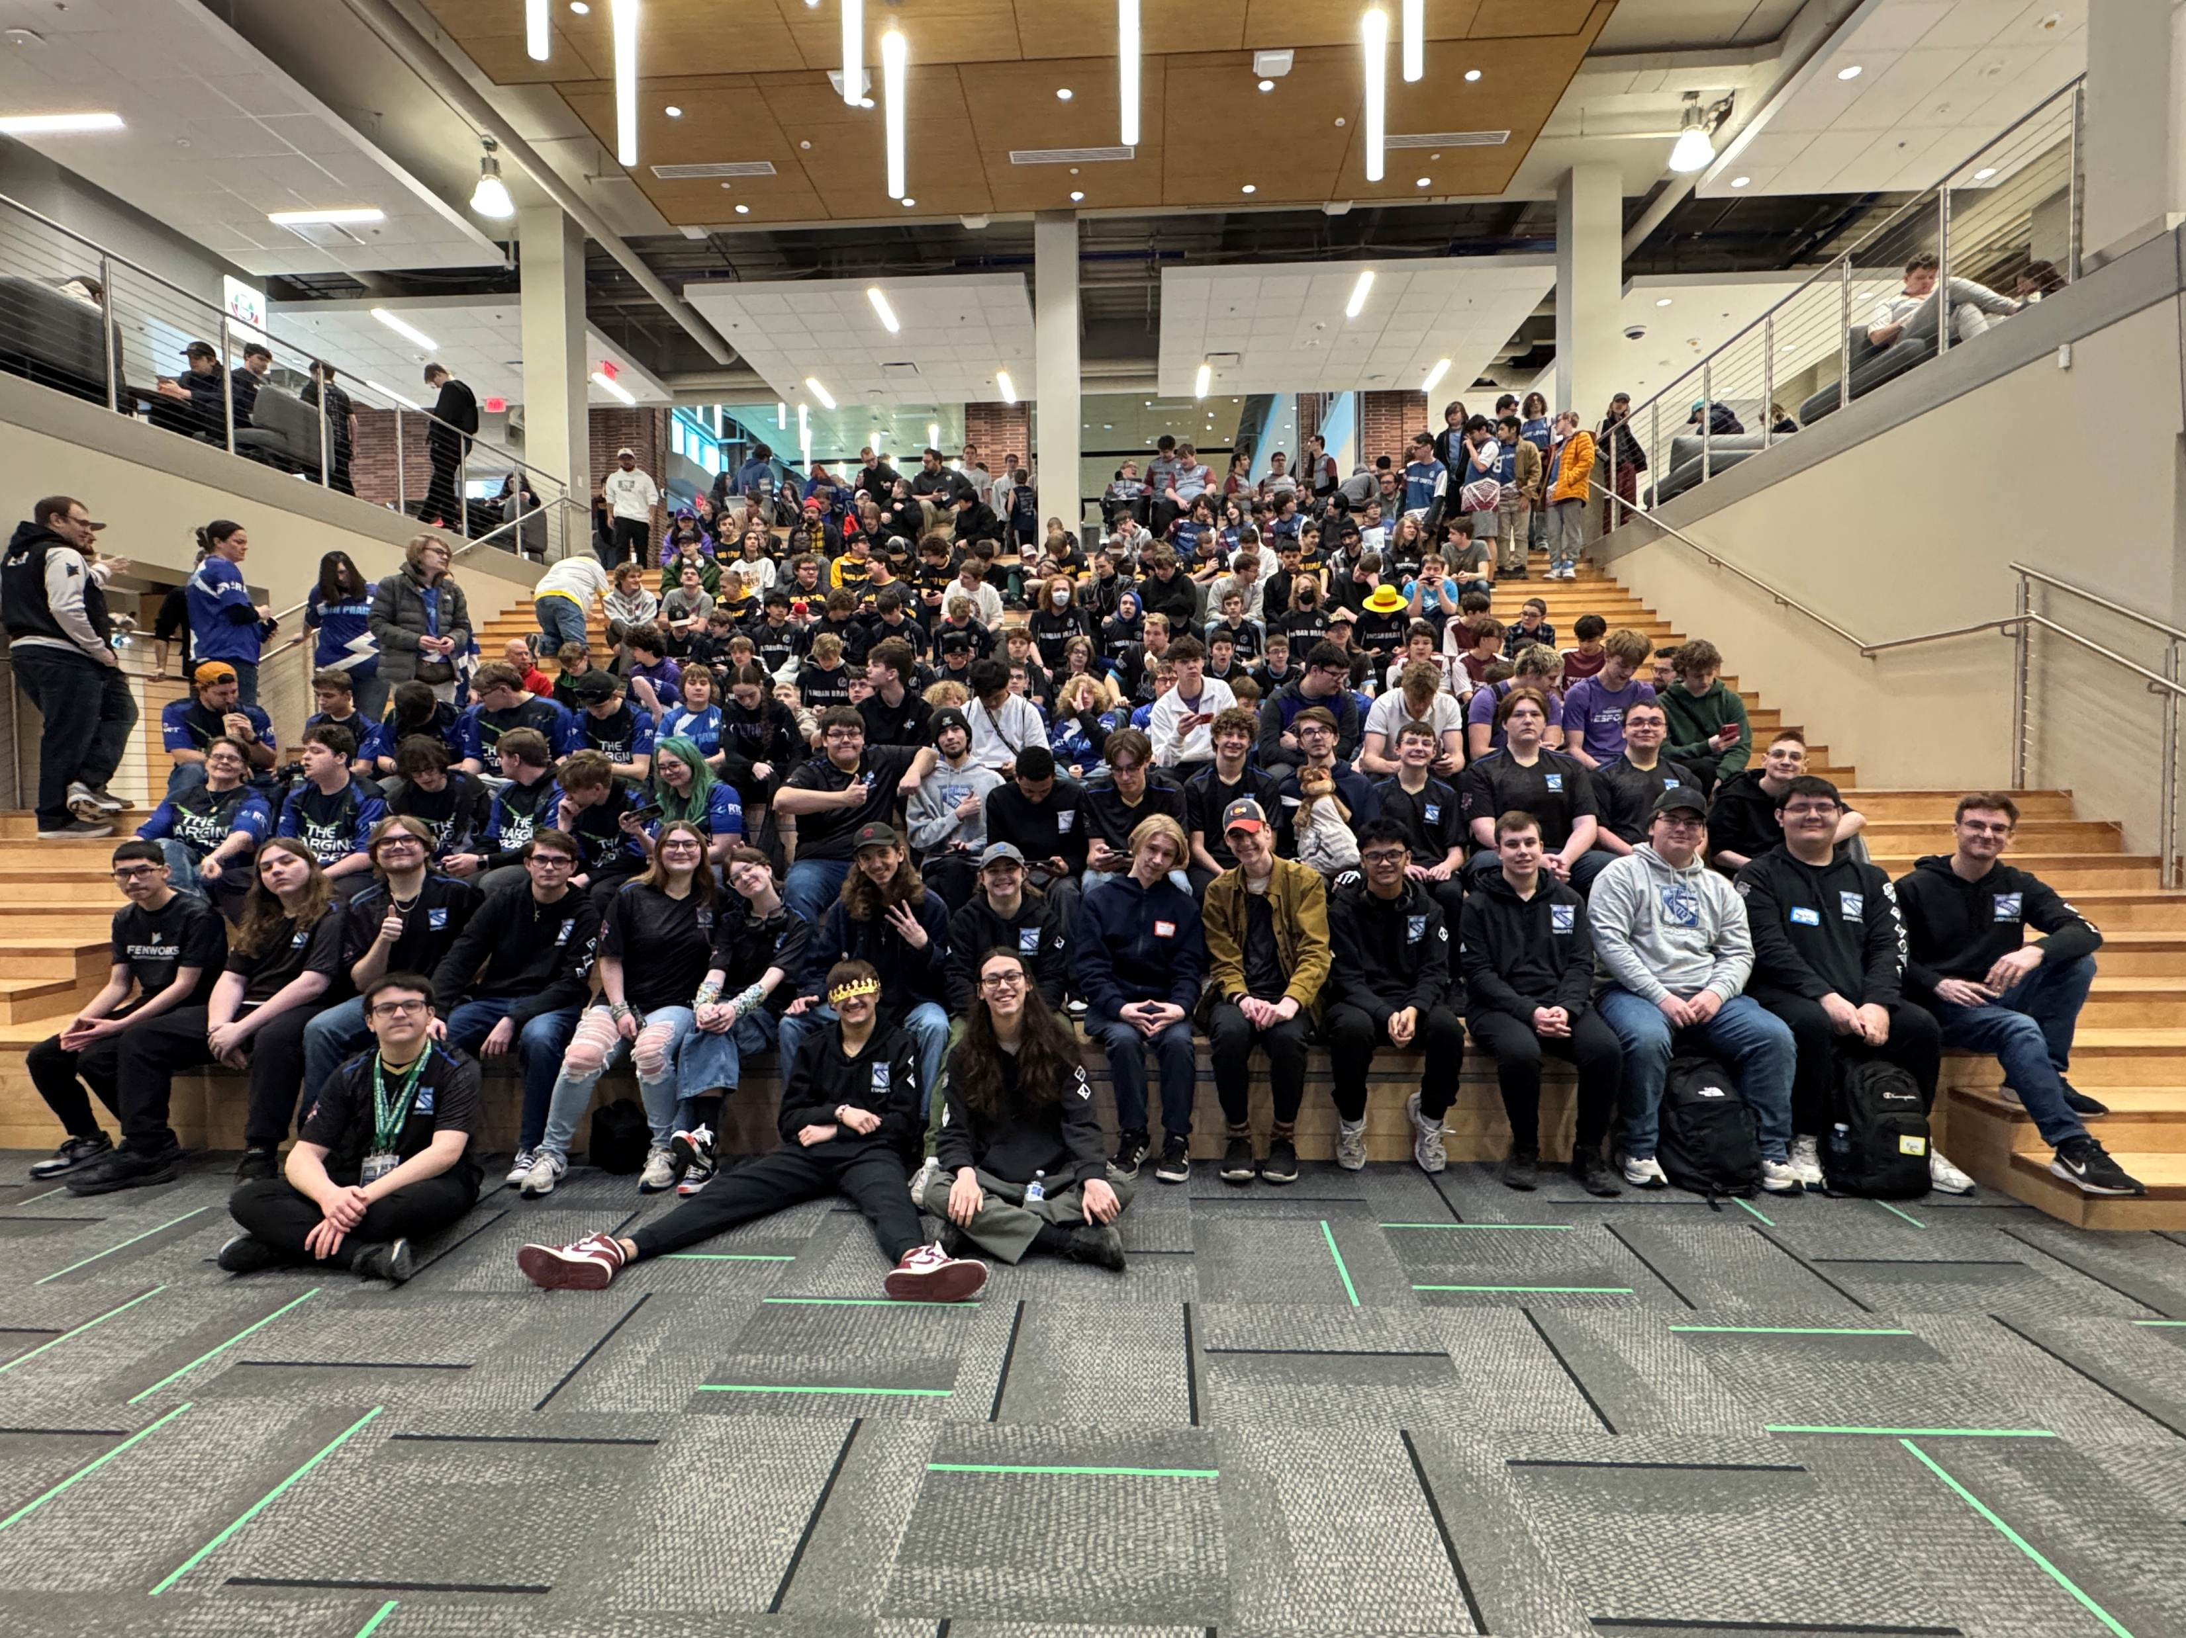
Questions

