Slide 1
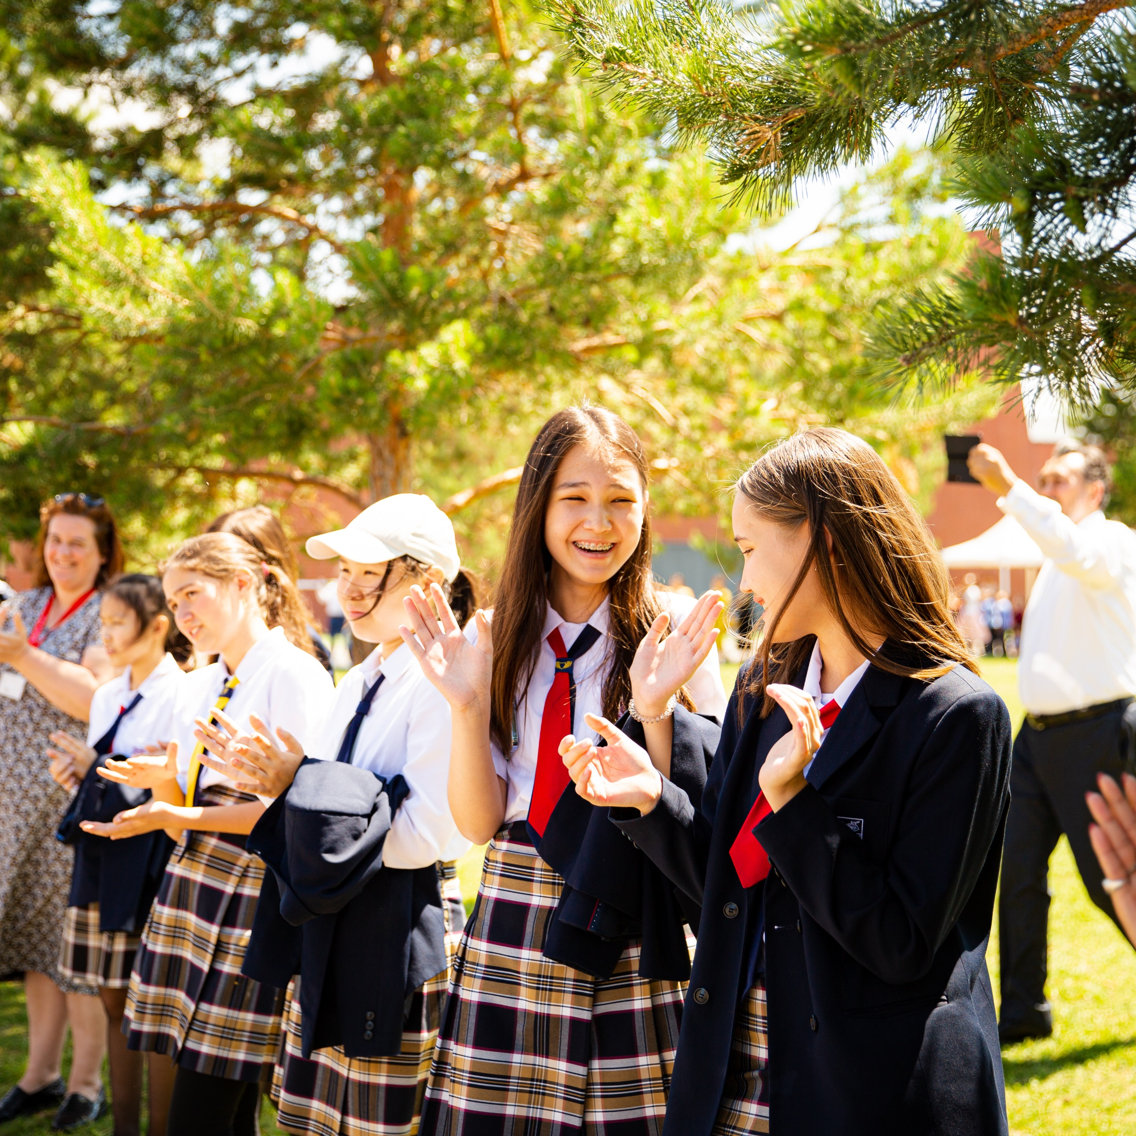


What COBIS Membership Means for Our School and Your Child
2026/2027

Slide 2

Your Child’s School is a Member of COBIS
COBIS is a global network that includes:
350+ Member Schools
275,000+ Students
85+ Countries
200+ *Supporting
Associates
20,000+ Teachers
*businesses that work with COBIS Member schools

Slide 3
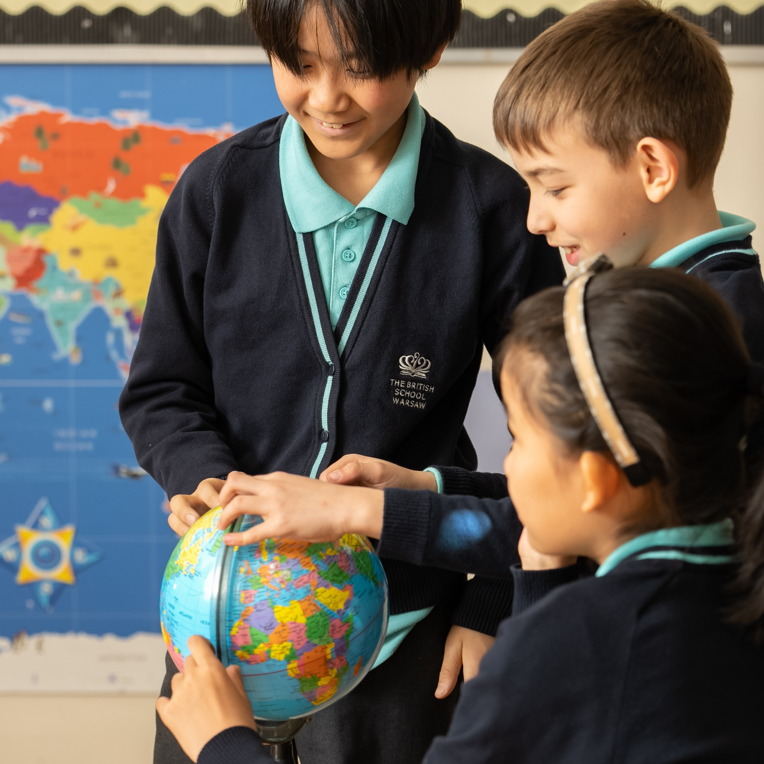
COBIS Mission and Vision
COBIS’ Mission is to support and empower all British international schools in their provision of high-quality education.
COBIS’ Vision is to reach and connect all British international school communities in order to support them in developing students who will have a positive impact on society.

Slide 4
COBIS Guiding Principles
Our Guiding Principles, which guide how we operate and make decisions, are Inclusivity, Collaboration and Ambition.
Inclusivity
Collaboration
Ambition
We work with schools to ensure that every student and member of staff, in a broad range of school contexts, feels that they belong.
We work in partnership with others aligned with our mission, vision and guiding principles, to ensure our members flourish and receive maximum value.
We continue to challenge ourselves to innovate and grow, as always with students as our focus. We stay true to our quality provision and the integrity of our practice.

Slide 5

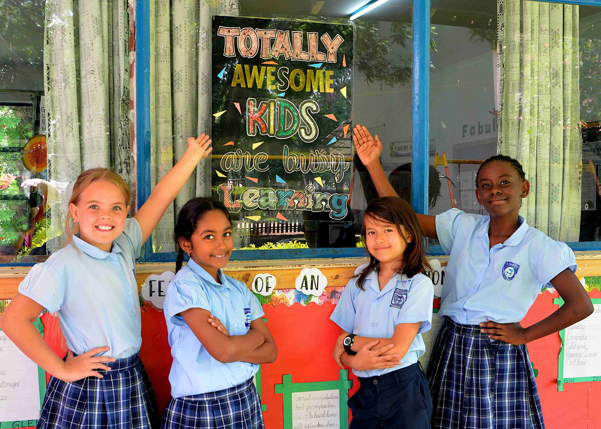
What is COBIS?
The Council of British International Schools (COBIS), is a global membership network of quality-assured British international schools.
They are the leading membership association supporting quality assurance, safeguarding, professional learning and student enrichment.

Slide 6
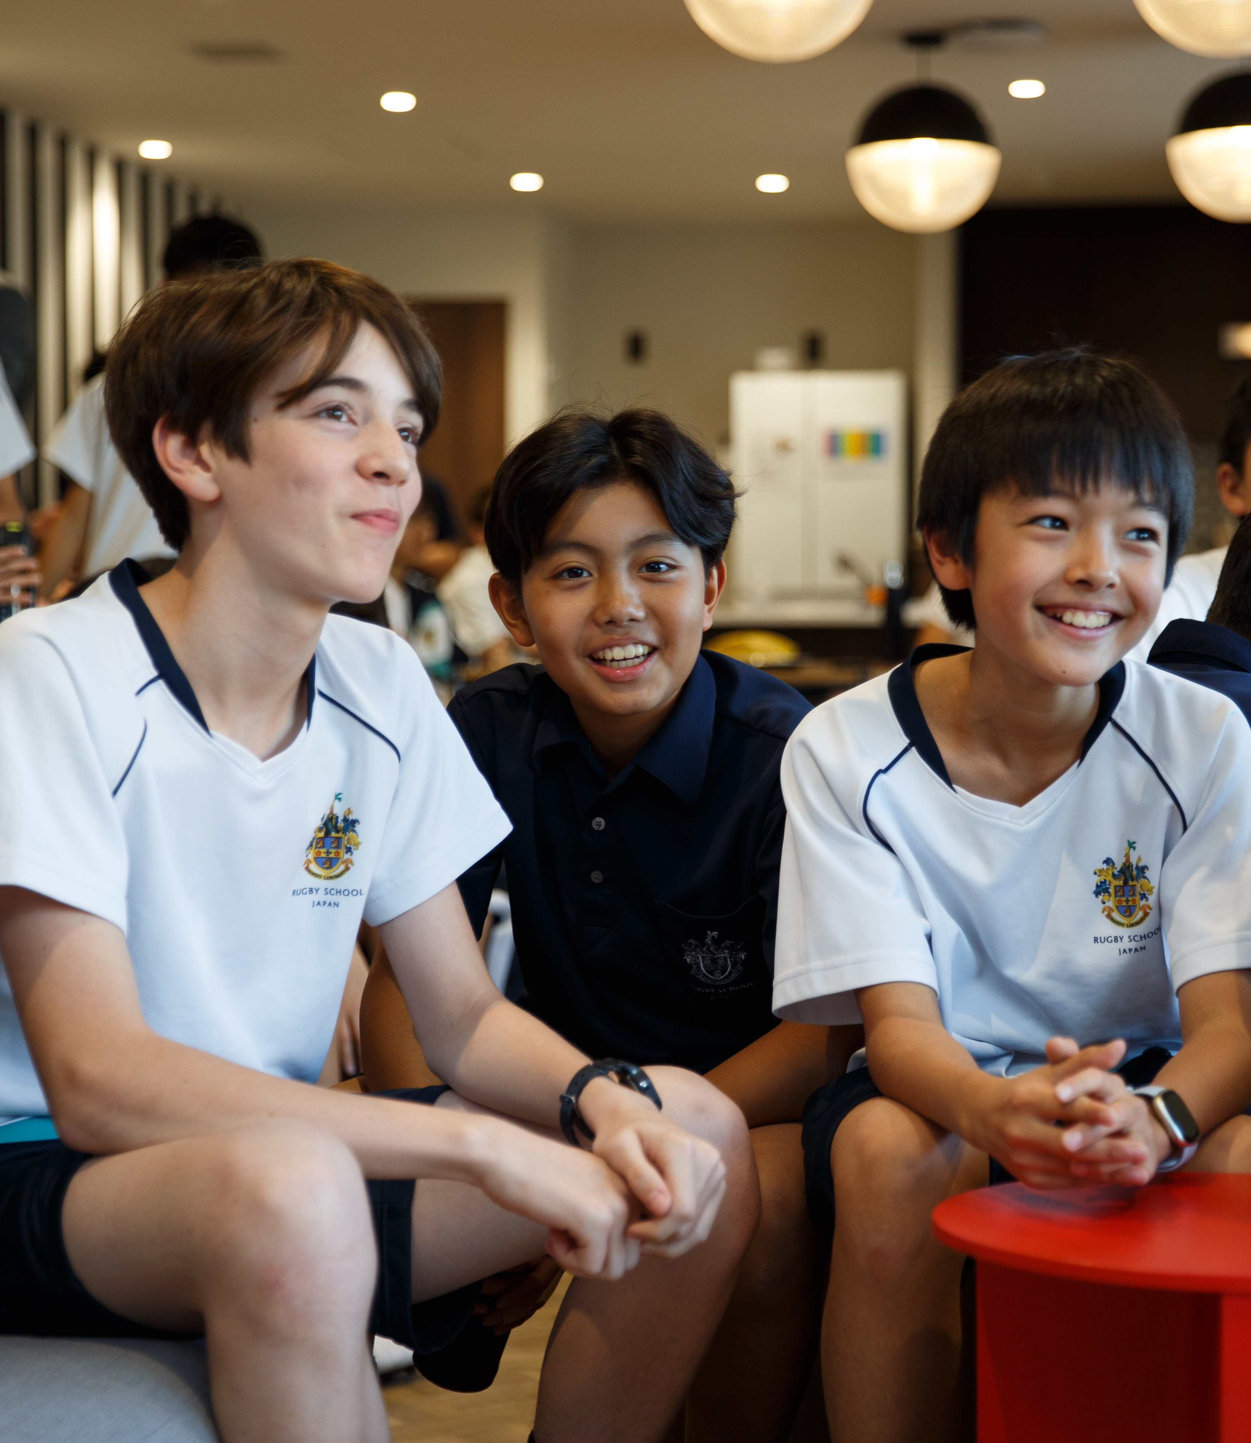
Our School’s COBIS Membership Is a Kitemark of Quality
COBIS is an internationally recognised kitemark of quality. Our school has demonstrated it meets the high standards required for COBIS membership.
COBIS schools have access to world-class safeguarding, professional development opportunities, and student enrichment activities, ensuring that COBIS schools deliver excellence across the board.

Slide 7
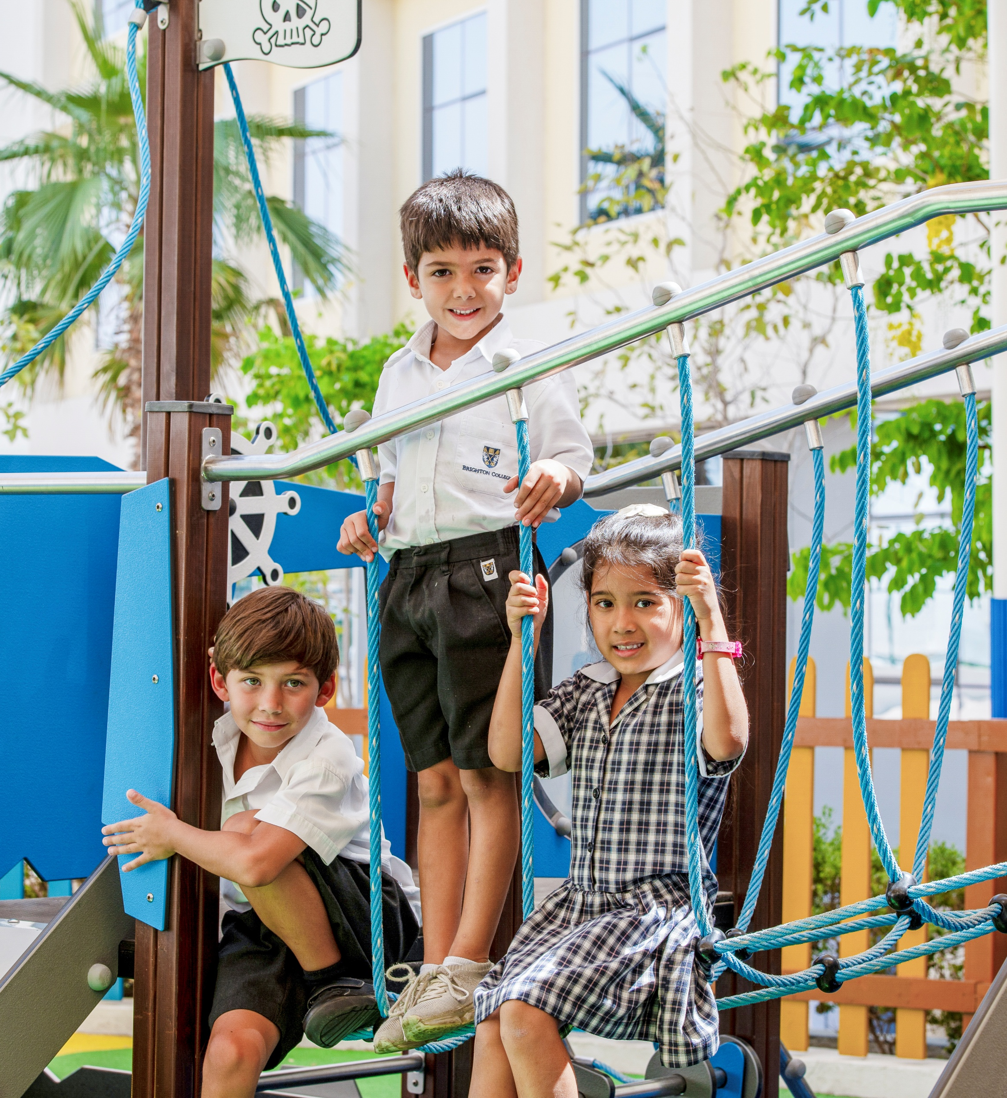
Safeguarding and Child Protection
COBIS has an unfaltering commitment to promote the welfare of all children, young people and vulnerable adults to keep them safe.​
COBIS schools meet rigorous international safeguarding, safer recruitment, and child protection standards, aligned with UK and global best practices.
As a COBIS Member, your child's school has met the high standards COBIS sets for child safety and wellbeing.

Slide 8
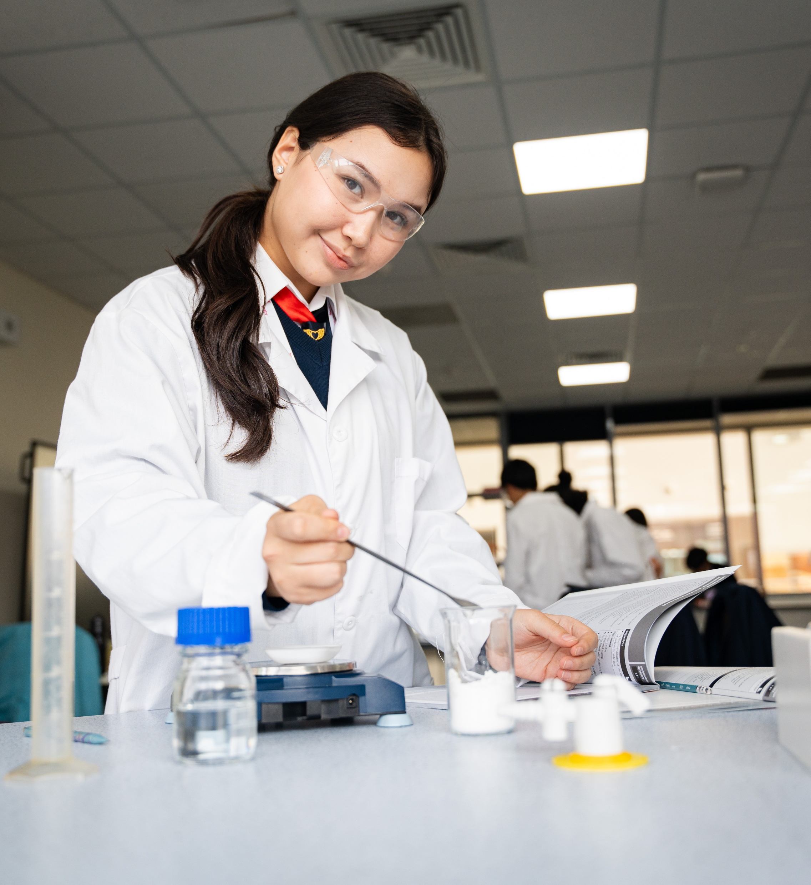
High Standards of Teaching and Learning
COBIS schools are committed to high standards in teaching and learning, world-class teachers and staff, and high-quality British orientated education delivered internationally.
COBIS membership demonstrates a school’s commitment to quality assurance, continual improvement, and meeting rigorous standards.
As a COBIS Member, your child's school has proven its commitment to high-quality teaching and learning.
Notes:
Change this picture

Slide 9
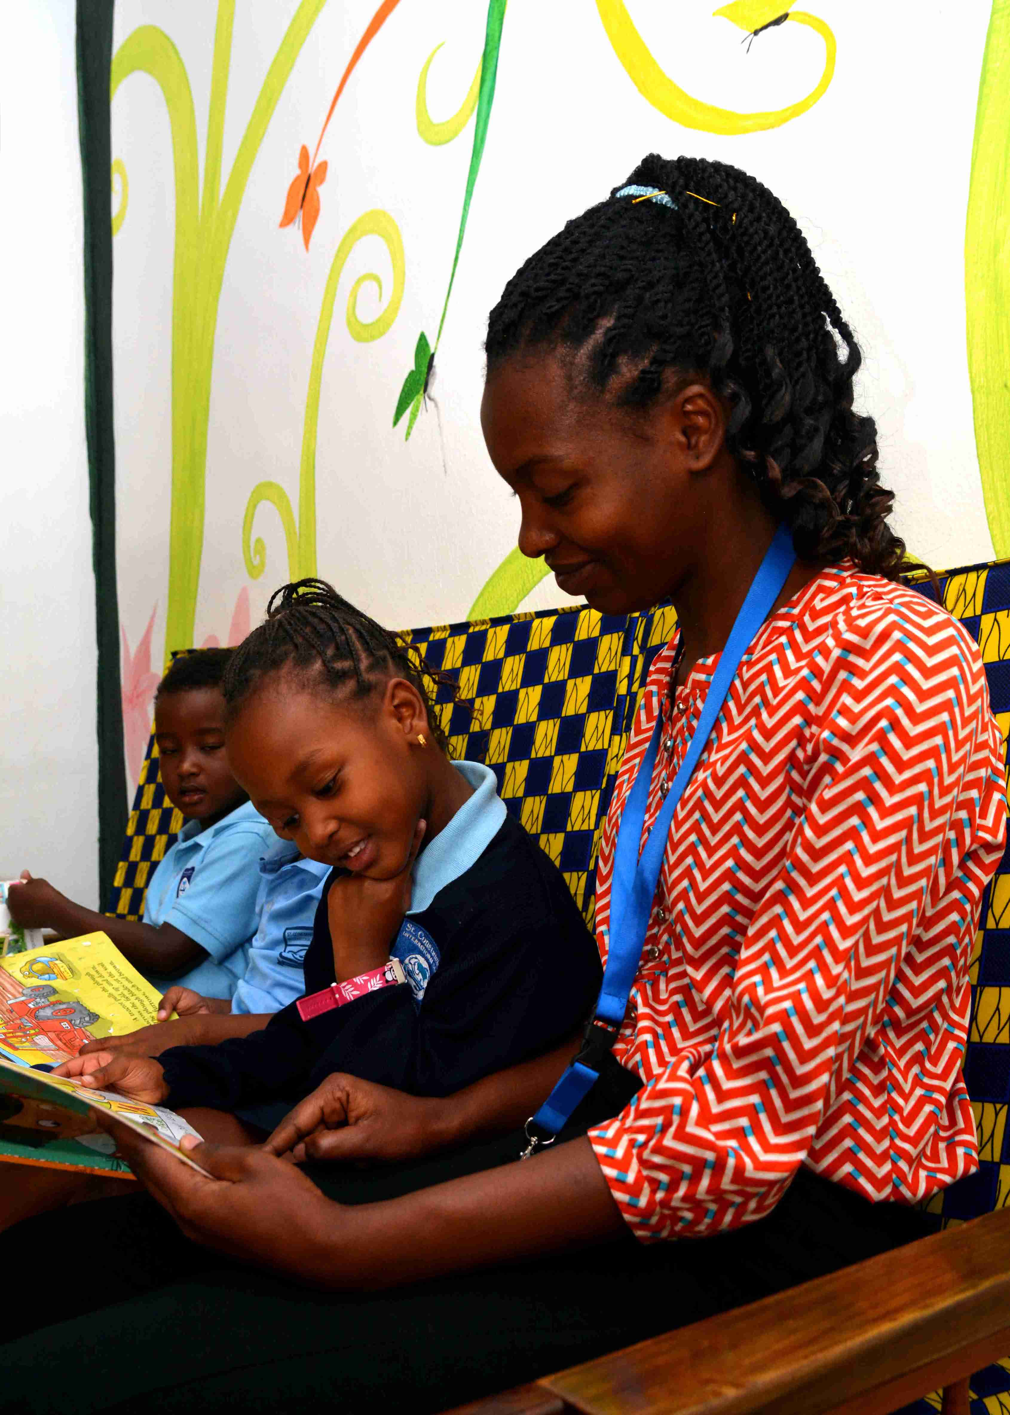
A Connected Global Community
COBIS schools are part of a trusted network of British international schools in more than 85 countries around the world.
COBIS promotes common values of integrity, inclusion, respect, and continuous improvement.
COBIS provides opportunities for students from across the globe to come together for diverse international events and competitions, both virtually and online.
As a COBIS Member, your child's school is part of a global network, sharing best practice and learning from each other.

Slide 10
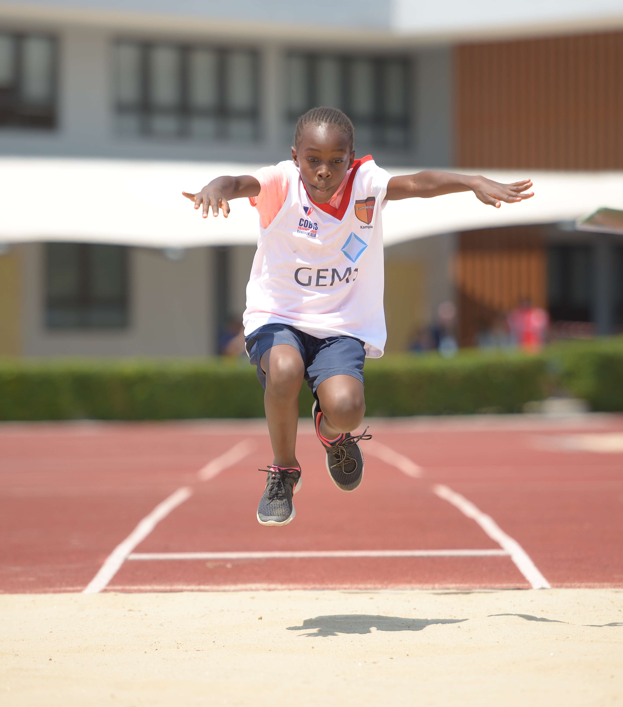
Developing Global Citizens
COBIS Student Events provide students with a global stage to share their creative talents in areas like art, drama, music, and poetry.
COBIS schools have co-curricular opportunities that include student leadership, arts, sports and esports competitions and much more.
These opportunities enable students to feel part of a wider global community, develop international-mindedness and prepare for life after school.
As a COBIS Member, your child's school gains access to global opportunities in arts, sports, leadership, and more, helping your child to to build skills and gain further confidence.
Notes:
Work on this

Slide 11
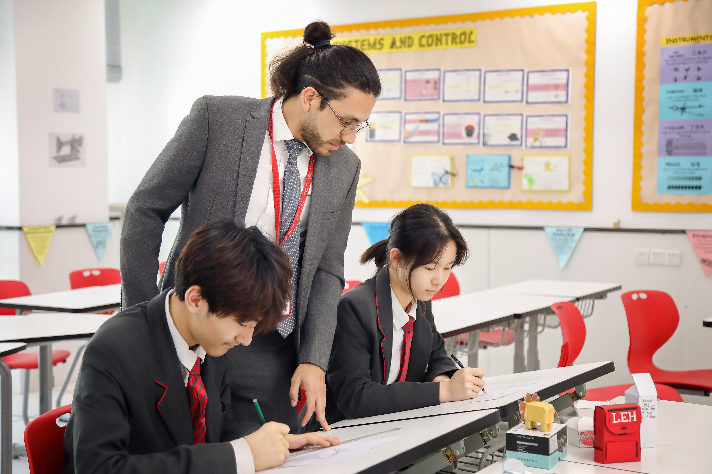
Commitment to Staff Training and Professionalism
COBIS creates pathways for teachers and leaders to continue to develop their skills and network through high-quality professional development, leadership training, and safeguarding updates.
COBIS has a rich network of schools that keep teachers and school leaders connected and up to date with global educational best practice.
COBIS provides recruitment support for Member schools to attract, recruit, and retain the highest calibre of teachers.
COBIS Membership ensures your child is taught and supported by knowledgeable and highly qualified professionals.

Slide 12

A Global and Local Organisation
COBIS works closely with local governments to support member schools, helping them understand and meet local regulatory requirements while maintaining the high standards expected of COBIS schools.
COBIS advocates on behalf of the international schools sector through ongoing engagement with the UK Government and ministries around the world, ensuring the interests of member schools and their communities are represented.
As a COBIS Member, your child's school is supported to deliver high-quality British education while adhering to local laws and cultural expectations.
Notes:
Work on this

Slide 13
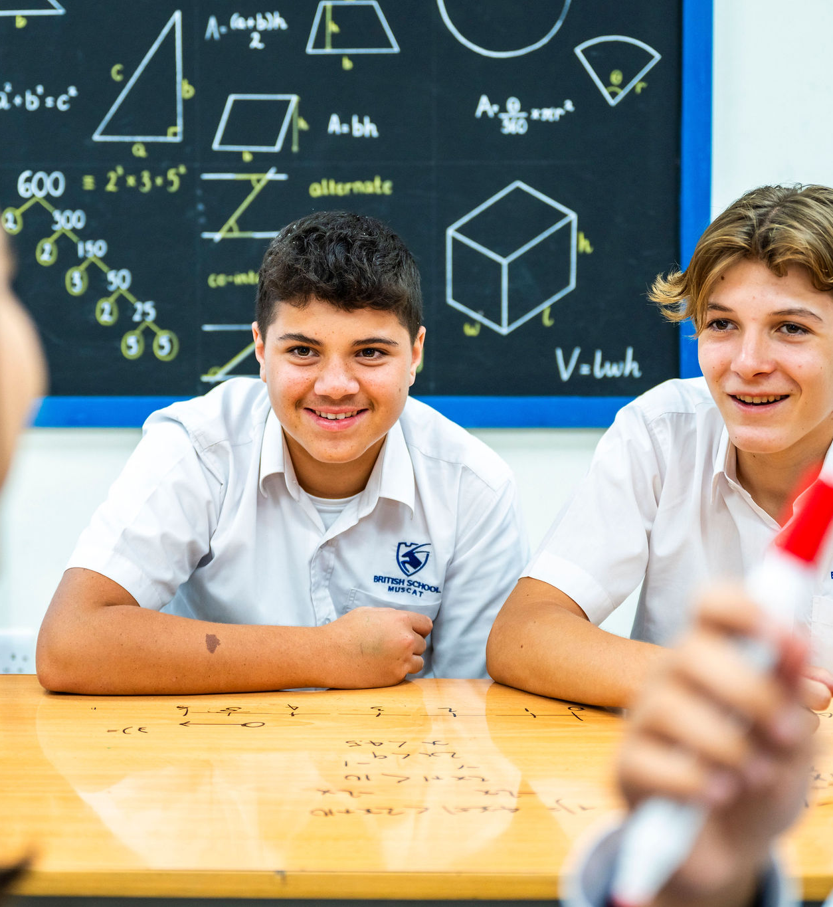

Recognised by Governments and Education Bodies
COBIS is recognised by the UK Department for Education and UK Department for Business and Trade and we work closely with inspectorates, safeguarding organisations, and global education stakeholders.
COBIS Accreditation also helps ensure schools align with both UK and international regulatory expectations as they are externally validated by the UK Quality Assurance Agency for Higher Education (QAA).
COBIS Membership gives your child’s school a voice with the UK Government, international exam boards, and UK and international universities.

Slide 14







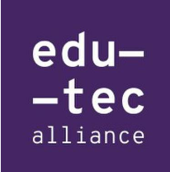








COBIS Partners
COBIS partners with a number of organisations dedicated to developing British education, safeguarding, higher education, sustainability and more.

Slide 15


Thank You!
If you have any questions, please visit our website
www.cobis.org.uk
Facebook
Instagram
LinkedIn
We're Here to Help – Meet the Team

