Slide 1



Your COBIS Membership
2026/2027

Slide 2
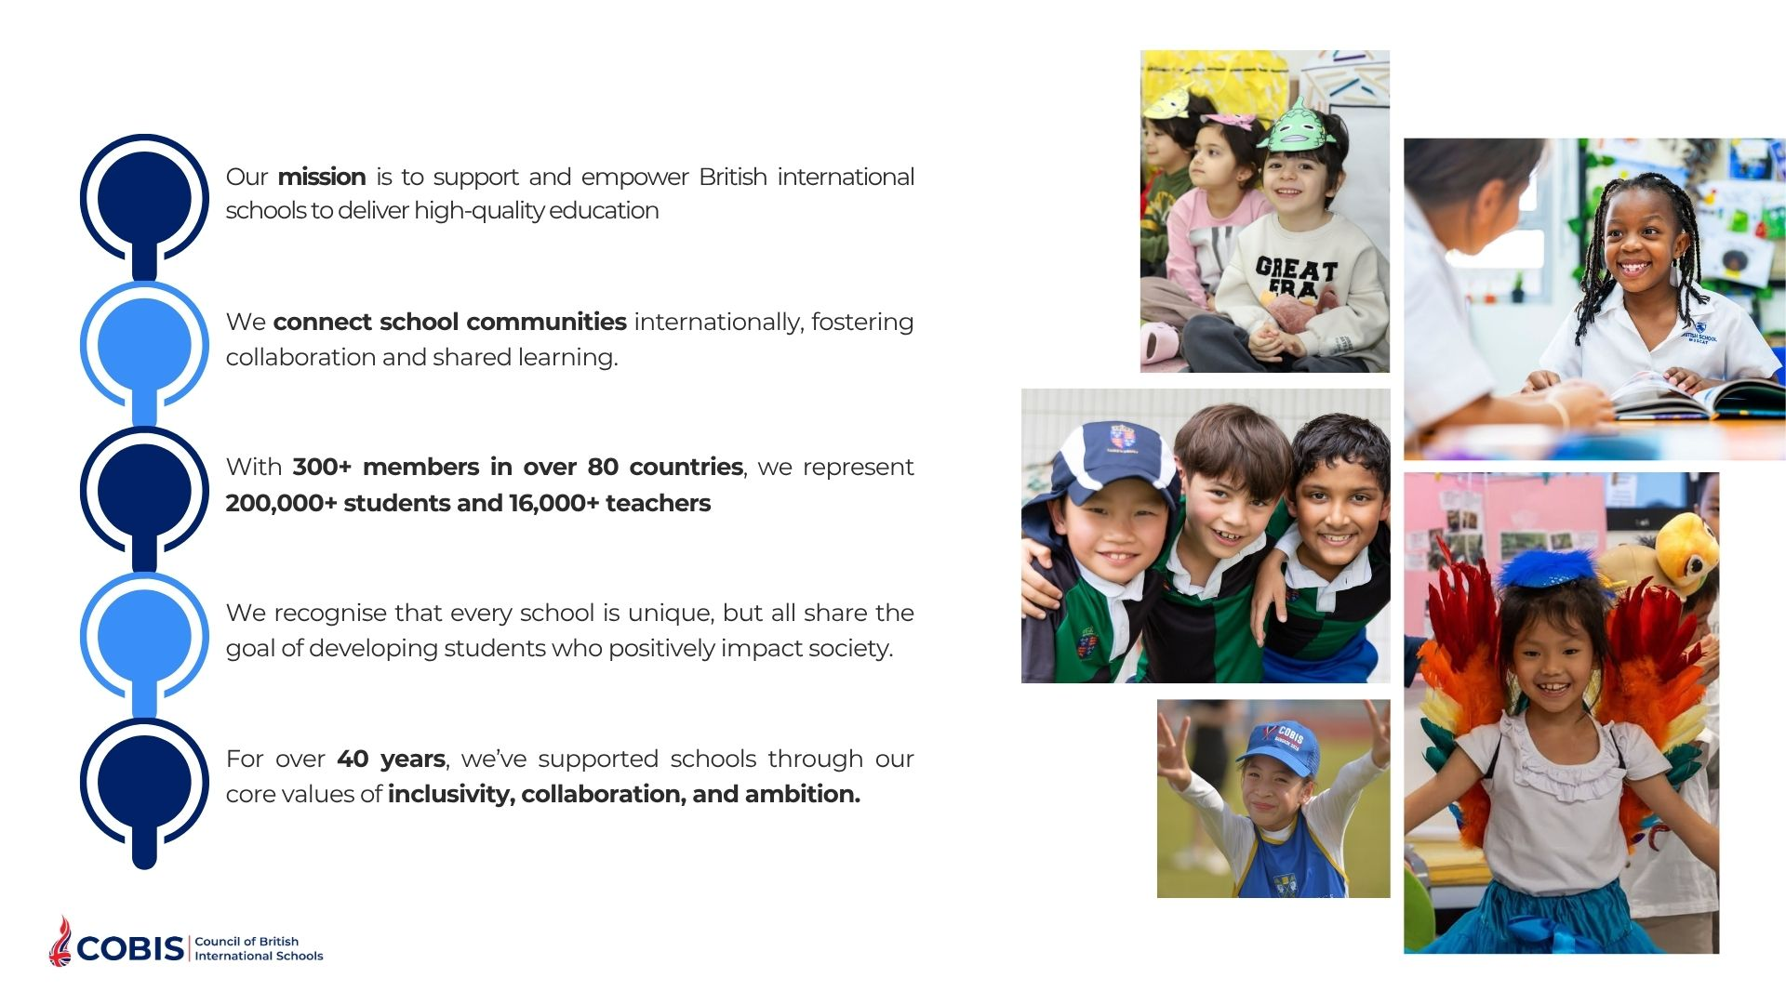
Welcome to COBIS
Your school is part of a global network that includes:
275,000+ Students
350+ Member Schools
85+ Countries
200+ Supporting Associates*
20,000+ Teachers
*businesses that work with our member schools​

Slide 3

COBIS Mission and Vision
COBIS’ Mission is to support and empower all British international schools in their provision of high-quality education.
COBIS’ Vision is to reach and connect all British international school communities in order to support them in developing students who will have a positive impact on society.

Slide 4
COBIS Guiding Principles
Our Guiding Principles, which guide how we operate and make decisions, are Inclusivity, Collaboration and Ambition.
Inclusivity
Collaboration
Ambition
We work with schools to ensure that every student and member of staff, in a broad range of school contexts, feels that they belong.
We work in partnership with others aligned with our mission, vision and guiding principles, to ensure our members flourish and receive maximum value.
We continue to challenge ourselves to innovate and grow, as always with students as our focus. We stay true to our quality provision and the integrity of our practice.

Slide 5
What COBIS Membership Means for Your School
A trusted kitemark of quality
Reassuring for parents and staff as COBIS schools adhere to high standards
Continuous support and development
Global network and representation
Safeguarding and child protection
Training for staff and staff recruitment support
Governor training and resources
Opportunities for student enrichment and global connection

Slide 6
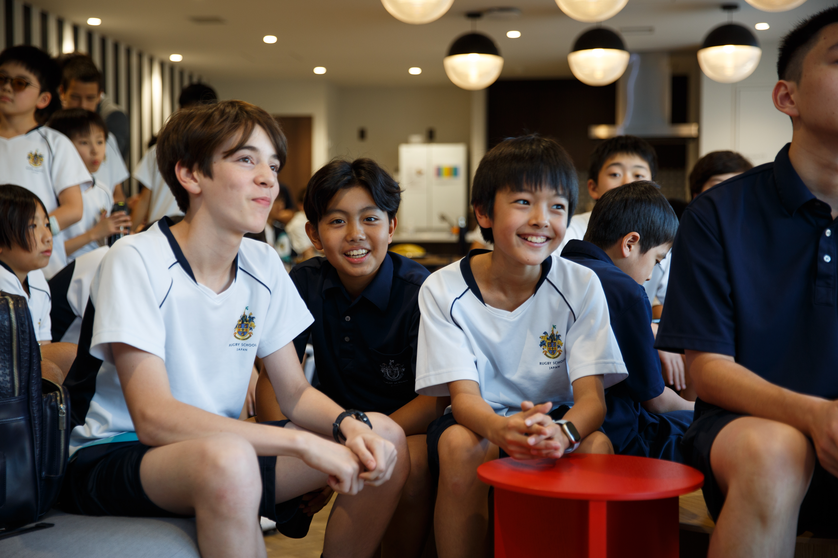
COBIS Membership Is a Kitemark of Quality
COBIS is an internationally recognised kitemark of quality. COBIS membership demonstrates that your school has met the world-class COBIS standards.
COBIS membership allows your school to be a part of a global network of high-quality British international schools.
COBIS membership also means your school has access to world-class safeguarding, professional development opportunities, and student enrichment activities, ensuring that COBIS schools deliver excellence across the board.

Slide 7

Your School Can Access:
News, emails, blogs and thought leadership
Continuing Professional Development (CPD) and reduced rates for Conferences and Training
Student Competitions and Events
Safeguarding and Safer Recruitment support through free prohibition checks
Webinars and online networking opportunities​
Lobbying and Representation
Sector Research
Staff Recruitment Support through Global Jobs service
Access to a global network
Buddy Scheme

Slide 8
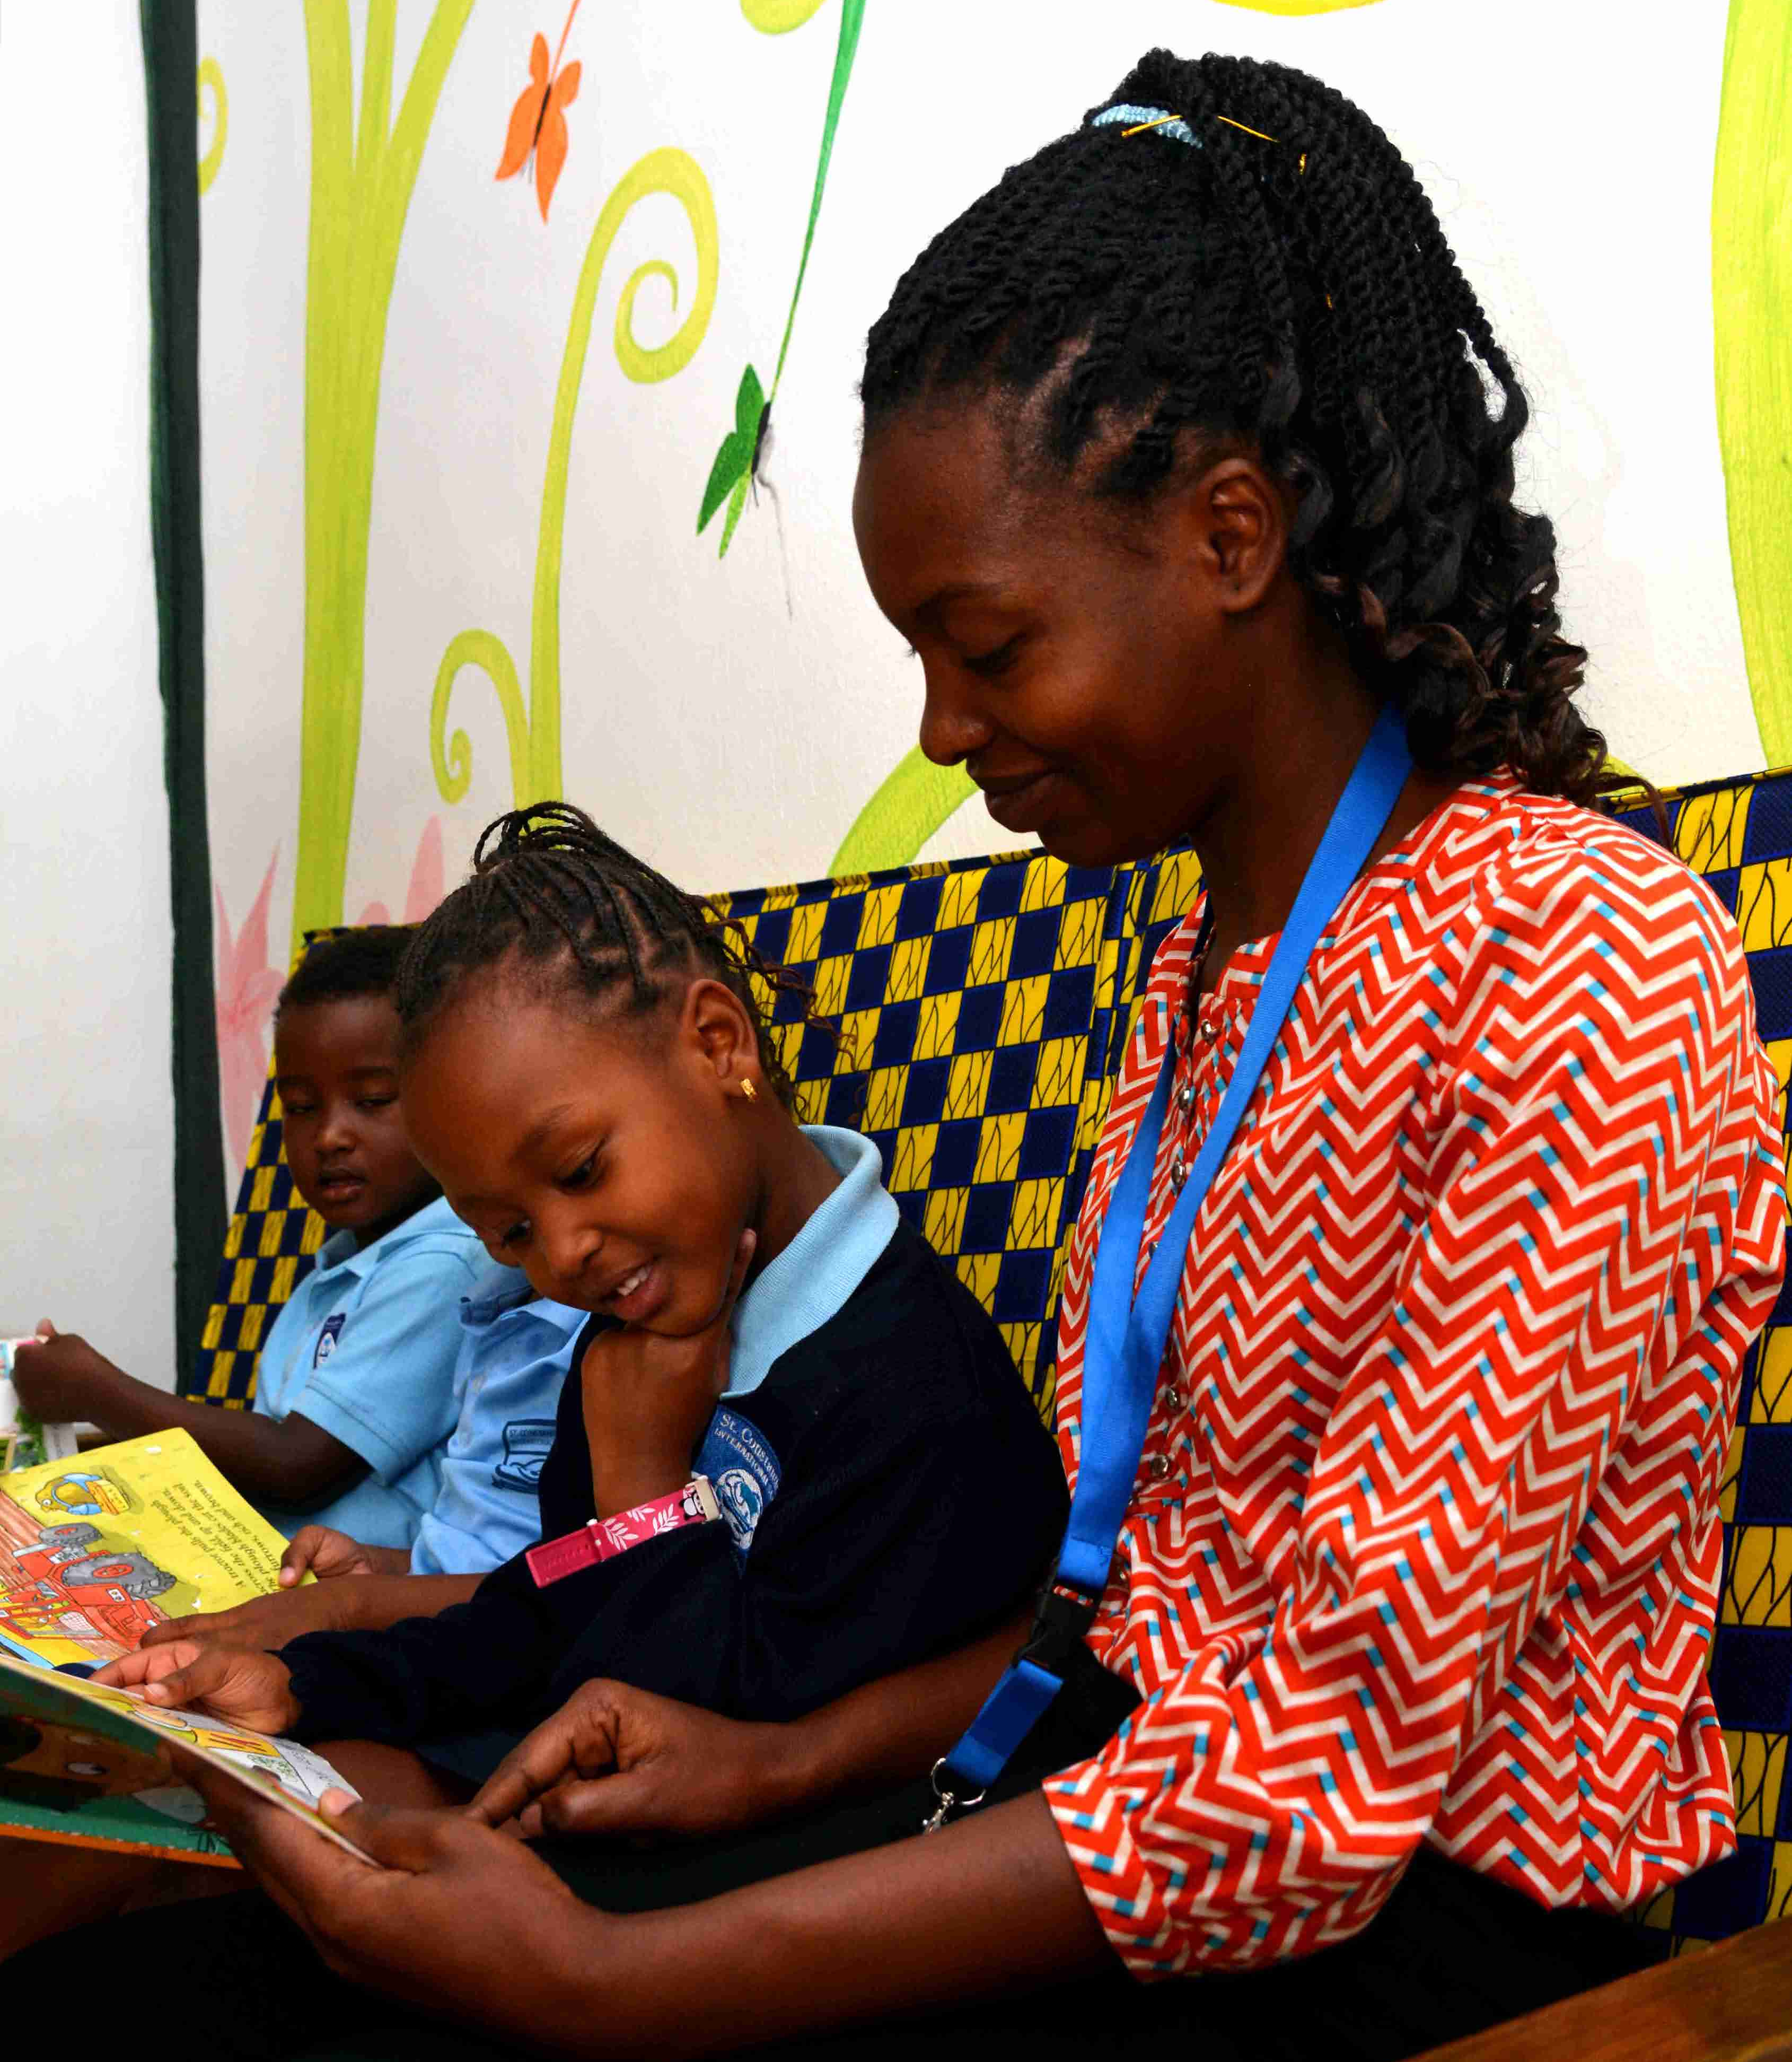
COBIS Membership Attracts Top Teachers
COBIS Membership is a trusted mark of quality. It signals to educators that the school meets rigorous standards, making it an attractive place to work.
During a survey*, member schools revealed that "Kitemark of Quality" was one of the top reasons schools joined COBIS.
COBIS also provides access to world-class professional development, helping teachers grow and improving student outcomes.
*COBIS Value Proposition Research 2025
Notes:
Work on this

Slide 9

Supporting Effective Governance and School Leadership
Governor training and resources, including safeguarding and governance guidance.
Access to the COBIS Guide to Good Governance.
Networking opportunities with governors and school leaders from across the global COBIS community.
Insights into sector trends, compliance requirements and emerging risks affecting British international schools.
Support for strategic decision-making through research, advocacy and policy engagement.
Notes:
Change this picture

Slide 10
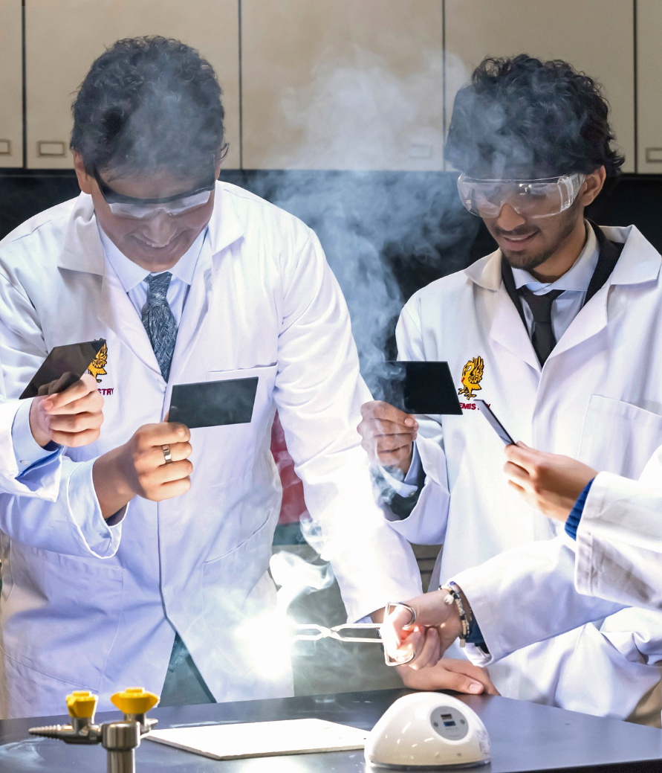
Governor Resources Include:
Child Protection and Safeguarding Training for Governors, Trustees, and School Owners
COBIS Guide to Good Governance
Safeguarding and Background Checks
COBIS Webinars, Blogs, and networking opportunities with the COBIS Network
View Governor Resources and Training

Slide 11
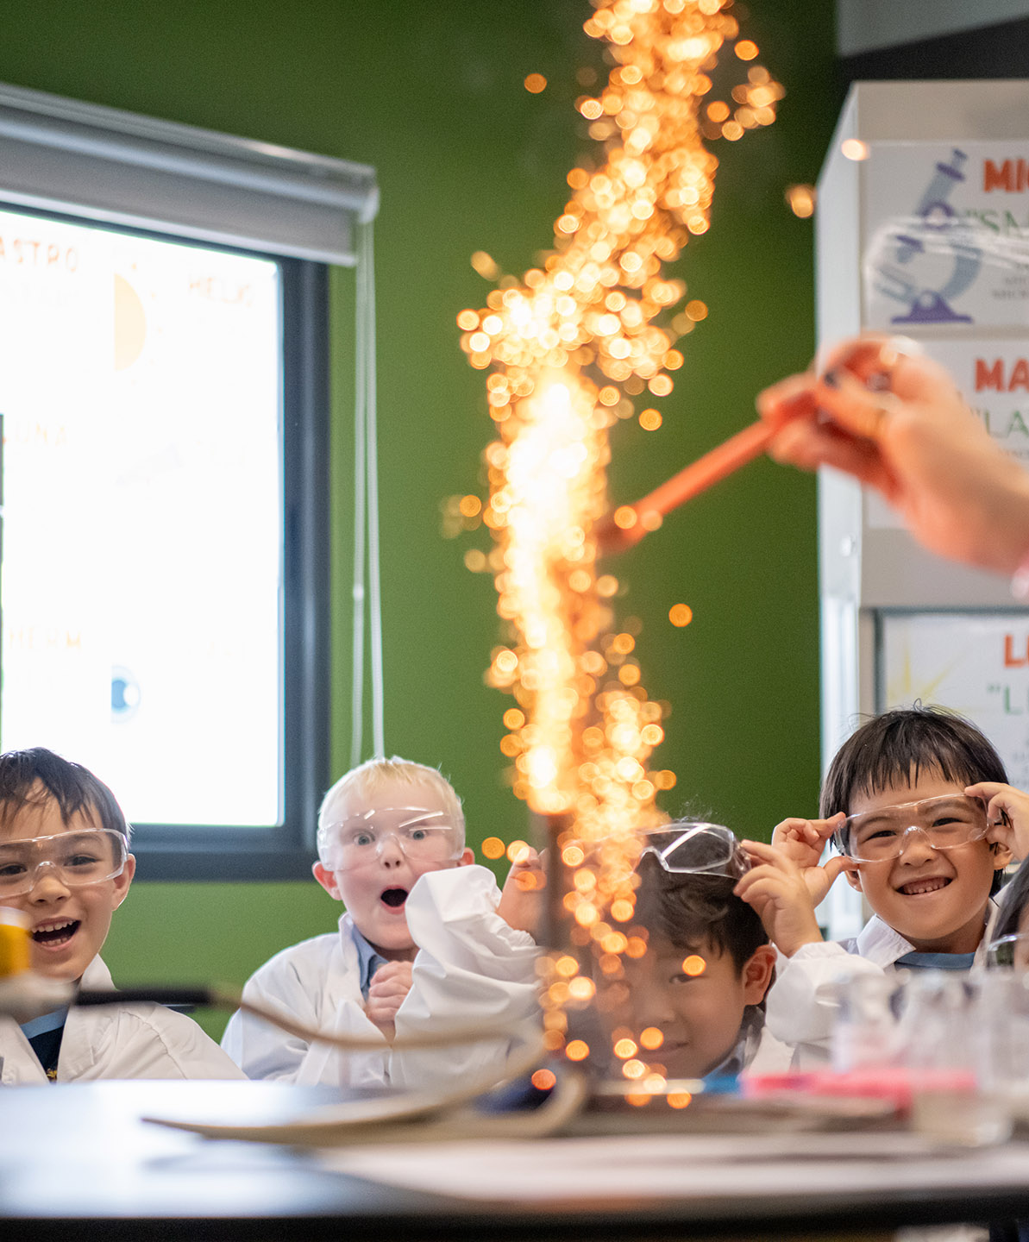
Lobbying and Influence
COBIS champions the interests of British international schools by engaging with UK government departments, including the Department for Education.
We work to shape education policy that affects global school communities and collaborate with sector partners to present a united voice on key issues.
We also engage in direct dialogue with policymakers to ensure fair recognition and support, and to promote the value and contribution of British schools overseas on the global stage.
COBIS Lobbying

Slide 12


Working With Local Governments
COBIS collaborates with local governments to support Member schools.
We help schools navigate local regulations and promote adherence to both local requirements and COBIS standards.
We ensure that British international schools maintain high-quality education while respecting the legal and cultural frameworks of their host countries.
COBIS Accreditation also helps ensure schools aligns with both UK and international regulatory expectations as COBIS Accreditation and Compliance scheme is externally validated by the UK Quality Assurance Agency for Higher Education (QAA).
We represent the needs of our sector in ongoing discussions with the UK Government and international ministries.
COBIS sheds light on topics like international teacher training, safeguarding, pre-employment checks, quality assurance, curriculum, assessment redesign, visas and mobility of teachers at these forums.
Notes:
Work on this

Slide 13
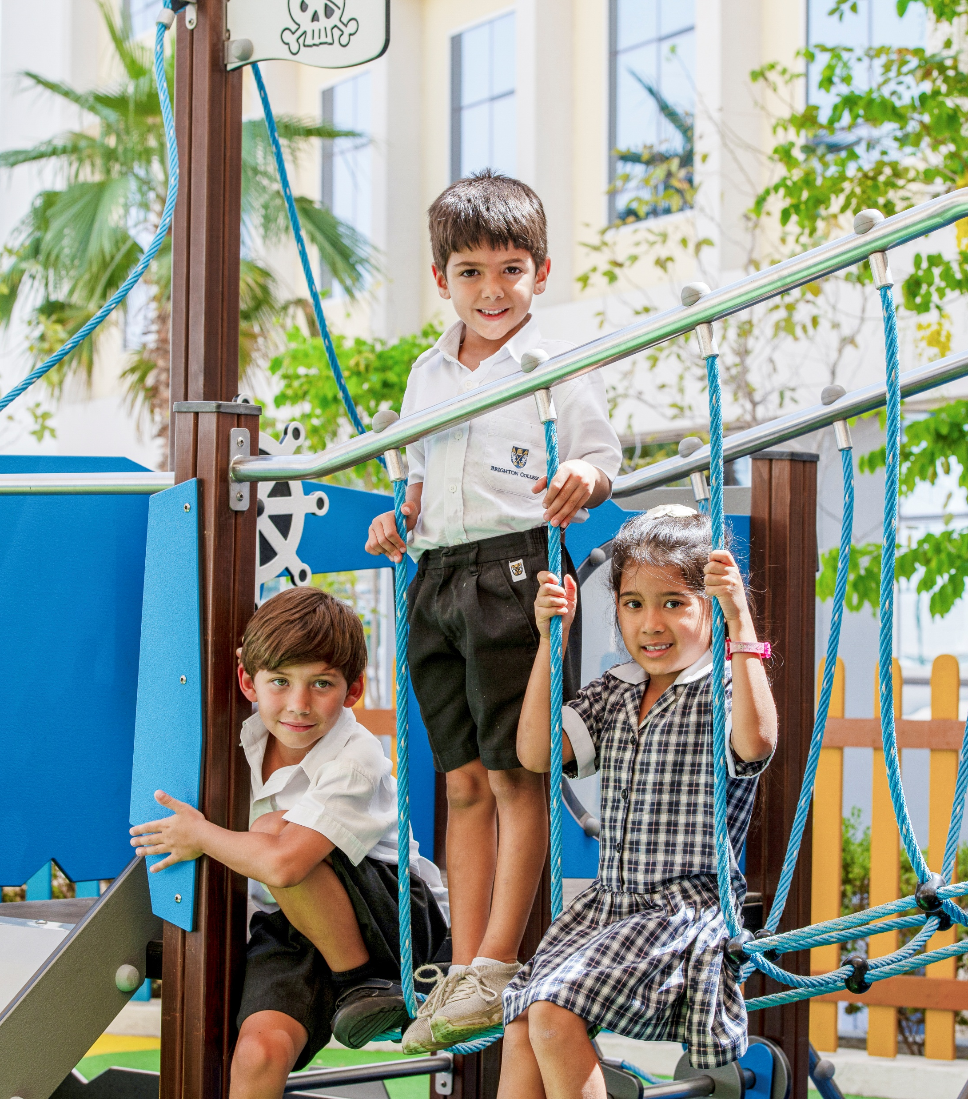
Safeguarding
We believe that children, young people and vulnerable adults should never experience abuse of any kind.
We have an unfaltering commitment to promote the welfare of all children, young people and vulnerable adults to keep them safe.
COBIS is committed to reducing risk connected to all safeguarding and child protection matters.
Check out more information about COBIS Safeguarding

Slide 14
How can your staff access Safeguarding support?
Access vital pre-employment checks: The International Child Protection Certificate (ICPC) and free prohibition checks to support schools to make informed decisions.
Training: Advanced Training for Designated Safeguarding Leads, Safer Recruitment in International Schools.
At COBIS, we have a dedicated Safeguarding Officer who is on hand to support and regular Safeguarding updates to keep you up to date with Safeguarding regulations.
Access COBIS Global Jobs to support safer school recruitment.
The Safeguarding Alliance: Our partnership with The Safeguarding Alliance includes training, audits, templates, safeguarding helpline and resources to help Designated Safeguarding Leads (DSLs) and school leaders ensure robust safeguarding practices.

Slide 15
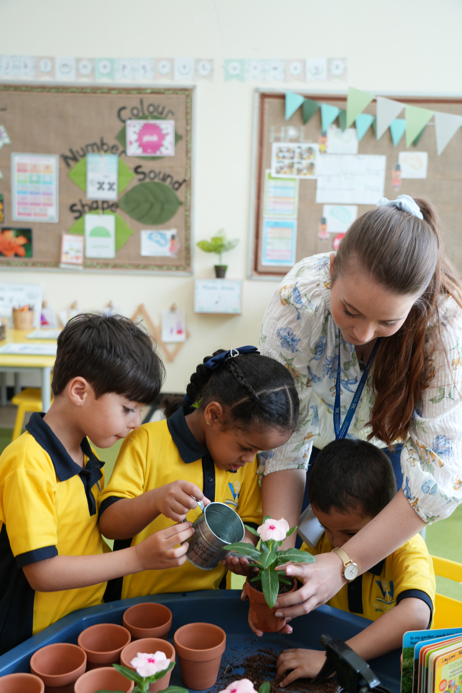
How COBIS Supports Strategic Workforce Sustainability
We help schools attract and retain high-quality staff through a globally recognised kitemark of quality.
We support safer recruitment through safeguarding checks and recruitment guidance.
We provide access to professional development opportunities that improve staff retention and career progression.
We enable governors and senior leaders to benchmark practices against leading British international schools worldwide.
Notes:
Work on this

Slide 16

COBIS Supporting
Associate Network
COBIS Supporting Associates include a wide range of educational companies and consultants which provide services to international schools.
We recommend you consider our Supporting Associates when you're looking for new products and services for your school. A directory of all Supporting Associates is on our website.
Check out more information about COBIS Supporting Associates

Slide 17
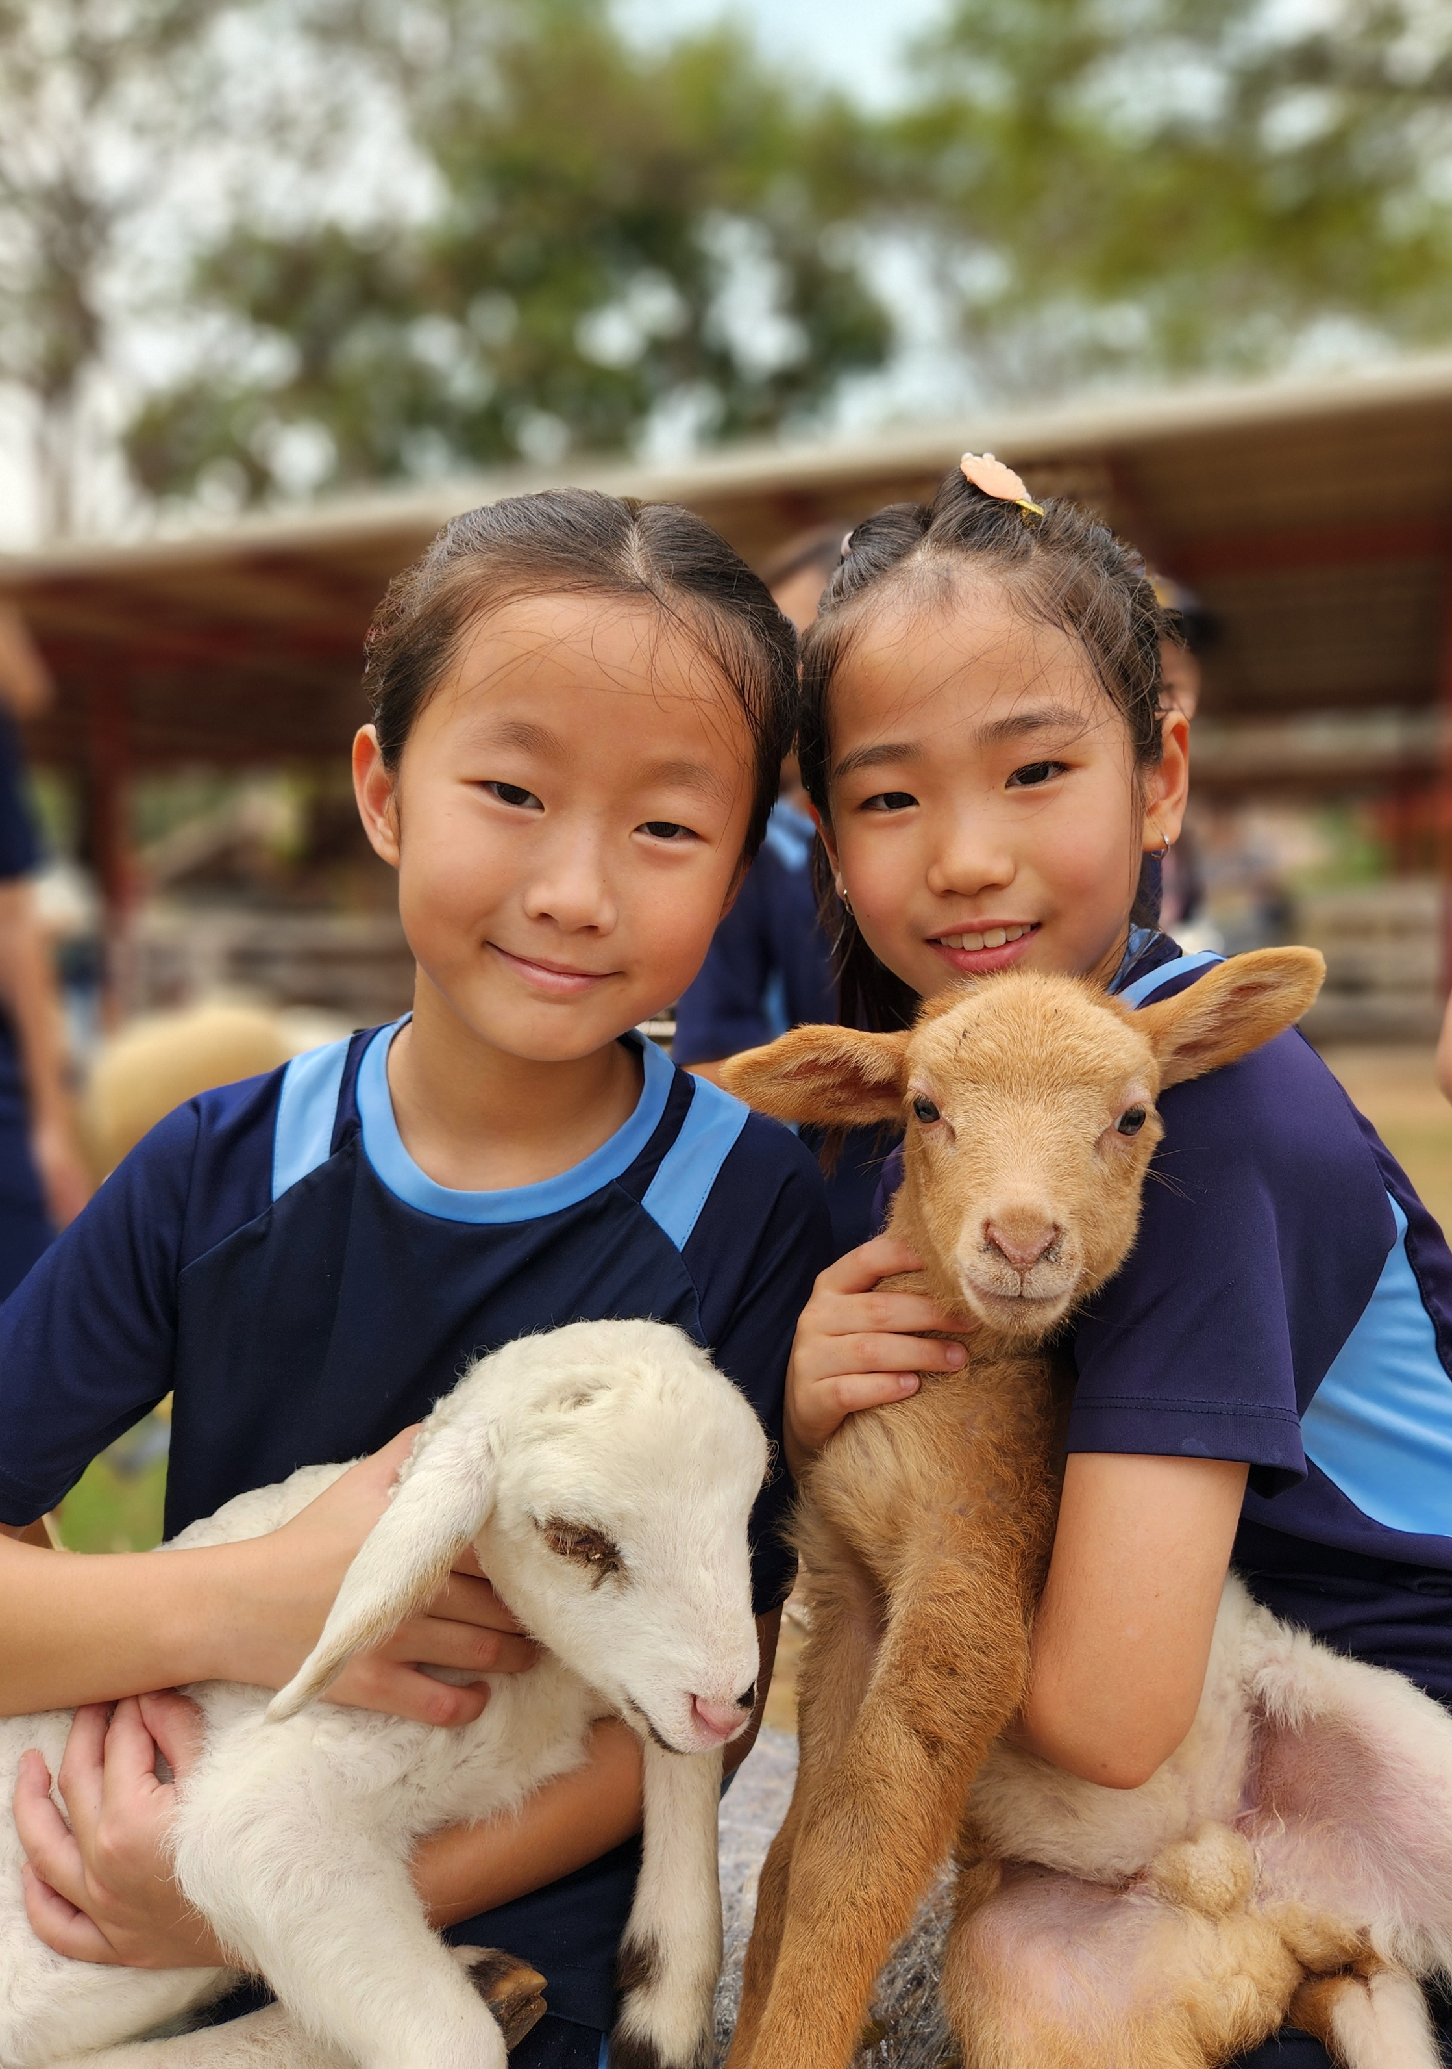
COBIS Accreditation Is Backed by External Validation
COBIS Accreditation is the primary route to COBIS membership. Founded in 2017, the scheme was externally validated and commended by the UK Quality Assurance Agency (QAA).
This recognition reinforces our commitment to maintaining the highest standards in international education and school accreditation.
“They are the number one British organisation for accrediting schools around the world, and they have the reputation that goes with that. We wanted to get that kitemark of quality.”
The King’s School Vattanacville – Accredited Member (COBIS)

Slide 18
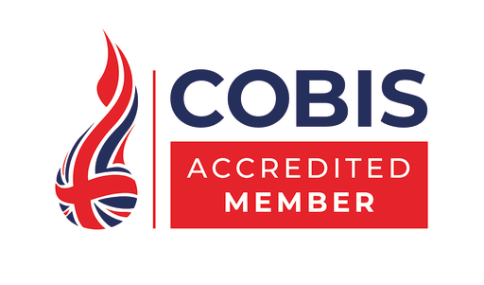







Routes to COBIS Membership:
Member schools must renew their quality assurance every five years in order to retain their membership and meet our high standards. This can be done either through the COBIS Accreditation or Compliance scheme, or through the BSO or ISI inspection or CIS, NEASC, WASC or OEAS accreditation routes. This upholds high standards within the COBIS network.
cobis.org.uk

Slide 19

Hear From Our Schools
"COBIS membership gives us opportunities for myself and for my staff and students that we really relish, and it gives us something we just would not have had otherwise."
Kyoto International School, Accredited Member (WASC)
"Aside from CPD and Safeguarding support, we’re looking forward to making connections between different schools around the world."
The King’s School Vattanacville, Accredited Member (COBIS)
Get in touch and tell us why COBIS is important to your school community
cobis.org.uk

Slide 20







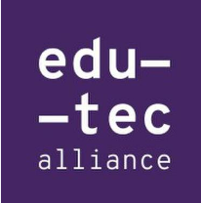







Our Partners

Slide 21


Thank You!
If you have any questions, please contact the COBIS Director of Membership and Engagement, Natalie Williams: natalie.williams@cobis.org.uk
Or visit our website
www.cobis.org.uk
Facebook
Instagram
LinkedIn
We're Here to Help – Meet the Team

