Slide 1
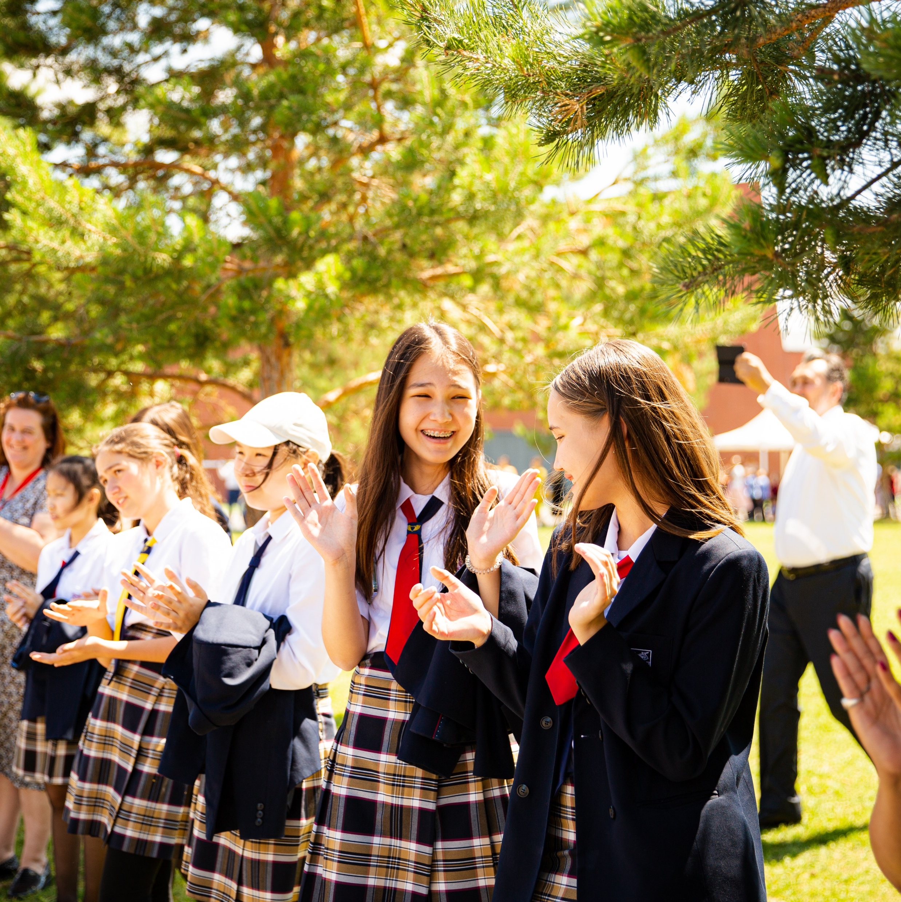


Your COBIS Membership
2026/2027

Slide 2
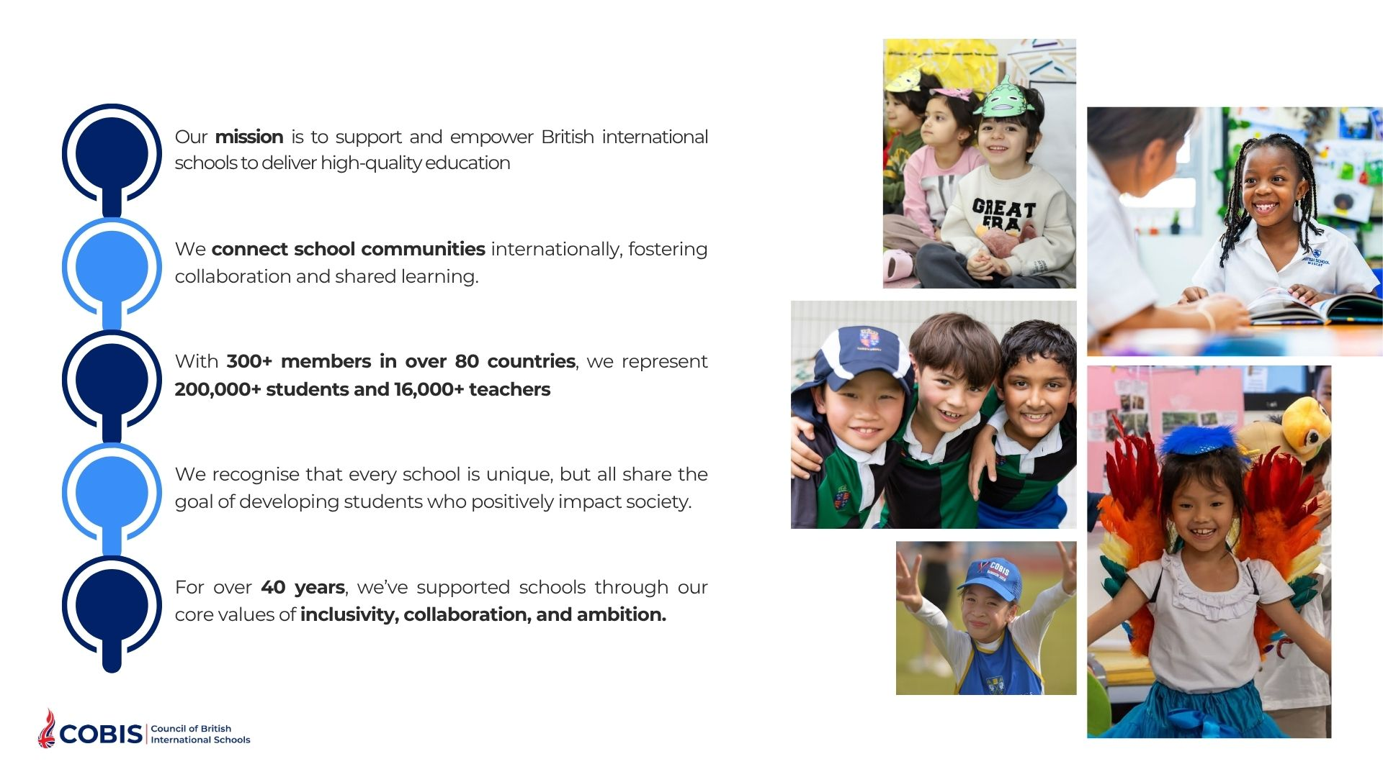
Welcome to COBIS
Your school is part of a global network that includes:
275,000+ Students
350+ Member Schools
85+ Countries
200+ Supporting
Associates*
20,000+ Teachers
*businesses that work with our member schools

Slide 3
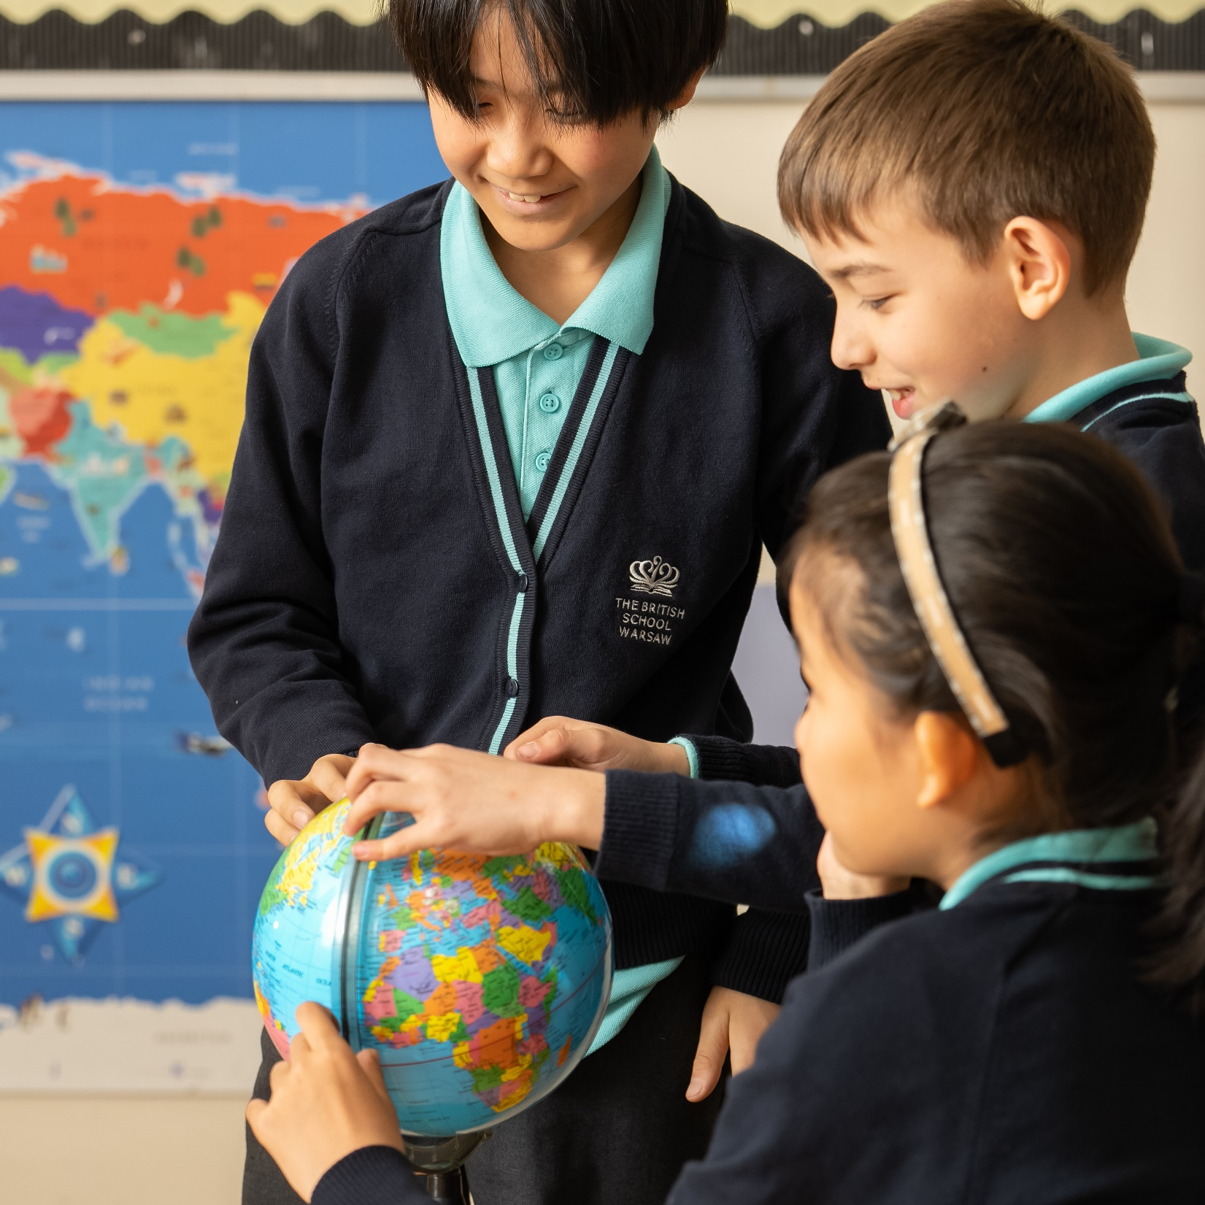
COBIS Mission and Vision
COBIS’ Mission is to support and empower all British international schools in their provision of high-quality education.
COBIS’ Vision is to reach and connect all British international school communities in order to support them in developing students who will have a positive impact on society.

Slide 4
COBIS Guiding Principles
Our Guiding Principles, which guide how we operate and make decisions, are Inclusivity, Collaboration and Ambition.
Inclusivity
Collaboration
Ambition
We work with schools to ensure that every student and member of staff, in a broad range of school contexts, feels that they belong.
We work in partnership with others aligned with our mission, vision and guiding principles, to ensure our members flourish and receive maximum value.
We continue to challenge ourselves to innovate and grow, as always with students as our focus. We stay true to our quality provision and the integrity of our practice.

Slide 5
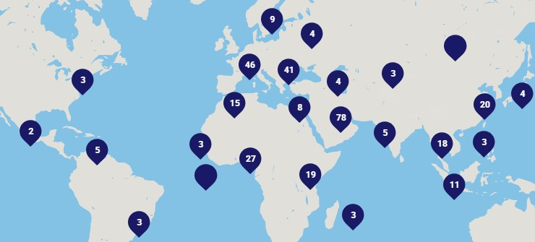
You Are Part of a Global Community of Schools

Slide 6

You and Your School Can Access:
News, emails, blogs and thought leadership
Continuing Professional Development (CPD) and reduced rates for Conferences and Training
Student Competitions and Events
Safeguarding and Safer Recruitment support through free prohibition checks
Webinars and online networking opportunities​
Lobbying and Representation
Sector Research
Staff Recruitment Support through Global Jobs service
A global network of professionals in British international schools
Buddy Scheme

Slide 7
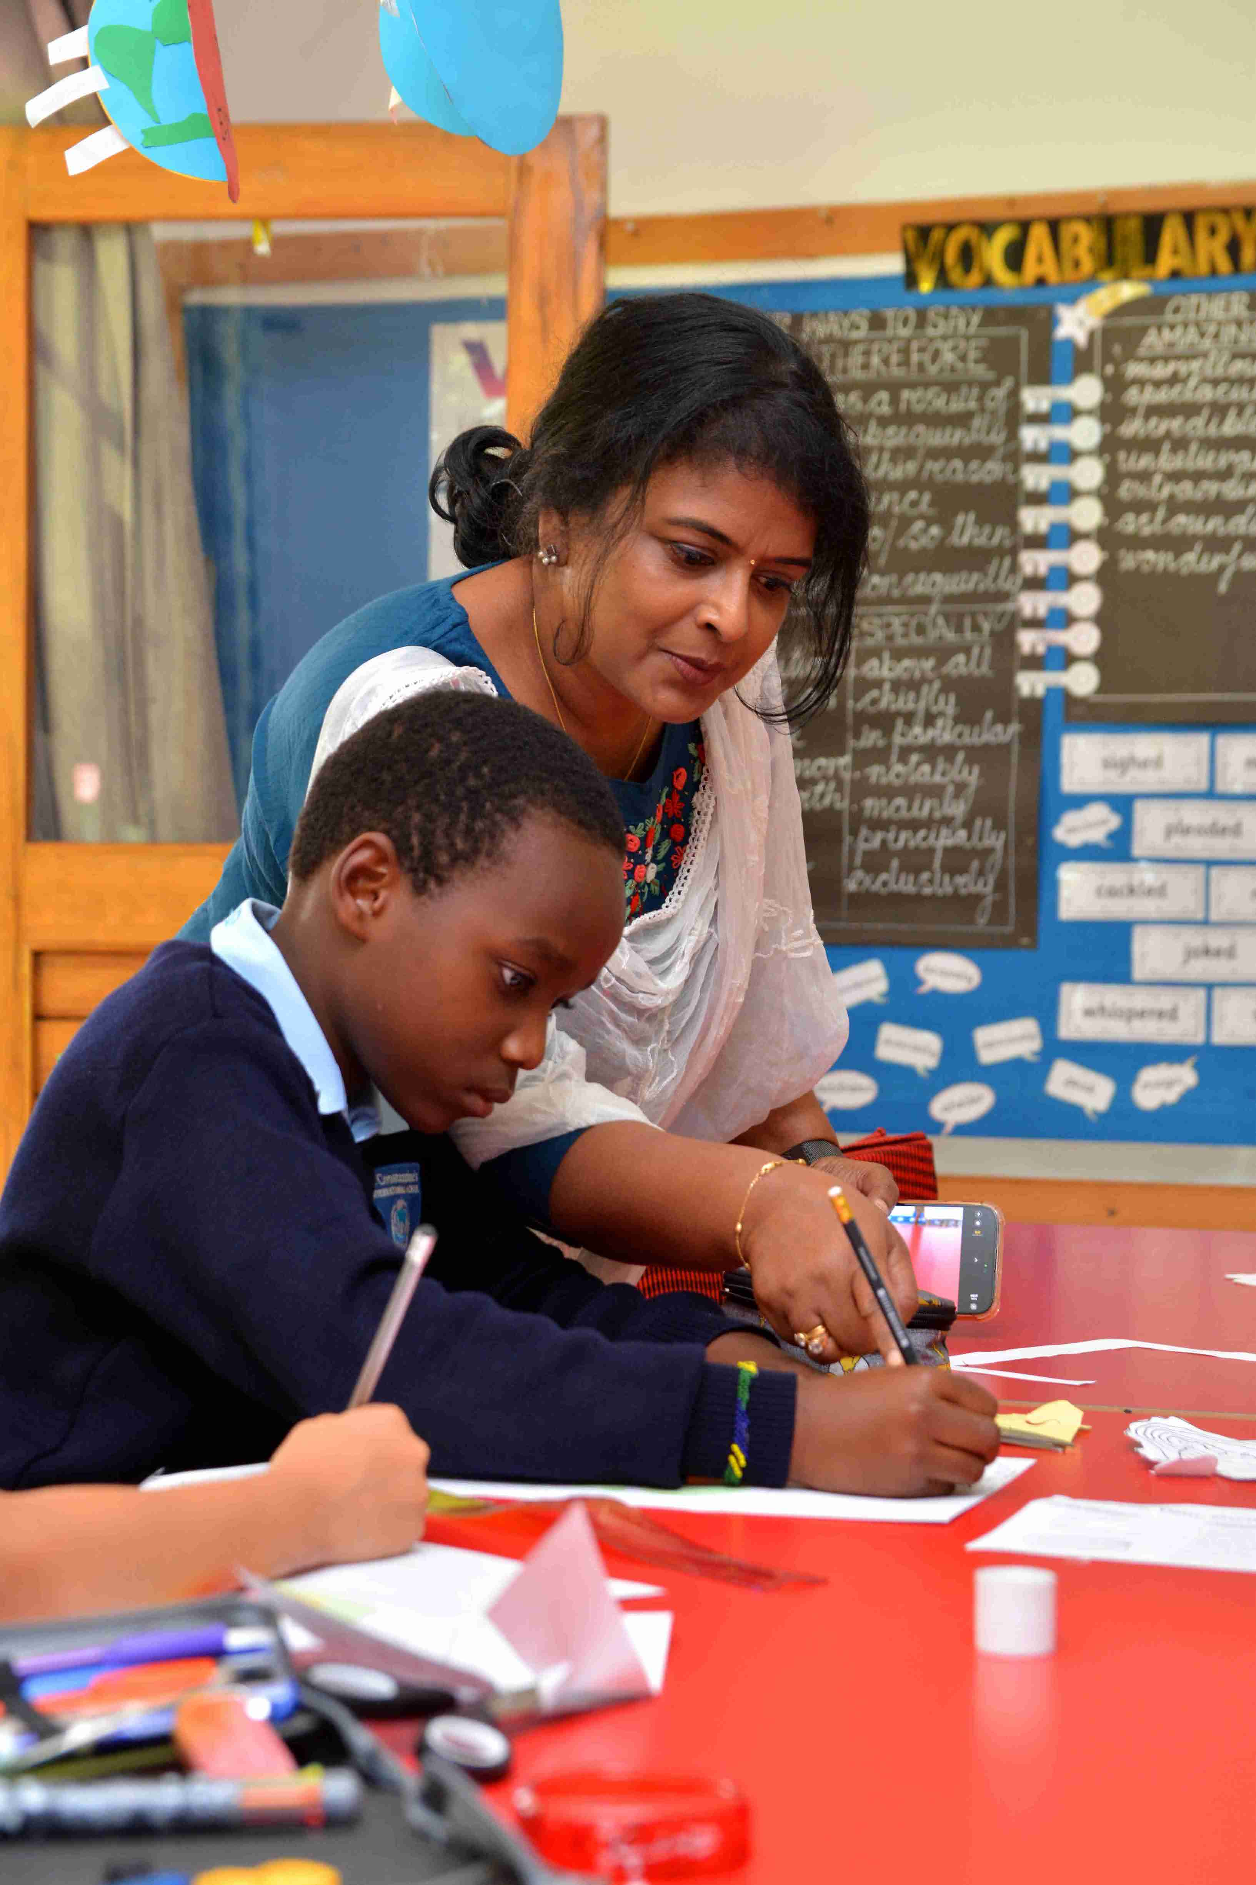
Professional Development
COBIS offers a wide range of professional learning opportunities for all members of the school workforce.
We offer online and in-person training designed to advance your career and set you and your school up for success.

Slide 8
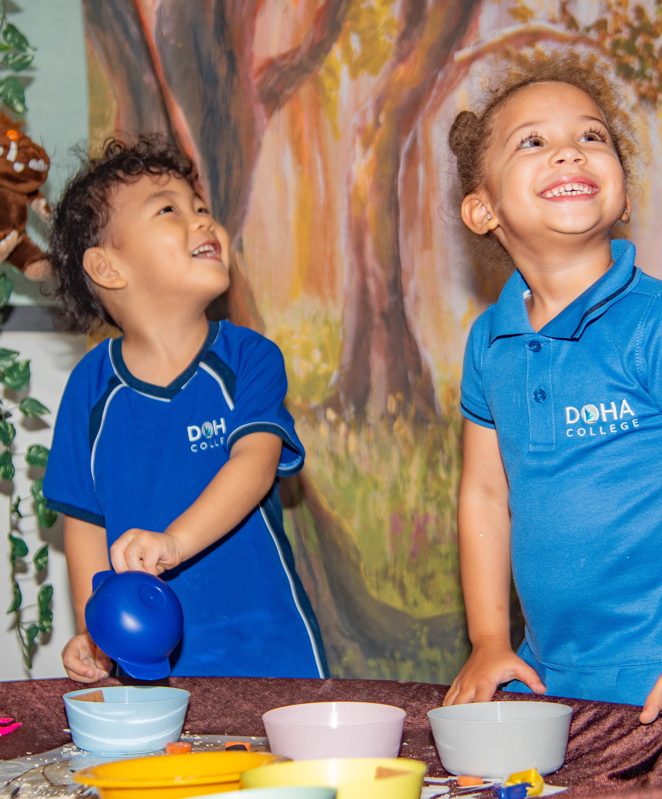
Online Courses
Diplomas for International Teaching Assistants.
Advanced Training for Designated Safeguarding Leads.
Safer Recruitment in International Schools.
COBIS Programme for Early Career Teachers.
In-Person CPD
Conference for Bursars, Business Managers and HR Staff.
Conference for Marketing, Development and Admissions Staff.
COBIS Annual Conference.
Blended
COBIS Programme for Middle Leaders.
COBIS Programme for Aspiring Heads.
Check out more of our CPD calendar

Slide 9

Connect With the COBIS Network
Online networking with the COBIS community around the world.
Webinars from COBIS schools sharing insights and knowledge.
Blogs and articles shared from school leaders around the world.
In-person and online training to learn from other British international schools.

Slide 10
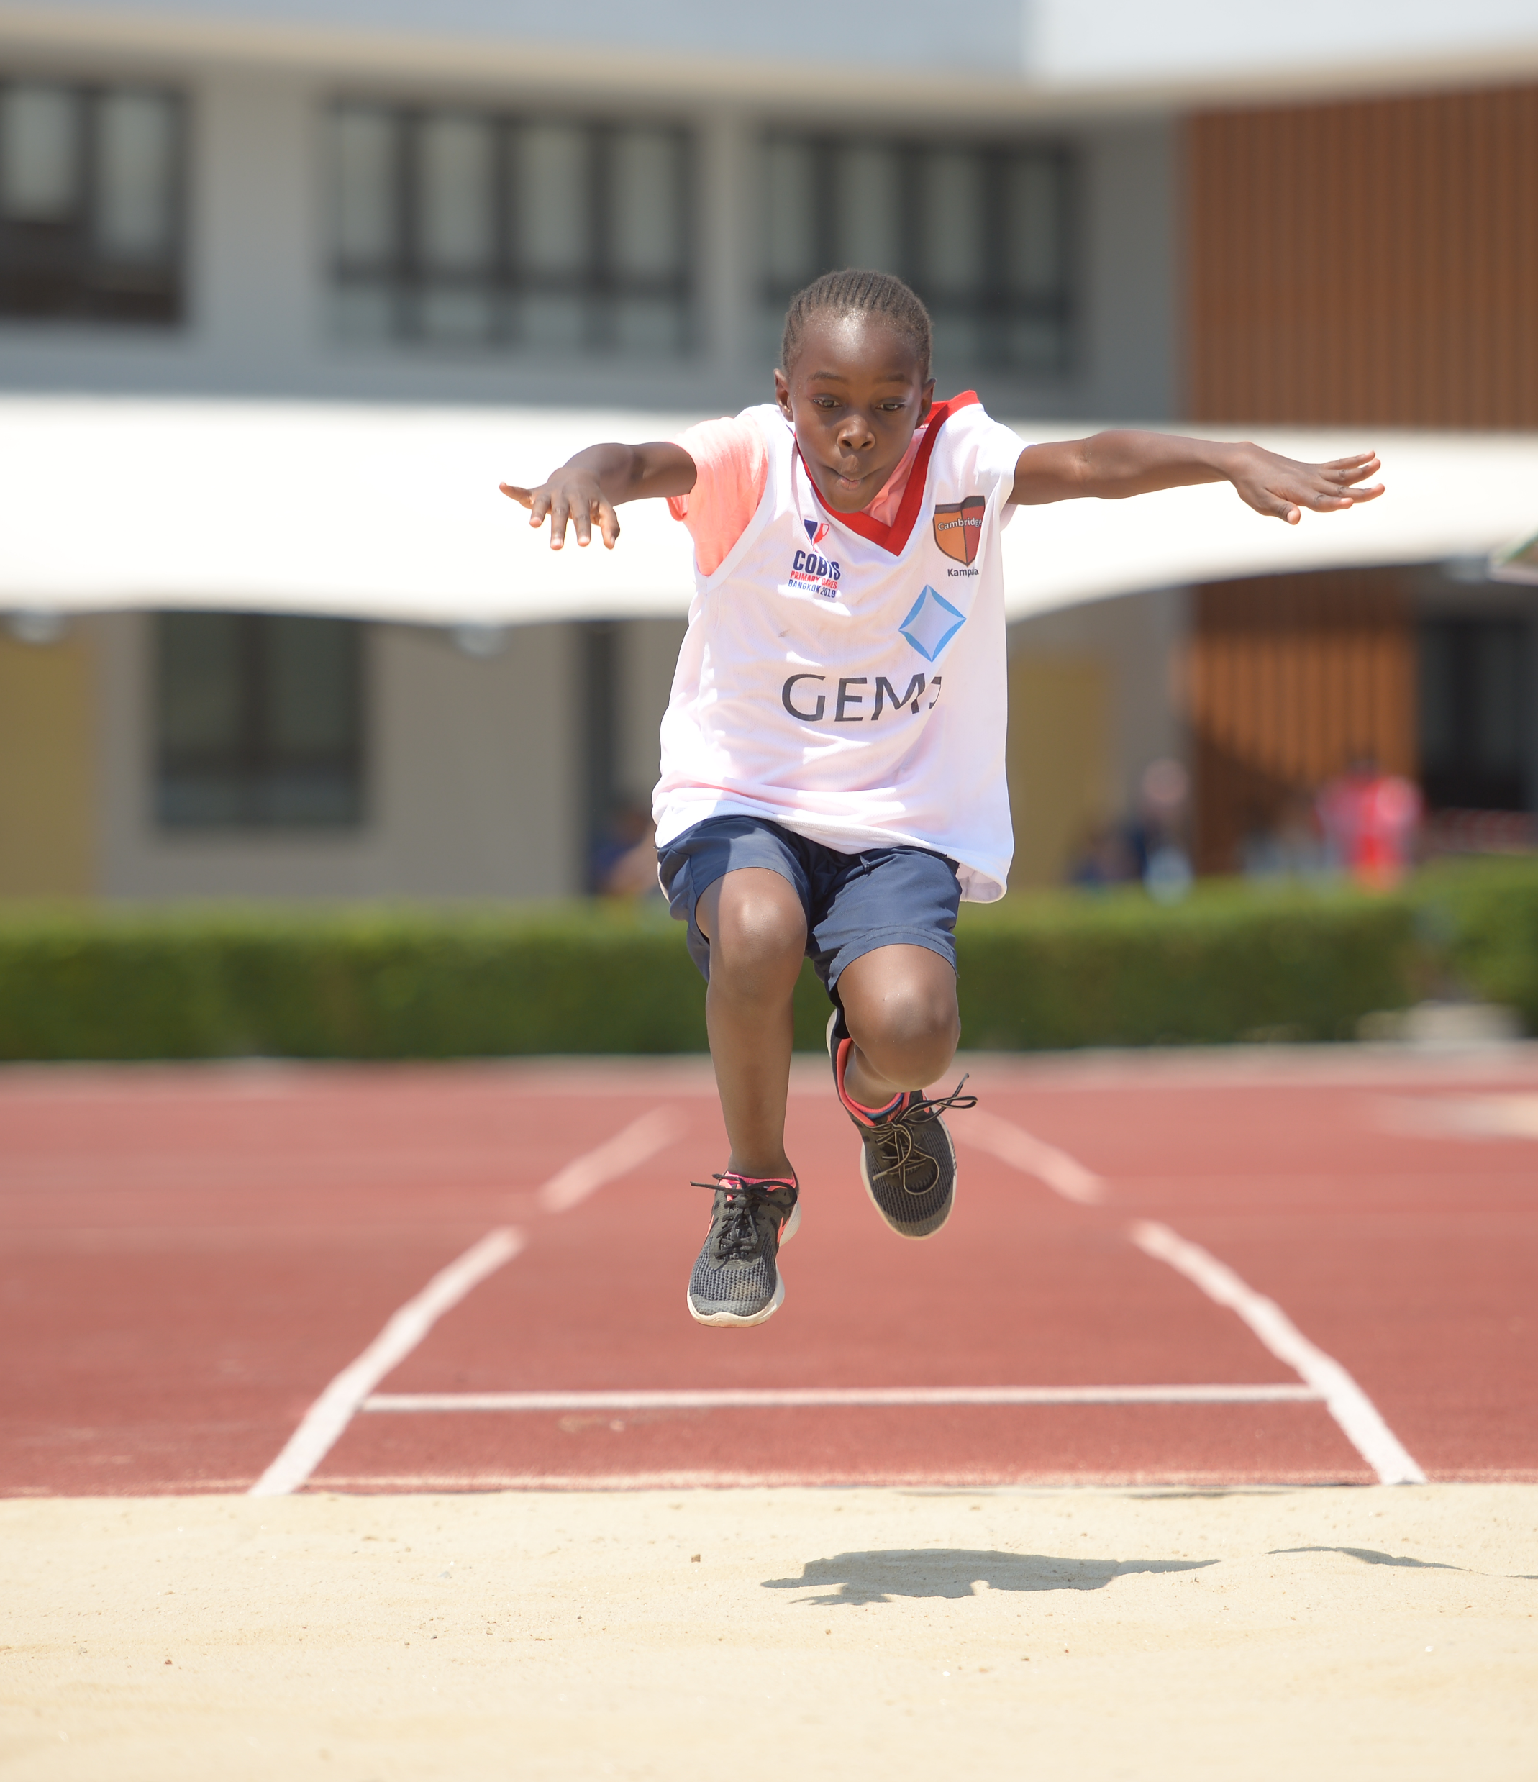
Student Events and Competitions
Our student activities include virtual and in-person events, competitions and awards. Through these activities, students showcase their talents on a global stage and forge friendships with others from around the world.
Our student events include art, poetry, student leadership, Esports, drama, MUN, music festivals, student achievement awards and much more.
Check out our student calendar for more information

Slide 11
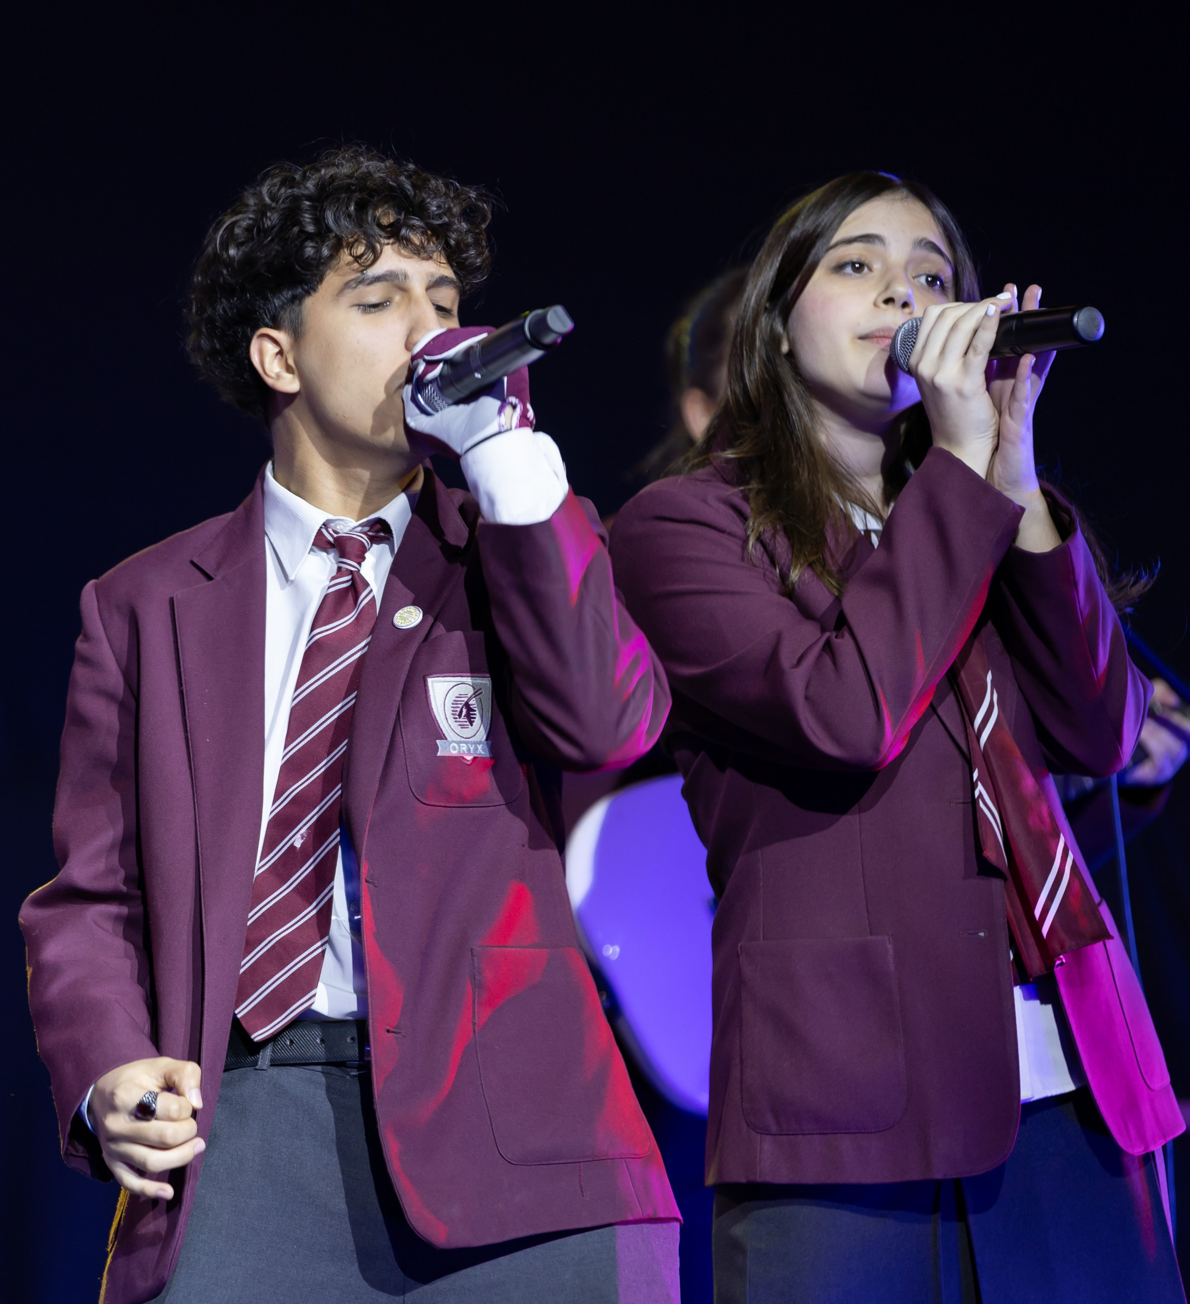
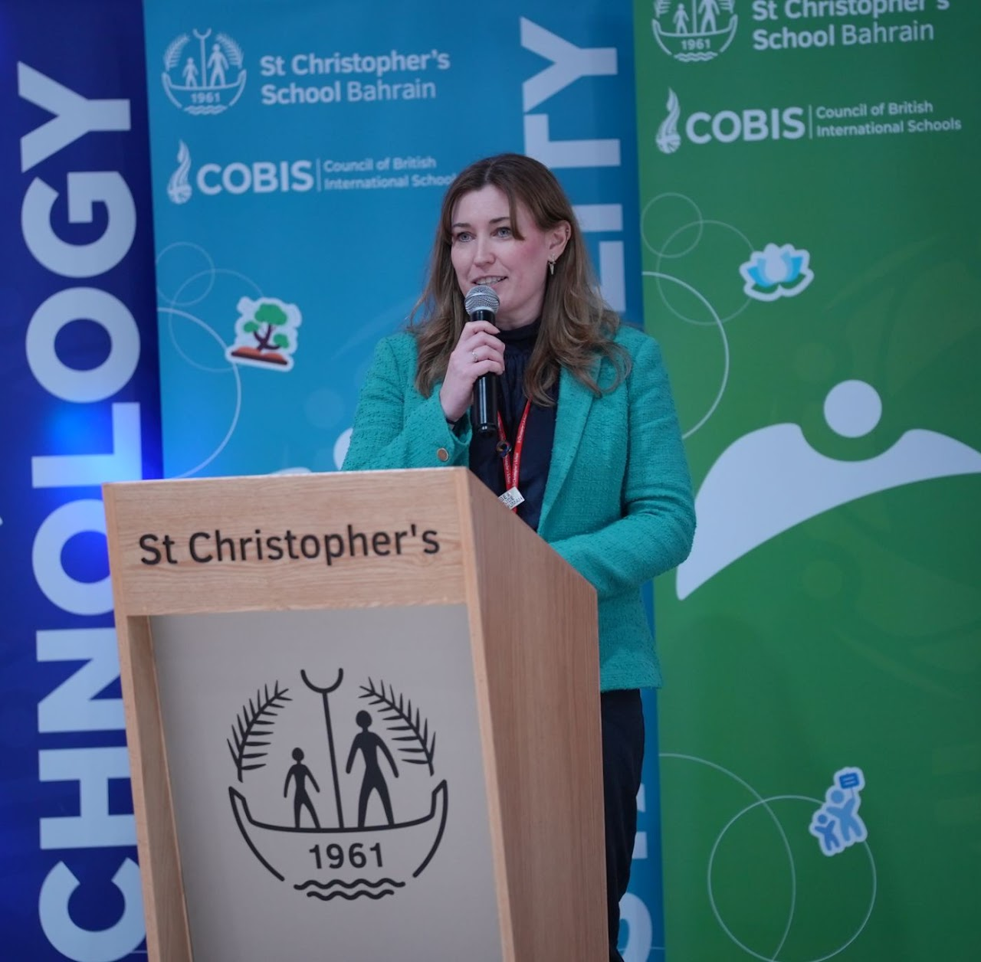
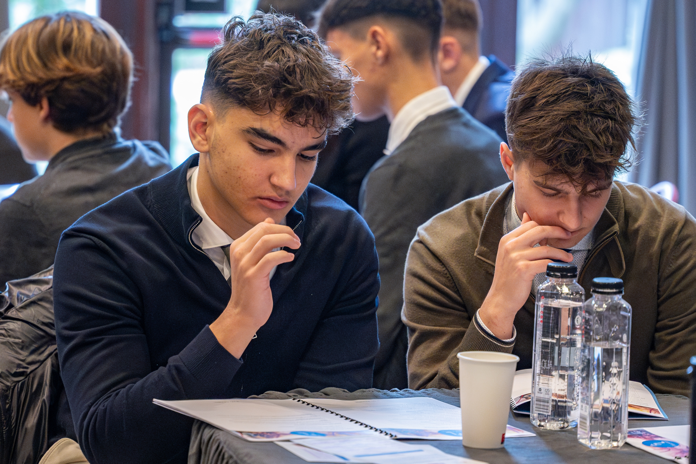
COBIS School-Led Events
Musical Theatre Festival, hosted by Tanglin Trust School
COBIS Regional Teachers’ Conference (in association with CCAAIBWS), hosted by European Azerbaijan School
Student Leadership Weekend, hosted by British School of Bucharest
Model United Nations, hosted by St Julian’s School Lisbon
COBIS Conference for Bursars, Business Managers and HR Staff, hosted by St George’s International School Luxembourg

Slide 12
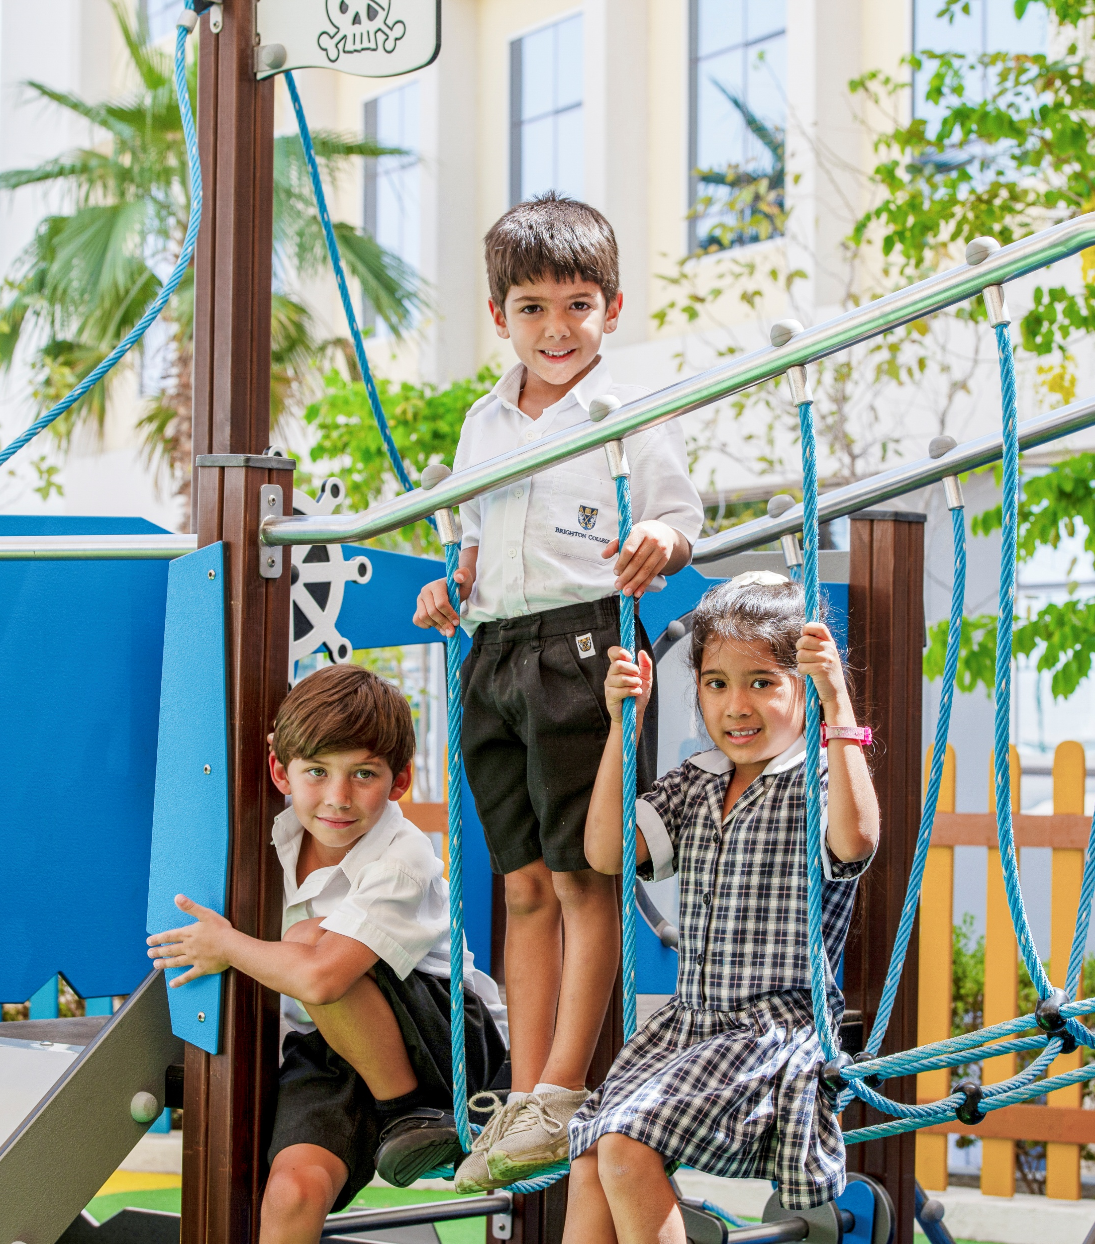
Safeguarding
We believe that children, young people and vulnerable adults should never experience abuse of any kind.
We have an unfaltering commitment to promote the welfare of all children, young people and vulnerable adults to keep them safe.
Check out more information about COBIS Safeguarding

Slide 13
How can you and your colleagues access Safeguarding support?
Access vital pre-employment checks: The International Child Protection Certificate (ICPC) and free prohibition checks to support schools to make informed decisions.
Training: Advanced Training for Designated Safeguarding Leads, Safer Recruitment in International Schools.
At COBIS, we have a dedicated Safeguarding Officer who is on hand to support and regular Safeguarding updates to keep you up to date with Safeguarding regulations.
Complete safer recruitment training and certification and utilise COBIS Global Jobs for school recruitment.
The Safeguarding Alliance: This includes training, audits, templates, safeguarding helpline and resources to help Designated Safeguarding Leads (DSLs) and school leaders ensure robust safeguarding practices.

Slide 14
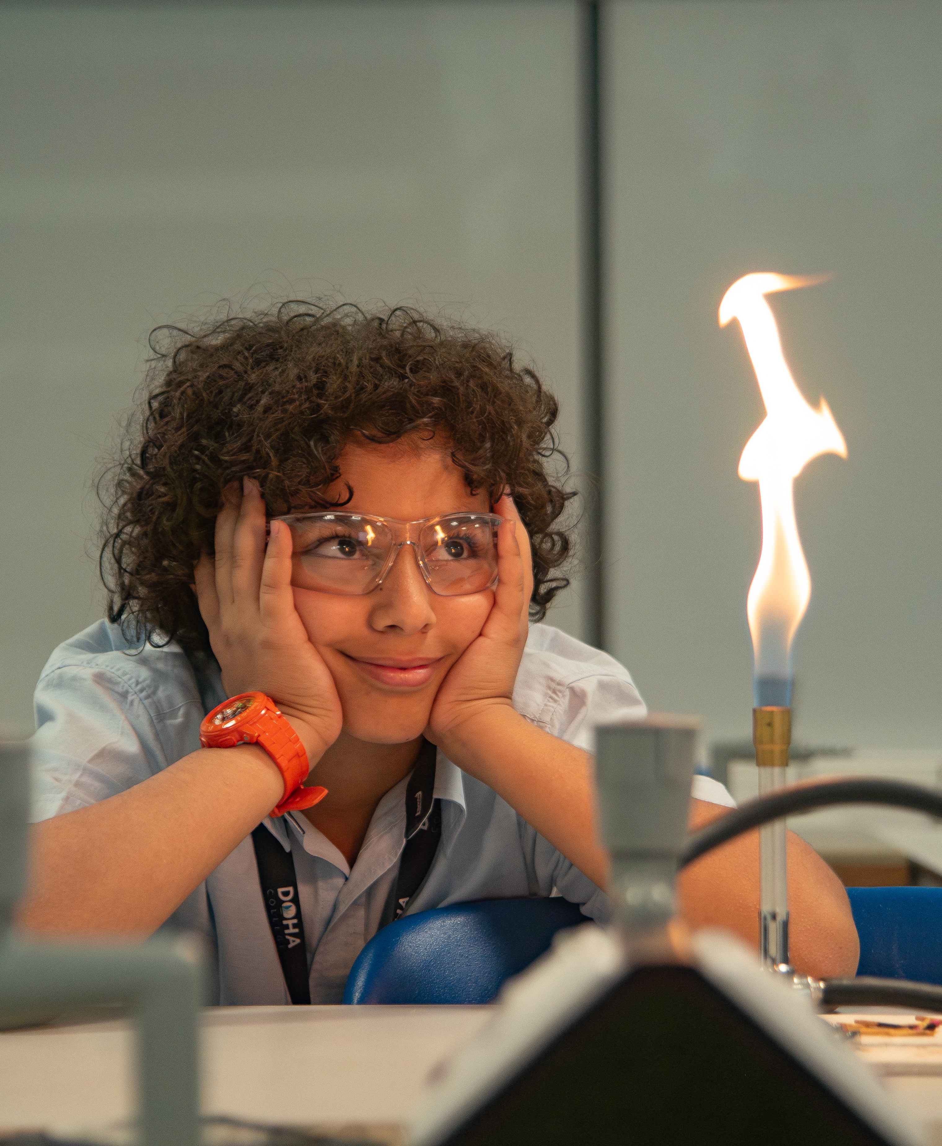
COBIS Supporting
Associate Network
COBIS Supporting Associates include a wide range of educational companies and consultants which provide services to international schools.
We recommend you consider our Supporting Associates when you're looking for new products and services for your school. A directory of all Supporting Associates is on our website.
Check out more information about COBIS Supporting Associates

Slide 15

How Can COBIS Members Get Involved and Share Their Stories?
Write blogs for the COBIS website
Represent your school at national and international conferences. Speaker opportunities available.
Host COBIS webinars to share insights and expertise on relevant topics.
Follow COBIS on social media for the latest news, webinars, training opportunities, and updates from across the COBIS network. COBIS can also share social media posts on behalf of schools.
Access COBIS Members' Area, for a comprehensive suite of tools and resources designed to support your school community.
Contribute to COBIS research, global analysis projects, and governmental lobbying efforts.

Slide 16
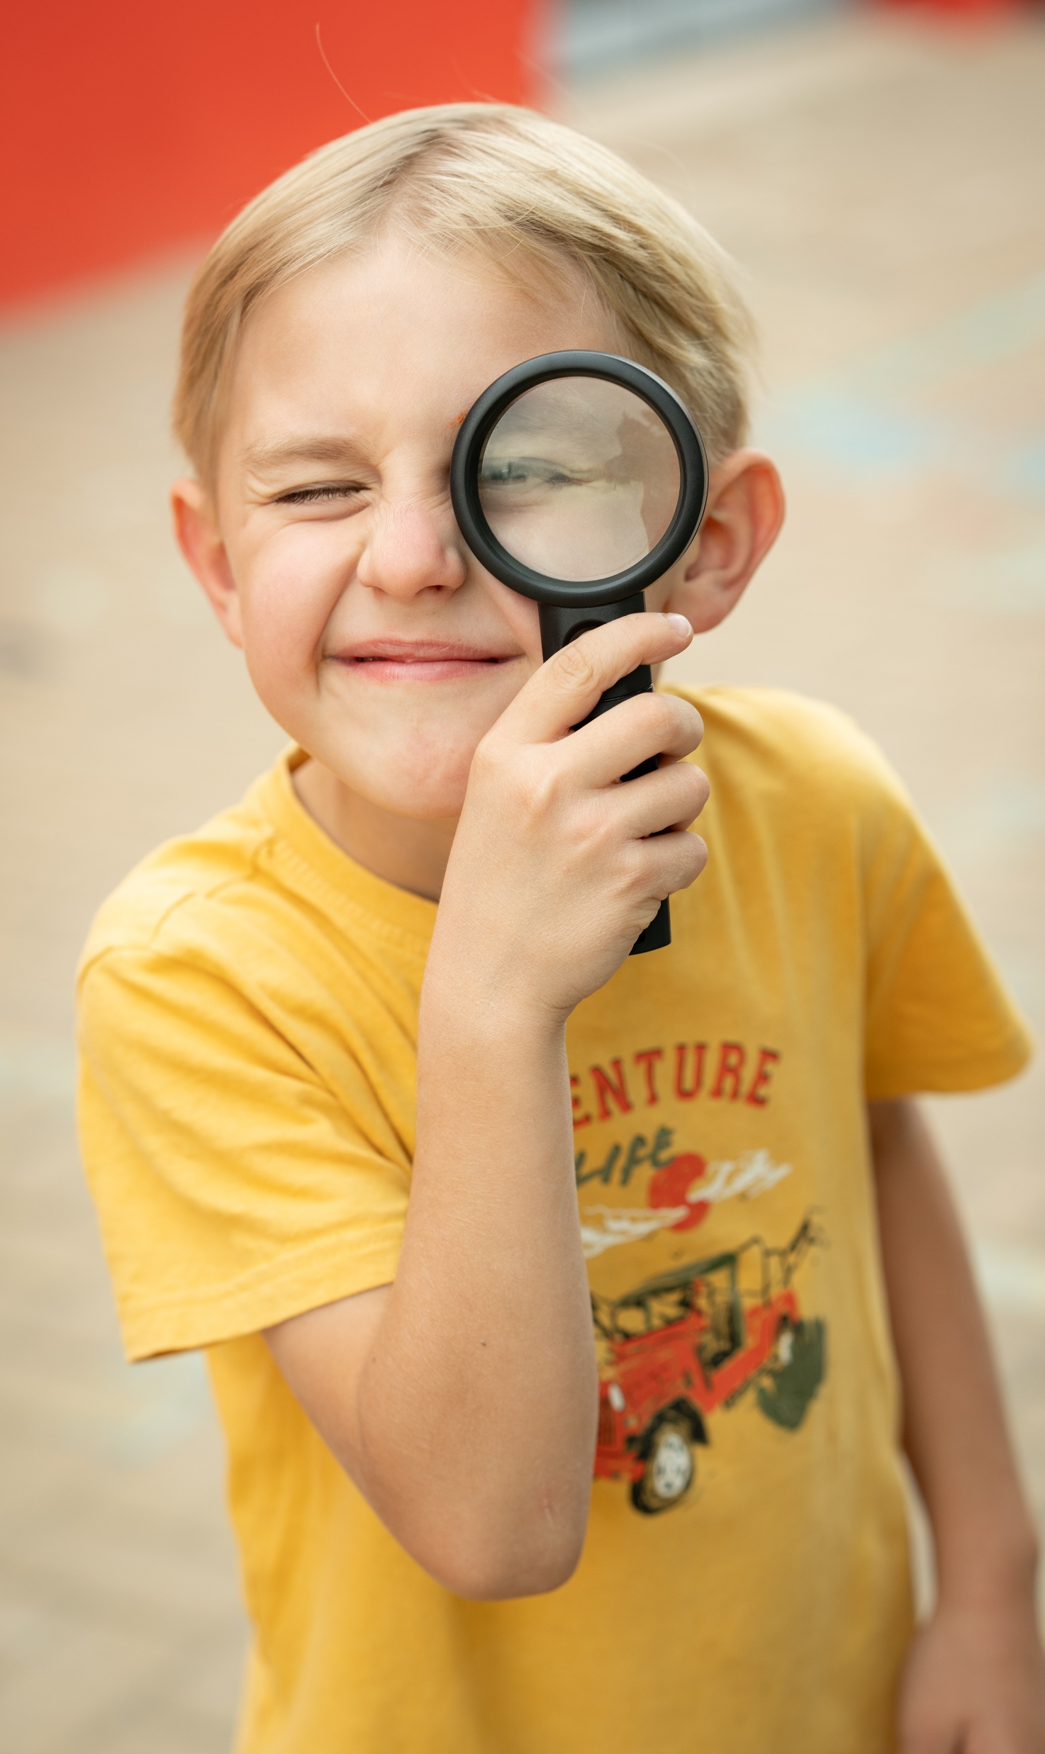
Hear From Our Schools
"COBIS membership gives us opportunities for myself and for my staff and students that we really relish, and it gives us something we just would not have had otherwise."
Kyoto International School, Accredited Member (WASC)
"Aside from CPD and Safeguarding support, we’re looking forward to making connections between different schools as well, around the world."
The King’s School Vattanacville, Accredited Member (COBIS)
Get in touch and tell us why COBIS is important to your school community
cobis.org.uk

Slide 17






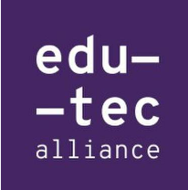









COBIS Partners
COBIS partners with a number of organisations dedicated to developing British education, safeguarding, higher education, sustainability and more.

Slide 18


Thank You!
If you have any questions, please contact the COBIS Director of Membership and Engagement, Natalie Williams: natalie.williams@cobis.org.uk
Or visit our website
www.cobis.org.uk
Facebook
Instagram
LinkedIn
We're Here to Help – Meet the Team

