Slide 1











Eldersburg Elementary Welcome 2026
Notes:
Cindy

Slide 2
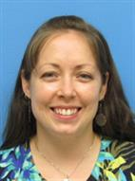
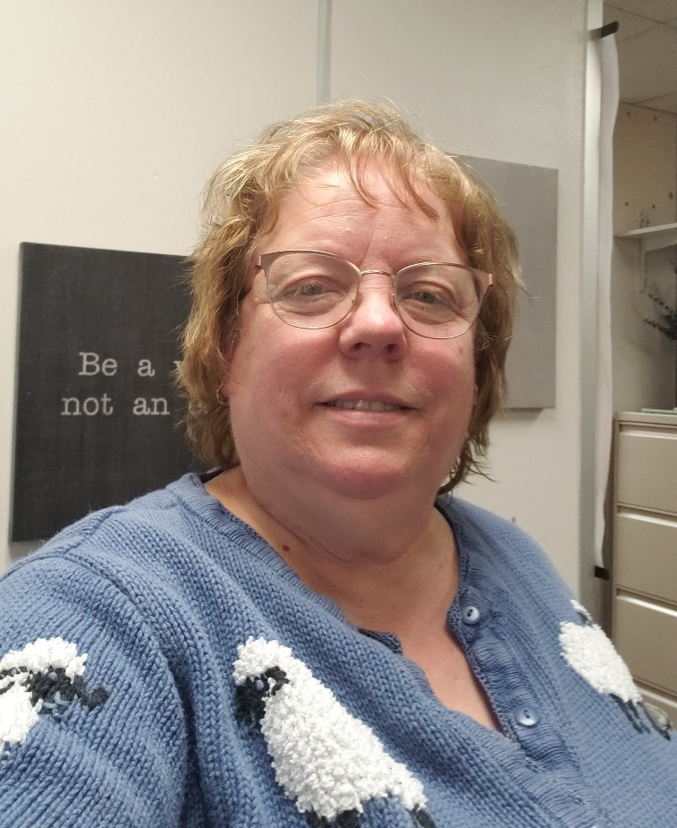
Ms. Cindy Bell
Principal
Ms. Erica Airing
Assistant Principal

Slide 3



Dino the dinosaur is our mascot.
Our school colors are green and white.
Notes:
Serena

Slide 4
Technology
Laptops -
Care / Responsibility
Instructional Use
Notes:
Biggest questions are of course around virtual learning.
Office 365, Google Chrome
HomeAccess – school email and login

Slide 5
Resources in our Building
School Counselor – Lisa Maher
Media – Sarah Parsons
ELA Specialist – Laura Broome
Math Specialist – Robin Mattox
Advanced Academics – Amey Sanders
Attendance and Enrollment – Jodi Carpini
School Nurse – Shannon Leuenberger
Notes:
Serena

Slide 6
Transportation
All elementary students are able to ride a bus if they live in district.
Buses give a reliable, safe mode of transportation.
Students may only have 1 AM bus and 1 PM bus.
Any change to transportation must be in writing before 11:00 AM- eesattendance@carrollk12.org
Bus tags
Safety on the bus

Slide 7
Parent Drop Off
We recommend that students arrive between 7:15 - 7:30 to allow them adequate time to unpack and get ready for their instructional day.
All drop off is in the back parking lot until 7:40 AM.
Please be sure your child is ready to exit the vehicle to minimize delays in the drop off-line.
Please do not pass other vehicles to maximize safety.
If bringing a student to the front (due to lateness), you must park and walk your child to the building.
Notes:
Serena

Slide 8
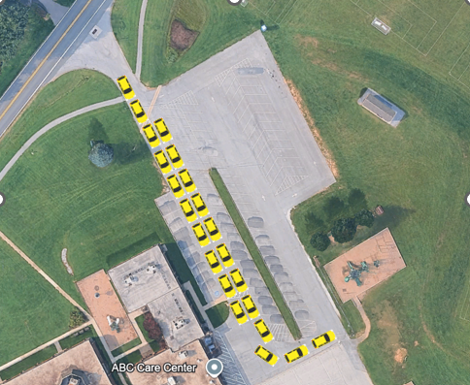
Parent Pick Up
Please do not arrive for parent pick up before 2:00 PM.
Have your tag visible for our staff
We will be using the “fast food” lane process for parent pick up this year.
When picking up, stay in the line and merge “zipper style” as you approach the fence. Your child will be called and come out to load into your car.
Hint – come at 2:20 – the line is dwindling!
Notes:
Serena

Slide 9

Calendar/Handbook

Slide 10
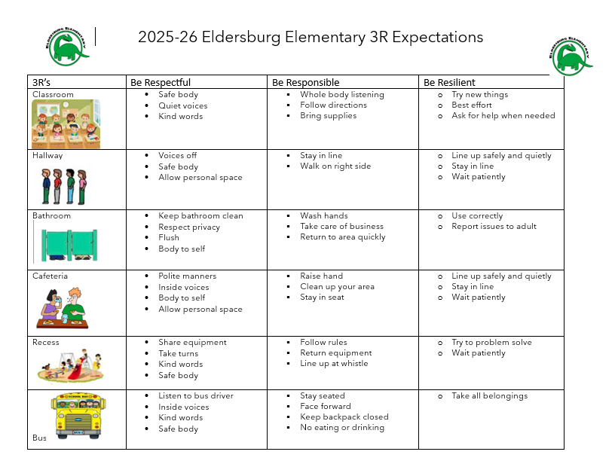
Expectations / Discipline
PBIS
Discipline
Time Out
Teacher conference
Parent contact
Support Room
Referral with or without administrative action

Slide 11
Notes
Please send notes for absence and changes in dismissal. You can send notes in with your child or through eesattendance@carrollk12.org.
Please be specific in why your child is absent. We must enter a code in our system to excuse absences.
If a change must be made for transportation during the school day call the office before 11AM. You will be asked to send an email or fax confirmation.
Students may not ride other buses home.

Slide 12
Cafeteria
Our cafeteria serves breakfast for $1.50 and lunch for $2.50 daily.
Students can buy or pack lunch. They may buy milk for 60 cents.
All students have a 5-digit PIN number.
If your child packs, please remember to send a napkin, spoon, or other things your child needs if they bring lunch from home.
Students sit at homeroom tables in the cafeteria.
Every student has a cafeteria account. You can put money on the account by sending cash or check in to the cafeteria or by credit card using MySchoolBucks
Grades 1-5 can buy “extras”
A link to apply for Free and Reduced Lunch will be in the September Dino Dispatch
Notes:
Serena

Slide 13
Electronic Portable Devices
Electronic devices from home are not permitted for use at the elementary level.
Phones must be off/silenced in the building and stored in the student’s backpack.
Smart watches may also not be used during the school day – we encourage students not to wear smart watches to school.

Slide 14
CCPS Security and Emergency Response

Slide 15
Goal
To provide a safe and secure learning environment for all students.
Security can be inconvenient
Balance security and efficiency
Cannot completely lockdown schools and operate
Notes:
It is important to stress that we do our best to provide a safe learning environment.
We take reasonable measures and follow best practices

Slide 16
Visitor Management
Standard practice for ALL visitors and parents
Visitors are expected to use the intercom system
  No answer - call the schools main number (posted by the intercom)
  Will be asked your reason for the visit
  Report directly to the main office
Do not hold the door open for other visitors
Be sure the door closes behind you
Beyond the main office
  Will be required to show valid govt. issued photo ID
  No ID – not permitted to go beyond main office without escort
Notes:
Stress the importance of consistency in our practices
This vetting process is our first line of defense

Slide 17
Special Circumstances
Visitor management system might not be used for large events like assemblies, etc.
Schools may require an RSVP for such events
Elem. Schools may use blocks of time for visits during events like field day
Notes:
Due to the number of visitors during assemblies, concerts, etc. it is impractical to check everyone in through the VMS
This is justified by an increase in parental supervision

Slide 18
Standard Response Protocol (SRP)
Critical incidents trigger one of 5 actions
  Hold
  Secure
  Lockdown
  Evacuate
  Shelter
Administrators and staff are trained on the SRP annually
Staff also receives additional training for active assailants
Schools to drill these actions in various forms (required by law)
Most actions precautionary

Slide 19
Parent Expectations
Receive notification from Central Office
  As soon as possible – accurate information must be obtained
  Remain by phone or email for updates/instructions
DO NOT GO TO THE SCHOOL UNLESS INSTRUCTED
  Many actions are precautionary - school will return to normal activity
  No access to students until situation is rendered safe
  Responding to school compounds issues for staff and emergency responders
DO NOT CALL THE SCHOOL FOR INFORMATION
  Staff are busy handling incident
  Updates will be sent via School Messenger

Slide 20

HOLD
Internal situation (medical emergency, hazmat spill, etc.)
Actions:
Clear the hallways and remain in room
No one enters the area in which isolation has been implemented
Conduct business as usual within held room or area
May be localized to one area or entire school
Notes:
You will remain in your class even if the bell rings. If you’re in the hallway, public address might be made to go to the nearest classroom. Or proceed to your next scheduled class.
With the Hold protocol, we just don’t want what’s happening in the hallway to spill into the classroom. Students remain in their seats, continue lessons, or if lessons are done, students may be given time to read or study

Slide 21

SECURE
External Threats or Police Activity in Area
Actions:
Verify all exterior doors are closed and locked
No outside activity
No one comes in or out of building
Classes may change – students may move around in building
*THIS REPLACED THE OLD SRP TERM OF LOCKOUT*
Notes:
It is important to stress that this is not a LOCKDOWN
Predominantly this is done as precaution at the direction of the police

Slide 22

LOCKDOWN
Internal Threats – Trespasser or Assailant
Actions:
Close doors (doors are staged in the locked position)
Fortify doors – barricade or tie off as appropriate
Move away from doorway – out of sight from hallway
Quiet – phones silenced and no talking
Evacuate through primary or secondary exit - if safe
Students stuck in hallway – evacuate through nearest safe exit
Notes:
Remind guardians during the initial stages of a lockdown they may not hear from their child due to the silence requirement.
Students will eventually be allowed to text their parent to let them know they are ok.
It is also important to remind guardians that not everything transmitted via social media by students and staff is accurate.

Slide 23

EVACUATE
Directed - fire, gas leaks, bomb threat or other internal issues
Actions:
Evacuate through nearest safe exit
Move to predesignated locations
May reenter building if determined safe by fire department
Notes:
No need to spend a lot of time on this.

Slide 24

SHELTER
External – Chemical spill, severe weather
Actions:
Remain inside the building
Take specific actions due to threat i.e., tornado
Depending on incident students may eventually be evacuated
Notes:
No need to spend a lot of time on this other than reinforce that this is not a term used for an action during active assailant incident.

Slide 25
Reunification
If students are evacuated to another location:
Guardians will receive specific instructions for student pick up or transportation via school messenger
Make sure you bring photo identification when picking up your student
Accountability is very important
Guardians should exercise patience

Slide 26
School Resource Officers (SRO)
Primary Responsibilities:
Provide security
Handle crimes that schools would normally request police response
Develop positive relationships with students (mentor)
Will not be used for or in lieu of school discipline
See CCPS - Security website for specific roles and authority for SROs

Slide 27
School Resource Officers (SRO)
Primary Responsibilities:
Provide security
Handle crimes that schools would normally request police response
Develop positive relationships with students (mentor)
Will not be used for or in lieu of school discipline
See CCPS - Security website for specific roles and authority for SROs

Slide 28
“See Something, Say Something”
“Don’t Repost”
Reporting
  Don’t delay
  During normal schools hours – report to school administrators
  After hours – report to local law enforcement
  Social media threats should be photographed, or screen shot
  Never repost or spread rumors
All threats are treated seriously
  Collaborative Investigations – school admin., school security and local law enforcement
  Most are unsubstantiated
Notes:
Stress how seriously we take all threats
Most end up not being a real threat and are statements taken out of context.
We look at the totality of the circumstances
Drive home the necessity to report immediately – many threats are not reported until very late in the evening, which reduces the amount of time for investigation before school reopens.
Also mention that it is typical to see patrol cars around the school in the morning
We are limited on what we able to communicate to guardians due to FERPA

Slide 29

Safe Schools Maryland Tip Line

Slide 30
Security is Everyone’s Responsibility
Concerns should be brought immediately to the attention of:
Your respective school administrators
SROs or other local law enforcement
Supervisor of Security and Emergency Management
  Curtis Pierce (410) 751-3073 or clpierc@carrollk12.org

Slide 31

Back to School Night:
Literacy Policy and Student Reading Improvement Plan
K-3rd Grade Students
Maryland State Department of Education Literacy Policy

Slide 32

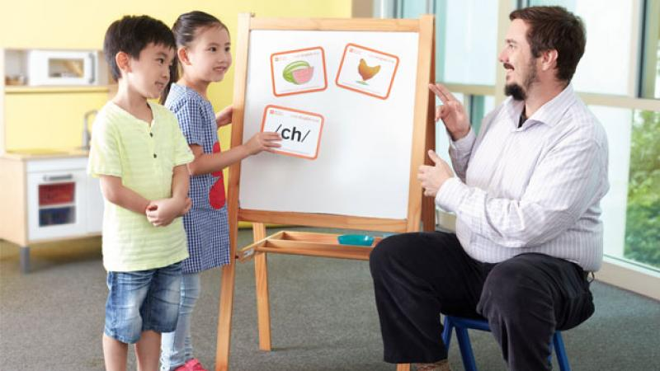
Supporting Students with Reading Difficulties (COMAR 13A.03.08)
The Ready to Read Act of 2019, Students with Reading Difficulties, and The Code of Maryland Regulation, 13A.03.08, Students at Risk for Reading Difficulties, requires local education agencies (LEAs) to provide screening for all kindergarten students and identify first-grade, second-grade, and third-grade students who may be at risk for reading difficulties. It includes a provision of supplemental reading instruction for identified students; progress monitoring; annual reporting requirements; and evaluation of the screening program.

Slide 33
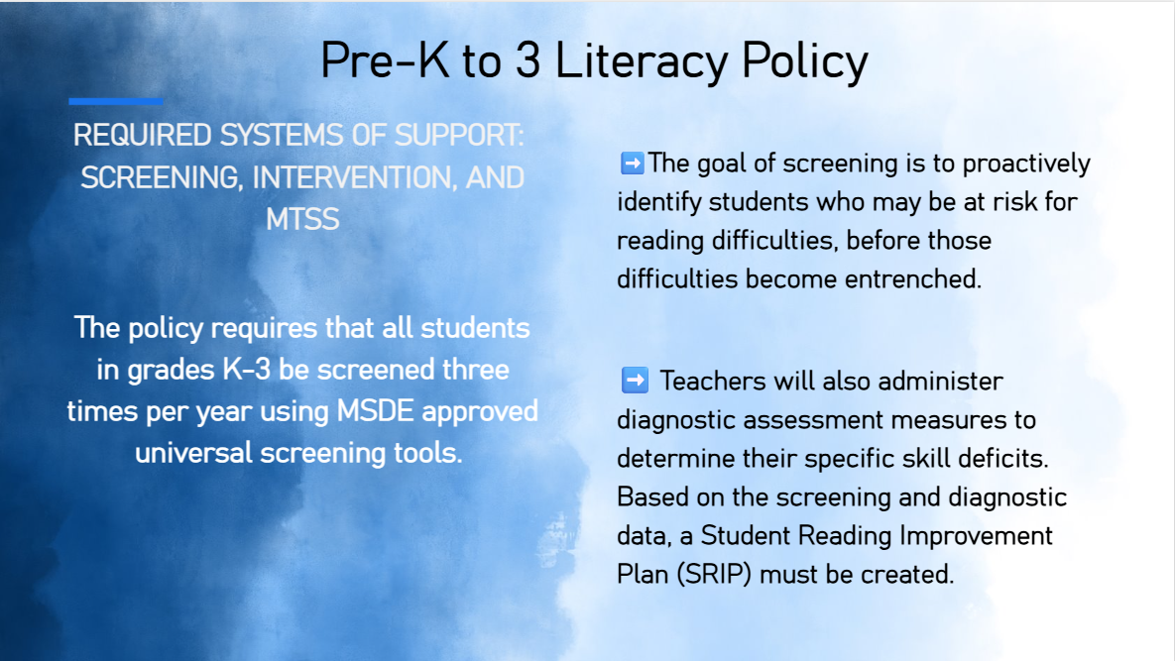

Slide 34
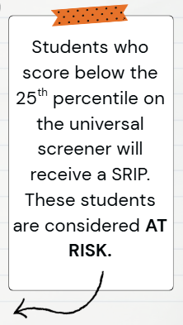
Qualifications for a Student Reading Improvement Plan
Universal Screening
3 Times Per Year
(K-3 students)
Determine Instructional Next Steps
Meeting/Exceeding Expectations- Continue/Extend Curriculum
Approaching Expectations- Targeted Small Group
Below Expectations- SRIP and Intervention

Slide 35

Student Reading Improvement Plan (SRIP)
Students in Kindergarten – 3rd grade who are identified as "at risk" as measured by the screener will receive a Student Reading Improvement Plan.

Slide 36
Student Reading Improvement Plan Process
Students in grades Kindergarten – 3rd grade will receive a screener assessment.
If student is identified as needing a SRIP, the school will notify and meet with families in October and the end of the school year.
If needed a midyear meeting may be requested to discuss changes or needs.
Student progress will be monitored throughout the year and communicated with parents 2x per quarter.
Students will not be identified for retention, under the Literacy Plan, until the 27-28 school year and not officially retained until the 28-29 school year.

Slide 37
What will the intervention look like?
Intervention block may vary from school to school, however, it can include, interventions, extensions for students, advanced academics, etc. focused around literacy.
Students may be regrouped based on student needs.

Slide 38
Upcoming SRIP Informational Nights
CCPS Regional SRIP Nights
9/30 Parrs Ridge, Mt. Airy, Winfield
10/6 Elmer Wolfe, Robert Moton, Cranberry Station, Westminster, Taneytown, William Winchester
10/7 Mechanicsville, Friendship Valley, Sandymount, Runnymede
10/8 Hampstead, Spring Garden, Ebb Valley, Manchester, Carroll Springs
10/13 Linton Springs, Eldersburg, Freedom, Carrolltowne, Piney Ridge
Family Guides for Student Success
Family Literacy Night
Finksburg Branch 11/4
Mt Airy Branch 11/10
North Carroll Branch 11/12
Eldersburg Branch 11/17
Taneytown Branch 11/18
Westminster Branch 11/19
Parent Resources
Updates pertaining to the Comprehensive Literacy Plan can also be found on the CCPS website:
English Language Arts - Carroll County Public School District

Slide 39
Who we are & Why we do what we do
Who we are & Why we do what we do what we do
We have 5 officers on the board
Joanne McGarry
LeeAnne Lafin
Tifani Stone
Desiree Williams
Tifani Stone
Teachers & Staff
General Members
We have 5 people on the board (all volunteers)
Joanne McGarry (President)
LeeAnne Lafin (Vice President)
Jennifer Canterbury (Vice President)
Desiree Williams (Treasurer)
Samantha Gill (Secretary)
Teachers & Staff
General Members
PTA's mission is to make every child’s potential a reality by engaging and empowering families and communities to advocate for all children.

Slide 40
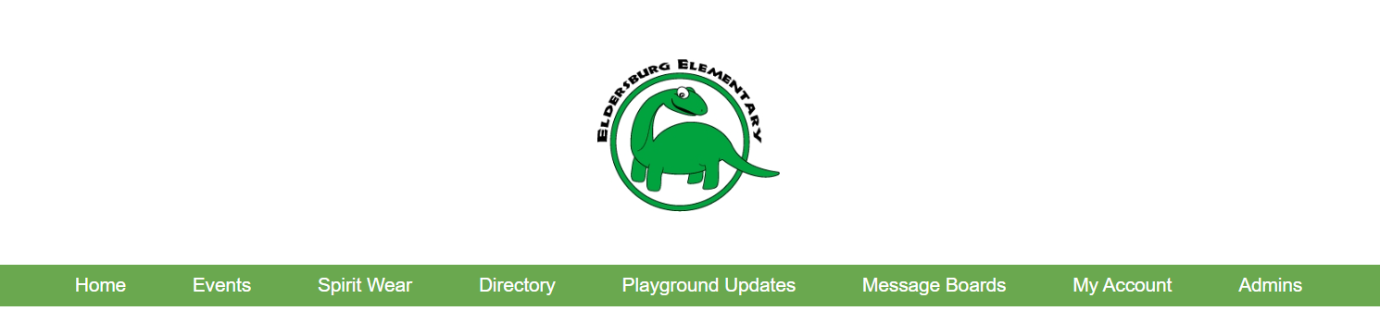
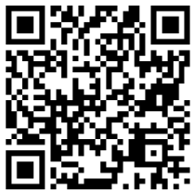
Eldersburg Elementary School PTA homepage
https://eldersburgpta.membershiptoolkit.com/
Bookmark this page!
-Become a member
-See upcoming events (calendar)
-Access the directory (find friends from class)
-Purchase tickets for events
-Buy EES gear

Slide 41
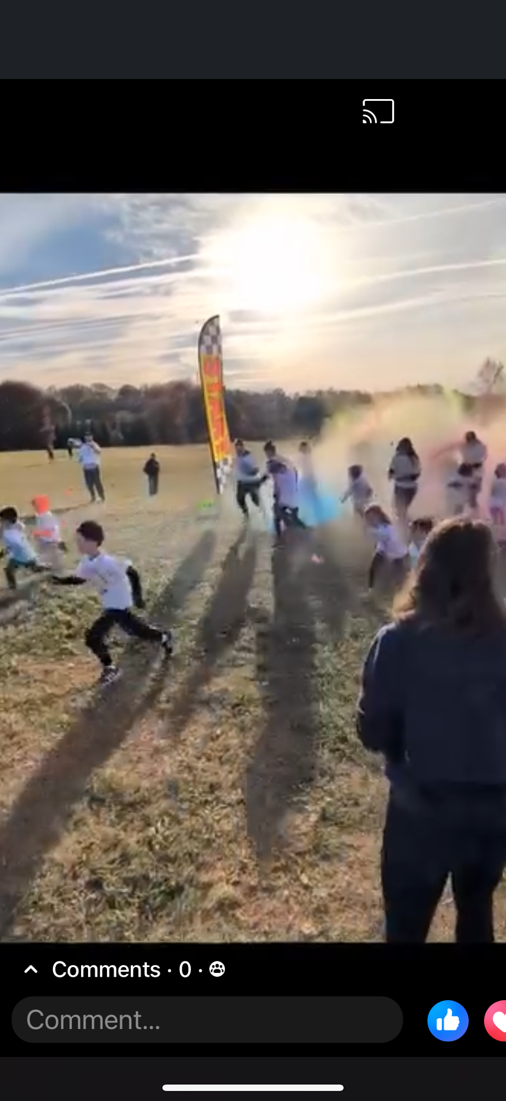
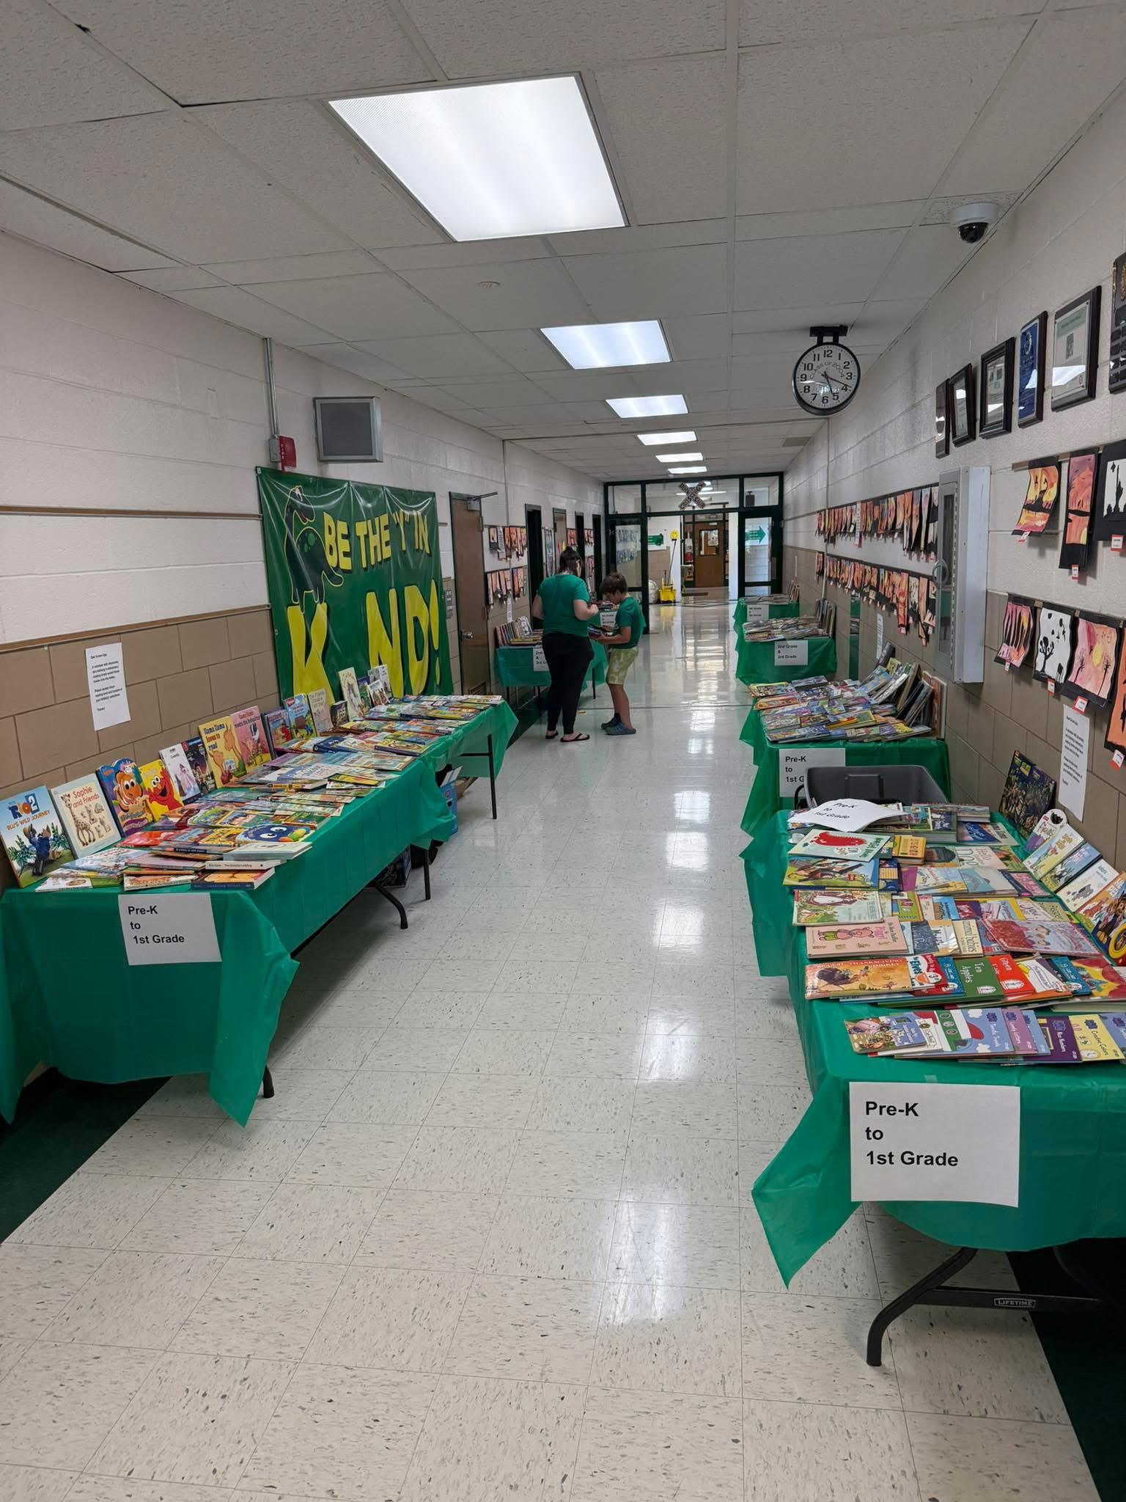
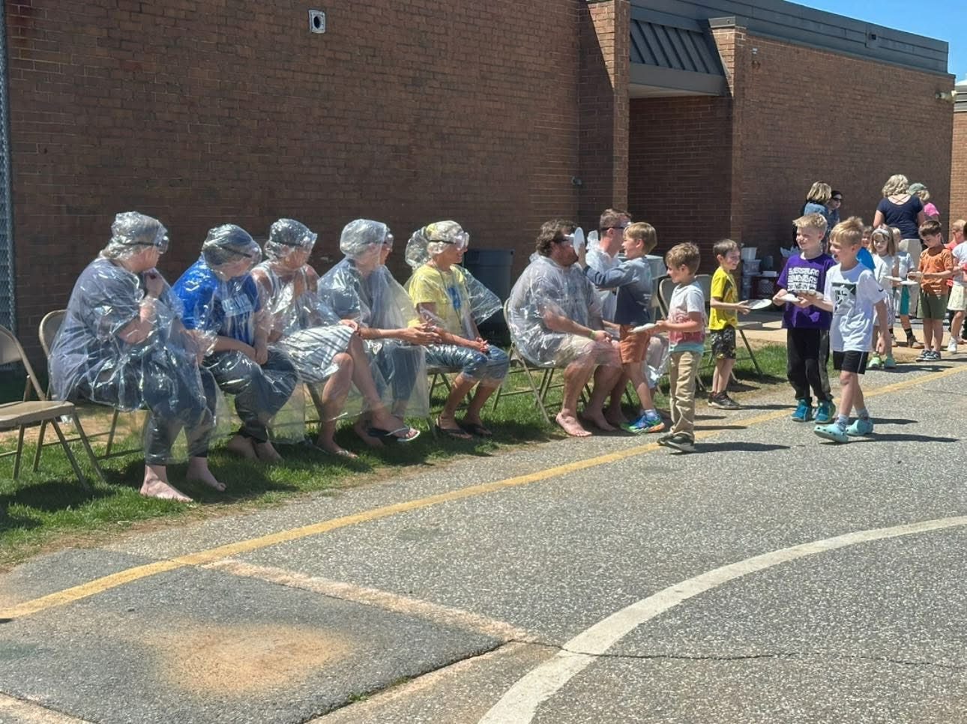
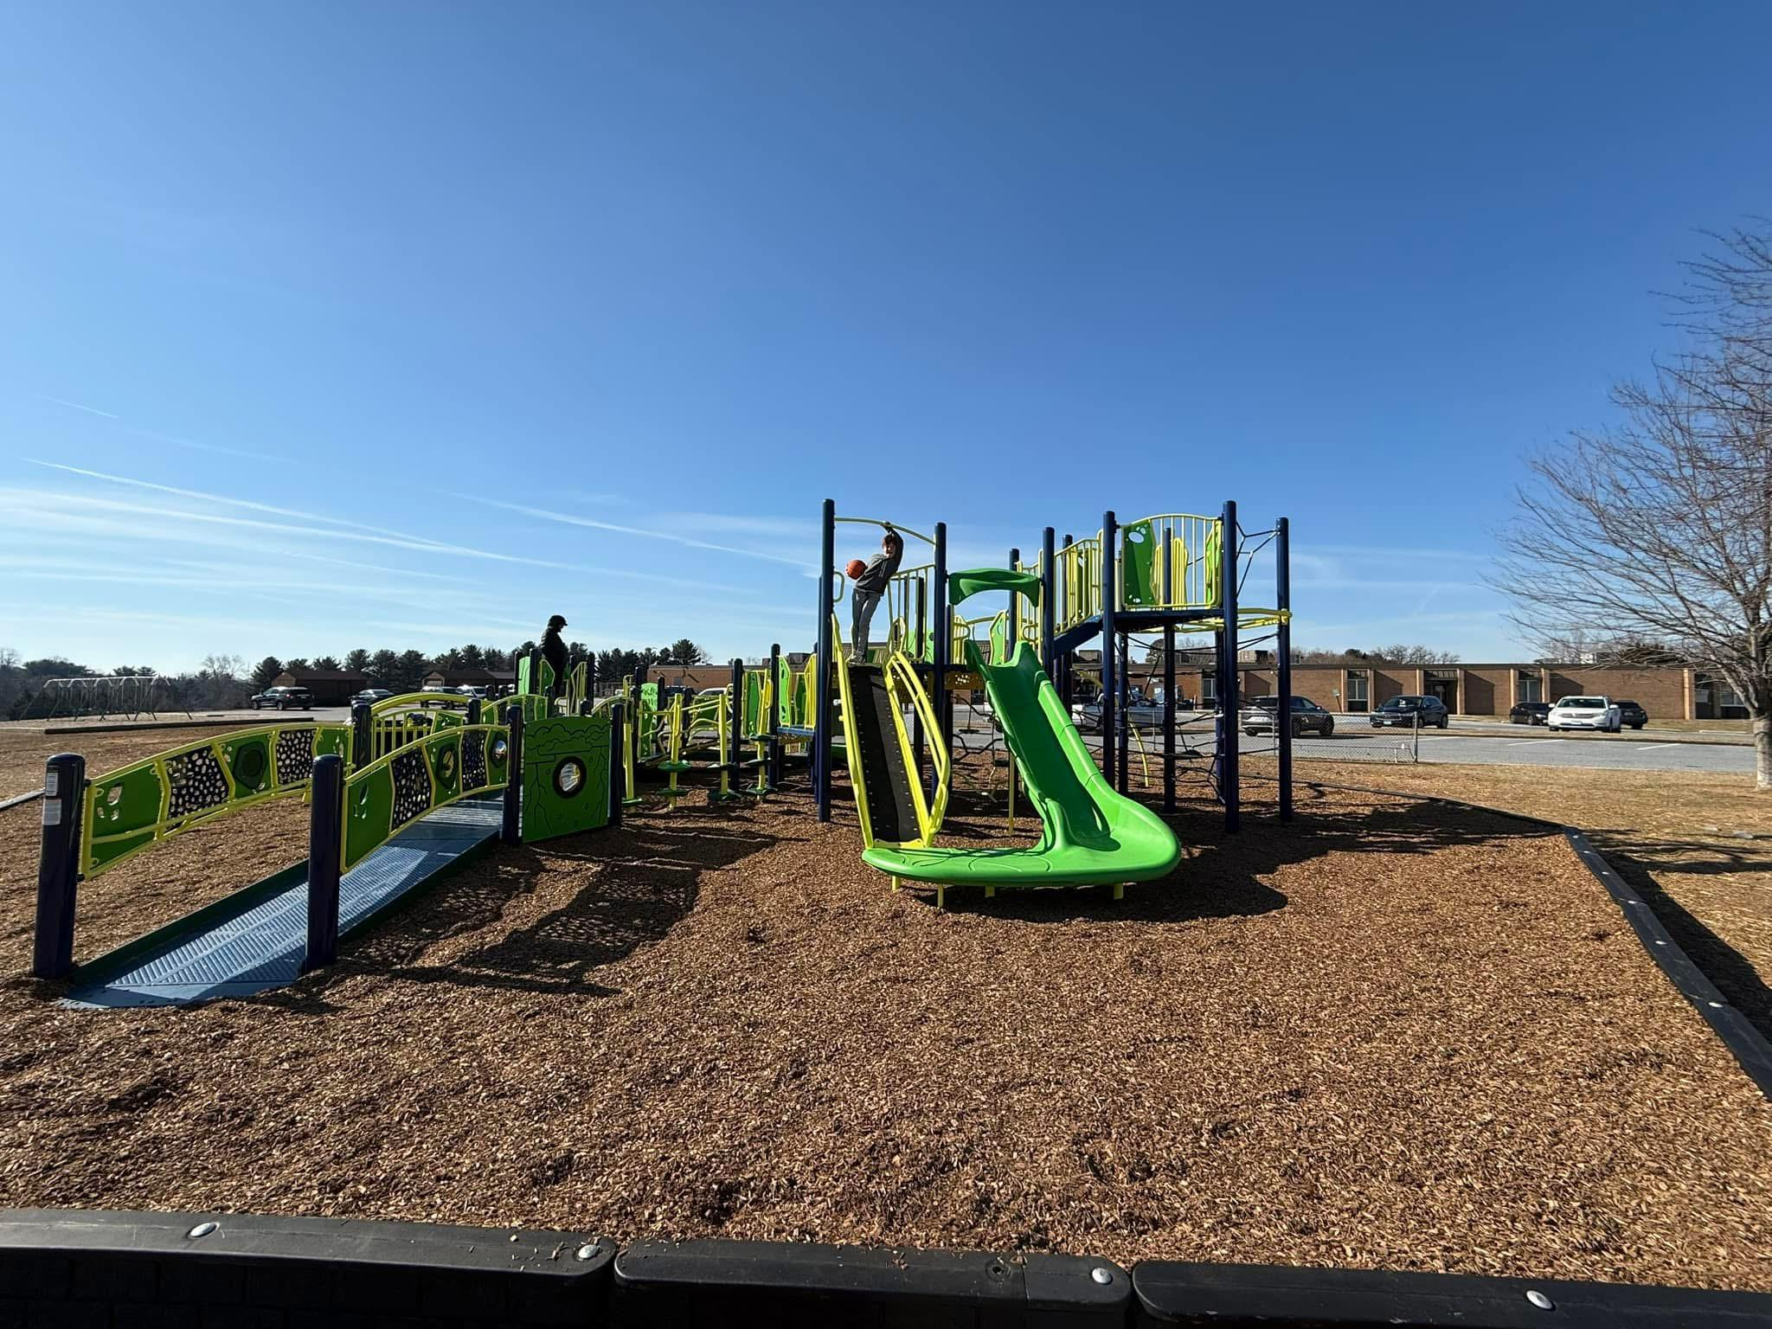
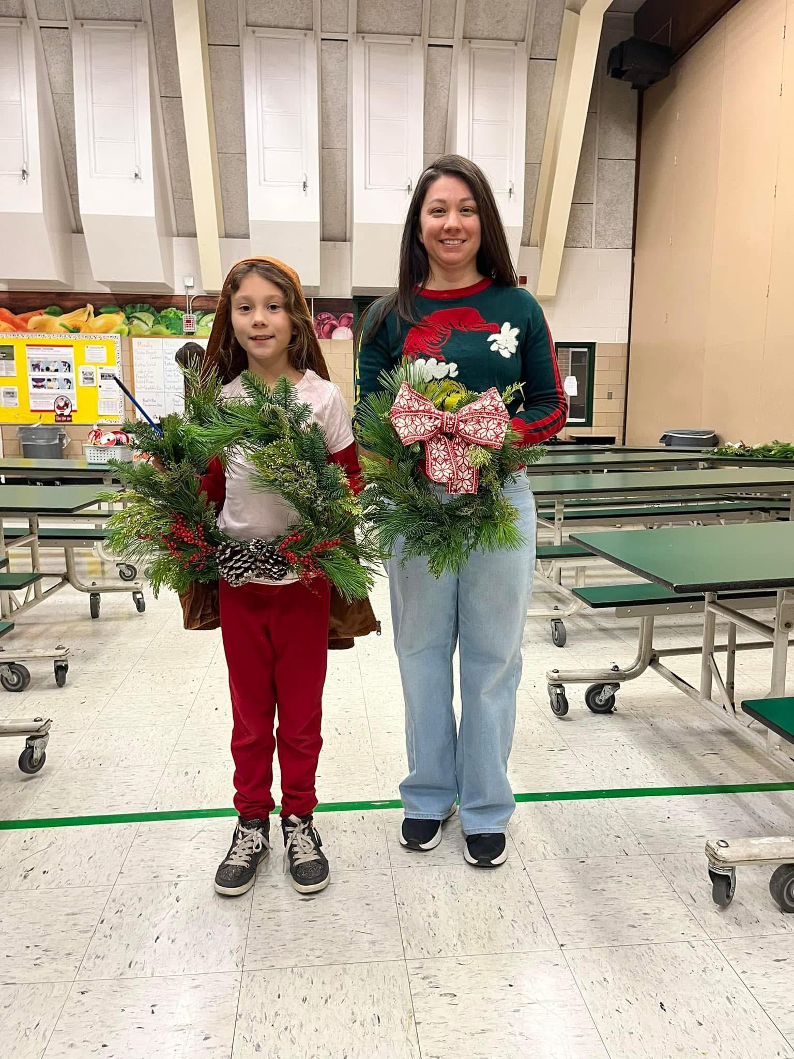
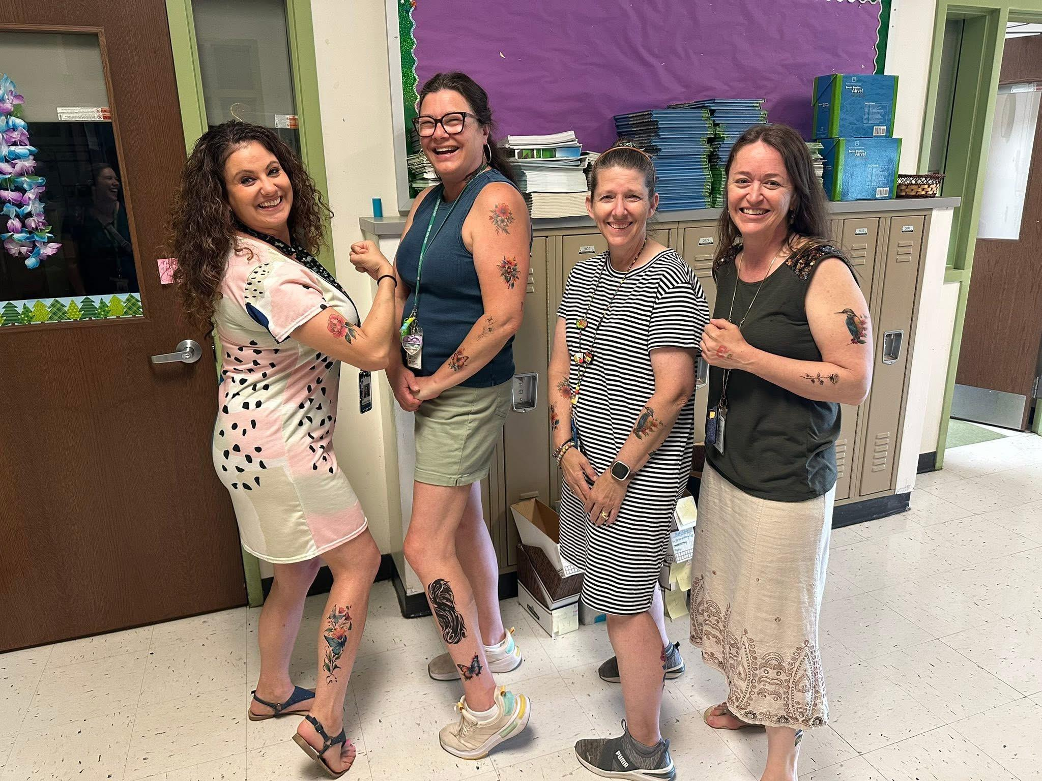
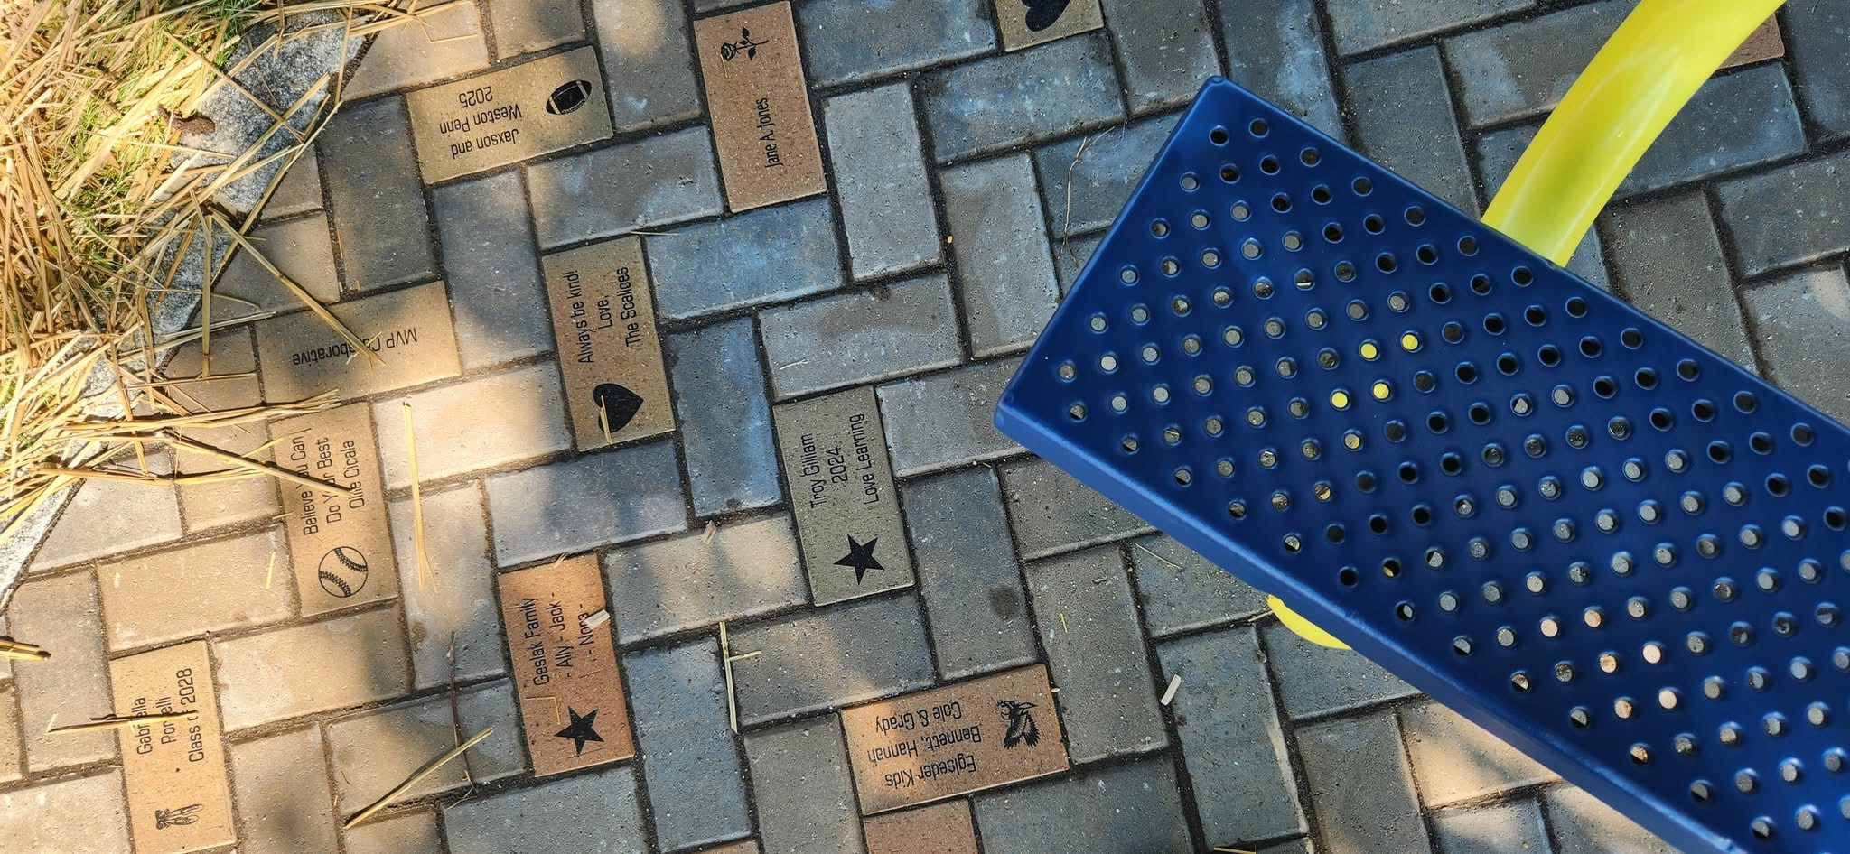
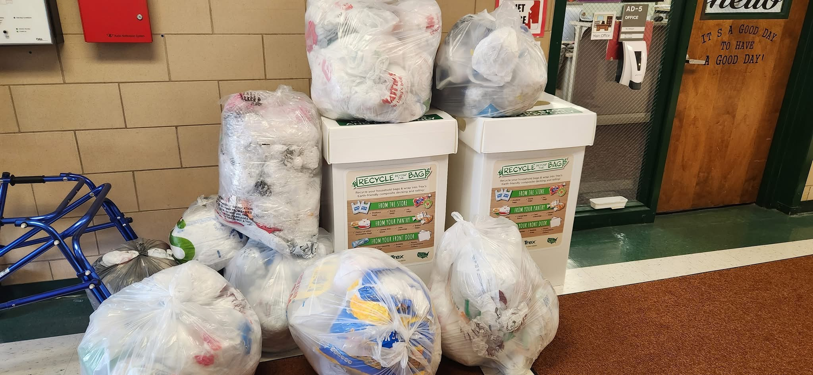
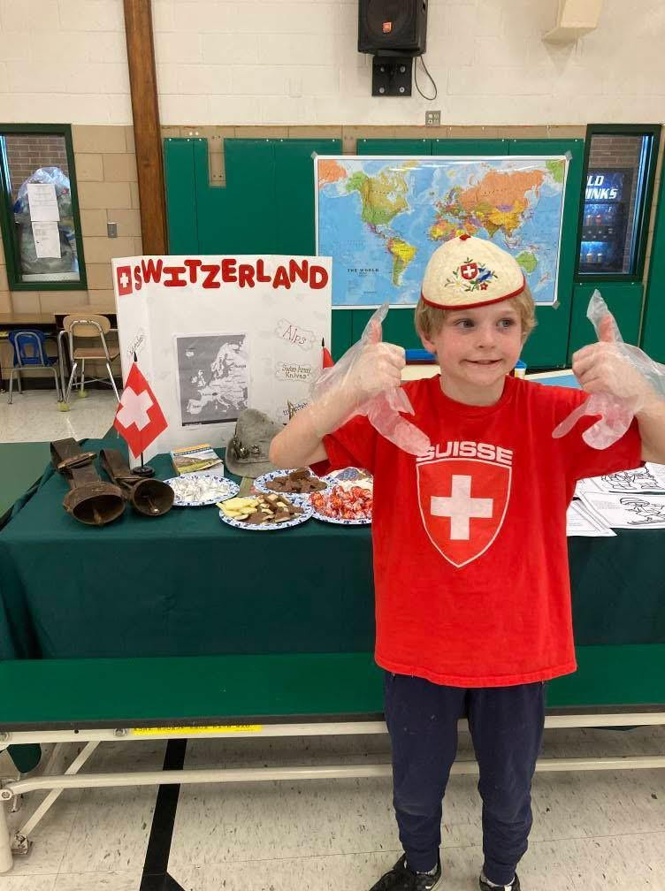
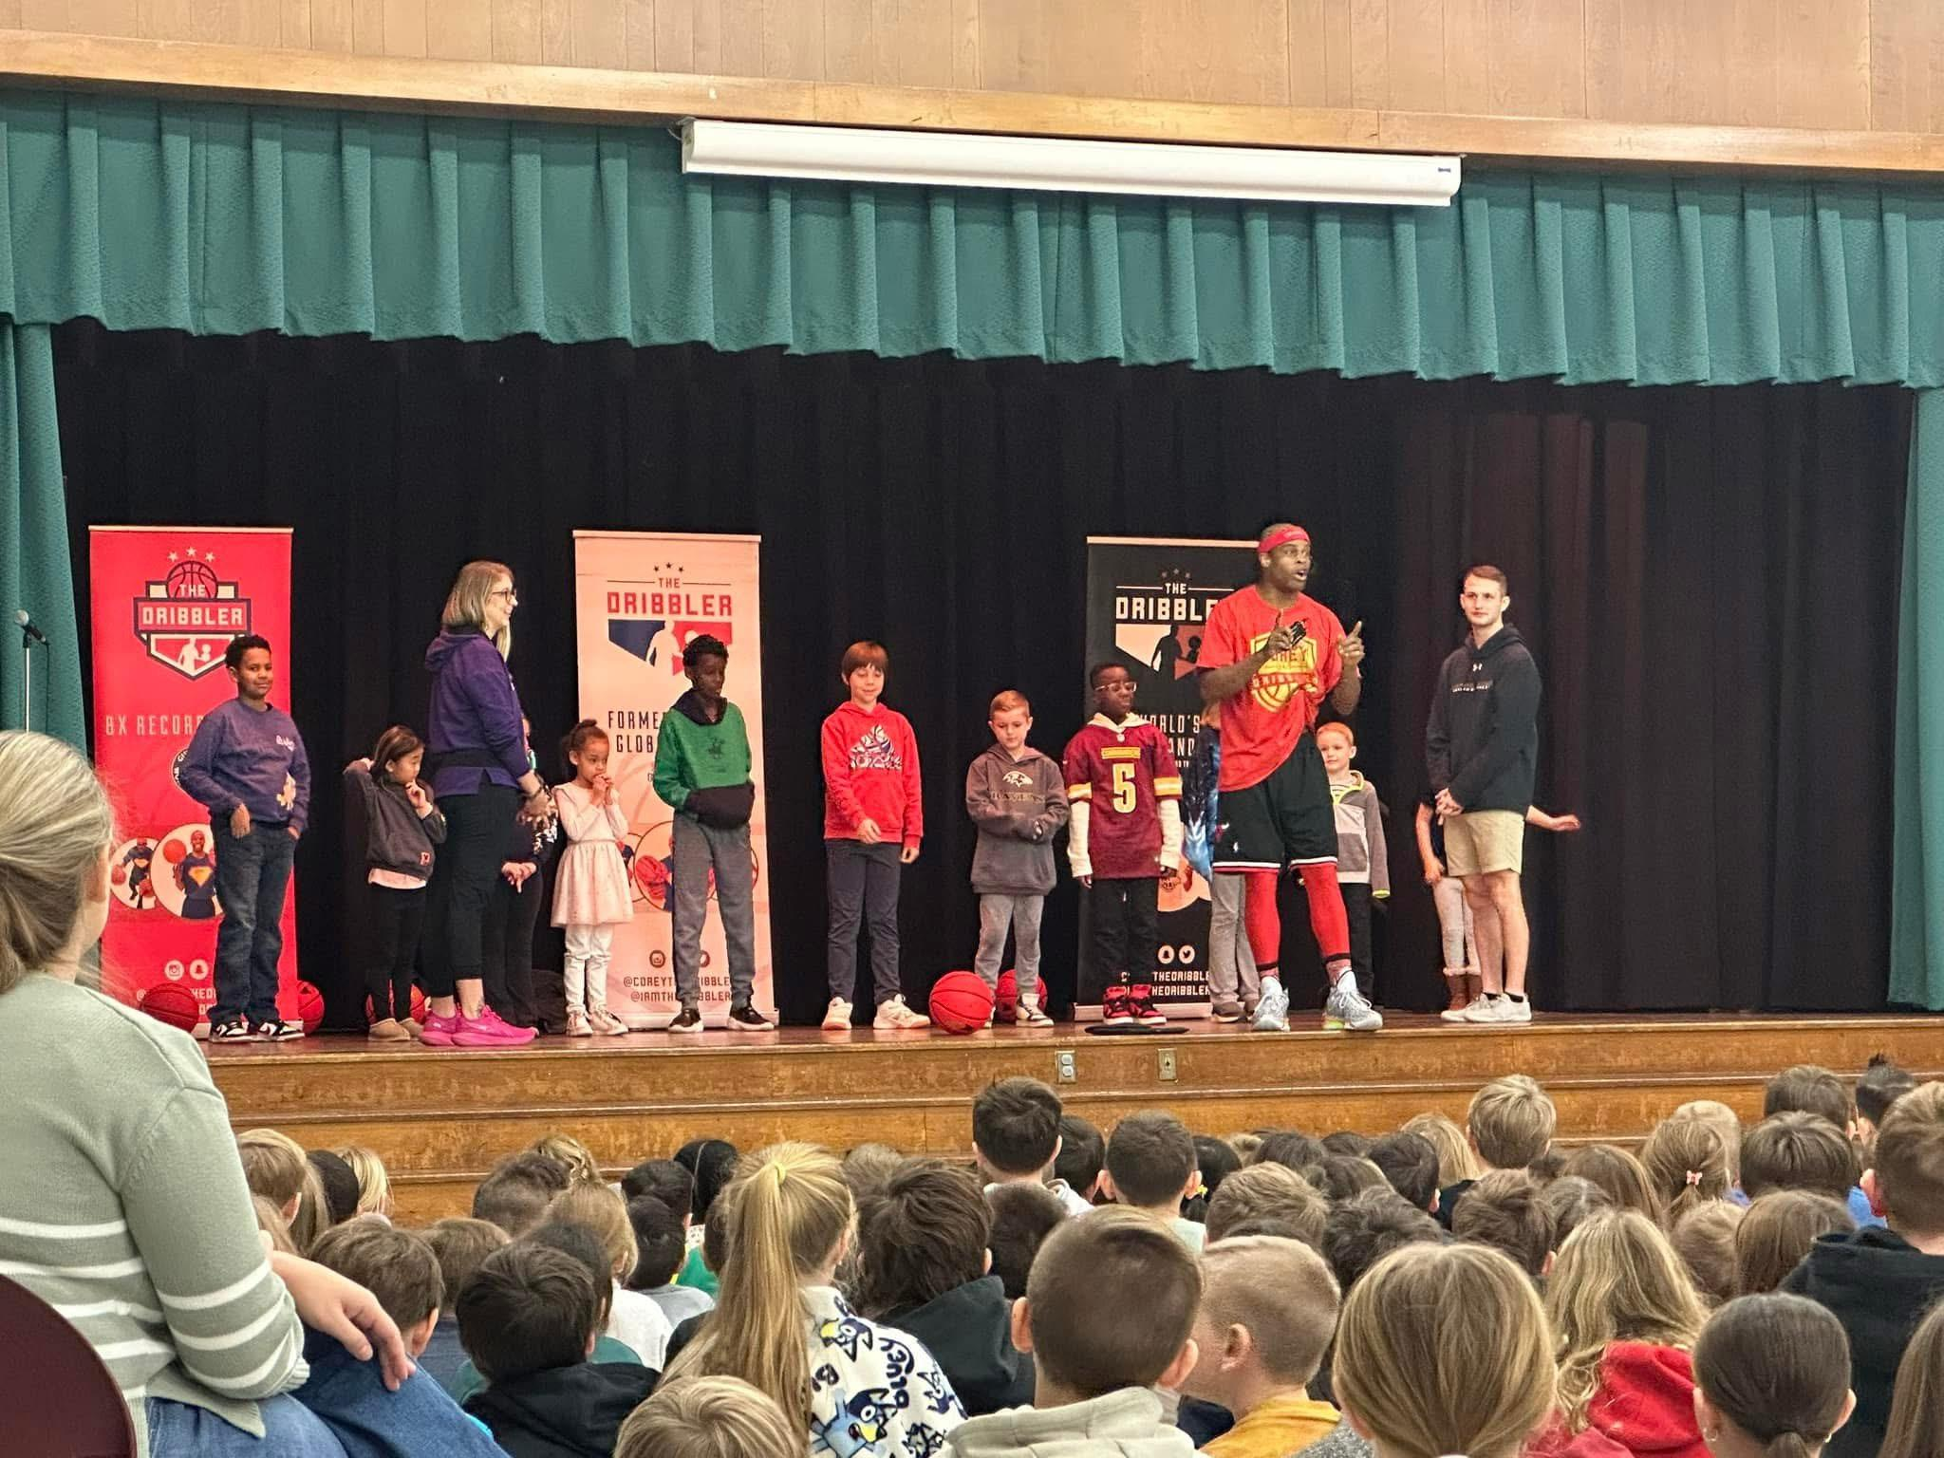
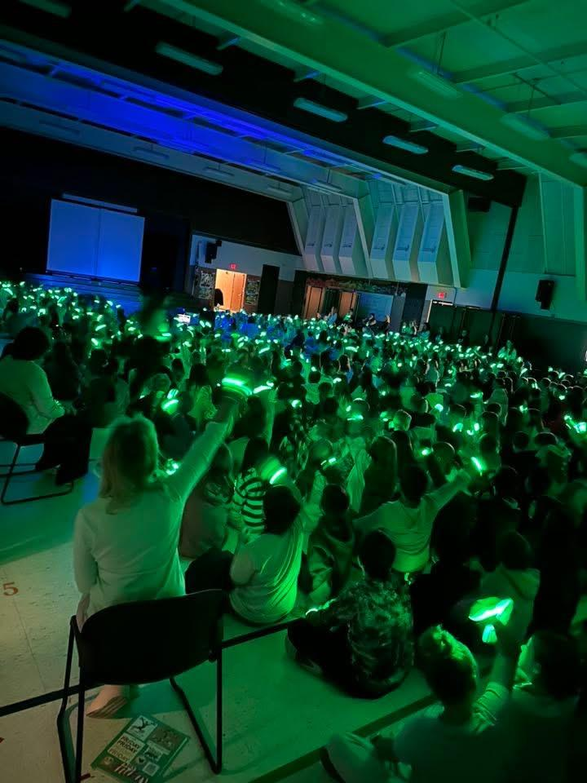
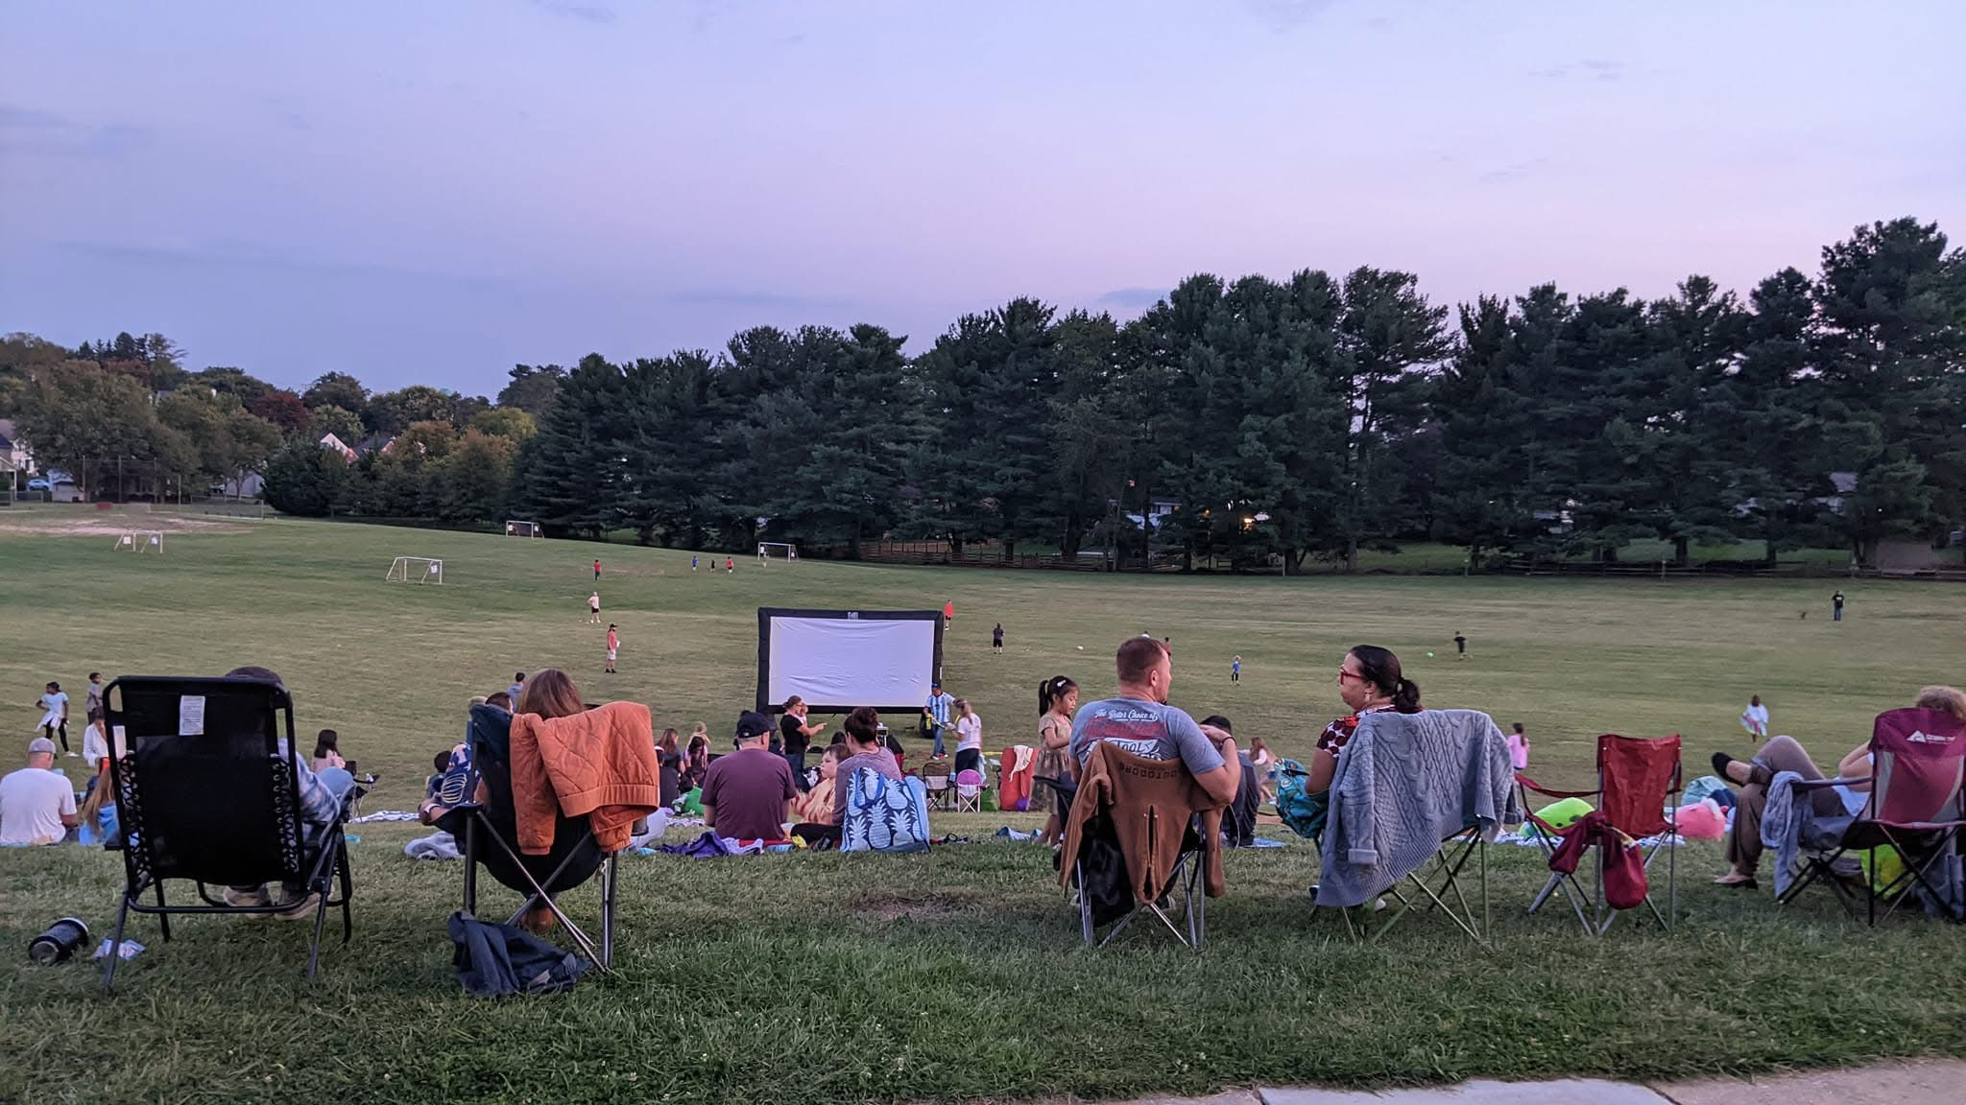
Add Pictures from events

Slide 42

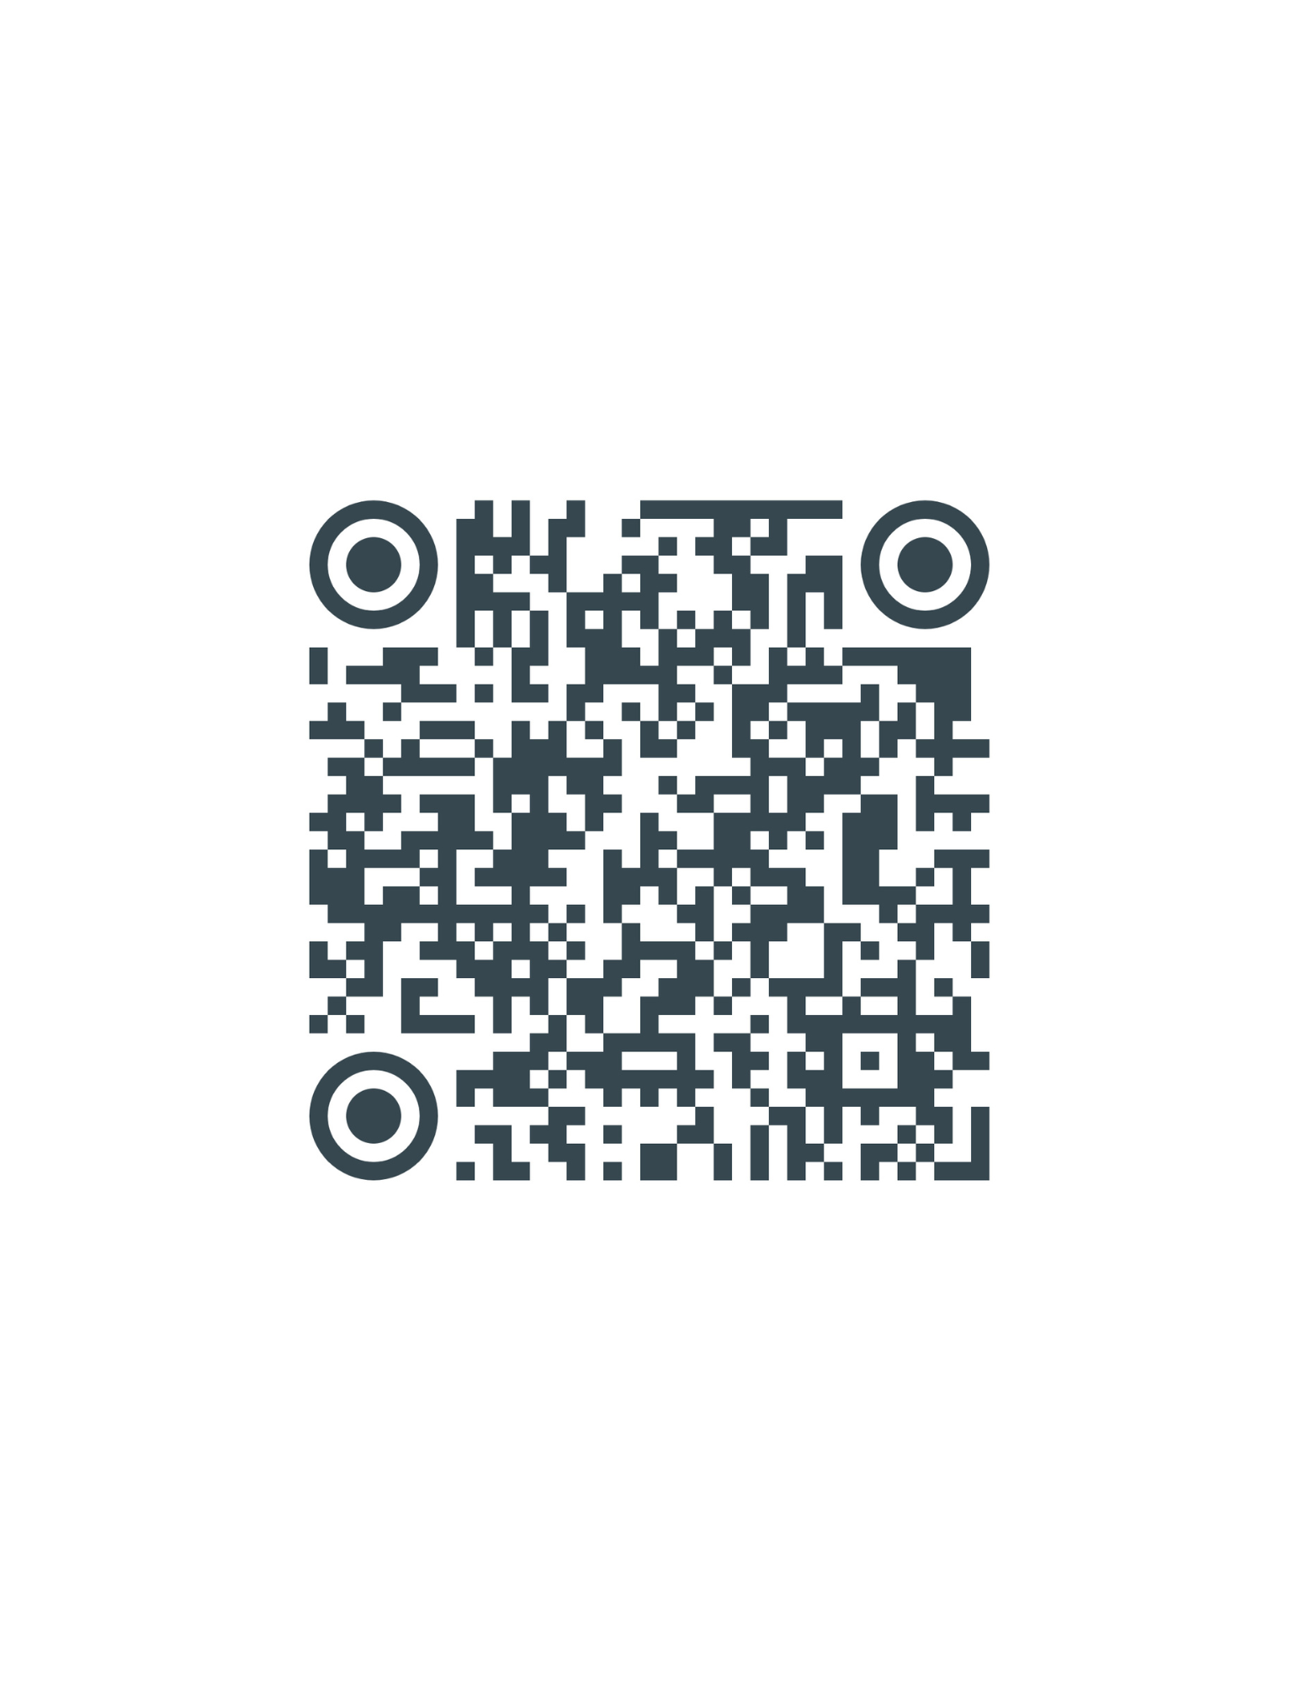

Why should you join the PTA?
-PTA can send messages directly to you
-Discounts on community events
-Access directory to connect with other EES families
-Join the advocacy effort
If you join before September 10th you will be entered into a raffle to win
4 Hershey Park
Tickets!
-PTA can send messages directly to you
-Discounts on community events
-Access directory to connect with other EES families
-Join the advocacy effort

Slide 43
How do we communicate with members?
Facebook: Eldersburg Elementary School PTA (general group)
Grade level specific groups
School Messenger: through the school program
Emails from our website: this can be event specific or member specific
Flyers: Purple (lilac paper) is our color, keep an eye out in your Dino folder

Slide 44
How you can get in touch with the PTA board?
Email: eldersburgelementaryschoolpta@gmail.com
Look for green tie-dye shirts at events
We do not work at the school so you cannot contact us by calling the school.
Please use the Facebook group to gather information and ask questions.
Complaining there is not an effective way to solve problems, please reach out to us directly if it is about a PTA event.

Slide 45
THE
END

