Slide 1

Senior FAMILY
Information NIGHT
2026-2027

Slide 2
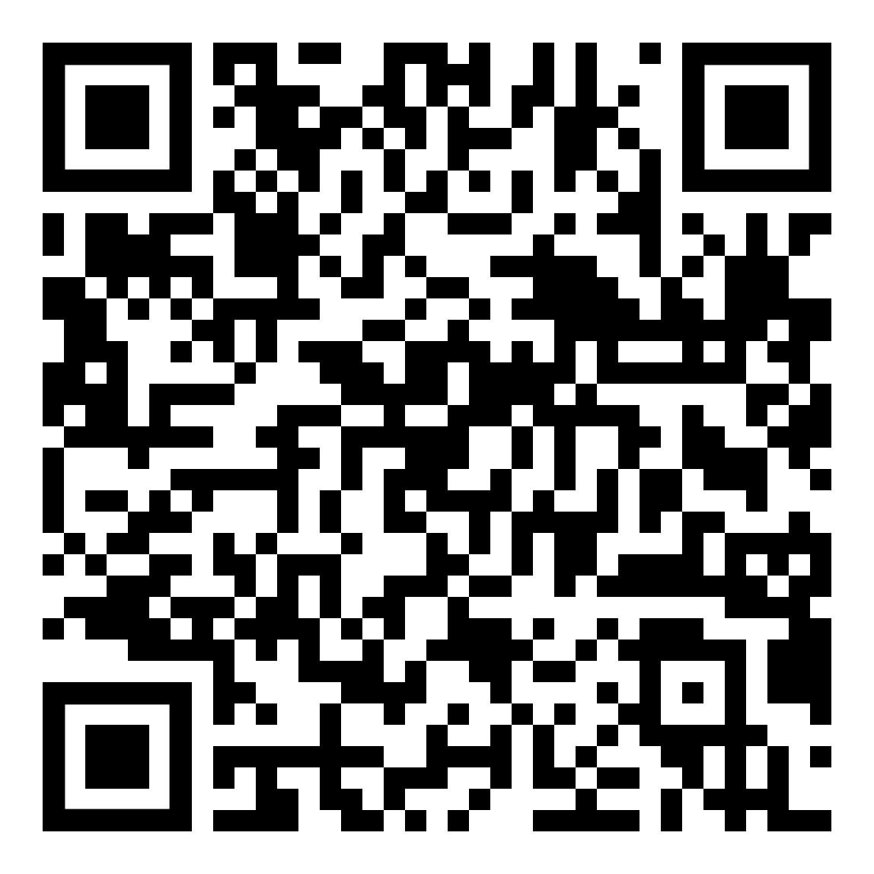
Welcome
This presentation is posted to the McQueen Counseling website. Please note this for later reference.
https://mcqueen.washoeschools.net/academics/counseling/senior-information
After the presentation, please see the following tables in the theater foyer:
Josten’s: Cap & Gown Sales
McQueen Boosters: Safe & Sober Night
UNR Admissions
TMCC Admissions
5. Military Recruiters
6. Associated General Contractors

Slide 3
Graduation Requirements

Slide 4
Diploma Type Quick Review
 | Standard | Advanced | Honors
Total Required Credits | 23 | 24 | 24
Flex Credit | 1 | 0 | 0
No Course Failures (11th and 12th Grade Only) | N/A | N/A | Applies
Minimum World Language Credits | 0 | 0 | 2
Total Honors/AP/Dual Credits | 0 | 0 | 8
Minimum Cumulative GPA (Weighted or Unweighted) | None | 3.25 | 3.40

Slide 5
Options after high school

Slide 6
Short-Term Certificate Programs
TMCC offers nearly 60 short-term certificate programs that can be completed in 1-2 semesters. These focus on in-demand job skills, such as those in the medical field, information technology, HVAC, and much more.
These help students build their skills and resumes to enter the workforce with greater credentials, which often means greater starting pay in the world of work.
Visit TMCC to learn more https://catalog.tmcc.edu/degrees-certificates/

Slide 7
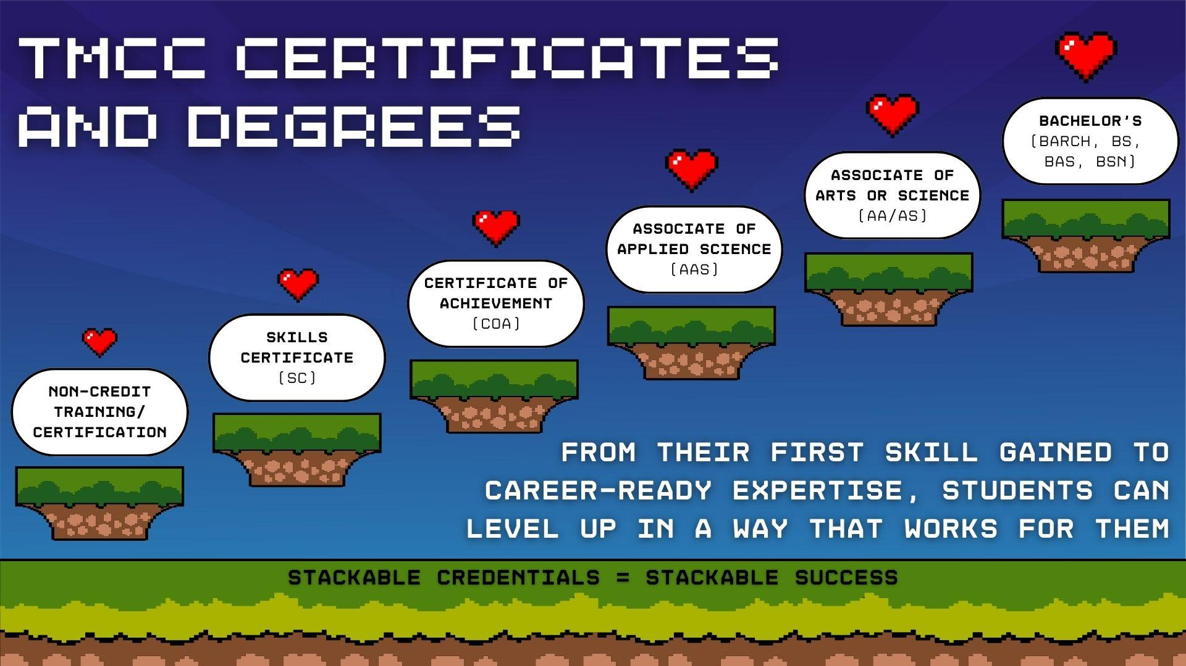

Slide 8
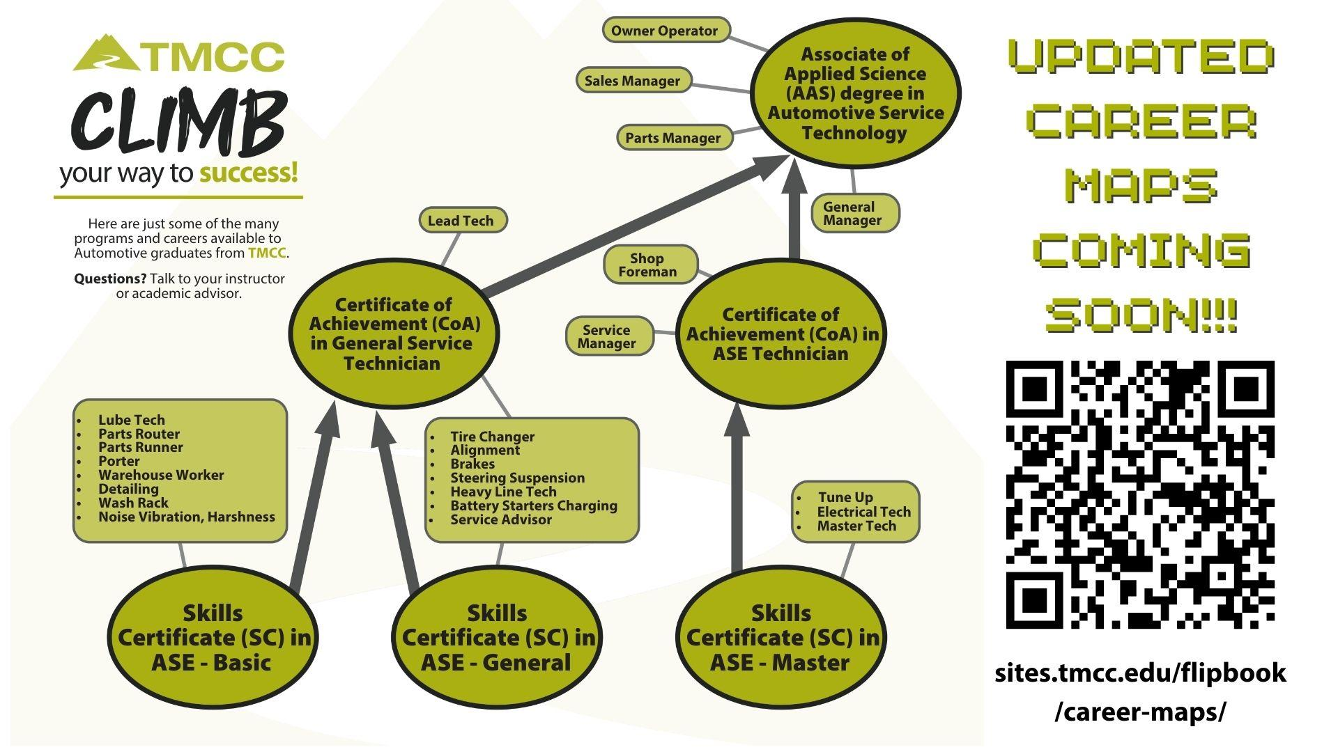

Slide 9
Apprenticeships or Military Service
Learn and earn on the job in construction and related industries (i.e., electrician, lineman, ironworker, painter, plumber, sheet metal worker, etc.) by visiting the Northern Nevada Apprenticeship Coordinator's Association (NNACA) at www.buildingtradejobs.org or by calling 775-772-7146.
ASVAB
Students interested in joining a branch of the U.S. military should consider taking the Armed Services Vocational Aptitude Battery, which is offered at McQueen. See Mrs. Brady in the College & Career Center, room 503, to sign-up for the ASVAB.
Military Recruiter Contacts
Air Force 775-443-7458 or www.airforce.com
Air National Guard 775-233-7219 or www.ang.af.mil
Army 775-829-2769 or www.army.mil
Coast Guard www.uscg.mil
Marines 775-829-8911 or www.usmc.mil
Navy 503-694-9237 or www.navy.mil

Slide 10
College planning

Slide 11
Get to Know Prospective Colleges
UNR and TMCC Field Trips for Seniors
UNR Nevada Bound Field Trip: Friday, September 18, 2026
TMCC: Tuesday, September 29, 2026
TMCC Day on the Hill: Saturday, October 24th @ 10am-12:30pm
Lancers Excel
Representatives from UNR and TMCC as well as other colleges will be visiting McQueen’s campus this year. Based off of the results of our Senior Survey that was given this week, we will be targeting students to participate in these information sessions and workshops.
College Board Big Future: https://bigfuture.collegeboard.org/plan-for-college
Western Undergraduate Exchange (WUE): https://www.wiche.edu/tuition-savings/wue/

Slide 12
How Much Does College Cost?
US Department of Education
  https://www.usa.gov/estimate-college-cost
CollegeBoard Net Price Calculator
  https://bigfuture.collegeboard.org/pay-for-college/get-started/college-costs-and-college-lists
Estimate Federal Student Aid
  https://studentaid.gov/aid-estimator/

Slide 13
College APPLICATIONS

Slide 14
How Do I Apply For College?
Common App
  Over 1,000 colleges and universities use this platform, including UNR and UNLV
  One application to apply to multiple schools
Directly Through College/University Website
  Example: TMCC

Slide 15
College Essays and Application Fees
Essay
  For colleges/scholarship providers to get to know the student
  Online Resources: https://mcqueen.washoeschools.net/academics/counseling/senior-information
  McQueen College Essay Writer’s Workshop: during Excel on September 24th.
Fee
  Varies by college
  Fee waivers available for those approved through the free/reduced lunch program

Slide 16
Transcript & Test Score Requests
Students are responsible for requesting their official transcript from WCSD by submitting an online request at https://washoeschoolsnv.scriborder.com/. The first four requests per school year are free of charge.
Students are also responsible for requesting their ACT and/or SAT score reports to be sent to their college(s) of choice:
  www.act.org
  www.collegeboard.org

Slide 17
Letters of Recommendation
McQueen Counselors
  Complete the “Request for Letter of Recommendation” form
  Submit form along with updated resume at least 2 weeks prior to the deadline date…earlier if possible
  Form can be found on the McQueen Counseling Website or a paper copy can be picked up in the Counseling Office
Teachers/Administrators
  Talk with teachers/administrators now
  Common courtesy – give at least two weeks notice
  Submit updated resume (copy of Request for Letter of Recommendation form is a plus)

Slide 18
Free application for federal student aid (FAFSA)

Slide 19
Create an FSA ID
This can be completed before the release of the FAFSA
The FSA ID is the username and password you will use to access the FAFSA website. The FSA ID also allows you to sign your FAFSA electronically
Go to https://studentaid.gov/fsa-id/create-account/launch to create a Federal Student Aid (FSA) ID
    Each senior student, along with one or both parents/guardians, will need to create an FSA ID.
    The student and parent may not share an FSA ID. Your FSA ID is your signature, so it has to be unique to you.
    If you have more than one child attending college, you can use the same FSA ID to sign all applications, but each child must have his or her own.
    If a parent already has one from being in college recently or for another child in college – they will not need to create a new one.
    Note: Each FSA ID user must have a unique mobile phone number and/or email address.

Slide 20
Complete the 2027-2028 FAFSA
Complete this step on/around October 1, 2026
Go to https://studentaid.gov/h/apply-for-aid/fafsa or download the free app “myStudentAid” to begin the application
  Use 2025 tax information
  Must complete within 45 days of starting
  Only takes 20-30 minutes to complete
  Completion
    The FAFSA is not complete until you submit it and receive a confirmation number

Slide 21
FAFSA Help
  TMCC FAFSA Family Workshop: Saturday, November 14 @ 12pm-3pm in the McQueen Library.
  McQueen FAFSA Family Night: December 10 @ 6pm
  TMCC Financial Aid Office: https://www.tmcc.edu/financial-aid
  UNR Financial Aid Office: https://www.unr.edu/financial-aid
  Federal Assistance Help Line: 800-433-3243

Slide 22
Scholarships

Slide 23
Institutional Aid
Money from in-house scholarship programs at colleges and universities. Institutions have their own requirements and deadlines.
Examples:
  UNR First-Year Scholarship Info: https://www.unr.edu/financial-aid/scholarships/first-year-scholarships
  TMCC Promise Scholarship: https://www.tmcc.edu/Nevada-promise-scholarship

Slide 24
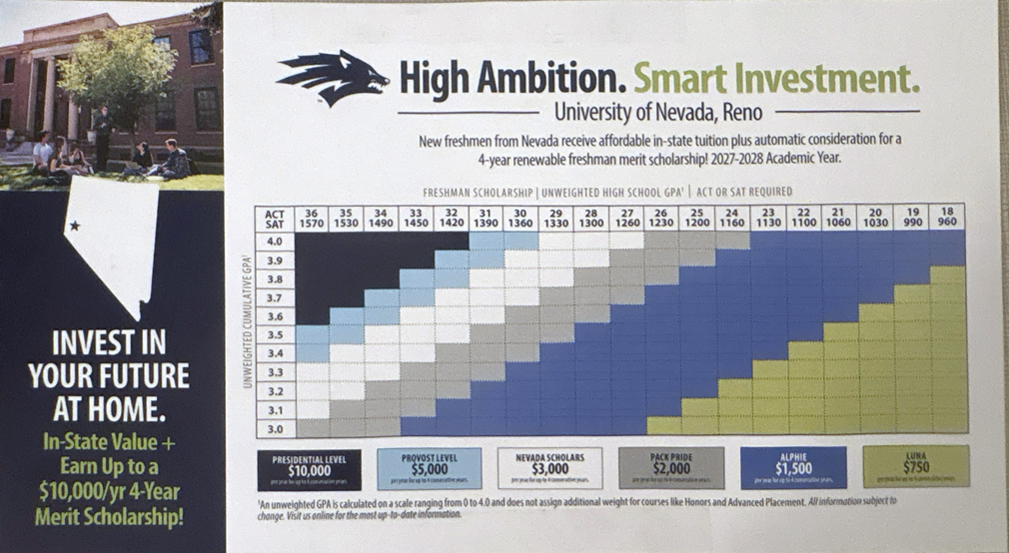

Slide 25
Nevada Millennium Scholarship
Graduate with an overall weighted or unweighted GPA of 3.25 OR earn an ACT composite of 21 or higher OR earn an SAT score of 1070 or higher
Complete appropriate high school course work (Advanced or Honors Diploma requirements)
Be a resident of Nevada for at least two years
Plan to attend a Nevada institution of higher education
There is not an application! Award notifications come by mail in July or August after graduation.

Slide 26
Other Scholarships
McQueen General Scholarship Program
  One completed application package to be considered for multiple awards!
  Application, Essay, and Resume
  Currently is open on McQueen High School Canvas page and the McQueen College and Career Center website.
  Closes October 31, 2026
Other Scholarship Resources
  McQueen College and Career Center website
  External Scholarship Websites
    www.fastweb.com
    Going Merry "Multiple No-Essay Scholarships in One" Scholarship | Bold.org
    Home – BigFuture | College Board

Slide 27
Testing

Slide 28
Should I Take the ACT/SAT Again?
Things to consider…
Sometimes an increase of 1-2 points could mean thousands of dollars
ACT/SAT scores determine:
    Millennium Scholarship potential
    College entrance and college-based scholarship eligibility
      Is your college test optional?
    Other scholarships
    Exemption from core college classes

Slide 29
National ACT Information
Test includes English, Mathematics, & Reading (Optional science and writing sections)
Cost
  ACT: $68
  Science Add-On Fee: $4
  Writing Add-On Fee: $25
  Fee waivers available for students who qualify for the Free and Reduced Lunch Program
Registration
  www.actstudent.org
  McQueen’s School Code – 290143

Slide 30
National SAT Information
Test includes reading, writing, and math
Cost
  SAT - $68 (fee waivers available for qualified students)
Registration
  www.collegereadiness.collegeboard.org/sat
  McQueen Code – 290143

Slide 31
Events and important dates

Slide 32
Important Dates
FALL 2026
Josten’s Cap & Gown Presentations in Government Classes September 2026; Or go to www.jostens.com to order
Senior Portraits at McQueen September 8-11; Sign-up at www.prestigeportraits.com
McQueen General Scholarship Application Opens : currently open
UNR Prospective Student Presentation: September 16, 2026 Excel*
Resume Writing Workshops: September 17, 2026 Excel*
UNR Nevada Bound Field Trip (Advance Sign-Up Required): Friday, September 18th
TMCC Prospective Student Presentation: September 23, 2026 Excel*
TMCC Day on the Hill (Prospective Student & Family Event): October 24th, 2026 10-12:30am
TMCC Field Trip (Advance Sign-Up Required): September 29, 2026
2026-2027 FAFSA Opens: October 1, 2026
College Essay Writer’s Workshop: September 24, 2026 Excel*
Purchase a Yearbook for Reduced Rate of $85: Now –10/16/26
Homecoming Dance: October 26, 2026 Location TBD
Financial Aid Presentation October 14, 2026 Excel – Theatre*
ASVAB (Advance Sign-up Required): To be determined
WCSD College Fair: October 18; 11-2 @ UNR
McQueen FAFSA Family Nights: December 10, 2026 6pm
TMCC Promise Scholarship Due Date: October 31, 2026
McQueen General Scholarship Application Due: October 31, 2026
McQ Scholarship Fundraiser: Be on the lookout for opportunities
Purchase a Senior Yearbook Ad (BEFORE January) Go to www.yearbookforever.com to place an order
*Facilitated during Lancers Excel class period; All dates are subject to change

Slide 33


Slide 34
Final thoughts

Slide 35
Stay in Touch!
Daily School Announcements
Announcements are posted on the McQueen Website each school day
McQueen School Calendar
https://arbiterlive.com/School/Calendar/14215
McQueen Counseling
Lots of resources on the Counseling Website
McQueen College & Career Center
Scholarships resources on the CCC Website
McQueen Main Office: 775-746-5880
Attendance Notifications
Infinite Campus Login Help
Student WCSD Login Help
General Questions

Slide 36
Thank you!
Student Last Name | Counselor | Email
A – C, San-Sam | Mrs. Benson | jbenson@washoeschools.net
D – Ho, Sn-Sz | Mrs. Schweickert | tschweickert@washoeschools.net
Hp – Mor, T-U | Ms. Smith | kmsmith@washoeschools.net
Mos – Sam, V-Z | Mrs. Parker | erin.parker@washoeschools.net
College & Career Center | Mrs. Brady | Joann.Brady@washoeschools.net

