Slide 1

Northeast High School
Title I Back to School Night

Slide 2
Vision
100% Student Success
Mission
All Northeast High School students will graduate prepared for college, career, and life.
Three Keys to Success
Attendance: Students attend classes daily, arrive timely to class, and prepared mentally for learning.
Attitude: Students exhibit relationship, scholarship, sportsmanship, citizenship, leadership, and partnership.
Achievement: Students submit all assigned tasks and never accept zeroes for any assignment.

Slide 3
Title I Funding
Title I is the largest federal assistance program for our nation’s schools.
The school district identifies eligible schools and distributes the Title I funds to the school.
Northeast High School implements a Title I Schoolwide Plan. All students and staff benefit from the supplemental services.

Slide 4
Title I Schoolwide Budget
Northeast High School is provided $110,592 to pay for supplemental resources and programs for increased student achievement. We have an additional $5,300 for Family Engagement.
This year we are using the Title 1 funding for the following:
  MTSS Intervention Instructor
  MTSS Intervention Assistant

Slide 5
Parent’s Right to Know
As a parent of a student attending a Pinellas County School Public School, you have the right to…
Be provided information on your scholar’s level of achievement on assessments in Reading/Language Arts, Writing, Mathematics, and Science.
Request and receive information on the qualifications of your scholar’s teacher and supplemental personnel working with your child.
Be notified of non-highly qualified or out-of-field teachers at the school.
Be informed if your scholar is taught by a non-highly qualified teacher for four or more consecutive weeks.

Slide 6
Parent’s Right to Know
Title I law requires that all Title I schools and families work together.
As a Title I Parent you have the right to be involved in the development of the following plans and documents for our school:
School Improvement Plan (SIP)
Title I Schoolwide Plan
Parent and Family Engagement Plan (PFEP) for the school and district
School-Parent-Student Compact
Check out our website www.pcsb.org/northeast-hs
You may request and attend virtual or in-person meetings to express your opinions and to formulate suggestions and to participate, as appropriate, in decisions relating to the education of your children.
Notes:
Discuss timeline and how does your school gather input. (Surveys, suggestion box, links to school personnel
Title I Schoolwide Plan should only include Comprehensive Needs Assessment, Areas of Focus, Program Implementation, Professional Development (No names or salaries)

Slide 7


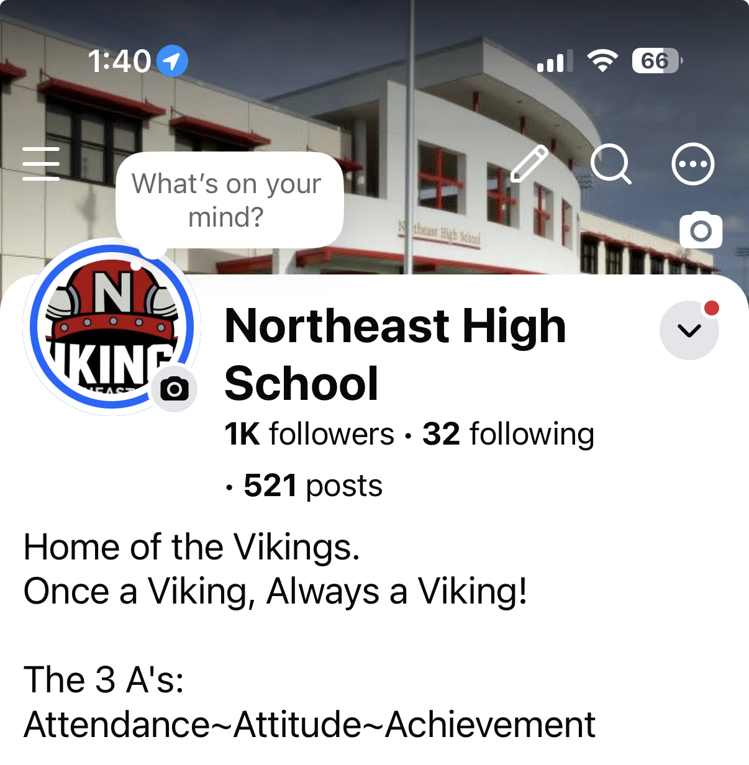
Parent Engagement
Follow us!
@northeasthsvikings
@NortheastHighSchoolVikings
Parents, please ensure all contact information in Portal is accurate, if not please contact Ms. Henderson or Ms. Johnson make necessary adjustments.
Northeast Website Address:
https://northeast-hs.pcsb.org/

Slide 8

Working Together for Student Success
School Advisory Committee Meetings
The 2nd Tuesday of the month at 6pm
SAC at 6pm, PTO at 6:30pm
Next meeting: September 8th
All SAC Meetings are held in the Media Center

Slide 9
Volunteers!
NEW THIS YEAR:
All Volunteers must be level 2 cleared
Please Contact:
Mrs. Sarah Alvarez
School Coordinator – College and Career Readiness
727-570-3138 ext. 2310
Alvarezsa@pcsb.org

Slide 10

Florida Benchmark for Excellent Student Thinking Standards (B.E.S.T). You may read more information by visiting www.fldoe.org
Florida Benchmark for Excellent Student Thinking Standards (B.E.S.T) form the framework of everything taught at school.

Slide 11
End of Course Assessments
FAST ELA PM3 (graduation requirement – grade 10)
Algebra (graduation requirement)
Geometry
Biology
US History

Slide 12
Accountability
SCHOOL REPORT CARDS:
•School Grade and Overview
•Population and Enrollment
•Assessments- Academic Achievement, Growth, and Population
•Assessments -English Language Learners
•Graduation and Beyond
•Educator Qualifications and Equity
•Long-Term Goals and Interim Progress
•Accelerated Course Enrollment
•Per-Pupil Expenditures
•National Data
Available Online at School Report Cards:
•School Grade and Overview
•Population and Enrollment
•Assessments- Academic Achievement, Growth, and Population
•Assessments -English Language Learners
•Graduation and Beyond
•Educator Qualifications and Equity
•Long-Term Goals and Interim Progress
•Accelerated Course Enrollment
•Per-Pupil Expenditures
•National Data
Available online at https://edudata.fldoe.org OR Front Office

Slide 13
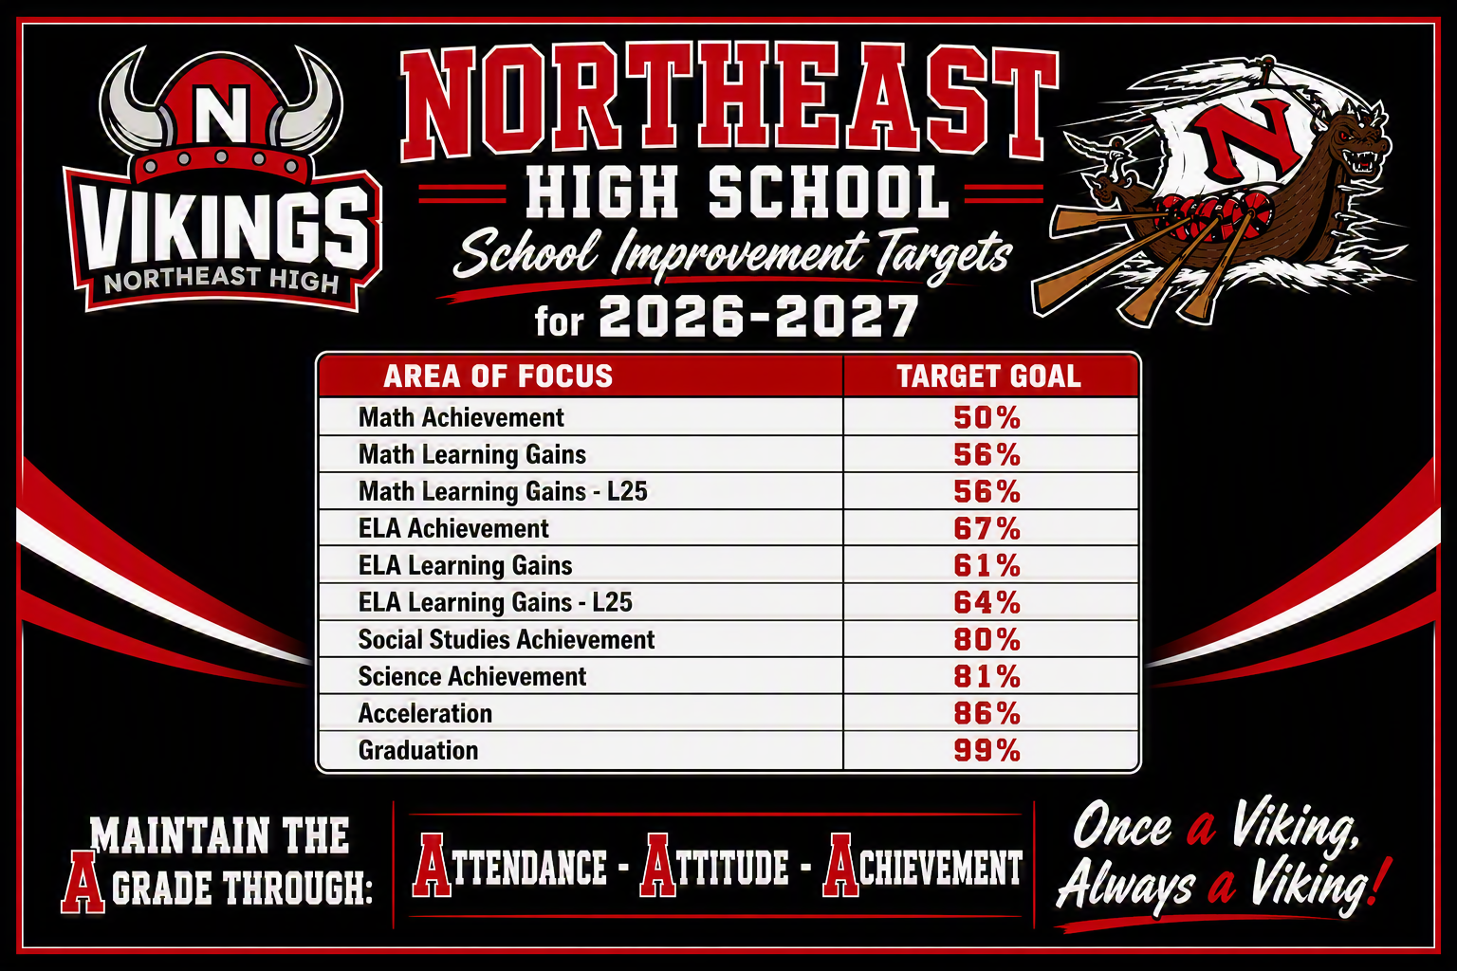

Slide 14
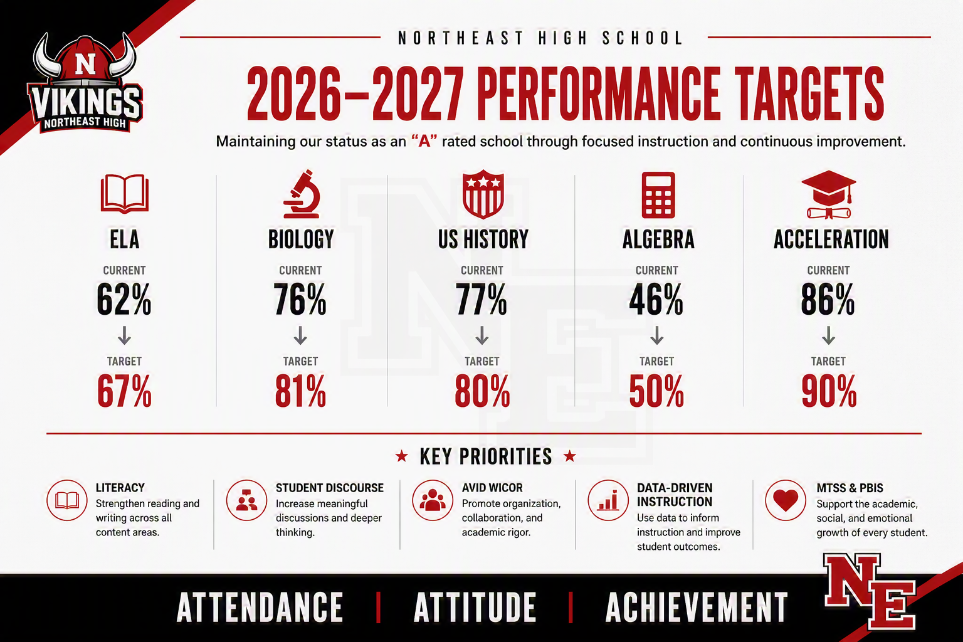

Slide 15
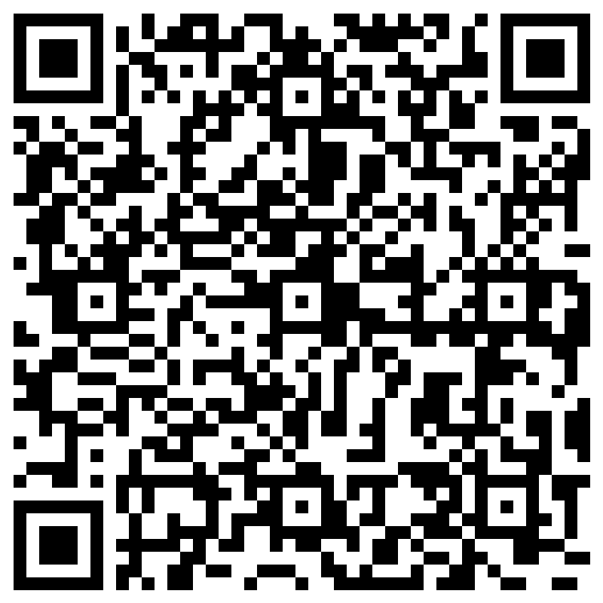

NEHS TITLE I Survey

