Slide 1


Slide 2
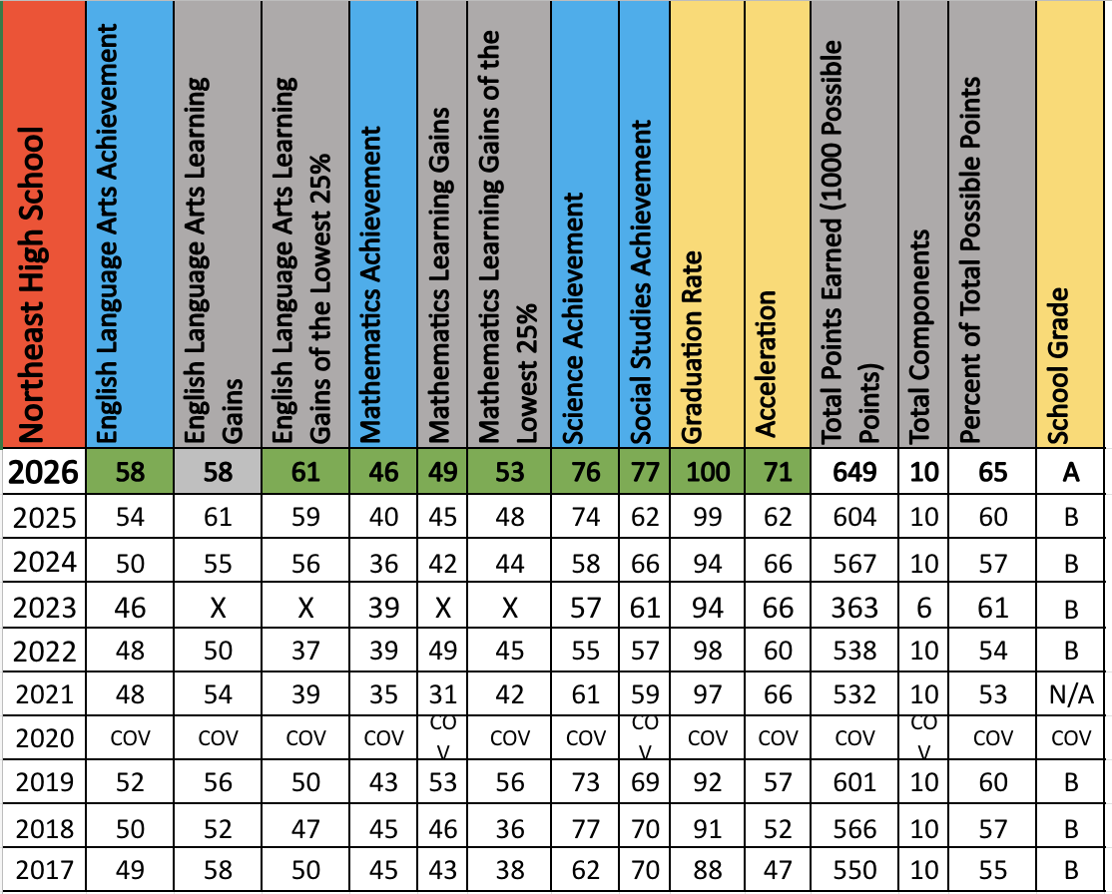

Slide 3
School Grade Increases
ELA Achievement 54% to 58% +4
ELA Learning Gains in the L25 59% to 61% +2
Math Achievement 40% to 46% +6
Math Learning Gains 45% to 49% +4
Math Learning Gains in the L25 48% to 53% +5

Slide 4
School Grade Increases
Science Achievement 74% to 76% +2
Social Studies Achievement 62% to 77% +15
Graduation Rate 99% to 100% +1
Acceleration 62% to 71% +9

Slide 5
Outpacing the District & State! (Proficiency)
ELA – Havelka, Patterson, Pickett
Math – Hemsley
Science – Aguilar, Byhanna, Osani
Social Studies – Daniel, Calcutt

Slide 6
Outpacing the District!
(Learning Gains)
ELA – Hamp, Havelka, Pickett
Math – Trewin, Zack

Slide 7
Areas to celebrate!
ACCESS students were 100% proficient!
Industry Certification:
  Increased number of passers from 534 to 566
  Increased Pass Rate from 55% to 71%
  Led by DIT (96%) and Marketing Essentials (96%) – Eggiman, Ngjelina, Taylor
Advanced Placement Highlights:
  AP Precalculus (Taylor) 61%
  AP Research (Havelka) 59%
  AP Seminar (Pickett & Holder) 50%

Slide 8
Updates
Stadium
Laptop transition
Tardy policy

Slide 9

Viking Voices
Keeping you in the loop of all of the news, events, celebrations, and information for Northeast High School !
Subscribe on Spotify!
Thank you Ms. Fajardo!

Slide 10

2026-27 PRE-SCHOOL TRAINING
Bridging the Gap
School Scorecard Review
Working Together to Improve Outcomes for Every Student
Northeast High School
Notes:
Facilitator Notes
Time: 2 minutes
Welcome everyone.
Today we're reviewing our Bridging the Gap Scorecard. This scorecard is more than a collection of numbers. It tells the story of how our students are performing compared to district expectations and where we need to focus our collective efforts.
Every staff member plays a role in helping improve these outcomes.
Today's goals are:
• Understand the scorecard
• Celebrate successes
• Identify areas for improvement
• Commit to actions that will move our students forward.

Slide 11
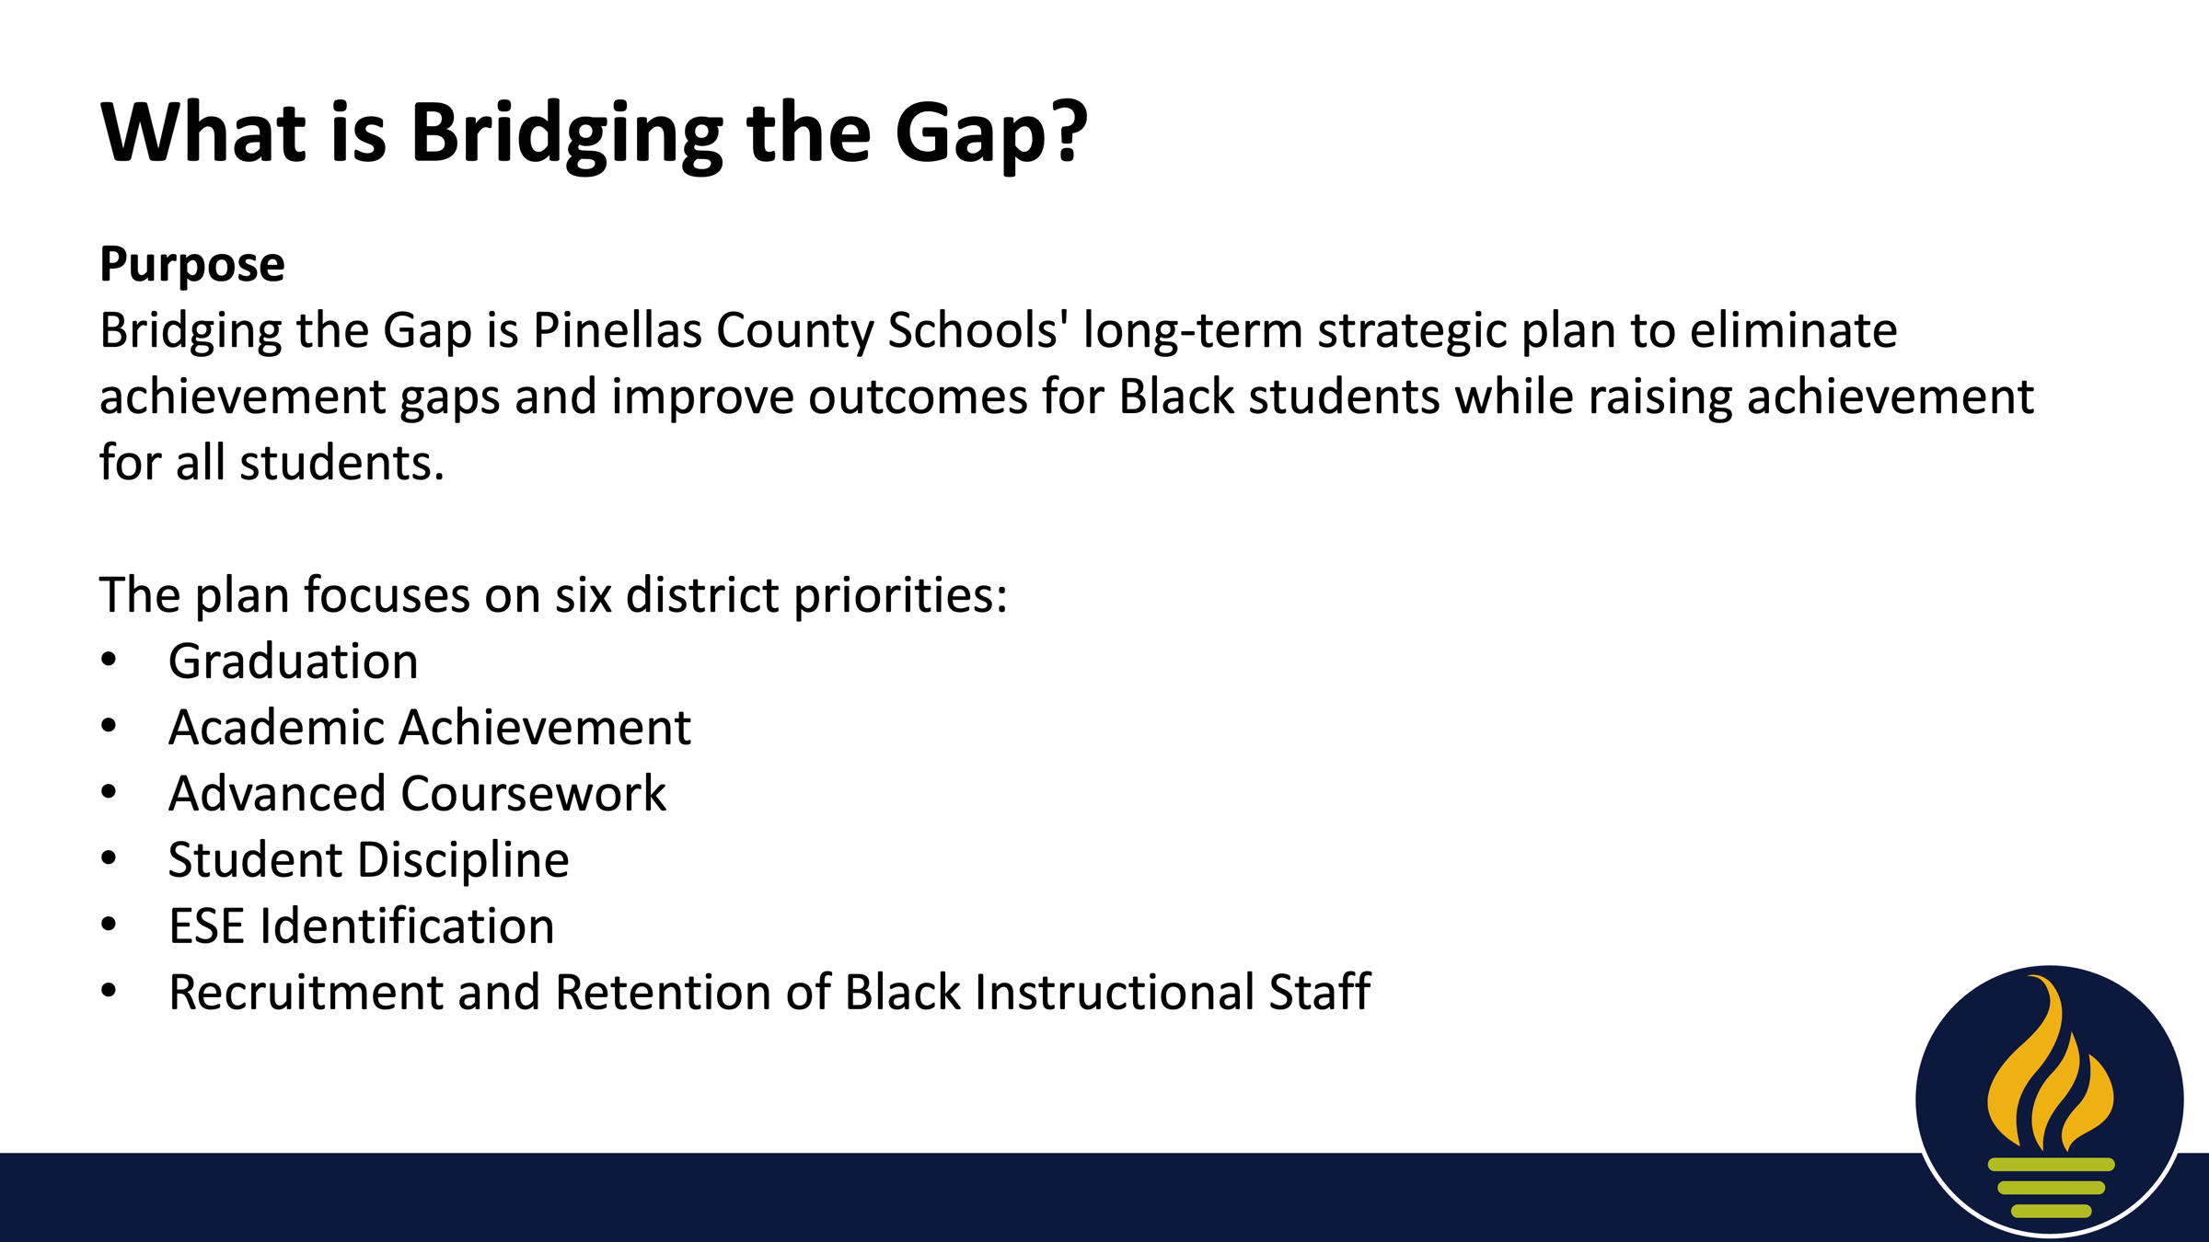

Slide 12
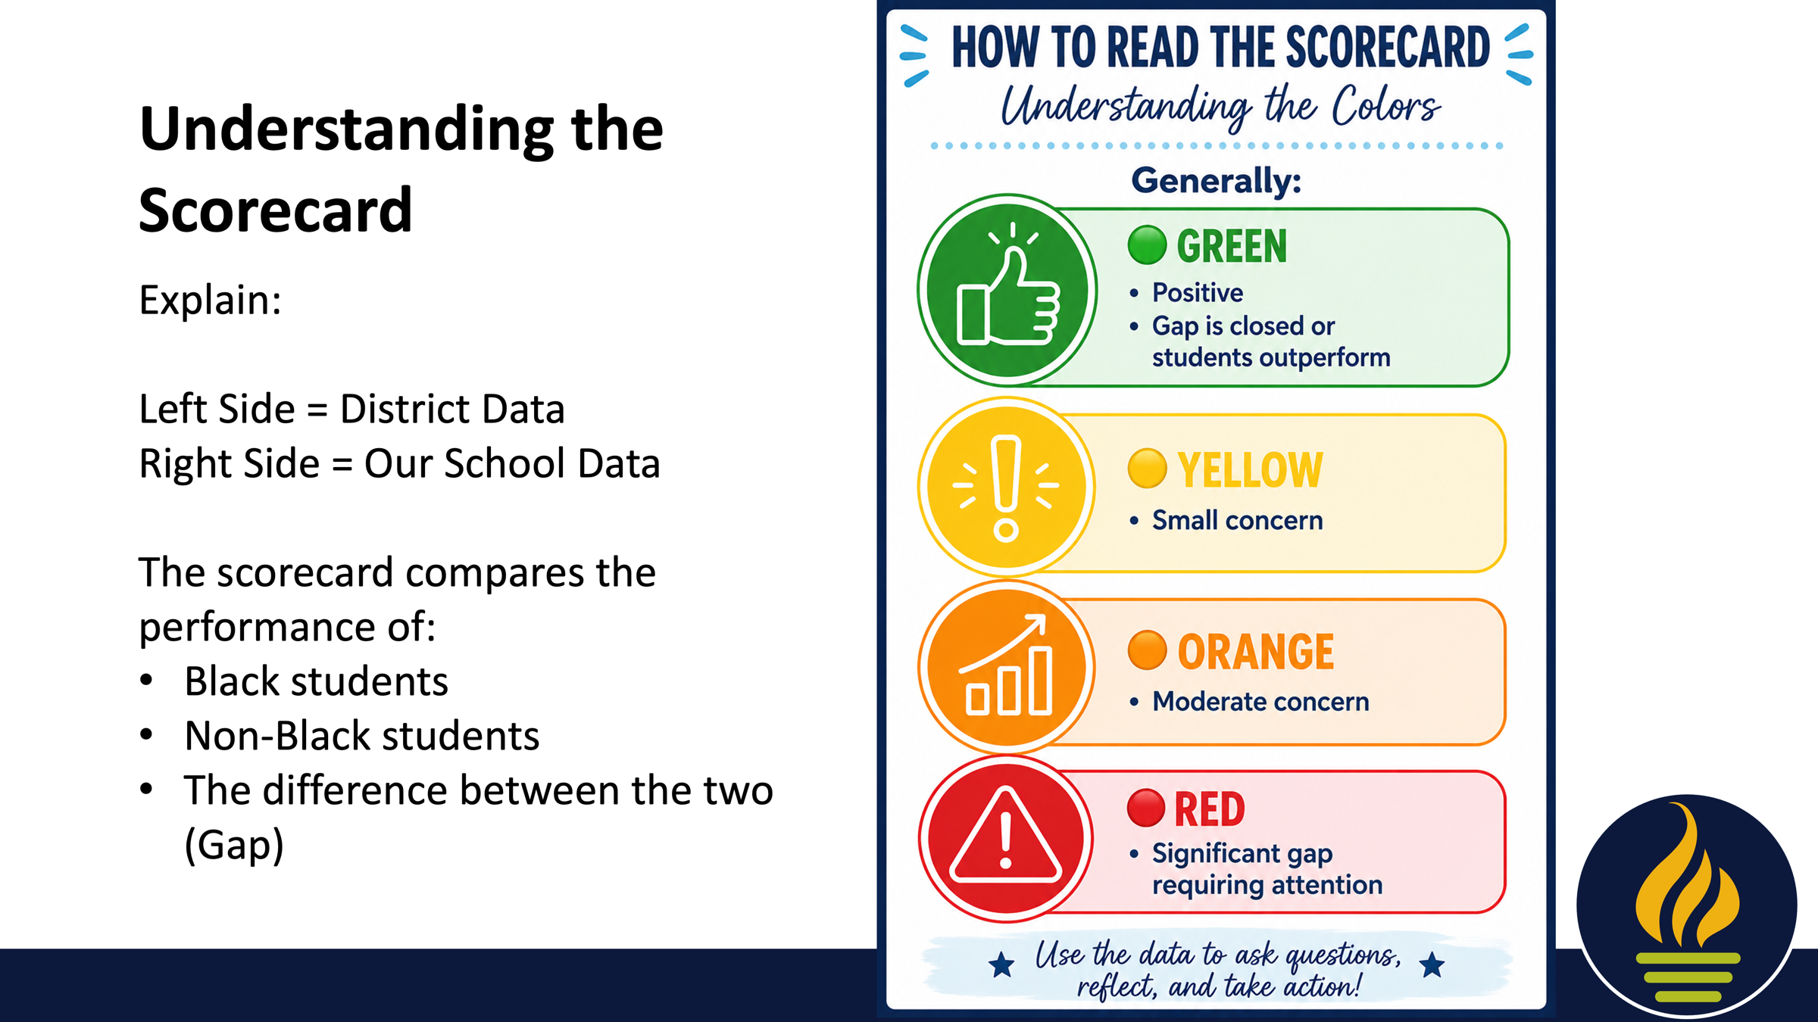

Slide 13
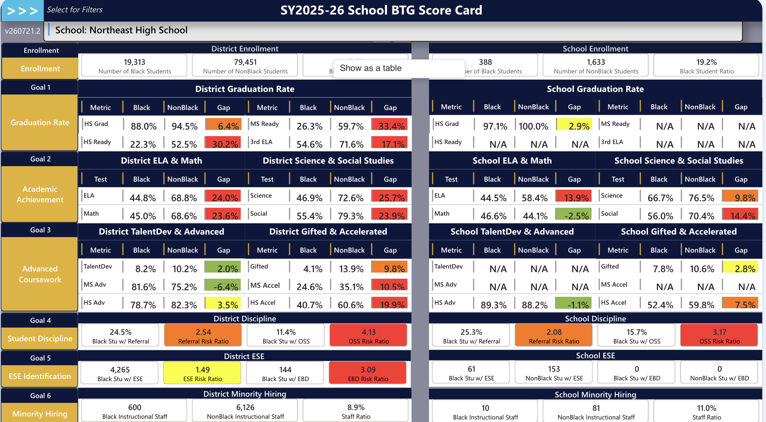

Slide 14
Our BTG Areas of Focus
Priority 1: ELA Achievement Gap
  Current Status: 13.9% Gap
  Action Steps: Increased Rigor, Data Drive Instruction, & WICOR
Priority 2: Social Studies Achievement Gap
  Current Status: 14.4%
  Action Steps: Increased Rigor, Data Drive Instruction, & WICOR
Priority 3: Discipline Disparity
  Current Status: Black students are twice as likely to be referred
  Action Steps: MTSS Supporting Social/Emotional needs of all learners

Slide 15
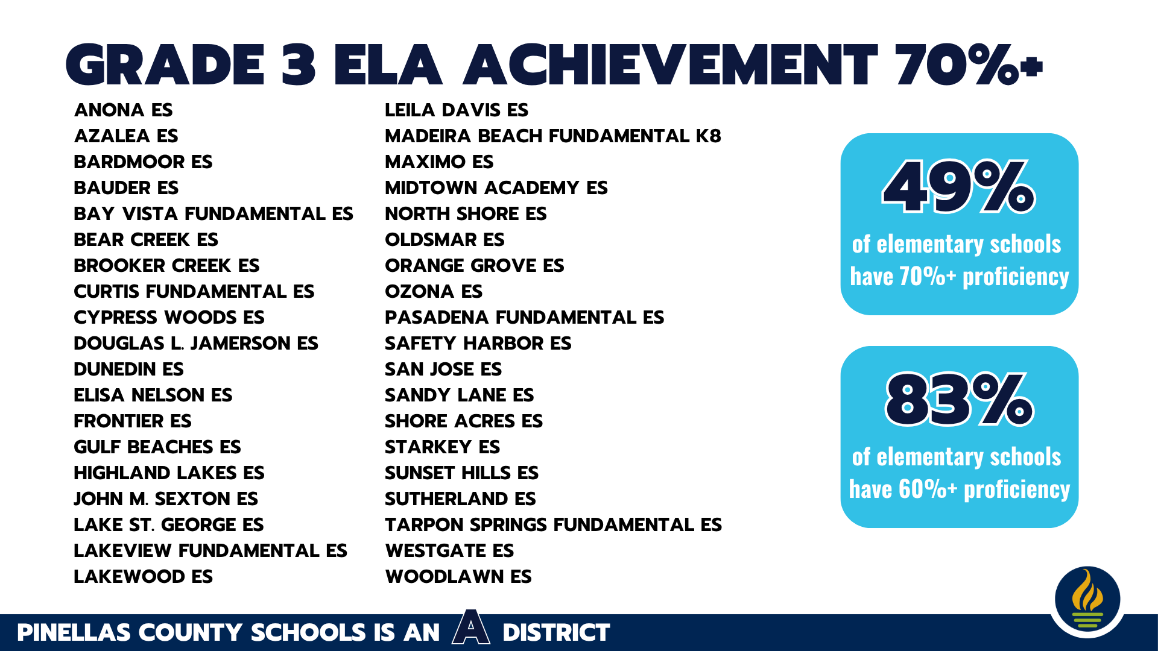

Slide 16
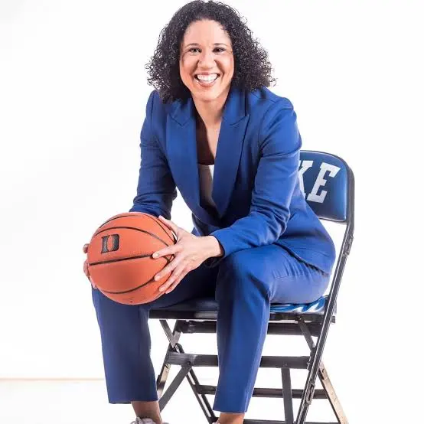
Kara Lawson
Duke Women’s Basketball Head Coach
Gold medalist
Elite Eight the past 2 years

Slide 17
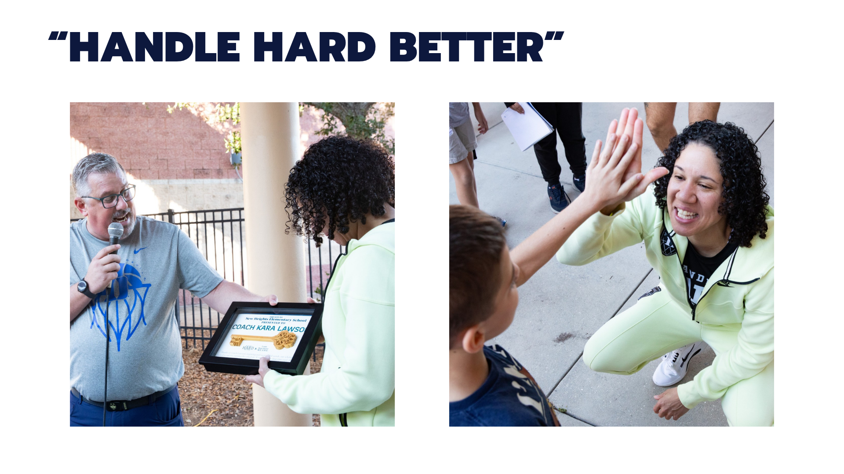

Slide 18
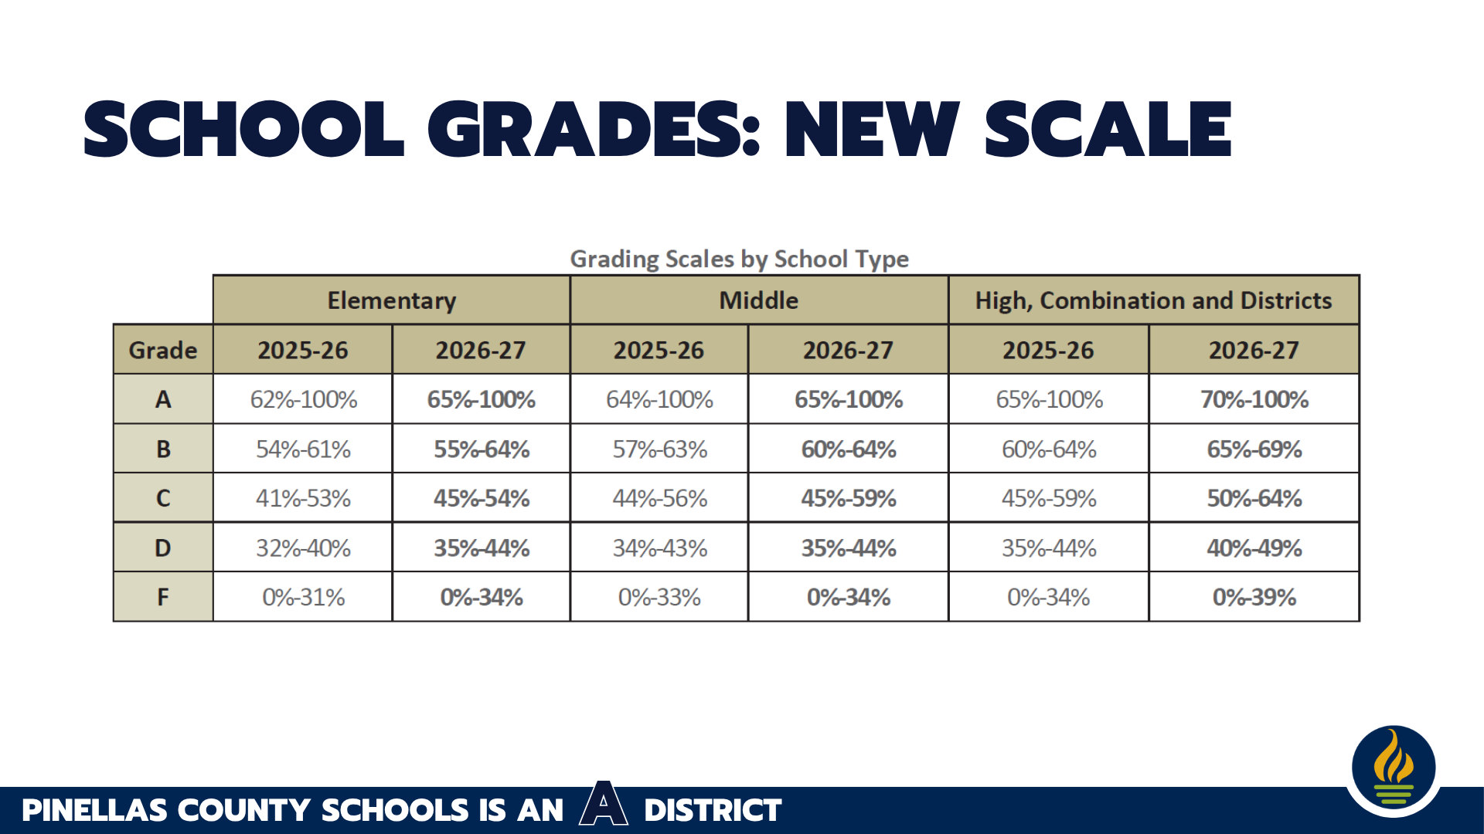

Slide 19


Slide 20
Northeast High School Dreams Big!
We are an A school because YOU dreamed big!
You also put in the work!
YOU ROWED!
You continue to Dream Big – taking Acceleration to 86%, which will count toward this year’s school grade!

Slide 21
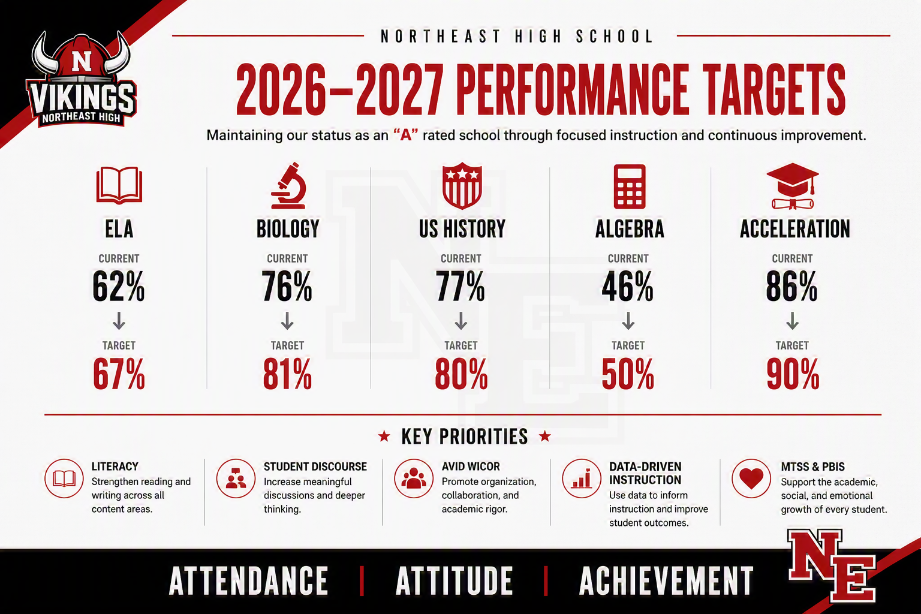

Slide 22


Slide 23
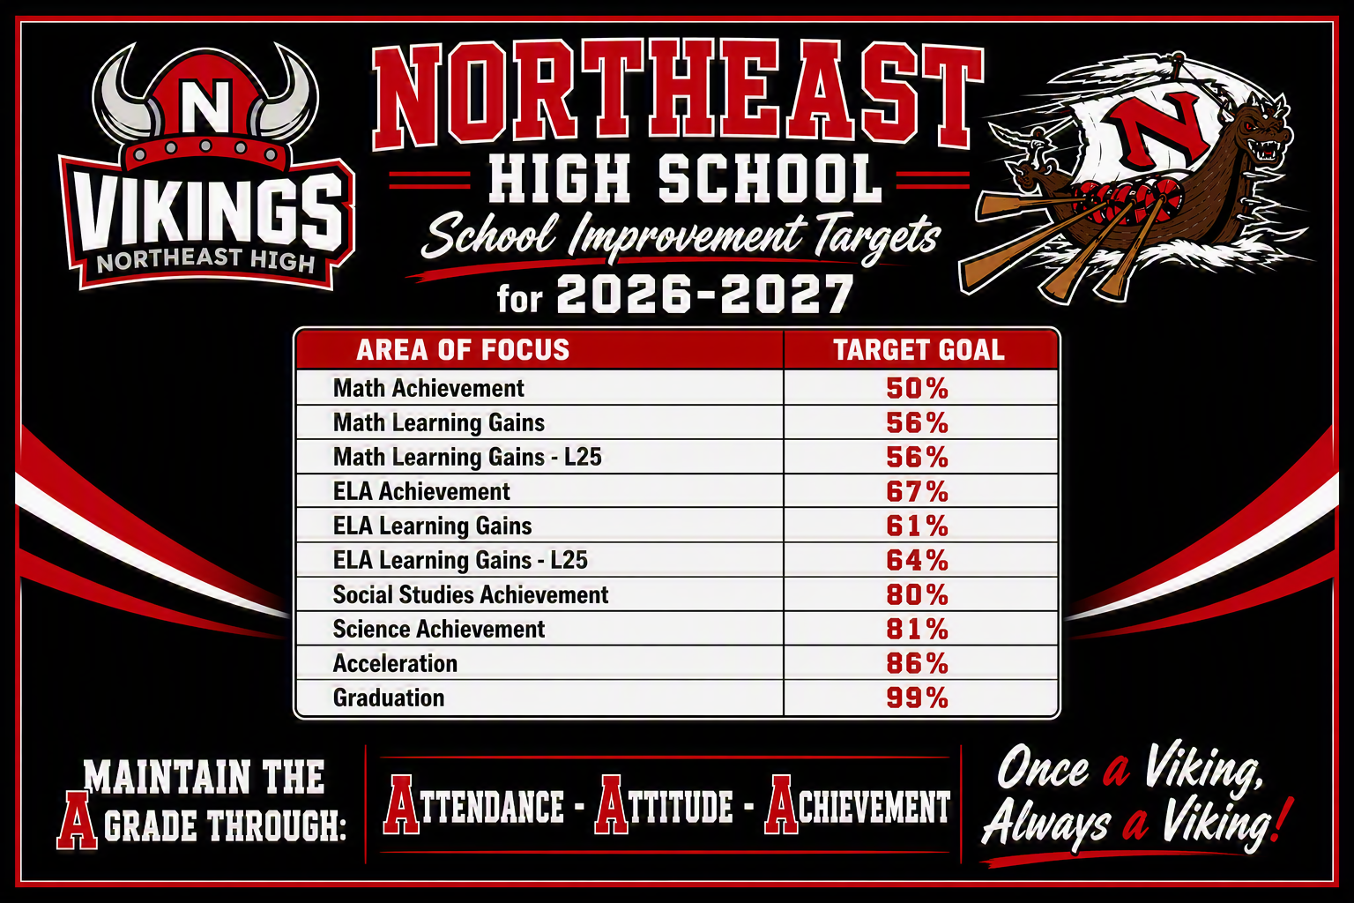

Slide 24



