Slide 1
Senior Presentation
Class of 2027
McQueen Counseling Presents

Slide 2
Objectives
01
02
03
04
Diploma Types & Graduation Requirements
Individualized Graduation Plans
Post-Secondary Options & Scholarship Info
Senior “To-Do” List

Slide 3
Diploma Types & Graduation Requirements

Slide 4
Standard Diploma
Course Title/Content Area | # of Credits
English | 4.0
Math (Must include Algebra I, Geometry, & Algebra 2 or equivalent) | 3.0
Science | 2.0
American Government/Economics | 1.0
U.S. History | 1.0
World History or World Geography | 1.0
PE or JROTC | 2.0
Arts, Humanities, or CTE | 1.0
Computer Science | 0.5
Health | 0.5
Flex Credit (4th Math in Algebra 2 or higher, 3rd Science, or Level 2 or 3 CTE) | 1.0
Electives | 6.0
TOTAL | 23.0
GPA Requirement | None

Slide 5
Advanced Diploma
Course Title/Content Area | # of Credits
English | 4.0
Math (Must include Algebra I, Geometry, & Algebra 2 or equivalent) | 4.0
Science | 3.0
American Government/Economics | 1.0
U.S. History | 1.0
World History or World Geography | 1.0
PE or JROTC | 2.0
Arts, Humanities, or CTE | 1.0
Computer Science | 0.5
Health | 0.5
Electives | 6.0
TOTAL | 24.0
GPA Requirement | 3.25 (Weighted or Unweighted)
No Flex
Credit

Slide 6
Honors Diploma
Course Title/Content Area | # of Credits
English | 4.0
Math (Must include Algebra I, Geometry, & Algebra 2 or equivalent) | 4.0
Science (Two must include Biology, Chemistry, or Physics) | 3.0
American Government/Economics | 1.0
U.S. History | 1.0
World History or World Geography | 1.0
PE or JROTC | 2.0
Arts, Humanities, or CTE | 1.0
Computer Science | 0.5
Health | 0.5
World Language (Both credits in the same language) | 2.0
Electives | 4.0
TOTAL | 24.0
GPA Requirement | 3.40 (Weighted or Unweighted)
No Flex
Credit
Must include 8 classes designated as Honors or AP
No F’s in 11th or 12th grade

Slide 7
ACT
Civics Exam
Required Exams for Graduation
This is given at McQueen to every junior in the Spring as well as any senior who has not taken it at least one time.
The McQueen test is FREE. Any additional re-tests can be taken at student’s own expense and time (go to www.act.org for more info)
Taken in Government or Economics classroom during senior year.
Any senior not in these classes will be pulled in by Ms. Amundson for testing.

Slide 8
Individualized Graduation Plans

Slide 9
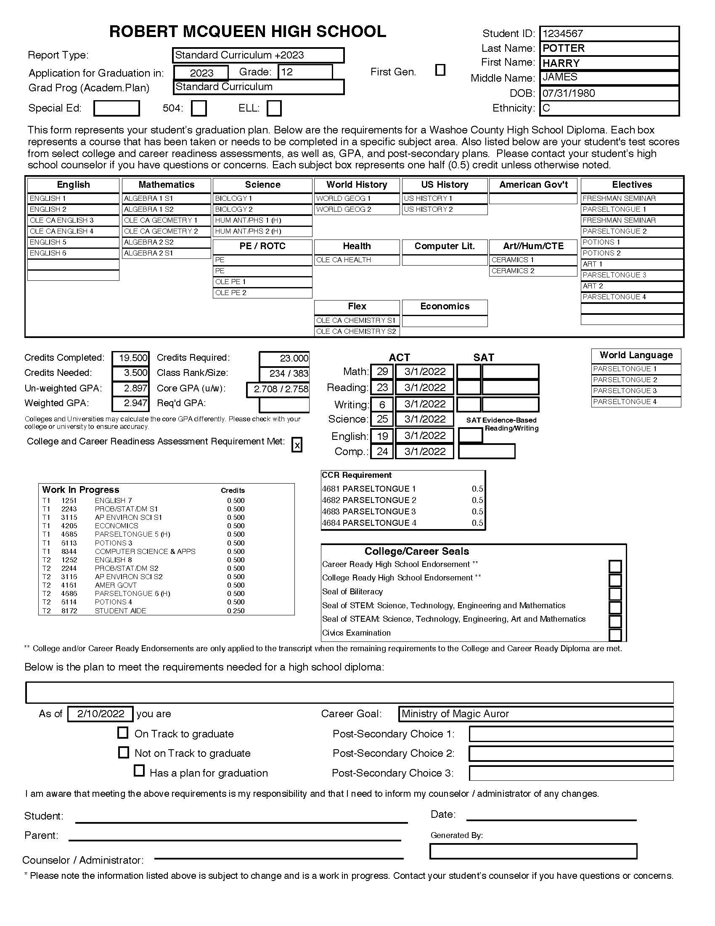
This is a Grad Plan

Slide 10
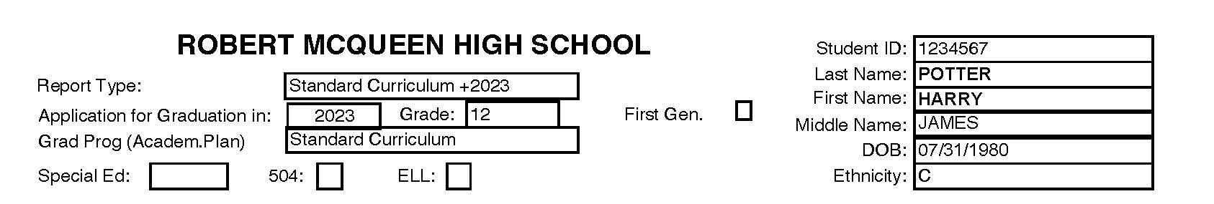
Grad Plan: Check Diploma Type

Slide 11
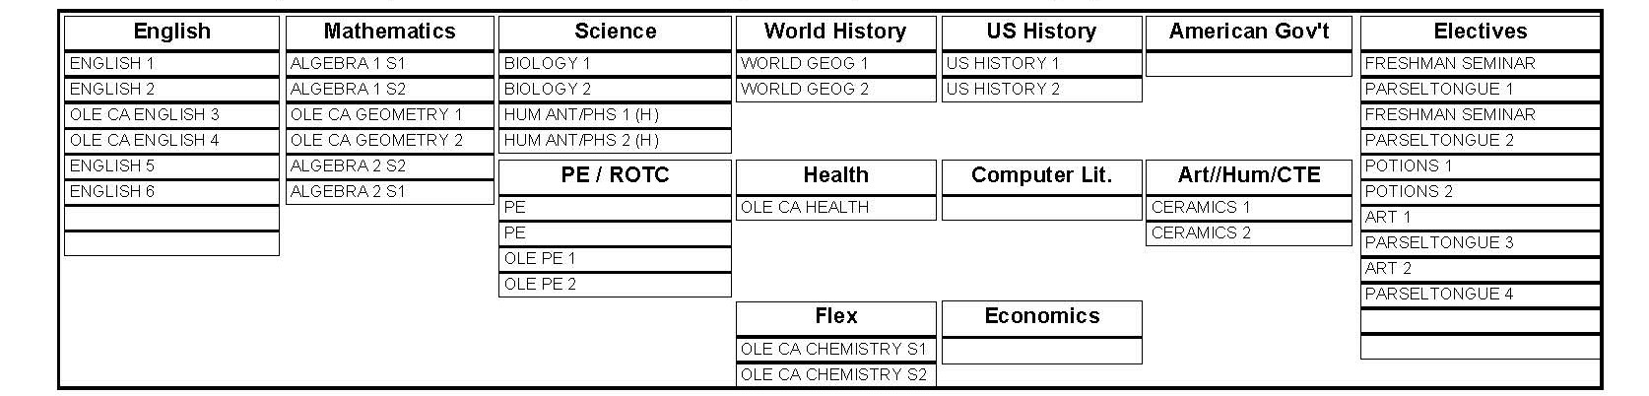
Grad Plan: Check Credits Completed

Slide 12
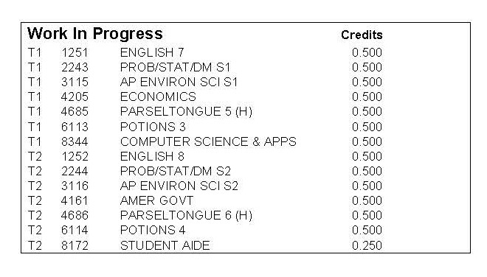
Grad Plan: Check Work in Progress

Slide 13
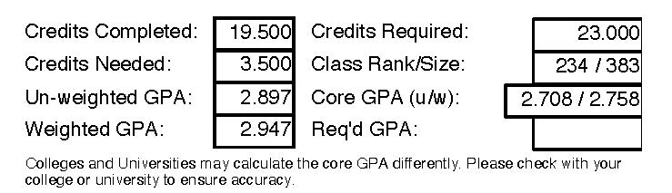
Grad Plan: Check Credits Earned, Credits Needed, and GPA Info

Slide 14
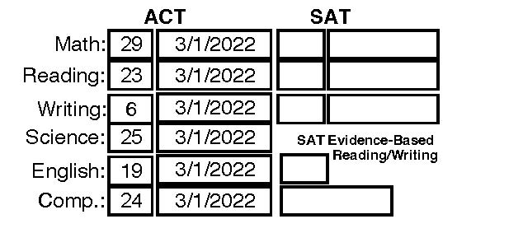
Grad Plan: Check ACT Exam Info

Slide 15
Post-Secondary Options

Slide 16
COLLEGE & CAREER CENTER
Not sure what to do after high school?
ASVAB
COUNSELOR
Visit the McQueen College & Career Center for information about postsecondary options, including trades and military service
McQueen offers the Armed Services Vocational Aptitude Battery (ASVAB). The test is free and has a career exploration component (military AND civilian career information). See Mrs. Brady in the College & Career Center to learn more and sign-up.
Make an appointment to speak with your school counselor about options that might be a good fit for you

Slide 17
CERTIFICATE PROGRAMS
APPRENTICESHIPS
MILITARY
WORKFORCE
Additional Post-Secondary Options
TMCC has a myriad of certificate programs, many that can be completed in one or two semesters. Visit https://www.tmcc.edu/academics/certifications for more information
Learn about paid internships by visiting the Northern Nevada Apprenticeship Coordinator’s Association (NNACA) website
Learn about military service by contacting local recruiters. Consider taking the ASVAB to learn about career field options.
Air Force: 775-829-2807
Army: 775-829-2769
Marines: 775-829-8911
Navy: 775-331-1126
Gain work experience, try out different career fields, and learn about your interests.
Take an interest inventory to guide your employment choices:
MAPP Career Assessment

Slide 18
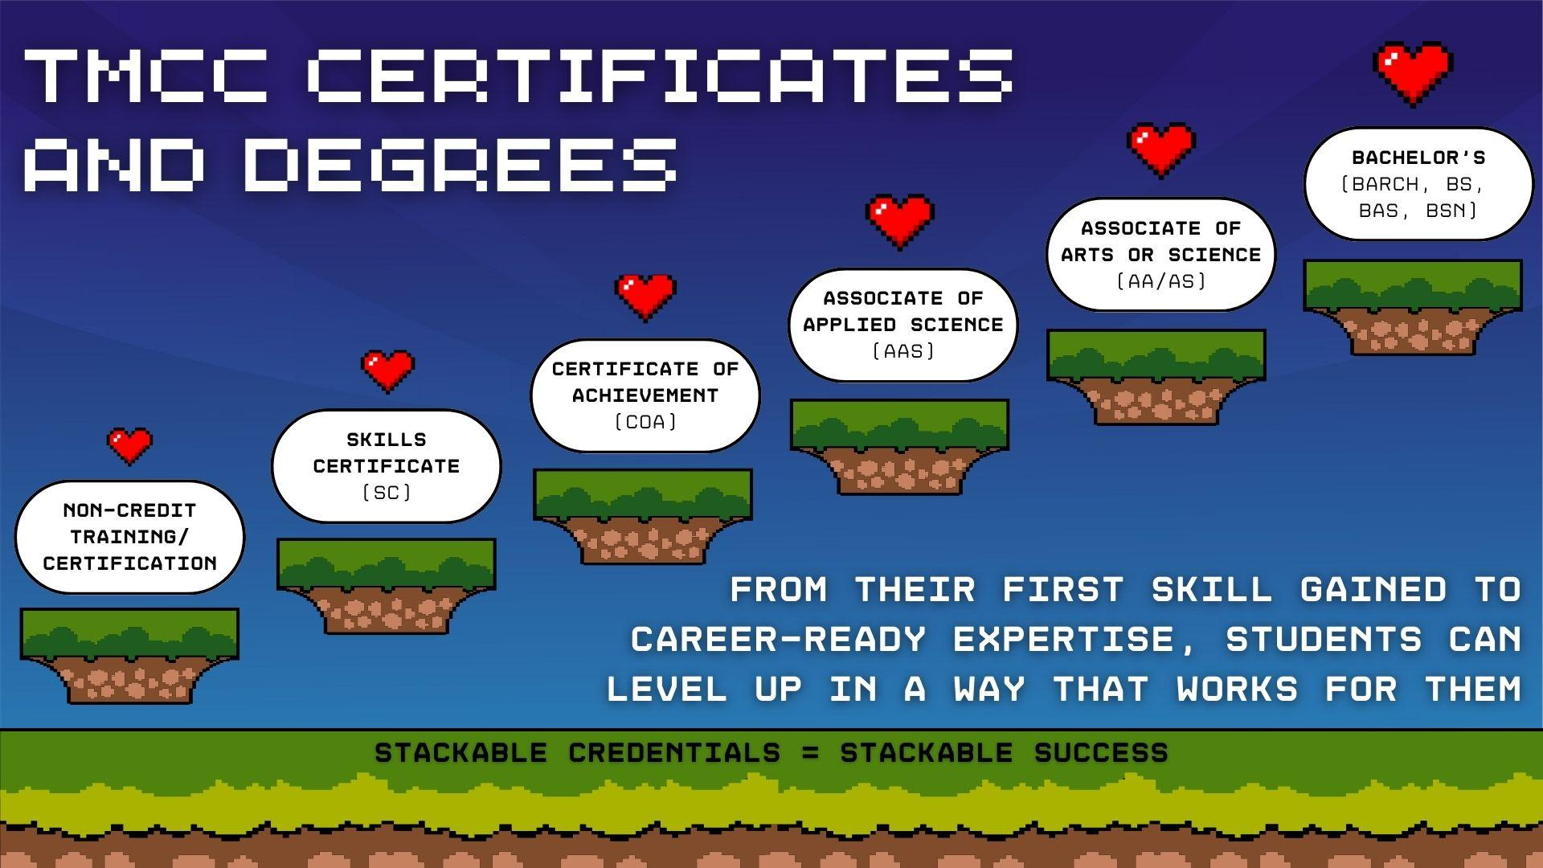

Slide 19
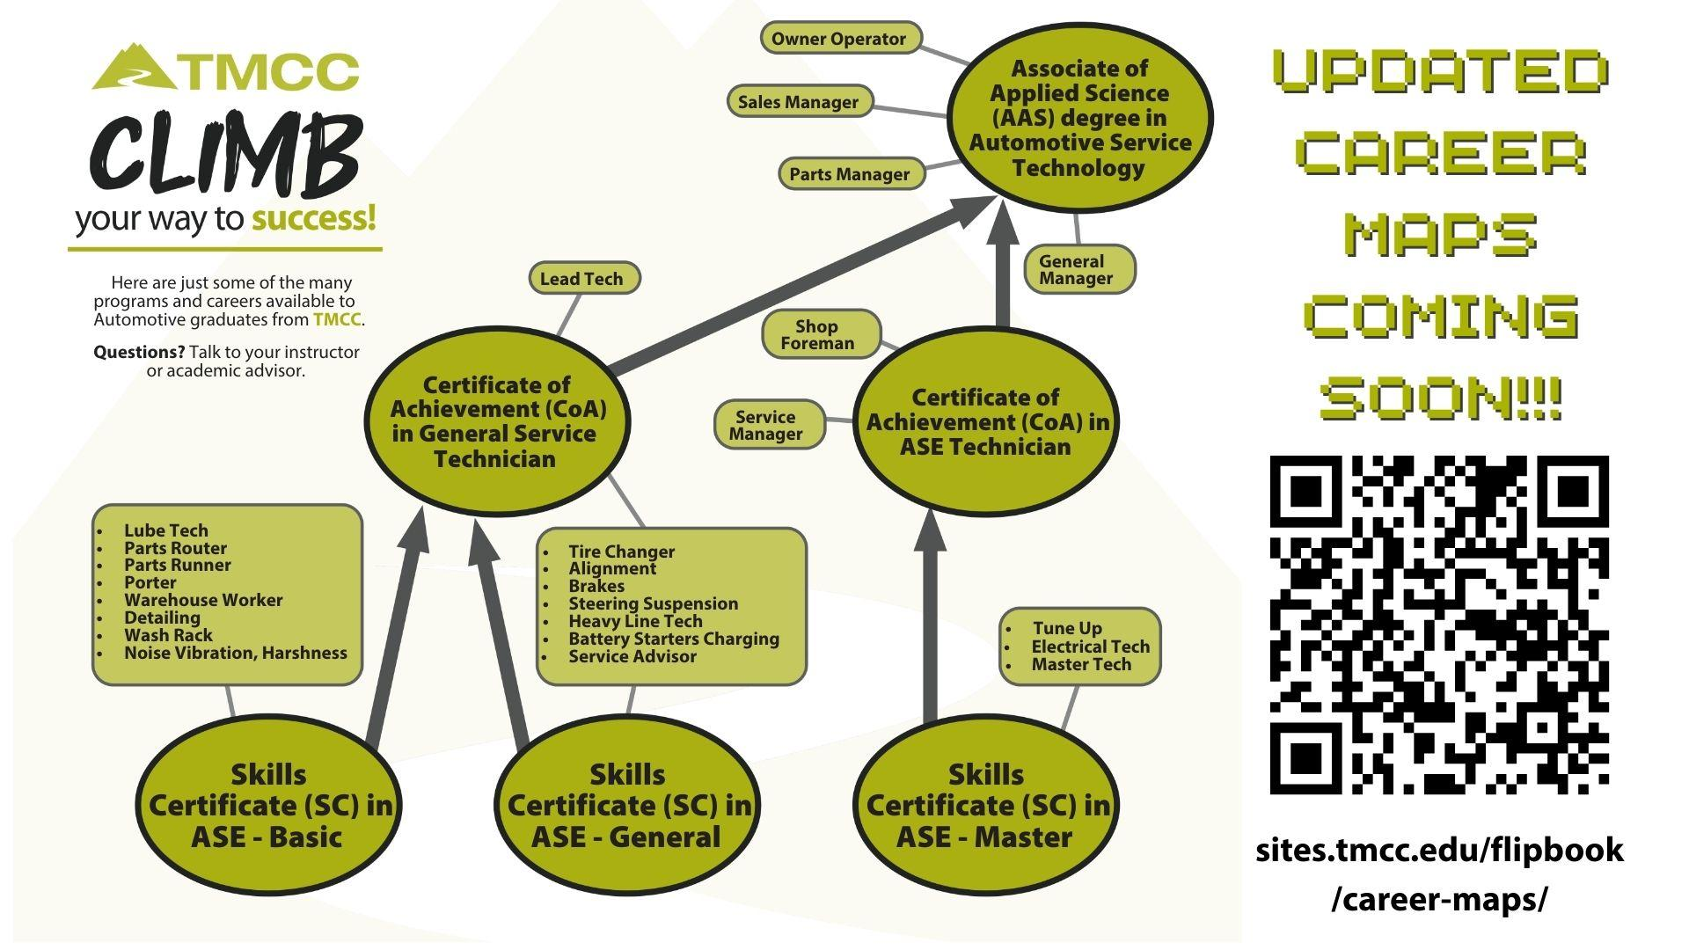

Slide 20
College &
Scholarship Info

Slide 21
HS Classes
Diploma Type
GPA
Test Scores
UNR Admissions Requirements
Must have taken
4 English
3 Math
3 Science
3 Social Studies
in High School
If a student does not meet the core GPA requirement, but graduates with an Advanced Diploma and has the 13 core courses, they will be admitted
Must have a 3.0 weighted GPA in core subjects: English, Math, Science, Social Studies
Standardized test scores are not required for admission, but can be used for class placement and scholarship decisions
Search “AGPA Calculator” on www.unr.edu

Slide 22
APPLICATION
FEE
HS TRANSCRIPT
IMMUNIZATIONS
UNR Admissions Checklist
The UNR application is now open at www.unr.edu/apply.
Early Action Deadline:
November 15, 2026
Final Admissions Deadline:
April 7, 2027
The application is FREE!
Advanced Registration Fee is $125, which guarantees an early freshman schedule and priority housing
Send official high school transcript by ordering directly from Scrib Order:
https://washoeschoolsnv.scriborder.com/
Immunization records are often on your transcript, but they may not include all required vaccines for admission
UNR Recruiter
Elizabeth Nubel
enubel@unr.edu
Text 775-204-6115

Slide 23
FEBRUARY 15, 2027
MATRIX
AWARDS
UNR Scholarship Process
Students must have all admissions requirements completed by this date, which automatically places them under consideration for the UNR scholarship program.
Students must have a qualifying unweighted GPA and ACT/SAT test score under the Scholarship Matrix to receive an award. There is also a GPA-only scholarship opportunity.
Awards vary and are based on a matrix (CO 2027 matrix to be released soon)
Pack Promise+ covers tuition, fees, and books. Must be Federal Pell Grant eligible and have a Student Aid Index of $7,000 or less

Slide 24
HS Graduate
Test Scores
TMCC Admissions Requirements
Be a graduate of a high school or its equivalent
Standardized test scores are not required for admission, but may be used for class placement

Slide 25
APPLICATION
FEE
HS TRANSCRIPT
IMMUNIZATIONS
TMCC Admissions Checklist
The TMCC application opens on September 1, 2026 at www.tmcc.edu
First Generation students may be eligible for the Success First Program
The $20 non-refundable application fee is not charged right away. This fee is charged after classes are enrolled in
Send official high school transcript by ordering directly from Scrib Order:
https://washoeschoolsnv.scriborder.com/
Immunization records are often on your transcript, but they may not include all required vaccines for admission
TMCC Recruiter
Jason Pinto Maldonado
jpintomaldonad@tmcc.edu

Slide 26
WHAT?
WHEN?
HOW?
TMCC Nevada Promise Scholarship
As a last-dollar scholarship, the Nevada Promise Scholarship can cover up to 3 years of tuition and fees not covered by other gift aid
The scholarship application due date is October 31, 2026. There are additional steps that have separate deadlines after the initial application is completed
Apply online at https://www.tmcc.edu/nevada-promise-scholarship

Slide 27
GPA
CLASSES
RESIDENCY
TEST SCORES
APPLICATION
NOTIFICATION
Millennium Scholarship
Graduate with an overall GPA of 3.25 (weighted or unweighted)
While in high school, complete
4 English
4 Math (inc. Algebra 2)
3 Science
3 Social Studies
Be a resident of Nevada for at least two years
If GPA requirement is not met, an alternate qualifier is to earn a qualifying test score:
ACT 21 or higher
SAT 1070 or higher
There is not an application to fill out! WCSD will submit the names of eligible students following graduation
Award notification will come by mail in July or August following high school graduation

Slide 28
McQueen General Scholarships
McQueen is fortunate to have many scholarships that are designated for McQueen HS students only. The best part is that there is only one application to fill out to be considered for all scholarships.
The application will be posted on Canvas.

Slide 29
Senior “To-Do” List

Slide 30
Senior “To-Do” List
Action Item | Helpful Tips
Research college admissions requirements | What are the admissions criteria? Do you need to write a college essay? Do you need letters of recommendation?
Start applying to your college(s) of choice | For out-of-state institutions, consider using the Common App. The Common App is used by over 1,000 colleges and universities.
Send official transcripts | Counselors will upload transcripts to the Common App and SendEDU only. All others must be ordered through Scrib Order. Students get four FREE transcripts per year
Send test scores | Students must send their ACT, SAT, or AP test scores directly from www.act.org or www.collegeboard.org to their college(s) of choice
Take placement tests | If ACT/SAT test scores did not place a student in their desired math or English class in college, taking a placement test at their school of choice may help
Complete the FAFSA | Students must list at least one college/university to receive their FAFSA
Search for scholarship opportunities | Check out websites such as www.fastweb.com, www.goingmerry.com, or www.bigfuture.collegeboard.org to search for additional scholarship opportunities
Apply for scholarships | Keep deadlines in mind to give yourself plenty of time to complete all the requirements
Check grades | Stay on top of your grades during senior year. Download the Infinite Campus Student app to stay informed

Slide 31
?
$$$
Free Application for Federal Student Aid
College-bound students need to complete the FAFSA to determine if they are eligible for federal aid, including grants, scholarships, student employment, and student loans
Many colleges use information from the FAFSA to make in-house financial aid decisions (aka institutional aid)
UNR and TMCC both require the FAFSA
Application opens on October 1, 2026
Complete the 2027-2028 FAFSA

Slide 32
Help with the FAFSA
McQueen FAFSA Family Night (TMCC):
October 14th @ 7-9pm
TMCC Financial Aid Office https://www.tmcc.edu/financial-aid
UNR Financial Aid Office https://www.unr.edu/financial-aid
FAFSA Official Website
https://studentaid.gov/h/apply-for-aid/fafsa

Slide 33
NCAA Eligibility Center
01
02
03
04
Check eligibility to play sports at a Division I, II, or III university by completing an online application and paying the $100 fee
Complete the required amateurism acknowledgement form
Order an official transcript from Scrib Order
Order official ACT or SAT score reports
McQueen School Code
290143

Slide 34
Letters of Recommendation
01
02
03
04
Are these required by your college or university? If so, how many are needed?
Consider teachers who know you best
If you need a counselor letter, pickup a request form in the Counseling Office
At least two weeks notice is required

Slide 35
Additional Resources
McQueen School Code: 290143
McQueen Counseling Website: https://mcqueen.washoeschools.net/academics/counseling
McQueen Counseling Instagram: @mcqueencounseling
McQueen College and Career Center Website: https://mcqueen.washoeschools.net/academics/college-and-career-center
McQueen College & Career Center Instagram: @mcqcollegeandcareer
TMCC New Student Information Day & Night Events, https://www.tmcc.edu/recruitment-access-center/info-events
UNR Nevada Bound Tours, https://www.unr.edu/visit
Nevada Career Explorer, https://wcsd.nv.headed2.com/signin
Writing a College Essay, https://myfuture.com/college/writing-a-college-essay
ACT College Planning Guide, https://www.act.org/content/act/en/students-and-parents/college-planning-resources.html

Slide 36
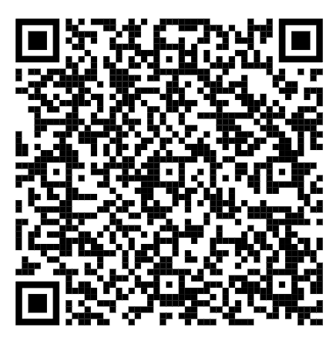
Senior Needs Survey
Please complete this survey so the McQueen Counseling Department can better serve you this school year. Click the link or scan the QR code:

Slide 37
McQueen counselors are available before school, during lunch, after school, or by appointment
Questions?
Student Last Name | Counselor | Email | Appointment Link
A – C San-Sam | Mrs. Benson | jbenson@washoeschools.net | https://calendly.com/jbensonmcqueencounselor
D – HO Sn-Sz | Mrs. Schweickert | tschweickert@washoeschools.net | https://calendly.com/tschweickert-washoeschools/30min
Hp – Mor T-U | Ms. Smith | kmsmith@washoeschools.net | https://calendly.com/kmsmith-1
Mos – Sam V-Z | Mrs. Parker | erin.parker@washoeschools.net | https://calendly.com/erin-parker-1

