Slide 1
Disclaimer on Artificial Intelligence
Need tech support during this meeting?
Contact Nathan Redford
redford_n@cde.state.co.us or 720-926-6108
This online event is offered by CDE for training purposes. By participating in this event, attendees agree that they may not save, record, capture, share, or post its contents without our express permission. Attendees may not use artificially intelligent (AI) software or services to capture the content of the event. CDE reserves the right to remove any attendee employing such services.
Note: This live event is being recorded. The recording will be posted online and sent to DACs.

Slide 2

2026–2027
District Assessment Coordinator
Kickoff Meeting
CDE Assessment Division

Slide 3
Welcome and Agenda
General Information
ACCESS
CMAS
CoAlt
Colorado PSAT and SAT
Assessment Accessibility and Accommodations
Data and Reporting
National and International Assessments
Assessment Technology
Final Thoughts and Reminders

Slide 4
CDE Assessment Contacts
Questions | Contact | Email
CMAS | Emily Hunter | hunter_emily@cde.state.co.us
CO PSAT and SAT | Melissa Carpenter | carpenter_m@cde.state.co.us
CoAlt and Accommodations for Students with Disabilities | Arti Sachdeva | sachdeva_a@cde.state.co.us
ACCESS and Accommodations for Multilingual Learners | Heather Villalobos Pavia | villalobospavia_h@cde.state.co.us
Technology, NAEP and International Assessments | Collin Bonner | bonner_c@cde.state.co.us
Psychometrics and Data | Jasmine Carey | carey_j@cde.state.co.us
Data and SBD Collections | Leon Merker | merker_l@cde.state.co.us
ELA and Social Studies Content | Nathan Redford | redford_n@cde.state.co.us
Math and Science Content | Brittany Peterson | peterson_b@cde.state.co.us

Slide 5
General Information

Slide 6
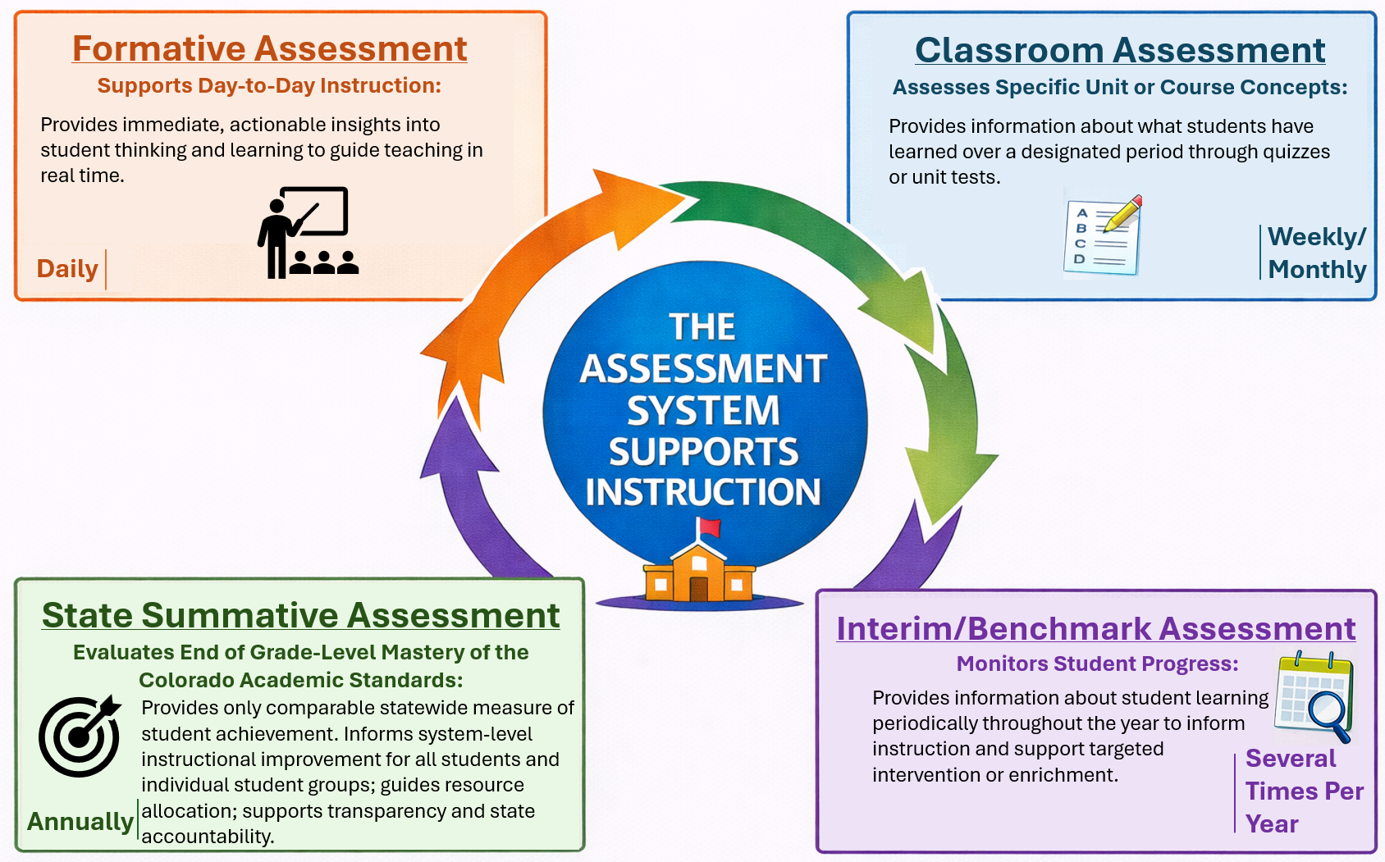
Colorado’s Assessment System
Assessments are an essential part of teaching and learning.
  Guide instruction
  Support student growth
  Ensure each student’s needs are understood
Colorado’s assessment system uses multiple types of assessments, each with a distinct purpose but all working to strengthen instruction and improve outcomes.

Slide 7
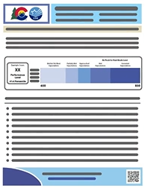
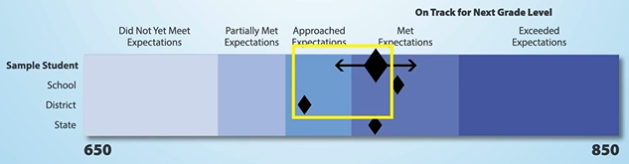
State Content Assessments: Purpose and Uses For Students/Parents
Serve as only statewide indicators of student mastery of the Colorado Academic Standards
Provide student achievement information to parents beyond their child’s school
PSAT/SAT provides a nationally recognized indicator of academic college readiness
As always, parents should consider multiple data points and sources of information when making decisions regarding student achievement and plans for instruction.

Slide 8
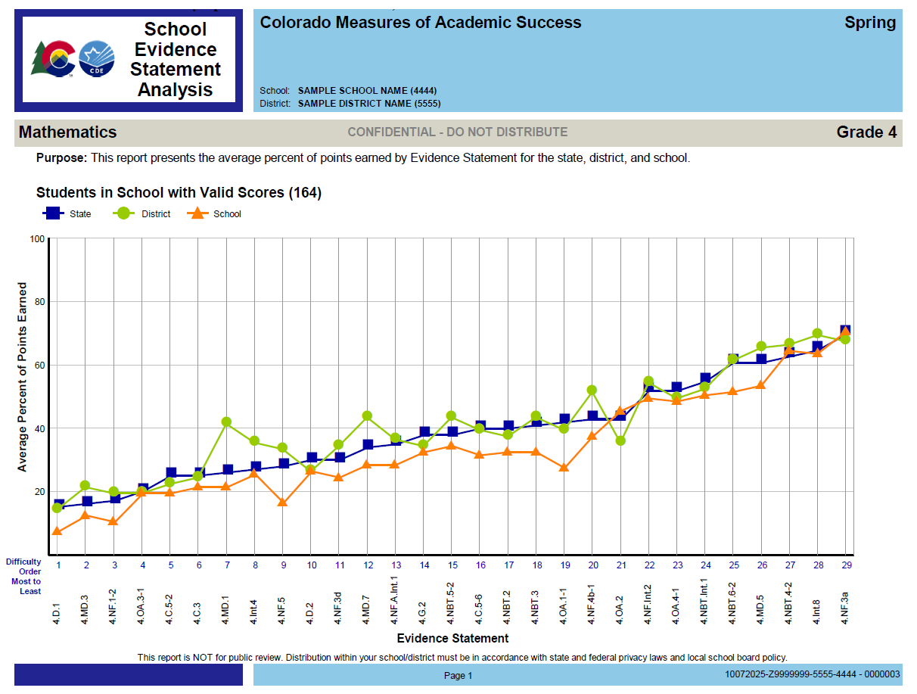
State Content Assessments: Purpose and Uses For Educators
Show student performance compared to school, district, and state peers at EOY
Help teachers see performance against standards and identify areas for instructional adjustments
Provide data to guide decisions about curriculum, scope and sequence, and resource allocation
Offer comparison points to evaluate the impact of efforts
As always, educators should consider multiple data points and sources of information when making decisions regarding student achievement and plans for instruction.

Slide 9

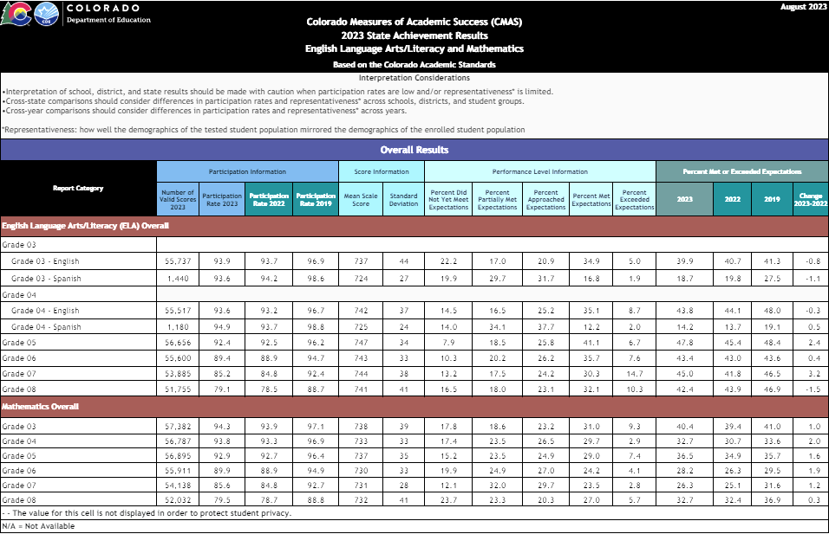
State Content Assessments: Purpose and Uses
For Stakeholders, Policy Makers and the Community
Clear, public information about how well schools are serving all students in the community
Provide information to inform the allocation of resources and evaluate the impact of policy

Slide 10
Communicating about State Assessments
District leaders, school leaders and teachers are key drivers of parent and student perceptions of state assessments.
State Assessment Communication and Information Flow
State
District Leadership
School Leadership
Teachers
Parents and
Students
Participation

Slide 11
Parent Excusals - C.R.S. §22-7-1013(8)(a-c)
Local Education Providers (LEPs) must have a written policy allowing parents to excuse their student from state assessments
Students and families may not face penalties or loss of access to school activities or rewards due to a parent excuse
LEPs may not create barriers or requirements that discourage participation or encourage parent excuses
Parent Excuse Factors Outside of School/District Control
Parent Excuse Factors Within
School/District Control
Statutory language and expectations including parent excuse allowance
Parent excuse decisions made independently of school messaging
Parent excuse policy and procedures
Communication and framing of the value and purpose of state assessments with parents and students
Looking for information about parent excusals and participation?
Visit Assessment Communications Toolkit > Participation
Note: CDE does not provide a parent excusal form (§22-7-1013(8)(a) Each LEP will adopt and implement a written policy and procedure…)

Slide 12
District Assessment Coordinator (DAC)
In this role you:
  Serve as your district’s point person for CDE Assessment Division communication
    Share information with School Assessment Coordinators (SACs)
  Attend all required state assessment trainings
    Train district and school level staff involved in assessment administration and materials handling
  Complete and submit state assessment forms such as training documentation, unique accommodation requests, and testing irregularity reports
Verify your contact information in the DAC Directory
  If information is incorrect, submit a DAC Appointment Form to Melissa Carpenter

Slide 13
Communication Structure
CDE Assessment works with the official superintendent-appointed DAC and DTC
  School-level staff, including Test Administrators and school leadership, refer questions to SACs
  SACs and district-level staff refer questions to the DAC and DTC
  Official DACs and DTCs refer questions to CDE Assessment
DACs and DTCs share information from CDE with district- and school-level staff, as appropriate
Using this communication structure ensures local policies and procedures are communicated
Note: CDE Assessment and CDE Accountability are separate groups
  The District Accountability Contact list is maintained by CDE Accountability
  Refer questions about Performance Frameworks and Growth to CDE Accountability
    accountability@cde.state.co.us
  Accountability is a downstream user of assessment data, so it can be helpful to share updates about assessment progress with your District Accountability Contact

Slide 14
DAC Responsibilities
Interact with assessment vendor systems
  Manage student test registration and material ordering
  Manage user accounts
  Manage and monitor assessment administration for the district
  Access demographic information, reporting files and reports*
Report, investigate and contain administration and security issues/concerns
  e.g., misadministrations and breaches
Work with the District Technology Coordinator (DTC)
Work with Data Respondents on final student demographics, especially invalidation codes, used for reporting
Share report and score interpretation information throughout the district
*DACs have access to sensitive personally identifiable information through vendor management and
administration systems. At the DAC’s discretion, others given sensitive data permissions also have access.

Slide 15
Assessment Systems Access
Due to the sensitive nature of the information available through state assessment systems, CDE Assessment manages accounts for official superintendent-appointed DACs
  CDE cannot verify an individual’s employment status or their ability to view sensitive assessment information
If an individual requires access to an assessment system, access is provided by the DAC or other authorized local user
If other authorized local users do not have access and the DAC is unavailable, requests for access must be emailed to the appropriate CDE Assessment contact by the superintendent
  Example:
    A DAC is out of office when CMAS student data files become available.
    Another district user needs access to ADAM to download the CMAS files.
    The superintendent must email Emily Hunter to enable CMAS access for the non-DAC employee.
    That individual can then enable other local accounts, as appropriate.

Slide 16

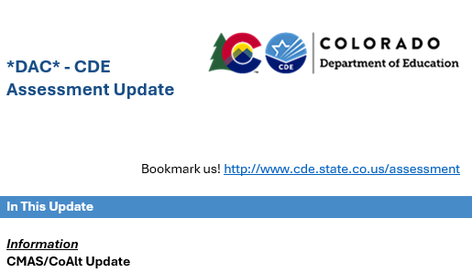

Assessment Emails (*DAC*)
CDE sends *DAC* emails on Thursdays
  Emails include information about:
    Important updates for the week and coming weeks by assessment program
      Tasks for DACs
      Resources
      Results availability
  Assessment program topics covered in the email are discussed during office hours if additional clarification is needed
If there are no new updates, an email is not sent
  Updates are not in the summer unless re: results
  Results messages sent as Special Edition

Slide 17

Transmitting Secure Information
Use Syncplicity to send secure information to CDE
Two users per district can access the CDE_Assessment folder
The official DAC
One additional individual, if requested
CDE will email a list of users to each district
  Respond with updates
  New users must create/access their accounts within 90 days
During SBD, the Data Respondent has access to a separate SBD folder
Reminder: Do not email personally identifiable information (e.g., SASID, name, FRL status, disability status, test scores, report copies, etc.)
CDE Assessment will not respond to emails containing PII
The email will be deleted
Remind all staff who may
communicate with CDE

Slide 18
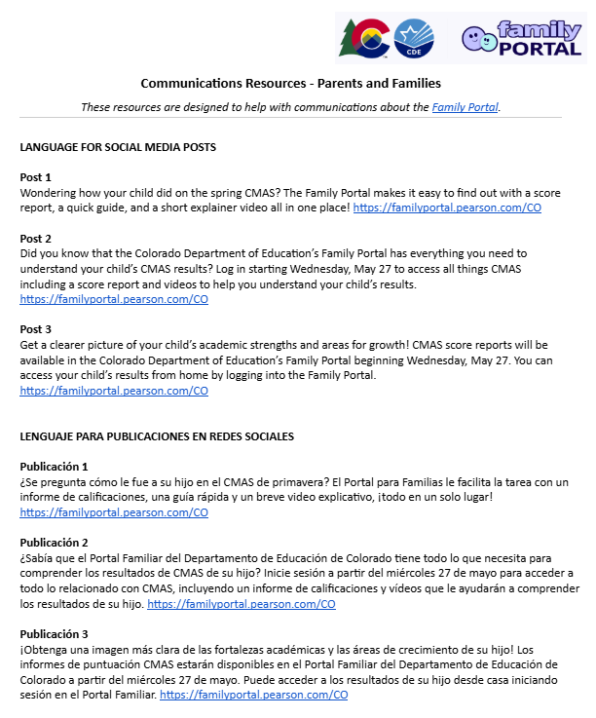
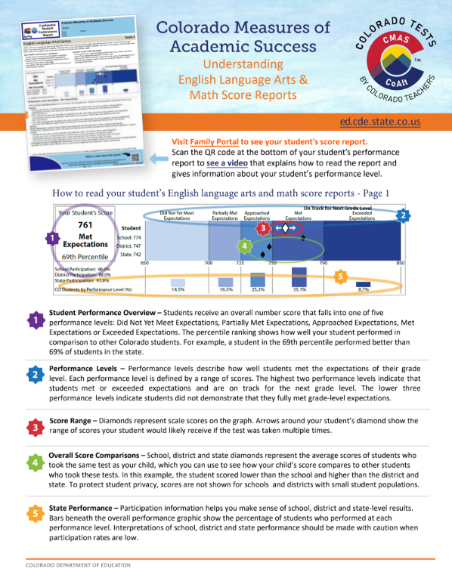
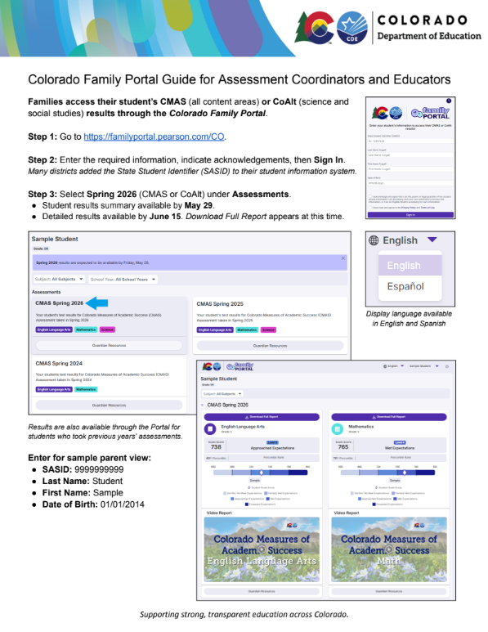
Wrapping Up Spring 2026
In May and June,
  DACs were provided access to individual student, school, and district results for all state assessments
  Families were able to access student performance reports through vendor portals
If student results were not already provided to families through portals (SASIDs), PDFs of reports, or hard copy reports, share ASAP
  Reminder: Colorado statute requires local education providers to ensure that appropriate personnel provide and explain assessment results to the parent or legal guardian of each student enrolled in the school district or the institute charter school (C.R.S. §22-7-1006.3 (8)(a)).
Communication resources are available to help parents and other audiences understand results
  Resources for communicating with educators
  Sample Family Letters
  Fact Sheets
Resources:
Assessment Communications Toolkit

Slide 19
Spring 2026 State Content Assessment Reporting Timeline
CMAS and CoAlt: ELA, Math, Science, Social Studies | District and school access: individual student level files and summary student reports on May 27
 | Family access: summary student reports on May 27; detailed student reports on June 11
 | District and school access: summary data and other confidential reports were made available early to mid-June
 | District and School Summary Files - June 2 Individual Student Level Reports - June 11 Participation Summary Reports - June 17 Performance Level Summaries - June 17 Content Standards Rosters and District Summary of Schools - June 17 Evidence Statement and Item Analysis Reports - June 17
PSAT/SAT | Individual students had access to their scores through their online College Board accounts or in the BigFuture School app on May 14
 | Educators had access to scores through College Board portal on June 5
Public Release | Results presented to State Board of Education Preliminary results: June 11 (state level overall/all students group) Final results: August 19 (state level) - district/school level publicly released

Slide 20
Meet the CDE Assessment Team
Christina Wirth-Hawkins
Chief Assessment Officer
Lisa Oliver
Director of College Entry, National, and Consortium Assessments
Sara Loerzel
Director of Colorado-Developed Assessments
Collin Bonner
Technology, NAEP, International Assessment
Emily Hunter
CMAS Administration
Melissa Carpenter
PSAT 9, PSAT 10, SAT
Brittany Peterson
CMAS Content Development
Arti Sachdeva
CoAlt and SPED Accommodations
Nathan Redford
CMAS Content Development
Heather Villalobos Pavia
ACCESS, CSLA, ML Accommodations
Jasmine Carey
Director of Achievement Data and Psychometrics
New addition: CDE’s Accountability Analytics Team
Leon Merker
Data and SBDs

Slide 21
2026–27 Colorado Assessments
Colorado Measures of
Academic Success
(CMAS)
Colorado Alternate (CoAlt)
Assessments
CO PSAT/SAT
PSAT – Grades 9 and 10
SAT – Grade 11
Math
Math (DLM)
Math
ELA
ELA (DLM)
Reading and Writing
Science
Science
NAEP *
and International Assessments
ACCESS
English Language Proficiency Assessment (K–12)
Listening, Reading, Writing, Speaking
Social Studies
Social Studies
*Reading and math administered in grades 4 and 8 in selected schools

Slide 22
2026–27
Winter State Assessments:
Grades K–12
ACCESS Suite of Assessments | Grades
WIDA ACCESS for Kindergarten | K
WIDA ACCESS | 1–12
Alternate ACCESS | K–12 (based on eligibility)

Slide 23
2026–27
Spring State Assessments:
Grades 3–8
Grade | ELA | Math | Science | Social Studies
3 | ✔ | ✔
4 | ✔ | ✔
5 | ✔ | ✔ | ✔
6 | ✔ | ✔
7 | ✔ | ✔ |  | ✔
8 | ✔ | ✔ | ✔
Note: CoAlt science and social studies and CoAlt ELA and math (DLM) assessments are the corresponding assessments to CMAS science, social studies, math and ELA for students with the most significant cognitive disabilities and who are instructed on the EEOs.

Slide 24
2026–27
Spring State Assessments:
Grades 9–11
Grade | CO PSAT | CO SAT | CMAS Science
9 | ✔
10 | ✔
11 |  | ✔ | ✔
Note: CoAlt eligible students take the corresponding CoAlt science and CoAlt ELA and math (DLM) assessment(s) at each grade level for students with the students with the most significant cognitive disabilities and who are instructed on the EEOs.

Slide 25
Tentative 2026–27 State Assessment Calendar
Assessment | Grade(s) | Tentative Windows
ACCESS | K through 12 | January 11 through February 12, 2027
CMAS and CoAlt: Science | 5, 8, 11 | April 5 through 23, 2027
CMAS and CoAlt: Social Studies | 7
CMAS: Math and ELA (CSLA¹) | 3 through 8
CoAlt: DLM ELA and Math | 3 through 8 | Aligned to CMAS: Math and ELA schedule
CO PSAT | 9 and 10 | April 12 through April 23, 2027
CO SAT | 11
CoAlt: DLM ELA and Math | 9 through 11 | Aligned to PSAT and SAT schedules
¹CSLA is for eligible multilingual learners in grades 3 and 4 only

Slide 26
Annual Training Requirement
State Assessment Training Requirements
Assessment-specific training (ACCESS, CMAS, CoAlt, PSAT and SAT) is required on an annual basis for all district and school personnel involved in any aspect of Colorado’s state assessments
DACs must be trained on each assessment each year
DACs must be trained on assessment accessibility and accommodations each year
DACs must meet with School Assessment Coordinators (SACs) to ensure a training plan is in place for training Test Administrators, Technology Coordinators and any other school staff handling secure materials
Districts are required to collect signed documentation from those who work with test materials that demonstrates an understanding of the policies and procedures set forth by the State of Colorado and the district

Slide 27

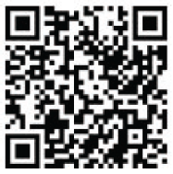

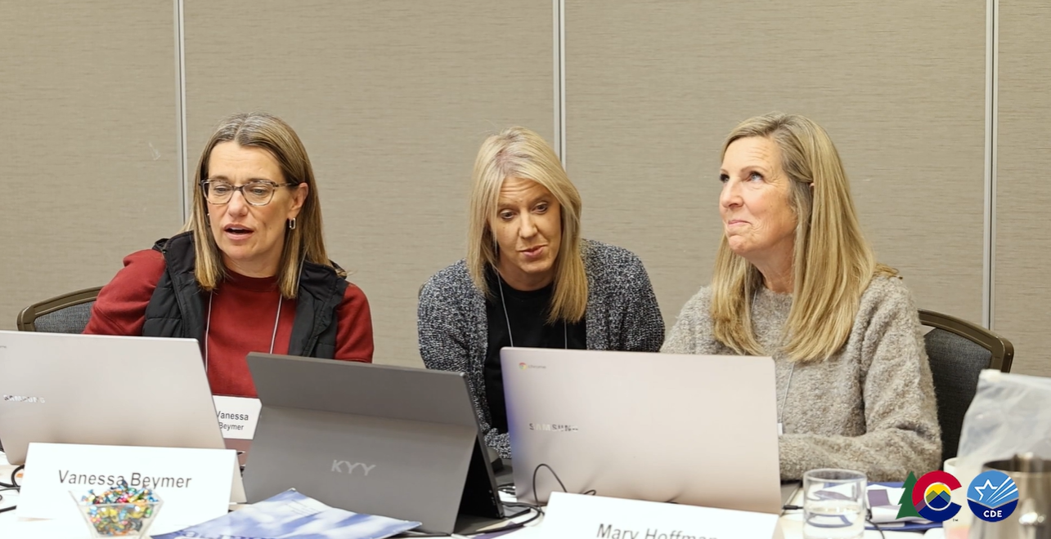

Get Involved!
Educator input is critical to Colorado's state assessment development and validation process.
Educators may participate in committees related to the following state assessments:
  CMAS: Science, Social Studies, Math, ELA and CSLA
  CoAlt: Science and Social Studies
State Assessment Development Flyer
Join the CDE Assessments Educator Database for
assessment development committee selection!
Hear from educators involved in CMAS development!
https://vimeo.com/1168672485
Scan Here!

Slide 28

Thanks to educators from the following districts for participating in Colorado’s 2026 assessment development work!
Academy 20 | Clear Creek | Ellicott School District | Holyoke | Monte Vista | Rocky Ford | Upper Rio Grande
Adams 12 | Colorado Springs D11 | Estes Park | Ignacio | Montezuma-Cortez | Sangre De Cristo | Valley
Adams 14 | Custer County | Fort Morgan | Jefferson County | North Conejos | Sargent | Walsh
Adams-Arapahoe | Deer Trail | Fountain | Julesburg | Park County | Sheridan | Weld County RE-4 (Windsor)
Akron | Delta | Fremont | Las Animas | Peyton | South Conejos | Weld County RE-5J (Johnstown- Milliken)
Bayfield | Denver Public Schools | Garfield | Littleton | Plainview | South Routt | Weld County RE-8 (Ft. Lupton)
Boulder Valley | District 27J | Greeley Evans D6 | Lone Star 101 | Platte Valley | Steamboat Springs | Weldon Valley
Calhan | District 49 | Hanover 28 | Mancos | Poudre School District | Strasburg | West End
Campo | Douglas County | Harrison | Mapleton | Primero | Stratton | West Grand School District
Canon City | Durango | Haxtun | Meeker | Pueblo City 60 | Summit | Westminster Public Schools
Cherry Creek | Eagle | Hinsdale County | Mesa County | Rangley | Swink | Widefield
Cheyenne Mountain | Education reEnvisioned BOCES | Hoehne | Miami Yoder | Roaring Fork | Thompson | Wray

Slide 29
ACCESS
Heather Villalobos Pavia

Slide 30
ACCESS Assessments
Test forms:
  WIDA ACCESS for Kindergarten (paper-based)
  WIDA ACCESS grades 1–12
    Online with Writing domain via paper in grades 1 through 3
    Paper available IEP or 504 plan
  Alternate ACCESS grades K–12, for students with IEPs written to the Extended Evidence Outcomes (paper-based)
All Test Administrators need to participate in WIDA’s modules/quizzes and participate in a local training.

Slide 31
Test Window
ACCESS Key Dates Monday, January 11 – Friday, February 12, 2027
Training October 2026
  10/6 and 10/7 (repeat virtual presentations)
  Post training Q&A 10/15 (virtual)
Test Ordering
  Accommodated form order due October 31, 2026 (to CDE via Syncplicity)
  Pre-Id upload pulled from Student October Snapshot on November 2, 2026
WIDA AMS Open for Test Setup
  November 23, 2026–February 18, 2027
  Accommodated form order due October 31, 2026 (to CDE via Syncplicity)
Preclusion Forms (DHH/VIB)
  Due to CDE December 1, 2026
Districts Receive Test Materials
  December 15–18, 2026
Material Return Deadline
  February 17, 2027

Slide 32
ACCESS Heads Up
ACCESS Time Expectations
Grades 1–3
  55 minutes (per domain)
Grades 4–12
  55 minutes (Listening and Speaking)
  75 minutes (Reading and Writing)
Details and specifics provided during October ACCESS training

Slide 33
Identification of Students for ELD Programs
Redesignation of Students from ELD Programs
Standardized Identification Procedures questions need to be addressed to the Office of Culturally and Linguistically Diverse Education (CLDE)
  Contact Doris​ Brock‑Nguyen brock-nguyen_d@cde.state.co.us
Standardized Redesignation Procedures questions need to be addressed to the Office of Culturally and Linguistically Diverse Education (CLDE)
  Contact Lindsay Swanton swanton_l@cde.state.co.us

Slide 34

ACCESS Training and Office Hours
Training Resource | Date and Location
Online Office Hours Wednesday 3–3:30 p.m. | Fall 2026 October 28 December 2 Winter 2027 Weekly January 6–February 10 Sent as a calendar invite to all DACs
DAC Administration Training (virtual) | Select one training session: October 6 from 12:30 to 3 p.m. or October 7 from 9 to 11:30 a.m. A recording will be available Q&A: October 15 from 8:30 to 9:30 a.m.
Training registration information will be emailed to DACs
Note: Dates and times are subject to change

Slide 35
CMAS Math, ELA/CSLA, Science and Social Studies
Emily Hunter

Slide 36



CMAS Updates for 2027 - New Administration Systems
Used by Assessment Coordinators
Used by Students
Manage user accounts and student registration data, access ADAM and LMS
Test administration setup, accommodations and reporting
Student testing platform
(unchanged)
LaunchPad/ADAM use will be covered during series of DAC trainings this fall/winter
  After introductory training in October, Assessment Coordinator training material will be accessible through LaunchPad’s LMS
CDE and Pearson will periodically disable LaunchPad/ADAM user accounts in preparation for various program activities
Test Administrators do not need accounts to administer tests

Slide 37
CMAS Updates for 2027 - Test Structure and Timing
CDE and Pearson reviewed timing data to determine possible unit (now “section”) count and/or testing time adjustments:
Some timing remains the same:
  Grades 3 through 8 ELA (including grades 3 and 4 CSLA): unchanged (three 90-minute sections)
  Grade 11 Science: unchanged (two 50-minute sections)
Grades 5 and 8 Science
Two 75-minute sections
(previously three 65-minute units)
Grades 3 through 8 Math
Two 75-minute sections
(previously three 65-minute units)
Grade 7 Social Studies
One 75-minute section
(previously one 65-minute unit)

Slide 38
CMAS Updates for 2027 - Paper/Pencil Testing Availability
Local Education Providers (LEPs) may request paper-and-pencil CMAS assessments for grades 3 and/or 4 (Senate Bill 26-023)
  LEPs are responsible for all material costs ($15 per student/per test subject) and a share of fixed program costs ($250 per grade/per subject)
  CDE will send an interest form link in an upcoming *DAC* email
    Request submission deadline: October 15
  Pearson will set up a contract with each LEP
    LEP pays Pearson directly
    Upfront payment is required
  Paper/pencil testing window: April 5–14; materials returned by April 14
Notes:
  The paper/pencil-specific dates do not apply to grades 5–8 or 11 or schools that do not purchase paper/pencil for grades 3 and/or 4
  Paper accommodated forms continue to be available at no cost to any student with an
  IEP/504-documented need tied to a disability preventing access to online CMAS tests
Example: LEP purchasing paper for 120 students across grades 3 and 4 math and ELA/CSLA will pay $4600:
$3600 test materials
$1000 fixed program cost

Slide 39
CMAS Updates for 2027 - Social Studies for Grade 7 Only
Social studies assessments will be administered to all grade 7 students
  Statewide administration; no sampling of students across districts/schools
    School, district and state achievement data will be available
  There will be no grade 4 social studies assessment
  Decided by House Bill 26-1353
Section test time for grade 7 social studies aligns with section test time for grades 5 and 8 science (i.e., 75-minute sections)
  Allows for combined science/social studies groups (requires reading both content area-specific SAY instructions, e.g., Look at your ticket. Do you see Grade 7 Social Studies or Grade 8 Science?)

Slide 40
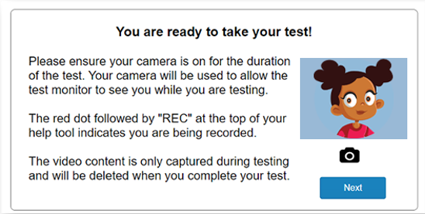
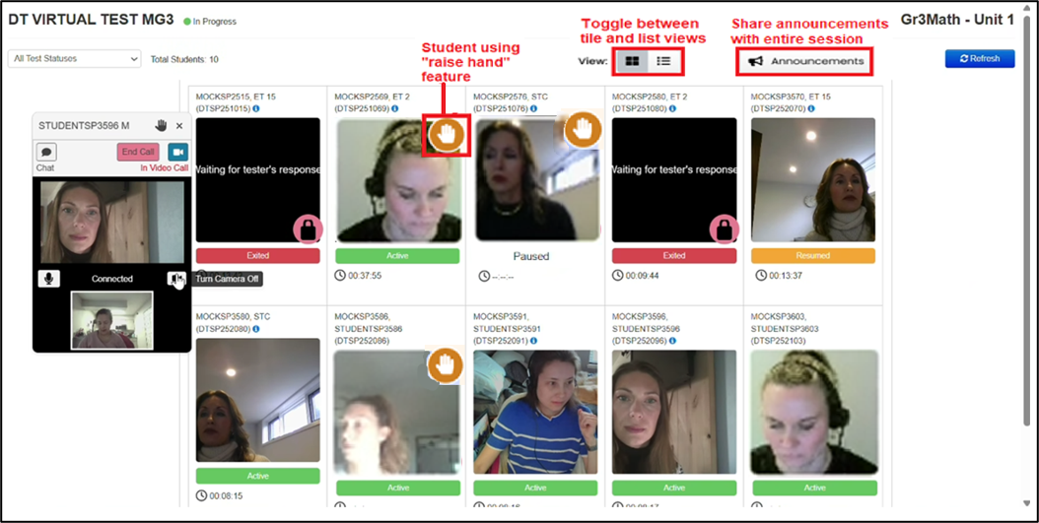
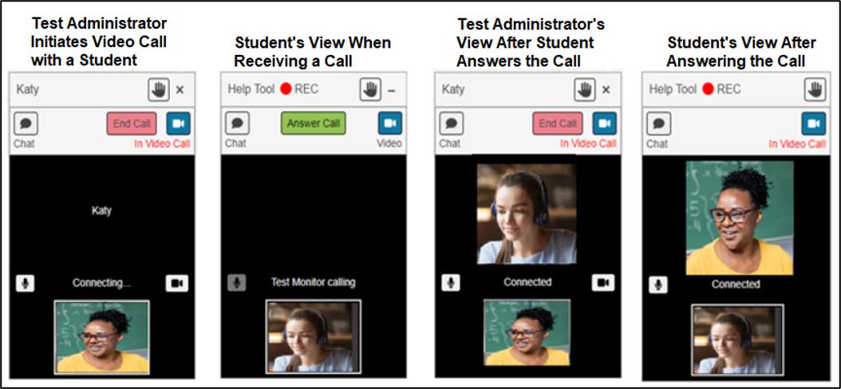
CMAS Reminder - Remote Administration §22-7-1006.3(1)(e)
The remote administration option is available to certain online schools
  Virtual Type = 01 (100% of instruction provided online, no in-person attendance requirements, no physical space)
  Eligible schools can decide to administer all CMAS tests remotely, all CMAS tests in-person, or use a combination of remote and in-person CMAS administration
At-home testing must meet the same high standards as in-person CMAS testing
  Remote administration-specific policies and procedures must be followed
  Separate training and administration materials are provided to participating schools in February
  Parent permission is required to participate
Districts with eligible schools will be contacted in late September to gather interest

Slide 41
CMAS Data and Reporting
Accessing Data Files and Reports in PearsonAccess^{next}
Download Results
  Ensure all legacy CMAS and CoAlt data files and reports (2013-14 through 2025-26 administrations) are saved locally
  Pearson will retire PearsonAccess^{next} in December 2026
  While DACs will be able to access legacy data files and reports through the new assessment management system, verifying the necessary records are locally saved prior to December will ensure there isn’t a delay in access should legacy results be needed during the transfer to the new system

Slide 42
CMAS Student Readiness
Practice resources are available for all grades and content areas
  Online practice available in English and Spanish, with and without text-to-speech
    Presented through TestNav, the platform used by students during the spring window
  Paper accommodated practice also available in English and Spanish
    Practice test books are formatted the same as test books used during the spring window
Online and paper practice sets contain the same items, so the scoring guide posted for each grade and content area is used for all associated practice sets and includes:
  Answer keys and Colorado Academic Standard-alignment
  Performance data from when the items were used on actual CMAS tests
  Writing (constructed response) scoring rubrics, sample written student responses, and scoring annotations
View Practice Resources

Slide 43
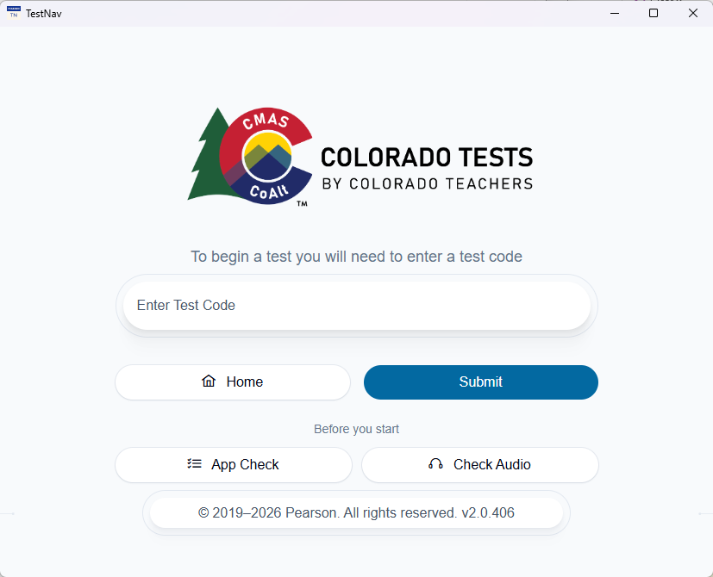
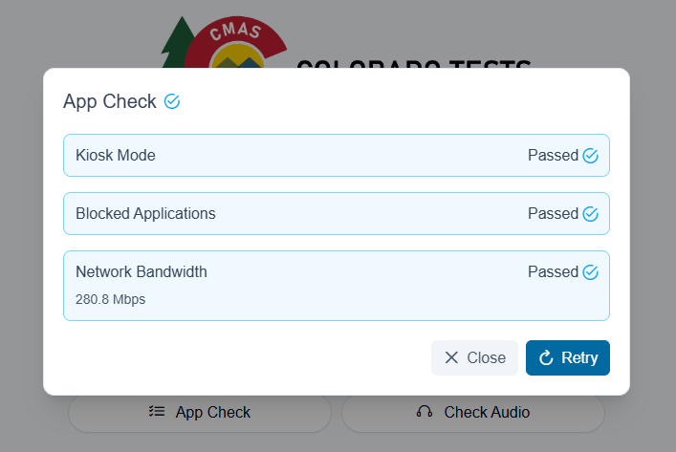
CMAS Technology Readiness
CDE recommends:
Before test window opens, conduct CMAS device readiness checks to ensure compliance with technical guidelines regularly updated and found here:
  TestNav Requirements: Updates and System Requirement Policy
  Network Requirements and Guidelines
Ensure District Technology Coordinators attend the DTC Kickoff in early October
Note: Proctor caching is no longer used/available for CMAS

Slide 44

CMAS High Level Activities for DACs
CDE initially registers students and assigns CMAS and CoAlt tests using data from October Count Collection in Data Pipeline
Create/update user accounts in LaunchPad and train other Assessment Coordinators
Review/update student registrations and tests in LaunchPad January 11 through 29
  Assign paper accommodations and auditory/signed presentation scripts in ADAM
Train SACs and Test Administrators on administration policies and procedures
Optional: Create proctor groups for student tests in ADAM
Verify accuracy of student registration information in LaunchPad and that form-dependent accommodations and accessibility features are correctly assigned in ADAM
  Paper testing setup - purchasing LEPs only
  Remote testing setup - eligible fully online schools only
Distribute manuals and materials
Administer assessments April 5 through 23
Ensure student responses from all accommodated paper tests are transcribed into the online forms by April 23*
Collect secure materials and ship back to Pearson by April 30*
*LEPs electing to purchase paper tests for grades 3 and 4 will follow separate instructions for those paper tests.

Slide 45
CMAS Training and Office Hours
Training Resource | Date and Location
Online Office Hours Thursday 3 to 3:30 p.m. | December 3 January 7 and 21 February 11 March 4 and 18 Weekly April 1 through May 6
DAC Administration Training | Mid-October through winter (virtual) High-level overview - policy and procedures (self-paced) Live how-to sessions hosted by Pearson
Training information and office hour URL will be emailed to DACs.
Note: Dates are subject to change

Slide 46
CoAlt Science and Social Studies / ELA and Math (DLM)
Arti Sachdeva

Slide 47




CoAlt Assessment Administration – Grades 3 through 8
Eligible students with the most significant cognitive disabilities take Colorado Alternate Assessments
Less than 1% of students
Administered during the same testing window as CMAS for all content areas
CoAlt Science and Social Studies
Science (5 and 8)
Social Studies (7)
Paper-based
Individually administered in a 1:1
testing environment
DACs and SACs will access student management through LaunchPad/ADAM
Transcribe responses into online form (TestNav) for scoring
CoAlt ELA and Math (DLM)
Grades 3 through 8
Computer-based
Individually administered in a
1:1 testing environment
Test Administrators/DACs
use Educator Portal for
student management
Students test using KITE Student Portal

Slide 48
CoAlt Assessment Administration – Grades 9 through 11
Eligible students in grades 9, 10 and 11 with the most significant cognitive disability whose IEP indicates instruction to the EEOs and participation in alternate assessments take the CoAlt assessments and not PSAT, SAT or CMAS Science
Alternate assessments are individually administered in a 1:1 testing environment
  CoAlt Science
    Grade 11
  CoAlt ELA and Math (DLM)
    Grades 9, 10 and 11
If a parent wishes for the student to take PSAT or SAT, the IEP team must convene an evaluation meeting to determine the appropriateness of the change in instructional standards and assessment before changing the IEP. The student must be instructed in the Evidence Outcomes for an appropriate time before taking the PSAT or SAT.
The CoAlt testing window should fit within the corresponding general assessment administration dates
  CDE recommends the testing schedule be set to allow CoAlt-eligible students to remain with their grade level peers as much as possible to reduce interruption to their regular instruction

Slide 49
CoAlt Training
Train teachers in all parts of the CoAlt assessments
  Separate modules
  CoAlt Assessment Administration Training: Colorado Policy - Available through Kite Educator Portal
  ELA/math – available through Kite Educator Portal
  Science and Social Studies – available through Kite Educator Portal
  Educators will be required to take and pass a quiz based on the information presented in each module
  Complete training by March 15, 2027
DAC-specific resource and FAQs
  Complete training through Kite Educator Portal by January 15, 2027

Slide 50
CoAlt Training and Office Hours for Accommodations and SWD
Training Resource | Date and Location
Accessibility and Accommodations Training | Select one training session: September 8 from 2 to 4:30 p.m. or September 10 from 9 to 11:30 a.m. Optional Q&A session: September 15 from 3 to 4 p.m.
Accommodations and SWD Office Hours Wednesdays 3:30 to 4 p.m. | December 9 January 20 February 10 and 24 March 10 and 24 Weekly beginning March 31
Office Hour for TVIs Wednesday 4 to 5 p.m. | January 13
CoAlt Training for DACs and Test Administrators | Through Kite Educator Portal CoAlt Policy – September 1 DLM Administration – September 1 CoAlt Science and Social Studies Administration – December
Optional: CoAlt Q&A Sessions for DACs | January 19 and 21, 2027
Training registration information will be emailed to DACs.
Note: Dates and times are subject to change

Slide 51
Colorado PSAT and SAT
Melissa Carpenter

Slide 52
Colorado PSAT and SAT Administration
Test Window: April 12–23, 2027
PSAT 9, PSAT 10 and SAT tests are administered online
  Paper-based testing is reserved for accommodated students who require paper testing, students with exemptions to technology use, or in a situation where a facility does not allow internet access for students – must be known in advance
Testing platforms
  Test Day Toolkit (TDTK) – Test administration website used by testing staff
  Bluebook – Testing application used by students
  SDMS - Student data management system used by DACs
Note: Students who participate in CoAlt take the CoAlt ELA and Math assessments through DLM instead of PSAT/SAT
Test structure:
Test Section | Question Count | Assessment
Reading and Writing | 54 questions | PSAT 9, PSAT 10, SAT
Math | 44 questions | PSAT 9, PSAT 10, SAT

Slide 53
PSAT 9, PSAT 10 and SAT Test Times
Standard Test Times
Test | Digital Test Times (minutes) | Digital Test Times + Breaks (10 minutes) | Paper-based* Test Times (minutes) | PB* Test Times + Breaks (10 minutes)
PSAT 9 | 134 | 144 | 164 | 174
PSAT 10 | 134 | 144 | 164 | 174
SAT | 134 | 144 | 164 | 174
*Accommodation only
Recommendation: To reduce the risk of misadministration, choose a specific day to assess paper-based students

Slide 54
Colorado PSAT and SAT Accommodations
Students who tested using College Board-approved accommodations for the PSAT or AP exams last year continue to be approved for 2027*
Accommodations requests must be submitted for:
  9th grade students and students who are new to Colorado
  Students whose accommodation needs have changed
  Students who have not been previously approved by the College Board for testing accommodations
ML Supports and State-allowed accommodations must be requested and approved each year
  State-allowed accommodations are not college-reportable
The default braille code for College Board assessments is UEB and UEB with Nemeth for math
  UEB Technical math code is available on request by contacting the College Board SSD office
*As long as there are no changes to student’s primary disability or accommodations listed in the student’s IEP

Slide 55
Colorado PSAT and SAT Online School Options
Online schools for PSAT 9 and PSAT 10
  Must establish a testing location for 9th and 10th grade students to test during the PSAT/SAT state testing window.
Online schools for SAT
  Option 1: May establish a testing location for 11th grade students to test during the PSAT/SAT state testing window
  Option 2: 11th grade students may test at a Colorado-sponsored SAT testing site for the SAT School Day Saturday test date: March 6. Online Schools must still establish a testing center location for the make-up date session within the PSAT/SAT state testing window for students who don’t attend and complete a test on March 6.

Slide 56
Difference Between CMAS and PSAT & SAT
Home-Schooled Students in Colorado
Full-time home-schooled students are permitted to take CMAS but are NOT permitted to take the state sponsored PSAT or SAT during the spring (see C.R.S. 22-7-1006.3(9)(b))
Full-time home-schooled students who contact the school or district should be directed to take the SAT on a national (Saturday) test date at their own expense
Full-time home-schooled students may have the option to take the PSAT 9 or PSAT 10/NMSQT during the fall administration window at a district’s discretion

Slide 57
Part-time Public/Part-time Home-schooled Students
Students who are considered part-time public school/part-time home-schooled may take the assessment with their public school
  Part-time public school/Part-time home-schooled students must be taking at least one course or participating in one school-sponsored activity with the public school

Slide 58
Key Highlights of New Changes This Year
There are Between-District Transfer enhancements in SDMS - ability to see requesting district/school
“Other” (preferred) first names can now be added in SDMS and will be front-facing for test staff and students/families
Student Practice test results can be accessed by educators in the K–12 Reporting Portal
Reason Not Tested/Special Use Only codes will only be entered in SDMS instead of both TDTK and SDMS

Slide 59
Colorado PSAT and SAT Resources
The CDE PSAT/SAT Assessments website is being redesigned 🚧
Bookmark the new College Board Colorado website for helpful resources and schedules
  Replaces the Colorado Resource Repository
College Board's CO Customer Service: 1-866-917-9030
  This line is specific to Colorado’s spring testing window
College Board State Partnerships - Customer Support Center
Contact the College Board Field Team ColoradoSchoolDaySupport@collegeboard.org
Sarah Orlowski | Noah Hurianek
sorlowski@collegeboard.org | nhurianek@collegeboard.org
720-470-2343 | 720-582-6735

Slide 60
Colorado PSAT and SAT - What is Next?
Attend the DAC Welcome Webinar (for new and returning DACs) on September 29 at 9 a.m. or 3 p.m.
⦁ Registration links will be emailed to DAC’s from College Board (ColoradoSchoolDaySupport@collegeboard.org)
Look for information about completing the SSOR Onboarding process which runs October 1–23
Have your SSD Coordinators start submitting/updating accommodations ASAP

Slide 61
PSAT and SAT Training and Office Hours
Training Resource | Date and Location
Online Office Hours Tuesdays 3 p.m. | Starting November for SSDs Coordinators Starting February for DACs and SACs
DAC Administration Training Tuesdays 9 a.m. and 3 p.m. | DAC Welcome Webinar- September 29 at 9 a.m. and 3 p.m. (virtual) SSD Training Webinar Series- October and March DTC Tech Readiness Webinar - December DAC and SAC Webinar- Late January (virtual)
Training registration information and Office Hour URLs will be emailed to DACs.
Note: Dates are subject to change

Slide 62
Assessment Accessibility and Accommodations
Arti Sachdeva

Slide 63
Accommodations Training
Assessment Accessibility and Accommodations Training
  Includes training on accessibility and accommodations available to students with IEPs, 504 plans, and ML plans
  Attendance options:
    September 8 from 2 to 4:30 p.m.
    September 10 from 9 to 11:30 a.m.
  Webinar recording and FAQ will be posted on the Accommodations Resources page by the end of September
Optional: Assessment Accessibility and Accommodations Q & A Session
  September 15 from 3 to 4 p.m.
Updated Accommodations Crosswalk available on the Accommodations Resources page

Slide 64
Accommodations Deadlines
Due to CDE by September 15
  Braille Colorado Practice Resources (CPRs) (order forms were sent to DACs on August 14)
  CMAS and CoAlt ancillary orders (order forms were sent to DACs on August 14)
Due to CDE by December 1
  WIDA ACCESS Unique Accommodation Requests (UARs) for enrolled students with IEPs/504s
Due to CDE by December 15
  CDE State Assessment Technology-Captured Response Secure Use Agreements
  CMAS UARs for enrolled students with IEPs/504s
    UARs for students who arrive in the district after January or are newly placed on IEPs/504s are due by March 15
Use of unique accommodations without CDE approval may result in invalidation or score suppression

Slide 65
Data and Reporting
Jasmine Carey

Slide 66
Assessment Data Collections
DACs: Know who your data respondent is for the Student Interchange snapshots, WIDA ACCESS, SBD Snapshot, and CMAS SBD
Pre-ID student data are pulled from the Student October Snapshot
  November 2: WIDA ACCESS data are pulled from the snapshot Report Review (students reported as ML – NEP and LEP will be uploaded on November 4)
    Make sure your data respondents have all NEP and LEP students and alternate testers identified, or they will not be loaded into WIDA AMS by the state
  January: All other assessment data are pulled from the final approved data
    Make sure data respondents have all alternate testers identified, otherwise they will be registered for CMAS/PSAT/SAT and not CoAlt

Slide 67
Student Biographical Data (SBD) Clean up Process
WIDA ACCESS will have SBD clean up in Data Pipeline in March (tentatively March 15–24)
CMAS data management will be done entirely within LaunchPad/ADAM
  Data clean up can begin when the system is open for districts and data can be updated as needed through the testing window, such as updates to data for transfer students and invalidations (April 5–23)
  All demographic data and invalidations should be reviewed during the district SBD clean up window in LaunchPad/ADAM (April 26–May 7)
SAT and DLM Student Interchange Snapshot will be open during the testing window (April 5–23) and district SBD clean up window (April 26–May 7) in the Data Pipeline
  SAT/PSAT Invalidation Codes must be entered in SDMS, and can be updated through the testing window and district clean up window (batch update available for 2026–27)
  DLM Special Circumstances codes must be updated during the testing window (by April 23)
    Codes can be entered at the student level, students do not need to be rostered
  Invalidation and Special Circumstances codes will be reviewable in the Snapshot, but must be updated in the vendor system

Slide 68
State Data Review
In the weeks after the district clean-up window, CDE will review submitted SBD data (May 10–21)
Districts may be contacted if any discrepancies/issues are identified and need to be addressed
Changes will be submitted through Syncplicity
CDE can only make changes with district approval
Updates made through this process can be verified when the Student Data Files are available for each assessment in late May/early June - Don’t wait for SPF/DPFs!
Reminder: These data are used for inclusion/exclusion of students for Frameworks

Slide 69
Data Clean-up Process Summary
Assessment | Process | Tentative Timeline
WIDA ACCESS | SBD Collection in Data Pipeline | March 15–24
CMAS (All), CoAlt (Science/Social Studies) | Clean up in LaunchPad/ADAM | January 11–May 7
CO PSAT/SAT | Invalidations in SDMS Snapshot in Data Pipeline | SDMS: January 27–May 7 DP: April 5–May 7
DLM | Invalidations in Educator Portal Snapshot in Data Pipeline | EP: January 11–April 23 DP: April 5–May 7

Slide 70
Assessment Data Trainings
WIDA ACCESS SBD: Training materials, layout, and manual will be updated in February on the Data Pipeline Website
  ACCESS SBD Training Webinar will be in late February 2027, exact dates and link will be announced through *DAC* emails and posted on the SBD page
CMAS SBD: Training for LaunchPad/ADAM will be provided in 2027 following the DAC trainings on using the new systems
  Training dates will be announced through *DAC* emails
Assessment Snapshot SBD (PSAT/SAT and DLM): Updated layouts and business rules will be posted in early 2027 on the Data Pipeline Website
  Training dates will be announced through *DAC* emails and posted on the Snapshot page
Data Pipeline Townhall: Assessment will provide short trainings and updates during SBD windows

Slide 71
Reporting of Results
Publicly posted State, District and School overall, and disaggregated results are available on the CDE Assessment Unit Website
Refer to the following Data and Results pages:
Program | Data and Results Webpage | Location of Confidential District and School Reports and Data Files
ACCESS | ACCESS - Data Summary | WIDA AMS
CMAS (all content areas) | CMAS Mathematics, English Language Arts, Science, and Social Studies Data and Results | ADAM
PSAT and SAT | Colorado PSAT and SAT Data and Results | Reports: CB K–12 Reporting Portal Student Data Files: CDE Assess. Sync.
CoAlt ELA and Math | CoAlt: English Language Arts and Mathematics Data and Results | Reports: Educator Portal Student Data Files: CDE Assess. Sync.
CoAlt Science and Social Studies | CoAlt: Science and Social Studies Data and Results | ADAM
Notes:
Confidential district data files were available by June 11 for all assessments.

Slide 72
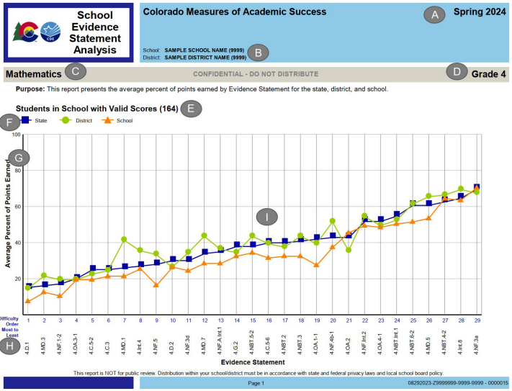
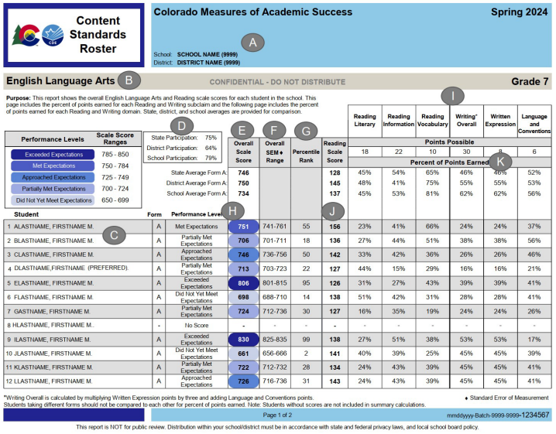
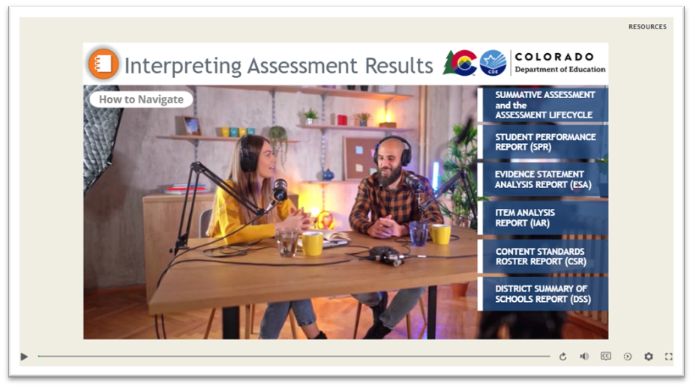
Report and Data Interpretation
CMAS Interpretive Guide to Assessment Reports
Interpreting Assessment Result Interactive Module
CDE CMAS Data Interpretation Training

Slide 73
National and International Assessments: Select Schools Only
Collin Bonner

Slide 74




NAEP Activities and Results
No NAEP Activities for School Year 2026–27 | Results for NAEP 2026 will be released January 2027 | State NAEP Activities will resume School Year 2027–28

Slide 75
Assessment Technology
Collin Bonner

Slide 76
District Technology Coordinators (DTC)
It is important to identify a DTC for the district – make sure this position is updated if there is a change
  Superintendent-appointed
DTC receives emails from CDE with information about required training and technology updates throughout the year
DAC will receive an email in early September confirming the designated DTC name and contact information

Slide 77
DTC Responsibilities and Privileges
Primary technology contact for the district who works with CDE Assessment Division regarding online administration of state assessments
  Attend CDE- and vendor-provided technology training (required)
  Receive critical, in-depth testing vendor communications directly from CDE during administrations
  Communicate pertinent technology information to district stakeholders concerning the online administration of state assessments
DTC support for CMAS
  DTCs are escalated to Pearson’s Level 2 Technical Support when contacting the help desk with questions regarding the online assessment system
  Only the one officially identified DTC for each district is escalated
Request support directly from Collin Bonner in the CDE Assessment Division

Slide 78





Online Assessment Platforms
Assessment | Test Engine | Student Info System | Features
WIDA ACCESS |  | WIDA AMS | Caching server Clients for Windows, Linux, Mac OS, Chromebooks, iPads and Android
CMAS |  |  | TestNav installable app for desktop, Chromebooks, Androids and iPads
CoAlt Science/ Social Studies | N/A |  | TestNav used by TAs to submit student responses for scoring
CoAlt ELA and Math (Dynamic Learning Maps) | Student Portal | Educator Portal | KITE Student Portal installed on each student device
PSAT and SAT | Student Portal: Bluebook App | Test Day Toolkit (TDTK) | Bluebook is an installable app for Windows, Mac, iPad or school-managed Chromebooks TDTK is accessed through an established College Board account

Slide 79
Disable Background Processes
For test security and device performance, disable unnecessary background processes and software during testing. Examples:
  Instructional Software
  Automatic Updates
  Intelligent Personal Assistant (IPA)
  iPadOS, Chrome OS, Netbook Devices
  Collaboration Tools
  Microsoft Game Bar and Other Screen Capture Software
Unnecessary applications and features running in the background on testing devices, including update processes, consume CPU and memory
  This can affect the testing experience
    If they become active, they can “kick out” students while they take secure online tests (ex: low battery)
    For ACCESS:
      Audio playback may be choppy
      Speaking test responses may be distorted

Slide 80
Final Thoughts and Reminders

Slide 81
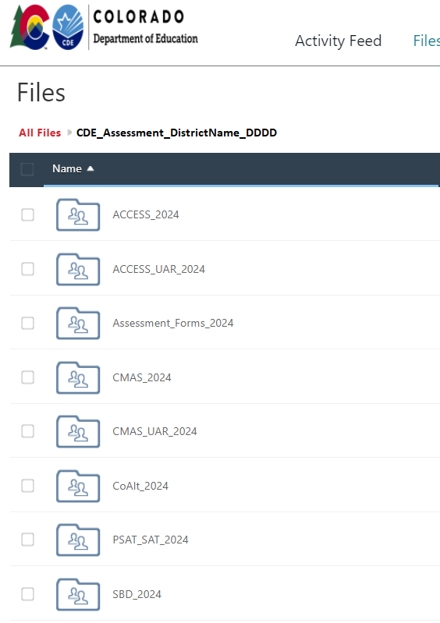
Syncplicity
All documents from previous years will be removed and archived externally by CDE on September 15
Locally retain copies of any needed documents
  Remember to save the DLM and PSAT/SAT data files for 2025–26
When adding documents this year:
  Ensure files are placed in the correct folders
  Provide notice of uploaded files to the appropriate contact at CDE

Slide 82
Reference Materials
Additional slides are included at the end of this slide deck
Local Education Provider Responsibilities
  Charter schools
  State statutes
Participation Resources
  District/School Actions Linked to Decreased Participation
  District/School Strategies that Help Increase Participation
Additional Resources
  CMAS ELA/CSLA Accommodations Policy
  Fall Checklist for DACs
  Office Hours Schedule for all programs
  2026–27 Training Dates

Slide 83
Thank you!

Slide 84
Reference Slides:
Local Education Provider Responsibilities

Slide 85

Charter Schools
Charter Schools are considered their own LEP (Local Education Provider) for purposes of the following state laws:
  Purchasing paper-and-pencil CMAS tests for grades 3 and 4: §22-7-1013(6.5)
  Assessment information for parents: §22-7-1013(7)(a)
  Parent excuse information: §22-7-1013(8)(a-c)
DACs are responsible for:
  Training SACs at charter schools in the district
  Communicating charter school paper-based testing selections to CDE
  Ensuring updates to student data are made during SBD if needed (schools do not have access to Data Pipeline)

Slide 86
SAT Scores on Transcripts
SB20-175: Student Score on Transcript
  This act prohibits a student's level of performance on the readiness assessment administered pursuant to 22-7-1006.3 (SAT) or on a national assessment (any assessment administered throughout the United States to measure postsecondary or workforce readiness) from being indicated on the student's high school transcript.

Slide 87
Requirements and District Responsibilities
Assessment Information §22-7-1013(7)(a)
LEP will annually distribute to parents and post on its website, as early in the school year as possible, written information regarding its assessments, including:
  The state and local assessments that the LEP will administer
  Identify whether it is required by federal law, required by state law or selected by the LEP
  Assessment calendar:
    Estimated hours of testing each testing day for specific classes/grades for each assessment
    Identify whether the assessment is required by state law, federal law or locally selected
  The purposes of the assessments
  The manner in which assessment results will be used

Slide 88
Requirements and District Responsibilities
Parent Excusals §22-7-1013(8)(a-c)
A student’s parent may excuse the student from participating in a state content area assessment
Each Local Education Provider (LEP) will adopt and implement a written policy and procedure by which a student’s parent may excuse the student from participating in one or more of the state content area assessments.
  If a parent excuses their student, the LEP shall not impose negative consequence on the student or parent including:
    Prohibiting school attendance; imposing an unexcused absence; or prohibiting participation in extracurricular activities.
    Prohibiting the student from participating in an activity or receiving any other form of reward that the LEP provides to students who participate in the state assessment.
LEP shall not impose an unreasonable burden or requirement on a student that would:
  Discourage the student from taking a state assessment or
  Encourage the student’s parent to excuse the student from taking the state assessment.

Slide 89
Reference Slides:
Participation Resources

Slide 90
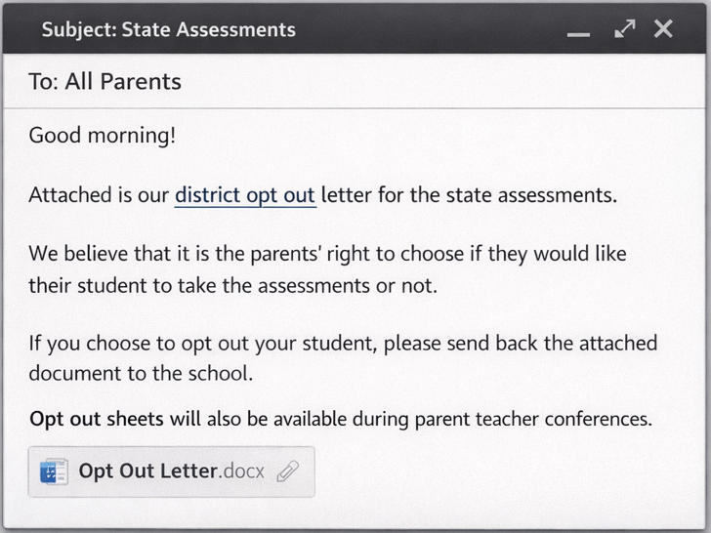
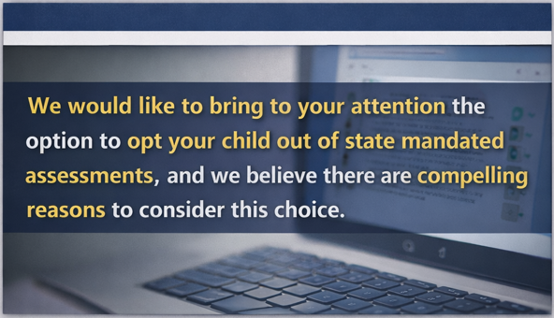
Participation - District/School Actions
Connected to Decreased Participation
Canceling school for the whole day to administer a state test (consider local context)
Scheduling test sessions across multiple days (High School CMAS) or multiple weeks
Communication with parents and students that
  encourages opt-out or
  devalues state assessment
  deviates significantly from approach to communicating about other district/school assessments
Sending opt-out forms or letters directly to parents

Slide 91
Participation - District/School Strategies that
Help Increase Participation
Support from district and school leadership, including teachers and counselors
  Letter of support from principal if participation is already low or state assessment has been devalued within community
Adoption of a parent excuse procedure that allows parents to excuse their students from testing if they choose, but does not include widespread distribution of opt-out letters or forms to parents

Slide 92
Participation - District/School Strategies that
Help Increase Participation (continued)
Positive Communication with Students and Parents around State Assessment
How does taking state tests help me?
All state assessment data provides information for
  students and families about student progress
  schools and districts that can be used to make improvements for all students
  communities about how schools are meeting the needs of all students
  leaders that helps them know which schools need more resources and support
PSAT/SAT Benefits
  Cost-free option for students, provided by the state, to have college entrance scores to submit to universities/colleges
  BigFuture free online resource
  Get help paying for college
  Leverage college course placement
  Helps meet a Colorado graduation requirement
Managing test anxiety and fostering positive approaches to testing
Stay positive
Remember that testing is a regular part of learning
Don’t stress over an item - Do your best and move on

Slide 93
Reference Slides:
Additional Resources

Slide 94
CMAS ELA/CSLA Accommodations Policy
CMAS English language arts accommodations policy was updated in 2020 to align with the CAS reading standards’ expectations that students read (decode a printed or tactile code) and comprehend (make meaning of) literary and informational texts independently and proficiently.
The following assessment administration adjustments would change this expectation and were phased out in the 2020–21 school year:
    Auditory Presentation Accommodation, including:
      Text-to-speech (TTS) for ELA
      Auditory Presentation script for ELA/CSLA
    Human Signer Accommodation for ELA
This policy is reviewed in more detail during the accommodations training.

Slide 95
Fall Checklist (1 of 3)
Fulfill district policy legislative requirements
  Adopt and implement a written policy and procedure by which a student’s parent may excuse the student from participating in one or more of the state content assessments
  Distribute to parents and post on LEP’s website written information regarding assessments, including an assessment calendar
PSAT and SAT
  Complete the SSOR School Onboarding Survey by October 23
CMAS
  LEP Purchased Paper for Grades 3 and 4 interest form due October 15
    LEP/Pearson contract and payment deadlines TBD
  District Testing Information form due December 15
    Indicate data respondent contact information for SBD
    Determine if printed, hardcopy Student Performance Reports are desired for 2027 results
    Districts with remote administration-eligible schools only: indicate interest in remote administration

Slide 96
Fall Checklist (2 of 3)
Gather accommodation information for assessments
  CMAS paper-based accommodations (standard print, large print, braille, auditory/signed presentation scripts [for math, science, social studies], etc.)
  CMAS computer-based accommodations (text-to-speech [TTS], Spanish, etc.)
  Determine the need for and submit ACCESS UARs by December 1
    Scribe for ACCESS Writing Domain
  Determine the need for and submit CMAS UARs by December 15
    Scribe for constructed response items on the ELA/CSLA assessment
    Calculator on non-calculator sections of the math assessment
  CMAS Student Registration files (in LaunchPad) and Personal Needs Profile information (in ADAM) updated in January 2027
  Start submitting PSAT and SAT accommodations requests for approval by College Board

Slide 97
Fall Checklist (3 of 3)
Attend virtual trainings
  Accommodations
  ACCESS
  CoAlt
  CMAS
  CO PSAT and SAT
Schedule and plan district/school trainings
  Accommodations
  ACCESS
  CoAlt
  CMAS
  CO PSAT and SAT

Slide 98
2026–27 Office Hours Schedule (dates subject to change)
ACCESS Administration
  Wednesdays from 3 to 3:30 p.m
    October 28 and December 2
    Weekly: January 6 through February 10
CMAS Administration
  Thursdays from 3 to 3:30 p.m.
    Monthly – December, February
    Bi-monthly – January, March
    Weekly – April through May
PSAT and SAT Administration
  Tuesdays from 3 to 3:30 p.m.
    Monthly – Beginning in November
    More frequent closer to testing
Students with Disabilities (SWD)
  Support for CoAlt administration
  Support testing students with IEP/504 plans
  Wednesdays from 3:30 to 4 p.m.
    Monthly – December, January
    Bi-monthly – February, March
    Weekly – April through May
  TVI Office Hour for DACs and all TVIs on January 13

Slide 99
2026–27 Training Dates – All Virtual (subject to change)
Assessment | Description | Timeline
All | Accommodations | September
CO PSAT and SAT | College Board Spring 2027 DAC Welcome Webinar | Late September
ACCESS | Administration | October
CMAS Math, ELA, CSLA, Science and Social Studies | Administration | Mid-October through Winter 2027
CoAlt ELA and Math (DLM), Science and Social Studies | Administration | September December/January
DACs must be trained on all state assessments each year.

