Slide 1
District Accountability System:
Sustaining Excellence and Aiming Higher
Presented by:
Kyle Schicker
Notes:
Instructions – Add the title and date to the first page of your School Board Meeting presentation.
All slide layouts that are approved to use are built within this presentation template. DO NOT use the “Designer” tool when creating your presentation.

Slide 2

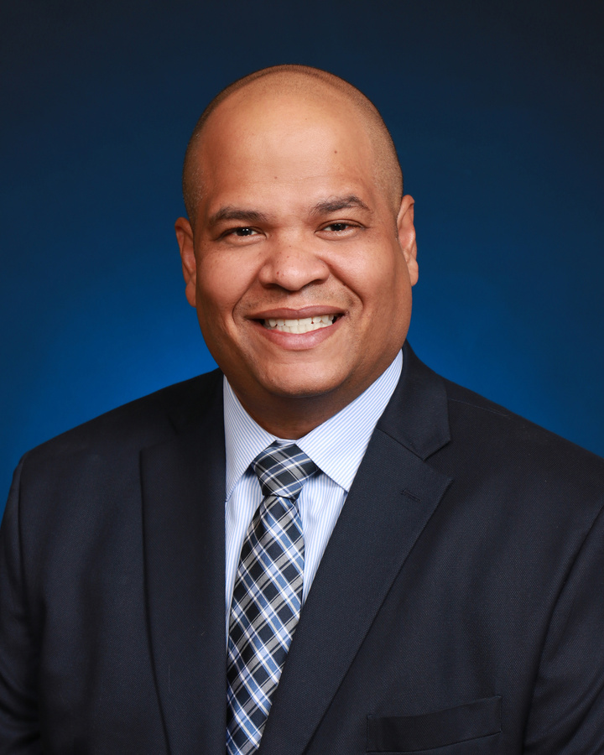
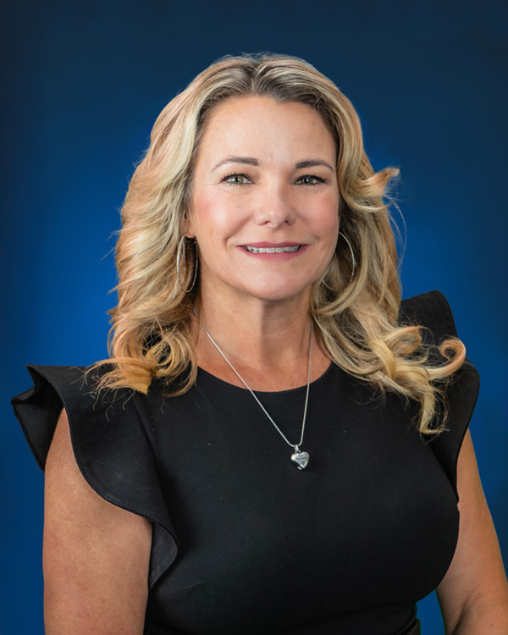
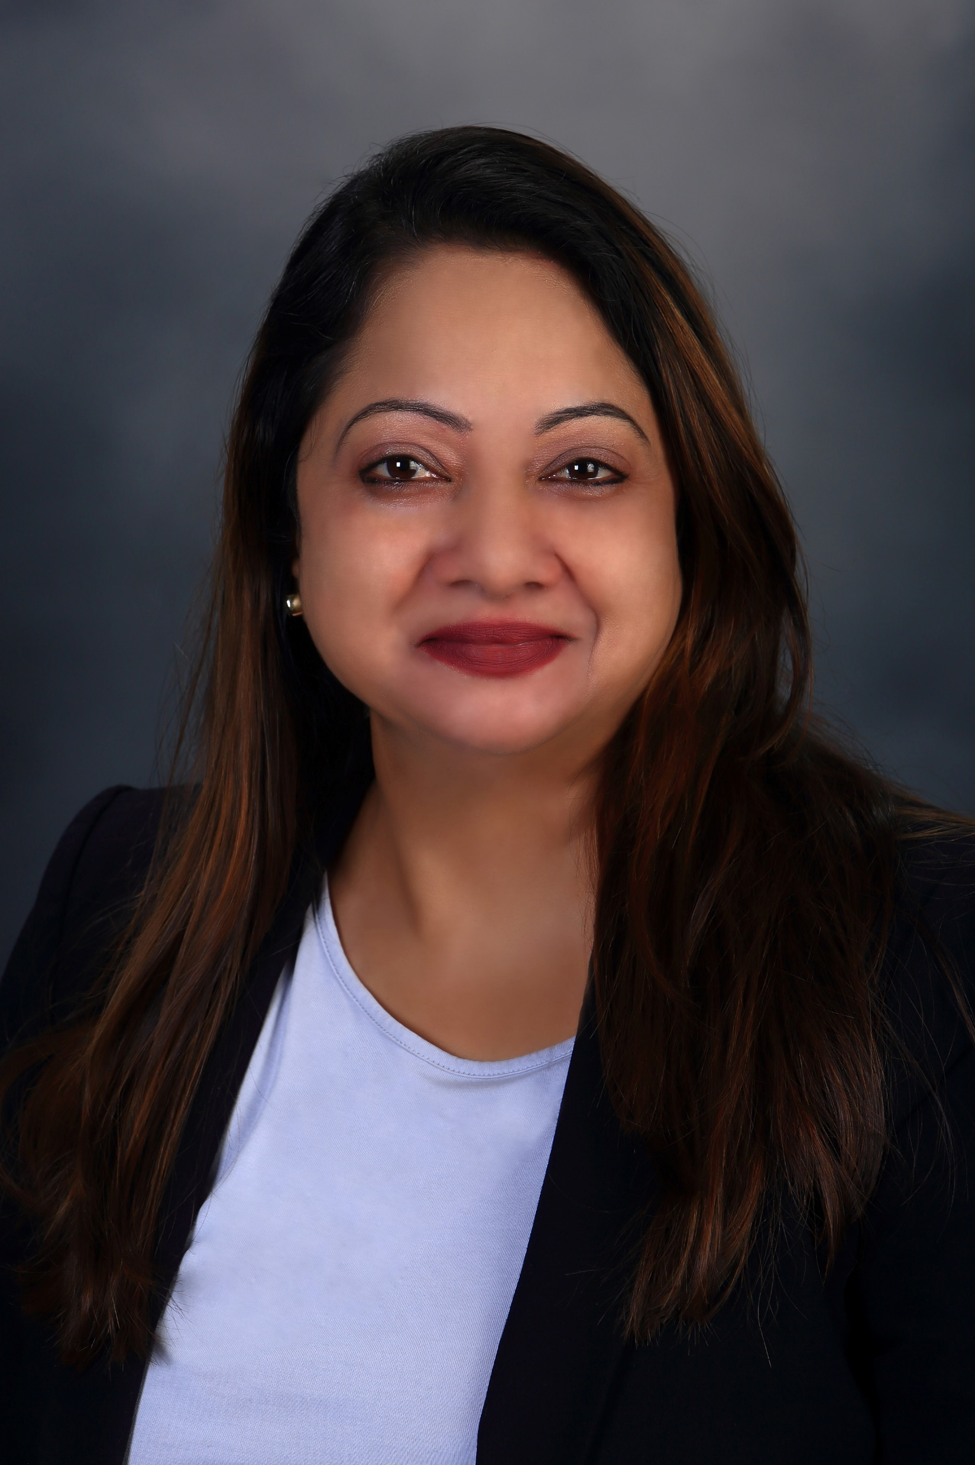
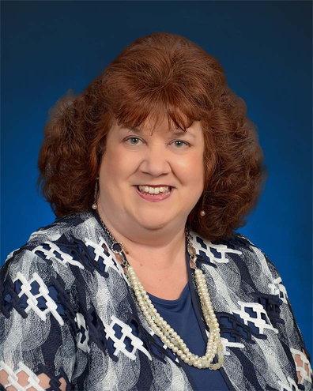

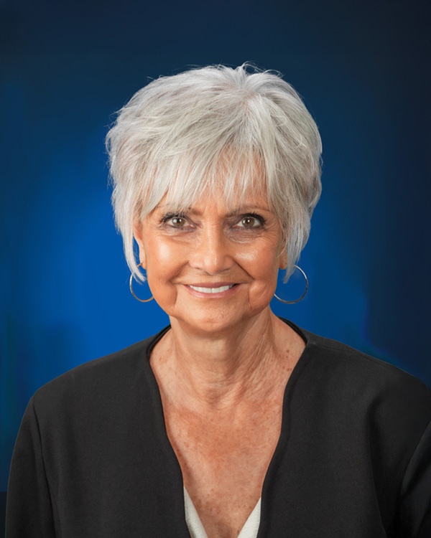
School
Board
Ruben Colón
Krista Goodrich
Board Chair
District 5
Vice Chair
District 2
Jamie Haynes
Jessie Thompson
Donna Brosemer
Dr. Carmen J. Balgobin
Board Member
District 1
Board Member
District 3
Board Member
District 4
Superintendent of Schools

Slide 3
This presentation conforms to the following district policy(ies):
  Policy #307: Student Progression Plan
  Policy #308: Consistent Performance Standards
Notes:
Please highlight the goal(s) your presentation supports in yellow. An updated version of the Strategic Plan slide will be shared once the new Strategic Plan is Board approved.

Slide 4
This presentation aligns to the following goals as part of the Volusia County Schools 2024-2027 Strategic Plan:
Goal: All Students will engage in high levels of learning EVERY day.
  Guardrail 1: Recruit, support, develop and retain high-quality staff.
  Guardrail 2: Provide conditions that enhance student learning.
  Guardrail 3: Improve operational efficiency and maximize resources to support student learning.
  Guardrail 4: Ensure high-quality community engagement with all stakeholders.
Notes:
Please highlight the goal(s) your presentation supports in yellow. An updated version of the Strategic Plan slide will be shared once the new Strategic Plan is Board approved.

Slide 5

Back-to-Back “A” Rating
A
797
66%
District Grade
Points
Possible Points
Volusia County Schools earned its second consecutive “A” district grade. This was last done in 2008-2009, well over one decade ago!
Highest total points in district history.
Increased from 64% to 66% of total possible points.
5

Slide 6
State Rule Over Time/
Accountability
Learning Gains
+Reading
+Math
+Reading Lowest 25%
2002
+Social Studies
+Middle School Acceleration
+Grad Rate
+College and Career Acceleration
2015
A
A
A
A
A
1999
Implementation
+Reading
+Math
+Writing
2007
+Science
+Lowest 25% for Math
2024
+Grade 3 ELA
04
08
09
25
26
FCAT (1999-2014)
FSA (2015-2022)
FAST (2023-Current)
Rule 6A-1.09981, Florida Administrative Code (F.A.C.), and section (s.) 1008.34, Florida Statutes (F.S.) govern school and district grade calculation.
Notes:
The state accountability system for measuring student learning at a district and school level has grown to become a more rigorous and robust system. Starting just over 25 years ago, the system began with just reading, math and writing performance, a few years later in 2002 learning gains were added to the system, the learning gains were calculated for reading and math and a third component of learning gains for the lowest 25% of students to close the reading gap for these students. In 2007 the lowest 25% for math was put in place as well as science performance. In the 2014-15 school year, the FCAT transitioned to the FSA and due to this, learning gains could not be calculated jumping from two different assessments. However, in this transition of assessments, the state rule adopted new measures to be included in calculating grades: social studies performance, graduation rate, middle school and college and career acceleration rates, given all of this transition the state identifies years like this as an informational baseline year. The following year all 4 learning gain components were put back in place now that there was at least two years of FSA data. The FSA transitioned to the FAST assessment in 2022-23 this transition would have the same impact as the prior transition where learning gains would not be included and the year would be an informational baseline year. When there are components missing or added from the calculation the state may readdress cut points for schools and districts, this happened as there was only 8 of the currently possible 12 components. The 2024 year saw the return of learning gains and the introduction of grade 3 ela performance to put us to the model currently in adoption with 12 total components
Across all of these years 20+ years and additions to the system, the ratings/scales have always been around the same number from 62%-68%, with the most recent year being a threshold of 65% to earn an A rating.

Slide 7
State Accountability Rules
Since the beginning of state accountability, schools and districts must test at least 95% of students to earn a grade and/or “A” rating.
  This includes ALL students
    Charter school students
    English Language Learners
    Hospital homebound students
    Students with severe cognitive disabilities
District grade results include performance of all aforementioned students.
68 Traditional Schools
7 Alternative Ed Sites
+ 6 Charter Schools
Volusia County Schools District Grade
Notes:
Percent tested has always been a factor within the school and district grading system, because it is how we ensure that the score received at the district and school level are truly representative of the student learning at that site. Here you can see the historical numbers for Volusia county schools.
Listing out alt sites….Halifax behavioral, highbanks learning, hospital homebound, Pace Center for girls, riverview learning center, stewart marchman residential, Volusia Regional Juvenile Detention Center.
Listing Charter schools…Burns science and tech, Ivy Hawn, Reading Edge, Richard Milburn Academy AKA RMA, Samsula Academy, The chiles academy.

Slide 8
Consistent System Growth
A
A
B
B
B

Slide 9
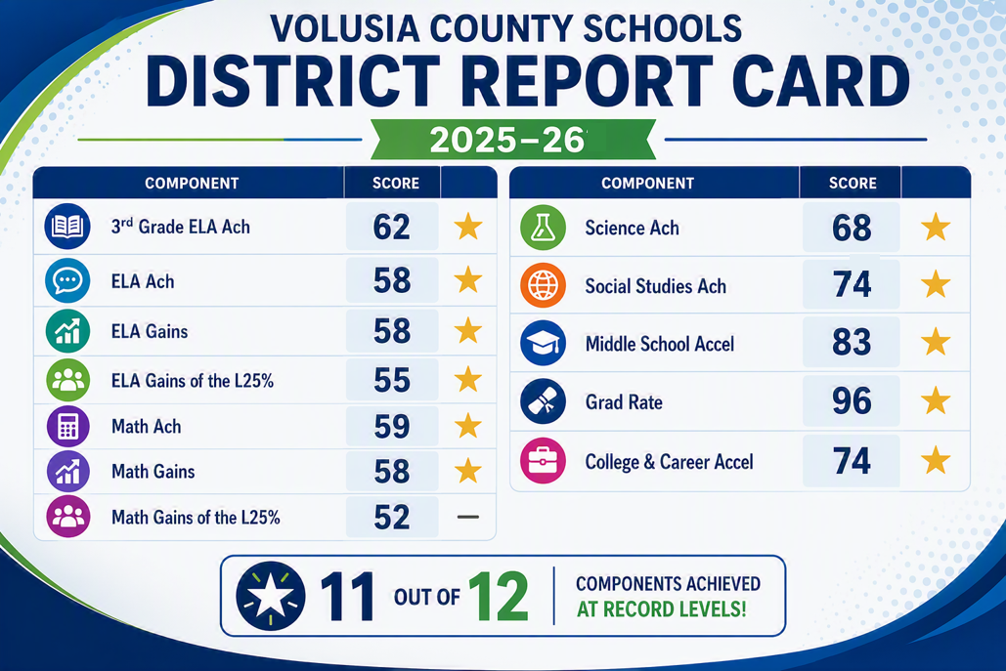
Stronger Across the Accountability System

Slide 10
Historic Milestones
0
100%
#2
D or F Schools
High Schools “A” or “B”
Grad Rate in Central Florida

Slide 11
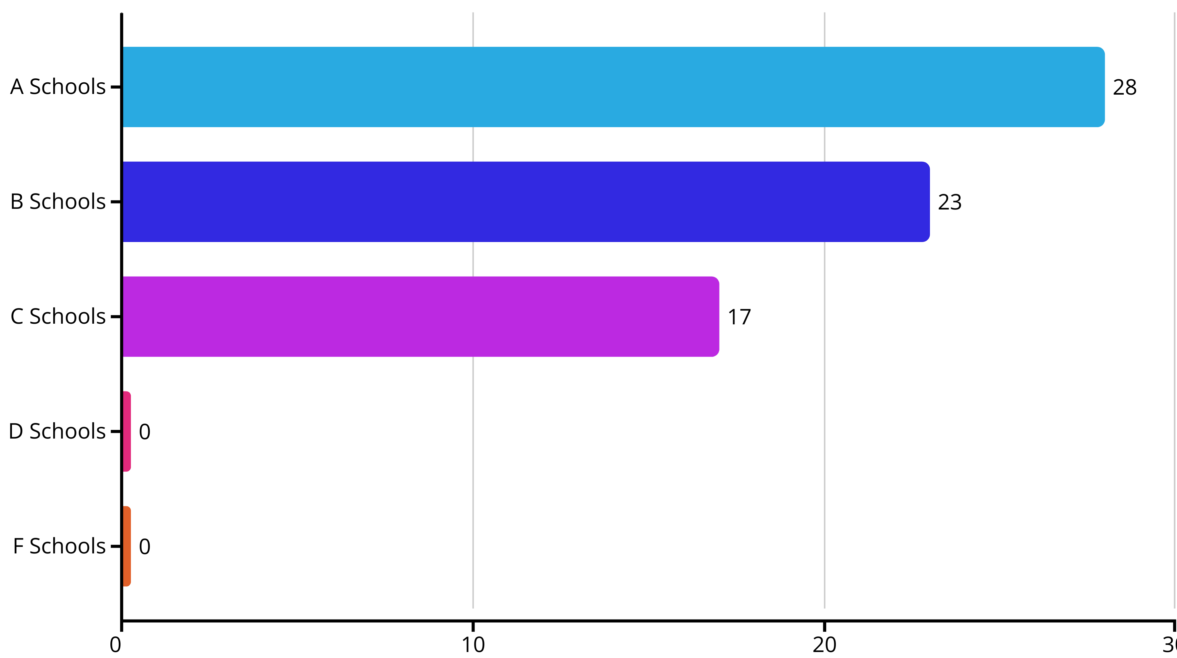

School Grade Distribution (2025-2026)
37
24
7
0
0
11

Slide 12
Consistent Growth
A’s by 5x
The number of “A” rated Volusia County Schools has more than quintupled,
from 7 in 2022 to 37 in 2026

Slide 13










School Success Stories
Sunrise Elementary- ‘11
Pride Elementary- ‘11
Southwestern Middle- ‘10
Orange City Elementary- ‘09
Westside Elementary- ‘14
Woodward Ave Elementary- ‘14
Historic Ratings
C → A
13

Slide 14
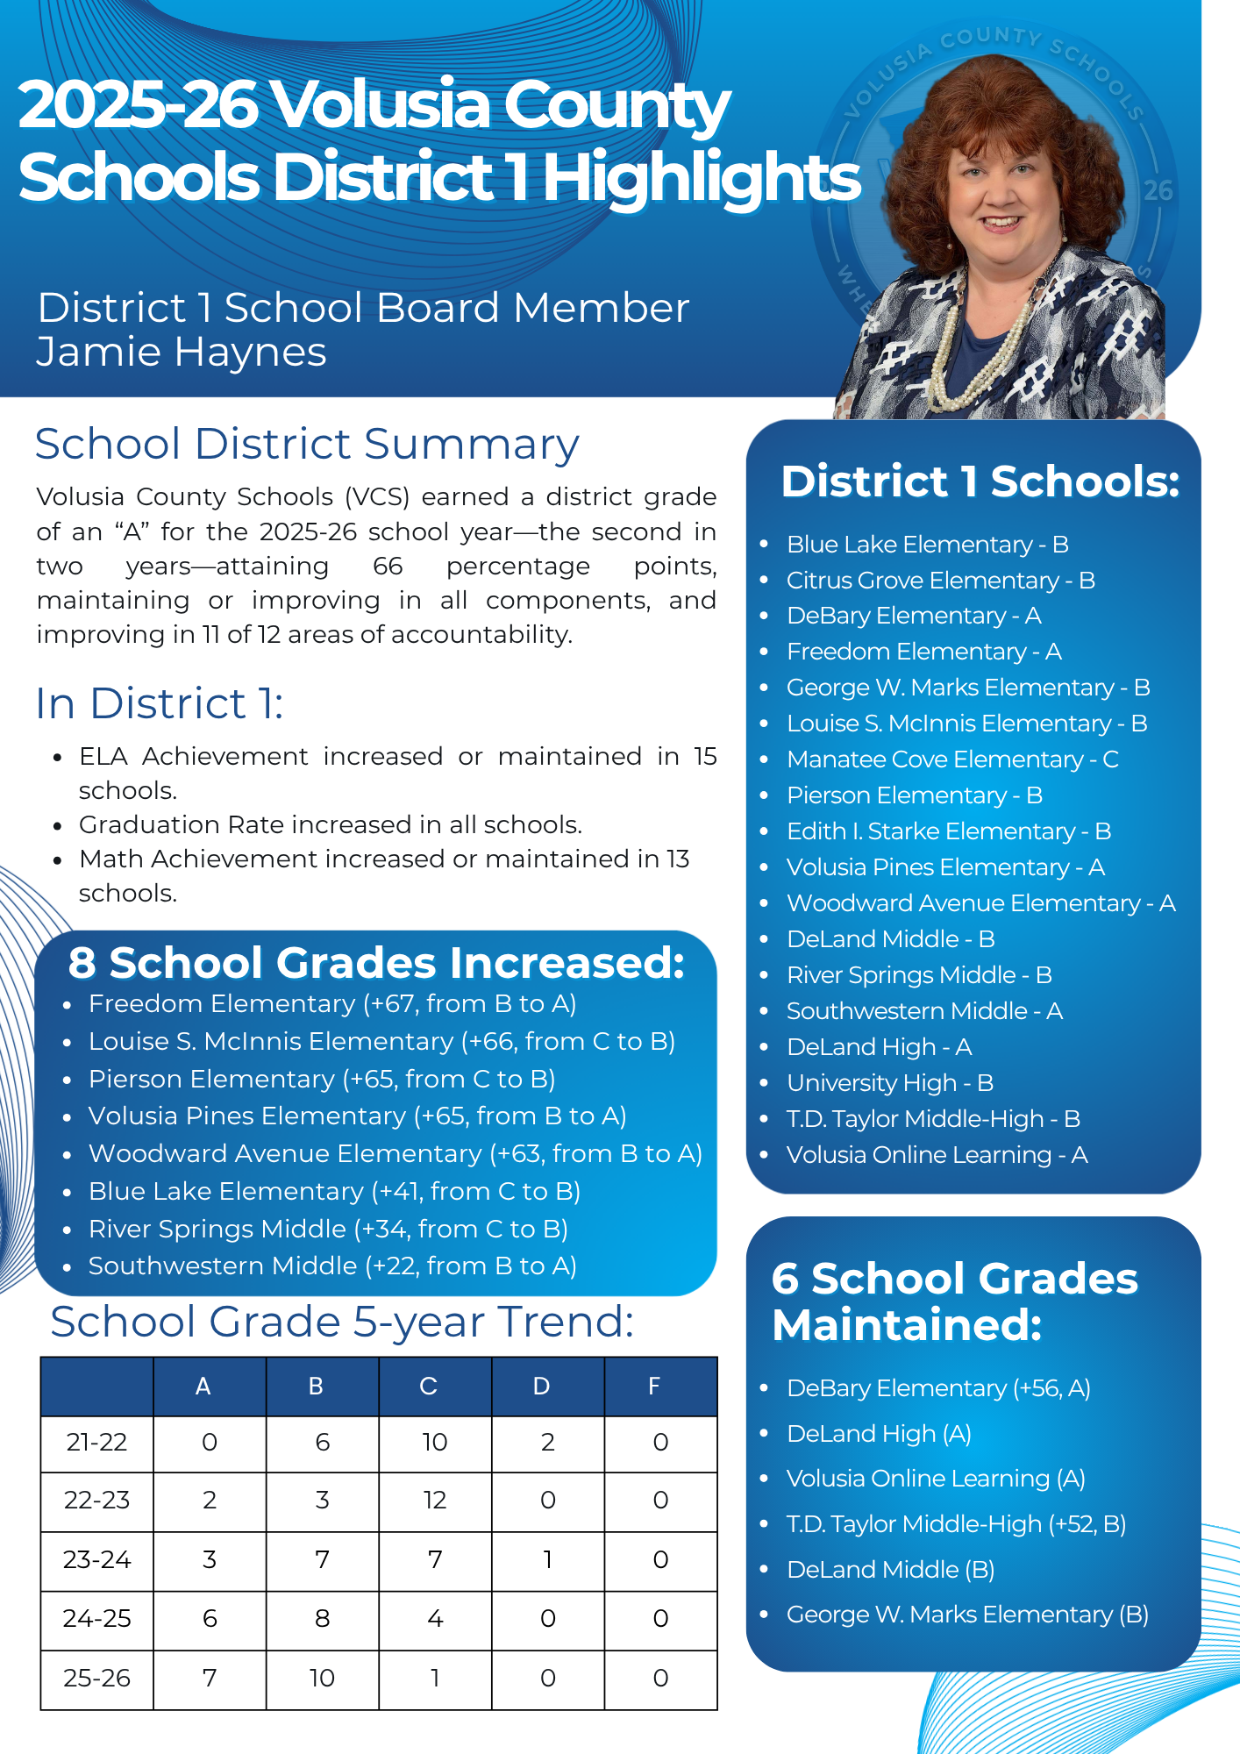
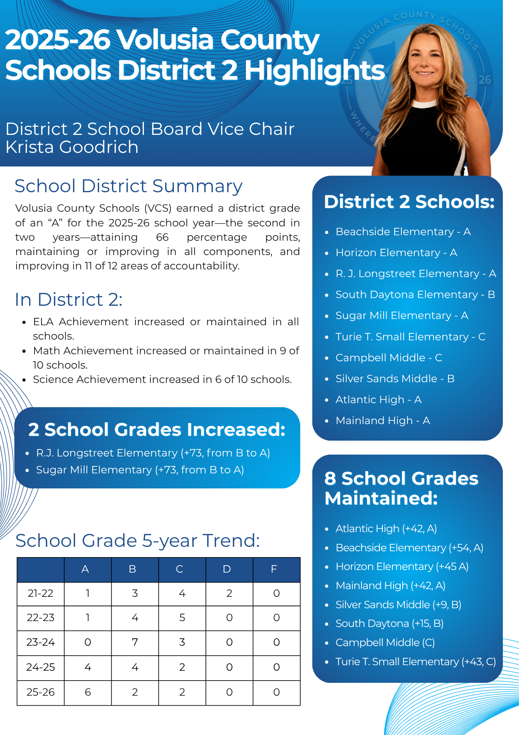
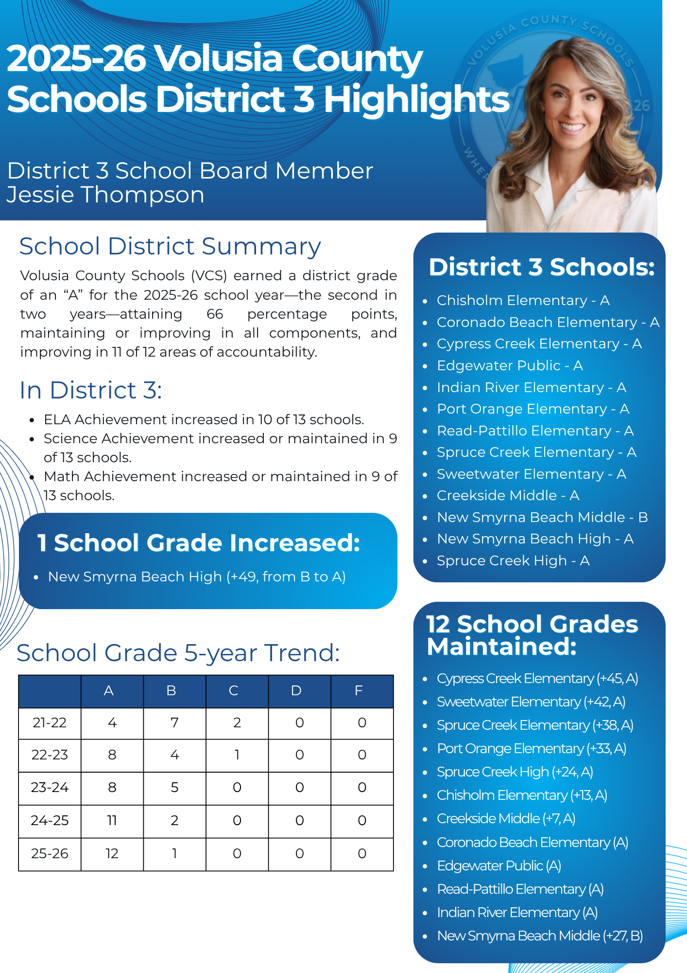
School Board District Highlights

Slide 15
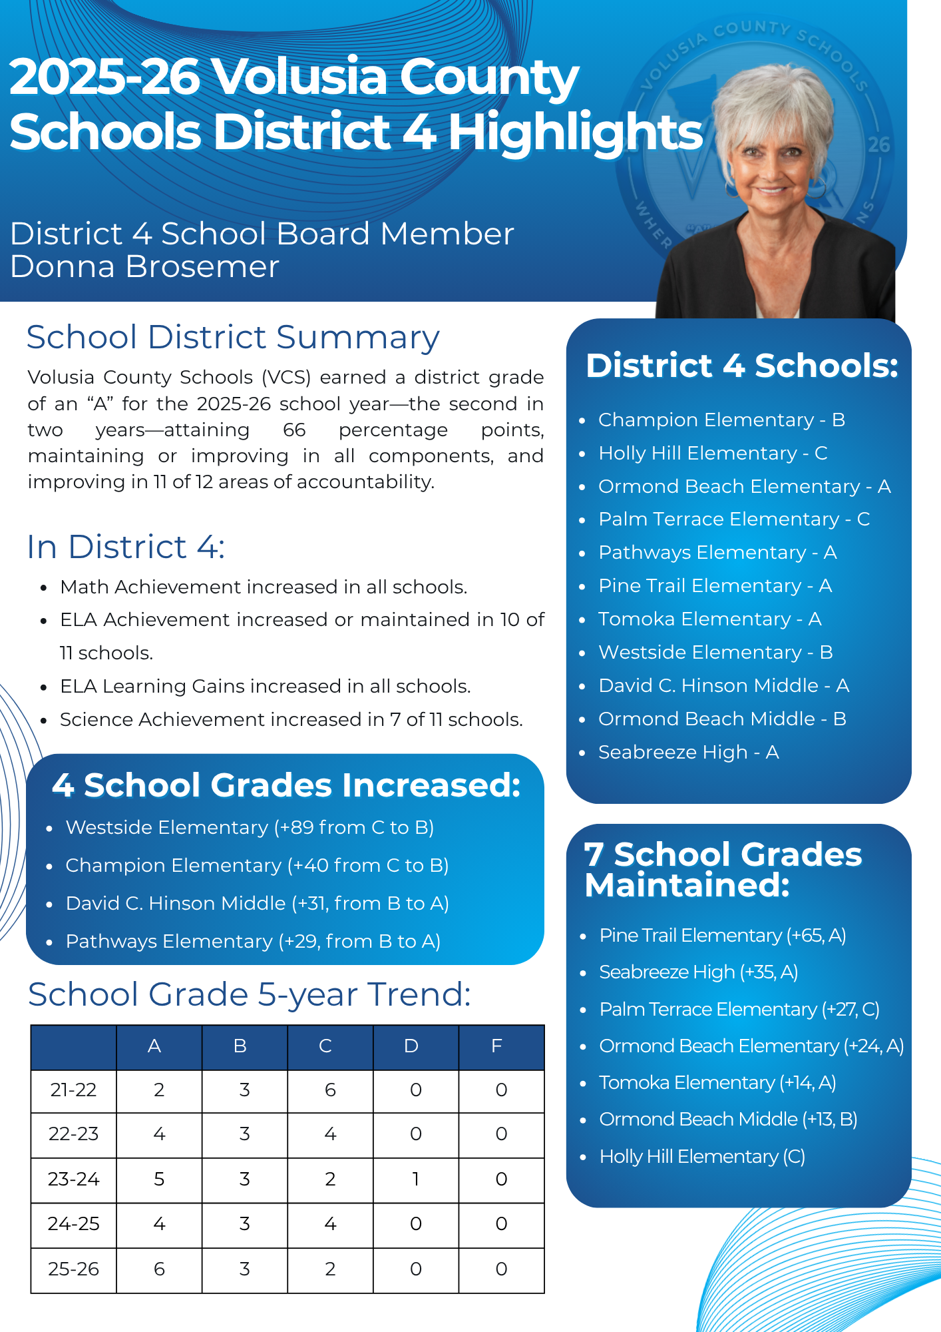
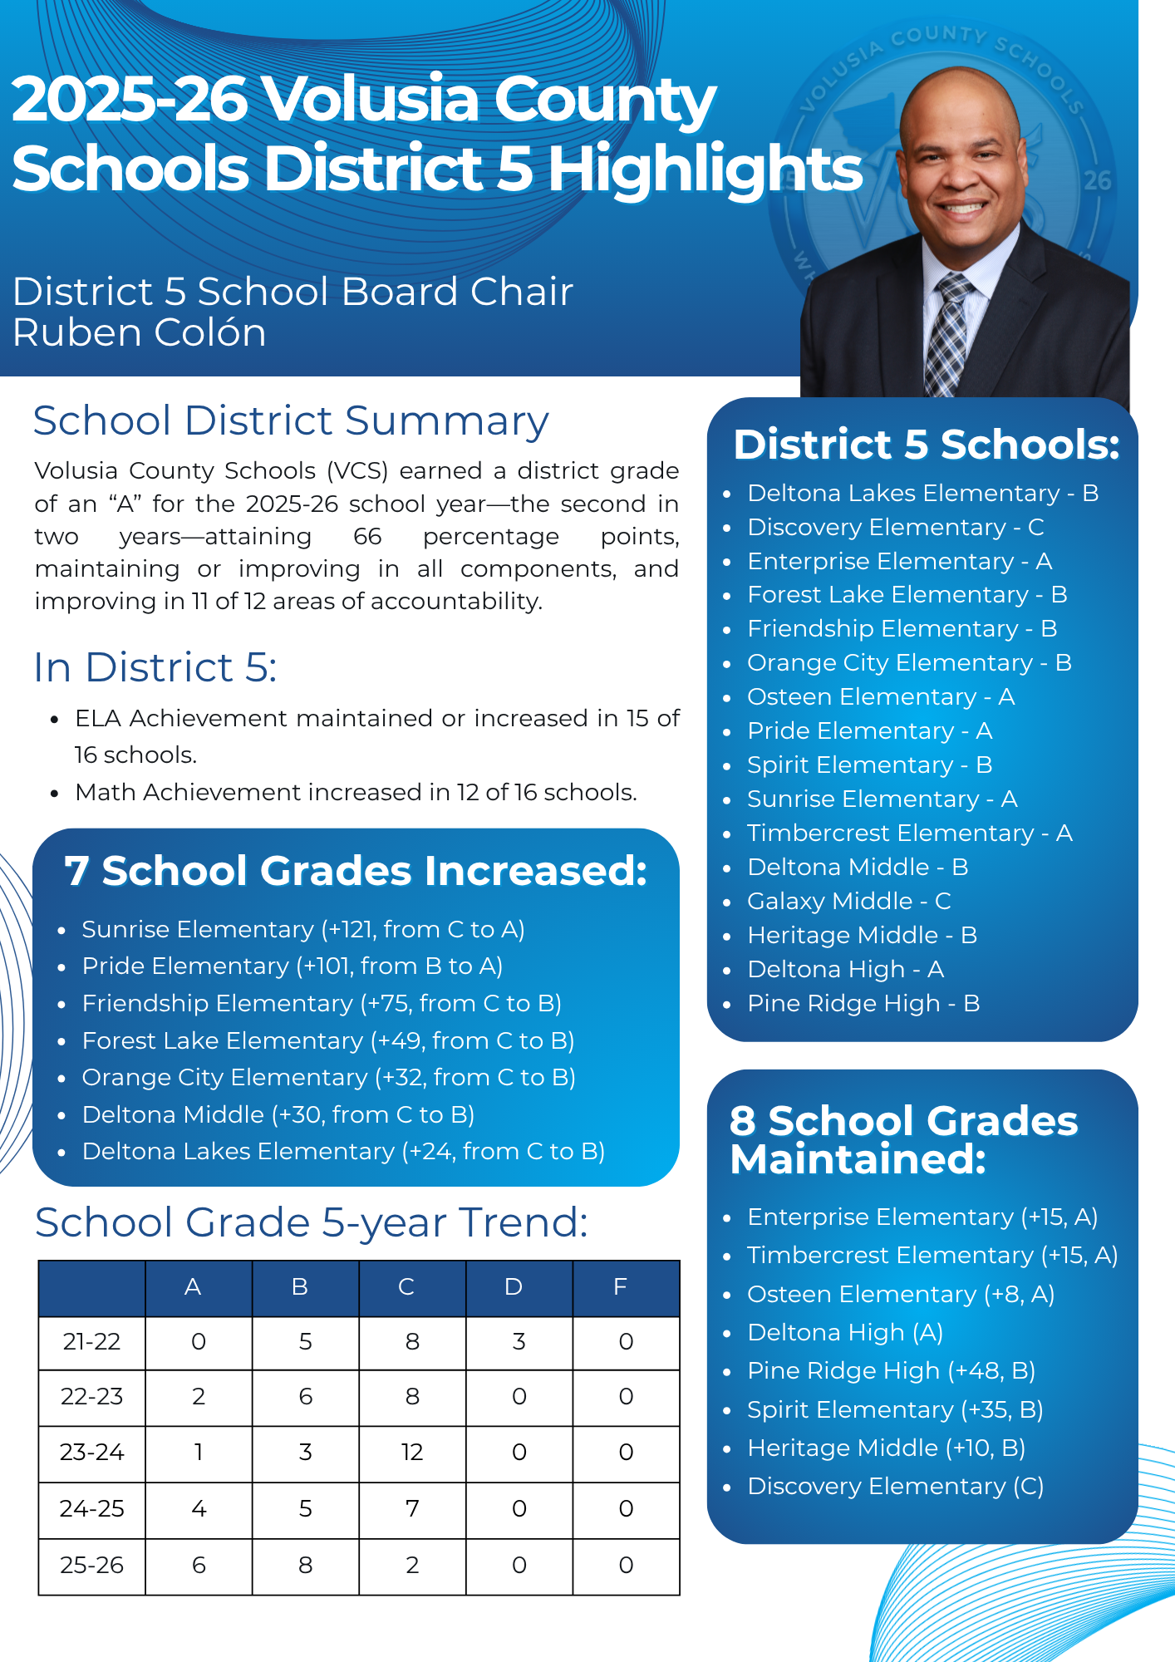
School Board District Highlights Continued

Slide 16
Escalator Clause
Florida Statute 1008.34 (3)(c)1.
Why?
To adjust grading system in response to increased student learning until ranges for grades reach “well known” ranges for A-F
How does it happen?
When 75% of schools within a school type (elementary, middle, high, combination)
What happens?
The grading scale for the school type will increase to the next 5 or 0

Slide 17
Volusia County Schools- Aiming Higher
More than 75% of all school types earned an “A” or “B” in 2026
    Grading scale for all schools and districts across the state will change for 2027.
    The change shown above will apply to high schools and combination schools as well as districts.
2025-2026 District Scale
Grade | Score Range
A | 65%-100%
B | 60%-64%
C | 45%-59%
D | 35%-44%
F | 0%-34%
2026-2027 District Scale
Grade | Score Range
A | 70%-100%
B | 65%-69%
C | 50%-64%
D | 40%-49%
F | 0%-39%

Slide 18
Volusia County Schools- Aiming Higher
Elementary School Scale Change
Grade | 25-26 Score Range | 26-27 Score Range
A | 62-100 | 65-100
B | 54-61 | 55-64
C | 41-53 | 45-54
D | 32-40 | 35-44
F | 0-31 | 0-34
Middle School Scale Change
Grade | 25-26 Score Range | 26-27 Score Range
A | 64-100 | 65-100
B | 57-63 | 60-64
C | 44-56 | 45-59
D | 34-42 | 35-44
F | 0-33 | 0-34

Slide 19


Celebrating the Work Behind the Results
This year’s success should be celebrated.
These results reflect the hard work of every student, family, teacher, school, and district support team.
The work includes everyone: traditional schools, alternative programs, hospital homebound services, and charter schools.
Sustaining excellence and aiming higher will continue to require all of us to be invested in student learning.
Notes:
As we close, I want to make sure we pause and celebrate what this past year represents. These results are not the work of one department, one school, or one group of students. They reflect the daily learning of our students, the support of families, the work of teachers and school leaders, and the efforts of district staff, bus drivers, support personnel, and many others who help make student success possible.
It is also important to remember that when we discuss the district’s accountability results, we are talking about all students served across Volusia County Schools. That includes students in our traditional schools, our alternative education programs, hospital homebound services, and our charter schools. The district grade reflects the work of the full system, and this year’s success belongs to the full system.
As Volusia County Schools continues to sustain excellence and aim higher, this work will continue to require the commitment of every student, every family, every educator, every school, and every support system working together.

Slide 20
Contact Information
Kyle Schicker,
Coordinator, REA
Phone Number: x20261
Email Address: kbschick@volusia.k12.fl.us

