Slide 1





Teurlings Catholic High School
Class of 2027
Welcome Parents
Presented by Anna Proctor
Senior Counselor

Slide 2







Overview
01
Have a Plan!
02
TCHS Transcripts/TOPS Core Transcript
03
tchs.net - Senior Resources
04
Scoir/College Applications
05
College Admissions
06
Financial Aid/FAFSA
07
TOPS
08
Scholarships
09
Tips and Dates to Remember

Slide 3



Graduation Requirements
TCHS Graduation Requirements and TOPS University Diploma
Curriculum *Cumulative GPA
  Religious Studies I, II, III, IV
  English I, II, III, IV
  Algebra I, Geometry, Algebra II and 1 Sr. Math Course (Advanced Math I, II, or Calculus)
  World Geography, Civics, United States History, World History
  Physical Science, Biology I, Chemistry, and 1 Sr. Science (Biology II, Physics, Human Anatomy, Environmental Science)
  Health ½ credit; PE I ½ credit and PE II 1 credit
  Foreign Language (2) credits
  Art elective (1) credit
  Electives (3)
  Total of 28 Credits completed

Slide 4

TOPS CURRICULUM
  Students must complete the following courses, maintain a 2.5 GPA on the TOPS Core Curriculum, and earn a minimum of a 20 on the ACT to qualify for a TOPS Award. The GPA and ACT requirement are subject to change by the state. *Core GPA
  Required courses
    English I, II, III, IV
    Algebra I, Algebra II, Geometry and 1 credit from either Adv. Math I, II, or Calculus
    Physical Science, Biology I, Chemistry, and 1 credit from either Biology II, Physics, or Environmental Science
    World Geography, Civics, U.S. History, and World History
    Fine Arts Survey or 1 credit in Art or Theatre
    2 years of the same foreign language
    19 credits

Slide 5
College Admission Requirements
UL-LAFAYETTE
  TOPS University Diploma Curriculum
  2.5 GPA (TOPS Core GPA)
  Or
  23 ACT Composite
  and
  ACT English (18)
  ACT Math (19)
**No student will be admitted with less than a 2.0 GPA
**Students with a 3.0 Cumulative GPA are guaranteed admissions regardless of their ACT scores.
**Any student not meeting these requirements may be admitted by committee.
Application Day
September 22
10:00 am - 2:00 pm
Counselor’s Office

Slide 6

College Admission Requirements
LSU
(Holistic Approach)
Suggested requirements
  TOPS University Diploma Curriculum
  3.5 gpa or greater (Test Optional)
  Under a 3.5 (ACT test required)
  (Average ACT score of admitted students was a 23-28)
  ACT English (18)
  ACT Math (19)
**Student’s applying to LSU must use the Common Application A letter of recommendation is no longer required.

Slide 7
College Admission Requirements
SLCC
(High School Diploma)
ACT Score will be used for course placement. Accuplacer is also available.
  Enter as a Transfer Student-Begin your degree at SLCC then transfer to a 4-year institution.
  Earn an Associates Degree (2 year)
  Technical Programs-location depends on program
  https://www.solacc.edu/academics/programs-offered/index

Slide 8

WHAT IS SELECTIVE ADMISSIONS?
Admissions officers review and make decisions on hundreds, sometimes thousands, of applications in a short period of time. They are under enormous pressure to assess the applicant pool in order to produce the best class and the best campus community possible. How you apply, when you apply, and what you say can all impact whether you receive an acceptance or a denial. What factors in to the increasingly selective college application process?

Slide 9

KNOW WHAT ADMISSION TERMS MEAN!
WATCH YOUR DEADLINES!
  EARLY ACTION (EA)
  EARLY DECISION (ED)
  OTHER TERMS
Many colleges enable you to apply Early Action in November-December, and you receive a decision by mid-December (or January). Early Action is NOT binding. You can apply to as many Early Action schools as you like. You have until May 1 to accept.
Many private colleges offer Early Decision which is an early BINDING route to college admissions. You apply in early to mid November to ONE college, and you find out by mid-December. You must attend if you get accepted. Can only apply to one selective college under these terms.
REGULAR DECISION
PRIORITY ADMISSIONS
PRIORITY DEADLINES

Slide 10




  Scoir is used to research colleges, and communicate with your counselor. It is a legal safe way to send transcripts and documents.
  Each senior created their account during 11th grade.
  Create a Profile to build a resume. (Junior Year)
  Add colleges to “Following” (Junior Year)
  Move colleges to “Applying” (August 2026)
  If required, request teacher recommendation in Scoir.
  Move colleges to “Applied” (Alert sent to counselor)
  Counselor sends required documents to college.
  Once accepted, update your outcome in Scoir.
  Once a final decision is made, update outcome to Enrolling.

Slide 11

Recommendations and Resumes
  Students applying to selective colleges and or applying for scholarships will need letters of recommendations from their counselors and teachers.
  A Student Resumé helps recommenders get a bigger picture of your accomplishments, interest, and future plans. Students will build their resume in Scoir.
  To request a Letter of Recommendations, for college admissions, the student will request it through their Scoir account for each college. (Application Documents)
  To request a Letter of Recommendation for a scholarship or any other reason, the student can email the teacher.

Slide 12
TRANSCRIPTS
  Need a transcript for college?
    In Scoir, move the college to “Applied”. This alerts the Guidance Office to send your official transcript.
  Need a transcript for a scholarship?
    Email Mrs. Proctor who will prepare your transcript. Some transcripts may need to be unofficial, some digitally uploaded, or official which will be sealed and placed in a TCHS envelope.

Slide 13


DE TRANSCRIPTS
  Seniors enrolled in Dual Enrollment courses have college transcripts. (NSU, LA Tech, LSU, UL Lafayette)
  You will need to access your college transcript for orientation. Links to these request will be provided in your Scoir Drive.
  After graduation, you will need to request official college transcripts be sent to your college.
  The Guidance Office does not have access to your college transcript.

Slide 14
VISITING COLLEGES
  It is a good idea to visit each college that you are considering. Tour the campus, attend an activity, but most importantly, talk with students.
  The admissions office at most universities can arrange a visit for you. Remember, you are not only choosing a place to go to school, but a home for the next four years.
  Several colleges host “Senior Day” on their campus. Visit their websites to learn more about these activities
  Let the front office and teachers know ahead of time when you will be out on a college visit.
  You are responsible for making up any missed work and/or test.

Slide 15






College Fair
AES
Wednesday,
OCTOBER 22, 2026
6:00-8:00 PM
AES will be hosting the College Fair this year from 6:00 pm to 8:00 pm. Other Catholic schools in the Diocese will be invited.
Over 30 colleges both in and out of state will be attending. A list of schools attending will be emailed to students prior to the fair.

Slide 16
www.fafsa.gov
  Do not google FAFSA!!
  Why complete the FAFSA?
    Grants (free money based on need)
    Loan (low interest loan-government)
    TOPS (Federal government forwards your application to Louisiana Government (LOSFA) Louisiana Office of Student Financial Assistance processes for any aid they offer. This is when TOPS kicks in if students have met CORE GPA and ACT requirements.

Slide 17
FSA ID
  Before you can begin your FAFSA in October, you must create a FSA ID.
  Create your FSA ID now, document your username, password, and recovery code.
  Who needs an FSA ID?
    Senior
    Parent (contributor)

Slide 18
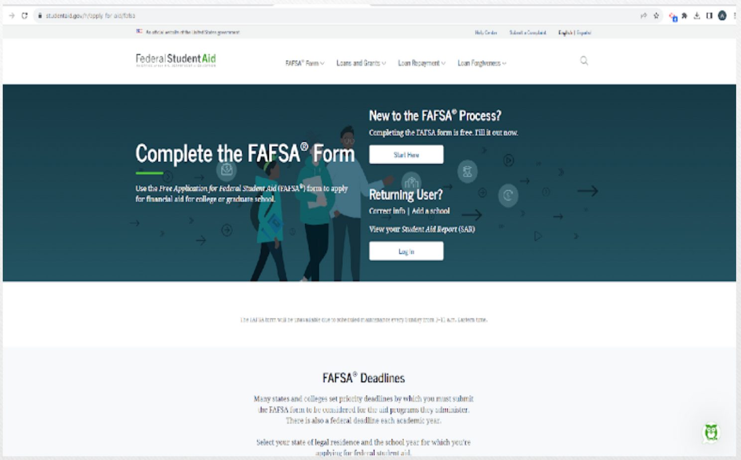
FAFSA.GOV

Slide 19
FAFSA TIPS
  Student will create an FSA ID (electronic signature) you will also provide an email for future notifications. Use a personal email that you will use after graduation. Do not use your TCHS email. Mrs. Proctor will visit the classroom and help Seniors Create their Accounts. All Seniors unless they choose not to will have a FSA ID prior to October 1.
  One parent will create an FSA ID (electronic signature). If you have other college students, you can use the same FSA ID, however you need to login and complete a new verification.
  Record your FSA ID to renew each year the student is in college.
  Seniors of 2027 are completing the 2027-2028 FAFSA.
  You will use your 2025 taxes.
  During the FAFSA application you will be given an opportunity to select each college you are applying to. The college will receive your SAR (Student Aid Report).
  The FAFSA opens sometime in October. Until then, create or update your FSA ID.
  You will not be able to create an FSA ID, then begin your FAFSA. You must create your FSA ID ahead of time.

Slide 20
TOPS
TOPS
  OPPORTUNITY
TOPS
  PERFORMANCE
TOPS
  HONORS
TOPS
  EXCELLENCE
TOPS
  TECH AWARD
3.5 CORE
31 ACT
TUITION+FEES
annual $12,000
2.5 CORE
20 ACT
TUITION
3.25 CORE
23 ACT
TUITION+$400
3.5 CORE
27 ACT
TUITION+$800
2.5 CORE
17,18,19 ACT
(TECHNICAL)
  TOPS WILL NOT USE A SUPERSCORE!
  HOW TO APPLY FOR TOPS?
Complete the FAFSA (Free Application for Federal Student Aid).
The FAFSA form should be completed online at www.fafsa.gov. Do not begin your FAFSA application until it opens in October 2025. The deadline to apply is July 1, 2026. (2026-2027 FAFSA)

Slide 21


TOPS TRACKER
WWW.OSFA.LA.GOV
02
04
01
03
Select LASECID (enter social security number) then complete form (It will ask for 10 digit number, but a 9 digit social security number will word with no dashes)
Select Student Hub
Select Continue to Student Registration/Login
Select next and continue with registration

Slide 22

To register for an ACT test, students login to their MyACT account.
It is important to complete the section “Where to send scores”. Colleges need an official copy. Copies from the Guidance Office are not official.
Science is now an option on the ACT test. No longer will Science be a part of the composite score. It will be a STEM score.
The test is now shorter, with less questions.
The Math section no longer has 5 possible answers. It is now 4.
April is the last test date TOPS will use without a penalty.
Students who earn TOPS in June, will be penalized 1 semester.
TOPS DOES NOT take a Superscore!!

Slide 23

SCHOLARSHIPS
  Colleges and Universities (example)
    UL-Lafayette: 3.0 cum gpa, 23 ACT; no application; apply for admission; must have earned the ACT 23 and the 3.0 gpa by May 31
    LSU: no application; apply for admission by Dec. 15th. To be be considered for a scholarship. LSU will consider ACT scores up until May 31.
    Other colleges: Each college is different. Inquire or research their scholarship section.
  Scholarship opportunities will be emailed to students through Scoir. (Scoir Drive) Students are encouraged to check emails daily.
  Several Scholarships opportunities are posted in the Senior College Handbook scholarship page located on the Senior Resource page of the TCHS Website. Listed under Academics/Guidance. Scholarship search engines! See flyer

Slide 24

RESOURCES
  SCOIR
  TCHS.NET
  Each senior has a Drive in Scoir. This is where scholarship opportunities and resources will be posted
  Parents who have not joined your child’s Scoir account please email me and I will send you an invitation.
  Under Academics/Guidance you will see Senior Resources
  College Handbook
  Links to important sites

Slide 25
Summary/To Do List
Add/Move college/trade school to “Applying”in Scoir.
Schedule an ACT if necessary.
Go online to the schools website or use the Common App. to apply. Have Mrs. Proctor review it before you submit.
If you need recommendations, make sure you enter activities in Scoir. Add teachers to write rec letters in Scoir.
Once you apply, let Mrs. Proctor know by moving the College to “Applied” in Scoir. Your documents will be sent through Scoir (transcript, recs, etc.)

Slide 26
Summary/To Do List
Create an FSA ID prior to completing your FAFSA. You and one parent must each have an ID.
Check your Scoir Drive for scholarship opportunities and resources.
Complete the FAFSA. Opens in October. This is for TOPS, Grants (free money), or loans.
Schedule a meeting with Mrs. Proctor for help or stop by!

Slide 27


Thank you!

