Slide 1
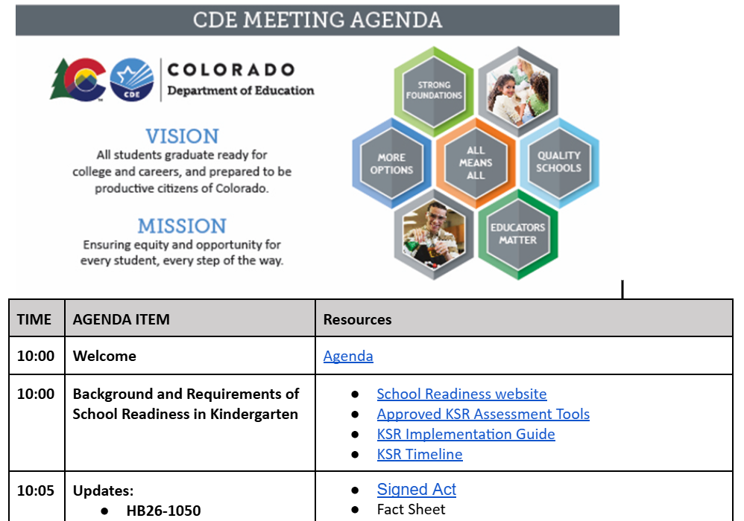
Agenda
Notes:
Agenda: https://docs.google.com/document/d/1qtw1x69MwADaFRSPaDBSNRPzW1gzLSXQ5J7GCx3_Sh4/edit?usp=sharing

Slide 2
Elementary Literacy and School Readiness Office
Kindergarten School Readiness Back to School
2026-2027

Slide 3

Ready System, Ready Child
School readiness describes both the preparedness of a child to engage in and benefit from learning experiences and the ability of a school to meet the needs of all students enrolled in publicly funded kindergarten. School readiness is enhanced when schools, families, and community service providers work collaboratively to ensure that every child is ready for higher levels of learning in academic content.
~State Board of Education, 2023

Slide 4
Overview of School Readiness in Kindergarten
Data-informed decisions at the classroom, school, district, and state level
Class: data-informed instruction and intervention
School and district: informed decisions on instruction, resources, and community partnerships.
State: informed policy decisions, state agency partnerships
STATE SYSTEM | Report to stakeholders to inform policy decisions and partner with state agencies.
DISTRICT | Partner with local agencies, plan resource allocation, and teacher support.
SCHOOL | Prepare ready schools and partner to meet needs within the EC community.
CHILD | Individualize Instruction
DATA-INFORMED DECISIONS

Slide 5

News and Updates

Slide 6
HB26-1050: Optional Individualized Readiness Plan
Key highlights:
Individualized Learning Plan (ILP) May Be Optional
A local education provider may choose not to provide an ILP when a student:
  Meets requirements on each of the 6 required domains of school readiness, AND
  Meets the requirements on the interim reading assessment.
ILP Is Required:
A local education provider must provide an ILP when:
  A student does not meet requirements on KSR assessments and the reading interim assessment, OR
  A student’s parent or guardian requests an ILP.
Notes:
Recent legislation
This past legislative session, HB26-1050 was passed by the Colorado Legislature, making the use of ILPs in Kindergarten optional for students who attain certain requirements
Review new bill: https://leg.colorado.gov/bill_files/115757/download
Key highlights:
In certain circumstances, an Individualized Learning Plan (ILP) may be optional
A local education provider may choose not to provide an ILP when a student:
Meets requirements on each of the 6 required domains of school readiness, AND
Meets the requirements on the interim reading assessment.
When is an ILP Required:
A local education provider must provide an ILP when:
A student does not meet requirements on KSR assessments and the reading interim assessment, OR
A student’s parent or guardian requests an ILP.

Slide 7
HB26-1050: Written Notification
Local education providers must provide written notice to families that includes:
Individual assessment results from the
  kindergarten school readiness assessment(s), and
  interim reading assessment:
The purpose of the assessment tools,
Transparency in how the information from the assessments is used,
If applicable, a statement indicating that the local education provider is not required to provide, and does not intend to provide, an ILP based on the assessment results; and
Information regarding the parent’s right to request an ILP for their child.
Notes:
Specifically, local education providers must provide written notice to families that includes:
Individual assessment results from the
kindergarten school readiness assessment(s), and
interim reading assessment:
The purpose of the assessment tools,
Transparency in how the information from the assessments is used,
If applicable, a statement indicating that the local education provider is not required to provide, and does not intend to provide, an ILP based on the assessment results; and
Information regarding the parent’s right to request an ILP for their child.
FACT SHEET: https://ed.cde.state.co.us/fs/resource-manager/view/6244d7b8-9d83-40d3-b2f5-2b9cdabcb389

Slide 8
Implementation of HB26-1050

Slide 9
Kindergarten: Key Responsibilities
You are here.
Schools and districts serving publicly funded students in kindergarten
  Use state board-approved assessment tools.
  Assess six domains of learning and development in school readiness.
  Administer the KSR assessment from the 1st day of school through the first 60 calendar days.
4. Create individual learning plans for each student who does not meet the minimum requirements on each required domain of KSR assessment and the Interim reading assessment.
NEXT

Slide 10
Beginning of Year Benchmarks

Slide 11
School Readiness Assessment Benchmarks: Tools assessing all required domains
Assessment tool | Beginning of Year Benchmark Descriptor
COR-K | Fully Meets
DRDP-K | Building Later
DIAL-4 | Low Average
GOLD | At or Above BOY Kindergarten expectations (purple)
Notes:
This table shows the approved assessment tools that assess all required domains.
For each of the approved KSR assessment tools, the benchmark descriptor is listed in this table
This descriptor indicates the benchmarks that meet (or exceed) BOY grade level expectations
NC KEA—please contact me; this will follow the BOY benchmarks used for reporting.
These cutpoints align with KSR data reporting, HB26-1050, and school readiness statute.

Slide 12
School Readiness Assessment Benchmarks: Tools assessing specific domains
Assessment tool | Beginning of Year Benchmark Descriptor
Acadience Math | At and Above BOY Benchmark
Brigance (Physical, Social-Emotional, Language) | Average and Above Average
FastBridge earlyMath | At or Above Benchmark
FastBridge earlyReading | At or Above Benchmark
FastBridge SAEBRS | Some Risk
ISIP Math | Tier 1
Notes:
These are the benchmark descriptors for tools assessing specific domains.

Slide 13
GOLD®, Teaching Strategies (Limited Item Set)
Domain | Composite Score
Physical | 35
Language Comprehension | 26
Social-emotional | 31
Cognition | 29
Math | 24
Literacy | 35
Notes:
Composite cutscores by domain.
These are for the limited item set only.
Align with the assessment tool’s expectations for students who are at benchmark at the beginning of the kindergarten year.
This would be the first score and indicator on the purple color band.
Link to additional support from GOLD:
https://teachingstrategies.my.site.com/portal/s/article/Now-Available-Enhanced-K-Readiness-Report

Slide 14
COR-K, Highscope (KER)
Domain | Composite Score
Physical | 12
Language Comprehension | 4
Social-emotional | 16
Cognition | 16
Math | 16
Literacy | 20
Notes:
Composite cutscores by domain.
This is for the Kindergarten Entry Record only
Align with the assessment tool’s expectations for students who are at benchmark at the beginning of the kindergarten year.

Slide 15
DIAL-4, Pearson
Domain | Standard Score
Physical | 85
Language Comprehension | 85
Social-emotional | 85
Cognition | 85
Math | 85
Literacy | 85
Notes:
Standard Score by domain.
Align with low average and 1 standard deviation below the mean

Slide 16
Brigance, Curriculum Associates
Domain | Composite Score
Physical | 9
Language Comprehension | 14
Social-emotional | 8
Notes:
Composite cutscores by domain.
Align with the assessment tool’s expectations for students who are at benchmark at the beginning of the kindergarten year.

Slide 17
FastBridge, Rennaisance
Tool Name | Domain | Composite Score
FastBridge Math | Math | 29
FastBridge earlyReading | Literacy | 32
SAEBRS | Social-emotional | 24
Notes:
Align with the assessment tool’s expectations for students who are ready for core instruction, ~40 percentile
Link for more information on the FastBridge Suite:
https://resources.finalsite.net/images/v1787946366/cdestatecous/pfxovdewgmjawfy5m0zi/KindergartenRenaissanceCutScores2026_Renaissance.pdf

Slide 18
ISIP Math, Amira (formerly iStation)
Domain | Composite Score
Math | 290
Notes:
Align with the assessment tool’s expectations for students who are ready for Tier 1 instruction, ~41 percentile

Slide 19
Acadience Math
Domain | Composite Score
Math | 24
Notes:
Align with the assessment tool’s expectations for students who are at benchmark and ready for core instruction

Slide 20
Interim Reading Assessments

Slide 21
SBE-Approved English Interim Reading Assessment, SY 2026-2027
Indicating the student is meeting BOY benchmarks and ready for differentiated core instruction.
Assessment Tool (ENGLISH) | Description | Composite Score
Acadience Reading | At and Above BOY Benchmark | 26
Amplify DIBELS 8th Edition | At and Above BOY Benchmark | 306
iREADY Reading | On Grade | 344
ISIP Reading | Tier 1 | 254
Star Early Learning | At and Above BOY Benchmark | 665
Notes:
These cut scores help to identify when an ILP is optional. As a reminder, a student must score at or above the BOY cutscore for kindergarten in each domain of school readiness and the interim reading assessment.

Slide 22
SBE-Approved Spanish Interim Reading Assessment, SY 2026-2027
Assessment Tool (SPANISH) | Description | Composite Score
mCLASS Lectura | At and Above BOY Benchmark | 269
ISIP Lectura | Tier 1 | 662
Star Early Learning Spanish | At and Above BOY Benchmark | 630

Slide 23
Individual Learning Plans in Kindergarten

Slide 24
Kindergarten School Readiness: Key Responsibilities
Schools and districts serving publicly funded students in kindergarten
  Use state board-approved assessment tools.
  Assess six domains of learning and development in school readiness.
  Administer the KSR assessment from the 1st day of school through the first 60 calendar days.
  Create individual learning plans for each student who does not meet the minimum requirements on each required domain of KSR assessment and the Interim reading assessment.

Slide 25
Reminder: Individual Learning Plans
Individual learning plans (ILP) are:
Based on standards
Used to monitor progress toward school readiness
Informed by a State Board of Education-approved school readiness assessment tool
If a READ plan is required, the READ plan is to be a component of the ILP
The format may include:
District designed template
Vendor created template
Integrated READ and individual learning plan template
Notes:
For students who receive an ILP, here is a reminder of the requirements

Slide 26
Example 1
Student meets beginning-of-year (BOY) benchmarks on physical well-being and motor development, social and emotional development, language and comprehension development, cognition, and literacy on KSR assessments.
Student meets BOY benchmark on the interim reading assessment
Student does not meet BOY benchmark on the math domain of the KSR assessment
Is this student required to receive an ILP?
Notes:
Please type your response in the chat.
Bonus: In which domain would this student likely receive specific learning goals and targeted support that would be documented in the student’s ILP?

Slide 27
Example 2
Is this student required to receive an ILP?
Student meets the BOY benchmark on physical well-being and motor development, social and emotional development, language and comprehension development, cognition, and math on the KSR assessments.
District uses the interim reading assessment in place of the literacy domain of the KSR assessment (§22-7-1014 2(a). The student meets the BOY benchmark on the interim reading assessment.
After receiving written notice of the assessment results, this student’s family requests an ILP.
Is this student required to receive an ILP?

Slide 28
Example 3
Is this student required to receive an ILP?
Student meets beginning-of-year (BOY) benchmarks on physical well-being and motor development, language and comprehension development, and cognition on KSR assessments.
Student does not meet the BOY benchmark on the social and emotional development, literacy, and math domains of the KSR assessment.
Student does not meet the BOY benchmark on the interim reading assessment and scores below the SRD cutscore.
What else would be required as a component of the student’s ILP?

Slide 29
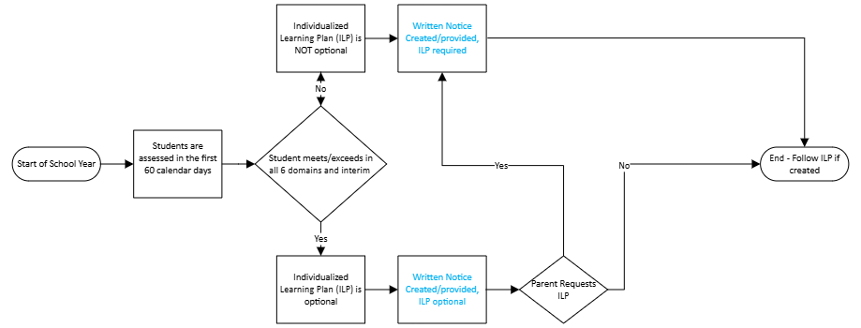
Individualized Learning Plan: Decision Tree

Slide 30
Written Notice to Families

Slide 31
Kindergarten School Readiness: Key Responsibilities #5
Schools and districts serving publicly funded students in kindergarten
  Use state board-approved assessment tools.
  Assess six domains of learning and development in school readiness.
  Administer the KSR assessment from the 1st day of school through the first 60 calendar days.
  Create individual learning plans for each student who does not meet the minimum requirements on each required domain of KSR assessment and the Interim reading assessment.
5. Provide written notice to each family concerning assessment results and individual learning plans.
NEXT

Slide 32
Written Notice to Families: Reminder
Provide written notice for each kindergarten family that includes:
Individual student assessment results for kindergarten school readiness and interim reading assessments,
Purpose of the assessment tools,
Transparency in how the information from the assessments is used,
If applicable, language stating the local education provider is not required to provide, nor intends to provide, an individualized plan based on those assessment results, and
The parent's right to request an individualized plan for their child.
Notes:
As a reminder, written notice is to include specific statutory requirements.

Slide 33
Additional Implementation Support
Checklist of required content and additional resources
Sample written notice to families whose child requires an ILP
Sample written notice to families whose child does not require an ILP
Notes:
Link: https://ed.cde.state.co.us/schoolreadiness/assessment#notice

Slide 34
SY2026-2027: Implementation of HB26-1050, CAP4K, and READ Act
Not Change
Use state board-approved assessment tools.
Assess six domains of learning and development in school readiness.
Administer the KSR Assessments from the 1st day of school through the first 60 calendar days.
Administer the interim READ assessment, within the first 60 calendar days to inform or replace the literacy domain. (HB15-1323)
Report data during the KSR data collection window.
Create a READ Plan for students identified as having a Significant Reading Deficiency as a component of the ILP.
Change
Provide written notice for each kindergarten family
Create an individualized learning plan (ILP) for:
  all students who do not meet the minimum requirements from HB26-1050, and
  students whose parents request an individualized learning plan
Notes:
In summary, on your screen is an outline of changes that will and will not occur under HB26-1050:

Slide 35
Key Responsibilities
Schools and districts serving publicly funded students in kindergarten
  Use state board-approved assessment tools.
  Assess six domains of learning and development in school readiness.
  Administer the KSR assessment from the 1st day of school through the first 60 calendar days.
  Create individual learning plans for each student who does not meet the minimum requirements on each required domain of KSR assessment and the Interim reading assessment.
  Provide written notice to each family concerning assessment results and individual learning plans.
  Report data during the KSR data collection window.

Slide 36

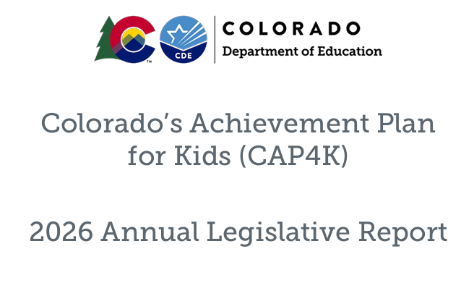
2026 CAP4K Legislative Report

Slide 37
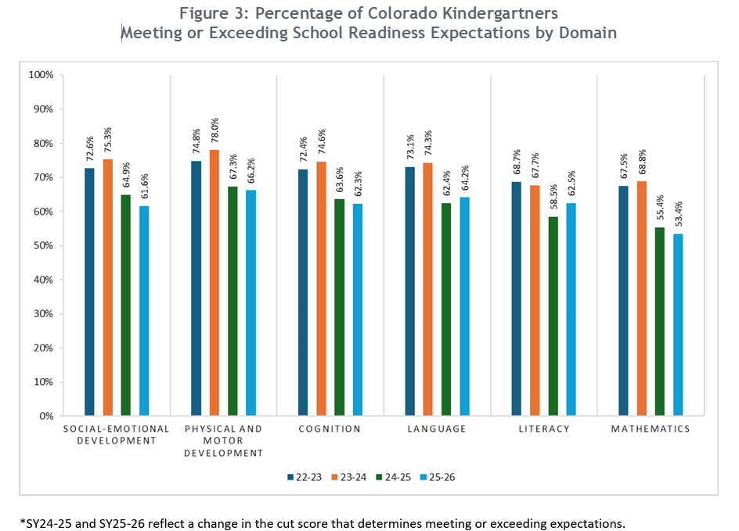
Percentage of Colorado Kindergartners Meeting or Exceeding Expectations by Domain, 2022 - 2025
Notes:
Report link: https://resources.finalsite.net/images/v1774295556/cdestatecous/visfbmmxn1gcoqcawmyu/2026CAP4KLegislativeReport-Final1.pdf

Slide 38
KSR Data Collection

Slide 39
KSR Data Collection Updates
Justin Chrisco – KSR Data Collection Lead
Collection Timeline
  October 6^{th,} 2026 – Collection opens
  December 11^{th,} 2026 – Collection closes
KSR Data Collection Training
  Data Respondent focus
  September 29th, 2026 – 11am to 12pm
  Webinar registration will be posted at KSR Data Collection
Identity Management Access
  Local Access Managers

Slide 40
Contact Information
Megan Rogers, Kindergarten School Readiness
  Rogers_m@cde.state.co.us
  Bookings link
Justin Chrisco. KSR Data Collection Lead
  Chrisco_j@cde.state.co.us
Notes:
Here is our contact information.

Slide 41

Questions

