Slide 1
2026-2027
Back to School Kindergarten School Readiness

Slide 2
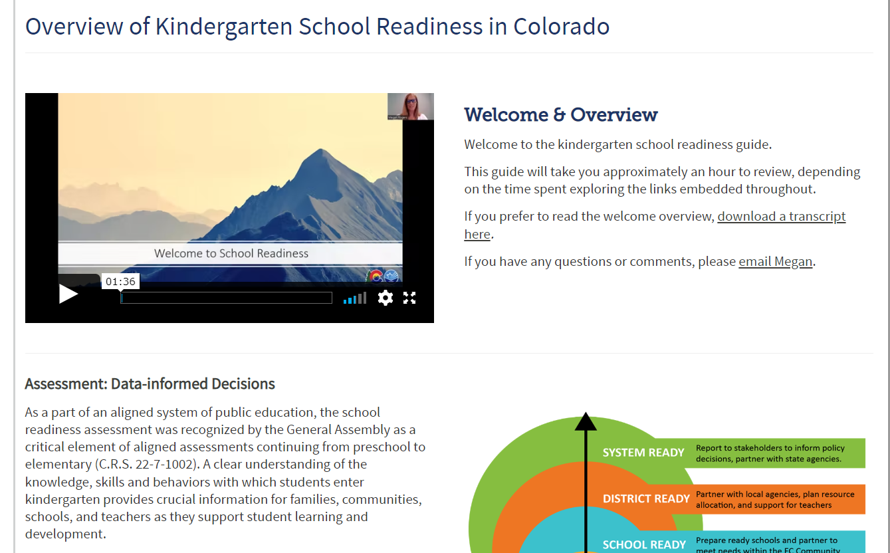
Agenda
KSR Guide
Key Ideas
Discussion
Questions
Notes:
Agenda: https://www.cde.state.co.us/schoolreadiness/ksrguide

Slide 3

Ready System, Ready Child
School readiness describes both the preparedness of a child to engage in and benefit from learning experiences, and the ability of a school to meet the needs of all students enrolled in publicly funded kindergarten. School readiness is enhanced when schools, families, and community service providers work collaboratively to ensure that every child is ready for higher levels of learning in academic content.
~State Board of Education, 2023

Slide 4
Overview of School Readiness in Kindergarten
Data-informed decisions at the classroom, school, district, and state level
Class: data-informed instruction and intervention
School and district: informed decisions on instruction, resources, and community partnerships.
State: informed policy decisions, state agency partnerships
STATE SYSTEM | Report to stakeholders to inform policy decisions, partner with state agencies.
DISTRICT | Partner with local agencies, plan resource allocation, and teacher support.
SCHOOL | Prepare ready schools and partner to meet needs within the EC community.
CHILD | Individualize Instruction
DATA-INFORMED DECISIONS

Slide 5

Kindergarten Assessment
Notes:
View Video Transcript: Watch online https://www.youtube.com/watch?v=skgP7isEsqg&t=2s

Slide 6
Key Responsibilities
Schools and districts serving publicly funded students in kindergarten
  Use state board-approved assessment tools.
  Assess six domains of learning and development in school readiness.
  Administer the KSR assessment from the 1st day of school through the first 60 calendar days.
  Provide written notice to each family concerning assessment results and individual learning plans.
  Create individual learning plans for each student who does not meet the minimum requirements on each required domain of KSR assessment and the Interim reading assessment.
  Report data during the KSR data collection window.

Slide 7

Why School Readiness
Brain Science: How brains are built and the impact of trauma
Child Ready, System Ready
Whole Child, Is There a Half? Understanding the relationship between learning and development
The Kindergarten Balance: Meeting the needs of every child
Authentic Assessment

Slide 8
Kindergarten School Readiness Assessment
Preparedness of the Child: Engaging in Kindergarten content
State Board-Approved Assessments aligned to CAS/ELDGs
Required domains of learning and development
physical well-being and motor development,
social and emotional development,
language and comprehension development,
cognition,
literacy, and
math.
Preparedness of the School: Meeting the needs of each student
Analyze child data for trends and inform local system goals and partnerships

Slide 9
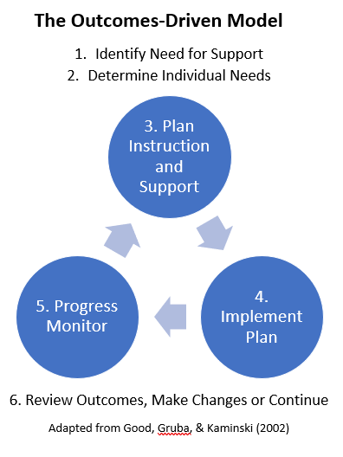
Assess and Instruct
Administer the KSR Assessment from the 1st day of school through the first 60 calendar days.
Using kindergarten assessment data to drive instruction involves data-based decision-making.
This is documented in Individual Learning Plans (School Readiness or K Plans)

Slide 10

Individual Learning Plans
1) Individual learning plans are required for students who do not meet minimum requirements at the beginning of the kindergarten year on:
each of the required domains of kindergarten school readiness assessments and
the interim reading assessments.
2) Individual learning plans are required for students whose parents request a plan for their child.

Slide 11
Individual Learning Plans Requirements
Individual learning plans (ILP) are:
Based on standards
Used to monitor progress toward school readiness
Informed by a State Board of Education-approved school readiness assessment tool
If a READ plan is required, the READ plan is to be a component of the ILP
The format may include:
District designed template
Vendor created template
Integrated READ and individual learning plan template

Slide 12

Data Sharing and Written Notice
Written notice to each kindergarten family includes:
Individual student assessment results for kindergarten school readiness and interim reading assessments,
Purpose of the assessment tools,
Transparency in how the information from the assessments is used,
If applicable, language stating the local education provider is not required to provide nor intends to provide an individualized plan based on those assessment results, and
The parent’s right to request an individualized plan for their child.

Slide 13

KSR Data Collection
Justin Chrisco – KSR Data Coordinator
  Chrisco_j@cde.state.co.us
KSR data is reported to CDE each fall during the KSR Data Collection.
  October 6th – December 11th
Data file layout is approved by the State Board of Education
  Additional race/ethnicity fields added this year
Some vendors provide a Colorado specific report
Get to know your KSR data respondent

Slide 14
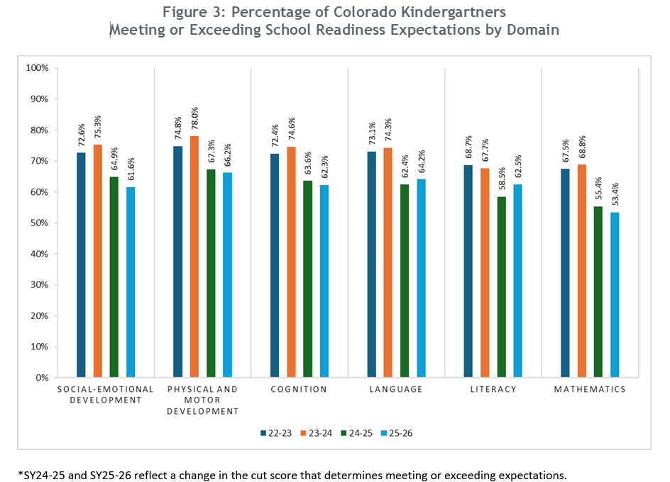
Percentage of Colorado Kindergartners Meeting or Exceeding Expectations by Domain, 2022 - 2025
Notes:
Report: https://resources.finalsite.net/images/v1774295556/cdestatecous/visfbmmxn1gcoqcawmyu/2026CAP4KLegislativeReport-Final1.pdf

Slide 15
Timeline
Summer (May-August)
Planning
Beginning of School (August-Sept)
Assessment Window: first 60 days
Provide assessment support
Monitor vendor platforms
Finalize scores
KSR Collection Window (Oct-Nov)
Ensure data respondent has the KSR file layout
Written Notice to Families
Develop Individual Learning Plans
Mid- and End-of-year assessment (Nov.-May)
Communicate dates for mid- and end-of-year assessment windows
Communicate domains to assess
Plan for transitions
Licenses
Review Assessment Options

Slide 16
Key Responsibilities Summary
Schools and districts serving publicly funded students in kindergarten
  Use state board-approved assessment tools.
  Assess six domains of learning and development in school readiness.
  Administer the KSR assessment from the 1st day of school through the first 60 calendar days.
  Provide written notice to each family concerning assessment results and individual learning plans.
  Create individual learning plans for each student who does not meet the minimum requirements on each required domain of KSR assessment and the Interim reading assessment.
  Report data during the KSR data collection window.
Notes:
School Readiness webpages: https://www.cde.state.co.us/schoolreadiness
Family webpage: https://www.cde.state.co.us/schoolreadiness/kindergartenfamilies

Slide 17
Upcoming Webinars
Back to School: School Readiness in Kindergarten KSR Contacts
This webinar will provide brief updates on school readiness in kindergarten for the 2026-2027 school year. We will cover the implementation of HB26-1050, minimum requirement thresholds for this legislation, and provide templates for written family communication. This session is targeted for all KSR contacts.
September 1st, 10-11:00 AM
Please register

Slide 18
Contact Information
Email: rogers_m@cde.state.co.us

