Slide 1

An Overview for Families

Slide 2
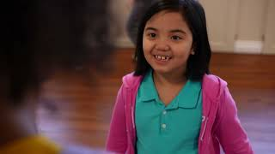
Notes:
3 minutes: This video provides a CharacterStrong overview for families.

Slide 3
It’s all about
RELATIONSHIPS
Notes:
1 minute:
Say: Ultimately all of this work is about relationships. We believe building relationships is foundational for learning, creating a positive school culture, and fostering belonging. The PurpsoseFull People curriculum provides so many fun ways to build relationships!
(On the next slide, you can model a connection activity from our curriculum called “My Happy Place.”)

Slide 4
Connect
My Happy
Place
Choose a letter to reveal an image. Share with a partner, a small group, or the whole class what makes you happy in the picture and what would you add to the photo to make you even happier!
H
A
P
P
Y
Slide 32
Notes:
3 minutes
Say: Connection doesn’t happen on accident, and just like we need to plan for content, we also have to plan for and make space for connection. Here is an example of one of the PurposeFull People connection activities. This one is called My Happy Place.
Note: Showcase a few questions by clicking one of the letters of the word “HAPPY”. Use the upper left hand corner icon to “go back” to this menu.

Slide 5
.3 Reasons. building skills for life success and character-development matter!
Notes:
.5 minutes:
Say: First, let’s look at three research-backed reasons that we are investing in this work.

Slide 6
Improved Academics
Addressing skills for life success and character-development increased students’ academic performance by 11 percentile points.
1
Notes:
.5 minutes:
Say: First, addressing students’ social and emotional needs improves academic performance by an average of 11 percentile points. That is an entire letter grade. It could be the difference between a student passing and failing, being labeled at risk or excelling, having negative academic associations or positive ones.
Study: https://casel.org/impact/

Slide 7
Improved Behavior
Students participating in life skills programs also showed improved classroom behavior, an increased ability to manage stress and depression, and better attitudes about themselves, others, and school.
2
Notes:
.5 minutes:
Say: Second, students participating in life skills programs like PurposeFull People showed improved classroom behavior, an increased ability to manage stress and depression, and better attitudes about themselves, others, and school. All of these help us, as educators, prevent teacher burnout and make sure students can effectively receive the instruction they need to be successful in school and beyond.
Study: https://casel.org/impact/

Slide 8
Families’ Belief
81% of parents believe that life skills are just as important as academic learning.
3
Notes:
.5 minutes:
Say: Third, a vast majority families believe this type of learning is equally important to academic learning. Thinking back to the rhetoric reality gap, attending to students’ emotional, social, and mental needs helps us not only foster students’ academic ability, but their ability to function in the world as kind and capable people.
Study: McGraw Hill 2018 Study
Other Sources of Interest:
RAND Corp 2019 Study of Teachers and Administrators
McGraw Hill 2021 Study (Post-pandemic need)

Slide 9
½
.Be Well.
.Be Kind.
.Be Strong.
Notes:
.5 minutes
Say: The PurposeFull People curriculum is designed specifically to generate 3 three main goals for students:
Be Well, Be Kind, and Be Strong
● Be Well: Skills that help students handle their emotions and deal with stress.
○ These skills are taught alongside Gratitude, Honesty, & Creativity
● Be Kind: Social skills like listening, friendship, solving conflicts, and leadership.
○ These skills are taught alongside Empathy, Respect, & Cooperation
● Be Strong: Skills that help students focus, stay organized, and set goals.
○ These skills are taught alongside Responsibility, Courage, & Perseverance

Slide 10
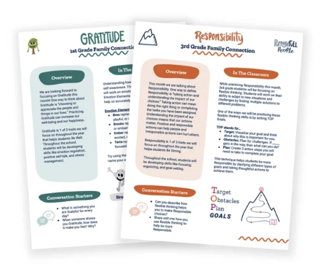
.Family Newsletter .
Notes:
.5 minutes
Say: We believe partnering with families is critical to supporting students to the fullest! Our approach to working with families is 2-pronged:
Communicate what skills we are working on and how we are teaching them
Provide resources and activities you can do with your family at home to build strong character!

Slide 11
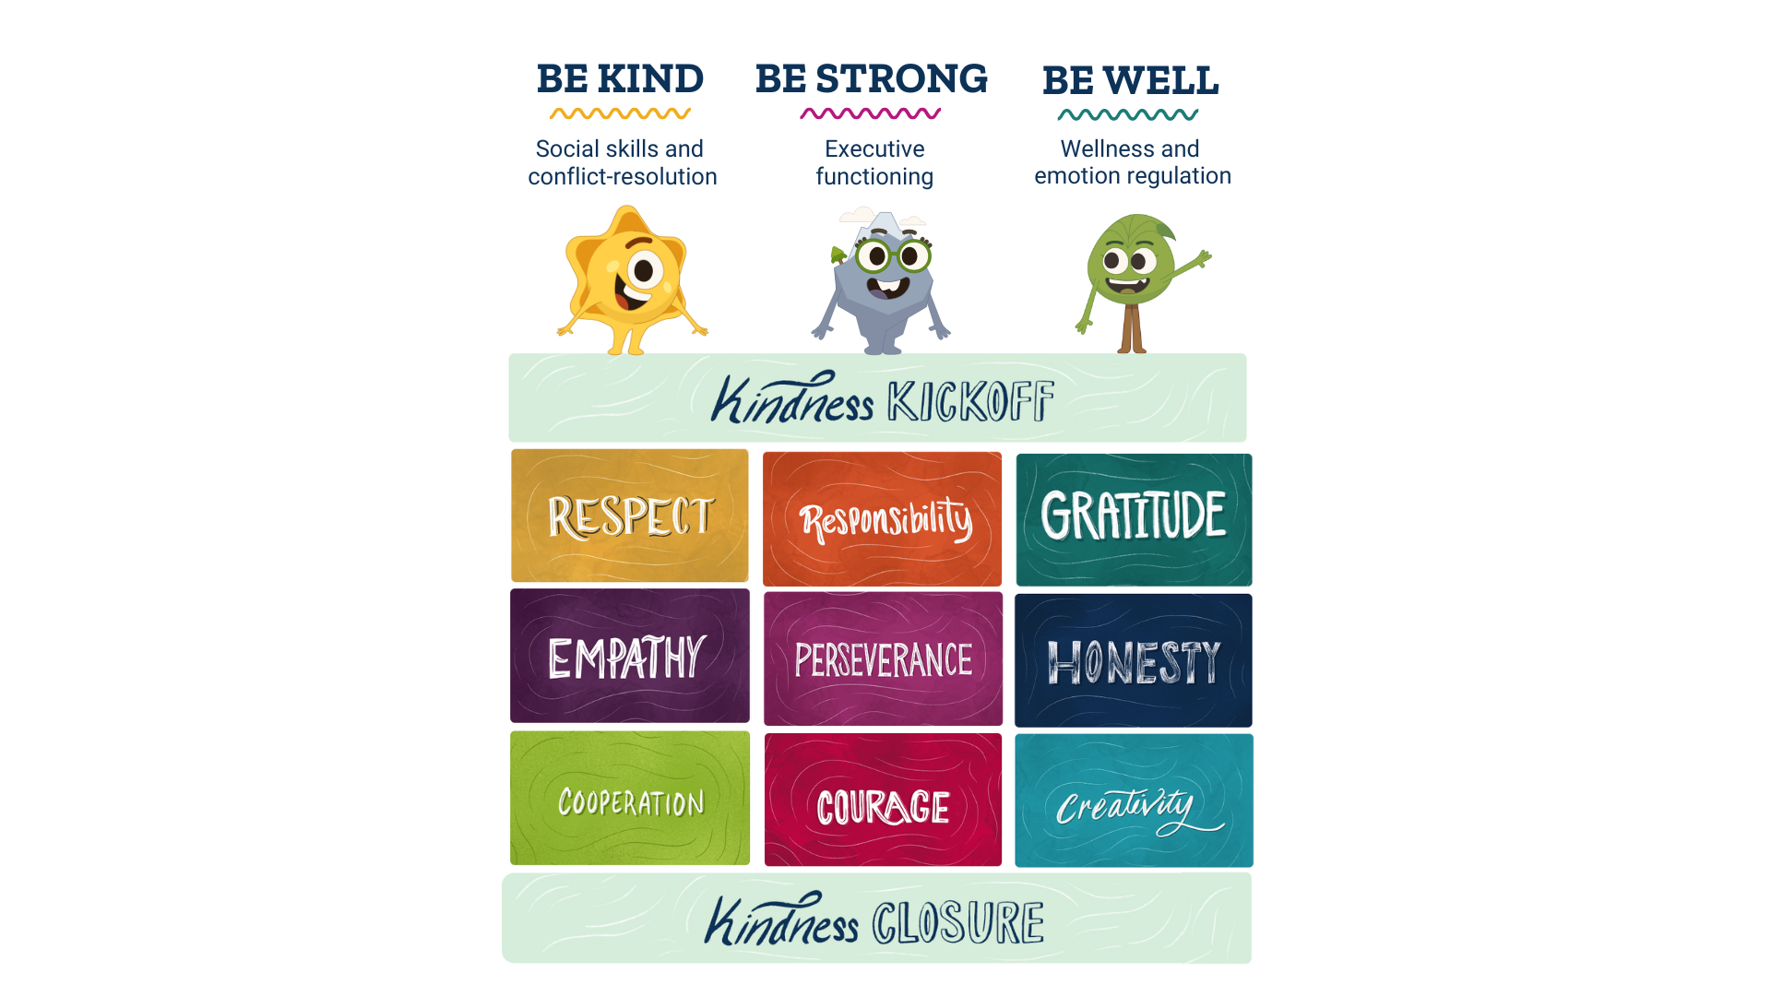
PurposeFull Outcomes
Notes:
1 minute
Say: This is the high level overview of PurposeFull People. There are 9 months worth of content, plus a 2-week Kindness Kickoff and Kindness Closure. Our lessons and activities are focused on developing character and teaching specific skills for life success. All of this leads to our three key outcomes: be strong, be kind, we well.

Slide 12
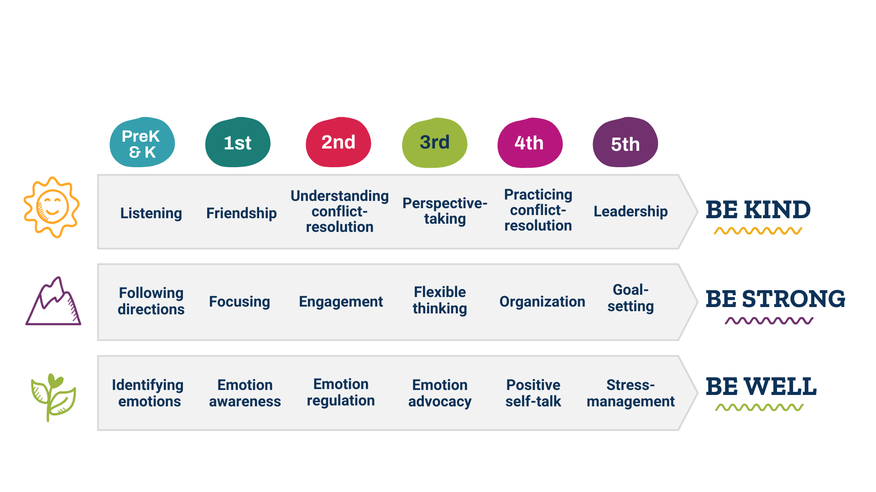
Grade-Level-Specific Skills
Notes:
1 minute
Say: Along with the Character Traits, we have grade-level-specific skills woven into our curriculum. Every grade level has 3 focus skills, creating a vertically-aligned path for students to reach the outcomes of Be Kind, Be Strong, and Be Well. Be Well has a focus on Emotion Regulation, Be Strong teaches Executive Functioning skills, and Be Kind focuses on Social Skills to help students improve prosocial interactions.

Slide 13
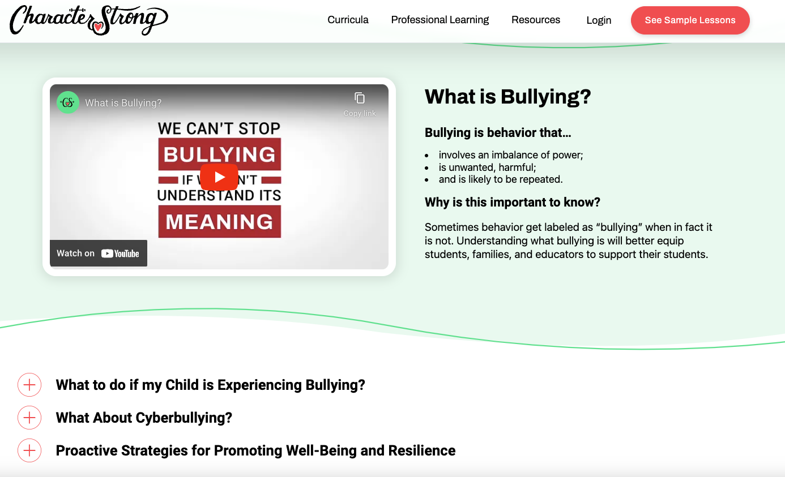
Bullying Prevention Resource
Notes:
2 minute
Say: Bullying-prevention is built into our curriculum. This includes specific instruction and engaging lessons around how to stop and report bullying; take-home materials for continued support; and a family site (shown here) that provides a deeper dive into our approach to bullying-prevention along with additional resources.
https://characterstrong.com/bullying-prevention

Slide 14
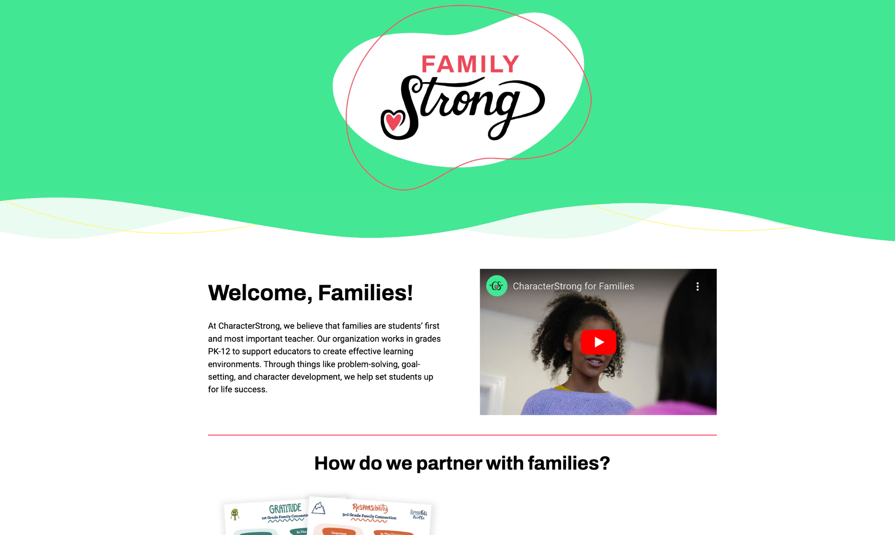
Bullying Prevention Resource
Notes:
1-2 minutes
Say: Speaking of family sites, CharacterStrong provides an overview for family on their FamilyStrong site, where you can find more information!
https://www.characterstrong.com/familystrong

Slide 15
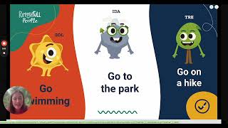
Demo
Notes:
5 minutes
(Optional - show this 5-minute demo of our curriculum site families want a closer look)

Slide 16
Notes:
Spotify Playlist: “CharacterStrong Seasonal Sounds”

Slide 17


Slide 18


Slide 19


Slide 20


Slide 21
