Slide 1
PfISD Insurance Committee Meeting
Placeholder for optional client logo
February 17, 2026

Slide 2

Level Set
Open Enrollment Feedback
Financial Update
Looking Ahead
Updates & Reminders
Agenda

Slide 3
Level Set
Benefit Changes for 2026
Medical & Pharmacy (PBM)
  Medical: MDLive remains at $0 copay for the High Deductible (HD) Plan.
  Pharmacy (PBM): Transitioned from Express Scripts to CVS Pharmacy (administered through RxBenefits) to improve service and cost-efficiency.
Dental (The Standard)
  Premium Adjustment: Received a 7% increase for Year 2, adhering to the 7% rate cap negotiated for the current term.
  Average Monthly Impact: [$2.00 - $3.70] per member/employee only rate.
FSA, HSA, COBRA
  FSA & COBRA: Moved from Inspira to WEX for streamlined administration.
  HSA: Moved from Inspira to Gulf Coast Educators Federal Credit Union (GCEFCU).
EAP
  Enhanced benefit from 3 visits to 5 visits per member, per session.
  Worksite Plans
  Achieved rate reductions across all plans while enhancing Wellness Benefits to "Full Wellness" (now including Dental and Vision coverage).
  Accident Injury:
    Low: 3% rate reduction; Wellness benefit increased from $50 to $75.
    Mid: 5% rate reduction; Wellness benefit increased from $75 to $100.
    High: 15% rate reduction; Wellness benefit held at $100.
  Critical Illness: 10% rate reduction; Added new Musculoskeletal benefit; Wellness held at $100.
  Hospital Care: Added Newborn Daily Stay & Admission benefits; Wellness increased from $50 to $100 for all plans.
    Low: 3% rate reduction | Mid: 5% rate reduction | High: 10% rate reduction

Slide 4
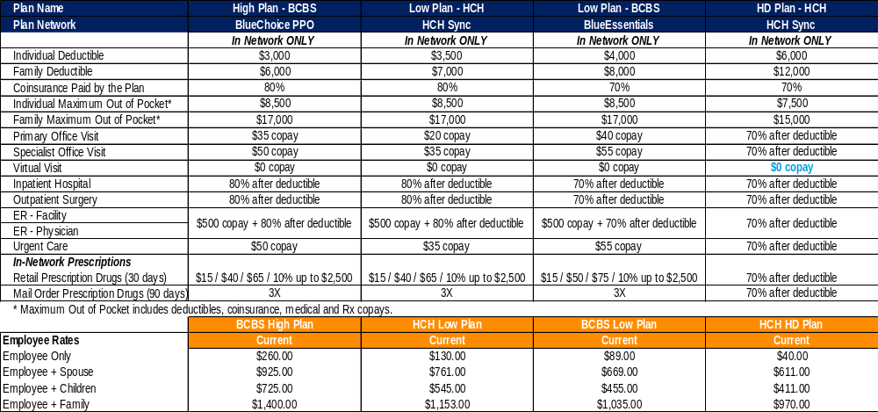
Level Set
Medical Plan Design- No Changes

Slide 5
Open Enrollment Feedback

Slide 6
Enrollment Results
Notes:
7% dropped coverage

Slide 7
Financial Update

Slide 8
Current State of the Plan
Our plan is self-funded. What does that mean?
  BCBS & HCH: They process the claims and provide the network of doctors, but the money to pay those claims comes directly from the District's funds.
  The majority of the plan costs come from actual claims (doctor visits, hospital stays, prescriptions). Because the District is paying for each service directly, the total cost of the plan isn't a fixed number—it fluctuates based on how much healthcare is used.
  The choices participants make directly affect the budget. For example:
    Choosing an Urgent Care over an Emergency Room for a non-life-threatening issue saves the plan (and the District) significant money.
    Using generic drugs instead of brand-name ones reduces the spend.
Healthcare costs, including our cost, have continued to rise each year
Claims have continued to run higher than expected
Adjustments have been made year over year to bring the plan back into budget

Slide 9
YOY Funding Summary
 | 2017 | 2018 | 2019 | 2020 | 2021 | 2022 | 2023 | 2024 | 2025 | 2026 Projected
Total Medical / Rx Paid Claims | $14,930,418 | $15,402,745 | $15,805,169 | $17,712,740 | $18,604,136 | $21,609,970 | $22,666,339 | $21,253,076 | $21,420,344 | $22,105,896
PMPM | $330.11 | $336.54 | $335.74 | $350.36 | $369.75 | $461.16 | $485.82 | $470.82 | $483.41 | $504.97
% Increase | -9.6% | 1.9% | -0.2% | 4.4% | 5.5% | 24.8% | 5.3% | -2.8%
District Funding PEPM | $400 | $400 | $400 | $400 | $400 | $400 | $410 | $435 | $435 | $435
High Cost Claimant Impact ($100k+) | 11 claimant $1.73MM | 16 claimants $2.49MM | 18 claimants $3.1MM | 24 claimants $4.1MM | 27 claimants $4.83MM | 38 claimants $7.39MM | 36 claimants $8.34MM | 35 claimants $6.04MM
Surplus/Deficit | Surplus $555,998 | Surplus $1,276,502 | Surplus $2,112,223 | Surplus $1,383,122 | Surplus $348,659 | Deficit ($3,982,758) | Deficit ($4,142,893) | Deficit ($95,748) | Deficit ($343,071) | Deficit ($2,412,930)
Strategies | Discontinued non-engaged plans Increased deductibles/copays Carved out Rx Added 4th tier specialty copay Eliminated Q4 deductible carryover | Added HDHP Increased deductibles/copays Removed iNGAGEDhealth | Move to UHC with EPO/ACO plans $0 premium plan Removed Compass Added CAP programs with RxB Introduced HSA contribution | Replaced ACO plan with EPO Moved to new AUM & opioid program with RxB | Consolidated Mid & High plans Implemented Naviguard Removed SaveonSP HSA to half match Increased ISL | Moved from UHC to BCBS/HCH 5 plan designs HSA to match only | Minor plan design changes to comply with IRS limits | Removed BCBS HD plan Plan design changes Implement PAP & CAP Programs $1MM infusion | BCBS Low plan to Essentials HMO Network Plan design changes $1MM infusion | Changed PBM from ESI to CVS No plan changes, no contribution changes
National Medical/Rx Trend* | 5.5% | 5.7% | 5.7% | 6.0% | 7.0% | 6.5% | 6.0% | 7.0% | 8.0%
*PwC Health Research Institute 2016-2025

Slide 10
Medical & Rx Per Employee Per Year
Your Cost Versus the Districts Cost Year over Year
EE Cost = 3.3% Avg Increase Year Over Year

Slide 11
Looking Ahead

Slide 12
Looking Ahead
Marketing Strategies for 2027
RFP – Direct Primary Care
  What this means: No disruption to current plans/networks
  Next Steps: Finalist Meeting & Vendor Selection
Due Date | Event
9/15/25 | Release of RFP
9/22/25 | Vendor questions due
9/24/25 | Vendor Q&A Posted
10/3/25 | RFP due
11/19/25 | MMA RFP Analysis
3/2/26 | Finalist Meetings

Slide 13
Updates & Reminders

Slide 14
Don’t Forget About….
EAP Enhancements
  5 Visits per member per issue available 24/7 visit www.livewellworkwell.com and enter access code pfisd or call 866-248-4094.
  Calm App available to no cost go to www.supportfinder.optum.com/pfisd
One Pass Select
  Membership Plans to access local gyms like Cowboy Fitness, Planet Fitness, Fitness Connection, Camp Gladiator, Orange Theory
  Available Plans: Digital-only $10, Classic Plan $34, Standard Plan $69, Premium Plan $109, Elite Plan $249
    Bonus: All plan members have access to free grocery deliver via Shipt with their membership ($99 value)
  Sign up by visiting www.onepassselect.com
Wellness Benefit with Cigna
  Members enrolled in the Cigna Accident, Critical Illness or Hospital Indemnity can receive a benefit for completing a preventive exam or health screening, now including Dental + Vision exams.
  $50 - $100 depending on coverage elected
  File claim online by logging into https://my.cigna.com
Benefit Resources Available
  MMA Service Center Call 855-550-9885 and dial PIN: 1083 or email PflugervilleISD@marshmma.com Support is available Monday - Friday from 8 am - 6 pm CT, provided in both English and Spanish.
  Employee Benefit Website to access benefit materials https://www.pfisdbenefits.com/

Slide 15
Next Meetings….
PfISD Administration Board Room – 4:30 pm
April 14, 2026
May 13, 2026

Slide 16
This document is not intended to be taken as advice regarding any individual situation and should not be relied upon as such. Marsh & McLennan Agency, LLC shall have no obligation to update this publication and shall have no liability to you or any other party arising out of this publication or any matter contained herein. Any statements concerning actuarial, tax, accounting or legal matters are based solely on our experience as consultants and are not to be relied upon as actuarial, accounting, tax or legal advice, for which you should consult your own professional advisors. Any modeling analytics or projections are subject to inherent uncertainty and the analysis could be materially affected if any underlying assumptions, conditions, information or factors are inaccurate or incomplete or should change. MarshMMA.com

