Slide 1



Bullying Prevention
Concern for the Common Good- If someone walked onto our campus for the first time, how would we want them to feel? 🙌

Slide 2










Our Mission Objective Today
How do we protect our community? It’s down to 3 major skills:
1. Recognize
2. Respond
3. Report
Spot exactly what bullying is, what forms it takes, and where it hides.
Switch your mindset from standing around watching to taking swift action.
Use safe, anonymous channels to protect your peers.

Slide 3
🔥
Video Slide

Slide 4









Decoding Bullying: What Is It?
It’s an act that abuses an imbalance of power, happens repeatedly, and can be expressed three ways:
Verbal & Written
Physical Acts
Cyber Bullying
Mean taunts, insults, text threats, or cruel name-calling meant to break someone down.
Hurting someone's body, breaking/stealing their things, or forcing them to feel terrified.
Happening completely digitally via phones, apps, and games—whether on or off-campus!
Notes:
An imbalance of power means there is a power advantage- For example, being bigger or stronger, being more popular, having influence online, having personal information, photos, or secrets about someone.

Slide 5






Turn & Talk: Crew Discussion
💡
Fact: Bullying stops much faster when classmates notice it and don't ignore it.
"Why do we need to notice bullying right away?"
How does pointing out bad behavior protect our school's "Common Good"?
🤝
Mission: Make sure nobody feels alone or invisible in our hallways.

Slide 6





The Bystander
The Upstander
A silent spectator. They see bad actions happening but choose to stand around and do nothing.
A frontline protector! They actively step in, speak up, or back up the victim safely.

Slide 7



Leveling Up to Upstander Status
Inclusion Power: Invite the excluded student to sit with you at lunch or hang out.
Stop the Hype: Do NOT laugh, film it, or act as an audience for the bully.
Your actions make a difference!
Direct Speak: If it’s safe, look at the bully and firmly say, "That's not cool, stop."
Adult Backup: Report the situation immediately to a teacher, counselor, or administrator.

Slide 8



IF YOU SEE SOMETHING,
SAY SOMETHING!
Notes:
Click on link to show students how to report via the cfisd.net website

Slide 9


Reporting Isn't Snitching!
Option A: Direct Reporting
👥
Find a trusted teacher, school counselor, assistant principal, or parent and fill them in directly.
💡 Snitching is getting someone in trouble for fun. Reporting is saving someone from getting hurt!

Slide 10
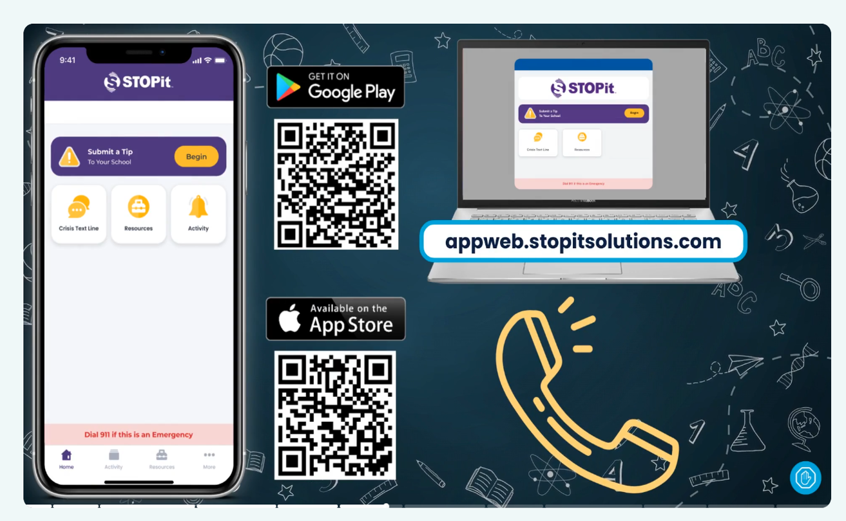


📱
Option B: Anonymous Tech
Submit a tip:
STOPit! Mobile App
Online reporting
Call the hotline: 512-649-8939

Slide 11



CFISD Secondary Safety Pledge
I will respect and maintain everyone's personal space and boundaries.
I will not bully, tease, or hurt anyone.
🌟
If I hear or see bullying or cyberbullying, teasing or harassment, I will tell the person to STOP.
Our Standards
Every student has the ultimate right to a totally safe learning environment.
I will immediately report any threats of violence, suicide, presence of weapons, explosives, or drugs to school administrators, allowing them to investigate and determine the seriousness of the report.
I will promote the acceptance of individual differences, recognizing that diversity contributes to the strength of my school.

Slide 12

🔥
The Upstander Challenge
"What is one concrete, practical action you can take this week to show Concern for the Common Good on campus?"
Talk it out with a partner or write down your goal!

