Slide 1
2026-2027
Annual Title I Meeting
Hasty Elementary School Fine Arts Academy
5:00-5:30 PM
Cafeteria/Media Center
KN

Slide 2
WELCOME & INTRODUCTIONS
KN

Slide 3
WHAT IS TITLE I?
MG

Slide 4
EVERY STUDENT SUCCEEDS ACT (ESSA)
The purpose of ESSA is to provide all children significant opportunity to receive a fair, equitable and high-quality education and to close educational achievement gaps.
MG
Notes:
District

Slide 5
PURPOSE OF TITLE I, PART A
To ensure that all children have a fair, equal and significant opportunity to obtain a high-quality education and reach, at a minimum, proficiency on challenging State academic achievement standards and State academic assessments.
MG
KN
Notes:
District

Slide 6
TITLE I SCHOOLS
Title I schools are schools that receive federal funding to improve the academic achievement of students.
The purpose of a Schoolwide Title I Program is to improve the entire educational program which should result in improving the academic achievement of all students.
MG
Notes:
District

Slide 7
TITLE I SCHOOLWIDE PLAN COMPONENTS
Components of the Schoolwide Plan include:
Comprehensive Needs Assessment
  Student data is analyzed for strengths and needs
Goals in ELA and Mathematics based on academic needs
Action Steps for Instruction, Professional Learning, and Parent and Family Engagement
Annual Evaluation
KN

Slide 8
SCHOOLWIDE ACADEMIC GOALS
K-2: The percentage of K and 1st grade students scoring at or above the district benchmark will increase by 3 percentage points (Kindergarten from 68% to 71% and 1st grade from 58% to 61%) from spring 2026 to spring 2027 as measured by the District Early Literacy Screener. The percentage of 2nd grade students scoring at or above the state benchmark will increase by 6 percentage points (from 29% to 35%) from spring 2026 to spring 2027 as measured by the District Reading Screener.
3-5: The percentage of 3rd, 4th and 5th grade students scoring at the proficient or distinguished learner level in ELA will increase by 9, 17 or 16.1 percentage points, respectively (3rd grade from 28.1% to 37.1%, 4th grade from 27.7% to 44.7%, and 5th grade from 34.3% to 50.4%) from May 2024 to May 2027 as measured by the ELA Georgia Milestones Assessment.
KN
KN
KN

Slide 9
SCHOOLWIDE ACADEMIC GOALS
K-2: The percentage of K-2nd grade students scoring at the 26th percentile or above will increase by 3 percentage points from fall 2026 to spring 2027 as measured by the District Math Screener.
3-5: The percentage of 3rd, 4th, and 5th grade students scoring at the proficient and distinguished learner levels in Math will increase by 9 percentage points (3rd grade from 37% to 46%, 4th grade from 42.7% to 51.7%, and 5th grade from
40.5% to 49.5%) from May 2024 to May 2027, as measured by the Georgia Milestones Math Assessment.
KN

Slide 10
TITLE I PROGRAMS AND SUPPORTS AVAILABLE
Instruction
Professional Learning
Parent Engagement
KN

Slide 11
TITLE I FUNDING
Academic Facilitator
Family and Community Engagement Liaison
Teachers
Paraprofessionals
Building Parent Capacity
  Materials
Professional Development for teachers
  Materials
  Substitutes
Instructional Materials
  ELA and Math
KN

Slide 12

PARENT AND FAMILY ENGAGEMENT
MG

Slide 13
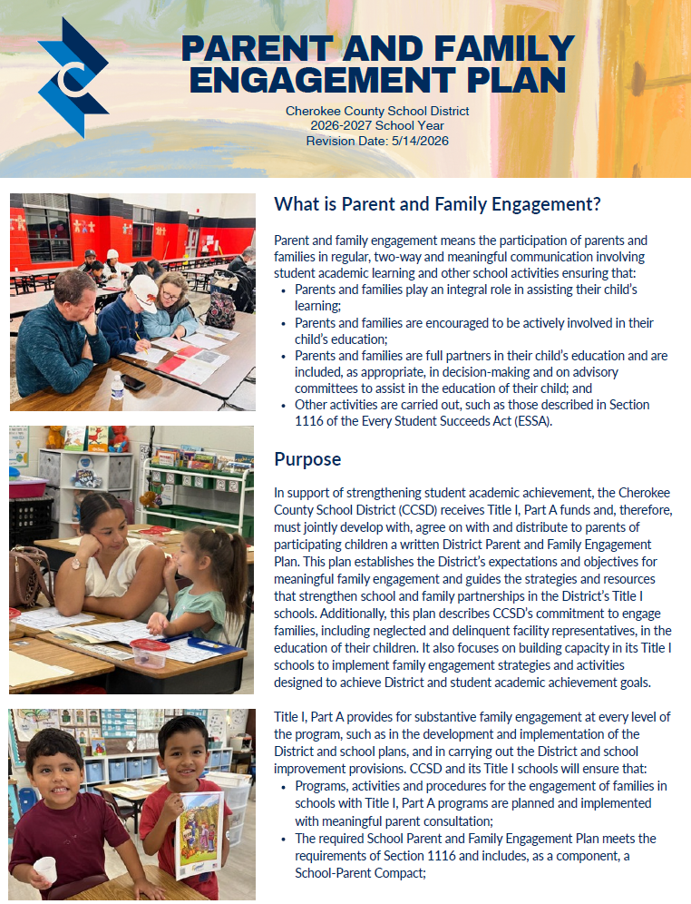
DISTRICT PARENT AND FAMILY ENGAGEMENT PLAN
Each District and school shall develop jointly, agree on and distribute to parents and family members of participating children a written Parent and Family Engagement Plan.
The plan should establish the expectations for meaningful parent and family engagement.
MG
Notes:
DIstrict

Slide 14
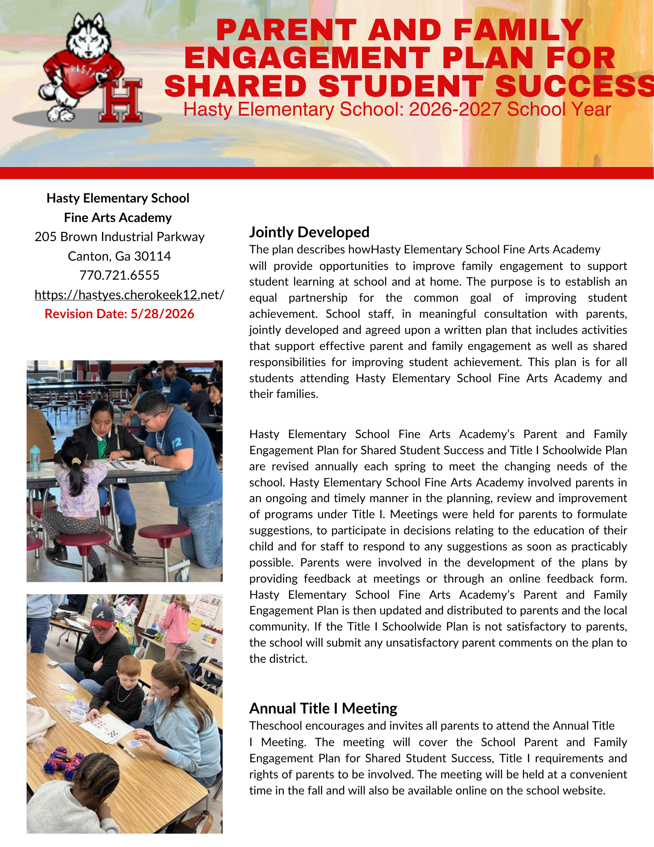
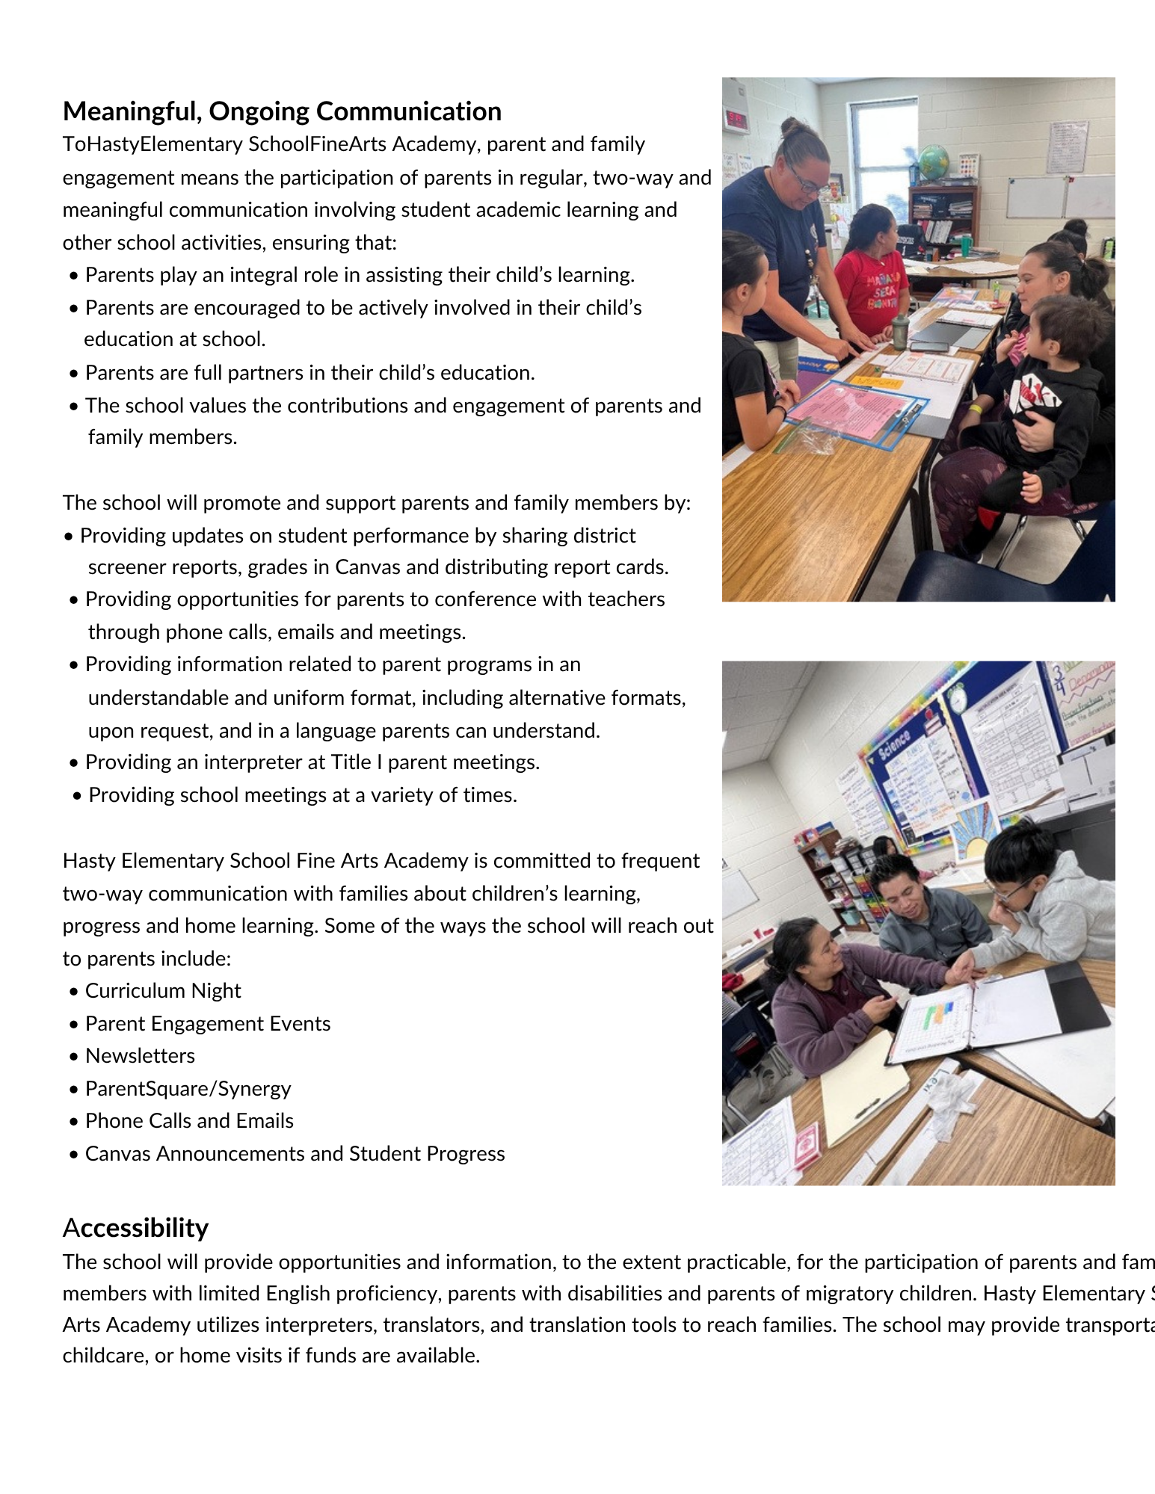
SCHOOL PARENT AND FAMILY ENGAGEMENT PLAN FOR SHARED STUDENT SUCCESS
MG

Slide 15
ENGAGEMENT & VOLUNTEER OPPORTUNITITES TO SUPPORT ACADEMIC ACHIEVEMENT
ENGAGEMENT OPPORTUNITIES
Open House
Curriculum Night
Building Parent Capacity Opportunities
PTA
School Council
Receiving Resources
VOLUNTEER OPPORTUNITIES
Reading Buddies
Math Buddies
Classroom Parent (Room Mom/Dad)
Volunteering for PTA Events
KN

Slide 16
WE ENCOURAGE PARENTS TO WORK WITH EDUCATORS TO IMPROVE STUDENT ACHIEVEMENT
Participate in Family Engagement events
Participate in decision making and volunteer opportunities
Engage in two-way communication with teachers
Review the District and School Parent and Family Engagement Plan
Encourage your student to share what they are learning in class
Utilize resources provided by the school
Check Canvas regularly
Check school folders regularly
KN

Slide 17
PARENT DECISION-MAKING OPPORTUNITIES
School Council Participation
Annual Title I Parent Survey
Parent Input on:
  Parent and Family Engagement Plan
  Building Parent Capacity Events
  Parent Engagement Funding
  Title I Schoolwide Plan
KN

Slide 18
PARENTS’ RIGHT TO KNOW:
PROFESSIONAL QUALIFICATIONS
Parents may request information about the professional qualifications of their student’s teacher(s) and/or paraprofessional(s).
Parent may request:
Whether the student’s teacher:
  has met State qualification and licensing criteria for the grade levels and subject areas in which the teacher provides instruction;
  is teaching under emergency or other provisional status through which State qualification or licensing criteria have been waived; and
  is teaching in the field of discipline of the certification of the teacher
Whether the child is provided services by paraprofessionals and, if so, their qualifications
KN
Notes:
District

Slide 19
CURRICULUM
AND
ASSESSMENTS
MG

Slide 20
CHALLENGING STATE STANDARDS
The CCSD Teaching and Learning Standards are aligned with the Georgia’s K-12 Standards and are designed to ensure that all students receive a consistent, high-quality education in every CCSD school. These standards outline what students should know and be able to do at each grade level and in each content area. By setting clear expectations, the standards help teachers plan lessons and activities that build important skills over time. For parents, this means having a clear understanding of what your child is learning and the ability to support their progress at home.
MG
Notes:
District

Slide 21
CURRICULUM (INSTUCTIONAL RESOURCES)
The following resources have been adopted for the 2026-2027 school year:
English Language Arts (ELA), Grades K–12: CCSD will use Savvas Learning Company for grades K–12.
Math, Grades K–12: CCSD will use Savvas Learning Company for grades K–8 and Cengage for algebra, geometry, and advanced algebra in high school.
The Cherokee County School District website has student resources available specific to elementary, middle school, and high school students.
MG
Notes:
District

Slide 22
GEORGIA KINDERGARTEN INVENTORY OF DEVELOPING SKILLS (GKIDS)
GKIDS Individual Student Report provides parents information about student progress throughout kindergarten.
Assessed areas include:
  English Language Arts
  Mathematics
  Science and Social Studies
  Approaches to Learning
  Social Development
  Personal Development
  Motor Skills
Performance Levels:
  Not Yet Demonstrating
  Beginning
  Emerging
  Developing
  Demonstrating
  Exceeding
  Not Yet Assessed
GKIDS Parent Guide: https://gkidsparent.gadoe.org
KN

Slide 23
GEORGIA MILESTONES
The Georgia Milestones Assessment System is designed to provide information about how well students are mastering the state-adopted content standards in the core content areas of English Language Arts, Math, Science, & Social Studies.
Assessed areas include:
  English Language Arts – Grades 3-8
  Mathematics – Grades 3-8
  Science - Grades 5 and 8
  Social Studies – Grade 8
Performance Levels:
  Beginning Learners
    Do Not Yet Demonstrate Proficiency
  Developing Learners
    Demonstrate Partial Proficiency
  Proficient Learners
    Demonstrate Proficiency
  Distinguished Learners
    Demonstrate Advanced Proficiency
Milestones Parent Guide: https://lor2.gadoe.org/gadoe/file/65da261d-7393-457b-bd7e-b7721b2f15cf/1/GM_Parent_Resources.pdf
KN

Slide 24
GEORGIA ALTERNATIVE ASSESSMENTS
ACCESS for English Learners
English Proficiency Test for English Learners
WIDA Alternate ACCESS
For English Learners with significant cognitive disabilities
Georgia Alternative Assessments (GAA)
For students with significant cognitive disabilities
KN

Slide 25
LOCAL ASSESSMENTS
CCSD District Reading & Dyslexia Screener
CCSD District Math Screener
Reading Screener Proficiency Levels
Early Literacy (K-2)
  Emergent Reader
  Transitional Reader
  Probable Reader
Reading (3-5)
  Below Basic
  Basic
  Proficient
  Advanced
Math Screener Proficiency Levels
Math (K-5)
  Beginning
  Developing
  Proficient
  Distinguished
KN

Slide 26
REPORT CARDS
Report cards are issued every quarter and show how your student is progressing through the grade level standards.
Kindergarten | Grades 1-2 | Grades 3-5
GKIDS | Standards-Based Report Cards | Letter Grades
Not Yet Demonstrating Beginning Emerging Developing Demonstrating Exceeding Not Yet Assessed | 3: Student can consistently and independently meet or exceed the standard, and the student can consistently produce quality work 2: Student is inconsistently applying learned skills with some teacher support 1: Student shows limited achievement and needs additional support and/or frequent reteaching | A=90-100 B=80-89 C=71-79 D=70 F= Below 70
KN

Slide 27

PARENT ACCESS TO STUDENT AND SCHOOL DATA
STATEWIDE LONGITUDINAL DATA SYSTEM (SLDS) | Georgia School Grades Report
Parents can access previous test performances, grades and attendance about their student. Login to Parent Canvas Account Click SLDS icon on left | Reports for all public schools in Georgia based on school performance and other information. Link to individual school’s GOSA School Report Card
MG

Slide 28
MONITORING YOUR STUDENT’S PROGRESS
Teacher Communication
Canvas
Parent-Teacher Conferences
Report Cards
KN

Slide 29
ENGLISH LEARNERS
  English Language Development Standards
  Reading
  Writing
  Speaking
  Listening
  Assessments for English Learners
  World-Class Instructional Design and Assessment (WIDA)
  ACCESS for English Learners
  Student Support for English Learners
  Attaining English Proficiency
  Achieving at high levels within a well-rounded education
  Meeting challenging academic standards expected of all students
  Student Programs for English Learners
  ESOL
KN

Slide 30
TRANSITIONING TO KINDERGARTEN
School transition is a process that prepares families and schools in developing the necessary skills to successfully move from one level to another.
Tips for Transitioning to Kindergarten
Read Together Every Day: Reading daily helps build vocabulary, listening skills, and a love of books before school begins.
Practice a School Routine: Start a consistent bedtime, wake-up time, and morning routine a few weeks before school starts. Familiar routines help children feel confident and prepared.
Build Independence: Encourage your child to practice everyday skills like using the bathroom independently, zipping a jacket, tying shoes, and cleaning up after themselves.
Practice Early Learning Skills: Have fun practicing letters, numbers, colors, shapes, writing their name, and using crayons, pencils, and scissors to strengthen fine motor skills.
Stay Involved and Positive: Keep open communication with your child's teacher, celebrate their efforts, and remember that every child learns and grows at their own pace.
KN

Slide 31
COPYRIGHT Piracy
The exclusive legal right to reproduce, publish, sell or distribute the matter or form of something.
Copyright is a form of protection given to authors or creators of work.
Work can only be copied, distributed or displayed with permission.
It bans illegally downloading or sharing copyrighted music, movies, etc.
Get permission before sharing.
Give credit for content and site sources of information
Additional information is available at www.commonsense.org
MG
Notes:
District

Slide 32
SCHOOL COMMUNICATIONS
Communication Methods
  ParentSquare
  Emails
  Phone Calls
  Agendas/Weekly Folders
Communication Timeline
  Respond to parent questions within 1 school day.
KN

Slide 33
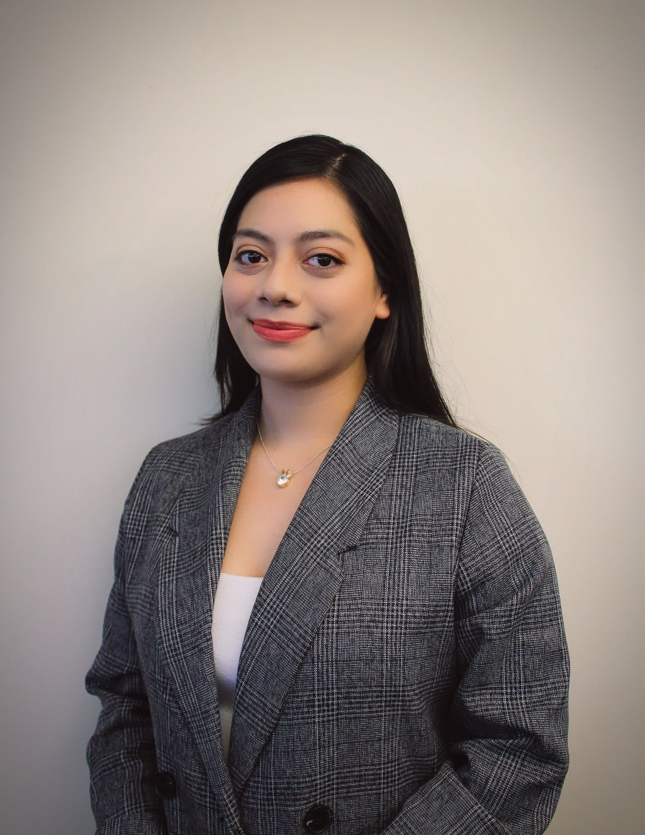
FAMILY AND COMMUNITY LIAISON
Provides support for parents to increase student academic achievement.
Rosa Diaz
Parent Liaison
Rosa.Diaz-Jarquin@cherokeek12.net
770.721.6563
KN

Slide 34
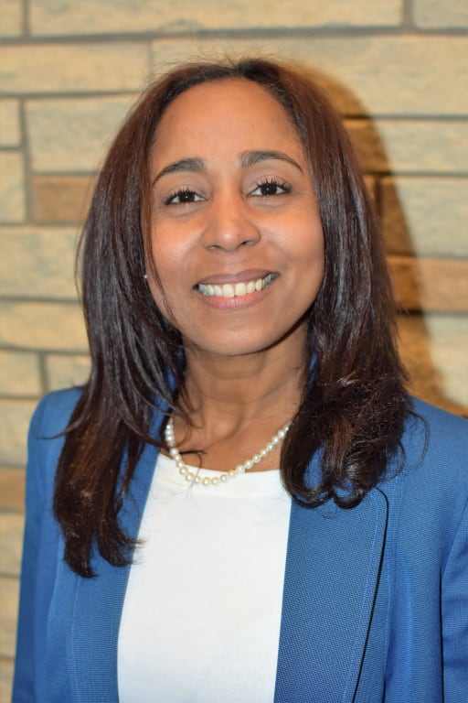
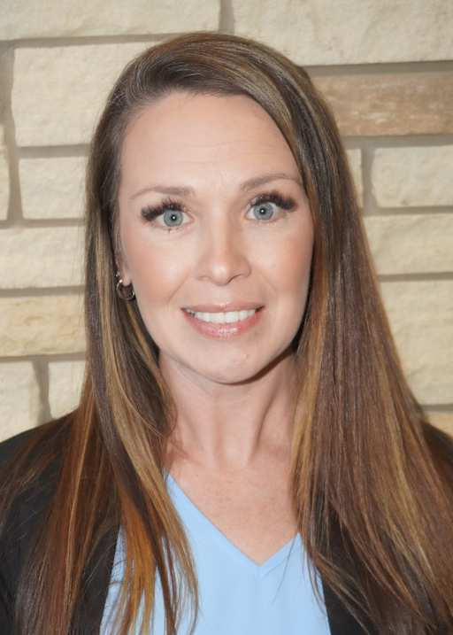
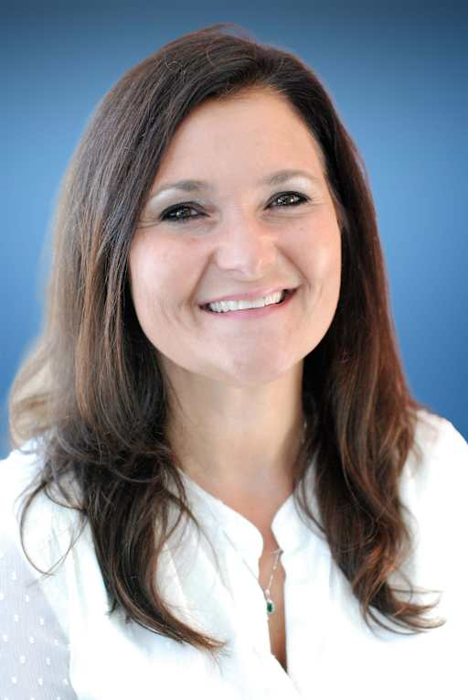
WE ARE HERE FOR YOU!
Principal
Dr. Maria Rosario-Regan
maria.rosario-regan@cherokeek12.net
Assistant Principal
Kelli Nastasi
kelli.nastasi@cherokeek12.net
Assistant Principal
Kirsten Hargadon
kirsten.hargadon@cherokeek12.net
KN

Slide 35
QUESTIONS?
WE APPRECIATE YOUR FEEDBACK!
KN

