Slide 1

SNJ Parent Informational Meeting
Welcome!
Thank you for coming!!!

Slide 2

Sierra Nevada Journeys – Overnight Field Trip Dates
Goal is to have all students attend.
May 19-21, 2027 W-F
Notes:
9.01

Slide 3
Sierra Nevada Journeys – Cost:
$300 per student
$200 per chaperone
  AND $58.50 to get fingerprinted due on arrival, directly to Fingerprinting Express
(This includes the cabins, food, and staff for two nights)
Notes:
9.01

Slide 4
Sierra Nevada Journeys – Chaperones!!!!
We need a total of 14 adult chaperones to attend the field trip. Chaperones will be assigned to the boys’ and girls’ cabins. The number of male and female chaperones needed will be determined based on the number of boys and girls attending.
Notes:
9.01

Slide 5
Sierra Nevada Journeys – Chaperones!!!!
You monitor a group of 8 students during the field trip and you also stay in the glamping type rooms. ☺
Notes:
9.01

Slide 6
Sierra Nevada Journeys – Chaperones!!!!
If we do not have 14 adults commit to going on this field trip to help chaperone – we will have to cancel the trip.
Notes:
9.01

Slide 7
Sierra Nevada Journeys – Chaperones!!!!
Additional Volunteer Approval:
  Fingerprinting:
    takes 6-8 weeks
  Background Check
Notes:
9.01

Slide 8
Sierra Nevada Journeys – Cost:
We are needing everyone to pay the $300 for student and/or chaperone by December 1, 2026.
Payment Options: Cash or Check ONLY
Options:
  Pay in full by 12/1
  Monthly Installments of $100 per month or one lump sum payment.
  Make checks our to Brown Elementary
Notes:
Cash or Check ONLY: If a parent chaperone or student decides to cancel we have to show how they paid in order to approve the refund.

Slide 9
Sierra Nevada Journeys – Cost:
If you want your student to attend but may not be able to afford it. We can provide a scholarship for half of the cost, $150.

Slide 10
Sierra Nevada Journeys – Cost:
If you would like to sponsor an additional student that is also an option as well. You will also get a receipt for tax purposes if requested at our office.

Slide 11

Sierra Nevada Journeys – Cost:
If you would like to sponsor an additional student that is also an option as well. You will also get a receipt for tax purposes if requested at our office.

Slide 12
Sierra Nevada Journeys – Luggage:
Each student brings: LABEL ALL ITEMS (Using duct tape is fine)
  1 carry on/duffel bag - Small
  1 backpack to walk around
  Toiletries in a small bag - ziploc
  1 Sleeping bag (use a trash bag to keep it clean)
  1 pillow (use a trash bag to keep it clean)
  Chaperones: Have to use some vehicles to get all luggage to SNJ.

Slide 13
Sierra Nevada Journeys – Fundraising:
Our 5th Grade Student Council does monthly popcorn sales and Candygrams 2-3 times per year to raise money for the scholarships.
We will need parent volunteers to help our Student Council students on the Friday popcorn sale days and Lunch Candy Grams.

Slide 14
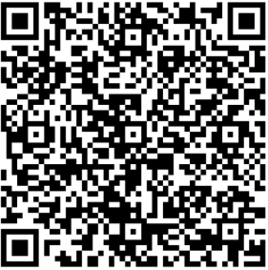
Sierra Nevada Journeys – Q & A TIME!
Questions???
FAQ Link
Notes:
You received a flyer with more information.

Slide 15
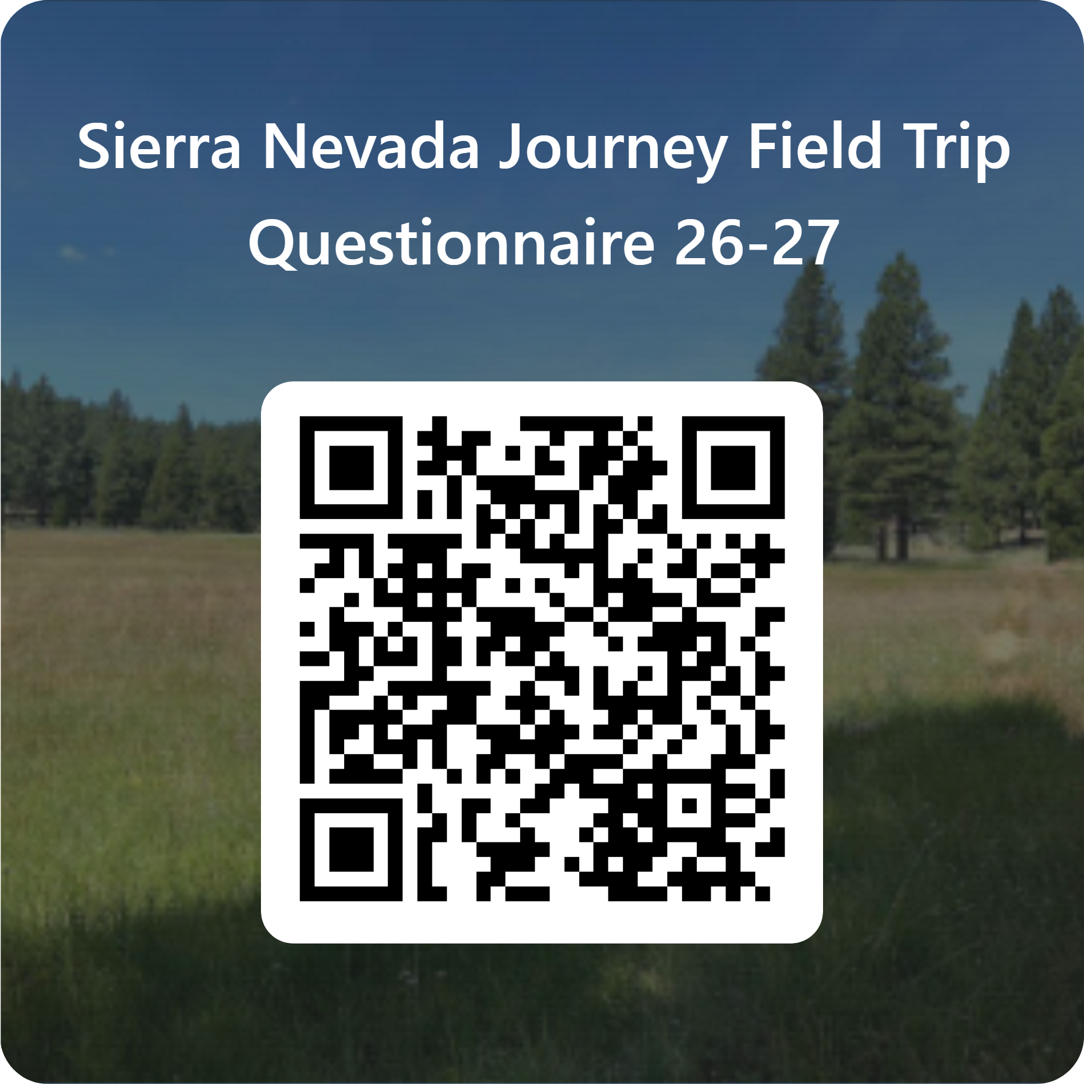
Sierra Nevada Journeys –
Parent Survey
Sierra Nevada Journey Field Trip Questionnaire 26-27 – Fill out form
Notes:
9.02- 9.04

Slide 16
Sierra Nevada Journeys – Video:
  SNJ Video link here: https://www.sierranevadajourneys.org/overnight-outdoor-learning
  Brown Video link here: 5th Grade Brown Elementary School Sierra Nevada Journeys Outdoor Educational Camp

