Slide 1
Springdale Elementary School
Annual Title I & Family Engagement Meeting
Springdale Elementary
08/20/2026
Ms. Caremen Gregory, Principal
August 2026

Slide 2
Why are we here?
The Every Student Succeeds Act (ESSA) requires that each Title I school hold an annual meeting of Title I families in order to:
      inform you of your school’s participation in Title I,
      explain the requirements of Title I, and
      explain your rights as parents and family members to be involved.

Slide 3
What will I learn?
What is a Title I school?
What are my rights?
What can Title I funds be used for?
How does our school use Title I funds?
What is the SIP?
What are our schoolwide program goals?
How is parent and family engagement funded?
What is the Parent and Family Engagement Policy?
What is the School-Parent Compact?
What curriculum does our school use?
What tests will my child be taking?
How can I be involved?
Who can I contact for help?

Slide 4
What is a Title I school?
Title I was passed in 1965 under the Elementary and Secondary Education Act (ESEA). It is the largest federal assistance program for our nation’s schools.
Title I schools receive extra funding (Title I dollars) from the federal government. These dollars are used to:
      identify students experiencing academic difficulties and provide assistance to help these students;
      purchase additional staff, programs, materials, and/or supplies; and
      conduct parent and family engagement meetings, trainings, events, and/or activities.

Slide 5
What can Title I funds be used for?
In general, Title I funds may be used for:
      additional paraprofessionals,
      additional training for school staff,
      extra time for instruction (before and/or after school programs),
      parent and family engagement activities, and/or
      a variety of supplemental teaching materials, equipment, and technology.

Slide 6
How does our school use Title I funds?
In Springdale Elementary, our school was allotted money in Title I funding.
We developed a Schoolwide Program, which means we plan to spend our funds on the following:
      Supplemental staff:
        Tutors
      Programs/Materials/Supplies:
        Grammar, Language, and Math Practice Materials
        Intervention Materials
      Teacher Professional Development:
        Training

Slide 7
What is the SIP?
The SIP is the School Improvement Plan. It includes:
      the identification of the school planning team and how they will be engaged in the planning process;
      a needs assessment and summary of academic and non-academic data;
      prioritized goals, strategies, and action steps to help address the academic and non-academic needs of students;
      teacher and staff professional development needs; and
      budgets and the coordination of resources.
The school must include family representatives on our school planning team.

Slide 8
What are our schoolwide program goals?
Increase ELA Achievement: Increase schoolwide ELA proficiency from the 31.1% baseline toward 44% proficiency during Year 1 (2026–2027) through standards-aligned instruction, small-group instruction, intervention, and data-driven planning.
Increase Mathematics Achievement: Improve schoolwide mathematics proficiency from the 40.0% baseline by strengthening standards-aligned core instruction, math fluency, problem solving, and targeted intervention.
Strengthen Tier 1 Instruction: Ensure students receive rigorous, standards-aligned Tier 1 instruction with consistent use of district-adopted curriculum, differentiation, and evidence-based instructional practices.
Strengthen RTI²/Intervention: Provide targeted Tier 2 and Tier 3 interventions based on universal screening, diagnostic, progress-monitoring, and classroom data.
Close Achievement Gaps: Provide additional academic support to students and grade levels performing below expectations, with particular attention to areas identified through TCAP, i-Ready, Aimsweb, and classroom assessment data.

Slide 9
What is our school’s designation status?
In accordance with Tennessee’s accountability system, the Tennessee Department of Education (TDOE) determines designations for all public schools. Designations include:
      Reward Schools: Recognizes schools with high levels of performance or student growth, including the top 5% of schools.
      CSI (Comprehensive Support and Improvement): Also known as Priority schools, these are identified for being in the bottom 5% of overall performance or having a graduation rate below 67%.
      TSI/ATSI (Targeted/Additional Targeted Support and Improvement): Also known as Focus schools, these are identified when specific student groups underperform. Springdale is a non-designation school. We were a level 5 the 2024-2025 school year.

Slide 10
What is the State Report Card?
TDOE releases an annual Report Card on Tennessee schools.
This report displays state-, district-, and school-level data for each school year.
It includes information on demographics, achievement, academic growth, attendance, graduation rate and more.
You can view the data statewide, or you can choose a specific district or school.
You can view the report card here:
      https://www.tn.gov/education/families/report-card.html

Slide 11
What curriculum does our school use?
The Tennessee Academic Standards provide a common set of expectations for what students will know and be able to do at the end of a grade for each subject area.
Tennessee's academic standards form the framework for everything taught at Springdale Elementary.
For more information about Tennessee’s academic standards, see: Academic Standards

Slide 12

What curriculum does our school use?

Slide 13
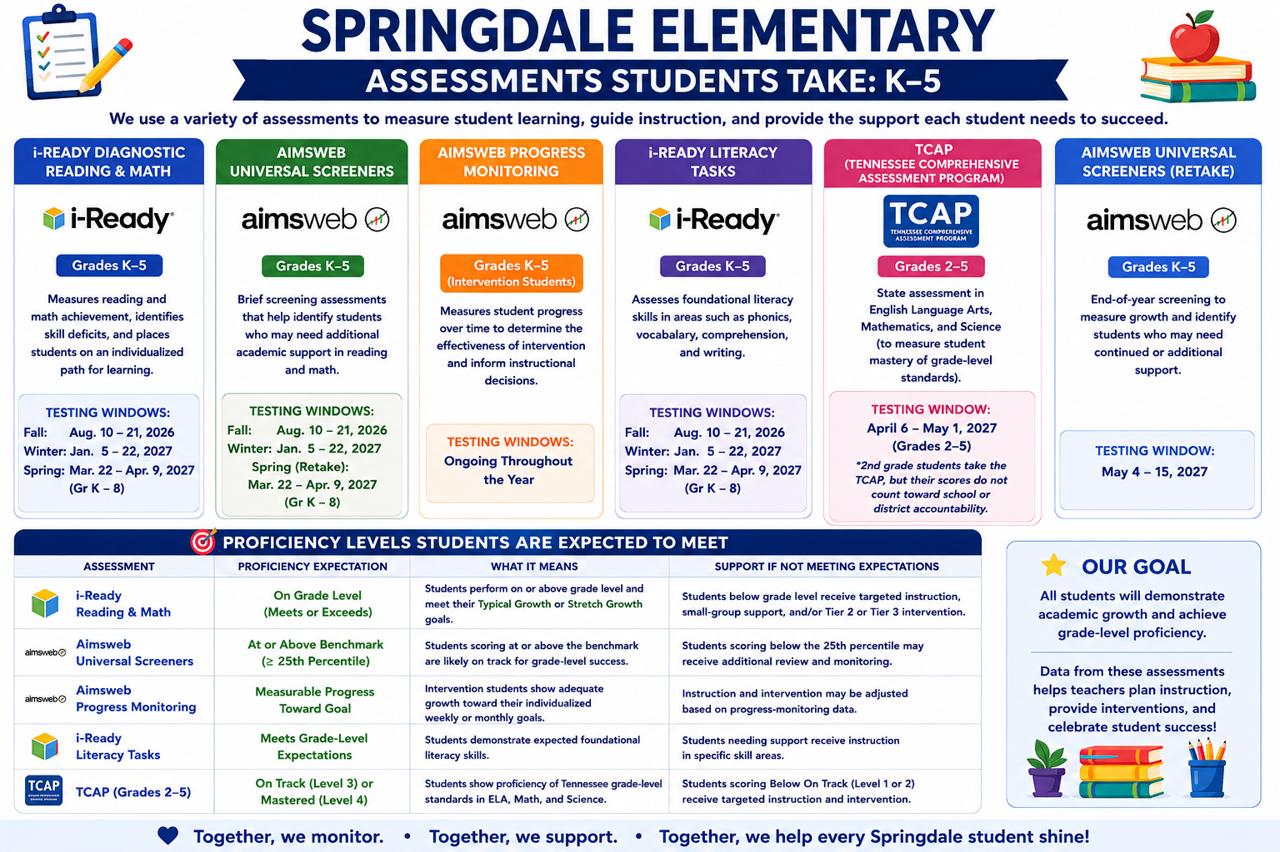
What tests will my child be taking?
Notes:
Springdale Elementary uses multiple forms of academic assessment to measure student achievement, growth, and progress throughout the school year. These assessments help teachers identify strengths, determine skill deficits, plan instruction, and provide appropriate interventions.
Universal Screeners/Diagnostics: i-Ready Reading and Math and other skills-based screeners are administered during the fall, winter, and spring to determine students’ current performance levels and academic needs.
Progress Monitoring: Students receiving intervention are assessed regularly to determine whether they are making adequate progress toward their individual academic goals and whether intervention should be adjusted.
Literacy Assessments: Skills-based literacy tasks assess foundational reading and literacy skills and help identify areas requiring additional instruction. The district assessment calendar includes skills-based reading, writing, and math screening as part of the universal screening process.
TCAP Assessments: Students in grades 3–5 participate in state-mandated TCAP assessments to measure mastery of Tennessee grade-level standards. Grade 2 also participates in district-mandated TCAP testing.
TCAP Writing: Students in grades 2–5 participate in TCAP Writing; Grade 2 participation is district-mandated rather than state-mandated.
Classroom/Formative Assessments: Teachers use curriculum-based assessments, quizzes, exit tickets, checks for understanding, student work, and other formative measures to monitor mastery of standards and make ongoing instructional decisions.
Together, these assessments provide multiple data points to help teachers monitor student growth, identify learning gaps, differentiate instruction, and determine when additional academic support or intervention is needed.

Slide 14
What is parent and family engagement?
Family engagement is a shared responsibility in which schools and other community agencies and organizations are committed to reaching out to engage families in meaningful ways and in which families are committed to actively supporting their children's learning and development.
Family engagement is continuous across a child’s life and entails enduring commitment but changing family roles as children mature into young adulthood.
Effective family engagement cuts across and reinforces learning in the multiple settings where children learn – at home, in pre-kindergarten programs, in school, in after-school programs, in faith-based institutions, and in the community.
Source: The National Association for Family, School, and Community Engagement (https://nafsce.site-ym.com/page/definition)

Slide 15
What is parent and family engagement?
“Through effective communication with parents, teachers can have the greatest impact on their day-to-day success with students. With parents on their side, teachers can more effectively manage most academic and behavioral issues that arise. When the most important adults in a child’s life are working together, students benefit enormously.”
                —Lee and Marleen Canter
Source: Parents on your Side: A Teacher’s Guide to Creating Positive Relationships with Parents

Slide 16
What is a Parent and Family Engagement Policy?
These plans address how the district and school will implement the parent and family engagement requirements of ESSA. Components should include:
      how parents and families can be involved in decision-making and activities;
      how parent and family engagement funds are being used;
      how information and training will be provided to families; and
      how the school will build capacity in families and staff for strong parent and family engagement.
You, as a Title I parent or family member, have the right to be involved in the development of these plans.

Slide 17
What is a Parent and Family Engagement Policy?
The district Parent and Family Engagement Policy can be found here:
      On the district’s website
The school Parent and Family Engagement Policy will be shared 8/20/2026. In addition, the policy can be found here:
    On our school website https://springdale-es.scsk12.org/

Slide 18
How is parent and family engagement funded?
Any district with a Title I allocation exceeding $500,000 is required by law to set aside 1% of its Title I allocation for parent and family engagement.
Of that 1%, 10% may be reserved at the district for system-wide initiatives related to parent and family engagement. The remaining 90% must be allocated to all Title I schools in the district.
You, as Title I parents and family members, have the right to be involved in how this money is spent.

Slide 19
How is parent and family engagement funded?
In 2026-2027, we received approximately $2,000 in parent and family engagement funding. We plan to use these funds for:
      Parent and Family Engagement Meeting and Events
        Family Literacy and Math Night
        TCAP readiness preparation
        Parent home packets
        Lunch with Leaders
      Materials/Supplies
        Refreshments for Meetings
        Printing/Supplies for Meetings

Slide 20
What is a School-Parent Compact?
A school-parent compact is a written commitment that outlines how the entire school community – teachers, families, and students will share the responsibility for improved academic achievement.
The compact must describe how the school will:
      provide high-quality curriculum and instruction;
      hold parent-teacher conferences, annually in elementary schools;
      provide parents with reports on their child’s progress;
      provide parents reasonable access to staff.
      provide parents opportunities to volunteer; and
      ensure regular two-way meaningful communication between family members and staff, to the extent practicable, in a language family members can understand.
You, as a Title I parent or family member, have the right to be involved in the development of the compact.

Slide 21
What is a School-Parent Compact?
The school-parent compact will be shared 8/20/2026. In addition, the compact can be found:
      On our school’s website https://springdale-es.scsk12.org/

Slide 22
What are the benefits of family engagement?
For students:
Higher grades and test scores
Better attendance
More positive attitudes and better behavior
Higher graduation rates
Greater enrollment in postsecondary education
For Parents and Families:
More confidence and trust in the school
Increased confidence in their parenting skills
Creates a home environment that encourages learning
Encourages families to form stronger relationships with teachers and other families
For Schools and Teachers:
Improved teacher and staff morale
Higher ratings of schools and teachers by families
More support from families
Higher student achievement
Increased and improved relationships within the community

Slide 23
How can I be involved?
We need you! Research has proven that family engagement in education has more impact on student achievement than any other factor.
To get involved with the Parent and Family Engagement Policy: Families can get involved by attending Title I and family engagement meetings, participating in school events and parent workshops, completing the survey on our school website, and providing feedback on the Parent & Family Engagement Policy. Parents may contact the school administration or PLC Coach for additional opportunities to participate.
To get involved with the School Parent Compact: Families are encouraged to review the School-Parent Compact, provide feedback, attend parent meetings and conferences, complete surveys, and work with teachers and school staff to support student achievement. Parents may contact their child’s teacher, school administration, or PLC Coach to get involved.

Slide 24
How can I be involved?
Join our PTO
Encourage Attendance
Monitor Grades and Schoolwork
Attend Family Events and Meetings
Safety Patrol
Career Day
Family STEAM Night
Meet the Teacher Night
Coffee with the Counselor
Parent Conferences
Muffins with Moms
Hot Dogs with Dad
Read Across America
Lunch with Leaders

Slide 25
What are my rights?
The families and parents of Title I students have a right, by law, to:
      be involved in decisions made at both the school and district level;
      be provided with information on your child’s level of achievement on tests in reading/language arts, writing, mathematics, and science;
      request and receive information on the qualifications of your child’s teacher and paraprofessionals who are working with your child(Families may request this information at any time by contacting the school’s main office or school administration and submitting a verbal or written request for educator qualification information.); and
      request opportunities for regular meetings to formulate suggestions and to participate, as appropriate, in decisions about the education of your child. The school is required to respond to any such suggestions as soon as practicably possible.

Slide 26
Who can I contact for help?
For general questions, call the front office at: 901-416-4883
To reach the principal, Carmen Gregory, call: 901-416-4981
To reach the school counselor, Dr. Kim Sexton, call: 901-416-4992
To reach your child’s teacher, call the front office

Slide 27
WE JUST WANT TO SAY…
THANK YOU!

Slide 28
Table Activity
Partner with those at your table to discuss the following questions:
      What form of communication works best for you? (e.g., phone calls, texts, emails, notes, face-to-face, etc.)
      What kinds of information do you most want to receive from the school?
      What might the school do differently to improve communication between school and home?
Record your group’s thoughts on chart paper.
Be prepared to share!
Notes:
OPTIONAL SLIDE

