Slide 1
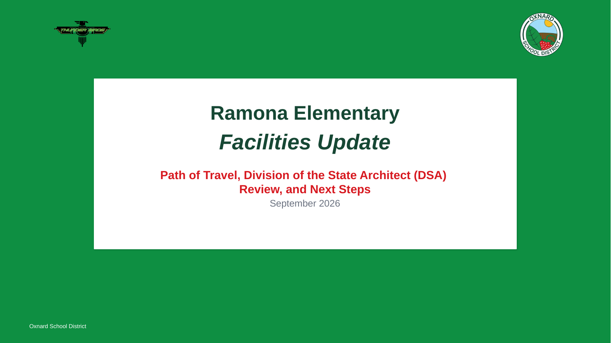
Notes:
[Sources]
- Original uploaded deck, title slide.

Slide 2
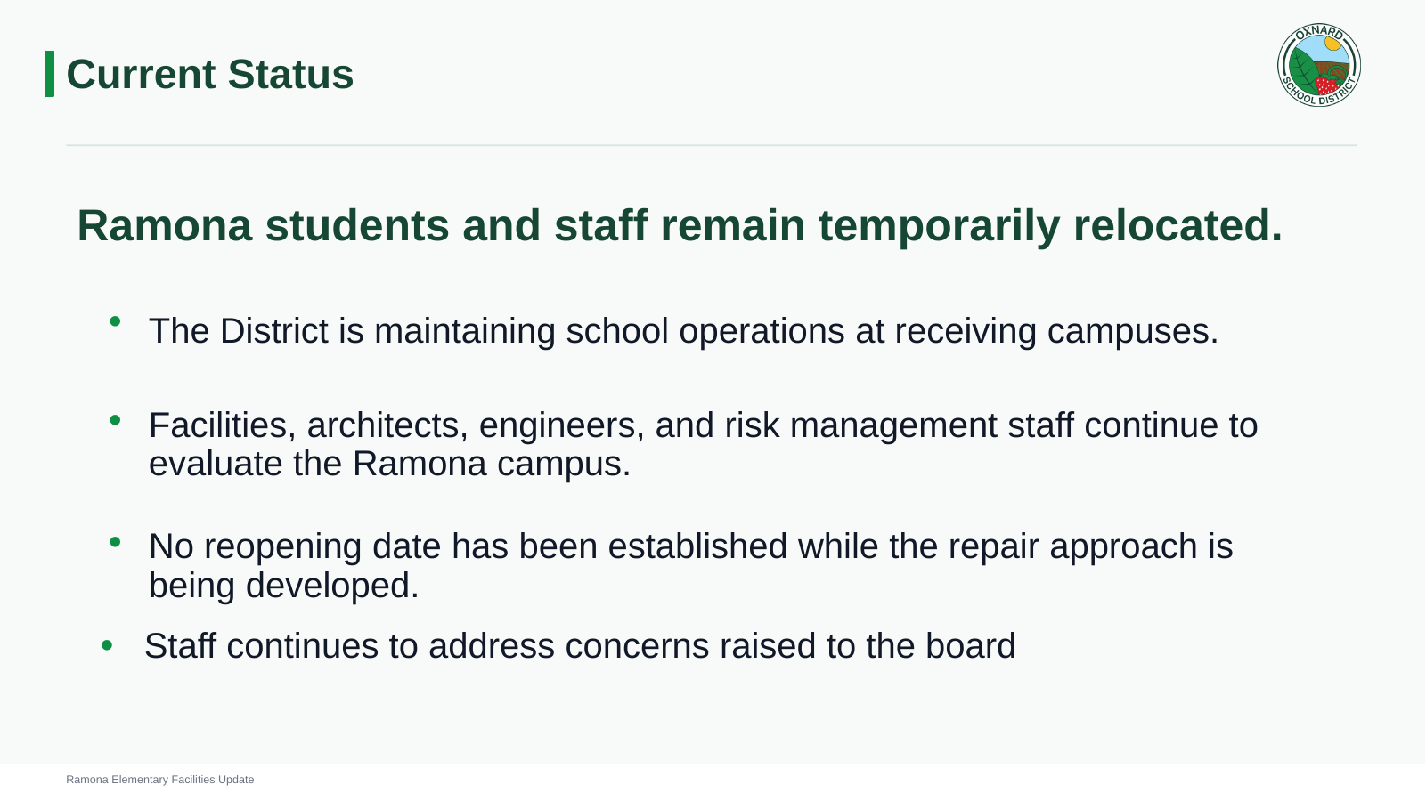
Notes:
[Sources]
- Original uploaded deck, Current Status slide.

Slide 3

Actions Taken Following Relocation
As a result of the Ramona relocation, the District added staffing support and expanded communication with families.
10
Parent Meetings
additional
campus assistants
July 30, 2026, 6:00 pm via Zoom
July 31, 2026, 9:00 am @ Juanita MPR
August 6, 2026, 6:00 pm via Zoom
August 25, 2026, 6:00 pm @ Juanita MPR
Hired to strengthen supervision and support at welcoming schools.
Held to provide updates, answer questions, and hear family concerns.
Continued focus
Supporting students and families while maintaining safe and orderly operations at welcoming schools.
Ramona Elementary Facilities Update
Notes:
[Sources]
- User-provided information: 10 additional campus assistants were hired following the Ramona relocation.
- User-provided information: several parent meetings were held following the Ramona relocation.

Slide 4
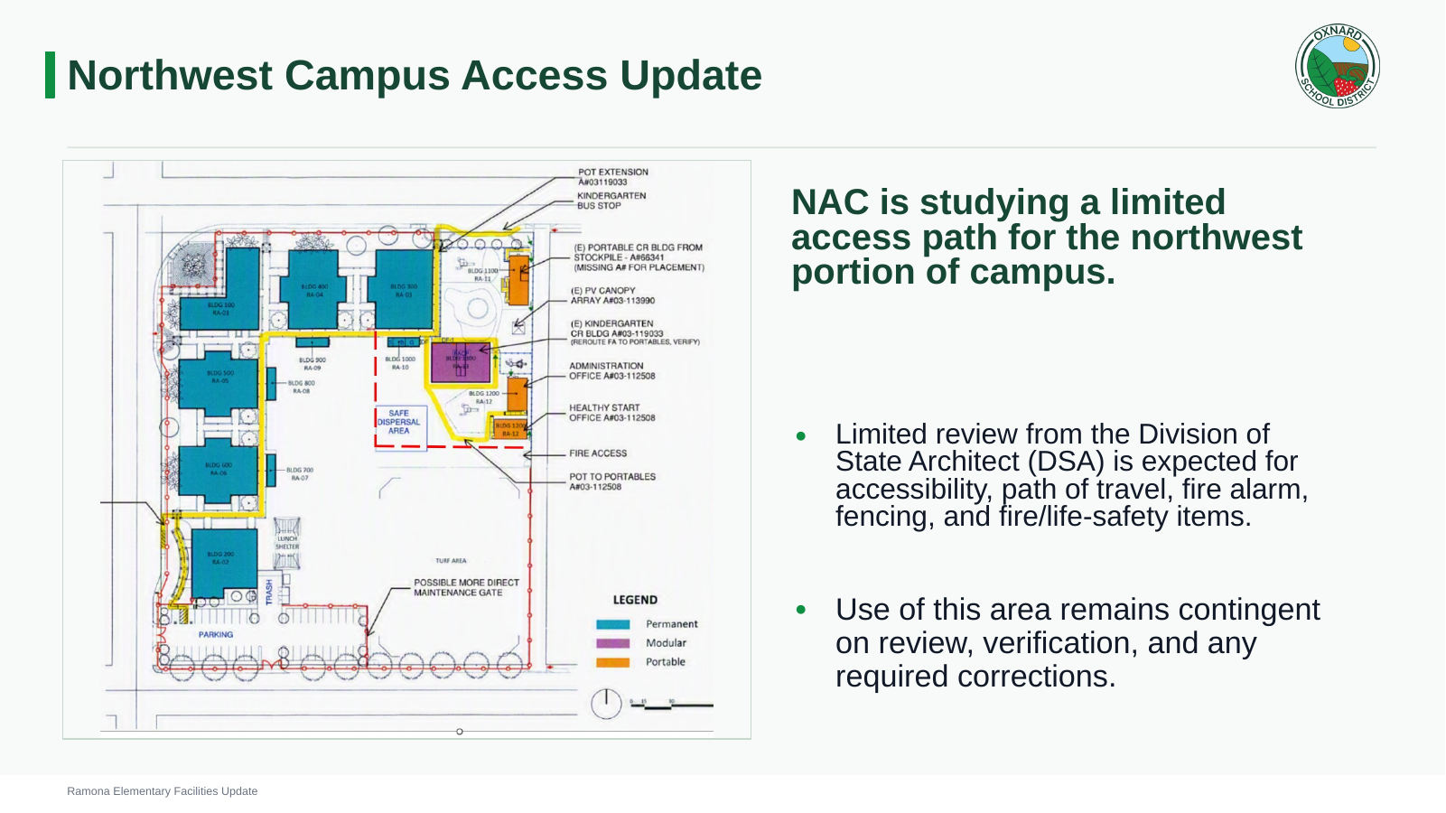
Notes:
[Sources]
- Original uploaded deck, Northwest Campus Access Update slide.

Slide 5
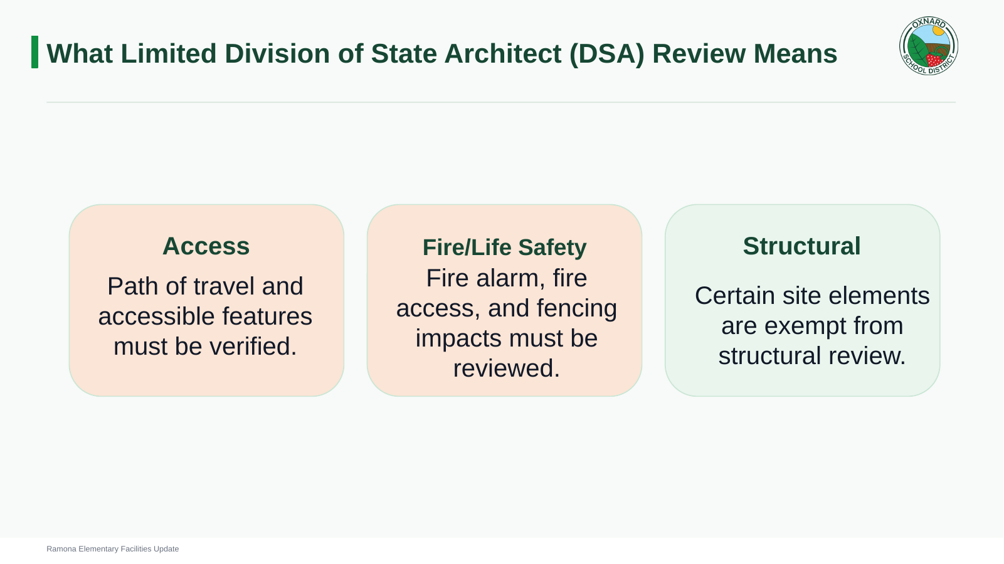
Notes:
[Sources]
- Original uploaded deck, Limited DSA Review slide.

Slide 6
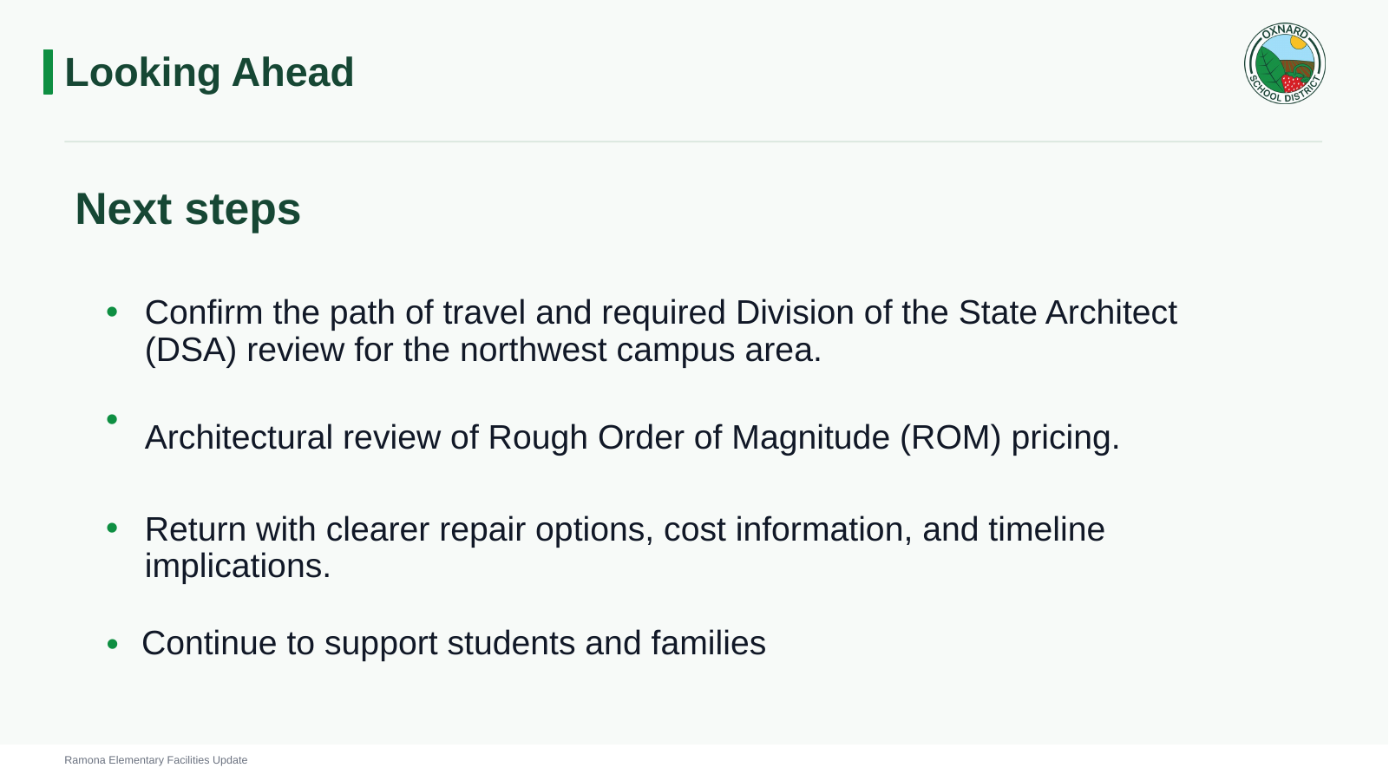
Notes:
[Sources]
- Original uploaded deck, Looking Ahead slide.

