Slide 1
E-Learning Days 1-5
Subtitle

Slide 2
Day 1

Slide 3
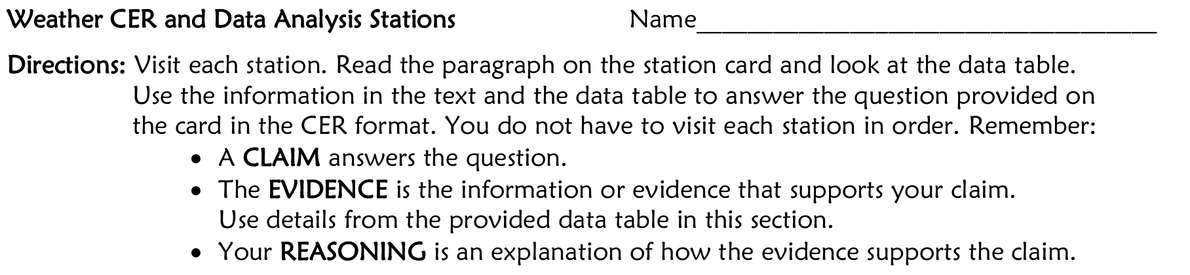
Weather Analysis Stations 4 - 6
You can either write this on notebook paper or print the worksheet
  If you are writing on paper, please make sure you title your paper
Worksheet Link: https://docs.google.com/document/d/1halJvi_p2rrLjqGHeplz-JxgkXXnZnRWB9MxAbaDlhk/edit?usp=sharing

Slide 4
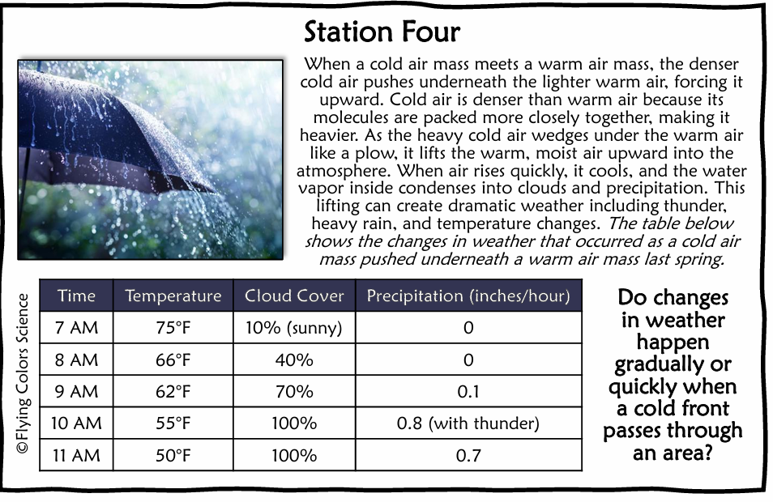

Slide 5
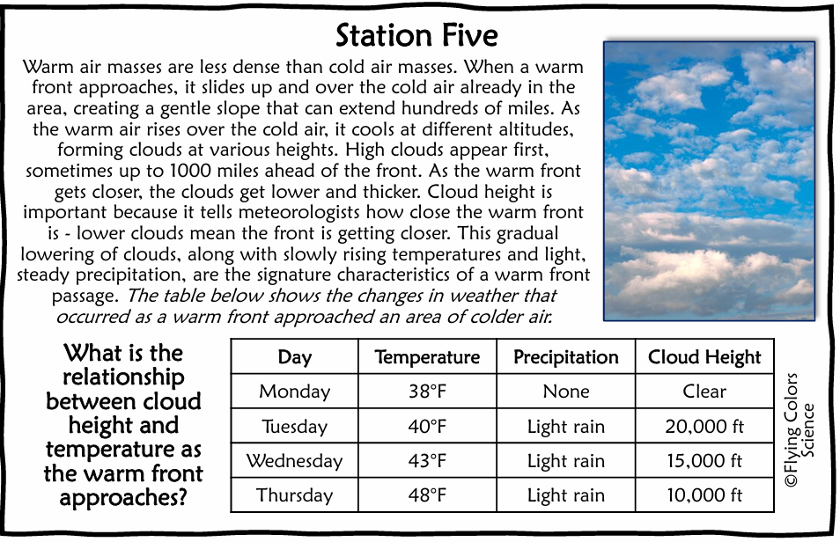

Slide 6
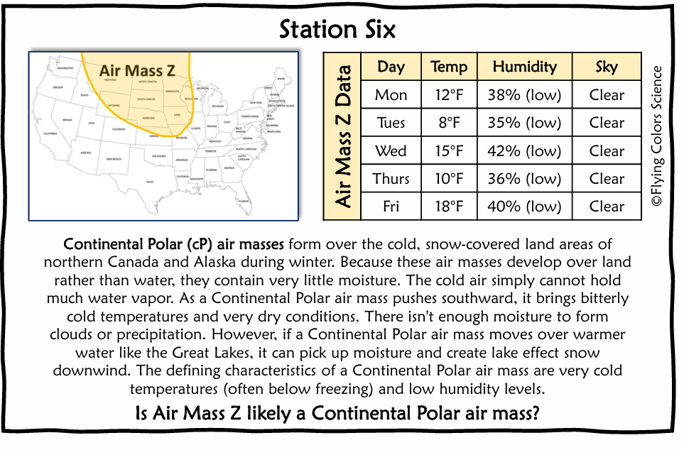

Slide 7
Day 2

Slide 8
Natural Disasters: Understanding Earth's Hazards
Students will use a video and their own knowledge to answer the questions about natural disasters.
Questions and answers can be written on paper, or you can print the worksheet.
  If you are writing on paper, please make sure to title your paper
Video Link: Natural Disasters: Understanding Earth's Hazards | Middle School Science
Worksheet Link: https://docs.google.com/document/d/1Q4iLviL0J3Ze4-oBG2o5Tt5qaDgxk7tv-7ytQxX6AyI/edit?usp=sharing

Slide 9
Day 3

Slide 10
Thermal Energy & States of Matter
Students need to login and complete e-learning day 3 on Study Island
Login to classlink and click on the study island app or go to studyisland.com and login
The lesson must be passed with at least a 70%

Slide 11
Day 4

Slide 12
Atmospheric Convection & Climate
Students need to login and complete e-learning day 4 on Study Island
Login to classlink and click on the study island app or go to studyisland.com and login
The lesson must be passed with at least a 70%

Slide 13
Day 5

Slide 14
The Rock Cycle
Students will use a video and their own knowledge to answer the questions about The Rock Cycle.
Questions and answers can be written on paper, or you can print the worksheet.
  If you are writing on paper, please make sure to title your paper
Video Link: Bill Nye The Science Guy | Rocks and Soil | Full Episode
Worksheet Link: https://docs.google.com/document/d/1S4zwKVg9TqcqIxSznJ5h69ESpq2YJS2FOhOZO9UoZS8/edit?usp=sharing

