Slide 1
Science E-learning Days 1-5
Presentation subtitle

Slide 2
Day 1

Slide 3
Force and motion
Students will need to read a passage on force and motion. Then they will need to answer questions that relates to the passage
Both the passage and questions are on the next four slides
Please write your answers on a sheet of paper
Your paper should include:
  Title
  Name
  Question answers

Slide 4
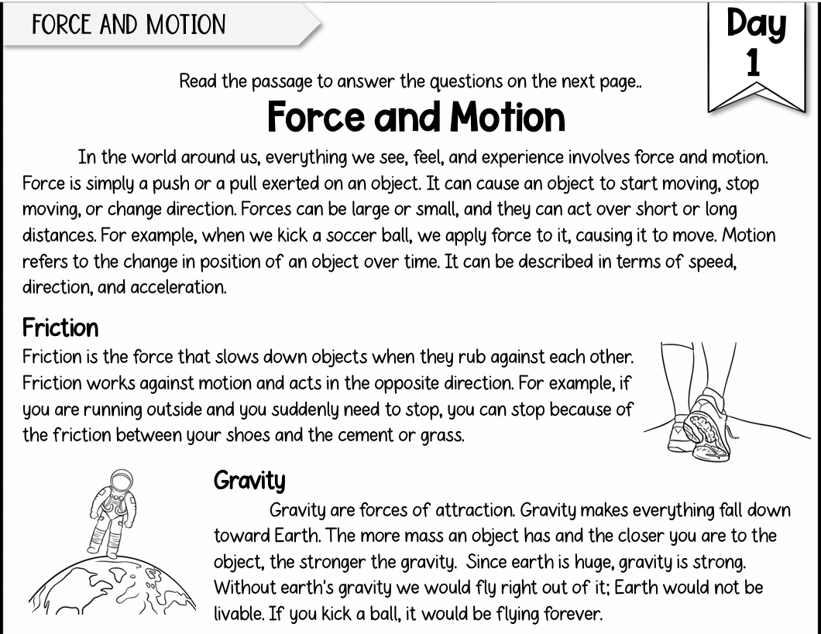

Slide 5
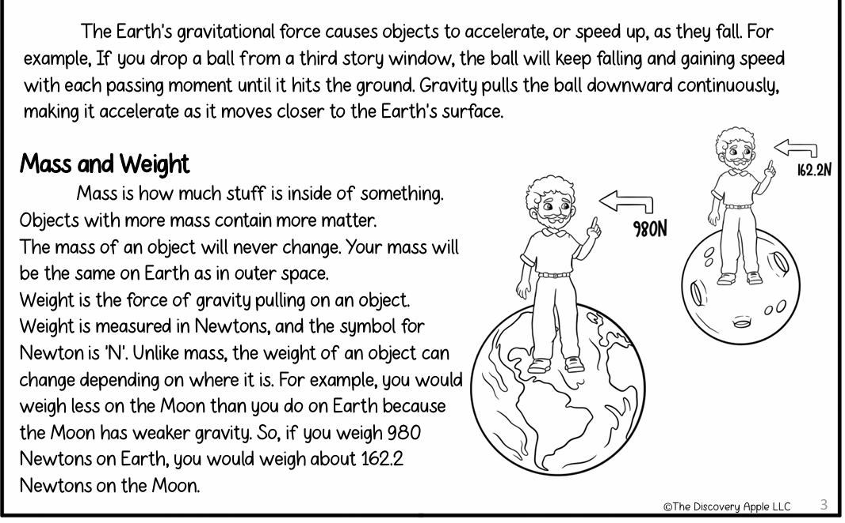

Slide 6
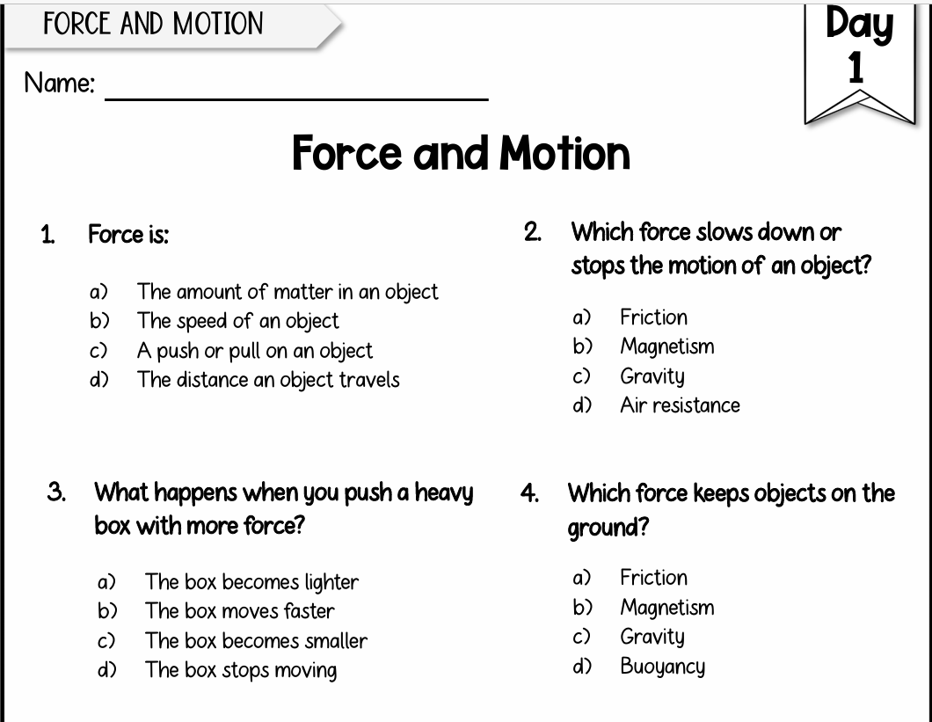

Slide 7
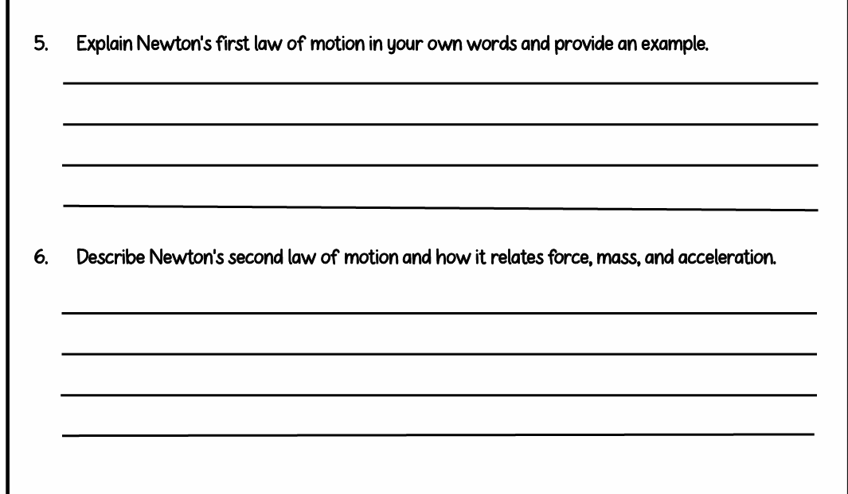

Slide 8
Day 2

Slide 9
Waves
Students will need to Watch a Bill Nye video on waves . Then they will need to answer questions that relates to the video
Video Link: Bill Nye The Science Guy | Waves | Full Episode
Worksheet Link: https://docs.google.com/document/d/16QvFfLaWoI3RjkNFdUAyGjzyhmDzdu7BmtgjsBkfNPg/edit?usp=sharing
You can print the worksheet or write your answers a sheet of paper
  Questions are on the next two slides
Your paper should include:
  Title
  Name
  Question answers

Slide 10
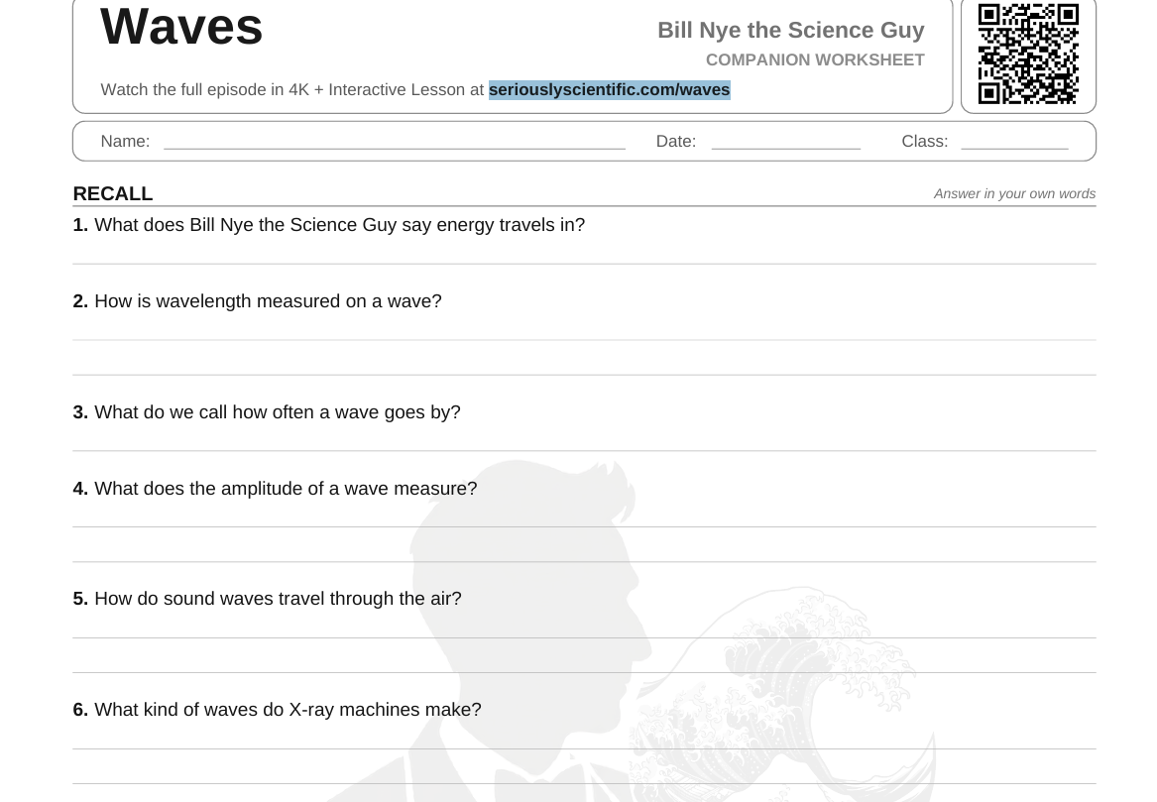

Slide 11
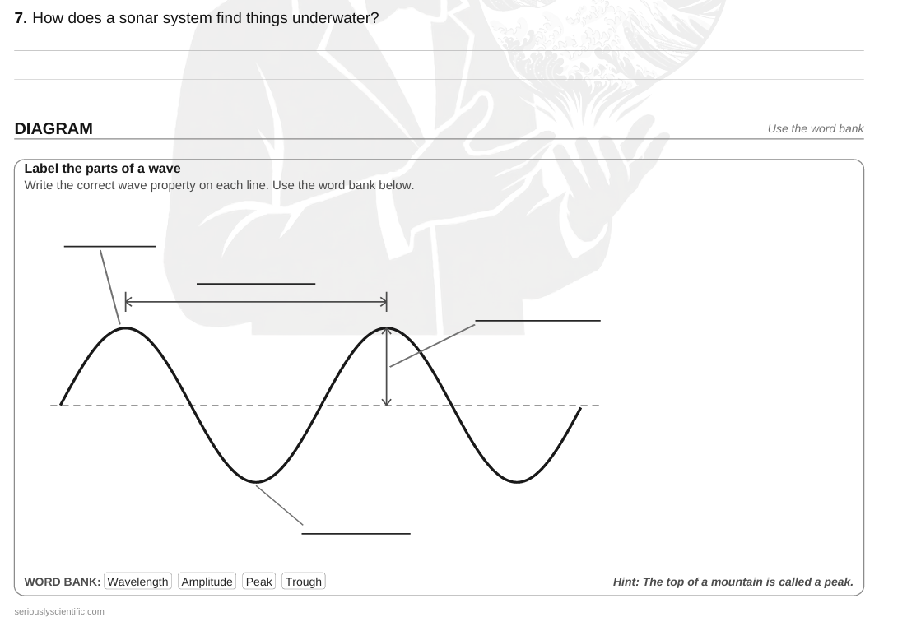

Slide 12
Day 3

Slide 13
Structure & Function: Animals
Students need to login and complete e-learning day 3 on Study Island
Login to classlink and click on the study island app or go to studyisland.com and login
The lesson must be passed with at least a 70%

Slide 14
Day 4

Slide 15
What Are Plant Structures
Students will need to read a passage on plant structures. Then they will need to answer questions that relates to the passage
Both the passage and questions are on the next four slides
Please write your answers on a sheet of paper
Your paper should include:
  Title
  Name
  Question answers

Slide 16
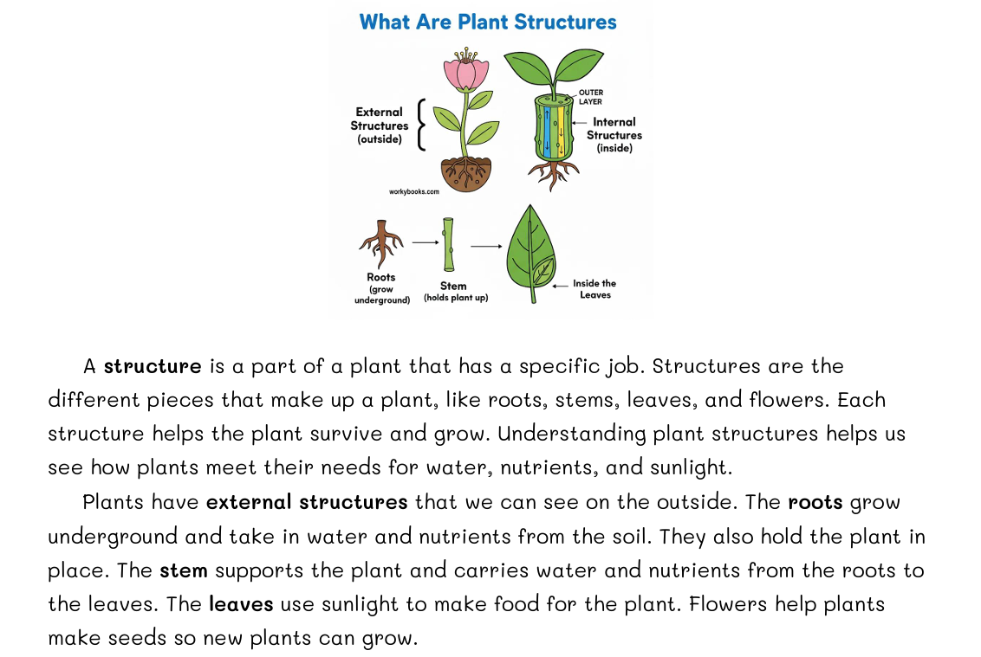

Slide 17
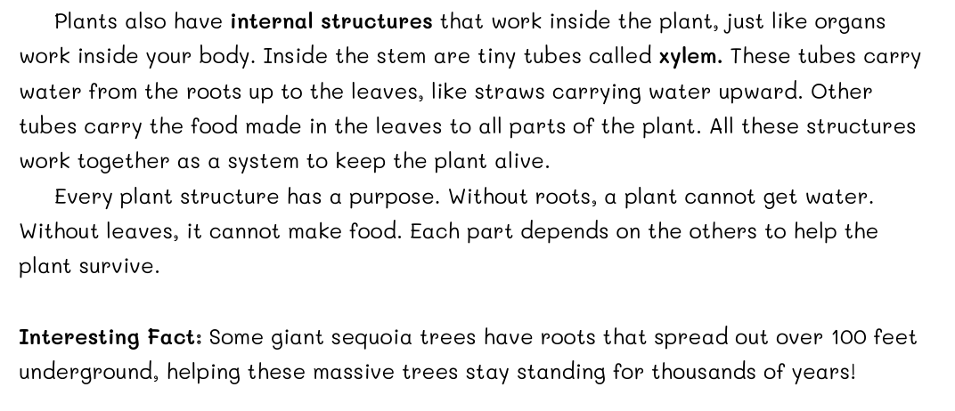

Slide 18
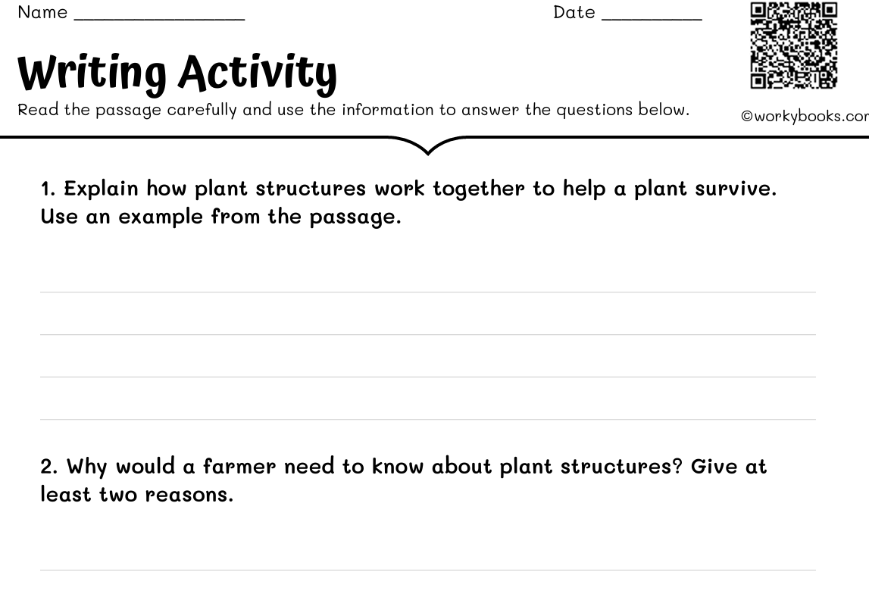

Slide 19
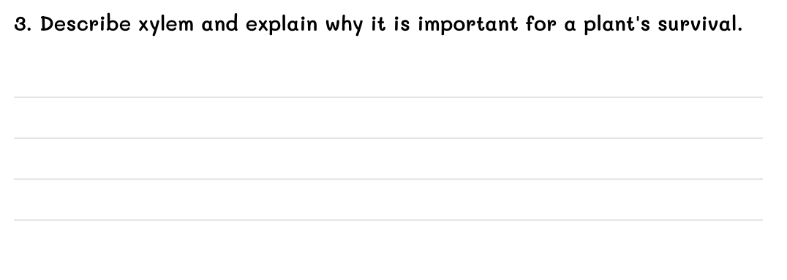

Slide 20
Day 5

Slide 21
Vision & Light
Students need to login and complete e-learning day 5 on Study Island
Login to classlink and click on the study island app or go to studyisland.com and login
The lesson must be passed with at least a 70%

