Slide 1
eLearning
Day 5
Click save every time you complete a task.

Slide 2
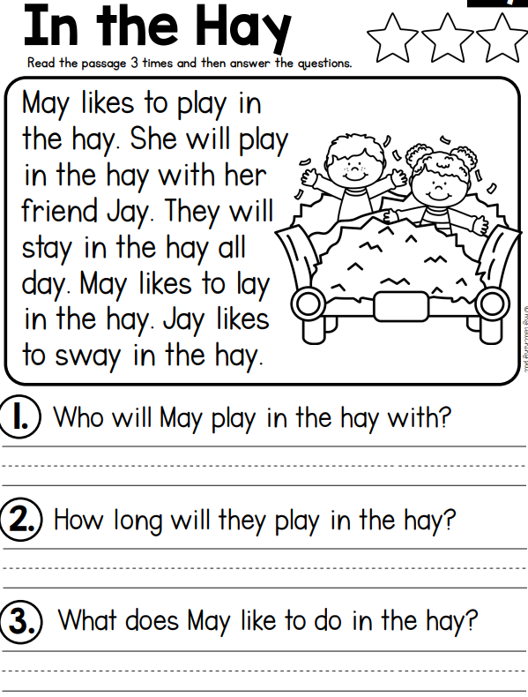
Reading: Write the answers on paper or type in the text box.
Answer
Answer
Answer

Slide 3
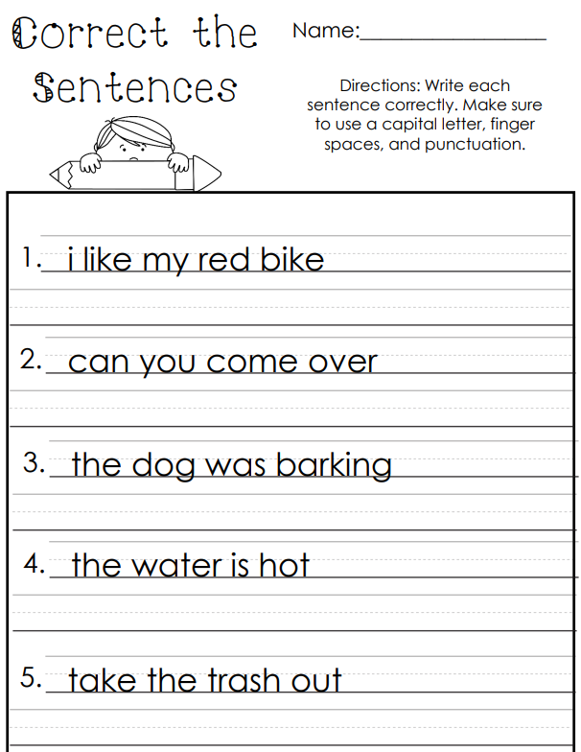
Writing: Type your answers. Click save when you finish.
Answer
Answer
Answer
Answer
Answer

Slide 4
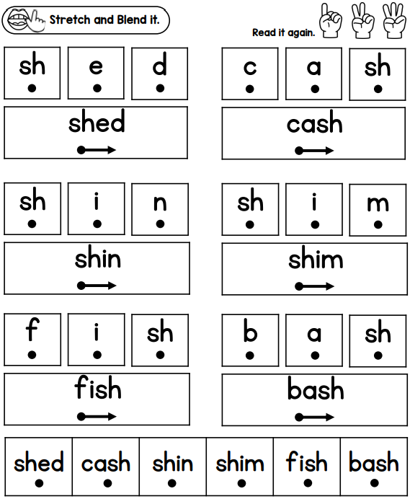
Phonics
Directions: Stretch and blend the words three times.

Slide 5
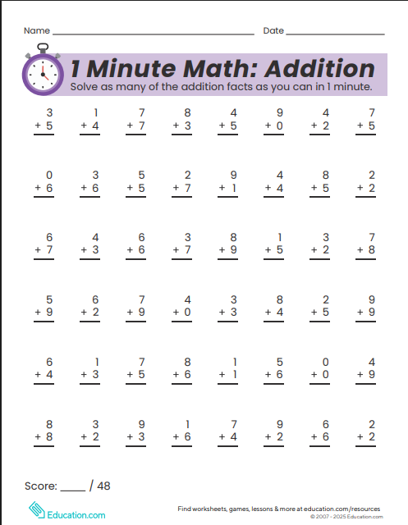
Math: Type your answer in the box. Save when done.
8

Slide 6












Social Studies: Click and drag the picture to sort.
Needs Wants

Slide 7
Did you save your work?
Once you have completed your work you can work on iReady Reading or Math.

