Slide 1
E learning
Day 4
Click save every time you
complete a task.

Slide 2
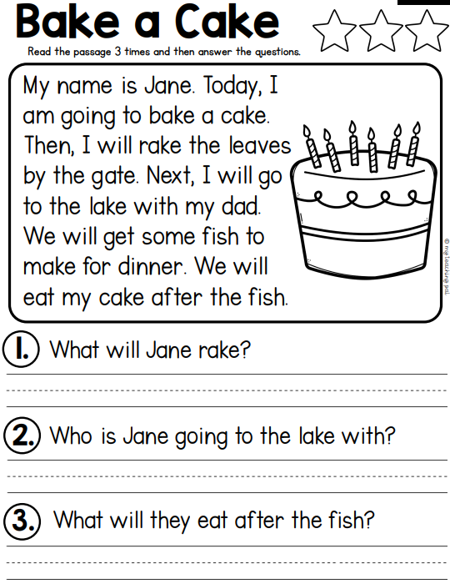
Reading: Write on paper or type where it says answer.
Answer
Answer
Answer

Slide 3
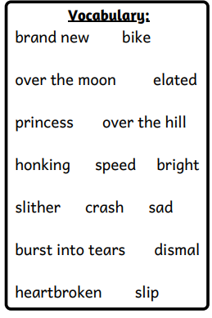
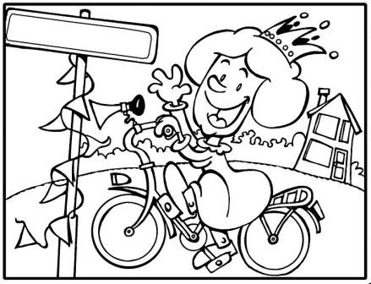
Writing: Write on paper.
Use the vocabulary words to write a story about the picture.

Slide 4
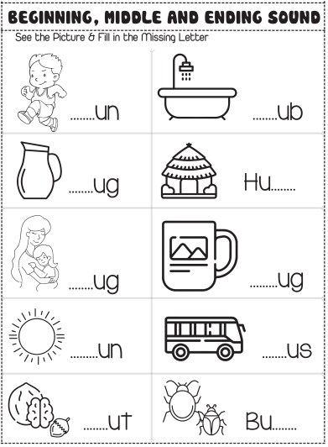
Phonics: Write on paper or type on question mark. Click save when you're done.
?
?
?
?
?
?
?
?
?
?

Slide 5
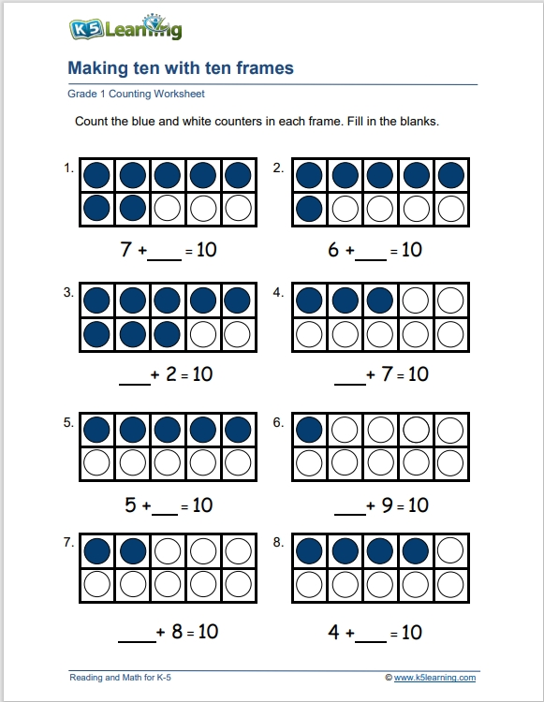
Math: Type your answer in the box. Click save when you're done.

Slide 6



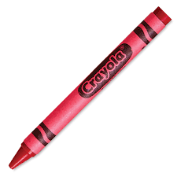


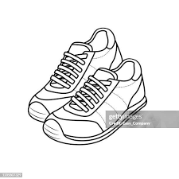




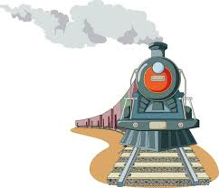

Science: Move the pictures to match each state of matter.
Solid Liquid Gas

Slide 7
Did you save your work?
Once you have completed your work you can work on iReady Reading or Math.

