Slide 1
eLearning
Day 3
Click save every time you complete a task.

Slide 2
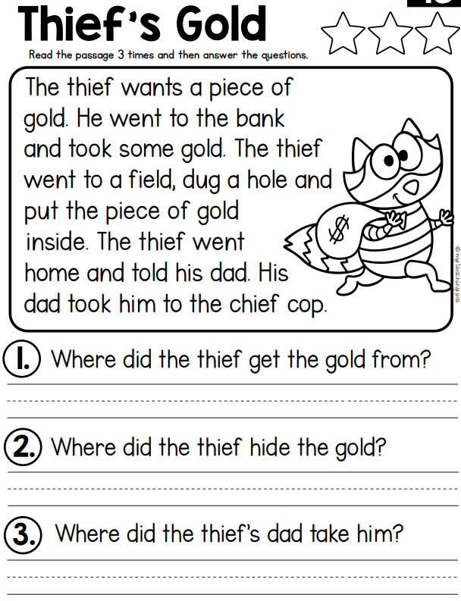
Reading: Write on paper or type in the box.
Answer
Answer
Answer

Slide 3
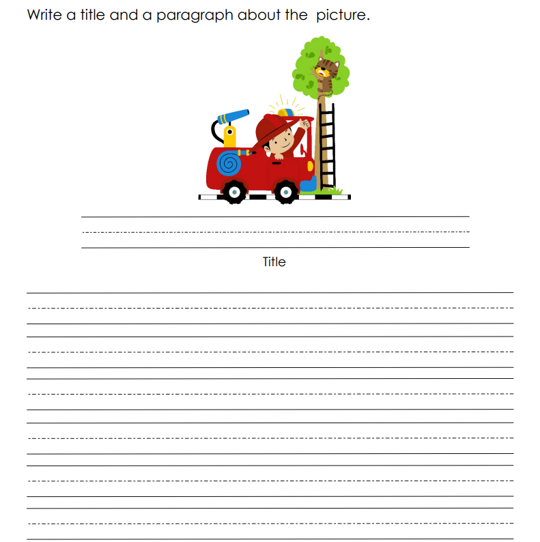
Writing: Write on paper.

Slide 4
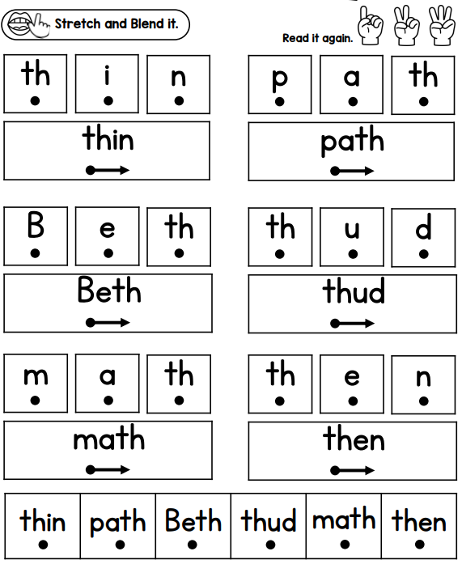
Phonics
Directions: Stretch and blend the words three times.

Slide 5
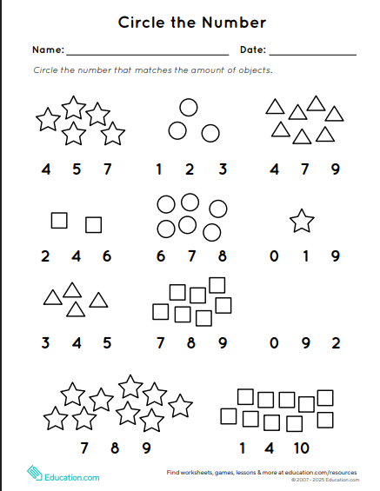
Math: Click the circle and drag it to the answer. Save!

Slide 6
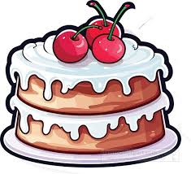

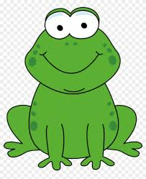
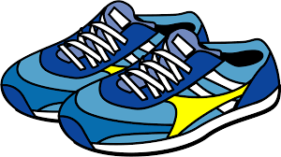
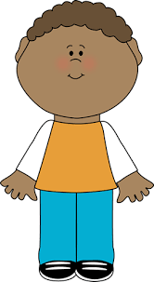
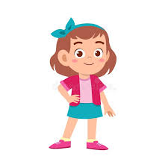
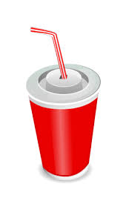


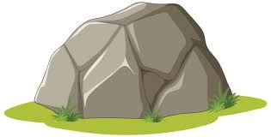
Science: Click and Sort the pictures. Save!
Living Things Non-living Things

Slide 7
Did you save your work?
Once you have completed your work you can work on iReady Reading or Math.

