Slide 1
eLearning
Day 2
Click save every time you complete a task.

Slide 2
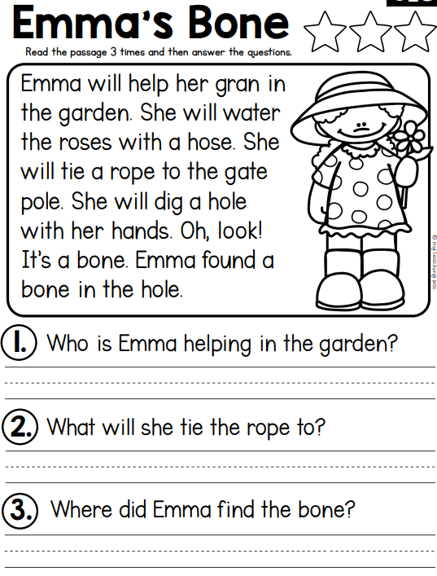
Reading: Type your answer. Save!
Answer
Answer
Answer

Slide 3
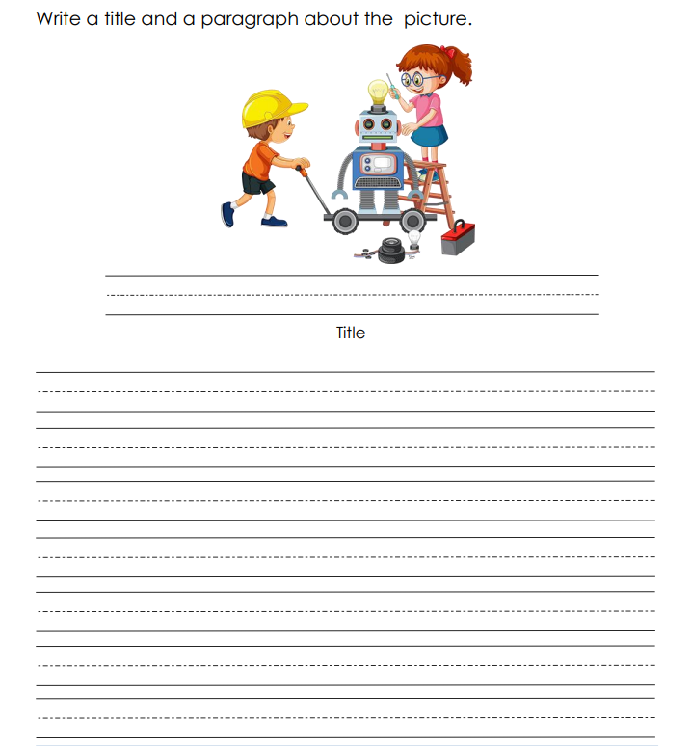
Writing: Write on paper.

Slide 4
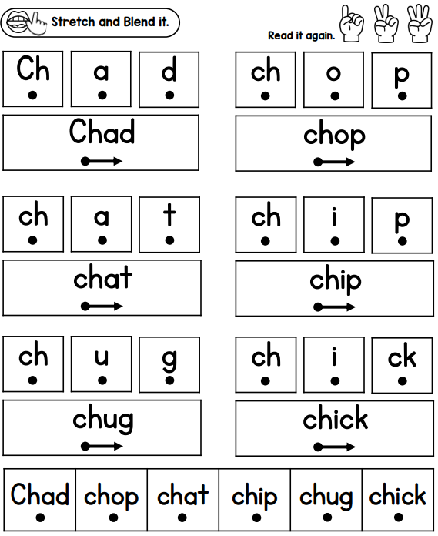
Phonics

Slide 5
Math: Type the answer into the box or write your numbers from 1-100 on paper. Save!
1 |  | 3 | 4 |  | 6 |  | 8 |  | 10
11 | 12 |  |  | 15 |  | 17 |  | 19
21 | 22 | 23 |  |  |  |  |  |  | 30
31 |  |  | 34 | 35 | 36
 | 42 |  |  |  |  | 47 | 48 |  | 50
51 |  | 53 |  | 55 |  | 57 |  | 59
 | 62 | 63 |  |  | 66 |  | 68 |  | 70
71 |  |  | 74 |  |  | 77 |  | 79
 | 82 | 83 |  | 85 |  | 87 | 88 |  | 90
 | 92 |  | 94 |  | 96 |  | 98 |  | 100

Slide 6
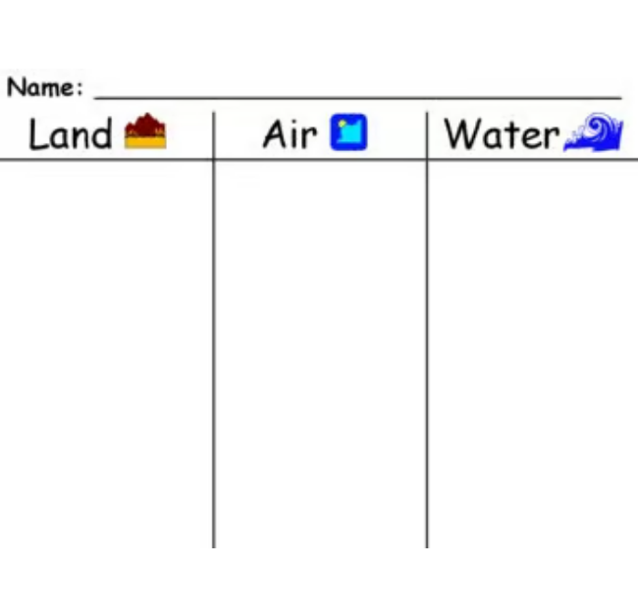
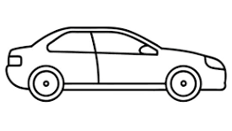
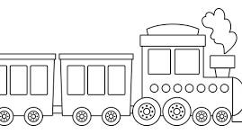

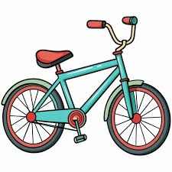



Social Studies – Transportation- Click and drag the picture. Save when done.

Slide 7
Did you save your work?
Once you have completed your work you can work on iReady Reading or Math.

