Slide 1
eLearning
Day 1
Click save every time you complete a task.

Slide 2
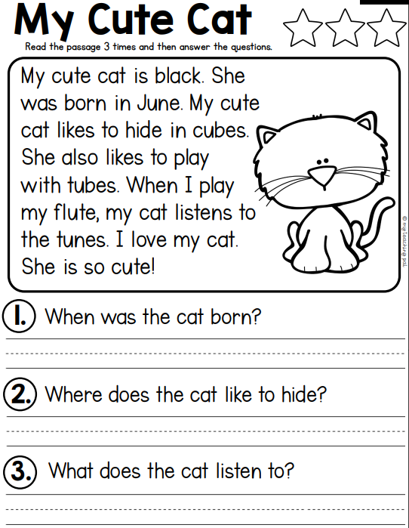
Reading: Type your answer. Save!
Answer
Answer
Answer

Slide 3
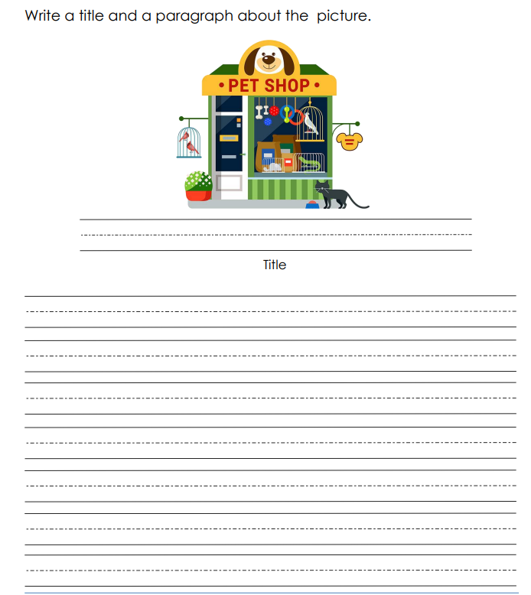
Writing: Write on paper.

Slide 4
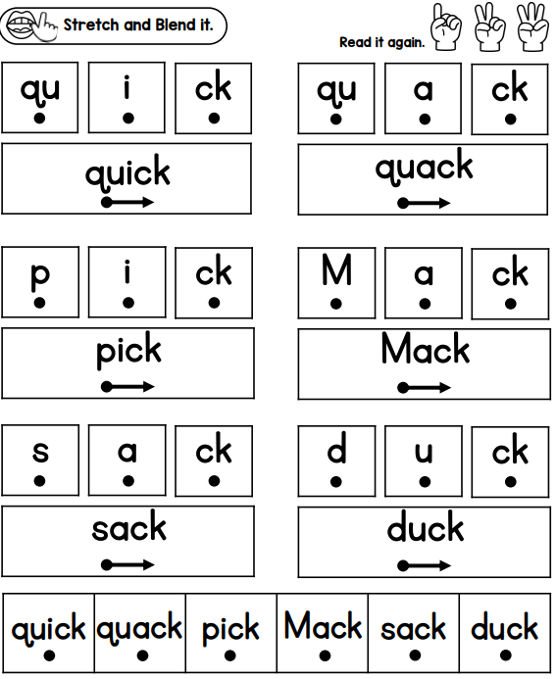
Phonics

Slide 5
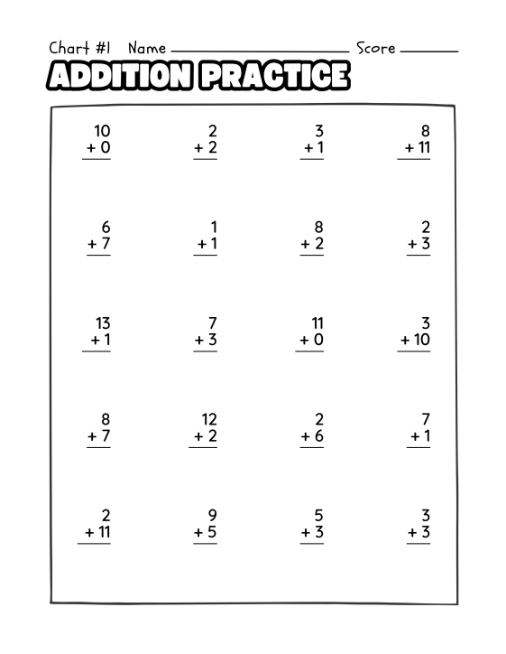
Math: Type the answer where you see a "?" or write them on a sheet of paper.
?
?
?
?
?
?
?
?
?
?
?
?
?
?
?
?
?
?
?
?

Slide 6
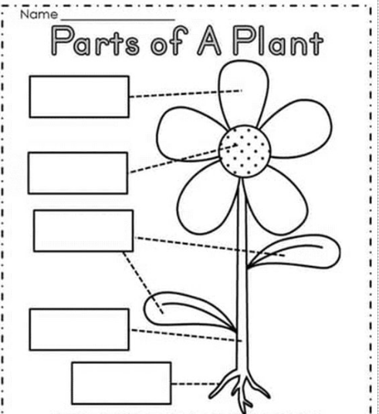






Science: Click and drag the words to their plant part.

Slide 7
Did you save your work?
Once you have completed your work you can work on iReady Reading or Math.

