Slide 1
Regional Transit Service
2026/ 2027 School Year
Service Overview
School of the Arts
August 25, 2026

Slide 2
Contents
RTS service TO and FROM School of the Arts
  Neighborhood Direct Service
    Morning Arrival/ Afternoon Departure Times
  RTS Connect Service
RTS Bus Passes (smartcard ID) Types and Rules
Two Plus Two Activity Pass
Temporary Passes
Boarding process with the RTS SmartCard ID Pass and Activity Pass
Exiting the bus
Behavior expectations/ RTS Rules of Conduct
Trip Planning/ Informational Tools
Notes:
At this point, I would like to share some important information relating to transportation provided by the Regional Transit Service for the 2026/ 2027 school year.
Specifically, I would like to address the following:
The types of RTS service students will utilize for travel to and from School of the Arts.
The RCSD Smart Card ID Pass.
The Two Plus Two Activity Pass, which is provided to students participating in after school activities.
The temporary paper pass to be utilized by students prior to receipt of their smart card ID’s.
How to properly board with the RCSD Smart Card ID and Activity Pass.
Student behavior expectations when utilizing RTS Services or when in the RTS Transit Center
and lastly
Where you can obtain information for trip planning and have any questions addressed.

Slide 3
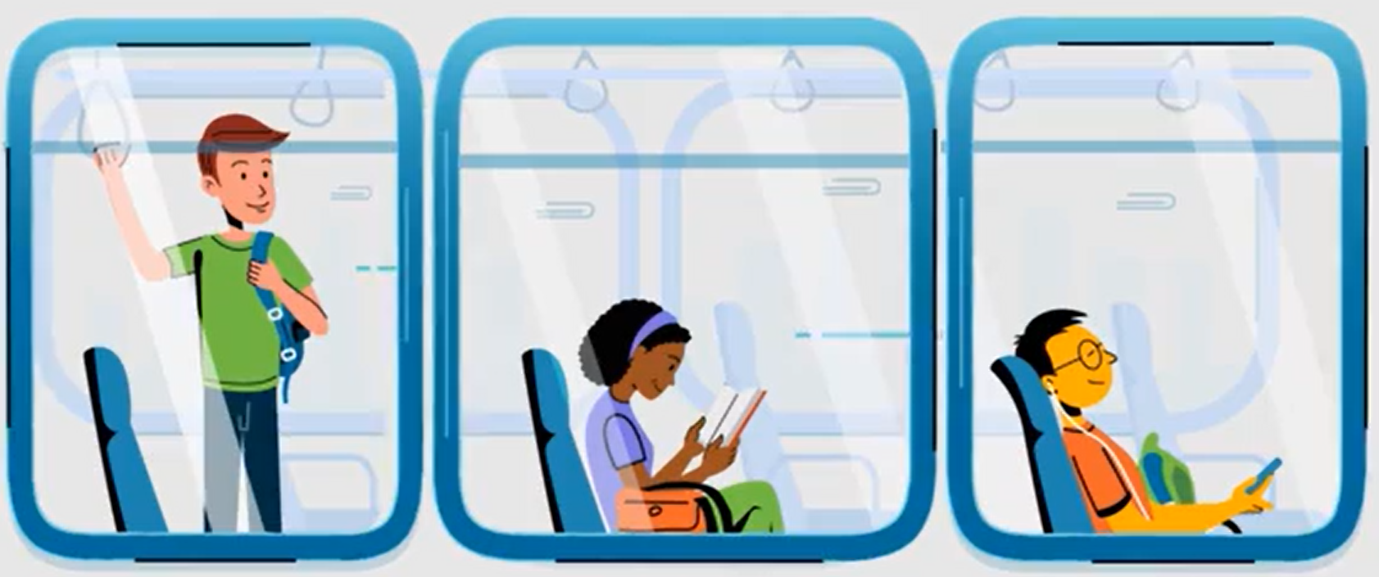
Types of Service

Slide 4
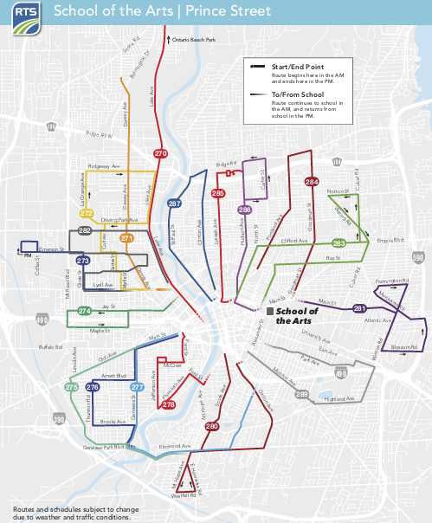
Neighborhood Direct Service (NDS)
Notes:
The majority of students traveling to and from the School of the Arts will utilize Neighborhood Direct Service.
Neighborhood Direct Service is quite convenient, as the routes travel from various neighborhoods throughout the City of Rochester to School of the Arts without stopping at the RTS Transit Center.
This map depicts the 18 Neighborhood Direct Service Routes available for use by students.

Slide 5
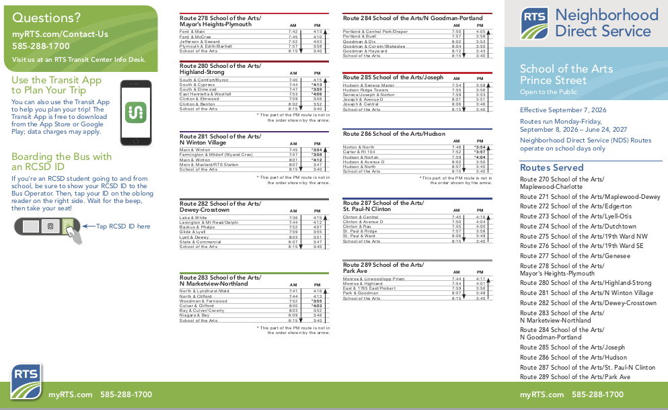
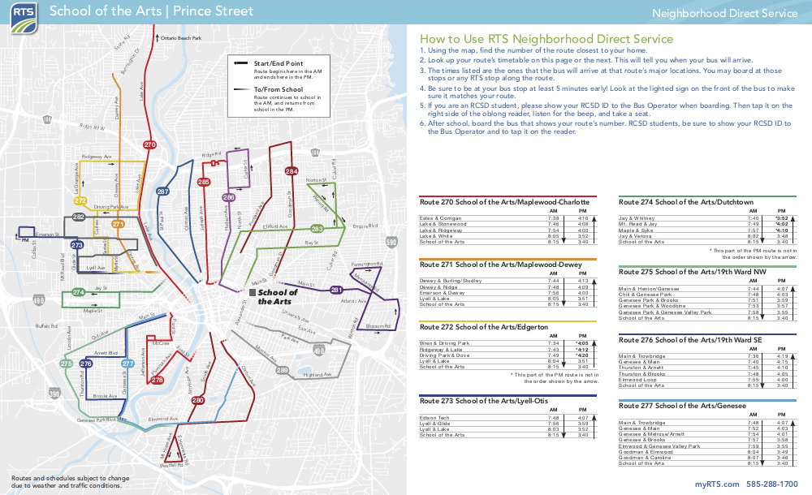
Neighborhood Direct Service (NDS)
The NDS Schedule is a single sheet, two-sided document
The document contains the service map for the school and route detail
Notes:
To identify the appropriate route for travel please refer to the Neighborhood Direct Service Schedule for School of the Arts..

Slide 6
Neighborhood Direct Service (NDS)
School of the Arts
Neighborhood Direct Service Times
Morning Arrival
  All buses will arrive to School of the Arts by 8:15am
Afternoon Departure
  All buses depart School of the Arts at 3:40pm
Notes:
All NDS routes will arrive to School of the Arts by 8:15am and depart in the afternoon at 3:40pm.

Slide 7
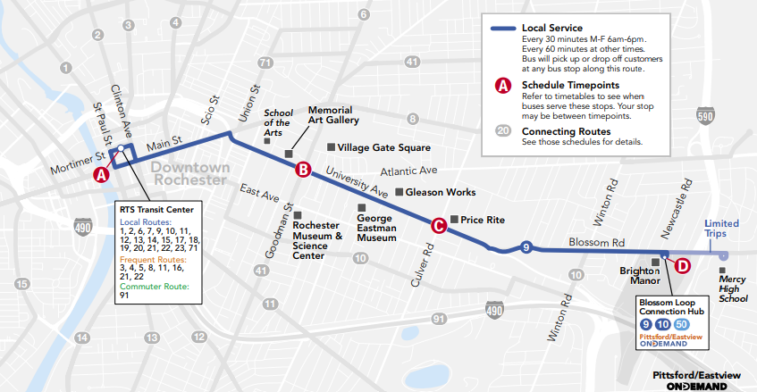
RTS Connect Service
Route 9/ University
School of the Arts
RTS Transit Center
Notes:
If a student must travel at an alternate time, when Neighborhood Direct Service is not in operation, “RTS Connect Service” will be utilized.
In this case, the student will travel downtown via the appropriate route from their neighborhood to the RTS Transit Center.
Upon arriving at the Transit Center, students will transfer to the 9/ University, as depicted above.

Slide 8
Types of Bus Passes

Slide 9
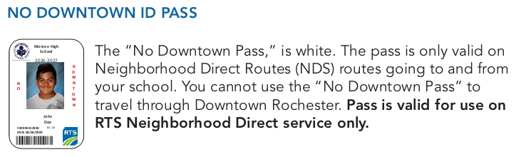
No Downtown Pass (white)
Notes:
Students entitled to transportation services vis RTS, will receive one of three types of RCSD Bus Passes.
The majority of students will receive a white/ No Downtown Pass, as you see pictured. This pass is only valid for use on Neighborhood Direct Service.
The pass contains the student’s picture and name, as well as the School they are attending and the school year.

Slide 10
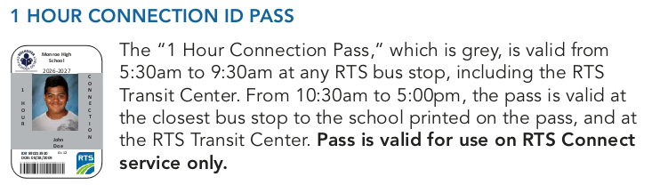
One Hour Connection Pass (gray)
Notes:
Some students, based upon specific travel needs, may receive a 1 Hour Connection Pass.
For travel to school, the pass is valid at any bus stop, including at the RTS Transit Center, from 5:30am to 9:30am.
For travel home from school, the pass is valid from 10:30am to 5:00pm at the closest bus stop to the school printed on the pass, as well as at the RTS Transit Center.
The pass is only valid for use on RTS Connect Service.

Slide 11
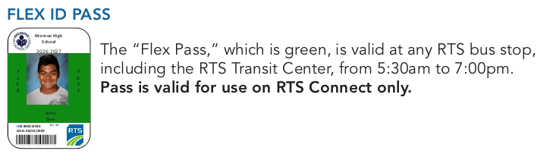
Flex Pass (green)
Notes:
Lastly, students that require the maximum amount of travel flexibility throughout the day for activities such as internships may receive a green Flex Pass.
The Flex Pass is valid from 5:30am to 7:00pm at any RTS bus stop, including at the RTS Transit Center.
It is only valid for use on RTS Connect Service.

Slide 12
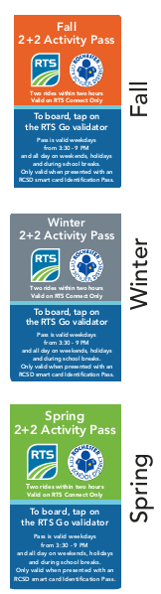
Two Plus Two Activity Pass
Activity Passes provide access to RTS for travel home after sports or other activities
The Pass provided the student with two rides in a two-hour period
The pass is valid from 3:30pm to 9:00pm weekdays, as well as all day on holidays, weekends and during school breaks
The pass is only valid when presented in conjunction with and RCSD Bus Pass (smart card)
Notes:
Students participating in after-school activities will be issued a Two Plus Two Activity Pass for travel home, as you see pictured here.
The Pass is valid for two rides within a two-hour period.
The Two Plus Two Activity Pass is can only be used on RTS Connect Service and is only valid when presented in conjunction with a Smart Card ID Pass.
The Pass is valid weekdays, when school is in session, from 3:30pm to 9:00pm, as well as all day on weekends, holidays and during school breaks

Slide 13
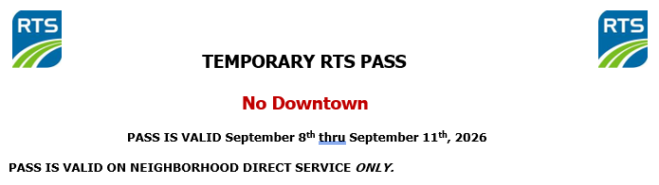
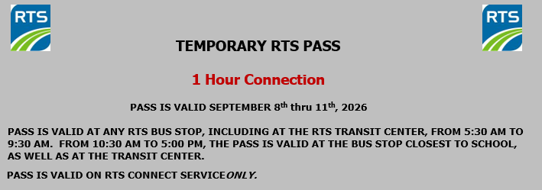
Temporary Passes (paper)
No Downtown (white)
The temporary passes are valid from Tuesday, September 8th thru Friday, September 11th, only.
1 Hour Connection (grey)
Notes:
For travel to and from school during the period of Tuesday, September 8th thru Friday, September 11th, students will be issued a temporary paper pass. The rules for the paper passes are identical to the permanent bus passes.

Slide 14
Boarding/ Alighting Process

Slide 15

Boarding Process
When traveling to school, arrive at your bus stop seven minutes prior to the scheduled departure time.
Stand next to the bus stop sign and have your RCSD Smart Card ID Pass in hand so the Operator knows you intend to board.
Look for the bus with the digital sign above the windshield displaying your route number.
Routes traveling to School of the Arts will start with the number “2”
Example:
285 JOSEPH TO SCHOOL OF THE ARTS
Notes:
When traveling to school in the morning, be sure to arrive at the bus stop seven minutes before the scheduled departure time.
Stand next to the bus stop and have your pass in hand, ready to board.
Look for the bus with digital sign displaying your route number and name. Routes traveling to School of the Arts start with the number “2”.

Slide 16
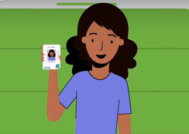


Boarding Process
Show your Pass to the Operator
  The Operator will verify:
    That the picture on the pass is indeed you.
    That the type of pass is valid on that route, at that given location and time.
.
Notes:
Upon boarding the bus, you are required to show your pass to the Operator.
The Operator will verify as to whether the picture on the pass is you, as well as if the type of pass is valid on that route, at that given time and location.
If you attempt to use a pass with someone else’s picture on it, the Operator is required to take it from you for return to the Rochester City School District Transportation Department.

Slide 17
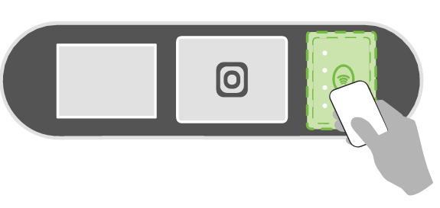
Boarding Process
Tap your pass on far-right window of the RTS Go Validator
  If pass is valid, a yellow screen appears with the words “School Pass”, and a flutter sound will be heard.
  If pass is invalid, a red light will appear on the validator and a buzzer will be heard.
Note: If you attempt to use a pass that is not valid, the Operator is
required to take it from you for return to the District Trans. Department.
Tap card here
Notes:
Upon boarding the bus, you are required to show your pass to the Operator.
The Operator will verify as to whether the picture on the pass is you, as well as if the type of pass is valid on that route, at that given time and location.
If you attempt to use a pass with someone else’s picture on it, the Operator is required to take it from you for return to the Rochester City School District Transportation Department.

Slide 18
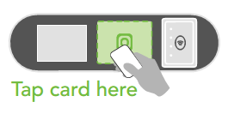
Boarding Process
If using an Activity Pass, you will then tap the Activity Pass on middle window of the RTS Go Validator
  If valid, yellow screen appears with the words “School Pass”, and a flutter sound will be heard.
  If pass is invalid, a red light will appear on the validator and a buzzer will be heard.
Note: If you attempt to use a pass that is not valid, the Operator is
required to take it from you for return to the District Trans. Department.
Notes:
If your are using an Activity Pass, you will then tap the Activity Pass on the middle window of the Validator.
If your pass is valid, you will hear a flutter sound, and a yellow screen will appear with the words “School Pass”.
If your pass has expired, a red light will appear and a buzzer will be heard.

Slide 19
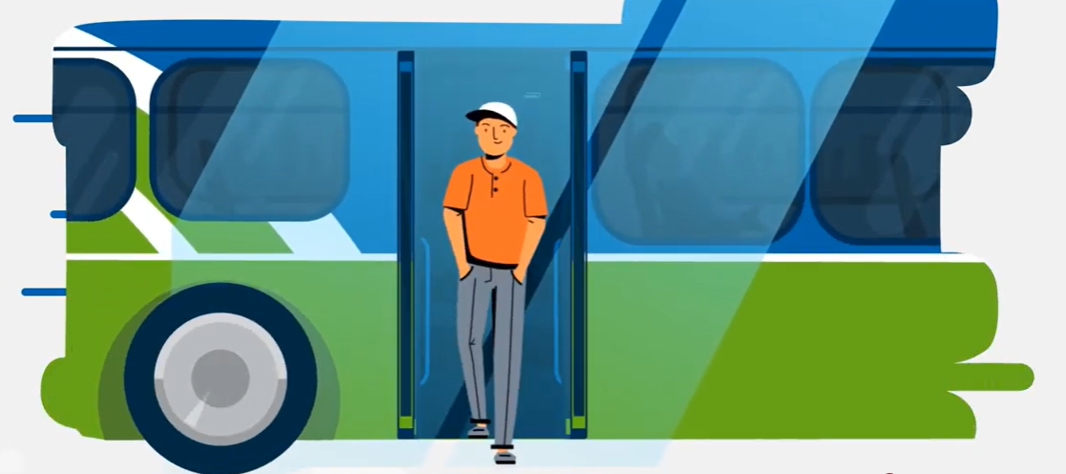
Alighting (Existing) Process
When alighting (exiting) the bus, please utilize the rear door.
Wait for the bus to depart from the stop, before crossing the street at the nearest crosswalk.
Note: If you attempt to use a pass that is not valid, the Operator is
required to take it from you for return to the District Trans. Department.
Notes:
When alighting the bus, customers are asked to utilize the rear door.
If crossing the street, please do so at the nearest sidewalk once the bus has departed.

Slide 20
Behavior Expectations

Slide 21
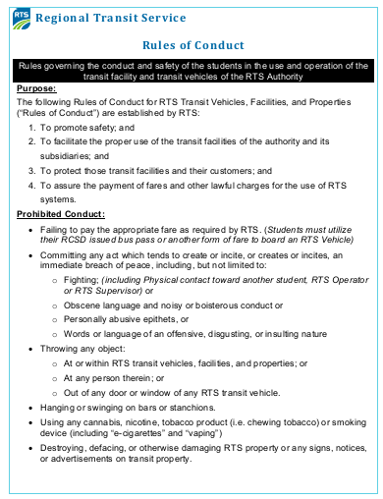
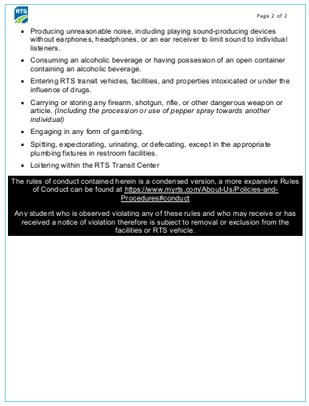
Behavior Standards
As is the case with all customers, students are expected to adhere to the RTS Rules of Conduct when utilizing RTS Service or when in the RTS Transit Center
All students will be provided with a copy of the document pictured below prior to the start of the school year
Note: If you attempt to use a pass that is not valid, the Operator is
required to take it from you for return to the District Trans. Department.
Notes:
While utilizing RTS Services, or when in the RTS Transit Center, all students are expected to adhere to the RTS Rules of Conduct for RTS Vehicles, Facilities and Properties when utilizing RTS Service or when in the RTS Transit Center.
All students will receive a copy of the RTS Rules of Conduct prior to the start of the school year.

Slide 22
Behavior Standards
Any student that violates the rules of conduct, i.e., smoking, vaping, or fighting, will be excluded from service for a stated period.
If a student is excluded from service, he or she will be presented with a Service Exclusion Report by an RTS Supervisor.
The Exclusion Report will be distributed to pertinent individuals within the Transportation and Safety and Security Departments at RCSD, as well as the school principal.
The school principal will notify the students parents/ guardians of the exclusion.
During the exclusion period, the student is prohibited from utilizing Neighborhood Direct Service.
Should the student wish to use RTS to travel to/ from school, the student is limited to the use of RTS Connect Service and must pay the regular fare.
Note: If you attempt to use a pass that is not valid, the Operator is
required to take it from you for return to the District Trans. Department.
Notes:
If a student violates the RTS Rules of conduct , the student will be excluded from the use of Neighborhood Direct Service for a period of time, as specified in the Exclusion Report.
If the student wishes to use RTS services during the exclusion period, the students is limited to the use of RTS Connect.

Slide 23
Trip Planning

Slide 24
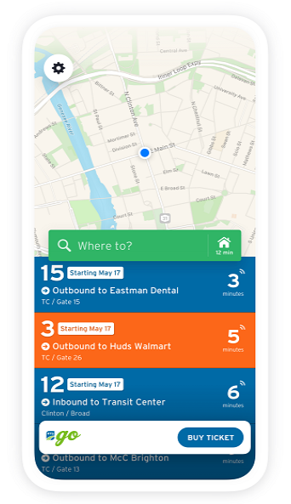
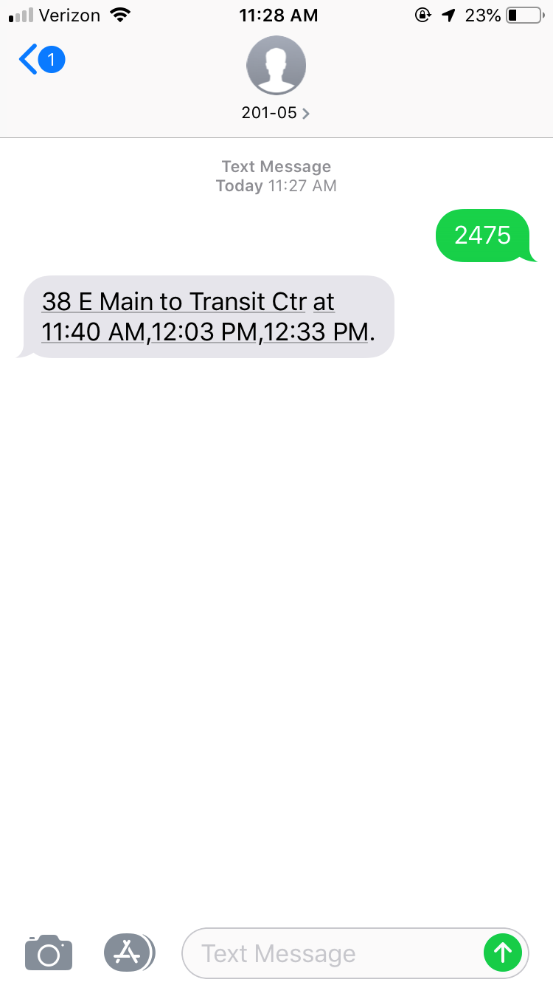

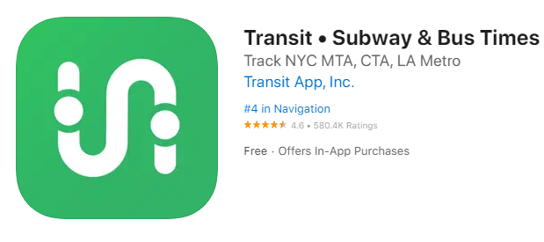
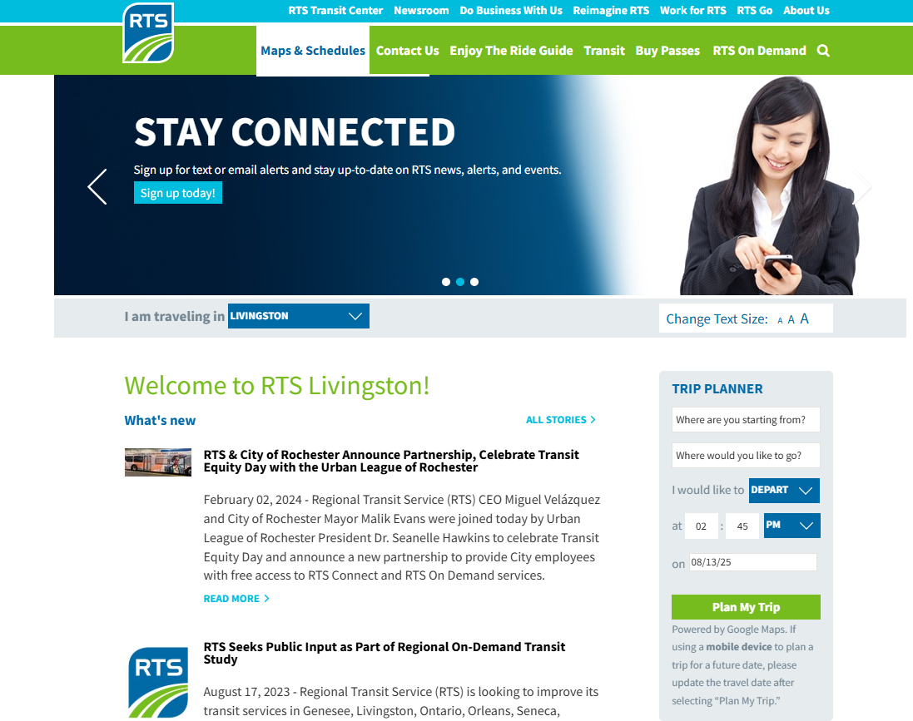
Trip Planning Assistance
Transit App | “Where’s My Bus” | RTS Website/ Customer Service
Note: The Bus Stop ID for the stop at the corner of University Avenue and Prince Street is #3892.
Available from the Apple Store and Google Play
Plan Your trip, track your bus, find bus stop, get service alerts
Text Bus Stop ID to 20105
Arrival time of next three buses will be provided
Customer Service:
  585-288-1700
  6:00am-7:00pm, Daily
Website:
  www.myrts.com
Note: If you attempt to use a pass that is not valid, the Operator is
required to take it from you for return to the District Trans. Department.
Notes:
There are several available to obtain detail regarding RTS Services. They include:
- The Transit App. - Available from both Google Play and the Apple Store, information can be obtained to plan your trip, track your bus in real time and obtain service alerts.
- Where’s My Bus- By texting the bus stop ID for your stop to “20105” you will receive the arrival time for the next three buses for the stop.
- RTS Website/ Customer Service- Obtain schedules, receive trip planning assistance and have your questions addressed.

Slide 25


