Slide 1




OPEN HOUSE
Annual Title I Meeting
Azalea Elementary School
August 26, 2026
Principal: Dr. Donita O. Moody
Assistant Principal: Brenda Butler
Rated
Notes:
Welcome to our Title I Annual Meeting. My name is Dr. Donita Moody. I am the proud principal of “A” rated Azalea Elementary. This presentation will provide important information about our Title I program.

Slide 2



ALL ABOUT TITLE I
> Title 1 is the largest federal assistance program for our nation’s school
> The program serves 83 schools in Pinellas County including eligible students in 38 non-public schools
>
WHAT IS TITLE I SUPPLEMENTAL RESOURCES?
Notes:
We are proud to be a Title I school which is the largest federal assistance program for our students and schools.

Slide 3
TITLE I FUNDING PROCESS
What does this mean for your child’s school??
With the help of parents, staff, and students, the school develops a budget and plans activities that best support the educational needs of all students.
How?
Glad you asked...
  Federal Government
On the next slide you will see our budget.
2. Florida Dept. of Education
3. Pinellas County Schools
4. Azalea Elementary!!!
Notes:
The Florida Department of Education receives funds from the federal government, Pinellas County Schools receives Title I funds from Department of Education, and the district distributes these funds to schools based on the percentage of children eligible for free/reduced priced lunch.

Slide 4
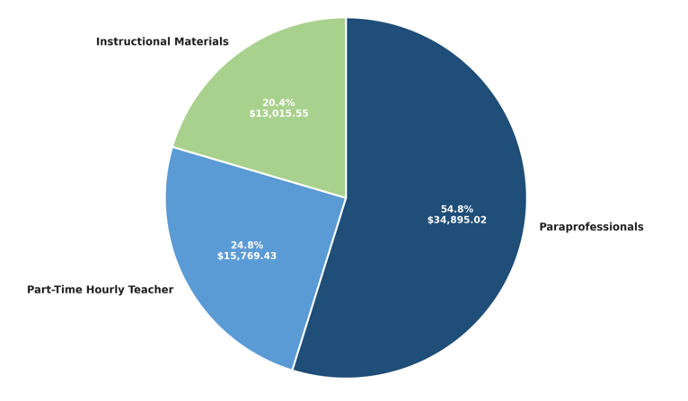
TITLE I SCHOOLWIDE BUDGET:
AZALEA ELEMENTARY IS PROVIDED $63,680.00 TO PAY FOR SUPPLEMENTAL RESOURCES AND PROGRAMS DESIGNED TO INCREASE STUDENT ACHIEVEMENT.
Total Allocation - $63,680.00
Paraprofessionals $34,895.02
Part Time Hourly Teacher $15,769.43
Instructional Materials $13,015.55
Family Engagement $5,900.00
Azalea Elementary School
Parent and Family Engagement 2026-2027 Budget
$5,900.00
Notes:
Title I funds are uses to provide hourly teachers, paraprofessional, instructional materials and family engagement resources.
Total Allocation - $63,680.00
Paraprofessionals $34,895.02
Part Time Hourly Teacher $15,769.43
Instructional Materials $13,015.55
Family Engagement $5,900.00

Slide 5

Title I Schoolwide Planning and Input
Please take a moment and help us
with our Title I planning for the
school year. We appreciate your help
and partnership in the education of
our students.
Notes:
Your input is important to us and helps us with schoolwide planning. Please use the input form in your child’s classroom to provide input regarding title I.

Slide 6

SCHOOL’S CURRICULUM
FLORIDAS BENCHMARKS FOR EXCELLENT STUDENT THINKING STANDARDS (B.E.S.T) FORM THE FRAMEWORK OF EVERYTHING TAIGHT IN OUR SCHOOLS. www.fldoe.org
Core Curriculum
TO LEARN MORE ABOUT STATE ASSESSMENTS, VISIT THE FLORIDA DEPARTMENT OF EDUCATION’S
WEBSITE, FLDOE.ORG/ACCOUNTABILITY/ASSESSMENTS
Mathematics & Science
Reading & Writing
PM Cycle testing, etc.
Notes:
Our school curriculum is guided by Florida Benchmark for Excellent Student Thinking Standards (B.E.S.T) www.fldoe.org

Slide 7
Working Together for Student Success
SCHOOL
School Improvement Plan (SIP)
Title I Schoolwide Plan
TITLE I
Parent and Family Engagement Plan
School- Parent- Student Compact
PARENT/FAMILY
SCHOOL
Notes:
As a Title I parent you have the right to be involved in the development of the following plans for our school which can be found on our website.
School Improvement Plan, Title I Schoolwide Plan, School’s, Parent and Family Engagement Plan, and the Compact.

Slide 8

PARENT AND FAMILY ENGAGEMENT PLAN (PFEP)
The PFEP sections include information about the following:
Parent trainings to increase student achievement
Staff trainings on effectively engaging parents
Communication methods between home and school
Flexible meeting times
Accessibility for parents
Coordination with other federal programs
Notes:
We encourage you to increase engagement by joining our School Advisory Council (SAC), Parent Teacher Association (PTA) General Meetings and our monthly school events.

Slide 9
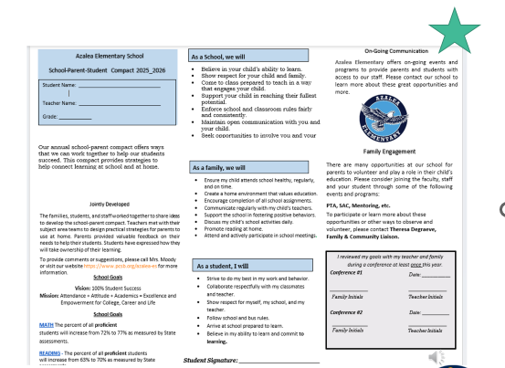

PARENT- SCHOOL- STUDENT COMPACT
By signing the Azalea Elementary Parent-School-Student Compact, teachers, staff, parents, and students agree to work together and share responsibility for helping students meet or exceed state, district, and school academic goals.
Please review and sign your child’s compact
Please have your teacher give you one and once completed- please turn in upon leaving the classroom.
OUR GOAL IS TO RECIEVE 100% SIGNED COMPACTS
Notes:
The PURPOSE of the compact is to foster student achievement. At the elementary level, school compacts are used as a progress monitoring tool through the year during parent teacher conferences. Parent, student, teacher and staff comments regarding the compact are welcome at any time during the year.

Slide 10


School Report Cards ​
​
  School Grade and Overview​
  Population and Enrollment ​
  Assessments – Academic Achievement, Growth, and Population​
  Assessments – English Language Learners ​
  Graduation and Beyond​
  Educator Qualifications and Equity ​
  Long-Term Goals and Interim Progress​
  Accelerated Course Enrollment ​
  Per-Pupil Expenditures ​
  National Data​
​Available online at School Report Cards ​
​
  School Grade and Overview​
  Population and Enrollment ​
  Assessments – Academic Achievement, Growth, and Population​
  Assessments – English Language Learners ​
  Graduation and Beyond​
  Educator Qualifications and Equity ​
  Long-Term Goals and Interim Progress​
  Accelerated Course Enrollment ​
  Per-Pupil Expenditures ​
  National Data​
​Available online at https://edudata.fldoe.org/ or Front Office ​
Notes:
Please visit Edudata.fldoe.org to access additional information regarding the FL DOE accountability system

Slide 11
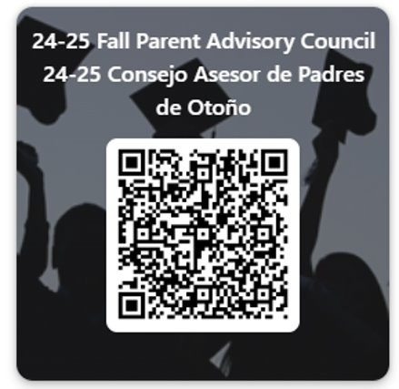

PARENT ADVISORY COUNCIL (PAC)
  The District has a Parent and Family Engagement Plan. The summary of the plan is in the Title I School & Family Partnership Overview.​
  You may access the full plan at www.pcsb.org/titleone​
  The Parent Advisory Council (PAC) is responsible for reviewing and revising the District PFEP. ​
  PAC will meet virtually or in-person with the district’s Title I staff.​
  Each school is committed to having at least one member representative on PAC. ​
  PAC meets twice a year, if you are interested in representing our school please notify, Insert contact person
Notes:
The District has a Parent and Family Engagement Plan. The Parent Advisory Council (PAC) is responsible for reviewing and revising the District PFEP. PAC meets twice a year, if you are interested in representing our school email Dr. Moody.

Slide 12
THANK YOU FOR LISTENING!
Please take a moment to take our survey located on the last page of your parent packet.
Your meet the teacher night will begin in 3 minutes in this classroom.
Team Azalea Elementary
One Team! One Goal! 100% Student Success

