Slide 1
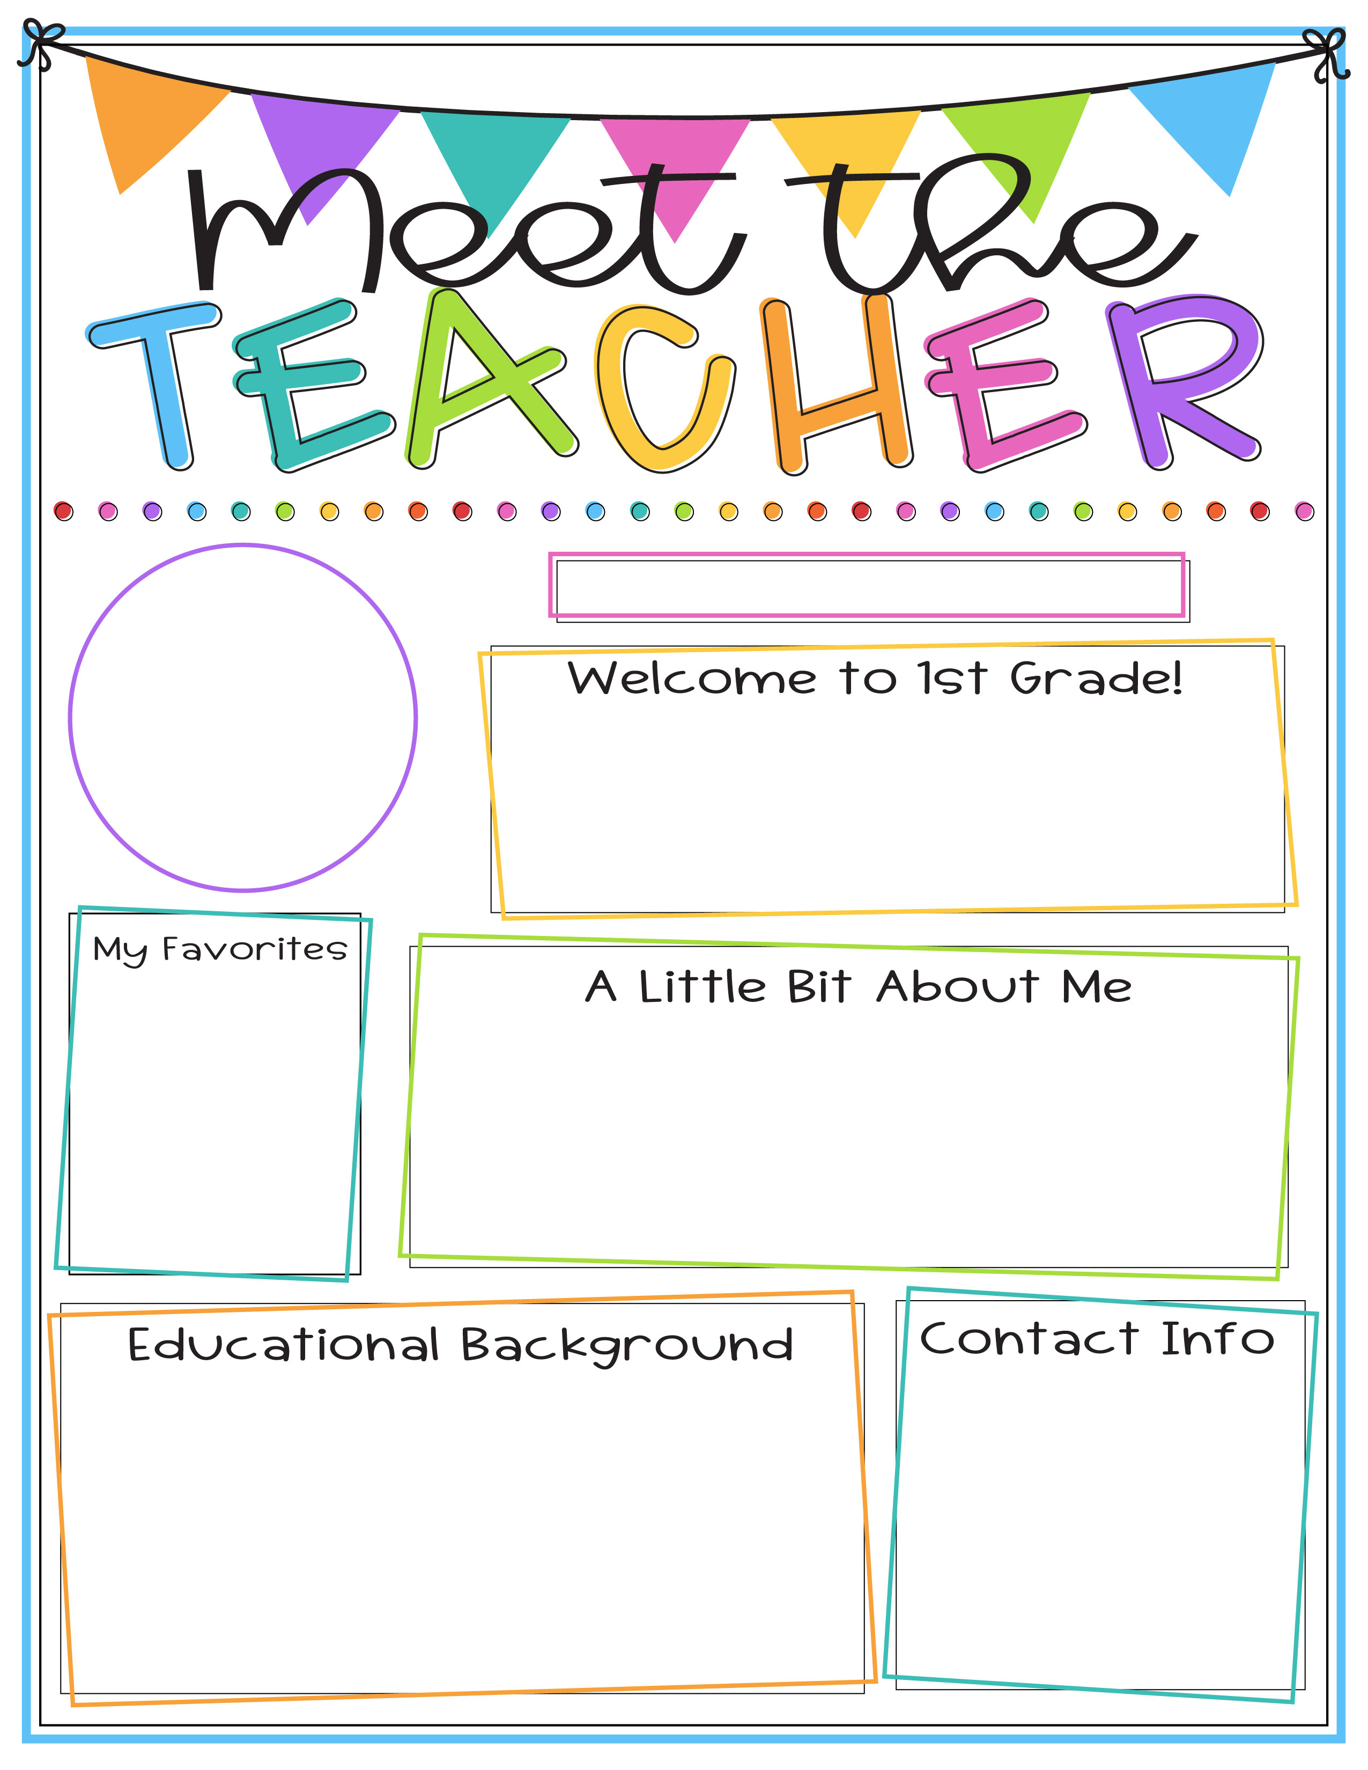
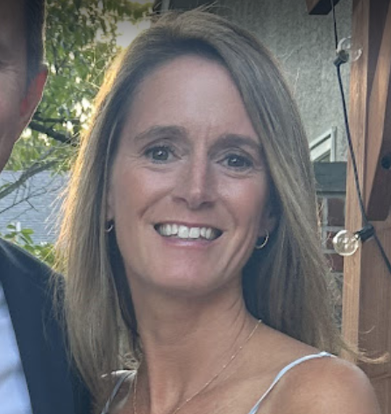
Meet the
TEACHER
Mrs. Debbie Rosica
I am very excited to be your child’s teacher this year. First grade is such a special time for students to grow both socially and academically, and I look forward to getting to know your family and having a wonderful year together!
FOOD: Sushi
COLOR: Pink
TEAM: Eagles
STORE: Target
DRINK: Coffee
When I’m not teaching, I love to swim, read, and take long walks at Lake Galena. My favorite place in the whole world is the beach. My husband, Mike, is also a teacher, and he teaches sixth grade. We have three children. Ryan (26) lives in Seattle, Matthew (23) lives in Malvern, and Mia (19) is a sophomore in nursing school at West Chester University.
I have a B.A. from Eastern University and an M.A. from Holy Family University. This is my eighth year at Butler. I have taught both first and second grade, and this is my sixth year teaching first grade. I truly love this age and stage of learning and all the growth that happens during this special year.
Our partnership is important to me. Please reach out with any questions, concerns, or comments.
drosica@cbsd.org
Room: C102

