Slide 1

Class of 2027
Post-Secondary Planning

Slide 2
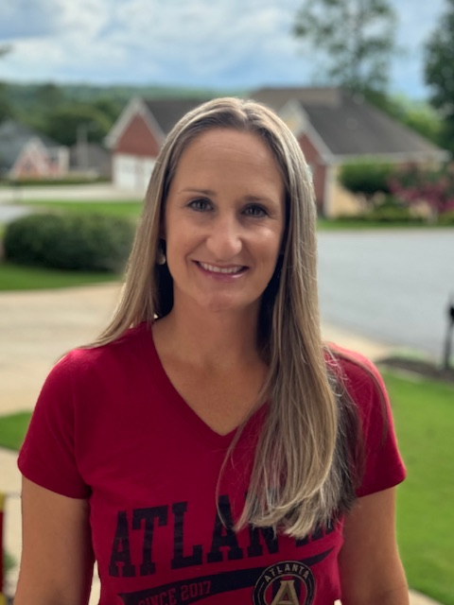


Counseling Staff
Whitney Morberg A-Cre
Alayna Petersen
Cri-Hen
Sharon Gustafson
Her-Mil

Slide 3
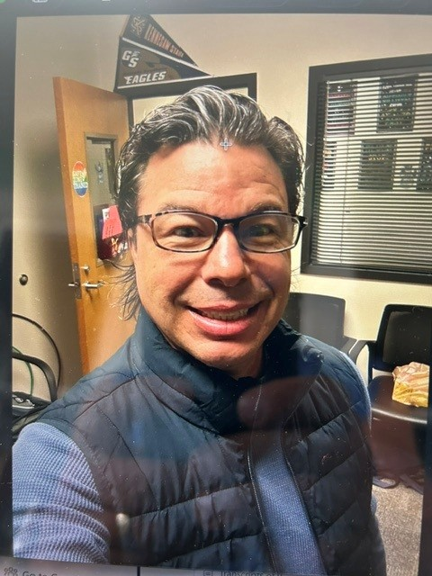
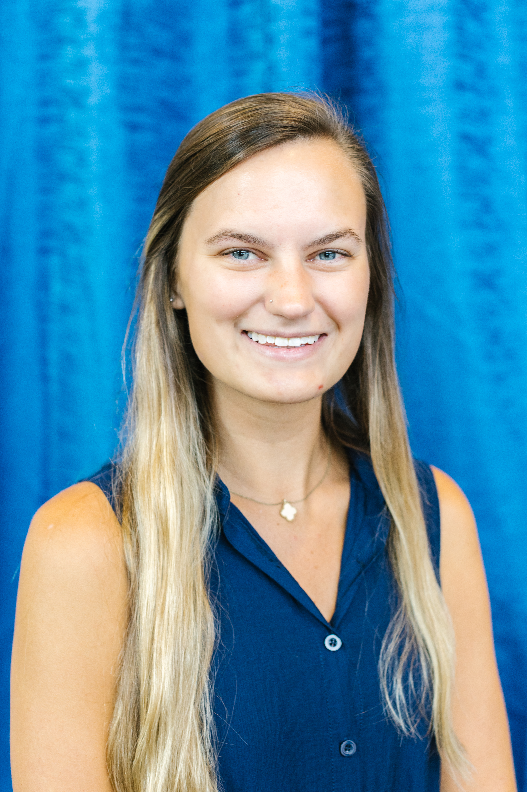
Counseling Staff
Travis Schmid
Mir-Ruz
Lauren Watkins
Sab-Z

Slide 4
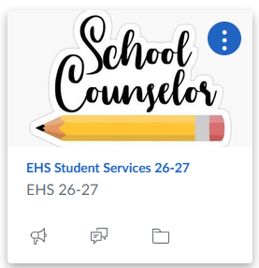
Resources:
EHS Senior Info on the counselor Canvas Page
A-Z Senior Reference Guide
Counselor Rec Packet
This classroom presentation
https://ehs.cherokeek12.net/student-services
(Senior Page/College Rep Visit Calendar)
https://bigfuture.collegeboard.org/
Georgia Match

Slide 5
Planning Information
Counseling Office information
Make sure you accept your 2026 EHS Student Services Course on Canvas for important announcements.
Post-secondary planning
Gain knowledge in next steps toward post-secondary plans:
Military service
Workforce
Apprenticeships
College Admissions
Other
Probe Fair October 21st 6-8pm Cherokee HS
Curriculum Night September 2nd 6pm
Financial Aid Night October 15th 6:30pm Virtual

Slide 6
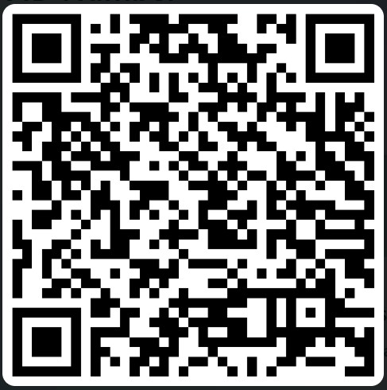
Armed Forces
High school diploma critically important
Very few spots are open for students without a high school diploma.
To even be considered, recruits with a GED must have much higher scores on the ASVAB than recruits with diplomas.
ASVAB testing at EHS is scheduled for November 6th, at 8:15 am in the Pod 2. Register online and email Ciarra.Malto@cherokeek12.net for questions. ASVAB Registration
For other requirements, see a recruiter from the branch of service in which you’re interested.

Slide 7
Work Force
Opportunities for Apprenticeships
Research trade jobs, manufacturing, and industries for benefits, training, and unions.
https://www.apprenticeship.gov/career-seekers
Paid Apprenticeships in Mechanical Trades
Bureau of Labor Statistics Occupational Outlook handbook https://www.bls.gov/ooh/

Slide 8
General Resume Tips
Make your name and contact information stand out
Write an Impactful Objective
Keep it under 2 pages
Keep it professional
https://www.jobhero.com/resume/formats

Slide 9
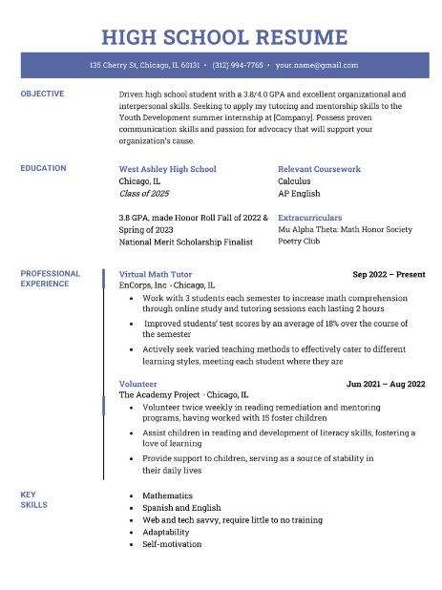
Work Force: Functional Resume

Slide 10
Technical, 2 year, or 4-year College?
Technical College:
SAT/ACT not required.
  Use Accuplacer exam to determine placement
Qualifies for HOPE Grant
Chattahoochee Tech is nearby
4 Year College:
Each college determines their minimum entrance requirements
Minimum GPA
ACT or SAT scores
Georgia 4-year colleges require:
  College Preparatory Curriculum requirements (2 years world language)
  Freshman Index requirement
  Minimum results on Test Scores
2 Year Community College:
SAT/ACT may not be required: could use Accuplacer exam for placement
School determines minimum GPA
Nearby 2-year schools: Georgia Highlands & GSU Perimeter College
Notes:
FRESHMAN INDEX NUMBER: The University System of Georgia colleges and universities use a standardized calculation to determine appropriate college placement for students in the state of Georgia. This is known as the Freshman Index Number. The Freshman Index is calculated by combining the core high school grade point average (GPA on a 4.0 scale) with the highest earned SAT or ACT test scores. The high school GPA is calculated from the grades earned in the 17 Required High School Curriculum (RHSC) courses for those students graduating 2012 or later.
The following formulas are used to calculate a student's freshman index:
Formula for SAT Test Takers
Freshman Index =
(500 x High School GPA)
+ SAT Critical Reading + SAT Math
Formula for ACT Test Takers
Freshman Index =
(500 x High School GPA)
+ (ACT Composite score x 42) + 88
Type of Institution
Minimum Freshman Index (FI)
Research Institutions
Georgia Tech, UGA , GA State, Emory
2500
Regional Universities
Georgia Southern, Valdosta State
2040
State Universities
GCSU, KSU, SPSU, UWG, NGCSU
1940
State Colleges
Gainesville State, Georgia Gwinnett College
1830
Two-Year Colleges
No FI Requirement

Slide 11
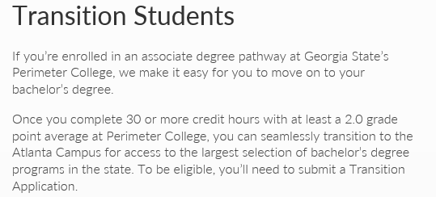
2 Year Colleges
Transferring to 4 Year Colleges:
Georgia Perimeter to Georgia State University
https://admissions.gsu.edu/bachelors-degree/apply/#transition

Slide 12


*Must maintain a 2.0 once admitted
https://tcsg.edu/free-tuition/

Slide 13
College Bound
How do you decide which college is right for you?
  Who are you?
  What do you need to succeed?
  What’s your admissions profile?
  How far from home do you want to be?
  How large a college do you want?
  What activities are available?
  What else is important to you?
  VISIT THE CAMPUS!
*Seniors can take two days for a college visit. The absences will be excused with a dated letter on letterhead from the college visited.
USG Freshman Requirements

Slide 14

Take Advantage
Low-Income Advantage (free/reduced lunch)-not just for food
SAT Fee Waivers
ACT Fee Waivers
College Application Fee Waivers
Scholarship options
October 28th SAT email Sara.DAntuono@cherokeek12.net
The National College Match application is now open! This college and scholarship application connects high-achieving high school seniors from low-income backgrounds with full four-year scholarships to top colleges and lifelong opportunities through QuestBridge.
Upcoming deadline to apply:
10/01/2026

Slide 15
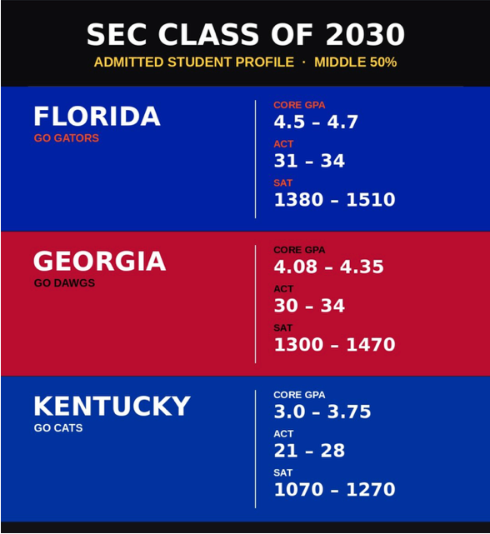

Slide 16
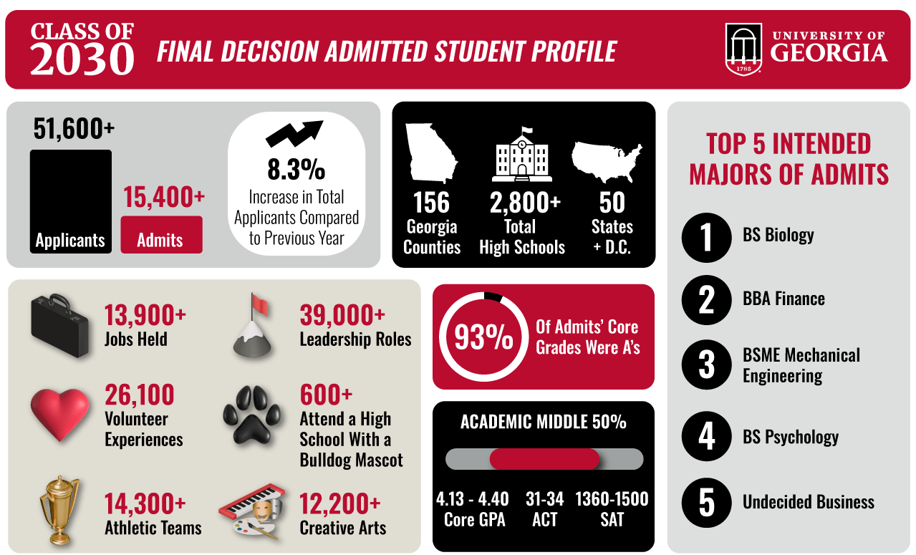

2026 Freshman Admits

Slide 17
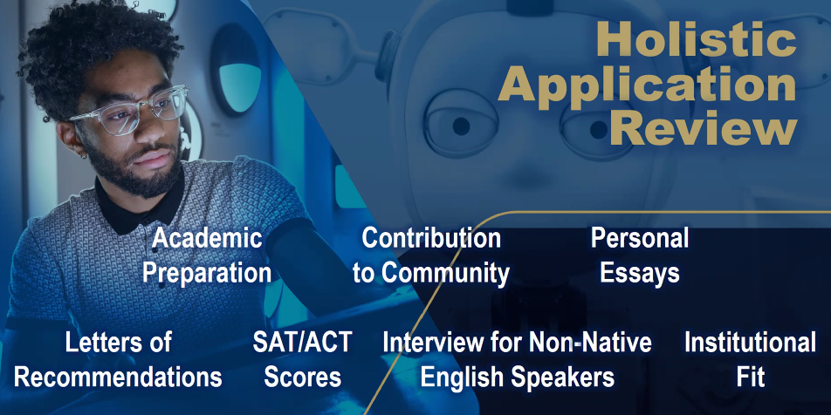




Georgia Southern University Admissions Info
Georgia State University Admissions Info
Albany State University Admissions Info
Georgia Military College Admissions Info

Slide 18
I’ve got my list of colleges – what’s next
(Stretch School, I think I Have this School, In the Bag school)
Before you apply make sure you’re eligible.
Have you taken the ACT or SAT?
  Register directly with the testing agencies!
  www.collegeboard.org & www.actstudent.org
  Check with the colleges to which you are interested in applying to determine the final test date accepted for admissions.
Do you meet the grade requirements? What is your Academic GPA?
  Colleges individually decide how they calculate their admissions academic GPA.
  Typically, basis is English, Math, Science, Social Studies, and World Language courses.
  Most will calculate an unweighted GPA on a 4.0 scale
Determine the additional requirements of the application:
  Counselor or Teacher recommendation?
  Essay?

Slide 19

SAT/ACT
SAT/ACT can be taken multiple times
Usually required to apply to colleges and universities (not required for technical colleges)
College-bound Seniors should try to take fall semester, if possible, to meet application deadlines
SAT vs. ACT: both are recognized at MOST colleges and universities

Slide 20
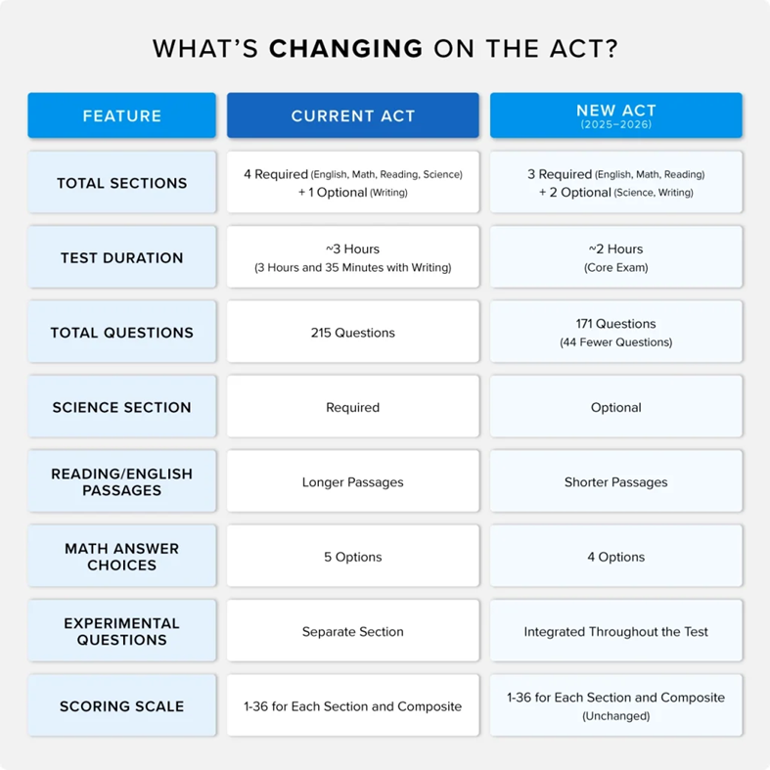

Slide 21

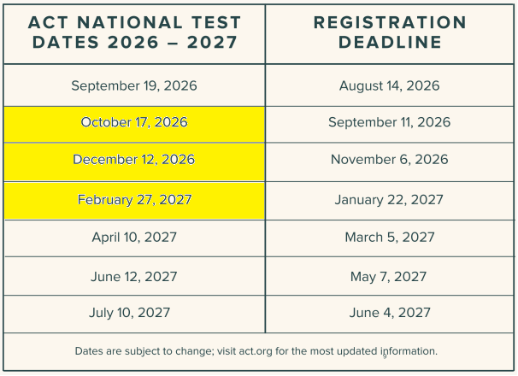
Notes:
March 5 is the first administration of the newly redesigned SAT.

Slide 22
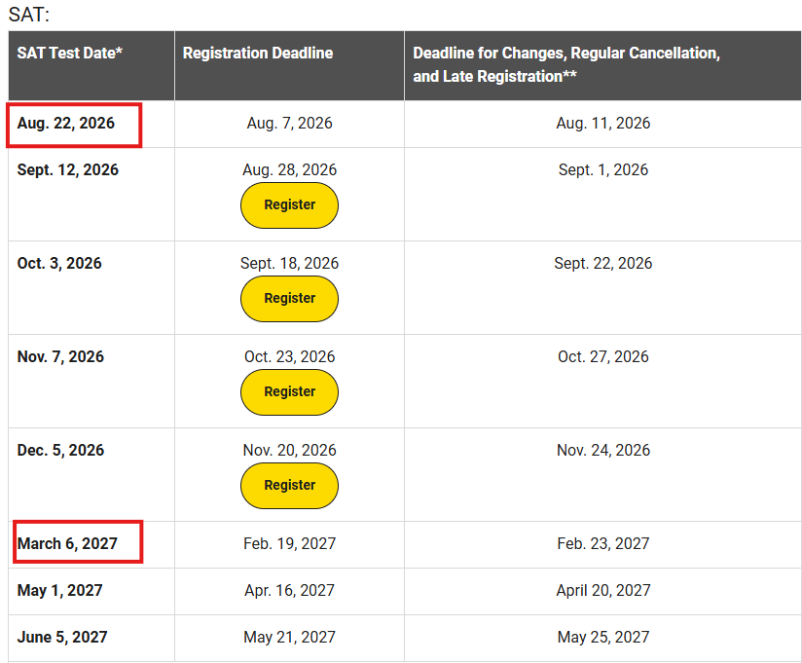
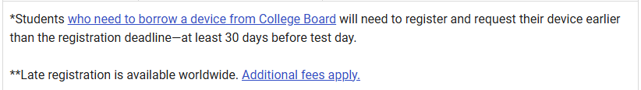
SAT Dates
  EHS DATE
  10/28 School Day
  11th and 12th Grade Only
  www.collegeboard.org
Notes:
March 5 is the first administration of the newly redesigned SAT.

Slide 23
NOW APPLY!
The Common Application: Fill out one form for multiple participating colleges
Check to see if your schools are available
www.commonapp.org
Through GAfutures.org
Through the individual college website

Slide 24

You may be asked to…
Submit an essay:
  Not every college application requires an essay.
  Number one rule from college admissions officers – PROOFREAD and FOLLOW DIRECTIONS.
  Be yourself in your essay!
  https://www.collegeessayguy.com/college-essay-resources FREE ESSAY RESOURCES

Slide 25
You may be asked to…
Submit a Transcript
Transcripts can be requested:
www.gafutures.org
  In-State participating schools only
  FREE!!!
www.parchment.com
  In or Out of State Colleges
  Around $5.90 per request
Before submitting your transcript check it for accuracy. VERY IMPORTANT FOR HOPE ELIGIBILITY

Slide 26
You may be asked to…
To Submit for a Counselor Recommendation Letter:
The Senior Brag Sheet for the Letter is Located on the Senior Canvas Page and Student Services Webpage.
Not required for all college applications
Senior brag sheet must be emailed to your counselor two working weeks prior to due date.

Slide 27
Teacher Recommendation
To receive a teacher recommendation, you will need to ask a teacher who knows you well enough to write about you.
Deal directly with the teacher!
  Talk with the teacher to see what he/she requires from you in order to write a recommendation and let your teacher know that they will be receiving a link to upload your recommendation.
  Follow-up with a thank-you note!

Slide 28
I’ve applied. What Now?
Once you are notified of acceptance by letter or email to your dream college, you’ll be expected to pay for it. The college will communicate with you directly on deadlines for housing, meal plans, financial aid and orientation.
Funding Sources:
  Federal - FAFSA: https://studentaid.gov/
    Application for 26-27 is not open yet. It should open Oct 1st.
Institutional
  Specific college Financial Aid website
  Departmental
  Business school, Music Department, etc.
  Private-Etowah High School/ Student Services/ Scholarships
https://www.usg.edu/georgia-degrees-pay/

Slide 29
Financial Aid
Because your financial aid package is created for you and is based on the cost of attending a particular school, your aid amounts will vary from school to school.
Figuring Out Net Price
Follow these easy steps to figure out your net price, or net cost, for each school, and find out which school will be most affordable for you.
First, find the cost of attendance for your program on the aid offer. If the school doesn’t list the cost of attendance on the aid offer, ask the financial aid office for this figure. Make sure it includes amounts you will pay to the school directly (such as tuition and fees) as well as other costs (such as living expenses, books and supplies, and transportation).
Next, subtract the grant and scholarship amounts on your aid offer from the cost of attendance amount. Also subtract any savings you have available to put toward your school costs for the school year. The remaining amount is your net or out-of-pocket cost.
Compare the net costs for the schools you are considering. The net cost is the amount you will have to pay out of your pocket, using earnings from work or loan funds that you borrow.
https://studentaid.gov/complete-aid-process/comparing-aid-offers

Slide 30
FINANCIAL AID NIGHT
Virtual Financial Aid Night
October 15th, 2026
6:30 – 8:00
A representative from the Georgia Student Finance Commission will answer questions related to FAFSA, HOPE, LOANS, GRANTS, etc.
Microsoft Teams meeting
Join: Join Here
Meeting ID: 279 408 615 728 711
Passcode: 9BV7YD93

Slide 31
HOPE and Zell Miller Scholarship
SSN Verification:
Social Security numbers are required to be in ASPEN for a student to be HOPE eligible.
Rigor Requirement
4 courses complete prior to graduation (examples: Advanced Algebra or higher, Chemistry, Physics, Astronomy, Zoology, 2nd year of Foreign Language or higher, AP Courses)
HOPE Scholarship:
3.0 academic GPA, covers The new rule states that HOPE will cover “100%” of tuition, but there are caveats.
Zell Miller scholarship:
3.7 academic GPA—covers 100% of tuition
SAT 1200 combined CR and Math or 25 ACT composite
This is the information that was shared with us:
HOPE will cover the current year at 100% of the prior year tuition amount. Example: the 2024 year of college gets covered at 2023 tuition rate under HOPE, the 2025 year gets covered at the 2024 rate. If the rates are the same from one year to the next, HOPE funds at 100%; if the rates change from one year to the next then HOPE only covers the amount equal to the prior year.
www.GAFutures.org

Slide 32
HOPE and Zell Miller Scholarship
1. HOPE:
3.0 Core GPA (AP classes weighted +.5 up to 4.0)
Students must maintain a 3.0 GPA in college
HOPE GPA IS NOT ROUNDED! 2.9999 is ineligible!!!
To apply for HOPE/Zell, FAFSA or GSFAPP
*HOPE/Zell Application
2. Zell Miller:
3.7 Core GPA (add .5 weighting for AP courses up to 4.0)
Students must maintain a 3.3 GPA in college
Students who drop below the college 3.3 GPA can earn Regular HOPE if their college GPA remains above 3.0
NOT ROUNDED: 3.6999 will receive HOPE, not Zell Miller
You must submit your SAT or ACT scores to the GA Student Finance Commission for Zell
*Test Score Submission Information

Slide 33

Four of these courses required prior to graduation
Requirement | Examples
Advanced Math | Advanced Algebra, Adv. Financial Algebra, Statistical Reasoning, Pre-Calc, Calculus, Honors Multi Variable Calculus
Advanced Science | Chemistry, Physics, Forensics, Anatomy, Astronomy, Zoology
AP Core Courses | AP English, AP Math, AP Science, AP Social Studies, AP Computer Science, AP Psychology
Dual Core Courses | Various Courses
Advanced World Lang | Spanish, French, German, (2,3,4 and AP)

Slide 34



Scholarships
DON’T PAY TO SEARCH OR VIEW SCHOLARSHIPS
EHS Student Services Website and Student Services Counseling Page
www.collegescholarships.com
www.gafutures.org
CHATGBT
The amount of scholarship money awarded is directly proportional to the amount of time spent searching and applying
www.fastweb.com
Eagle Mountain Messenger

Slide 35


The 2026 Georgia Probe College Tour will make its annual stop in Cherokee County on Wednesday, Oct. 21. The free event is from 6 to 8 p.m. at Cherokee High School in Canton. More than 75 colleges and universities are expected to attend to share information.
    www.gaprobe.org
Pre-registration is required online here.
The EHS College and Career Fair will be November 11th during the school day.
Notes:
Log on to gaprobe.org select high school students and you can register for a barcode that colleges can scan to automatically get your information and be able to send you information without you having to fill out their info cards all night.

Slide 36

Georgia Virtual Sessions
(All times listed are in Eastern Time)
Wednesday, September 2: 6:00-7:00 p.m.
Wednesday, September 9: 6:00-7:00 p.m.
​
Georgia Financial Aid Session​
​(All times listed are in Eastern Time)
Tuesday, September 15: 6:00-7:00 p.m.
http://www.peachstatetour.org/students.html
Notes:
Log on to gaprobe.org select high school students and you can register for a barcode that colleges can scan to automatically get your information and be able to send you information without you having to fill out their info cards all night.

Slide 37
Choose your Activity?
College
Work Force/Apprenticeship military

Slide 38

Smart Money Choices
Student Loan Trouble
After College Loan Debt

