Slide 1


2027 Senior Classroom Lesson
Presented by the Milton Counseling Department
August 27, 2026
Feel free to take notes during the presentation!
This PowerPoint with active website links will be posted to our website to view: milton.fultonschools.org/academics/counseling

Slide 2
Presentation Agenda
01
02
03
Introduction
Graduation
Testing
04
05
06
Apply to College
SchooLinks
Financial Aid
Counseling Department
Credits
Calculating GPA
SAT
ACT
LORs
Transcripts
Post-secondary Options
Post-Secondary Plan Survey
Understanding Financial Aid
HOPE/ Zell Miller
Scholarships

Slide 3
Counselor Caseloads
Ms. Kloboves (Last Names A-Car) | Suite 1380 | Kloboves@fultonschools.org
Ms. Hoglander (Last Names Cas-Gi) | Suite 1340 | HoglanderC@fultonschools.org
Ms. Szymendera (Last Names GL-KL) | Suite 1380 | SzymenderaB@fultonschools.org
Ms. Latham (Co-Dept Chair, Last Names Kn-McD) | Suite 1380 | LathamSJ@fultonschools.org
Mrs. Ruppe (Last Names McE-Ra) | Suite 1360 | Ruppe@fultonschools.org
Mrs. Chriscoe (Co-Dept Chair, Last Names Re-Si) | Suite 1360 | ChriscoeB@fultonschools.org
Ms. Ramsey (Last Names Sk-Z) | Suite 1340 | RamseyA1@fultonschools.org

Slide 4



Stay Connected
@miltoncounseling
Sign up for the Eagle Update
milton.fultonschools.org/academics/counseling

Slide 5
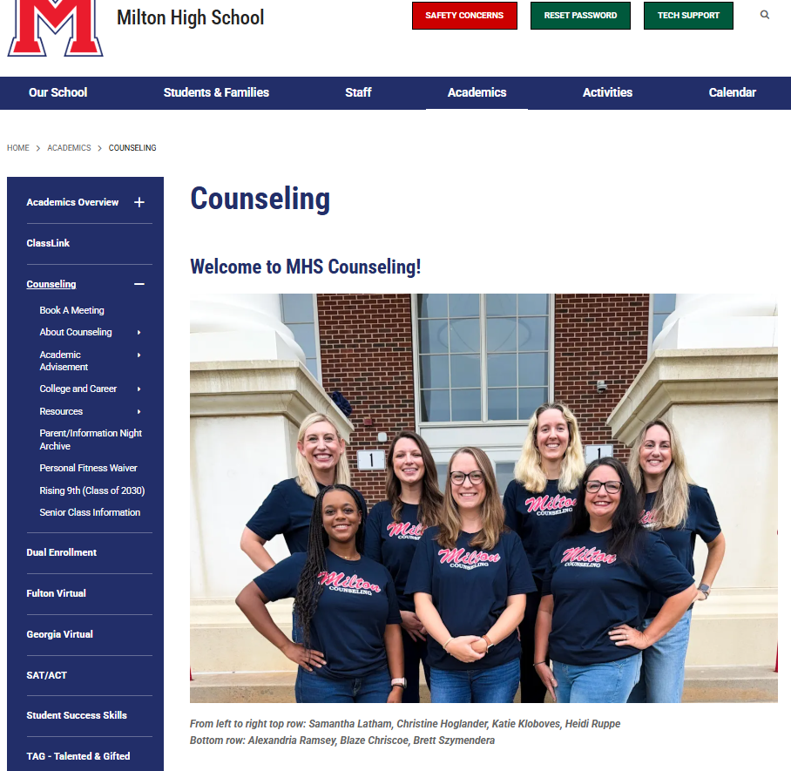
Top Resources for Information
Bookmark the Milton Counseling website: milton.fultonschools.org/academics/counseling
Read the weekly Eagle Update
Update your email address in IC to receive IC Messenger emails
  Counselors send A LOT of important information
  over IC Messenger!

Slide 6

True or False?
You need a world language to graduate.
Most Georgia 4-year colleges want 2 years of the same world language.
17 credits means you’re a senior.
You can see your transcript on Infinite Campus.
Fulton County’s GPA calculation uses a 4.0 scale.
This Photo by Unknown Author is licensed under CC BY-SA-NC

Slide 7
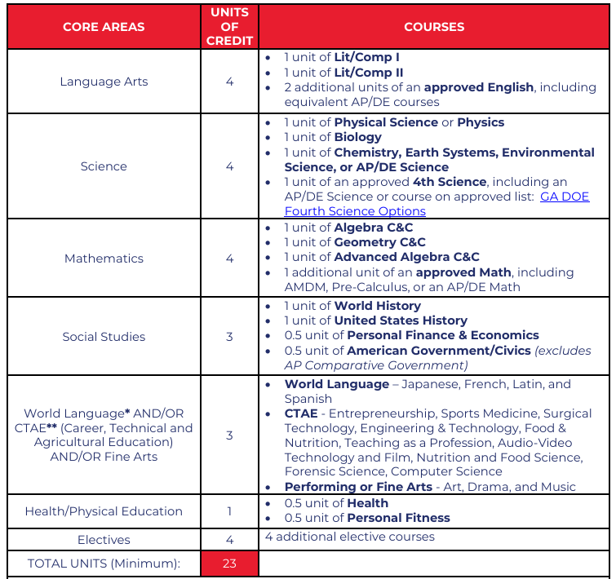
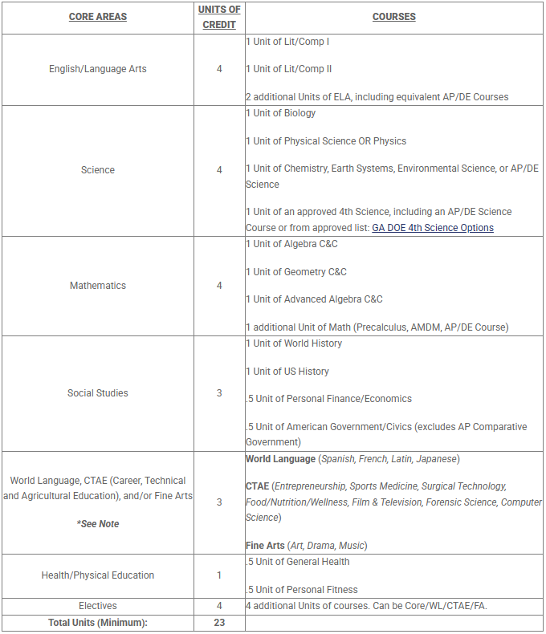
Graduation Requirements
Unofficial Transcripts: Available for viewing any time in Infinite Campus > Documents > Unofficial FCS Transcript
Students interested in attending a 4-year college need a minimum of two consecutive years of the same World Language
Some courses count towards graduation requirements but may not be recognized as core credit by colleges
  Verify by viewing USG’s Staying On Course document
If you need a Personal Fitness Waiver to waive the requirement of PF:
  Instructions are on the Milton Counseling Website > Academic Advisement > Personal Fitness Waiver
Promotion from 9th to 10th Grade = 5 Credits
Promotion from 10th to 11th Grade = 11 Credits
Promotion from 11th to 12th Grade = 17 Credits

Slide 8

How to Calculate Your GPA
Fulton County uses a 100-point GPA scale
Core vs. Cumulative
Weighted vs. Unweighted
Report Your Official GPA:
  Use your cumulative weighted numeric average
Do NOT recalculate to a 4.0 scale for your applications, unless specifically requested
  Always check with the college specifically what they need!
  GPA Calculator form to self-calculate estimated GPA on a 4.0 scale is located our website: HOPE/Zell Miller Scholarship - Milton High School
  Fulton County does not rank students
When applications ask for class rank or percentile of graduating class,
select ‘Does not rank’ or ‘No ranking’

Slide 9


Testing
To register and view upcoming test dates for the SAT, visit www.collegeboard.org
To register and view upcoming test dates for the ACT, visit www.actstudent.org
Test Prep Resources:
CollegeBoard and ACT Website
Counseling Website > College & Career > ACT/SAT/PSAT
Applerouth
Khan Academy
REMEMBER: Many colleges require either the SAT or ACT for admission
Check the admissions page for your school of interest
If you meet the financial requirements to qualify for a fee waiver, reach out to your assigned counselor

Slide 10
Applying To College – Hot Topics
Campus Tours
Campus Tours
Virtual Campus Tours
Virtual Campus Tours
Schedule your visit through the College Admissions Office/Website
Visit when school is in normal session!
Visit the College’s website for virtual tour availability and information
College Rep Visits
College Visits at Milton
College representatives will be visiting during all lunches throughout the semester
Visit & ask questions!
SchooLinks
SchooLinks
Letters of Rec
Letters of Recommendation
Extracurriculars
Extracurriculars
SchooLinks is the college and career planning platform being rolled out by Fulton County
Teachers
Counselors
Mentors
Employers
Be involved!
Organize by section
Include Leadership Positions/Awards (Do NOT use ABBREVIATIONS

Slide 11

Applying To College
This is unique to you!
Submit your application when you feel it best reflects YOU and What You’ve Achieved!
A polished application sent the right time is better than rushing to meet an earlier deadline
WHEN is the best time to apply?
Early Decision (Binding → COMMITMENT)
UGA EA deadline - October 15
GT EA 1 deadline - October 15
GSU EA deadline, Honors College, and Priority & Scholarship deadline - November 15
Regular Decision
Rolling Admission (continual)
Early Action/Admission/Notification (Non-binding → NO COMMITMENT)

Slide 12
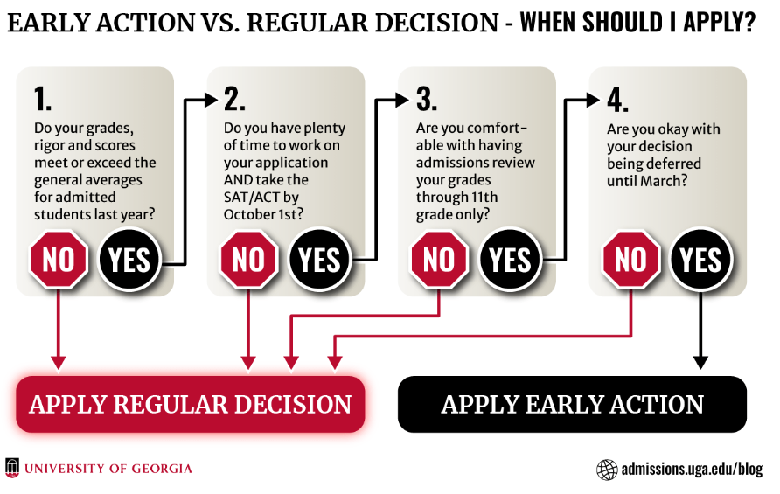

Slide 13
What do I need to apply to college?
Application (+ application fee or fee waiver)
Send SAT/ACT Scores
Official Transcript
Teacher LOR (if required)
Counselor LOR (if required)
Optional or Required Essay

Slide 14
Sending Application Materials
How do I send LORs and Transcripts?
3 steps
Step 1: Request a LOR to be written at https://bit.ly/MHSLOR2027
Step 2: Send your Senior Brag Sheet via e-mail to your counselor
Step 3: Add your counselor as a Recommender and request transcripts directly from your application platform (using Common App, Coalition App, etc.)
Counselors will start fulfilling requests after September 1
If you are applying directly to the college/ institution, request your transcript using ScribOrder at https://fultonga.scriborder.com
**REMEMBER: Allow 10 school days for counselors to write recommendations.
Make a plan of the college application deadlines
and submit your requests for LORs and transcripts ahead of time!

Slide 15
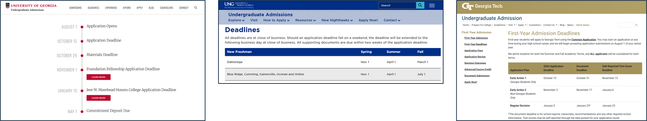
Sending Application Materials
Application deadlines and document deadlines may be different
  Check each college’s requirements carefully
  transcripts deadline, SAT/ACT scores deadline, etc.
PLAN ACCORDINGLY: Many college deadlines are during our school breaks (i.e., Fall Break, Winter Break, etc.)
Popular college application deadlines are October 15th, November 1st, and January 1st
  Counselors are not available to submit materials when we are off-contract for breaks
  Request your materials needed from your counselor 10 days AHEAD of your college’s deadlines
  NOTE: Counselors often have a later deadline to turn in their materials (i.e. LORs, transcripts, etc.)
  DO NOT MISS YOUR DEADLINE for your application because you are waiting on materials!

Slide 16
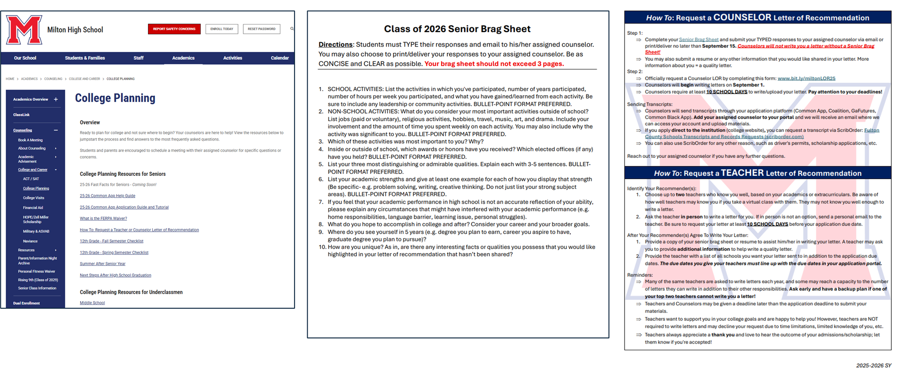
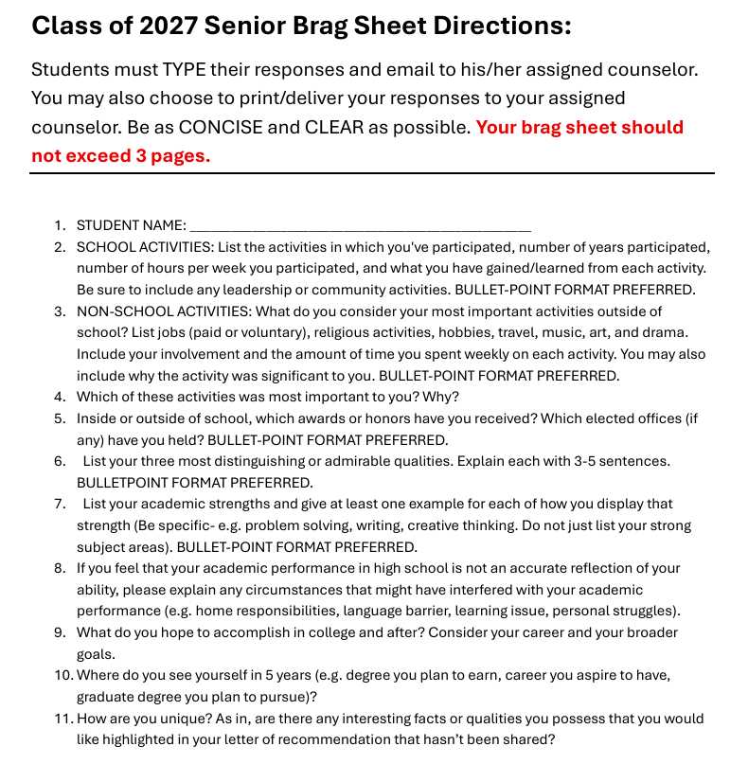
Application Resources
Find these resources on https://milton.fultonschools.org/academics/counseling
*Senior Brag Sheet is due 9/15 for all students, regardless of deadlines
Senior Brag Sheet is due to your counselor by Sept. 15 for all seniors, regardless of deadlines

Slide 17

Applying To College
College-Bound Student Athletes
Are you planning on participating in intercollegiate athletics at an NCAA Division I or II institution?
Register with NCAA Eligibility Center
  https://www.ncaa.org/eligibility-center/
Send SAT/ACT test scores to NCAA Clearinghouse
Review the NCAA requirements on the NCAA website
  They may differ from FCS’ graduation requirements
Be aware that the NCAA Eligibility Center may not accept courses taken via Fulton Credit Recovery (FCCR), Georgia Credit Recovery, or other online programs. If you need to recover a failed course → Summer School, Fulton Virtual School, and Georgia Virtual School are available options

Slide 18
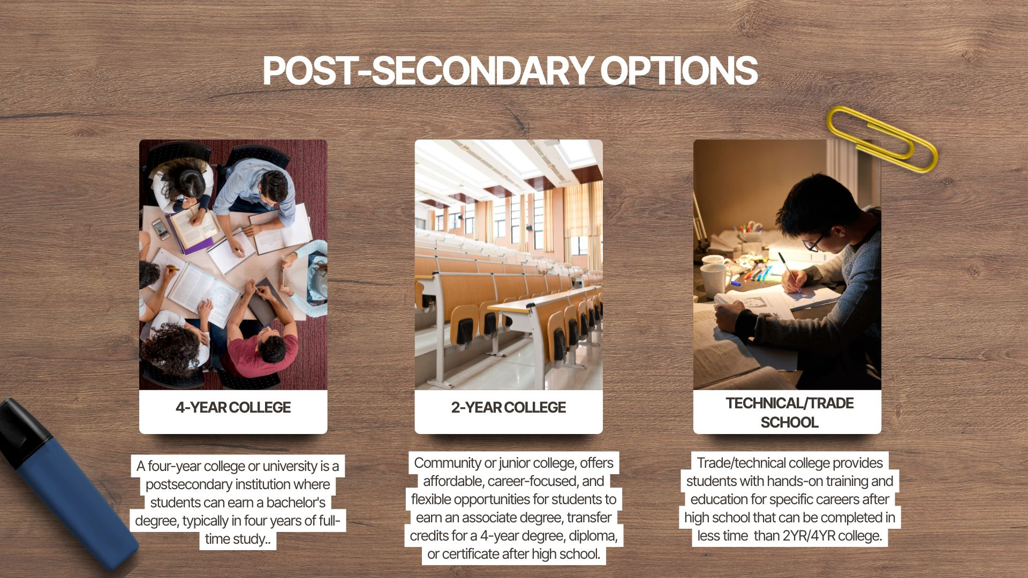

Slide 19
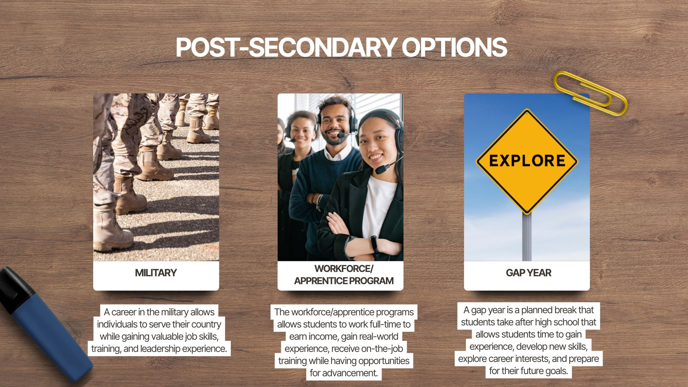


Additional Post-Secondary Options
Gap Year
Trade
Travel Abroad
Volunteer
Mission Work
Peace Corps
Construction
Electrician
HVAC
Metal-Work
Mechanic
Certificate Programs
Military
ASVAB in Fall or Spring
Paid College
Travel the world
Esthetician
Cosmetology
Medical Assistant
Dental Assistant

Slide 20


Slide 21

SchooLinks is the college & career planning program platform for all Fulton County students. Use it to explore and research careers, in-depth college information, and take personality tests!
You will use SchooLinks to complete the required graduation tasks

Slide 22
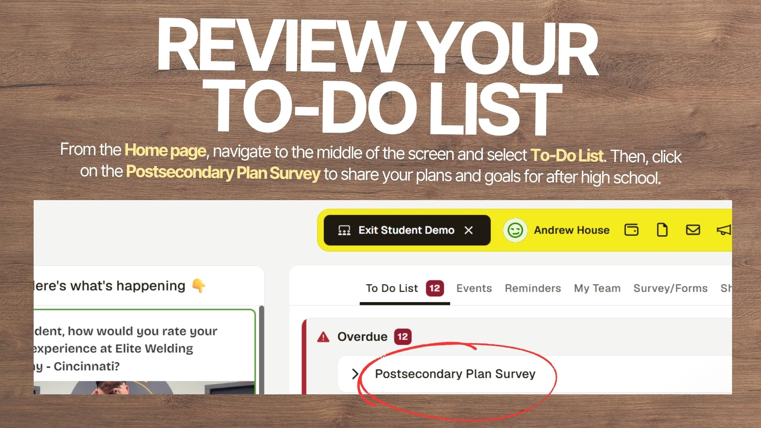

Slide 23
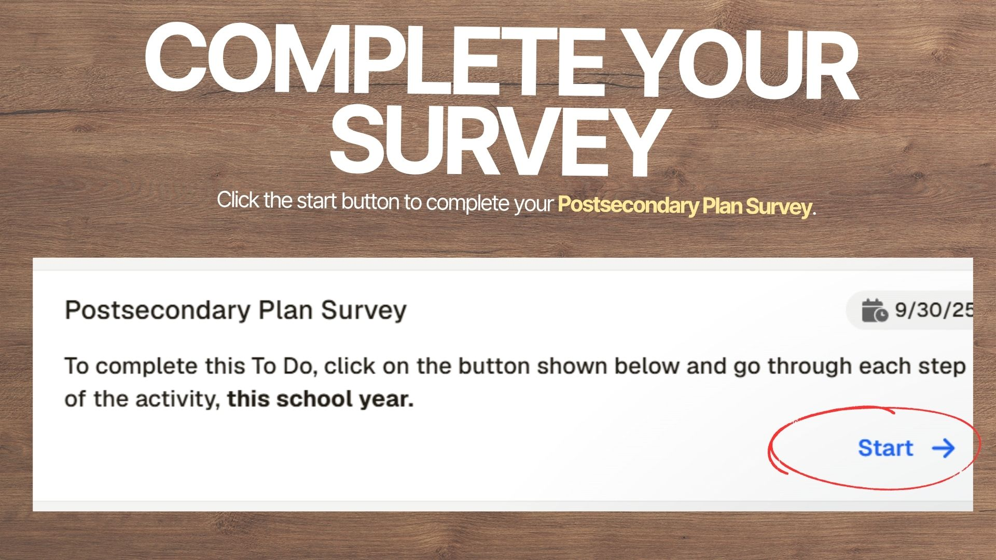

Slide 24


Understanding Financial Aid
I probably don’t qualify for aid; should I apply anyway?
Yes! Many families don’t think they qualify, but they do! Your parent(s) and you will need to complete the FAFSA to be eligible for specific loans.
2. Do I have to reapply for financial aid every year?
Yes! Most schools will send a renewal application after the first year
3. What is the earliest date I can submit my financial aid paperwork?
FAFSA opens on October 1, 2026 for students who are entering college for the 2027-2028 school year
4. Do I need to start the financial aid process before I start my applications?
Ideally, yes!
Discuss your family's financial situation and goals before applying to schools
Helps with scholarship applications, conversations with school-specific Financial Aid Offices, and more
5. What is Merit-Based vs. Need-Based Aid?
Merit-Based is earned through accomplishments
Need-Based is earned through financial circumstances.

Slide 25
Financial Aid
Georgia’s HOPE Scholarship Program
How to Apply for HOPE:
Complete the Free Application for Federal Student Aid (FAFSA) each year at studentaid.gov/h/apply-for-aid/fafsa
Complete the Georgia Student Finance Application (GSFAPP) at gafutures.org
HOPE Scholarship | Zell-Miller Scholarship | HOPE Grant | Zell-Miller Grant
Use at 4-Year Colleges Must have 3.0 Unweighted Core GPA upon graduation Meet 4 rigor course requirement Will pay a percentage of tuition up to 15 credit hours for public institutions Will pay a stipend amount towards tuition at private institutions | Use at 4-Year Colleges Must have 3.7 Unweighted Core GPA upon graduation Meet 4 rigor course requirement Earn a 1200 in one sitting of SAT or 25 in one sitting of ACT Will pay full amount of tuition for public institutions Will pay a stipend amount towards tuition at private institutions | Use at 2-Year or Technical Colleges Not required to graduate with a specific GPA Must maintain a 2.0 GPA at checkpoints in college to keep Will pay a percentage of tuition | Use at 2-Year or Technical Colleges Not required to graduate with a specific GPA Must maintain a 3.5 GPA at end of each term in college to keep Will pay full amount of tuition

Slide 26
Financial Aid
Georgia’s HOPE Scholarship Program
What Counts?
HOPE GPA is your skinny, ugly, GPA
Calculates only Core Classes
-- English
-- Math
-- Science
-- Social Studies
--World Language
Middle School courses are NOT included
No GPA rounding
2.999 ≠ 3.0
Important Details
Calculated by the Georgia Student Finance Commission
Final GPA determined after graduation
Honors/AP/Dual Enrollment weighting removed
Extra 7-point weight does not count
Monitor your 4-credit rigor requirement
HOPE GPA at GAFutures.org
Check your current
How to monitor the status of your HOPE rigor courses: Log on to GAFutures.org to view your rigor course count Use your transcript in IC and count your rigor courses Resources available about the HOPE Scholarship at: HOPE/Zell Miller Scholarship - Milton High School

Slide 27
Mental Health MATTERS!
Preparing for the future is important, but so is your mental health
Consider your workload and cut where necessary.
You don’t win any awards for being the first to break down over the stress!
Take time to pursue your interests beyond planning for your future:
Quality time with family, friends, pets
Community service
Exercising
Reading / Writing
Cooking
Gaming / Art
Practice healthy coping mechanisms:
You are not alone! Lean on others
Take walks
Meditate
Yoga/Breath Work

Slide 28

Know When to A.C.T.
  All students receive the Signs of Suicide Lesson in 9th grade in Fulton County. The primary focus is to empower students to recognize the warning signs in themselves or others, and ACT accordingly:
Trusted Adults at Milton High School:
School Counselor
Teacher
Administrator
Coach
Mentor
Trusted Adults outside of Milton High School:
Parent/Guardian
Adult Relative
Coach
Church Leader

Slide 29

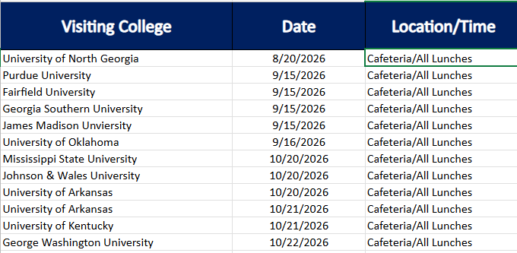
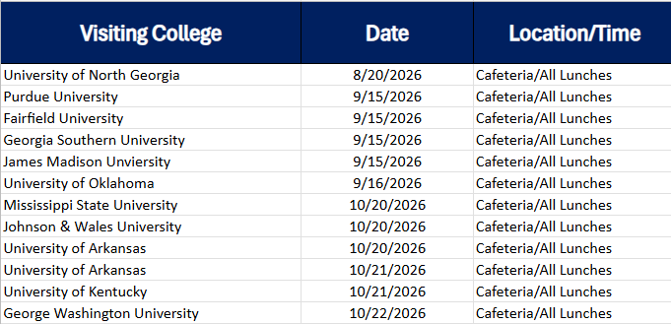
Save The Dates
Every Third week in the month, counseling will be hosting colleges on Tuesdays/ Wednesdays/ Thursdays during all lunches!
View the list of colleges visiting Milton here: https://milton.fultonschools.org/academics/counseling/college-and-career/college-visits

Slide 30



Slide 31
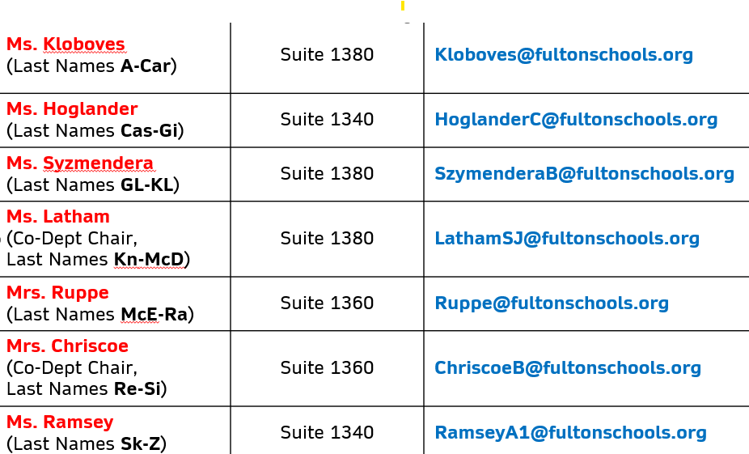
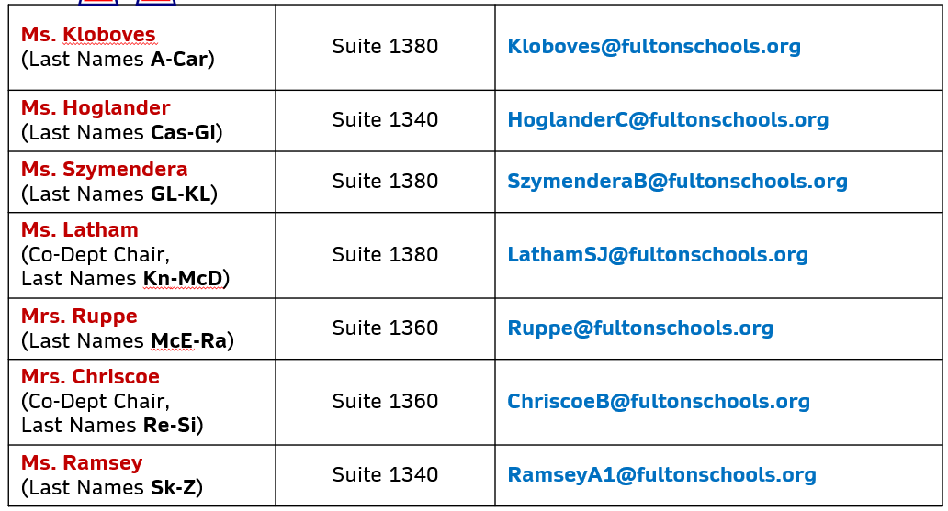
Questions?
If you have a specific or private counselor question,
visit the counseling website to schedule a meeting with your assigned counselor:
Thanks for your attention!

