Slide 1

General Fund
Five Year Forecast
July 1, 2026 Through June 30, 2031
August 19, 2026
Presented By:
Carmen Siefring, Treasurer

Slide 2
O.R.C. and O.A.C. Requirements
O.R.C. 5705.391 and O.A.C. 3301-92-04
    HB96, our current state budget, changed the dates and years of a district forecast submission.
    HB96 requires a Board of Education to submit a four-year projection of operational revenues and expenditures along with assumptions to the Ohio Department of Education prior to October 15th and an update by end of February of each fiscal year.
    In Fy27, the filing dates moved to August 31 and an update February 28.
    Required funds to be included in the five-year forecast are:
        General Funds (001)
        Any special cost center associated with general fund money
        Emergency levy funds (016)
        Any debt service (002) activity that would otherwise have gone to the general fund
    Our district will continue to utilize a five-year forecast and planning horizon.

Slide 3
Purposes and Objectives of the Forecast
Engage the Board of Education and community in long range planning and discussions of financial issues facing our schools.
To serve as a basis for determining the school district’s ability to sign the certificate required by O.R.C. 5705.412, commonly known as the “412 certificate”.
To provide a method for the Ohio Department of Education and Auditor of State to identify school districts with potential financial problems.

Slide 4

Before we get to the numbers …
A financial forecast is somewhat like a painting of the future based upon a snapshot of today.
The five-year forecast is viewed as a key management tool and should be updated periodically.
In a financial forecast, the numbers only tell a small part of the story. For the numbers to be meaningful, one must review and consider the Notes and Assumptions before drawing conclusions or using the data as a basis for other calculations.
The five-year forecast encourages district management teams to examine future years’ projections and identify when challenges will arise.
This helps district management to be proactive in meeting those challenges.

Slide 5
Key Line Items
The five-year forecast is divided into two sections: revenue and expenditures.
A district’s revenue is made up of two main sources, local and state funding.
The expenditures are mainly salary and wages, benefits, purchased services, and supplies and materials.

Slide 6
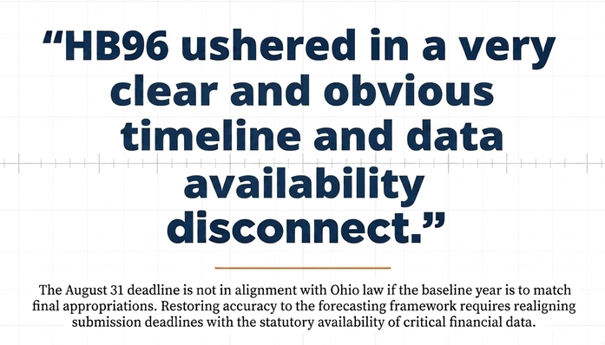

Slide 7

New August and February Forecast Filing Deadlines Inhibit Accurate Forecasts
February, 2026: we had no data on HB186 and no 1st half tax settlements.
August, 2026: we have HB186 forms but no 2nd half tax settlements to verify payment of taxes...for potential major adjustments.
New forecast rules require baseline year to match district final appropriations.
State Law allows district to have appropriations final by September 30.
The August forecast should be no earlier than September 30 NOT August.
February forecast update we will likely never have the final 1st half settlement a complete mismatch for key data.
In state budget years sitting governor state budget deadline January 31, newly elected March 15. We will have little or no idea what is being proposed.
With former May date we would see the governor’s proposal, the house and the Senate for an idea what state funding may be in the future.
It appears the decision to move the filing dates From November and May was as ill conceived as the raft of confusing and convoluted new property tax laws.

Slide 8
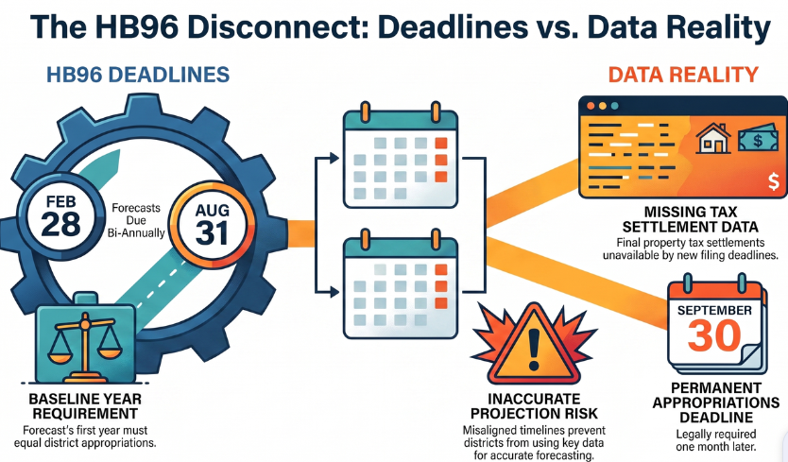
Projecting the Best We Can with Key Data Unavailable at Forecast Deadlines

Slide 9

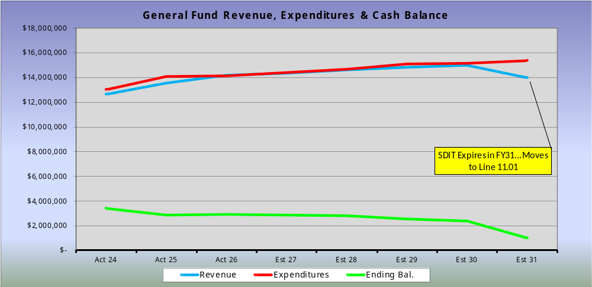
Revenue vs Expenditure
HB186 & Piggyback impact
New legislation HB96 Piggyback and HB186 impacting district.
New property tax laws reduce taxes and threaten our finances.

Slide 10
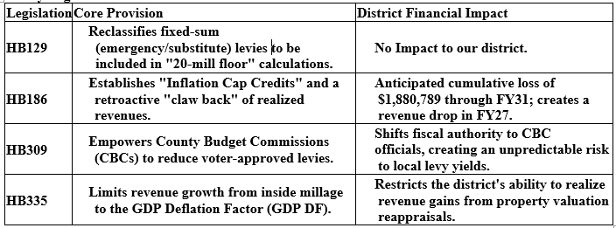
New Legislation Targets Property Taxation
Governor signed into law four (4) pieces of legislation December 19, 2025:
  HB129 / HB186 / HB309 / HB335
New laws took effect March 19, 2026.

Slide 11
HB186 Targets Property Taxation Retroactively
Caps property tax growth at the 20-mill to inflation using the GDP deflator plus new construction over the three preceding tax years.
Applies in counties undergoing reappraisal/update in tax year (TY) 2025 and thereafter.
Guarantees impacted school districts receive the same amount in property taxes as they received in TY2024; applies this guarantee in TY2025 for TY2023 reappraisal/update counties and TY2025 and TY 2026 for the TY2024 counties. Tax Year 2025 revaluations like we just had are not eligible for reimbursement.
If applicable, ODEW will make payments in August 2026 and 2027 to ensure affected districts receive at least the same real property tax revenue as in TY2024.
We anticipate HB186 will cost us $626,930 in FY27 and possibly an additional $1.88 million through FY31 due to retroactive caps back to our last reappraisal/update…No final 2nd half settlements yet to verify.

Slide 12
HB186 Targets Property Taxation Retroactively
We are not estimating a guarantee payment with HB186.
FY27 expected to take the brunt of the HB186 implementation.
The TY2025 credit applies entirely against the second-half tax bill…most likely September or October due to new tax laws.
Will incur 100% of the TY2025 revenue loss in FY27 when the second-half payment for TY2025 is due.
Later in FY27, will incur 50% of the estimated TY2026 revenue loss when the first-half Feb/March 2027payment is due.
In FY28 and years thereafter, the more conventional pattern of 1st half and 2nd half settlements should resume.
Does not retroactively adjust local capacity in state funding formula to account for lower effective assessed value due to tax claw backs creating a "double loss" for districts (less local revenue, less state aid).

Slide 13
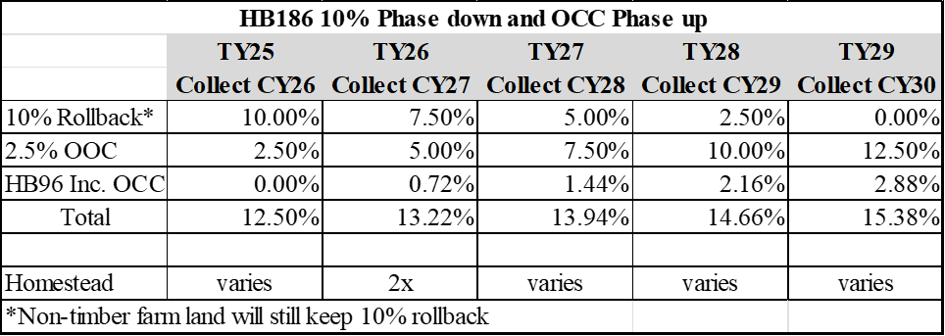
HB186 Changes to Rollback & OOC Structure
10% Rollback and 2.5% Owner occupied tax credit structure.
Largely revenue neutral to the district until tax year 2029 payable in 2030 when owner occupied credit will be net 2.88% higher than todays combined 12.5% Rollback credit.
By 2030 local taxes for Class I will fall 2.88% and state reimbursements increase by the 2.88%....should be revenue neutral for our district and give a small decrease in taxes to home owners paid for by the state.
HB479 (eff. 9/30/26) Doubles Homestead for 1 year with reimbursement

Slide 14
HB309 Expanded County Budget Commission Power
Allows CBCs to reduce and override any voter-approved levy (except debt) to bring the taxes levied within levels the CBC finds reasonable and prudent to avoid unnecessary or excessive collections.
Unnecessary collections: collections beyond the reasonably anticipated financial needs of the taxing authority, after considering fund balances, projected expenditures, and other available resources.
Excessive collections: collections at a rate that exceeds what is required to provide services consistent with statutory obligations.
Public Hearing Requirement: The CBC must give the taxing authority an opportunity to present information at a public hearing before any reduction.
Preceding Year Collection Floor: A levy may not be reduced below the amount it collected in the preceding year unless the district has funds available from reserve balance accounts, nonexpendable trust funds, or carryover balances to offset a reduction.
Exclusion of Debt Levies: The CBC is prohibited from modifying all levies for unsatisfied debt charges under this authority.

Slide 15
HB335 Capping Inside Millage Growth
Caps revenue growth from inside millage to inflation, measured by the GDP deflator over the prior three years in reappraisal/triennial update years.
Excludes revenue growth from new construction and from expiring abatements.
Applies beginning in tax year 2026 for counties undergoing a reappraisal or triennial update.
Requires the county budget commission, in September of the reappraisal or update year, to make this adjustment.
By projecting increases in our forecast of reappraisal/triennial updates at anticipated GDP deflator we do not expect adjustment to our projected tax revenues.

Slide 16
Funding Schools in the Future
With these new property tax laws, districts must reassess levy strategy, timing, and eligibility.
Prohibits a school district from submitting a new money current expense levy to voters if its general fund carry-over balance is more than 100% of general fund expenditures in the preceding fiscal year.
Allows a district to exclude funds to be used within the next 3 years on permanent improvements from the carry-over balance calculation.
Modifies ballot language to include the percentage and amount of district’s general fund carry-over balance for a school district current expense levy.
Renewals with an increase and replacement levies eliminated.
Fixed sum (former emergency & substitute) levy renewals permitted for up to five years if in existence prior to 2026.
New emergency levy authority eliminated for districts not in fiscal distress.

Slide 17
FY26-FY27 State Budget & Piggyback Exemptions
HB96 the current state budget provided no increase in foundation funding. Only small amounts outside the formula.
HB96 included a Piggyback Tax Exemptions law that allows County Commissioners to give a 2nd tax credit for Homestead and Homeowners 2.5% credit without reimbursement.
The Piggyback exemption for homestead was approved by the Miami County Commissioners and will cost our district $129,250.
The Piggyback Exemption can be approved annually by July 1 for the commissioners and presents another uncertainty about property tax collections.

Slide 18

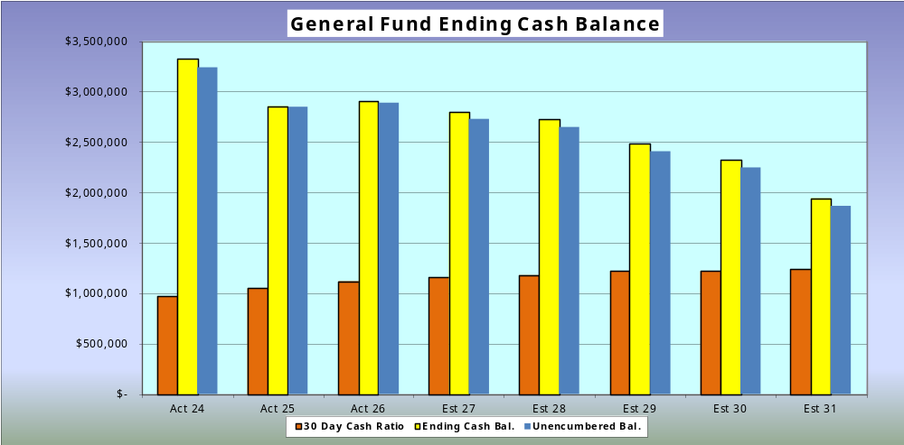
Ending Cash Balance
30 to 60-day cash balance a responsible target to end year.
No less than $-0- required by Ohio law.

Slide 19

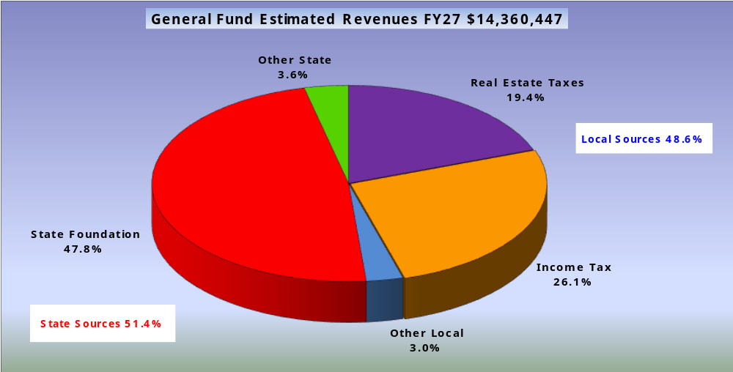
Est. General Fund Revenue Sources FY27
HB96 has us on the formula in FY26.
We must watch FY28-FY29 biennium budget carefully.

Slide 20
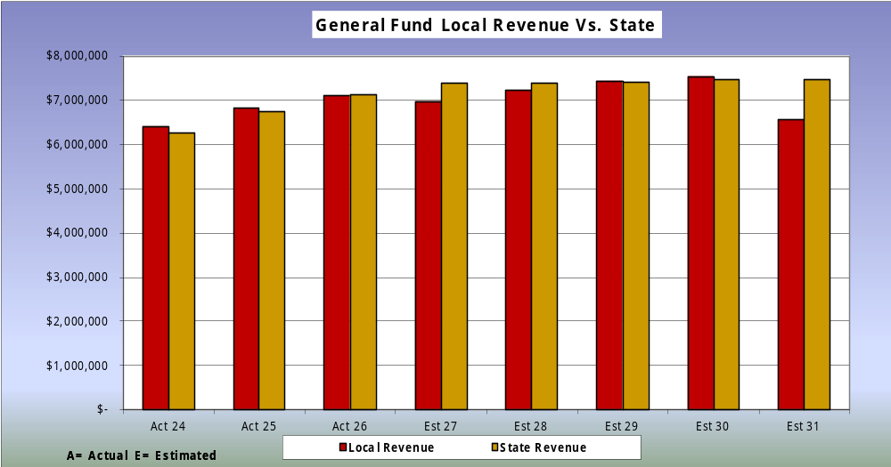
Local vs. State Funding
Our district is roughly 50/50 funded locally and state.
HB186 new property tax law reduces taxes starting in FY27.

Slide 21
Operating Revenue
As already highlighted HB186 the new legislation will cut taxes for our district.
HB96 continued the fair school funding plan we have no idea if it will be continued or funded in the FY28-29 state budget.
HB96 the fair school funding plan had us on the formula in FY27 if the state keeps the current formula and does not fund it, we will ultimately be on the guarantee.
Total revenue is estimated to grow by 1.123% annually over the next 5 years while expense are estimated to grow by 2.220% a year.
Enrollment growth will not result in new revenue for our district as increases in local capacity will likely offset any increase district in FY27.
With the new property tax legislation there is no good news about revenue in FY27 through FY31.

Slide 22
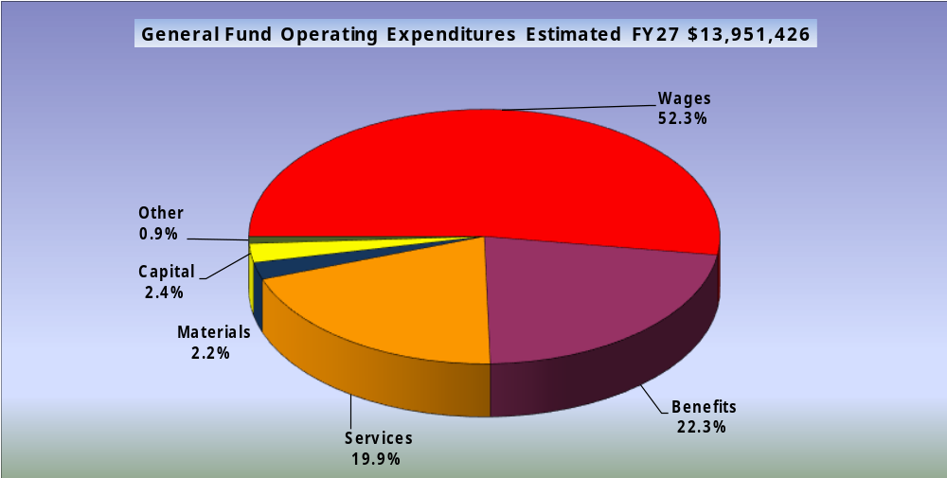
Est. General Fund Expenditures FY27
Wages and benefits are estimated to be 74.6%.

Slide 23
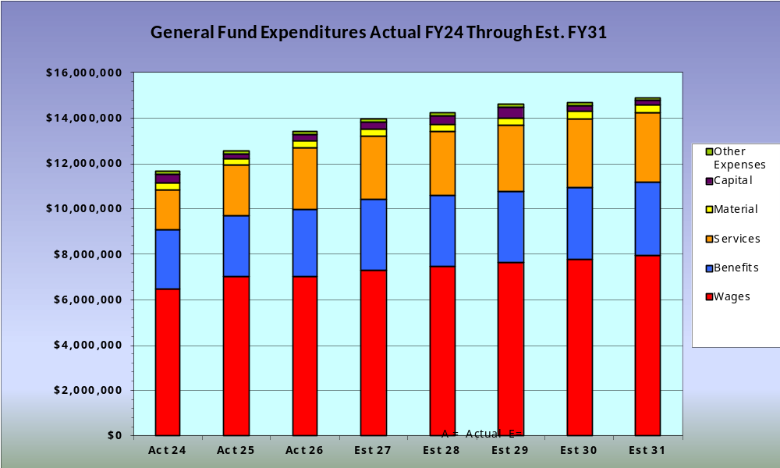
General Fund Expenditures By Object FY24 through Est. FY31
  Expenses increasing across all categories average 2.22% annually

Slide 24

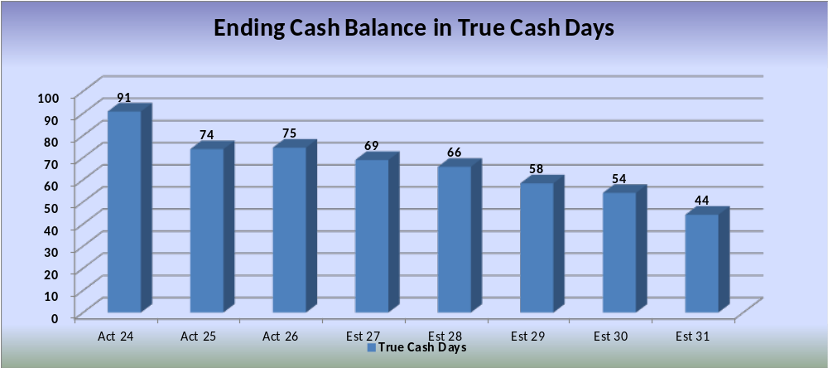
Ending Cash Balance
GFOA recommends 60 true cash day balance 30 days long term is a reasonable target.

Slide 25
Our District Financial Story Overview
HB96 continued the fair school funding plan FY26 & FY27.
Current funding has us on the formula through FY27.
Future funding is uncertain still for FY28-31 as Fair School Funding Plan not funded beyond FY27.
51.4% of our revenue from the state of Ohio and 48.6% from local sources.
Revenue growing 1.123% and expenses 2.22% unsustainable long term.
New property tax reforms that became law March 19, 2026 are going to reduce property taxes for our district.
The new property tax reform laws will limit growth on future reappraisals and make it harder to pass new levies and renew existing levies.
If the state cuts or reduces our state funding and severely impacts our ability to raise local funding…our district will need to make cuts and/or pass new levies in response to maintain our instructional programs.
Our local revenue and ability to manage the district is under threat as a result of the recent property tax legislation.
Under the new tax laws and lack of state funding we are projecting a positive cash balance in FY31 of the forecast with SDIT renewal.

Slide 26
Thank You for Listening
Questions and Answers

