Slide 1
Site council meeting
8-25-26

Slide 2


Agenda
Welcome to Site Council
Enrollment and Staffing
Data
Focus for 2026-2027
Looking Ahead
Tax Credit Vote
Questions, Thoughts, Concerns…

Slide 3
Site Council
Welcome
In-Depth Quarterly Summaries (State of the School)
Ideas and Discussion

Slide 4
Introductions
Who are you?
What is your role (on-campus), or what is your profession?
What do you love about our school?

Slide 5
“New” and New Bridges Faces
Sunni Braaksma- 6th Grade ELA
Taylor Ahles- 4th Grade Math and Science
Rick Hagan- Crosswalk
Olivia Meicke- 3rd Grade
Bryce Paulson- Plant Foreman
Jackilyn Arnold- Lunch Aide
Martin Trainor- Behavior Intervention Specialist
Azaria Ford- Psychologist
Matt Frahm- IT
Jackie Barbere- 5/6 Resource
Paige Haggard- 4th Grade ELA and Social Studies

Slide 6

Enrollment Update
Open-Enrollment: 433
In Boundary: 299
Year 1- 525
Year 2- 700
Year 3- 715
Year 4- 740
Year 5- 723
Year 7- 756
Year 6- 732
Year 8- 775
Year 9- 775
Year 10- 771
Year 11- 732

Slide 7
AASA ELA Passing Percentage Ranking
School | Rank
Bridges | 1
School A | 2
School B | 3
School C | 4
School D | 5
School E | 6
School F | 7
School G | 8
School H | 9

Slide 8
AASA Math Passing Percentage Ranking
School | Rank
Bridges | 1
School A | 2
School B | 3
School C | 4
School D | 5
School E | 6
School F | 7
School G | 8
School H | 9

Slide 9
Letter Grade
Coming soon…

Slide 10
Bridges Elementary School “Why”
At Bridges Elementary School, we believe in equipping all students with the skills they need to thrive in the ever-changing 21st century workplace.

Slide 11
“How to Prepare the Next Generation for Jobs in the AI Economy” -Harvard Business Review - June 05, 2017
"With AI taking over routine information and manual tasks in the workplace, we need additional emphasis on qualities that differentiate human workers from AI - creativity, adaptability, and interpersonal skills."
“At the elementary level, that means we need to emphasize exercises that encourage problem solving and teach children how to work cooperatively in teams. Happily, there is a lot of interest in inquiry-based or project-based learning at the elementary levels."

Slide 12
Standards for Sustained Excellence
1. Why?:
  We are driven by a cause that is much bigger than any one individual, or even the whole organization, as the future of our world is in our hands.
  We are committed to preparing our students for the unpredictable and ever-changing 21st century workplace.
2. Infinite Game and Growth Mindset:
  We consistently reflect upon and refine our practice.
  We are always willing to try something new.
  We regard potential as limitless, in the fact that there is always room to grow.
3. Valuing and Appreciating Others:
  We are a people-centric community that cares about and supports one another.
  We strive to build meaningful connections with all.
  We take time to have fun and enjoy those around us.
4. Collective Teacher Efficacy:
  We believe impactful ideas and best practices should be shared.
  We ensure collaborative teamwork is a priority.

Slide 13


Slide 14
Purpose
Rooted in Your "Why": Ground your mindset in the original passion that drew you to education.
Fueled by Connection: Draw energy from positive relationships with students, staff, and families.
An Impactful Gift: Embrace the daily opportunity to shape lives and make the world a better place.
Intentional Joy: Dedicate time to finding fulfillment and happiness in the work, even during challenging times.

Slide 15
GRIT
Embrace the Adversity: Challenges are inevitable; our success is defined by how we choose to respond.
The Infinite Game: Commit to being continuous learners who always strive to improve and get better.
A "Can-Do" Attitude: Navigate tough times with fortitude, staying focused on the big picture.
The Circle of Control: Focus energy exclusively on our reactions, emotions, words, and actions, and let go of the rest.

Slide 16
Rigor and Relevance
Intentional & Rigorous Instruction: Maximizing academic potential through engaging, differentiated lessons and the Rigor and Relevance Rubric.
Data-Driven PLCs: Dissecting priority standards, analyzing CFAs, and targeting intervention and enrichment to drive student achievement for ALL learners.
Tiered & Small Group Learning: Using daily cumulative review and mandatory small group instruction to support ALL learners.
PBL & STEAM at the Forefront: Committing to four PBL projects per year (one per quarter) and regular utilization of the Makers' Place. Culminating events in Quarters 3 and 4 (STEAM Night and STEAM Day)

Slide 17
Professionalism
The Foundation: Professionalism is the "glue" that sustains our long-term success.
Daily Excellence: Focus on being our best professional selves every single day (in planning, logistics, and relationships).
One United Team: Commit to a culture of "all build up all"—elevating and supporting each other positively.
Resilient Partnership: Be each other’s biggest fans and teammates through the inevitable ups and downs of the school year.

Slide 18
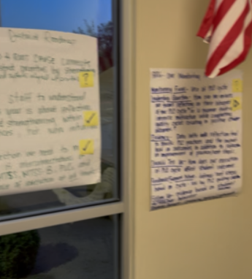
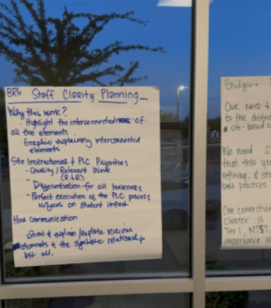
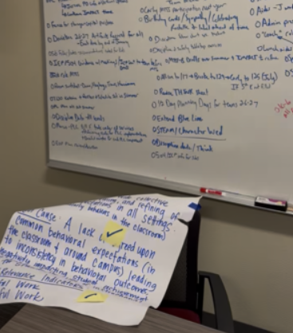
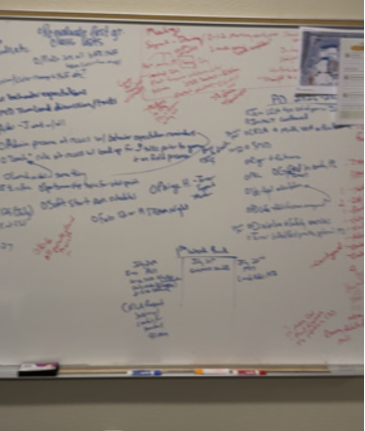
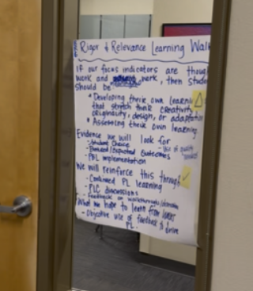
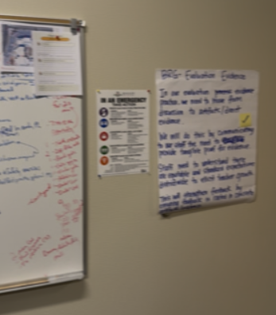
The “Lab”
Intentional Planning and Preparation all Summer!

Slide 19

The "Lab" Focus Areas – Continual Improvement Driven by Data, Survey Input, Leadership Team Input, District Vision, Law, HUSD Policy, and Best Practices Related to what is Best for Students
Instruction & Coaching
PLC Process
Systems Improvement
IMPACT Committees
Fun!
MTSS-B
Safety

Slide 20
School Improvement Process
Comprehensive Needs Assessment, Survey Data, Achievement Data, Discipline Data
Leadership Team Dissection
Root Cause
Analysis

Slide 21
School Improvement Process
Comprehensive Needs Assessment, Survey Data, Achievement Data, Discipline Data
Leadership Team Dissection
Root Cause Analysis
Root Cause Determination
Integrated Action Plan
Professional Learning Plan
Your Input was Integral and Dissected Heavily in this Process!

Slide 22
IAP Components Connected to Goals
Mathematics
  Bridges Elementary School will increase schoolwide math proficiency to 81% from 78.6% in 2024-2025 and 79% in 2025-2026 as evidenced by AASA performance for 3rd through 6th grade students by the end of the 2026-2027 school year.
ELA
  Bridges Elementary School will increase schoolwide ELA proficiency to 81% from 77% in 2025-2026 as evidenced by AASA performance for 3rd through 6th grade students by the end of the 2026-2027 school year.
PLC/MTSS Implementation
  Bridges Elementary School will implement the PLC and MTSS process (includes all tiers of MTSS both academically and behaviorally) with fidelity and systematically, resulting in weekly or bi-weekly PLC meetings for every grade level (including Specials and Special Education), supported by evidence of PLC cycle progress tied to student achievement submitted to Microsoft Teams at the culmination of each meeting (PLC document will be provided for teams to complete, with an emphasis placed on student outcomes).

Slide 23
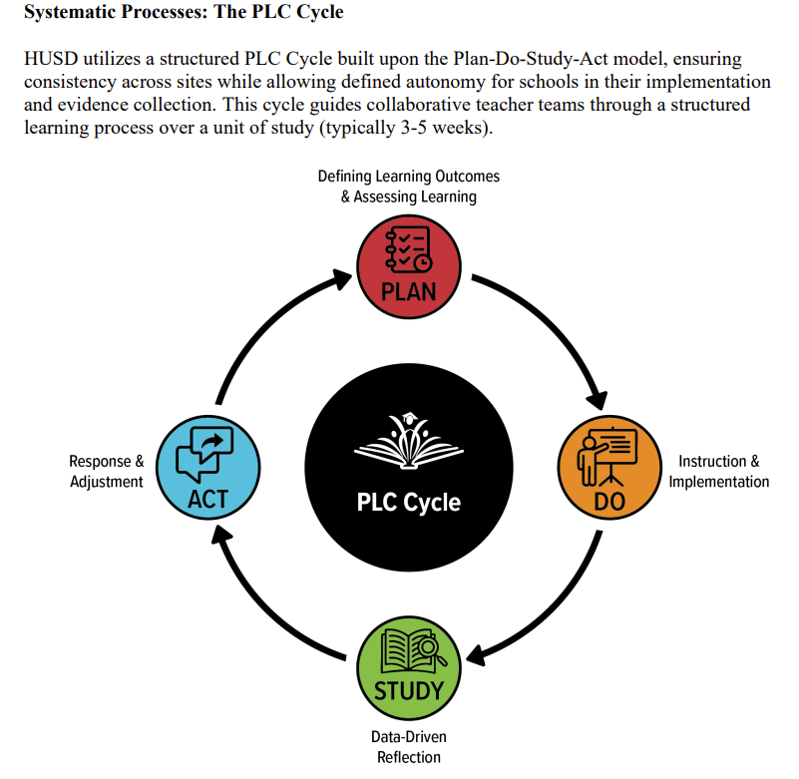

Slide 24
Campus Impact committees
Leadership Team
PLC IMPACT Committee
Healthy Culture and Climate IMPACT Committee
MTSS-B and Safety IMPACT Committee
STEAM/PBL Future-Focused Instruction IMPACT Committee

Slide 25

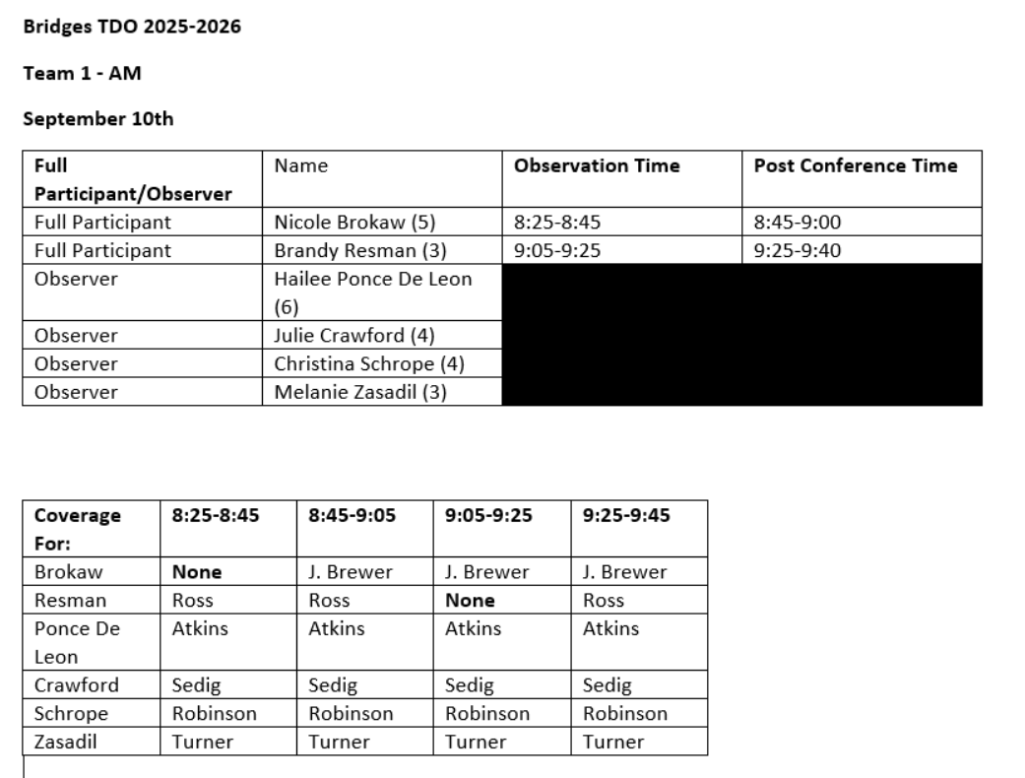
Teacher driven observation
Every Bridges teacher will participate in TDO this year
Takes place on Wednesdays with a New team of teachers (approximately 5-8 per group) during each rotation

Slide 26
Project Based Learning and STEAM
Expectation of 4 PBL units per grade level per year (1 per quarter saved in Teams Project Based Learning Folder)
Expectation of 1 use (minimum) of makers place per semester (schedule with Donna)
STEAM Night is making a comeback on February 11th from 5-6:30pm- All Teachers Expected to Attend
Plan to have PBL products to display for STEAM Night
STEAM Day will occur as in house showcase during 4th quarter as a culmination event showcasing PBL projects from the year
Parents working in STEAM related fields will be sought to participate for STEAM Night
Future-Focused Instruction/STEAM/PBL Campus IMPACT Committee will support with planning each event
Dedicated PL time for continued growth, and planning related to PBL and STEAM

Slide 27
Future Focused Forums
Once per month
Designed to reinforce our Keys to Success, open student eyes to career pathways, and build community
Community leaders in various fields will participate in a Q and A style forum at an assembly
  STEAM/Engineers
  Entrepreneurs
  Professional Athletes
  Healthcare Workers
  Veterans and First Responders
  Lawyers
  HUSD MS and HS Principals, District Personnel, and Superintendents
  Former Student Leaders

Slide 28
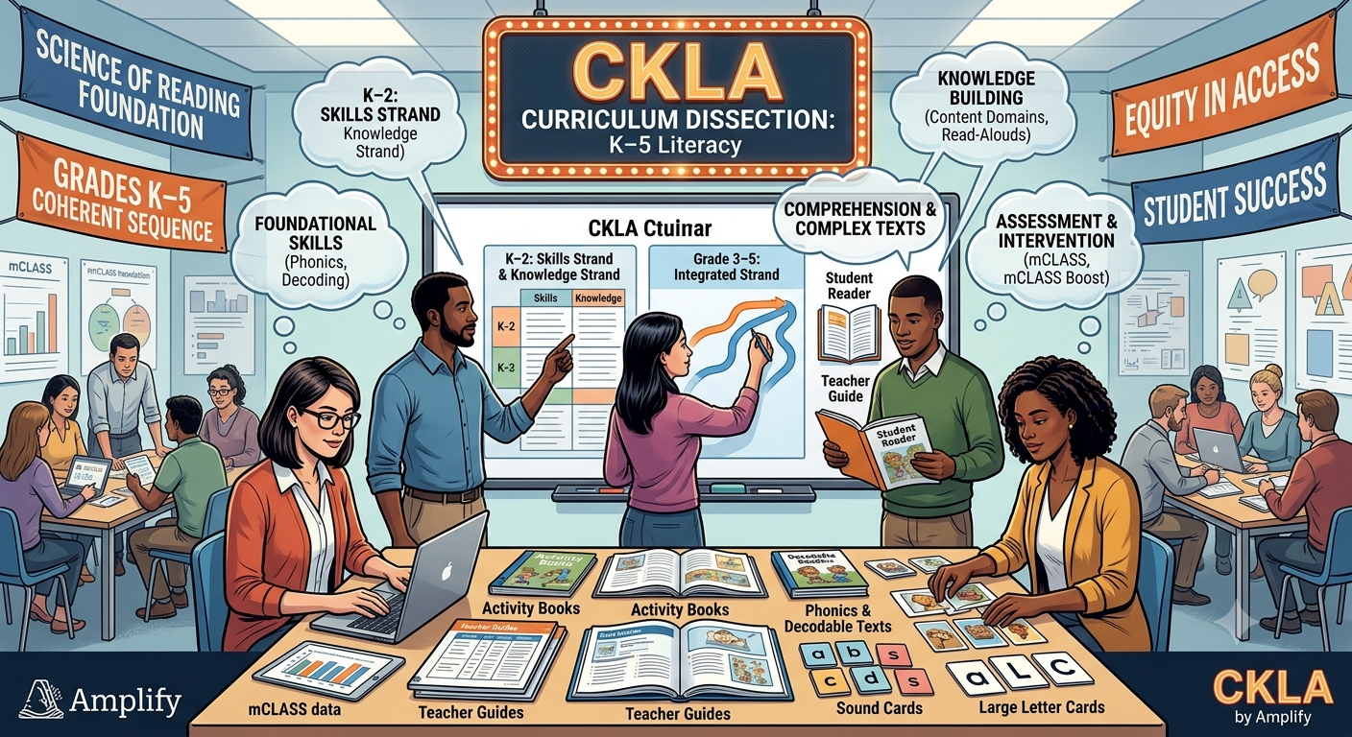

Slide 29

Positive Student Behavior Encouragement and Recognition Systems
Character Lessons- Specials Team
Ongoing Positive Recognition for Students
  Schoolwide expectation to submit Student of the Month nominations (resulting in 250+ for the year)
  Winners recognized in front of peers each month
  Medals given to winners
  Extra recess for winners
  Tracking system for SOM recipients for their years at Bridges
  Boo-Yah Tickets
  Stickers

Slide 30

Bobcat Pledge
As a Bobcat, I choose to be
Safe in my actions,
Respectful with my words,
Responsible in my choices, and
A 21st Century Learner in all I do.
I will work hard, help others, work cooperatively, and think critically.
These are our Keys to Success, and I will use them to make a positive difference in our school and community.

Slide 31
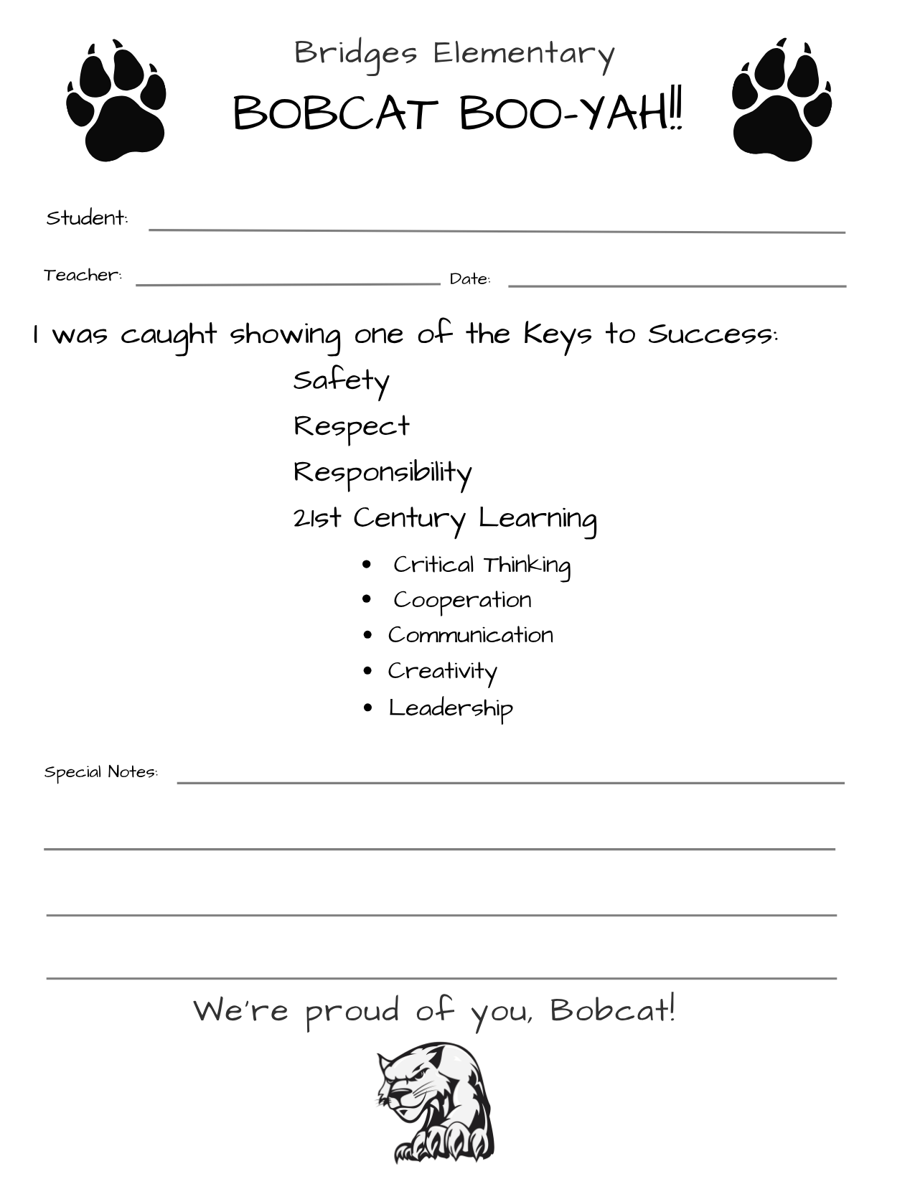





Expectations and Behavioral Tools
Student Behavioral Expectations Matrix

Slide 32
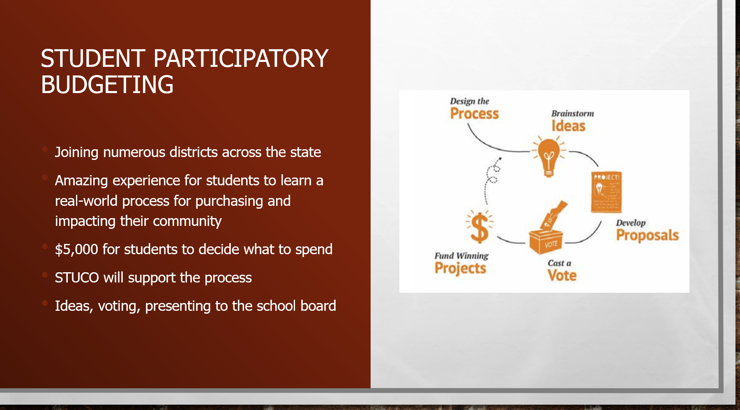

Slide 33

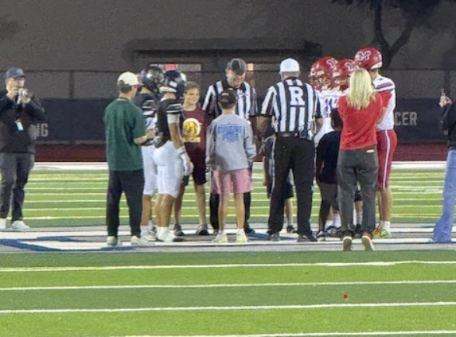
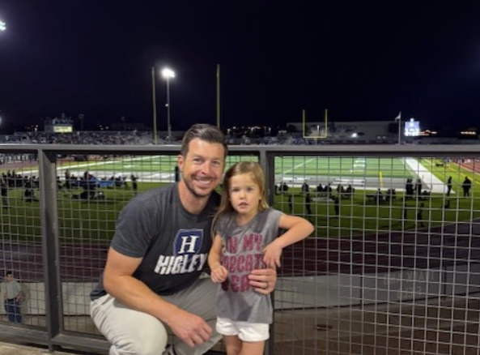
Vertical Feeder Collaboration
Bridges night at hhs September 11th vs. Casteel
HHS Football Bridges night
STUCO attending HHS Assembly
Shirt swapping with administration
Feeder concerts
Field trip to HHS for a play

Slide 34
Where do we go from here?
Continued emphasis on positive connections between all humans on campus (staff, students, parents, community)
Ensure all students are growing
Targeted instruction to fill gaps, reinforce, and enrich:
Ongoing and targeted cumulative review
Reincorporation of target standards
Creation and implementation of CFA’s
Utilization of modified intervention systems based on achievement data

Slide 35
Looking ahead at 2nd Quarter
Trunk or Treat + Movie Night
Fun Run
Concerts
Letter Grade

Slide 36
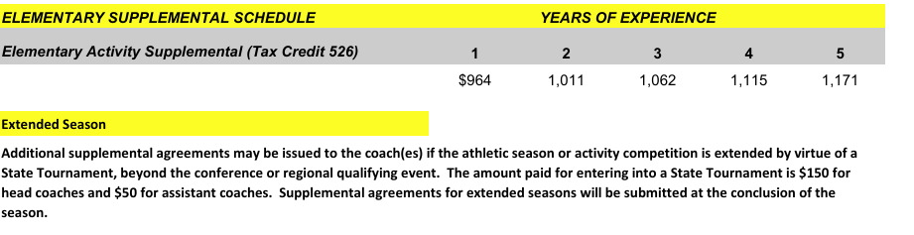
Stipend schedule
Undesignated Tax Credit Account Balance= $32,448.94

Slide 37
Tax credit vote
Garden Club- Shauna Hamman-4 years complete, this is 5th year $1171
Garden Club- Amber Moore-4 years complete, this is 5th year $1171
STEAM- Clauda Henze 2 years complete, this is 3rd year $1062
STEAM- Brandy Resman- 2 years complete, this is 3rd year $1062
Future Cities- Sunni Braaksma- zero years complete, this is 1st year $964
Future Cities- Hailee Ponce De Leon -zero years complete, this is 1st year $964
Student Council- Brandy Resman-five years complete, this is 6th $1171
Student Council- Leslie Boston -zero years complete, this is 1st year $964
Robotics- Felecia Mendoza- one year completed, this is 2nd. $1011
Robotics- Christina Schrope- zero years complete, this is 1st year $964

Slide 38
Questions, Comments, thoughts?
Thank You For
Your Time!

