Slide 1
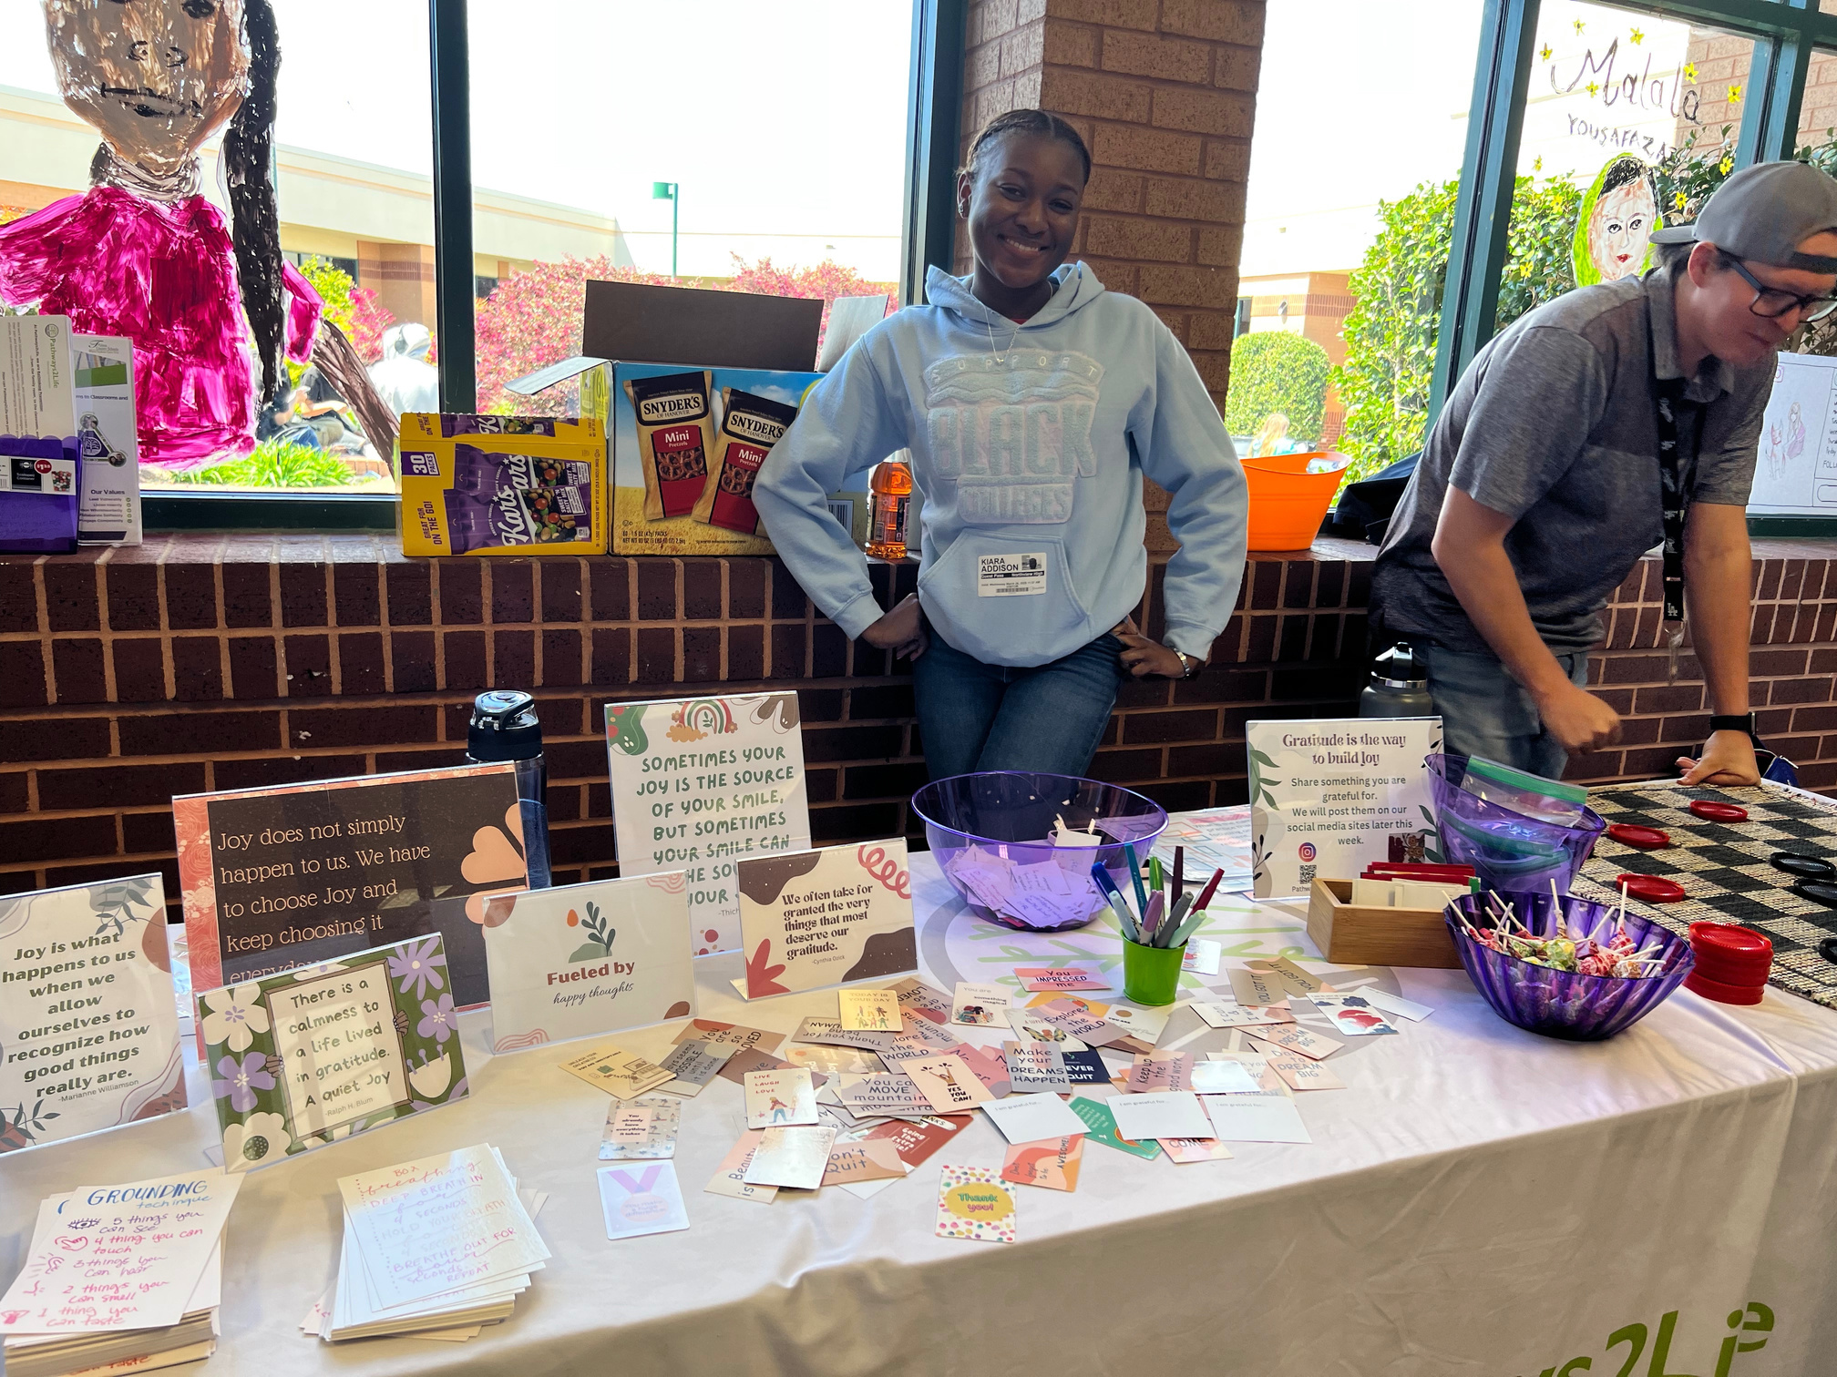
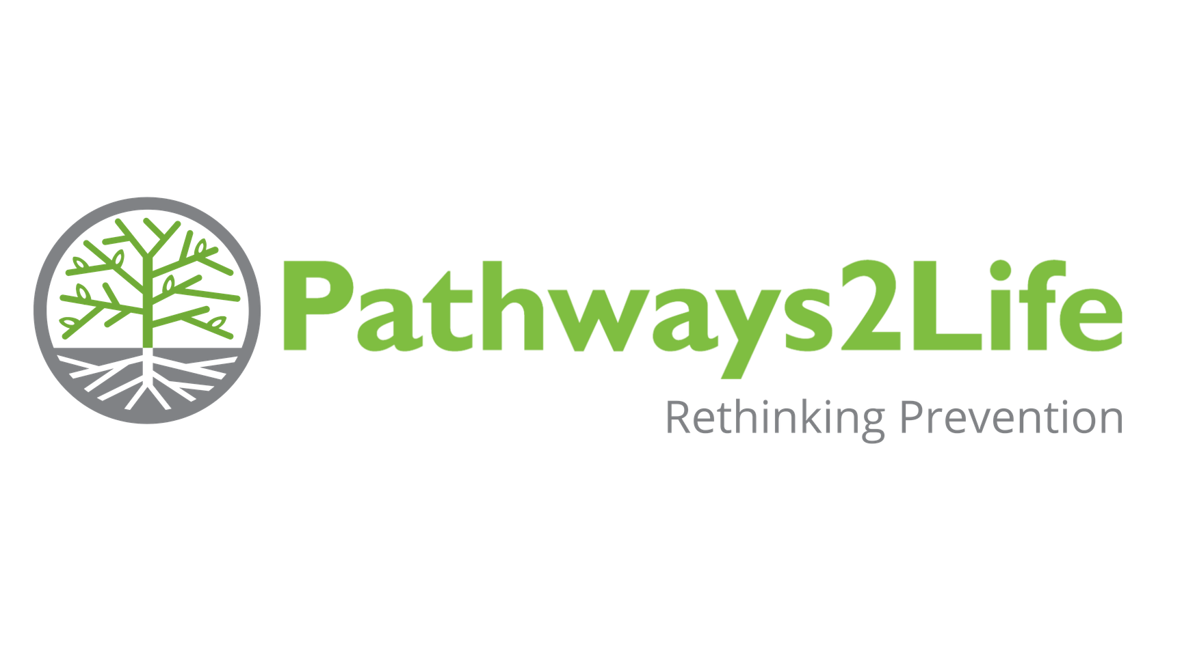
Pathways2Life at Northview
  Prevention Education
  Trusted Connection
  Practical Support
Notes:
Pathways2Life is a prevention and early-intervention organization that walks alongside students, families, schools, and communities.
At Northview High School, our role is much broader than delivering a single program.
We provide classroom education, leadership opportunities, mentorship, individual support, restorative discipline, and resources for families.
Our goal is to create meaningful connections with students while giving them practical tools to recognize risks, make wise decisions, and move toward a healthy and hopeful future.

Slide 2


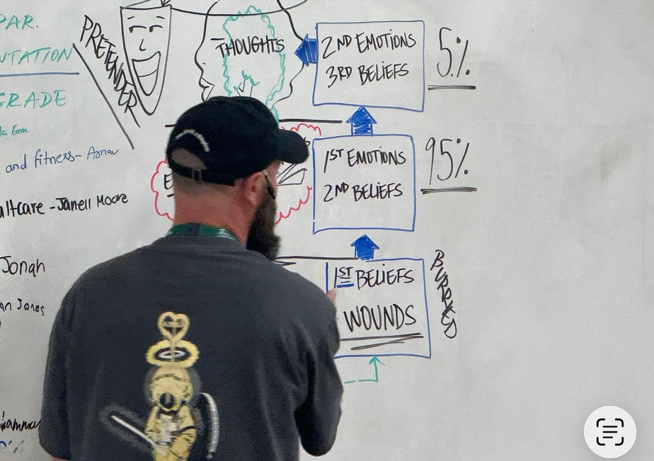
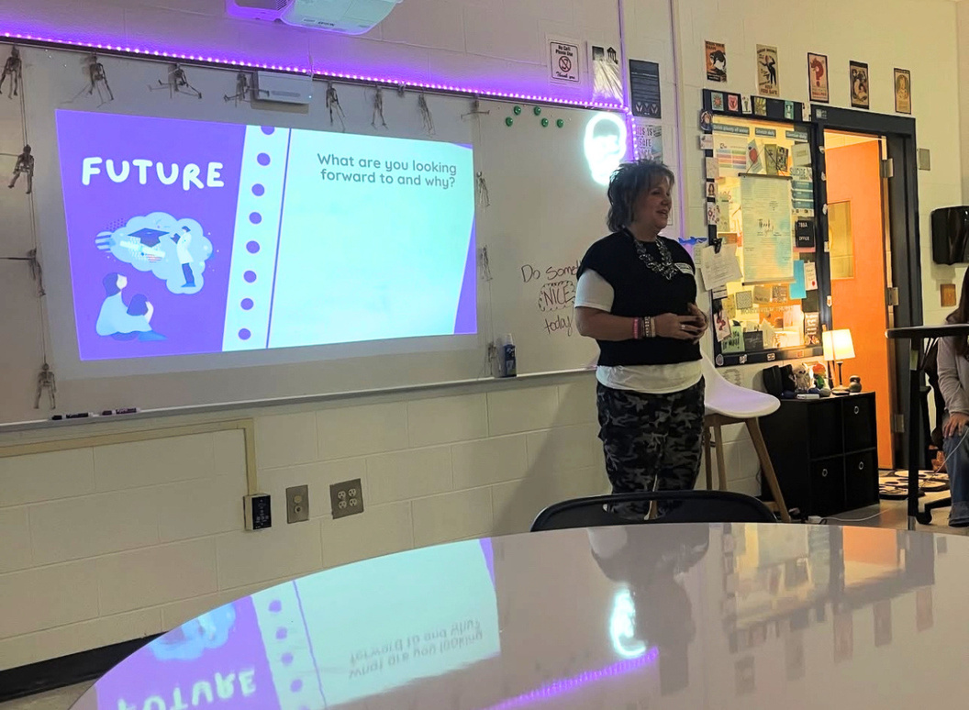
In the Classroom
Health Class (CODA)
Mental Health Professional Class
Notes:
A major part of our Northview partnership happens in the classroom.
Each semester, Pathways2Life teaches six Health classes using the CODA curriculum.
These lessons address real decisions students face, including relationships, alcohol, drugs, risk, and the consequences of everyday choices.
We also teach six sessions in the Mental Healthcare Professional class.
There, the emphasis is on caring for yourself first so you are prepared to care for others.
Students explore emotional intelligence, mental health, self-awareness, and healthy responses to stress.
Across both settings, the goal is not simply to share information.
We want students to develop judgment and life skills they can use immediately and carry into adulthood.

Slide 3

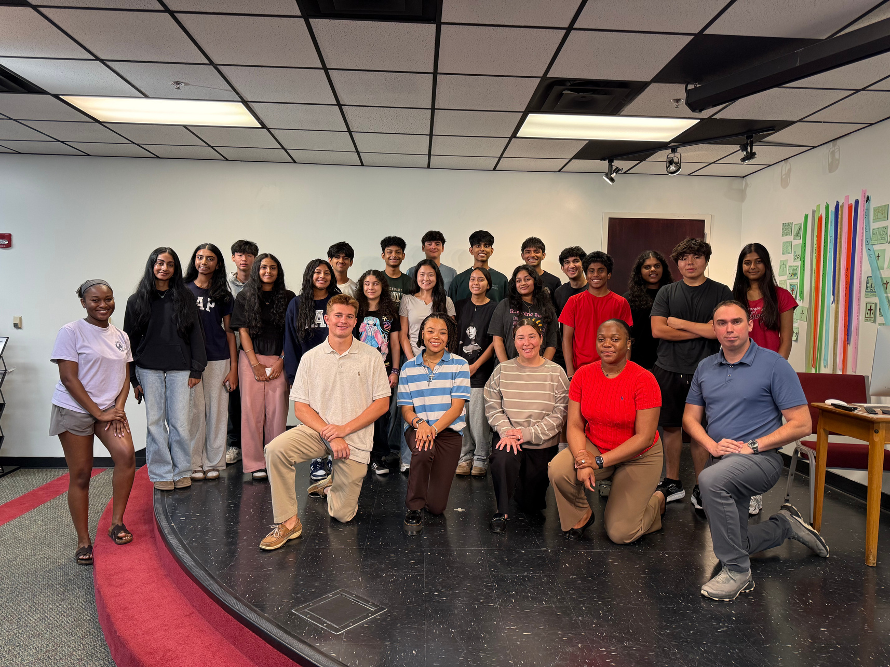
Beyond the Classroom
Student Internship and Thrive Ambassadors
Wellness Tables and Events
Notes:
Our connection with students continues well beyond classroom instruction.
Pathways2Life runs a year-long internship for 20 to 24 students, most of whom attend Northview.
Interns contribute to community events, media, workshops, and policy projects while developing leadership experience and a stronger student voice.
Interns contribute to community events, media, workshops, and policy projects while developing leadership experience and a stronger student voice.
Interns are also apart of the Thrive Ambassadors Program which is a Fulton County Initiative that gives voices to the students allowing them to be representatives of and create change at their respective schools from a district perspective.
Wellness lunch tables give students another approachable way to connect with us on campus several times each semester.
Together, these programs create consistent access to trusted support.

Slide 4

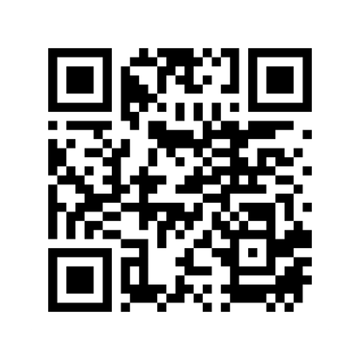
Parent and Student Support
A focused response to vaping, substance use and behavioral infractions-built around reflection, accountability, and better choices.
  Healthy Communication
  Conflict Resolution
  Friendships and Relationships
  Boundary Setting
Restorative Discipline
90%
of student’s report reducing use of nicotine, alcohol, and other drugs
- P2L Post Survey data 2023-2026
Notes:
We also meet individually with students and parents to listen, identify needs, and determine practical next steps.
Students who want additional encouragement can participate in four to six mentorship sessions, typically about 45 minutes each.
When a student needs more focused intervention, Pathways2Life offers a three-session Restorative Discipline program for vaping, substance use, and behavioral infractions.
Rather than focusing only on punishment, the program helps students reflect, accept accountability, understand risk and protective factors, and choose better next steps.
Pathways2Life post-survey data from 2023 through 2026 shows that 90 percent of participating students reported reducing their use of nicotine, alcohol, and other drugs.
We also support parents and guardians through three one-hour Parent and Family Sessions focused on healthy communication, conflict resolution, and boundary setting.
These student and family supports work together to help people repair relationships, reconnect, and move forward.
To learn more or request support, visit pathways2life.org.

