Slide 1

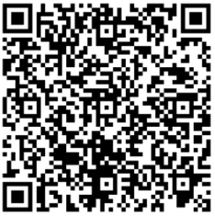
Questions?
Please scan the QR Code to submit questions:
We will post the FAQ next week on our Northview Counseling website

Slide 2


Slide 3

Northview High School
Counseling Department
Senior
Information Meeting
Class of 2027
Don't forget to follow us on Instagram!
@Northviewcounseling

Slide 4
  Meet Your Counselors
  Graduation Requirements
  Researching Colleges
  College Admission Standards
  College Application Process
  Transcript Request Procedure
  Scholarships & Financial Aid
  Resources
Topics for Discussion

Slide 5
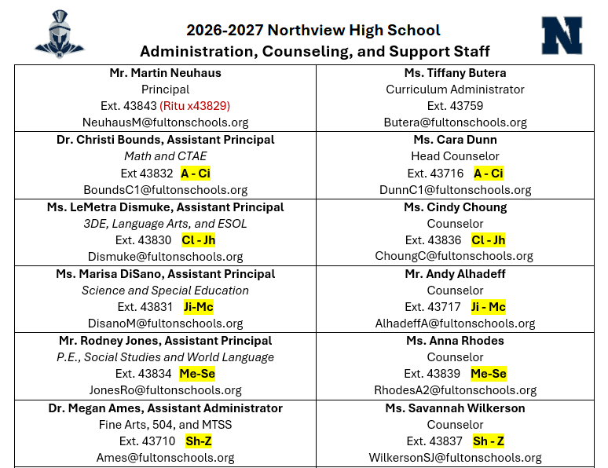
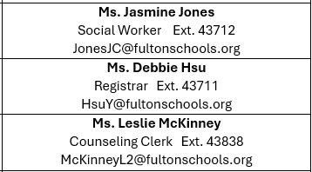
Counselors and Administrators

Slide 6
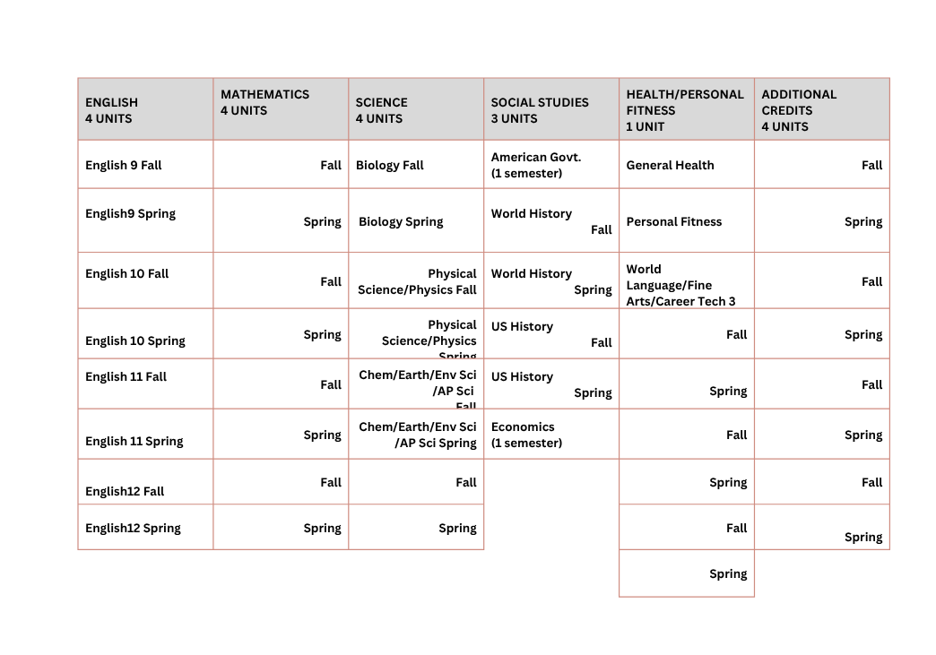
Graduation Requirements

Slide 7
Post-Secondary Options
  Gap Year
  Military
  Workforce
  Technical/Trade School
  Two-Year and Four-Year College/University

Slide 8
Gap Year
A gap year is a period in which recent graduates take a yearlong break to engage in other educational and/or meaningful experiences or activities such as:
  Experiencing new cultures through travel.
  Joining the Peace Corps or other service/volunteer programs.
  Participating in a Gap Year Program such as college bridge year programs.
  A Gap Year should not be seen as a period in which a student does nothing. Students should intentionally plan for their Gap Year and seek out opportunities that will add to their personal and or educational development and growth. Students who take a GAP year can still apply to college and defer their admissions.
Military
The military offers access and training for hundreds of careers! By joining
one of the US Armed Forces, students will not only earn a salary but
benefits, money for college, and the opportunity to travel.
Requirements: Armed Services Vocational Aptitude Battery (ASVAB) scores
determine qualifying careers
  More Information:
  https://www.todaysmilitary.com/ways-to-serve/service-branches
  https://www.defense.gov/About/our-forces/
Post-Secondary Options (continued)

Slide 9

  Research Colleges and Universities
    Virtual Tours & Representative Visits
    Consider location (In-state/Out-of-state)
    Consider schools that match your personality, interests, and career goals
  How Many?
    Narrow your list to somewhere around 4-8 colleges
    List should be balanced, including safety, target and reach schools.
  Check Admissions Data
    View the school profiles and compare the admissions data to your own academic record and test scores.
    Utilize SchooLinks
Narrowing Down Your College List

Slide 10
Where Should I Apply?
Dream/Reach School
  Less than 30% chance of admission
  Your Academic Record/Test Scores are below average
Target/Good Fit School
  30%-60% chance of admission
  Your Academic Record/Test Scores are in line with average
Safety School
  Greater than 60% chance of admission
  Your Academic Record/Test Scores are above average
  You should have at least one safety school
  A highly selective school should not be considered a safety or target school

Slide 11

  Early Action – Invites early applications and receives early notice of decision. If accepted, student is not obligated to attend.
  Early Decision – Invites early applications and receives early notice of decision. If accepted, student is obligated to attend and withdraw all other applications. Students may only apply to ONE early decision school.
  Regular Decision – applying during regular admission, not early. Deadlines typically begin in January.
  Rolling Admissions – applications are reviewed as they're sent in; there is no hard deadline by which you need to submit your application.
Types of Admission

Slide 12
Georgia MATCH in GAFutures
Helping seniors connect directly with colleges
What is Georgia Match?
A direct admissions program in GAfutures that shows seniors which Georgia public colleges and technical colleges they are eligible for admission based on a student's HOPE GPA.
Students receive a personalized Georgia Match letter and can view potential schools in GAFutures starting in October.
How to Apply:
    Log in to GAFutures to review your matches
    Select "Claim Your Spot!" button next to the institution(s) you are interested in.
    GAFutures will submit your details to the institution(s)
    The institution will communicate with you about their required steps to apply.
For more information visit: https://www.gafutures.org/college-planning/georgia-match/georgia-match/
    *GT, UGA, and GCSU do not participate in this program.
    *Being matched does not guarantee admissions.

Slide 13
How Am I Being Evaluated/Application Components
  Numeric Average – Typically a recalculated average of all academic core courses on a 4.0 scale (English, Math, Science, Social Studies, and World Language).
  Course Selection (rigor; difficulty level) – Colleges are looking at the strength of your courses throughout high school, including your senior year.
  Test Scores (SAT and/or ACT) - Please check the institutions' admissions page for additional info regarding test optional. Students are responsible for sending their official standardized test score to the college/university.
  Extracurricular Activities/Community Involvement/Volunteer/Awards/Recognition – Leadership and participation in clubs, service, and sports can be particularly important to competitive colleges.
  Essays – Required essays on the college application are important because they demonstrate your writing ability and give the college more information about you. Please seek advice when writing an essay and be sure to proofread for errors.
  Letters of Recommendation – Most committees prefer letters from core academic teachers in your junior or senior year. Some college/universities will require a counselor letter of recommendation.
  Interviews
College Admission Standards

Slide 14
  Fulton County reports on a 100-point scale
  Contact each college/university to determine how the numeric average/GPA is calculated
  Most use the following to calculate numeric average onto a 4.0 GPA scale: A = 4.0, B = 3.0, C = 2.0, D = 1.0, F = 0.0
  Many postsecondary institutions only consider academic courses (ELA, Math, Science, Social Studies, World Language)
  Some colleges/universities may remove the additional 7 points added for Honors, AP and college courses.
Numeric Average/Grade Point Average
High School GPA used for postsecondary admissions on a 4.0 scale is calculated by the postsecondary institution, not the high school (Fulton County does not calculate).

Slide 15
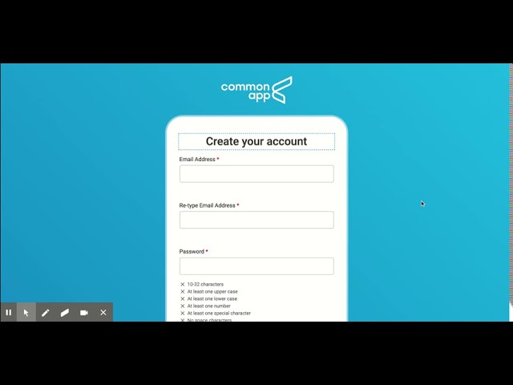
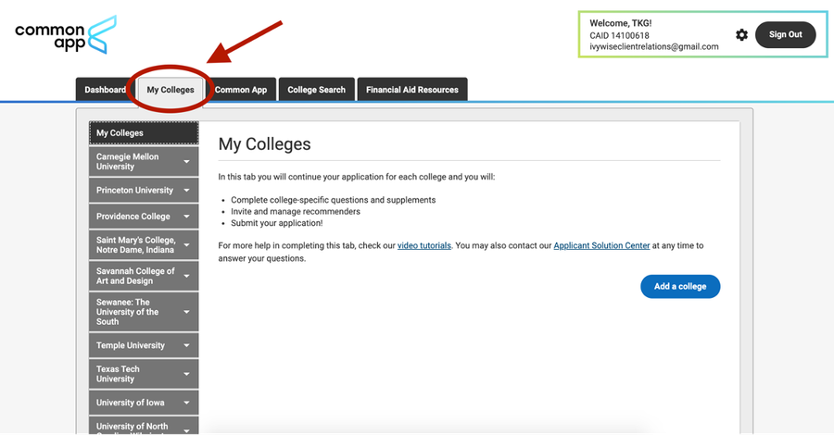
Common App: Creating an Account and Adding Colleges
Use your personal email address when creating an account
Link for how to get started:
  https://www.commonapp.org/apply/first-year-students

Slide 16
  Log in to Common App
  Click My Colleges Tab
  Click College Name
  Click “Recommenders and FERPA”
  Complete your “Release Authorization”
  Click “Invite Recommenders”
  Under the Teacher section, type in Teacher’s email address
  *You will only need to do the FERPA Agreement once.
  *For all non-Common App schools, you must follow the college's procedures for mailing, emailing, or uploading LORs. You are responsible for managing this process.
Requesting LORs from Non-NHS and NHS Recommenders for Common App

Slide 17
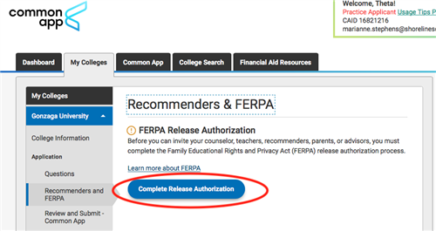
Common App: Letters of Recommendation

Slide 18
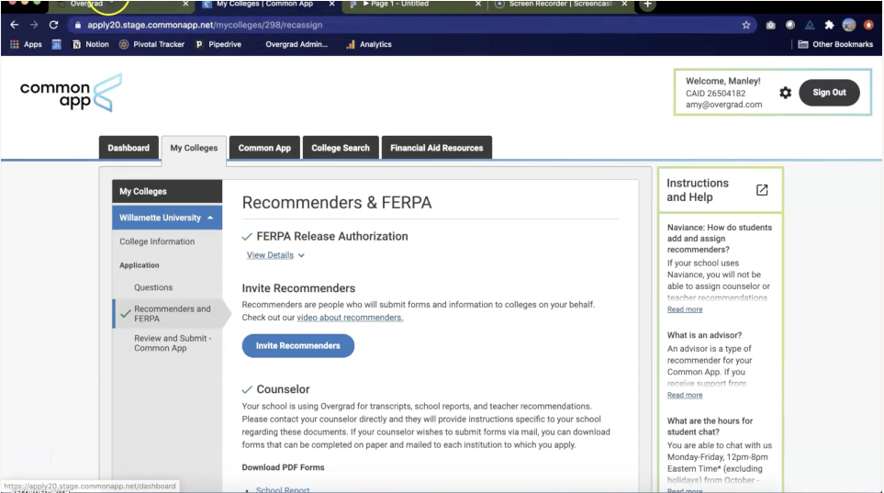
Common App LOR (continued)

Slide 19
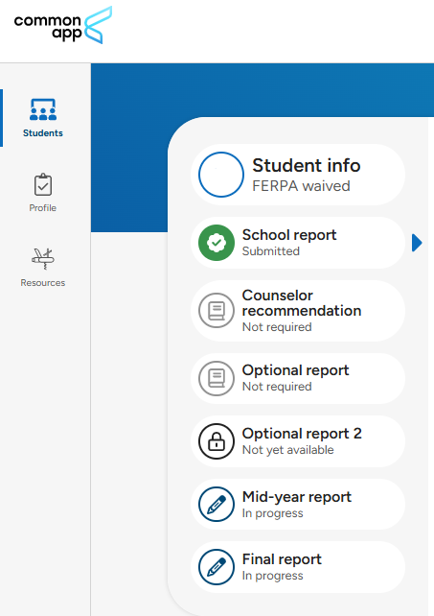
Common App LOR (continued)

Slide 20
  Most transcripts will be submitted on behalf of the student once they add their counselor to the application platform, i.e., Common App, Coalition, etc.
  All other transcript requests, must go through Scrib Order. This includes NCAA, GAFutures, sent to an individual, technical schools, etc. Counselors are not permitted to send a transcript via email.
    https://fultonga.scriborder.com/applicationCurrent
Requesting Transcripts

Slide 21

Georgia Futures transcript replaces self-reported grades: Georgia applicants are asked to log in to Georgia Futures and request their transcript be sent to UGA — no counselor approval required.
For additional information including how to request a transcript via GAFutures, why UGA is requesting the transcript in this format, how are grades being reviewed and evaluated, and more, please visit: https://admissions.uga.edu/apply/first-year-applicants/first-year-criteria/gafutures-transcripts/
In Common App, students will be asked whether they will be sending their transcript via GAFutures or not.
As a reminder, counselors will still be submitting the official, weighted transcript via Common App. You the student will need to submit the unweighted transcript via GAFutures.
Please DO NOT request the GAFutures transcript now. We will send out communication when the GAFutures transcripts are ready.
Requesting a transcript for UGA ONLY

Slide 22
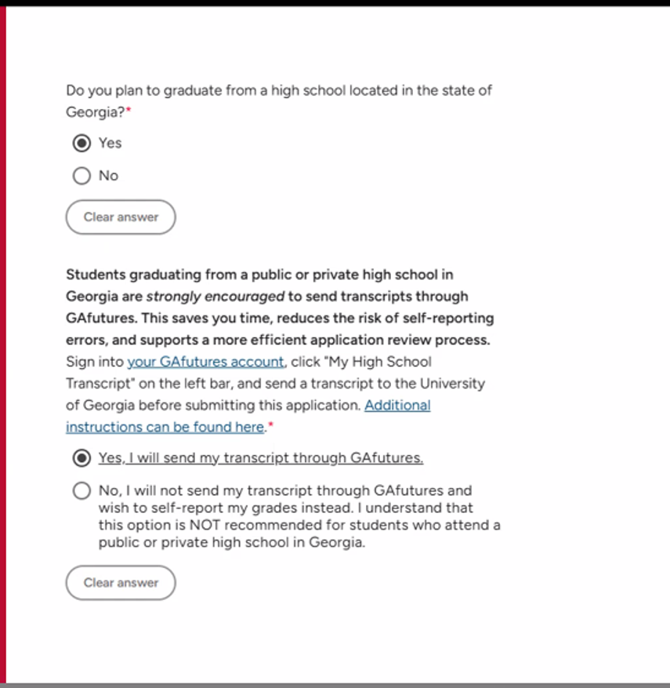
What you will see on Common App

Slide 23
  Students will have 15 school days prior to their application deadline to request the following:
    Transcripts
    Letter of Recommendations
    Counselor Evaluations
  Students who fail to meet this deadline may receive a generic/informational letter of recommendation from their counselor.
  Admissions committees strongly prefer students waive their right to view letters of recommendation and counselor evaluations.
  Counselors use university deadlines to prioritize counselor-related document submissions.
  Students may submit prior to counselor/teacher documents are submitted.
Deadlines & Expectations

Slide 24
  Check your application status and material submission through the provided admission's portal.
  Send any additional application materials, if applicable.
  Review institution-specific scholarships, honors programs, etc. Many schools will have priority deadlines.
  Submit financial aid forms, including FAFSA, Georgia Student Finance Application, and/or CSS Profile (some private schools).
    For HOPE/Zell Miller students will need to complete either the Free Application for Federal Student Aid (FAFSA) or online Georgia Student Finance Application (GSFAPP).
  Review decisions and financial aid offers carefully.
  Make your choice and submit the deposit.
"I've applied, what's next?"

Slide 25
  All seniors need to submit a Senior Information Sheet by September 11, 2026. This document can be found on SchooLinks, under "Events".
  Counselors will use your information sheet for letters of recommendation for any path you choose.
  Be thorough in your responses!
Senior Information Sheet

Slide 26
  Scholarships will be posted to the NHS Counseling website and Instagram page. Check often!
  Financial Aid Night will be held on October 20th, 2026. The FAFSA application will open in October 2026.
  Contact colleges directly about financial aid and scholarship opportunities. Colleges award many renewable scholarships. Ask about criteria, procedures and deadlines.
  To complete FAFSA, learn more about eligibility, types of aid, and more go to http://studentaid.ed.gov/.
  If assigned a temporary social security number upon enrolling at NHS, please contact Ms. Elliott before the end of 1st semester and report your official social security number. This is required to be eligible for HOPE/Zell Miller Scholarship.
Scholarships and Financial Aid

Slide 27
  Partial tuition covered – varies by year
    Payment amount for private & public colleges and universities can be located on www.gafutures.org/hope-state-aid-programs/
  Eligibility Requirements
    Graduate from an eligible high school
    Meet HOPE/Zell Miller US citizenship or eligible non-citizen requirements
    Be a legal resident of Georgia
    GPA of at least a 3.0 (calculated by GSFC) in core classes and world language
    Academic Rigor: Four classes that are academically rigorous
      https://www.gafutures.org/media/apofcfmn/rigor-list-september-2025.pdf
HOPE Scholarship

Slide 28
  100% of tuition covered
  Must meet all the requirements to be eligible for the HOPE Scholarship, plus:
    Graduate from an eligible high school
    GPA of at least a 3.7 (calculated by GSFC)
    SAT: min. 1200 combined critical reading score and math score (single administration) or ACT: min. composite score of 25. *SAT/ACT scores MUST be submitted directly to GSFC by the student to be considered.
    OR, Be the Valedictorian or Salutatorian of your graduating class
Zell Miller Scholarship

Slide 29
  GPA Calculation Process
    You must create an account on www.GAFutures.org in order view and track your preliminary HOPE/Zell Miller GPA.
    NHS automatically sends transcripts electronically to GSFC for calculation at the end of each semester.
    GSFC calculates HOPE/Zell Miller GPA in January and June
    Your final GPA will be sent directly to applied colleges/universities from the GSFC
    Please contact the GSFC directly with all questions
  Apply for the HOPE/Zell Miller Scholarship
    Apply for the HOPE/Zell Miller or complete FAFSA starting October of your senior year.
    Free Application for Federal Student Aid (FAFSA) www.fafsa.ed.gov
    Georgia Student Financial Aid Application System (GSFAPPS) www.gafutures.org/hope-state-aid-programs/state-aid-applications/
  For Additional Information on HOPE/Zell Miller
    Contact Georgia Student Finance Commission (GSFC)
HOPE/Zell Miller Scholarship
Counselors are not responsible for calculating the HOPE GPA
A 2.9999 GPA does NOT qualify you for HOPE

Slide 30

  If you are planning on participating in intercollegiate athletics at an NCAA Division I or II institution, you must register with the NCAA Initial-Eligibility Clearinghouse
  Access the registration materials by visiting the NCAA website www.ncaaclearinghouse.net
  When taking the SAT/ACT, enter 9999 for scores to be sent to NCAA
  You will need to send your official transcript by requesting your transcript through Scrib Order.
NCAA Eligibility Clearinghouse
Students and parents are responsible for determining
NCAA eligibility to Division I and Division II schools
Counselors are neither responsible, nor allowed
to determine eligibility.

Slide 31
Final Reminders/
Upcoming Events
  Complete Post-Secondary Plan Survey in SchooLinks by August 31st.
  Complete Senior Information Sheet by September 11th in SchooLinks
  Upcoming Senior Events
    Coffee with Counselors – September 9th
    Probe College Fair – October 5th
    Financial Aid Night – October 20th
    Apply to College Day – November 5th
    ASVAB Testing – First Week in November

Slide 32

  Fulton County required tasks – Bridge Bill
  College and Career search
  Aptitude tests
  You can find the app in Classlink

Slide 33
  Size of Class of 2027: 367
  Class Rank: We do NOT Rank (We do not have deciles, percentiles, etc.)
  GPA = Numeric Scale: 100; Weighted
Application Information

Slide 34

NEXT Conference is an end-of-year, one-day event where seniors celebrate the conclusion of high school and look to the future as they prepare for the transition to whatever is next for them.
Seniors sit side by side with other senior students from across Atlanta, hear from the best main-stage communicators about relevant topics, choose additional breakouts for the areas they would like to learn more about.
2027 Conference Date: March 17th!

Slide 35
Resources
Northview Counseling Department
https://northview.fultonschools.org/our-school/counseling
*This presentation and an FAQ will be available on our website
Common App
https://www.commonapp.org/
SAT- School Code: 111148
www.collegeboard.com
ACT
www.act.org
College and Career Exploration
www.bigfuture.collegeboard.org
GAFutures
(HOPE/Zell Miller Scholarship Info)
www.gafutures.org/
SOAR
https://soarfamily.org

Slide 36

Follow us on Social Media!
@northviewcounseling

Slide 37
Questions?
Please scan the QR Code to submit questions:
We will post the FAQ next week on our Northview Counseling website

Slide 38
  SOS Signs of Suicide High School Program - MindWise
  If you signed the opt out form, please wait in the lobby until the bell rings
SOS
Signs of Suicide
12th Grade Student Refresher Lesson

