Slide 1

Northview High School
Counseling Department
Class of 2028 Junior Information Meeting
Don't forget to follow us on Instagram!
@Northviewcounseling
Northview High School
Counseling Department
Senior Advisement Fall 2014

Slide 2

Topics for Discussion
  Meet Your Counselors
  Graduation Requirements
  Credits & Honor Points
  College Admission Standards
  SAT & ACT
  Scholarships & Financial Aid
  HOPE
  NCAA
  Researching Colleges
  Transcript Requests
  Junior Meetings

Slide 3
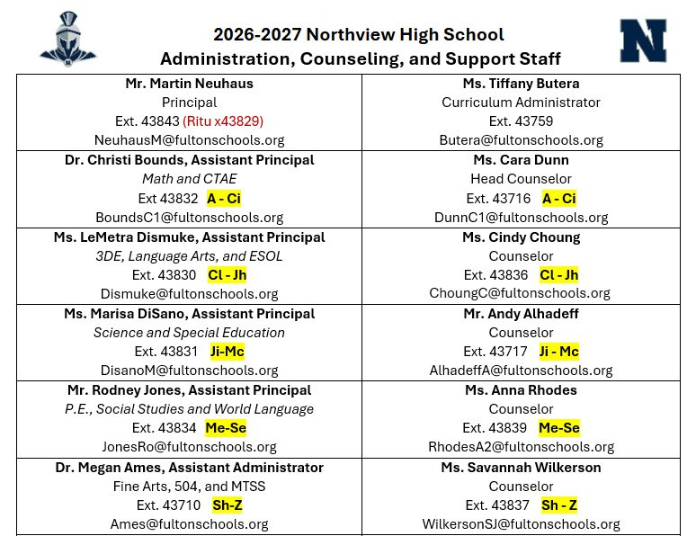

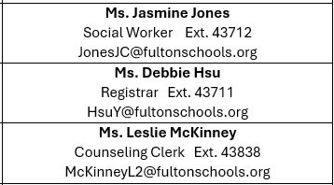
Counselors and Administrators

Slide 4
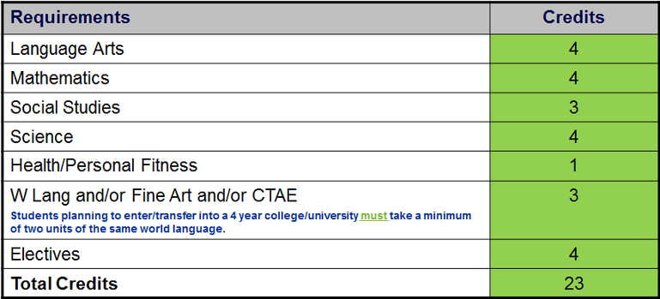
Graduation Requirements
ENGLISH​ 4 UNITS​ | MATHEMATICS​ 4 UNITS​ ​ | SCIENCE​ 4 UNITS​ | SOCIAL STUDIES​ 3 UNITS​ | HEALTH/PERSONAL FITNESS​ 1 UNIT​ | ADDITIONALCREDITS​ 4 UNITS​
English9 Fall ​ | Fall​ | Biology Fall​ | American Govt.​ (1 semester)​ | General Health​ | Fall​
English9 Spring​ ​ | Spring​ | Biology Spring ​ | World History​ Fall​ | Personal Fitness​ | ​ Spring​ ​
English10 Fall​ ​ | Fall​ | PhysicalScience/Physics Fall​ | World History​ Spring​ | World Language/FineArts/CareerTech3 UNITS (any combination)​ | Fall​
​ English10 Spring​ ​ | Spring​ | PhysicalScience/Physics Spring​ | US History​ Fall​ | Fall​ | Spring​
English11 Fall​ ​ | Fall​ | Chem/Earth/Env Sci /AP Sci ​ Fall​ | US History​ Spring​ | ​ Spring​ ​ | Fall​
​ English11 Spring​ ​ | Spring​ | Chem/Earth/Env Sci /AP Sci Spring​ | Economics​ (1 semester)​ | Fall​ | Spring​
​ English12 Fall​ | Fall​ | Fall​ | ​ | Spring​ | Fall​
English12 Spring​ | Spring​ | Spring​ | ​ | Fall​ | ​ Spring​ ​
​ ​ | ​ ​ | ​ ​ | ​ ​ | Spring​ | ​

Slide 5
Sample Senior Schedule
SEMESTER 1 | SEMESTER 2
English | English
Math | Math
Science | Science
Economics/AP Micro | Elective/AP Macro
World Language or Elective | World Language or Elective
Elective | Elective
  Students should take 4-5 academic classes per semester.
  Research classes carefully.
  You are encouraged to attend AP Night and our Dual Enrollment Info Meeting in January if you wish to take AP or Dual Enrollment classes next school year.

Slide 6

Dual Enrollment (DE)
  Students have the opportunity to earn high school and college credit simultaneously.
  Up to 30 hours of tuition is paid for through state funds.
  Please visit www.gafutures.org for more information.
  The NHS Dual Enrollment process can be found on https://northview.fultonschools.org/our-school/counseling
  DE Information Night: February 9, 2027 at 6:00pm.

Slide 7
Credits and Honor/AP Points
  How many credits are needed to be considered a 12ᵗʰ grader?
    17 credits are needed at start of the 2026/2027 school year.
    You will remain in an 11ᵗʰ grade homeroom if 17 credits are not attained.
  Students can be promoted to 12ᵗʰ grade when proper credit is earned.
  Honors/AP/Dual Enrollment points?
    7 additional points are awarded to a passing grade in honors, AP, and Dual Enrollment courses.

Slide 8
GPA or Numeric Average?
  FCS utilizes a Numeric Average:
    Based on a 100-point scale.
    All grades included on transcript, including failing grades.
    Failed courses remain on transcript even if credit is made up.
    Additional 7 points for passing grades in honors/AP/Dual Enrollment courses.
      7 points are included on transcript.

Slide 9

Testing
  Georgia Milestones (20% of final grade)
    Students taking one of these classes through DE are required to take the corresponding milestone.
MATH SOC STUD ENG/LANG ARTS SCIENCE
Algebra US History Lit/comp II Biology
  PSAT
    TBD: 9th – 11th Grade Students
    For Juniors, this is the score that may qualify you for the National Merit Scholarship

Slide 10
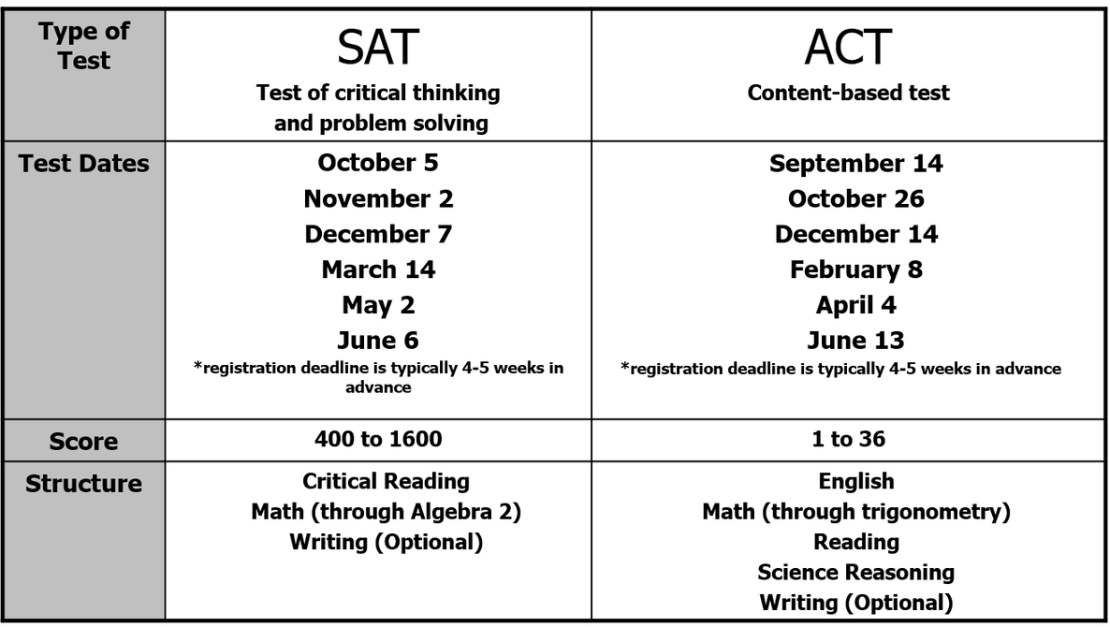
SAT vs. ACT
October 3, 2026
November 7, 2026
December 5, 2026
March 6, 2027
October 17, 2026
December 12, 2026
February 27, 2027 April 10, 2027
SAT and ACT scores are NOT automatically sent with your transcript.
You must send your scores directly to the college/university through College Board or ACT.

Slide 11
Post-Secondary Options
Gap Year
Military
Workforce
Travel, missions work, etc.
Technical/Trade School
Two-Year and Four-Year College/University

Slide 12
Researching Options
GAP Year
Employment Opportunities and Apprenticeship Programs
Work
Travel/Missions
    https://www.goaheadtours.com/
    https://www.adventures.org/mission-trips/
Volunteer
    www.peacecorps.gov
    https://www.volunteer.gov/
    https://www.volunteermatch.org/
Attend Workshops (Cooking classes, Managing finances, etc.)
www.indeed.com
www.dol.gov/apprenticeship
https://www.ziprecruiter.com/

Slide 13

Researching Options
  Military
    Local Recruiting
      Air Force - https://www.airforce.com/find-a-recruiter
      Army - https://www.goarmy.com/locate-a-recruiter.html
      Coast Guard - https://www.gocoastguard.com/about-us/find-recruiter
      Marine Corps - https://rmi.marines.com/request-information
      Navy - https://www.navy.com/local
    ASVAB
      Career exploration tools offered to 10ᵗʰ – 12ᵗʰ grade students
      Required for entry into all military branches
      More information to come regarding our test date

Slide 14

Researching Colleges
  Sign-ups are located in SchooLinks
  Did you know….You are allotted 6 pre-approved absences for college visits both junior and senior years!?
  Please visit attendance office prior to college visit
  Meet with representatives from admissions, financial aid and from your area of interest.
  Utilize www.gafutures.org

Slide 15
Where Should I Apply?
Dream/Reach School
  Less than 30% chance of admission
  Your academic record and test scores are at or below average
Target/Good Fit School
  30%-60% chance of admission
  Your Academic Record/Test Scores are in line with average
Safety School
  Greater than 60% chance of admission
  Your Academic Record/Test Scores exceed requirements
  You need at least one safety school
  A highly selective school should not be considered a safety school

Slide 16

College Admission Standards
  How Am I Being Evaluated?
  Numeric Average – Average of your academic core classes
  Course Selection (rigor; difficulty level) – Selective colleges are looking at the strength or rigor of your courses throughout high school, including your senior year. We highly recommend seniors take a minimum of 4 academics each semester. (For highly selective colleges, a minimum of 5 each semester)
  Test Scores (SAT and/or ACT)
  Extracurricular Activities – Leadership and participation in clubs, service and sports can be particularly important to competitive colleges

Slide 17

Application Components
  Essays – Required essays on the college application are important because they demonstrate your writing ability and give the college more information about you. Please seek advice when writing an essay and be sure to proofread for errors.
  Letters of Recommendation - Often preferred from core academic teachers
  Resume – Contains academic info, honors & awards, extracurricular activities, work/volunteer experience, etc.
  Interviews - Colleges will notify students if an interview is desired.
  **NHS does not have class rank**

Slide 18

Types of Admission
  Rolling Admissions
  Regular Decision
  Early Action – Invites early applications and receives early notice of decision. If accepted, student is not obligated to attend.
  Early Decision – Invites early applications and receives early notice of decision. If accepted, student is obligated to attend and withdraw all other applications. Students can only apply to ONE Early Decision school.

Slide 19

Scholarships and Financial Aid
  Scholarships will be posted to the NHS Counseling website. Check often!
  Research scholarships on the internet:
    www.scholarships.com
    www.fastweb.com
    www.gsfc.georgia.gov
    www.gafutures.org
  Visit college websites directly about financial aid and scholarship opportunities. Colleges award many renewable scholarships. Ask about criteria, procedures and deadlines.
  A great site to learn about types of Financial Aid, who is eligible, FAFSA and more is: http://studentaid.ed.gov/
  Financial Aid Night: Tuesday, October 20th @ 6:00 PM

Slide 20

H.O.P.E. Scholarship
  Partial tuition covered – varies by year
    Payment amount for private & public colleges and universities can be located on www.gafutures.org
  Requirements:
    Graduate from an eligible high school
    GPA of at least a 3.0 (calculated by GSFC)
    Academic Rigor: 4 classes that are academically rigorous.
      https://www.gafutures.org/media/ks5f5zw5/rigor-course-list-09252024.pdf
  In college, must maintain 3.0 GPA.
    If a student falls below a 3.0 GPA in college, he/she may only regain the HOPE Scholarship one time.
  A student that does not graduate from high school as a HOPE Scholar can earn a 3.0 GPA in college.

Slide 21

Zell Miller Scholarship
  100% of tuition covered
  Must meet all the requirements to be eligible for the HOPE Scholarship, plus:
      Graduate from an eligible high school
      GPA of at least a 3.7 (calculated by GSFC)
      Academic Rigor: 4 classes that are academically rigorous.
        https://www.gafutures.org/media/188054/rigor-list-august-2019-print-ready-rv10232019.pdf
      SAT: min. 1200 combined critical reading score and math score (single administration)
      ACT: min. composite score of 25
        SAT/ACT scores MUST be submitted to GSFC to be considered
      Valedictorian or Salutatorian
  In college must maintain 3.3 GPA

Slide 22
H.O.P.E. GPA
A 3.0 GPA is calculated by averaging core coursework, including failing grades, on a 4.0 scale
Core Courses Conversion
English
Math
Science
Social Science
World Language
Honors points are removed and a 0.50 weighting is added back in for AP courses/Dual Enrollment/IB courses only, not to exceed 4.0
Middle school credit is not calculated in the HOPE GPA
All calculations are done by the Georgia Student Finance Commission
A | 90 to 100 | 4.0 Points
B | 80 to 89 | 3.0 Points
C | 70 to 79 | 2.0 Points
F | 0 to 69 | 0 Points
Counselors are not responsible for calculating the HOPE GPA
A 2.99 GPA does NOT qualify you for HOPE

Slide 23

H.O.P.E. Scholarship
  Apply for the HOPE
      Apply for the HOPE or complete FAFSA starting October senior year:
      Free Application for Federal Student Aid (FAFSA) - www.fafsa.ed.gov
      Georgia Student Financial Aid Application System (GSFAPPS) - www.gafutures.org
  View your preliminary HOPE average
      Go to www.gafutures.org and login to your account.
  For Additional Information on HOPE
      Contact Georgia Student Finance Commission (GSFC) www.gsfc.georgia.gov

Slide 24
Grade Point Average (GPA)
  Contact each college/university to determine how GPA is calculated.
  Most colleges only consider academic courses (Language Arts, Math, Science, Social Studies and Foreign Language)
  Some colleges may take off the additional 7 points added for Honors, AP and college courses.
  Fulton County reports on a 100-point scale. The weighted and unweighted grades are included on the transcript.
High School GPA is calculated by the postsecondary institution not the high school (Fulton County does not calculate)
College GPA is different than the Fulton County Numeric Average

Slide 25

NCAA Eligibility Clearinghouse
  If you are planning to participate in intercollegiate athletics at an NCAA Division I or II institution, you must register with the NCAA Initial-Eligibility Clearinghouse
  Access the registration materials by visiting the NCAA website www.ncaaclearinghouse.net
  When taking the SAT/ACT, enter 9999 for scores to be sent to NCAA
  You will need to send your official transcript directly to the NCAA clearinghouse through Naviance
Students and parents are responsible for submitting documentation for
NCAA eligibility to Division I and Division II schools via the Clearinghouse
Counselors are neither responsible nor allowed
to determine eligibility

Slide 26
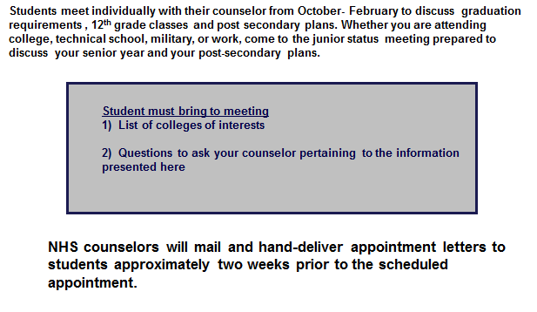
Junior Status Meetings
  NHS Counselors will send meeting invites via email
  Students will meet in person with their counselor and parents will join virtually through Teams

Slide 27

Communication
  https://northview.fultonschools.org/our-school/counseling
    Check the counseling website frequently for scholarship opportunities, tutoring resources, summer opportunities, course catalog, registration information, and much more!
  This entire presentation will be added to the counseling website to review as needed.
  NHS Counselors will provide a FAQ document after the presentation

Slide 28
Communication
You should have received email alerts for this meeting.
If you do not receive any email communication from the counseling office, make certain we have your updated email address.
You may send your updated email to our registrar hsuy@fultonschools.org
Be sure to include student’s legal name and grade level.
Don't forget to follow us on Instagram!
@Northviewcounseling

Slide 29
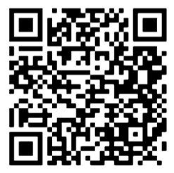

Follow us on Social Media!
@northviewcounseling

Slide 30
Resources
School Code: 111148
SAT
www.collegeboard.org
ACT
www.act.org
GA Futures
(HOPE/Zell Miller Scholarship Info)
www.gafutures.org
Northview Counseling Department
https://northview.fultonschools.org/our-school/counseling
Naviance
https://student.naviance.com/northview
SOAR
https://soarfamily.org

Slide 31
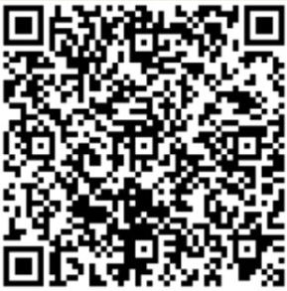
Questions?
  Please scan the QR Code to submit questions:

Slide 32


