Slide 1




Wellington Elementary
FIFTH GRADE CURRICULUM NIGHT

Slide 2



FIFTH GRADE TEAM
Mr. Camuel
Ms. Hart
Ms. Orme
Ms. Pickens
Support Staff: Ms. Blakey, Ms. Steele, Ms. Buchanan

Slide 3

COMMUNICATION
Please use ParentSquare for communication with the teacher.

Slide 4

DAILY SCHEDULE
Morning Work/SEL
Specials
Math
Language Arts
Lunch
Recess
Social Studies
Novel Study
Dismissal

Slide 5
SPECIALS
We are all on a five day rotation. Your child will experience PE, Art, STEM, Technology, and Music.
REMEMBER TENNIS SHOES FOR PE!!!
As the year progresses, the schedule will also include Guidance and Library check out time.

Slide 6

FIFTH GRADE CLASSROOM JOBS
  Quarterly
  Fines
  Earning Money
  Store-Each nine weeks
  Auction at the end of the year

Slide 7
POSTITIVE BEHAVIOR SUPPORTS EOS: SCHOOL-WIDE
Expectations:
  4 parts of creed (Prepared, Hard Work, Thinker/Problem Solver, and Kind/Caring/Respectful)
  Expectations do not give $$$ and are reflected as a percentage.
  Students will need to have 95% meeting expectations to be able to shop at Wel-Mart
  Recognition referrals for positive behavior
  Focus referrals for negative behaviors (you will be contacted if your student receives one)

Slide 8




Math nightly
HOMEWORK
Reading two nights
Study SS notes nightly

Slide 9


GRADING
In accordance with our school guidelines, your child’s grades will be based on class work, chapter tests & quizzes, and unit assessments.
Areas Graded:
Math
Language Arts
Social Studies
Homework is an add on system!

Slide 10
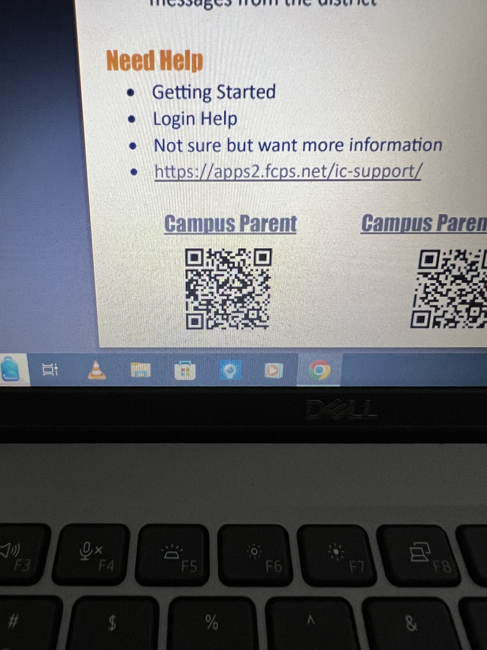
PARENT PORTAL
Use the parent portal to check your child’s grades!

Slide 11


ASSESSMENTS
I will let you know each Sunday of the content we will be learning and when we have scheduled tests.
Students will be participating in benchmark tests throughout the year:
  iReady (math and reading)
  District Common Unit Assessments

Slide 12



PER STATE LAW
ALL STUDENT CELL PHONES AND SMART WATCHES WILL BE TURNED OFF AND KEPT IN BACKPACKS DURING THE DAY.

Slide 13
FIELD TRIPS
  Fort Boonesborough: Thursday, September 17
  Toyota: December 17
  Cincinnati-Freedom Center and Museum Center: April 29

Slide 14
MUMS FUNDRAISER
  Order forms will go home Monday, August 31st
  Orders/money will be due Friday, September 18
  Mums will be delivered to school on Tuesday, September 22; pick up 4-6pm
  We will need parent volunteers to help with unloading mums from trucks

Slide 15


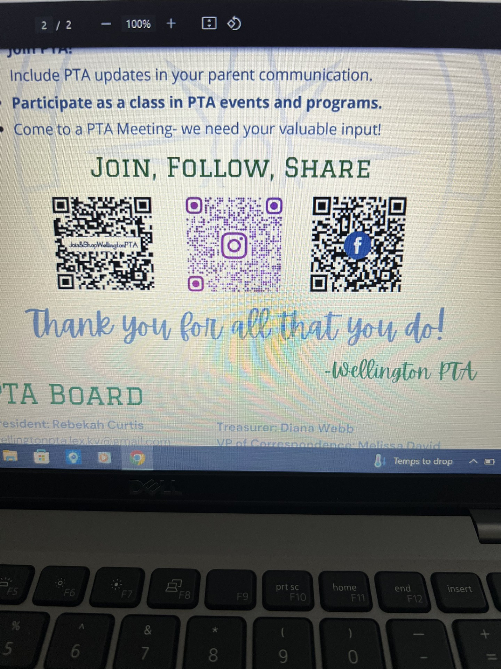
THANK YOU
Please join the PTA!

