Slide 1

Hidden Valley High School
School Counseling Department Presentation

Slide 2
Counseling Staff
School Counselors
  Mrs. Williams (A-G)
  Mrs. Bamber (H-N)
  Mrs. Laubach (O-Z)
Counseling Secretary
  Mrs. Nichols

Slide 3

Where to get information?
Colleges (websites, college visits)
School Counselors
The Career Center

Slide 4

The Career Center
Mrs. Holley
  Cholley@rcps.us
  Volunteer Service Hours
  Scholarships
  College Visits
  Financial Aid Research

Slide 5

College Admissions 101:
William Byrd High School
September 8th
6:00
Hear from a Virginia Tech representative and other local colleges!

Slide 6

Financial Aid presentation:
  Get helpful information about filling out the FAFSA!
  Roanoke County Public Schools presentation: October 6th, Cave Spring High School- 6:00pm

Slide 7

Plan for the future with many representatives from two-year and four-year colleges and universities, and representatives from career, technical and business schools from all over the country!
Patrick Henry High School
Tuesday, September 15th
6:00 PM – 8:00 PM

Slide 8
ASVAB
Armed Services Vocational Aptitude Battery Test
Helps with interests and careers
Testing Date: TBD

Slide 9

Senior Interviews:
With your Counselor
Starting in
Late September/early october
Tis Photo by Unknown author is licensed under CC BY.

Slide 10
Seals offered by Roanoke County Public schools:
Governor's Seal- ADV Diploma and 9 transferable college credits.
Board of Education Seal- ADV or Standard Diploma 4.0 GPA
CTE Seal- ADV or Standard Diploma, complete CTE sequence, pass exam, or obtain license.
STEM Seal- ADV or Standard Diploma, must have 50 volunteer hours in STEM related field, must complete all requirements for Math and Science for an ADV Diploma.
Excellence in Science and the Environment Seal-ADV or Standard Diploma, complete 3 first level science courses and one rigorous level course, complete 50 volunteer hours that involve the application of science.
Civics Seal- ADV or Standard Diploma, completion of VA/US History and VA/US Government with a B or higher, complete 50 hours of volunteer work in a civics field, have good attendance and no disciplinary infractions.
Biliteracy Seal- pass all end of the year assessments in English, reading and writing at a proficient level or higher, be proficient in one mid-level or higher language as demonstrated through an assessment.

Slide 11
Ordering a transcript? Here’s how to pick your school on Parchment!
Be aware of your application type (Common App, Specific College etc.) before ordering on Parchment.
Only order transcripts for schools where you are definitely applying.
Orders for self-view will not be honored. You will be able to see your unofficial transcript on Parchment and will be given a copy during senior interviews.

Slide 12
Applying to a
4 Year School
Apply for college…submit application
Request your high school transcript through Parchment
Request Dual Enrollment transcript from VWCC (Only for Dual enrollment students)
Send your SAT and ACT scores to schools from Collegeboard.org

Slide 13
Applying to a
4 Year School
If applying via the Common Application
1. Create an account via commonapp.org
2. Under FERPA Tab- Add Counselor
(You may need to add some info prior)
3. Add Colleges you plan to apply for and select deadlines. Counselors and recommenders will not know otherwise.

Slide 14
Applying to VWCC
1. Complete the Virginia Western application
  https://www.virginiawestern.edu/get-started/
2. Request your transcript off Parchment
3. If interested in CCAP:
  Fill out the application: www.virginiawestern.edu/ccap/
  Fill out FAFSA- VWCC offers FAFSA workshops
  Meet placement requirements

Slide 15
ADDITIONAL information
Early College Scholars
  Have you taken/ will take 3 AP or Dual courses?
CCAP
  Community College Access Program
  Apply for 2-3 years free years at Virginia Western Community College
  Listen to announcements and check the HVHS Counseling Blackboard page for information on dates and VWCC visits.
AP Credit Policy
  Learn what colleges will take what AP Scores
  https://apstudents.collegeboard.org/getting-credit-placement/search-policies

Slide 16
ADDITIONAL information
  Letters of Recommendations
    Polite to ask all recommenders if they are willing even if required by college
    Provide a resume or whatever is requested to assist recommender
    Ask ahead of time. Even two weeks prior could be not enough time. Recommend a month prior.
    Ask a person who you know will provide you with the best character reference

Slide 17
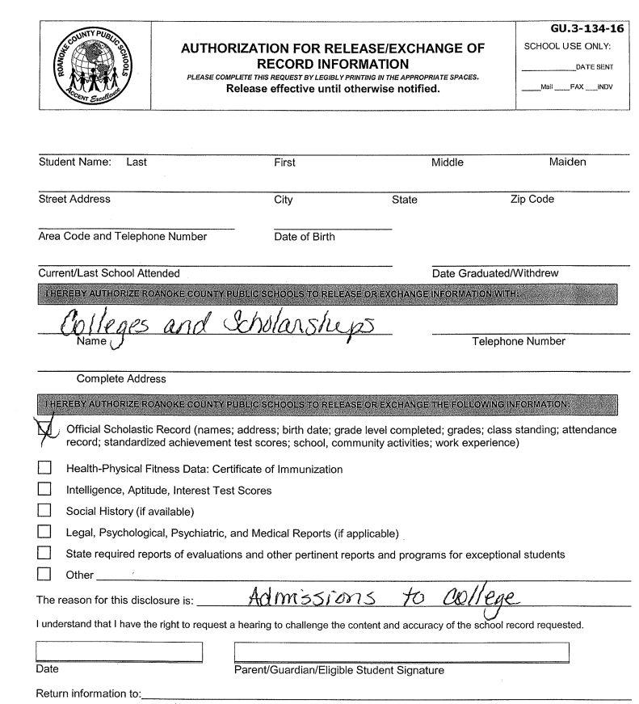
TRANSCRIPT rELEASE fORM
If we do not have this on file, we CANNOT send a transcript.

Slide 18
Scholarship information
Check HVHS CANVAS page on Blackboard
Find a scholarship
Follow Application Instructions
  Keep in mind that some applications must be mailed.
Do you need a transcript? See Mrs. Laubach

Slide 19

NCAA Clearinghouse
Register at ncaaclearinghouse.net
See Mrs. Nichols to request a transcript.

Slide 20
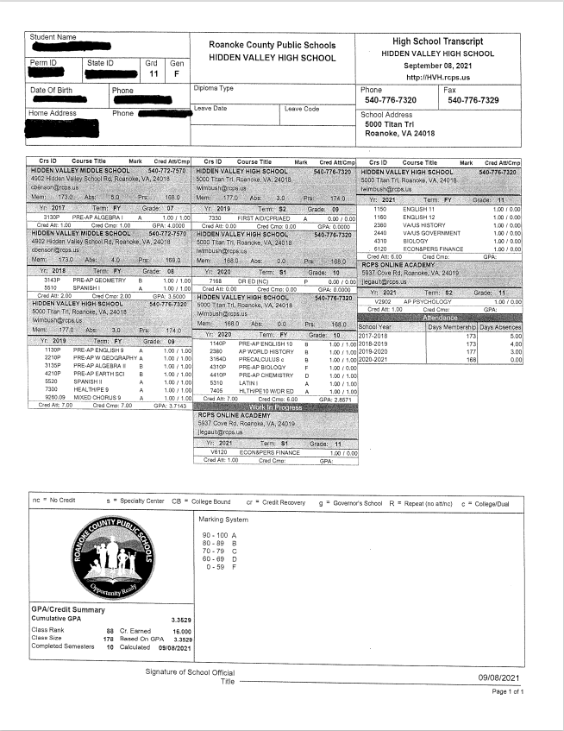
HOw to REad
Your TRanscript!

Slide 21

Thank you!
Have a great SENIOR Year!

