Slide 1
Point Proud Schools
2040 Task Force
Meeting #5: August 5, 2026

Slide 2
Welcome back!
This is the fifth of nine Task Force meetings, leading to a recommended long-range facilities plan
As you make your way into the room…
  Please sign in
  Help yourself to a snacks and a drink
  (Re)introduce yourselves to your table mates

Slide 3
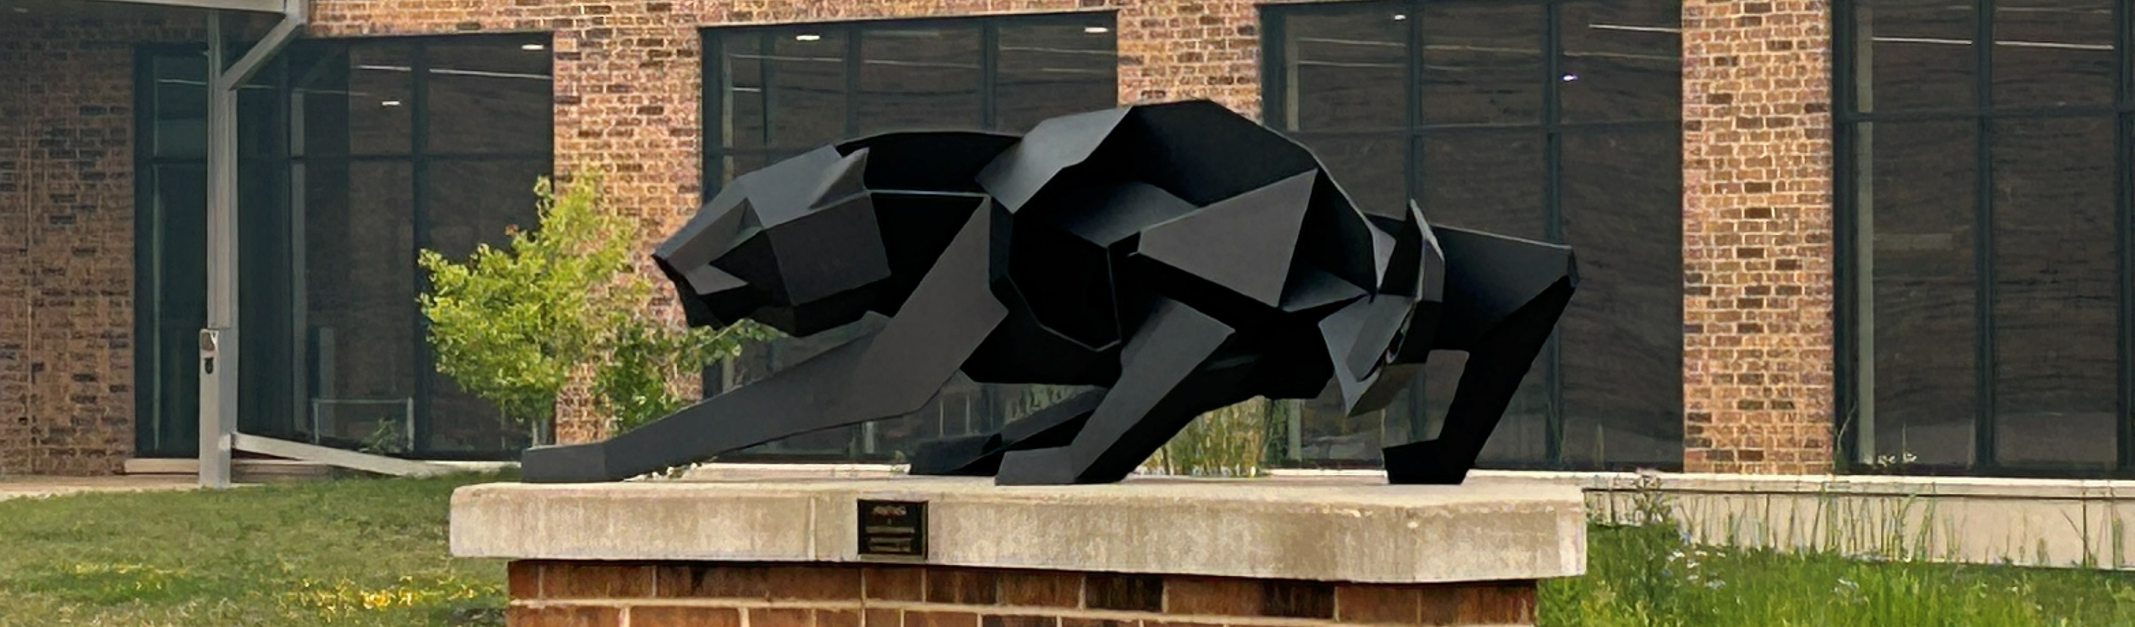
What is the Task Force’s charge and criteria?
Recommend a long-range school facilities plan for the District, including phasing advice, to the School Board by winter 2026-27.
Develop and evaluate a range of different long-range options with phasing related to the utilization of the District’s school buildings.
Utilize option evaluation criteria approved by the School Board:
    Maintained or Enhanced Student Opportunities
    Manageable Student and Family Impacts
    Fiscal Responsibility
    Efficient Building Utilization

Slide 4
How will Task Force meetings progress?
Common Understanding (April-June)
General Directions (July-August)
Specific Advice (September- December)
Enrollment projections
Educational policy
Financial conditions
Building conditions
Other information
Explore, rank, and narrow broad school facility-related options
E.g., Should District reconfigure its grade groupings? To what?
E.g., Should District reduce the number of school buildings?
Present, evaluate, and rank detailed facility paths, including phasing, reflecting general directions
Recommend preferred option to school board

Slide 5
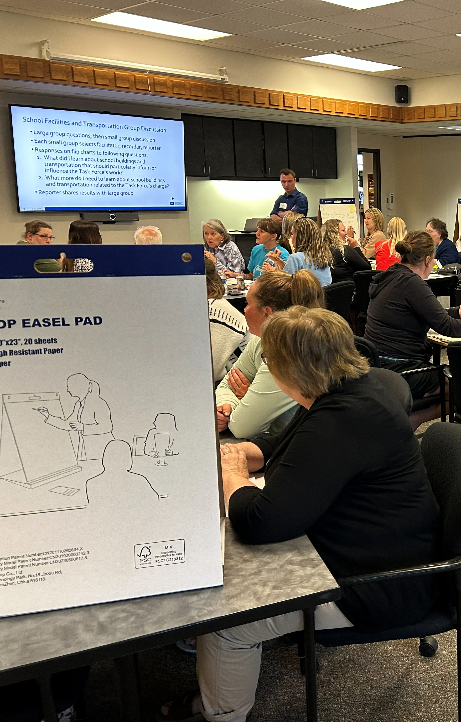
Main outcomes from last meeting
“I wish the [background] presentations had been significantly shorter, and we had much more small/large group discussion. ”
Can we tour or meet at SPASH?
See “Outcomes” document and updated “Questions & Responses” document (new questions 47-49) shared via email and on webpage

Slide 6
Main outcomes from last meeting
Learned about SPASH including how it might handle 9th graders
Narrowed then evaluated potential grade group options:
  Current grade groups (K-6, 7-9, 10-12): Familiar, least disruptive but does not solve long-term fiscal or facility-utilization challenges & leaves 9th graders away from other high schoolers.
  Option A (K-5, 6-7, 8-9, 10-12): Some middle-grade benefits and might be first step to a K-5, 6-8-, 9-12 grouping later, but more transitions, transportation complexity, family burden, and 9th graders remaining in reconfigured junior highs.
  Option B (K-6, 7-8, 9-12): Moves 9th grade to SPASH for a more traditional high school but does not address 6th grade placement, underuses junior highs, raises concerns about SPASH capacity, capital costs, and possible referendum.
  Option C (K-5, 6-8, 9-12): Aligns with common statewide/national model, benefits 6th and 9th graders, better curricular/co-curricular alignment, and improved building utilization, but raises concerns about SPASH capacity, capital costs, and possible referendum.

Slide 7
Main outcomes from last meeting
Preliminary rankings from individual members at end of meeting:
  Gold numbers = # of members assigning option the indicated rank
  “Average Rank” is on a 1-4 scale (lower number is better rank)
Rank | Current Grade Groupings | Option A: K-5, 6-7, 8-9, 10-12 | Option B: K-6, 7-8, 9-12 | Option C: K-5, 6-8, 9-12
1 | 4 | 3 | 1 | 32
2 | 10 | 14 | 9 | 5
3 | 14 | 9 | 12 | 2
4 | 10 | 11 | 15 | 0
Average Rank | 2.8 | 2.7 | 3.1 | 1.2

Slide 8
Main outcomes from last meeting
  Task Force members supported Option C (K-5, 6-8, 9-12) over the other options, including retaining SPAPSD’s current grade groups
  Primary benefits of shift to K-5, 6-8, 9-12 include creating standardized grade alignments and improving student experience
  Concerns focus on its potential cost and community reaction
  Potentially closing schools while improving the high school would require a careful plan, possibly including phased implementation, to gain public support
  QUESTIONS? COMMENTS?

Slide 9
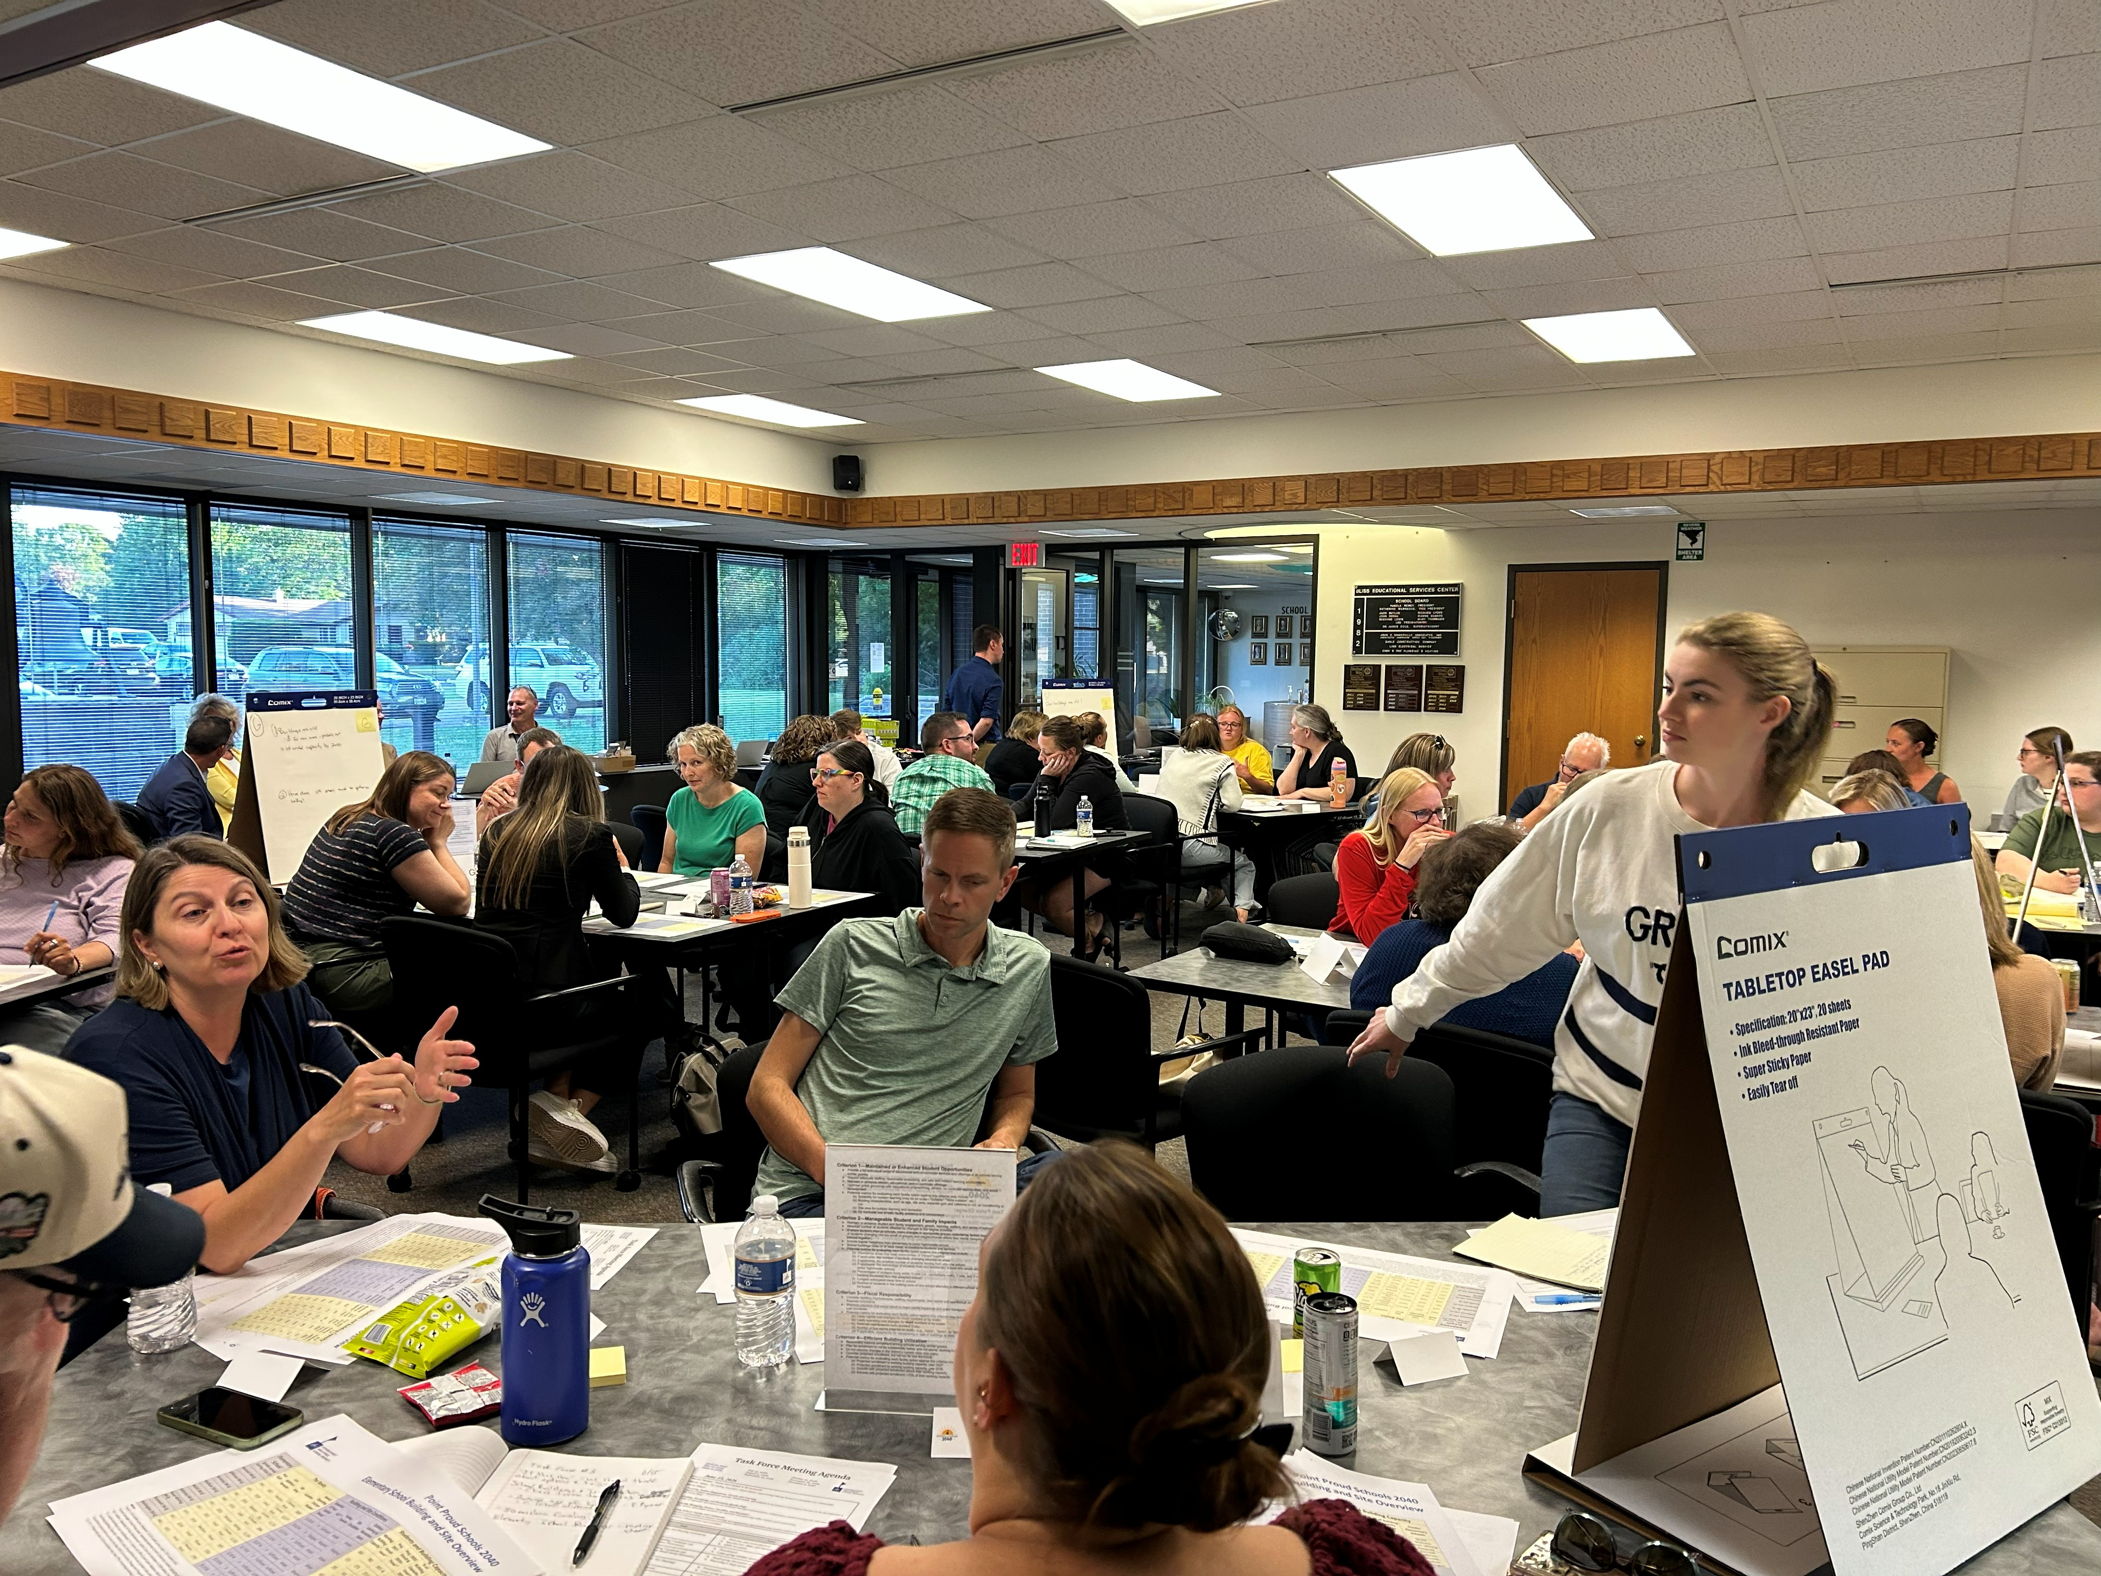
Reminder of our summer proposal
We should first understand whether there is sufficient understanding and interest in either or both:
  Reconfiguring to a different grade group model (JULY), and/or
  Consolidating/reducing the number of school buildings (AUGUST)

Slide 10
Potential School Consolidation Options

Slide 11
Junior high/middle school consolidation possibilities
May be possible to have just one building for middle grades if:
  Shift 9th graders to SPASH without accepting 6th graders from elementary schools, and (i.e., grade 7-8 middle school), with ~900 student enrollment, or
  If grades 7-9 or 6-8 in building, build or expand to one large (1,400-1,500 student capacity) junior high/middle school
Show of hands: Does Task Force wish to further discuss junior high/middle school building consolidation (i.e., 2 buildings to 1 building)?

Slide 12
For elementary school consolidation possibilities, let’s start with a review against option evaluation criteria…

Slide 13
What are elementary consolidation possibilities considering enrollment alone? (Criterion 4)
Grade Group Configuration Option | Excess Combined Elementary Building Working Capacity (in Student Seats) ³ |  | Equivalent Number of School Buildings Associated with Excess Working Capacity ⁴
 | In 2027 | In 2035
If no grade group changes, including current 4K changes | ~677 | ~785 | 1.5 - 1.8 building equivalent
If reduced to K through 5th grades, including current 4K changes | ~1,152 | ~1,243 | 2.6 - 2.8 building equivalent
If no grade group changes, but with full day 4K in all elementary schools ¹ ² | ~416 | ~507 | 0.9 - 1.2 building equivalent
If reduced to K through 5th grades, but with full day 4K in all elementaries ² | ~890 | ~964 | 2.0 - 2.2 building equivalent
¹ Assumes that all elementary schools would have capacity for 4K students from elementary attendance area adjustments.
² Assumes that SPAPSD would educate all 4K students in its buildings. This assumption was intended to show the maximum possible impact of this option. Actual future policy may differ.
³ Assumes continuation of current SPAPSD class size policies.
⁴ Uses current 440-student average working capacity of SPAPSD’s nine elementary buildings. “Equivalent Number of School Buildings” does not account for different building sizes, “stickiness” associated with operating nine separate buildings, inevitable unevenness in class sizes, and different student living locations.

Slide 14
What would be fiscal impacts of closing one elementary school? (Criterion 3)
  One-time revenue from potential building sale
  Each year, for average school, in current dollars, a projected:
  ~$116,000 in capital cost savings (based on average 10-year savings of ~$1.16 M)
  ~$340,000 less in operating expenses (running the school, not including staff)
  ~$625,000 less in staff expenses (not including any teacher reduction)
  Possible annual increase in bussing costs depending on school and student locations
  e.g., Wausau generally estimated 2 more bus routes per closure at $50,000/route, but depended in which school closed

Slide 15
How manageable would student and family impacts be with an elementary school closure? (Criterion 2)
  All students in closed school would obviously need to be relocated
  Through the 2020s, students from closed school would likely have to be relocated to two or three remaining schools (likely only two if 6th graders shifted from elementary schools)
  More students and families in closed school would likely live further from their new school
  Some rebuilding of student and family engagement, growth, learning, welfare, and sense of belonging may be required
  May or may not have on impact on junior high/middle school attendance areas

Slide 16
How would/could an elementary school closure maintain or enhance student opportunities ? (Criterion 1)
  Average class size would likely increase (within policy guidelines) at “receiver” schools, with the increase partially counteracted by projected elementary enrollment decreases and if 6th graders shifted out of elementaries
  May support more efficient staffing, including the possibility of fewer traveling staff
  Possible that some cost savings from building closure could be redirected to staffing, programming, or improvements in remaining school buildings (but such amount would not contribute to $1 million/year operational savings target)

Slide 17
Other districts’ consolidation models
  Wausau: 100% of students from each closed building relocated to one other significantly undercapacity remaining building
  La Crosse, Oshkosh: 2 or 3 existing elementary buildings closed, replaced by 1 new, larger elementary building with most or all students from the closed buildings attending the new building (required capital referendum of $30-35 million)
  Spring Valley, Wausau: One closed elementary school repurposed as an early learning center
  Other districts have partnered to repurpose closed buildings to meet other community priorities and support surrounding neighborhood

Slide 18
Small Group Discussion on Building Consolidation
  With consideration to the option evaluation criteria, each member responds on post-its the “pros”, “cons”, and “considerations/ questions” for consolidating/reducing the number of elementary school buildings
    Write 1 “pro” per post-it note, 1 “con” per note, and 1 “consideration/ question” per note
    Do not get too specific at this stage (e.g., try not to indicate specific schools)
  Place and cluster notes on 3 flip chart sheets, one sheet per each of “pros”, “cons”, and “considerations/questions”
  Discuss outcomes, select reporter, and then report from each small group:
    What are the primary pros and cons of consolidation?
    What is your group’s preliminary advice on consolidation?

Slide 19
Interaction Among Preliminary Facility Plan Components

Slide 20
Preview of September+ Meetings—Overview
  Starting in September, we plan to share alternative “paths”
  Each path will have different approaches (or not) to grade group changes, building consolidation, general building improvements, attendance area changes, 4K/early childhood, etc. based on Task Force guidance to date
  Each path will have phases, with different steps in each phase to lead to a long-term target
Short Term
(By 2030)
Mid Term (~2030 to ~2035)
Long Term
(After ~2035)

Slide 21
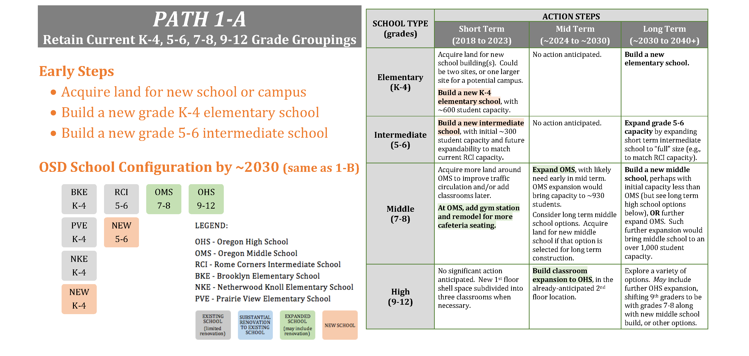
Preview of September+ Meetings—Other District Example

Slide 22
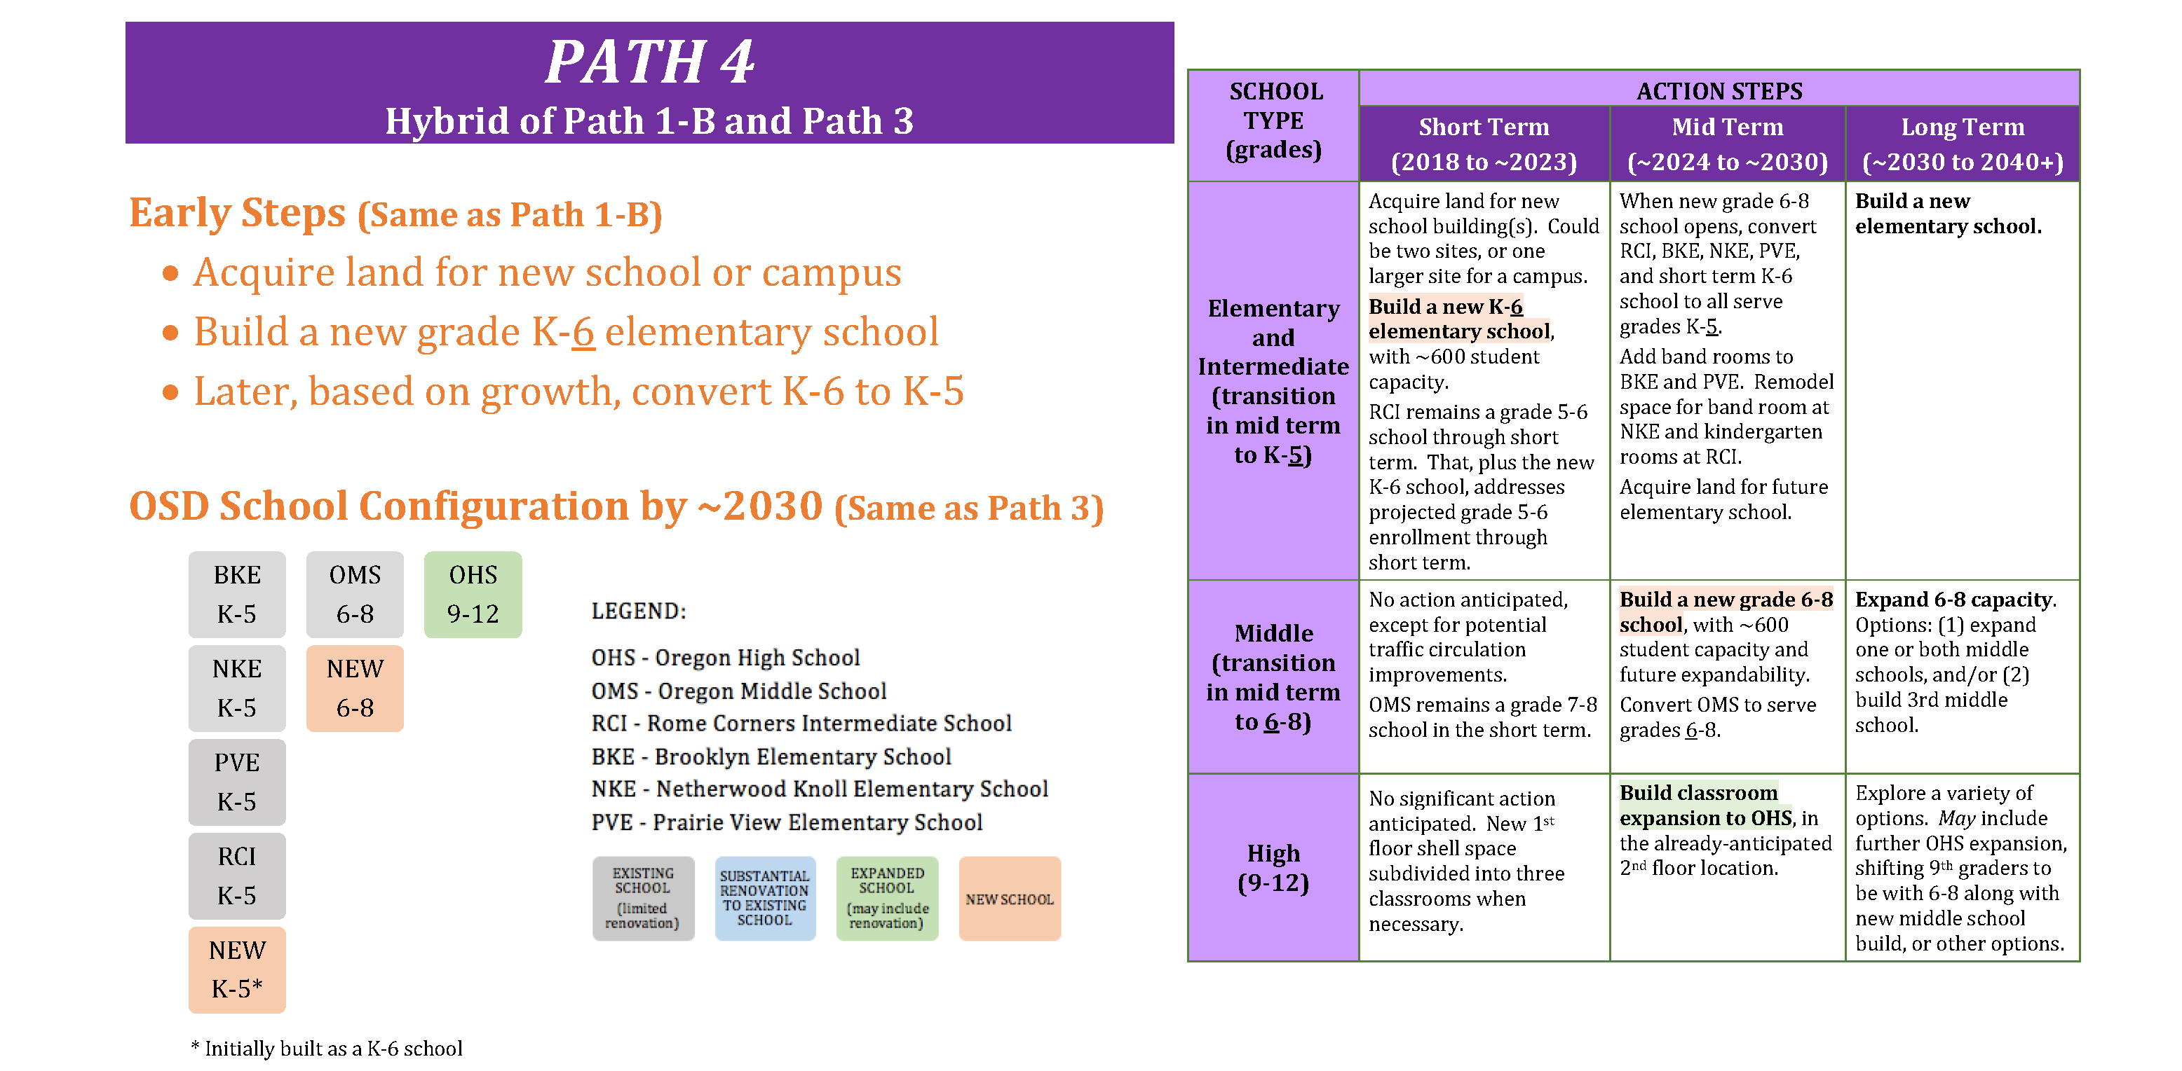
Preview of September+ Meetings—Other District Example

Slide 23
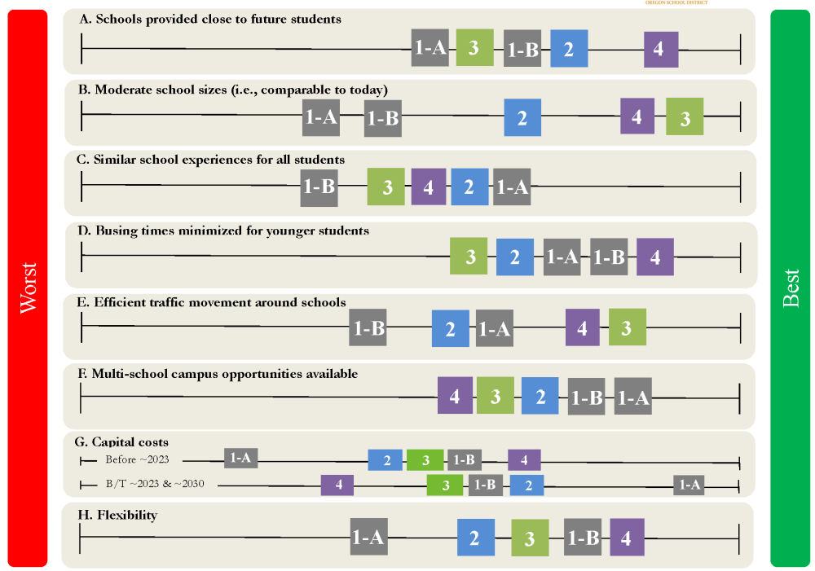
Preview of September+ Meetings—Other District Example
  Each numbered “path” evaluated against same criteria (rows)
  Different paths then compared with each other on criteria achievement

Slide 24
But, before that, another small group discussion
  (Re)select facilitator, recorder, and reporter
  On flip-charts, generally respond in small groups to following questions (remember, each member participates):
    What has discussion so far taught us about potential grade group changes, school consolidation, and the interaction between them?
    How does the discussion so far interact with possibilities and interests for attendance area shifts and other school facility-related changes?
    What initial ideas/outlines do you have for potential “paths” for the Task Force to consider starting in September?
Small group reporting (time permitting)

Slide 25
What Comes Next

Slide 26
Please complete evaluation form
We want your preliminary individual opinions and preferences on the school consolidation idea discussed this evening
Results will be tallied and will guide what we discuss at subsequent meetings, but these are not final votes
Still also interested in knowing how things went and what you need to complete your work

Slide 27
Meeting wrap-up and next meeting
Next meeting:
  When: Wednesday, September 16th, 6pm-8:30pm
  Location: Professional Development Center at Bliss Educational Services Center (1900 Polk Street, same location)
  Purpose: Evaluate set of potential alternative “paths” for facility plan
Any final questions or comments?
Thank you!

