Slide 1
PERT
Postsecondary Education Readiness
Test

Slide 2
Usage
PERT is now only used for Dual Enrollment eligibility and certain math courses as a semester exam
Criteria set by Rule 6A-10.0315, F.A.C., adds the following categories of alternative methods and associated minimum standards for dual enrollment eligibility determinations, admissions counseling, and developmental education placement:
Reading (106)
Writing (103)
Mathematics (114)*
* MAC1105 requires a score of 121

Slide 3
Test Setup
PERT is a three subtest computer based test that is used to see how ready students are for college level courses
Each subtest has 30 questions
Once you click “submit” on a question, you cannot revisit that question
Handheld calculators are not allowed on the math portion – if the system determines a questions needs a calculator, once will pop up on the screen
Students cannot use the “Enter” key on the keyboard to move to the next question – they must use the mouse and select the word “Next” on the screen and click

Slide 4
Test Setup
PERT math
Students should have a good grasp of algebraic equations. You should be able to solve linear and quadratic equations as well as apply standard algorithms. You will be expected to manipulate polynomials and use coordinate planes.
PERT reading
Critical reading facilitates the PERT reading test. Students must be able to find the meaning in passages including the author's intent, the difference between fact and opinion, and be able to pull out key ideas.
PERT writing
Questions on the PERT writing test focus on grammar, sentence structure, and the ability to write cohesively. Synthesis of information, as well as key organizational and structural concepts, will be tested. You will also be expected to understand appropriate word choice and syntax.

Slide 5
Policies/Procedures
Training
New PERT test coordinators will need to be trained by Evaluation Services. Other school staff may be trained by school test coordinator.
Users
Test coordinators will have a Site Manager account
Site Manager can add other users
If you need access, email Heather Rykard
Security Agreements
All test administrators are required to sign the security agreement every year
Keep all test agreements at your campus and turn in with your PERT materials.
Notes:
Existing PERT coordinators who have been previously or newly trained MAY train others at the school. If you are not comfortable, I can come out to train.
Please sign your PERT agreement and leave it in the PERT Agreement folder on the sign in table.

Slide 6
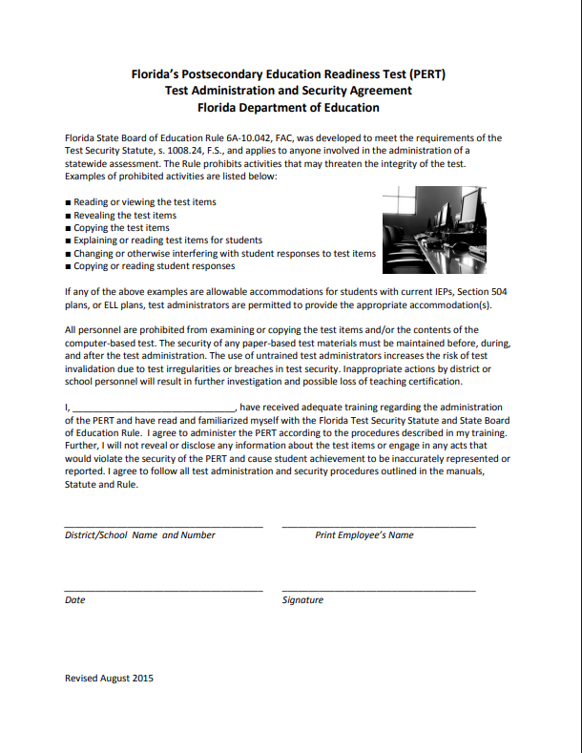
PERT Agreement
Notes:
This is for any one who will administer the PERT this school year

Slide 7
Security/Invalidations
Proctor Rules
  Proctor required if testing more than 30 students.
Windows - Vanguard Secure Browser
  Login with CBTXXXX user and run secure browser
  Secure Browser requires a password to exit
Chromebooks – security through login profile
  Login with CBTXXXX user
  Do not have students sign in with their own username
Invalidations
  Tests administered without security measures will be invalidated
Notes:
If you have an invalidation, you must email the details (student name, ID, date of test, what happened) as we have to complete a written invalidation sheet and send to McCann Associates/.

Slide 8
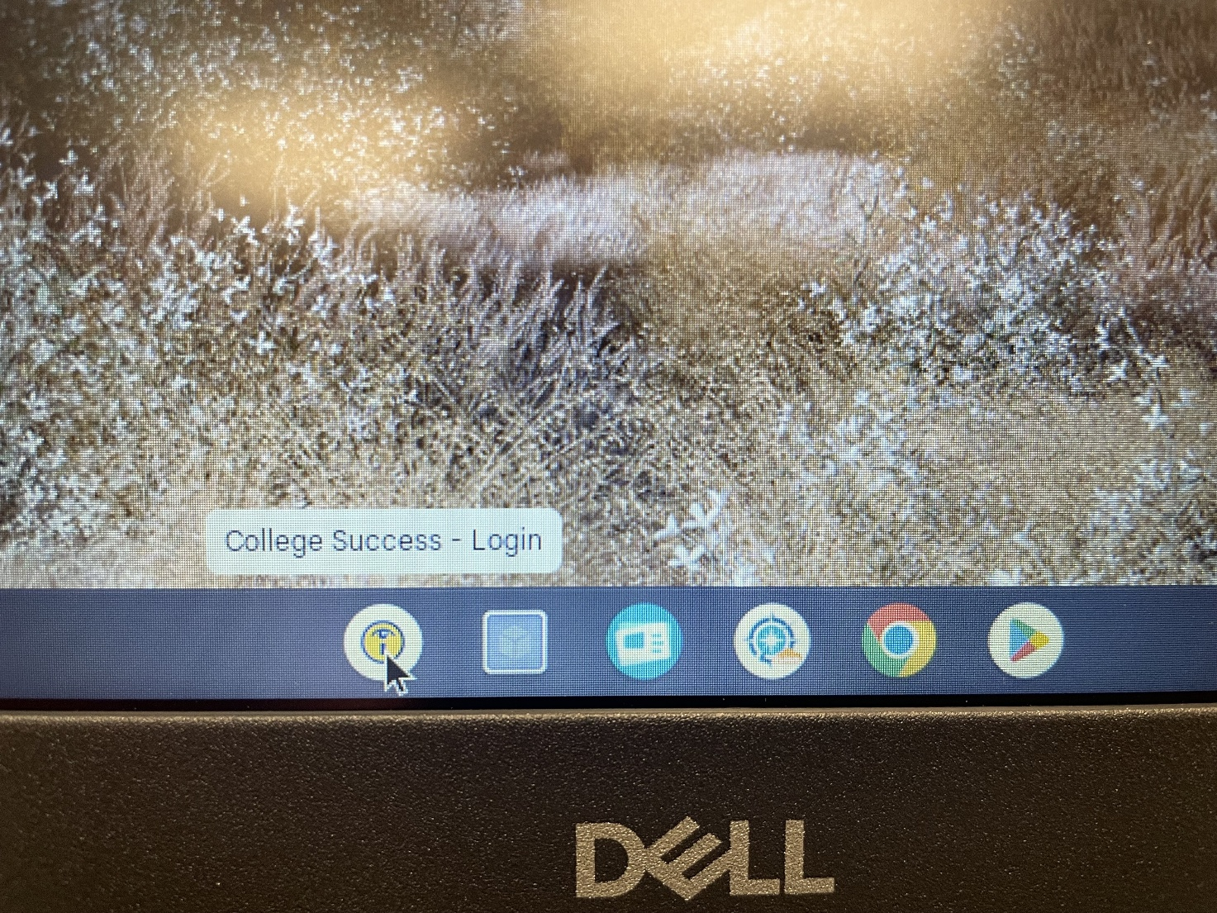
Log In
Logging into a Chromebook with the CBTxxxx profile
Notes:
Vanguard icon with college success pass through is in the tray when students log in with cbt profile. If your tech is unsure how to manage the profile, contact Latresa or Janet Windham

Slide 9
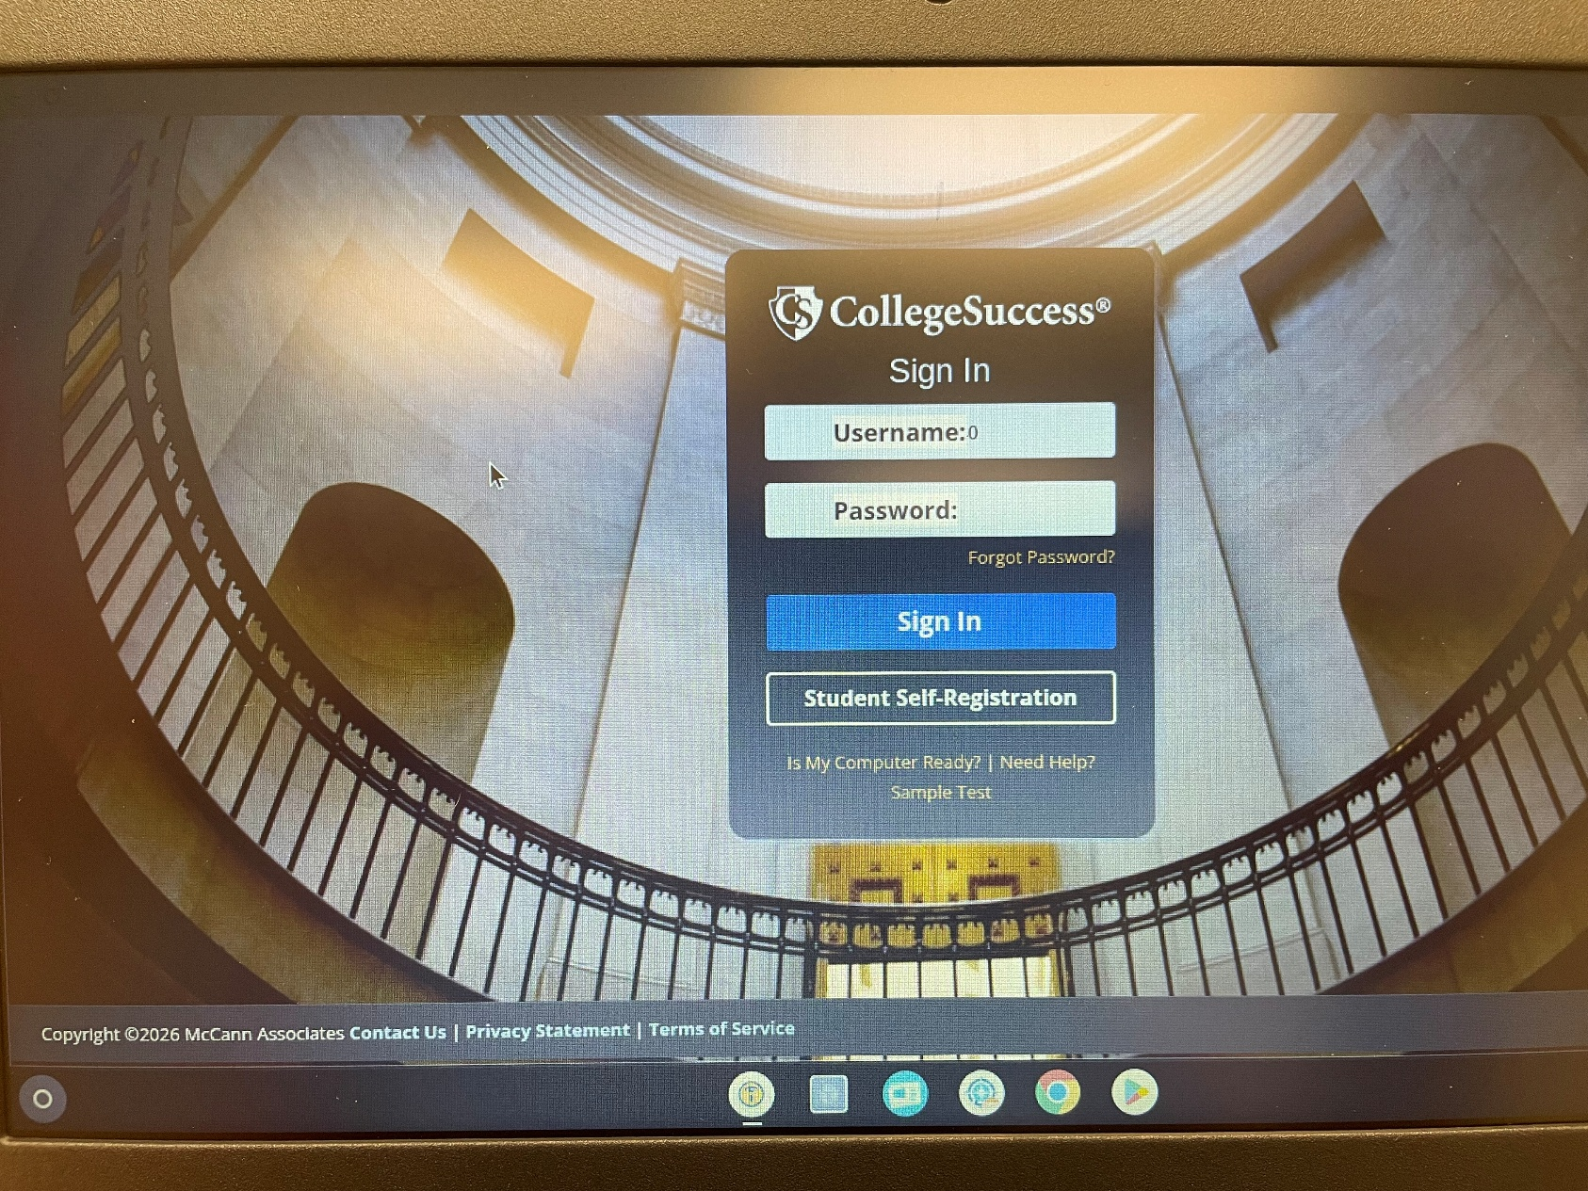
College Success
Notes:
Vanguard icon is visible in the tray

Slide 10
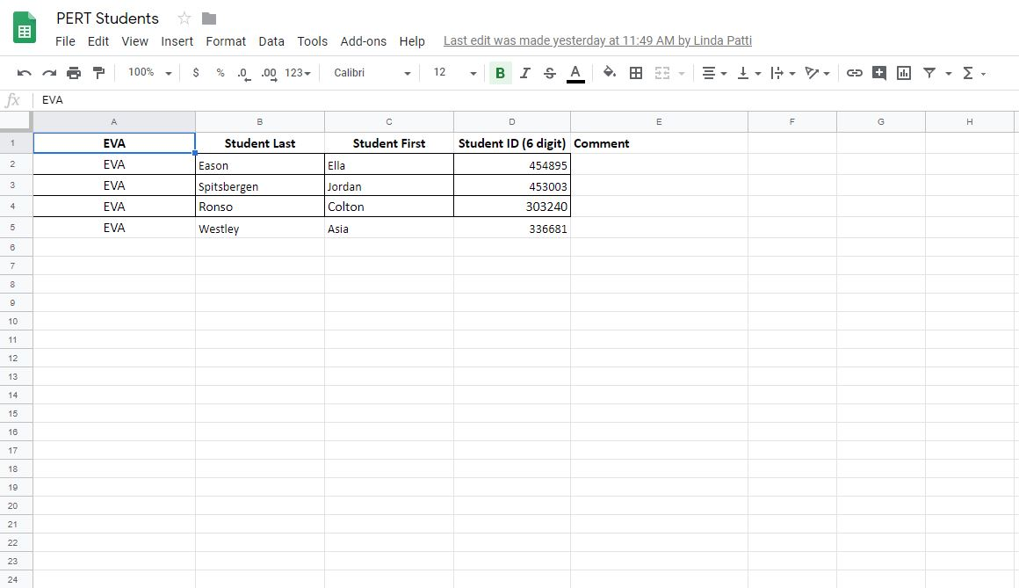
Before Testing
Student Upload Request Form
  Enter student info on Google Doc at any time
  Eval will upload twice a month (1st and 15th)
  If you do not have access, email Heather Rykard
Notes:
Please ensure that you are entering correct student information – there can be multiple same named students. A few years ago, we had a student who passed the PERT, but the school had uploaded the incorrect student (7+ yr ago grad) with same name. Don’t forget that we do not delete students from your college success accounts.

Slide 11
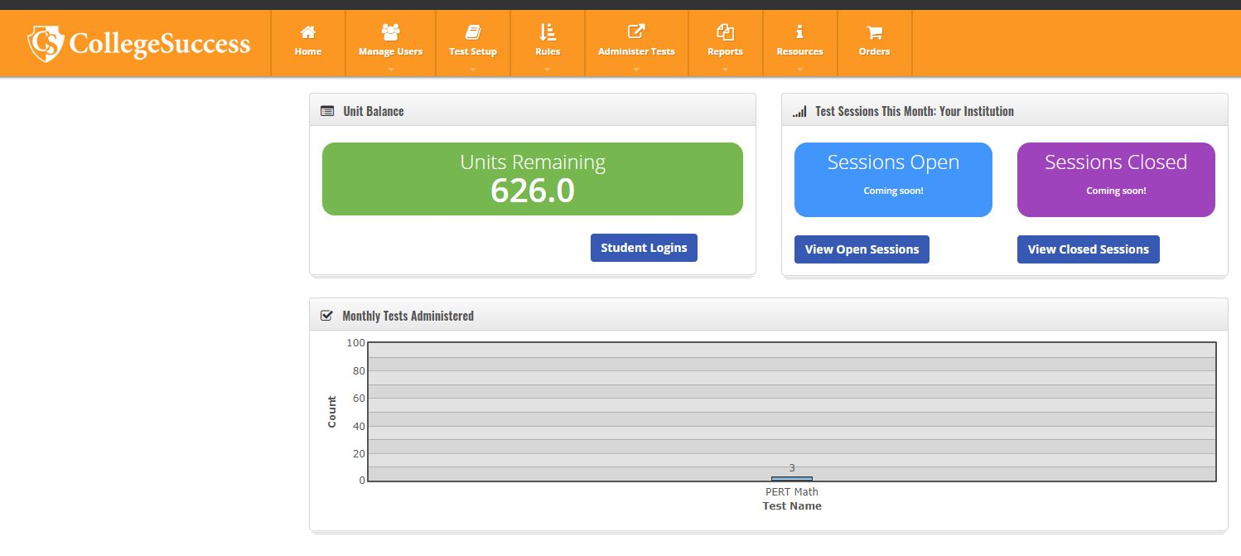
Before Testing
Testing Units
  Check to make sure you have enough testing units
  Found on your dashboard in College Success
  Each subtest = 1 testing unit
Notes:
If you need more units, please let us know in advance of your testing date.

Slide 12
Before Testing
Activate Students
  Students are inactive when uploaded
  Go to “Administer Tests” → “View and Export Student Logins”
  Select students to activate by selecting the box by their name and choose the “Activate Students” button at the bottom of the screen
Notes:
Make sure you deactivate after testing so students cannot log in outside of school and test.

Slide 13
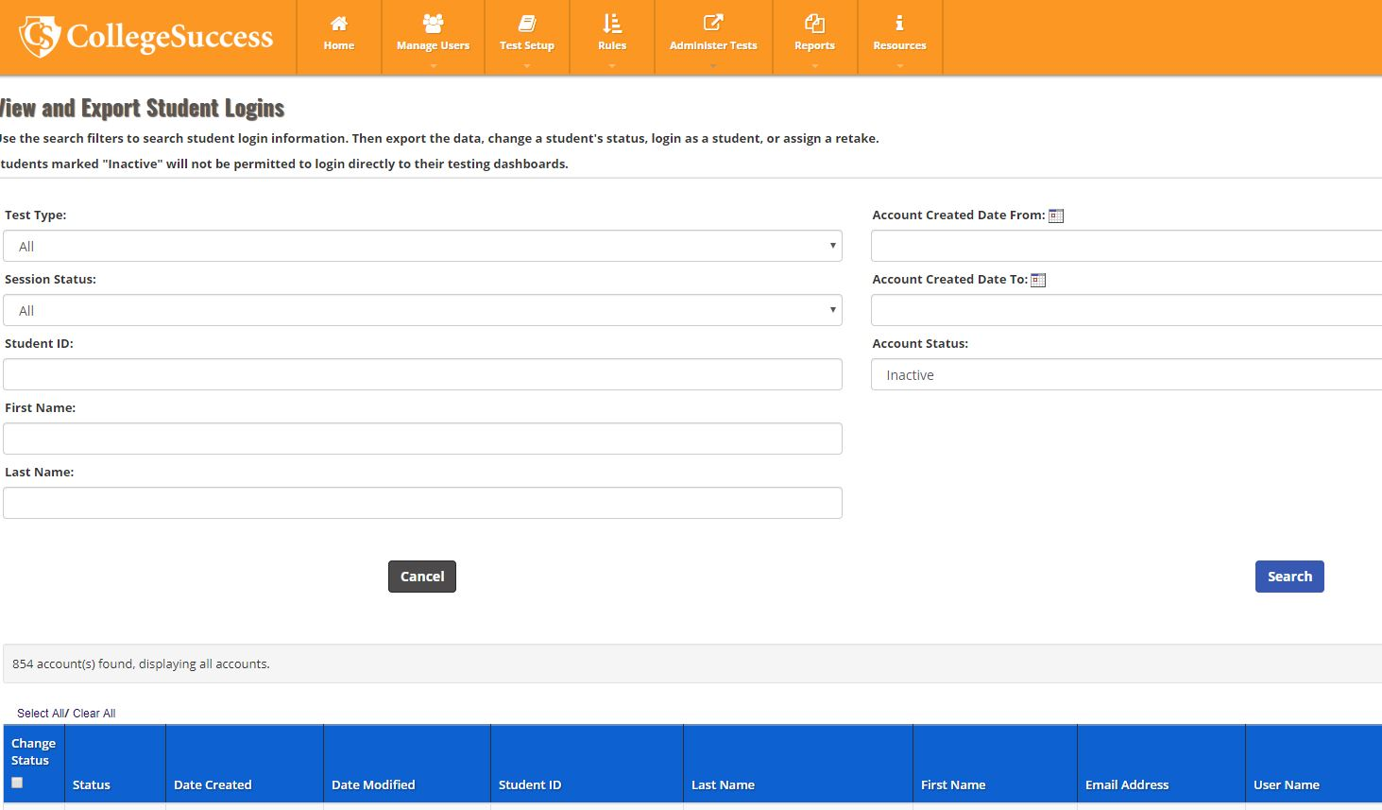

Slide 14
Preparation – Required Materials
Access Codes (emailed as needed)
Script
Authorization Tickets (created by school)
Student Sign-in Sheet
Seating chart
Security Log
Math Scratch Paper
No handheld calculators
* All required items found on Evaluation Services webpage
Notes:
Heather will send out codes every month
Print tickets and have them ready for testing
TA’s collect tickets immediately after students log in – All pages are found on Evaluation services webpage under PERT

Slide 15
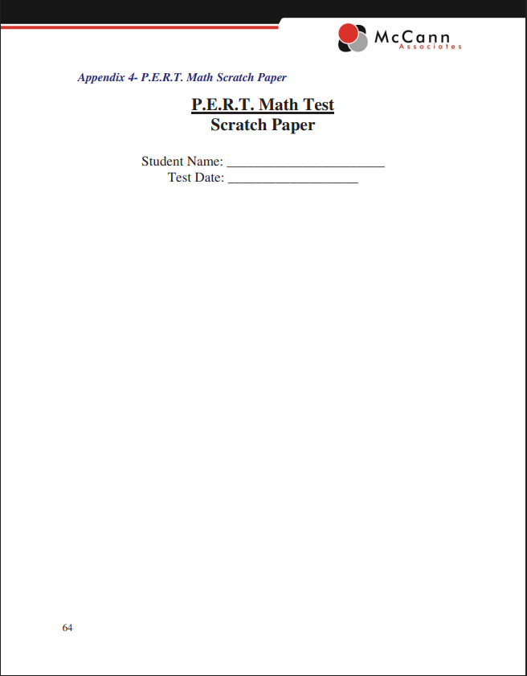
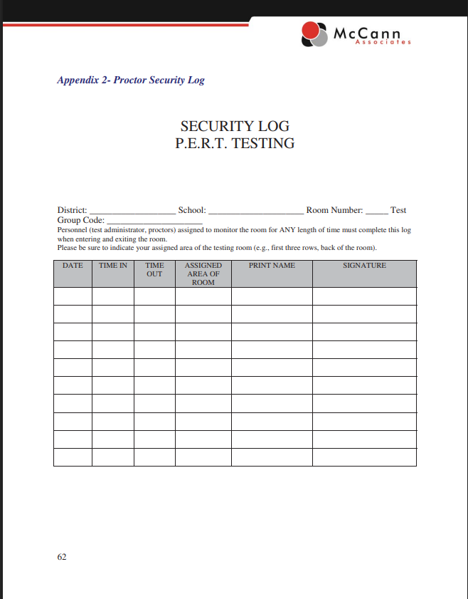
Materials
Notes:
Please make sure to use these pages as they are specific to PERT

Slide 16
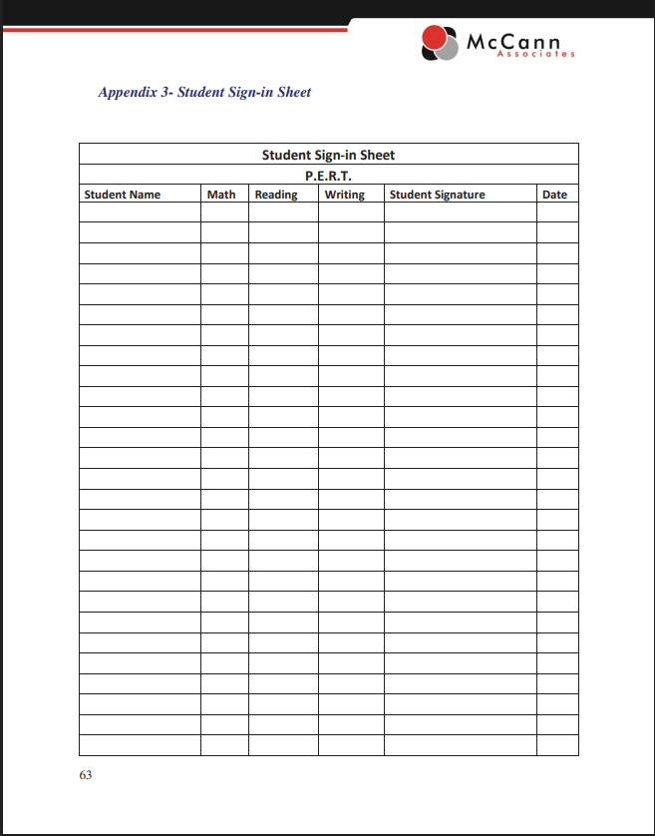
Materials

Slide 17
Before Testing – Adding Users
As a Site Manager, you can create other user accounts at your school
You can create users as a Proctor or Reporter
Proctors can administer the PERT, while Reporters can only see scores
Creating New PERT Users

Slide 18
Test Day
Have students sign in upon entry
Ensure you make a seating chart – *District required
Take up electronic devices
Make sure students have logged in with the CBTxxxx account, not their own
Read the script
Take up log in tickets once students are logged in
Make sure you are using correct month’s access codes

Slide 19
After Testing
Exit out of secure browser (Windows only)
This is a secure password and MUST NOT BE ENTERED BY THE STUDENT
Students may only test once a week
Students may only take each subtest once in a 7 day period. Please coordinate with your guidance department to keep up with outside PERT Referral Forms (used for PSC Testing).

Slide 20
After Testing
Secure items held at school until end of year
  Security agreements
  Authorization Tickets
  Student Sign-in sheets
  Seating charts
  Security Logs
  Math Scratch Paper

Slide 21
After Testing
You may run a report to show a student his/her score, if requested
Evaluation Services will upload scores into FOCUS – notify Heather and/or Scott that your school has completed testing

Slide 22
Running a Score Report
From the dashboard, select “Reports” from the top menu
Choose “Standard Reports” and then “Individual Score Report”
Many items are pre-filled.
Select the date or timeframe you want to see
If you do not enter a student’s name into the search boxes, the report will show all students who have tested in your selected timeframe

Slide 23
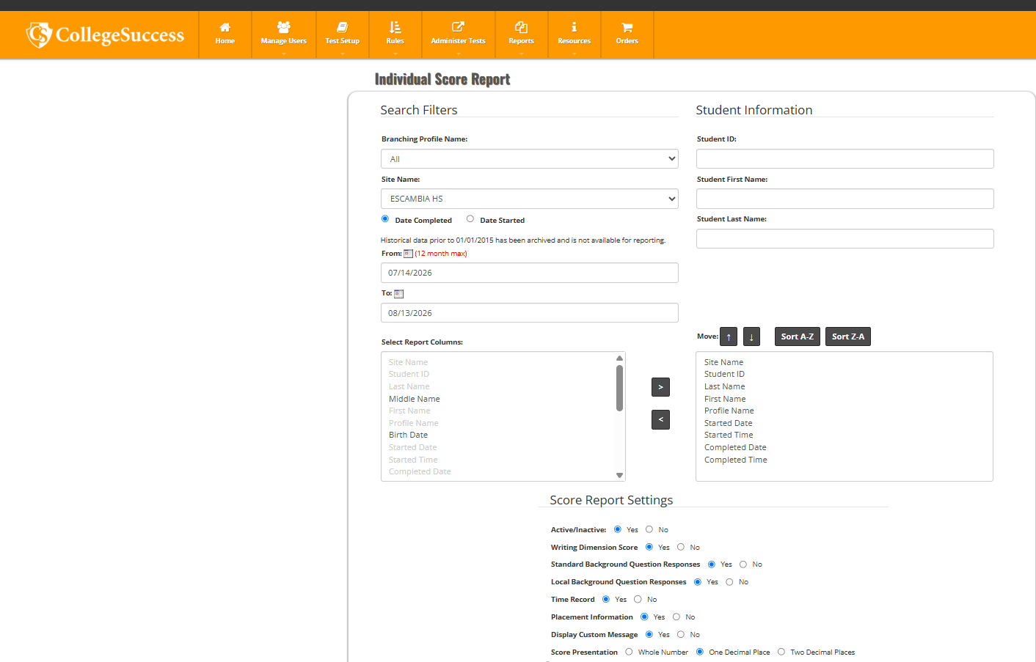

Slide 24
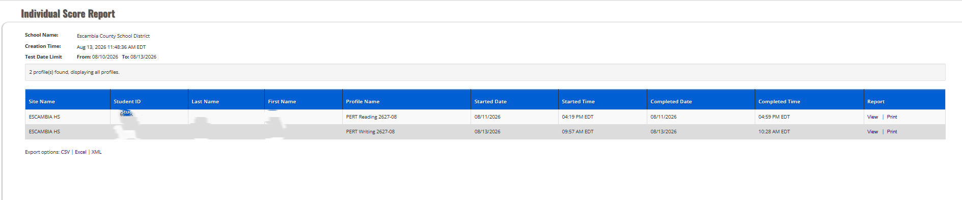
Score Report Results
Scores are not displayed – you will have to click the “View” or “Print” button to display/print score report
If you want a report that shows scores, you can create a “Custom Report” from the Reports menu

Slide 25
QUESTIONS?
Heather Rykard, TSA
850-469-5387
hrykard@ecsdfl.us

