Slide 1


Welcome
Class of 2030!
2026-2027

Slide 2

WE ARE CENTENNIAL!
...Centennial High School will foster successful learners in an ever-changing world.​
​
… Centennial High School will provide an environment where students can succeed intellectually, emotionally, and socially in high school and beyond.

Slide 3

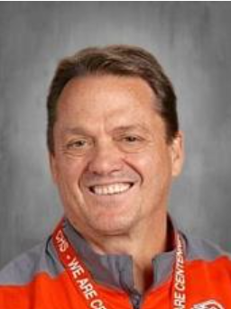



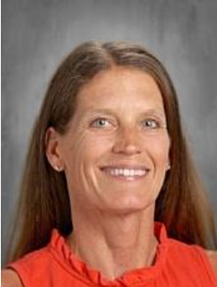
Your Administrative Team
Tom Breuning​
Principal​
tbreuning@isd12.org
Matt St. Martin​
Activities Director​
mstmartin@isd12.org ​
Ben Fuller ​
Assistant Principal ​
A-K, Y & Z​
bfuller@isd12.org
Breanna Peloquin ​
Assistant Principal​
L-Q ​
bpeloquin@isd12.org
Kristin Hilger​
Assistant Principal​
Special Education​
khilger@isd12.org

Slide 4
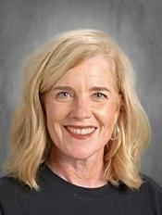



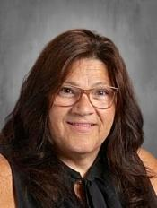
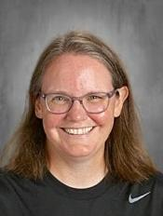
Your Counseling Support Team
Heather Trettel
Counselor
A-D, Y & Z
Kelli Hillestad
Counselor
E-K
Sarah DiMartino
Counselor
L-Re
Angie law
Counselor
Rf-X
Deanne Miller
Counseling Secretary
Lori Guyer
Career Center Specialist
Notes:
Needs works

Slide 5



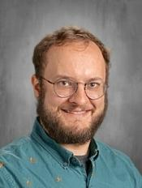
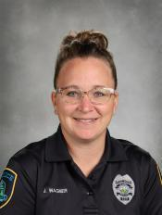


Your Support Services Team
Kimberly Hartert
Academic & Attendance Specialist
Cory Reisdorfer
Lead Teacher
Michael Tomten School Psychologist
Jackie Wagner
School Resource Officer
Stephanie Spencer
Indian Education Coordinator
Dani Bevins
Student Assistance Coordinator
Notes:
Needs works

Slide 6


Kathy Berrios Cordero
Last Name, A-Har & Spanish Families
Centennial High School
KBerrios_Cordero@isd12.org
STUDENT & FAMILY ADVOCATES
Ramla Iman
Last Name, Has-Pa & Somali Families
Centennial High School
RIman@isd12.org
Matthew Thao
Last Name, Par-Z & Hmong Families
Centennial High School
Mthao@isd12.org

Slide 7

COMMUNICATION
Email: School Messenger/Cougar News
Online: isd12.org
Online communication tools: Schoology & Parent Portal
Twitter: @CHSAnnouncement
Phone: 763.792.5000

Slide 8

STANDARD SCHOOL DAYS
Period 1 | 52-minute classes | 7:55 – 8:47
Period 2 | 52-minute classes | 8:54 – 9:46
Period 3 | 53-minute class | 9:53 – 10:46
LEAP Hour | Lunch: Cougar Connect: 9B | 10:46 – 11:46
Period 4 | 52-minute class | 11:53 – 12:45
Period 5 | 52-minute class | 12:52 – 1:44
Period 6 | 52-minute class | 1:51 – 2:43

Slide 9

What is LEAP?

Slide 10

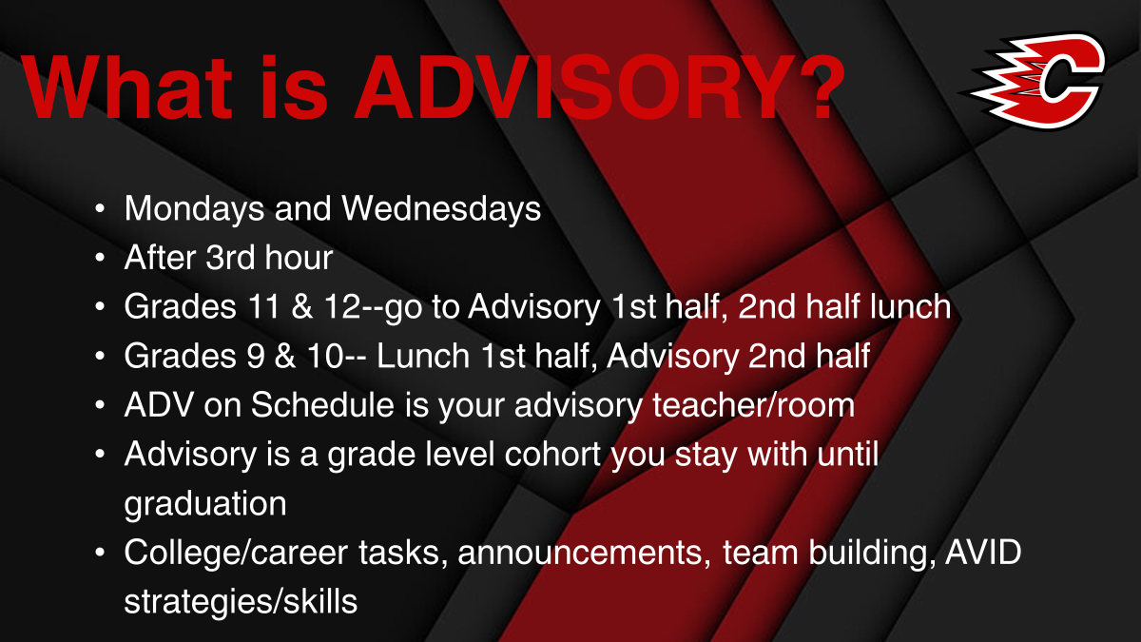
Needs to be changed

Slide 11
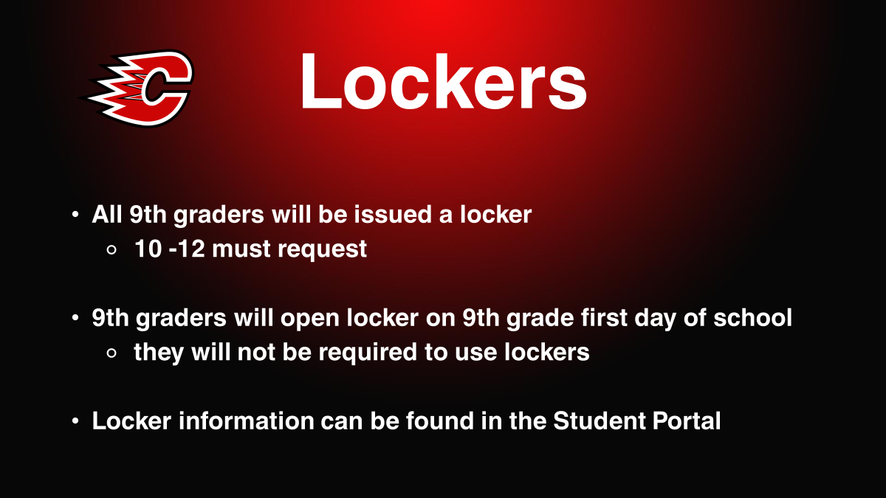

Slide 12
Cell Phones & Technology
To maximize learning opportunities for students and to encourage our students to be safe, respectful, and responsible, CHS has the following guidelines for students.
RED Zones are times and places when cell phone use is unacceptable, and they should be put away, silenced, with notifications turned off and/or placed in a location determined by a teacher’s classroom procedures.
GREEN Zones are times and places when cell phone use is acceptable.

Slide 13
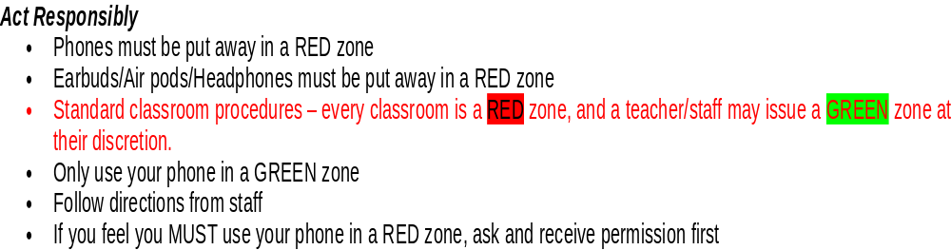
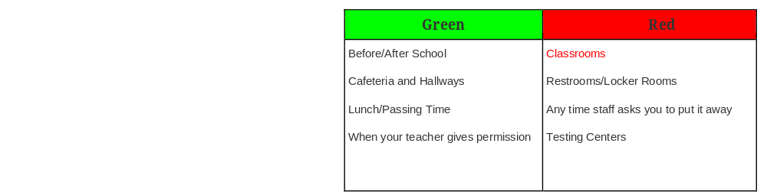

Slide 14
Start the Year off Right!
How can I be successful in high school?
Be organized – planner/folders/notebooks ready before bedtime
Manage you time – make “to do” lists, figure out when/where you study best
Be successful in the classroom – be present, do your work everyday, participate, ask questions, use Schoology
Take good notes – pay attention to the teacher, write down important info, make your notes easy to read, if absent ask friend/teacher for copy of notes

Slide 15
Start the Year off Right!
How can I be successful in high school?
Use test taking strategies – read directions carefully, budget your time, answer easy questions first
Study Smart - study each day, explain concepts out loud, make flashcards
Get involved – activities, clubs, music, sports, groups
Show up and be present – attendance matters!
Dress appropriately
Have fun!

Slide 16


Slide 17


Slide 18
Reminders
The first week of school, you will attend your Cougar Connect class every day after 3rd hour
Cougar Connect meets every Wednesday after 3rd hour
LEAP is Monday, Tuesday, Thurs, and Friday after 3rd hour
On LEAP days 9th graders eat lunch in classrooms, cafeterias and the Student Union
Take a picture of your bar code for faster access in the cafeterias

Slide 19
BUSES
Bussing Cards will be mailed late this week
and early next week
If you do not receive a card, call or email:
612-789-5143
transportation@isd12.org
All buses go to the middle school at the end of the day,
students can get on any bus in the afternoon.

Slide 20
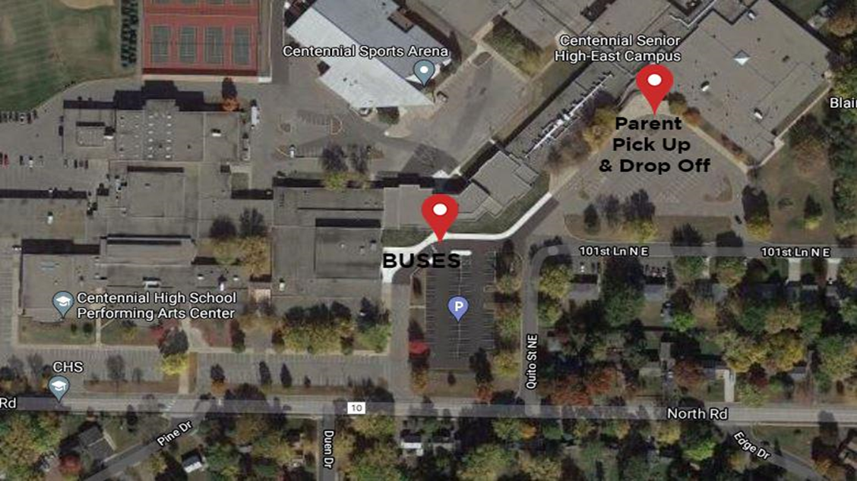
Bus Drop Off/Parent Pick Up

Slide 21
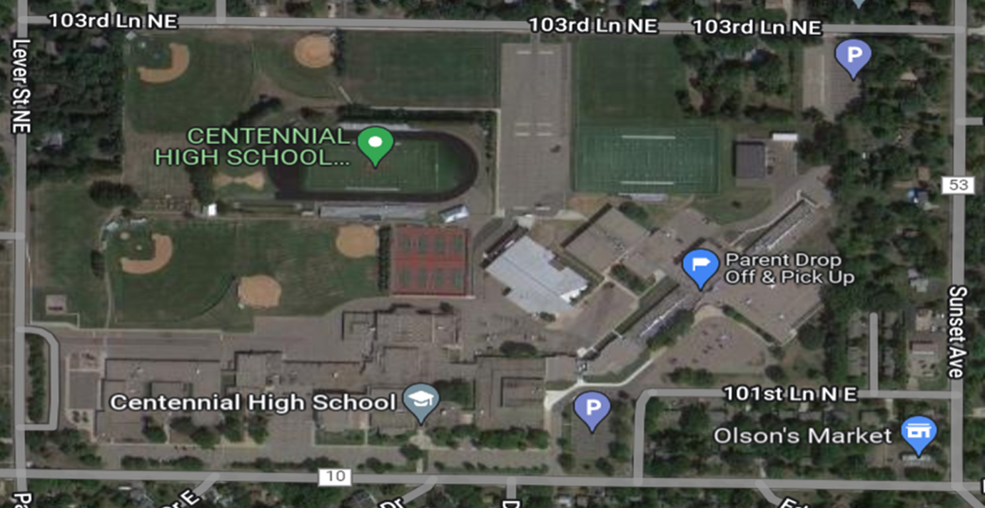
WELCOME TO CENTENNIAL HIGH SCHOOL

Slide 22
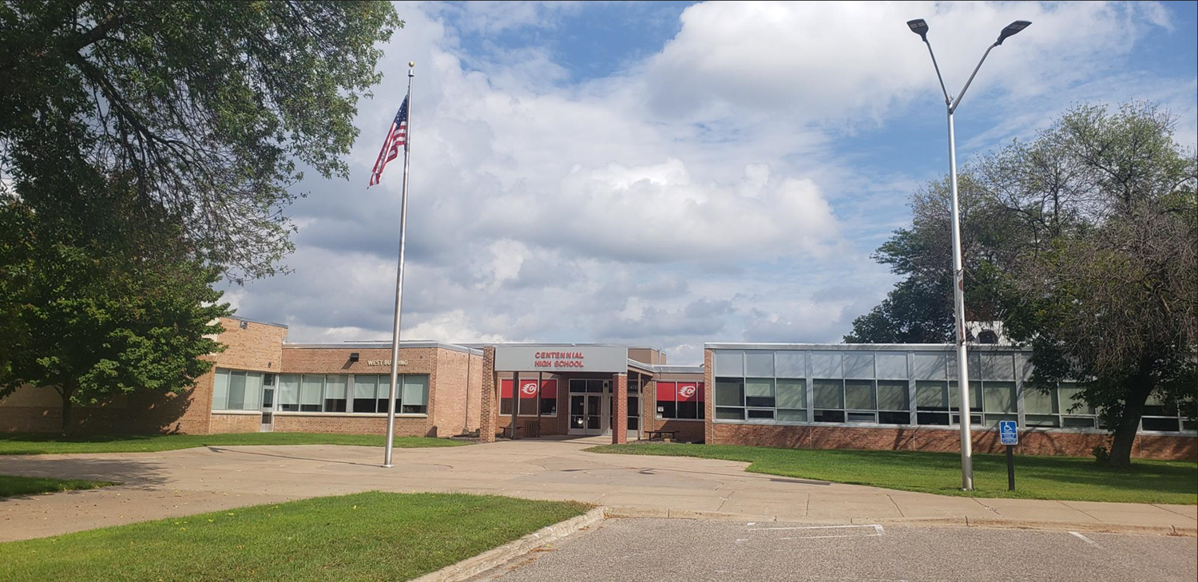
WEST ENTRANCE & COUNSELING OFFICES

Slide 23
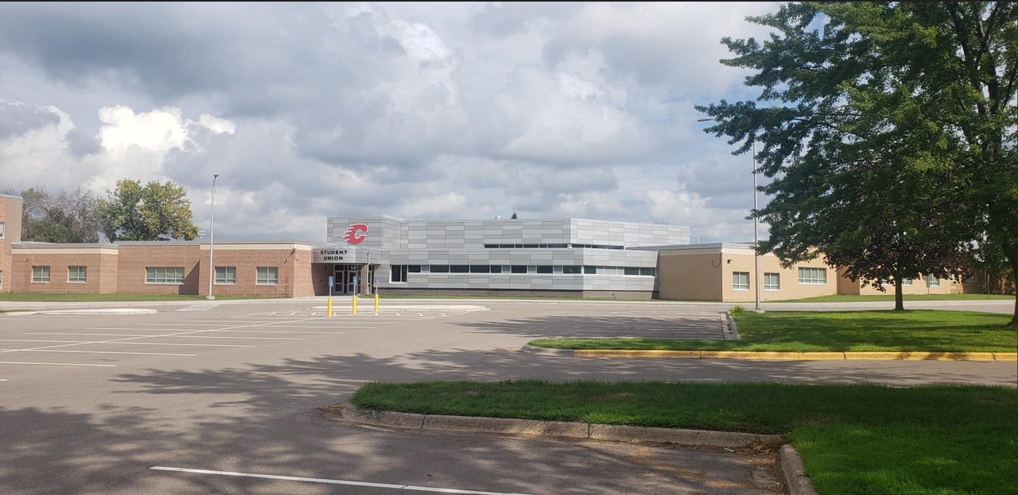
STUDENT UNION & BUS ENTRANCE

Slide 24
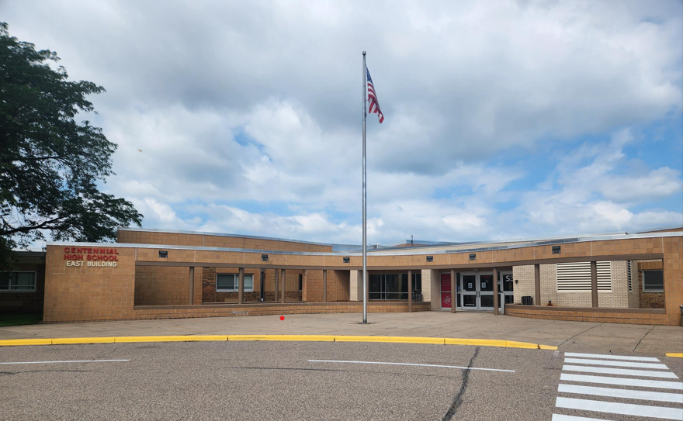
EAST ENTRANCE & PARENT DROP-OFF AND PICK-UP

Slide 25
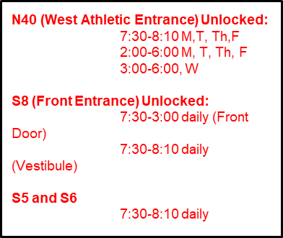
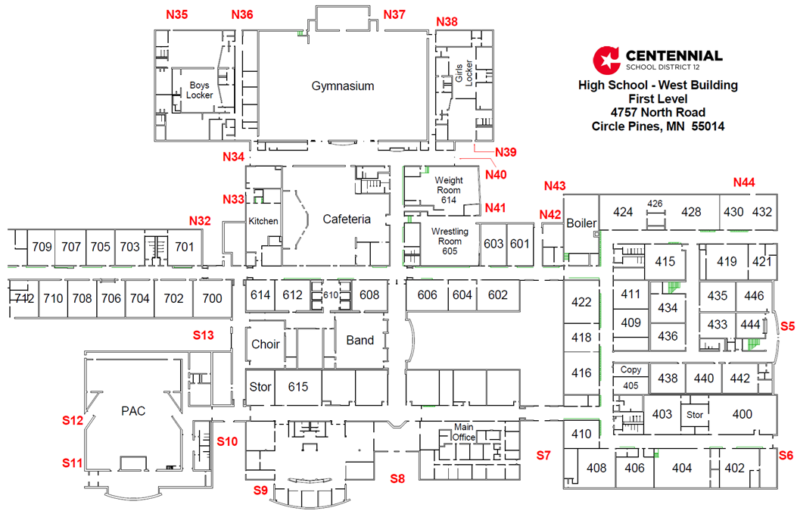
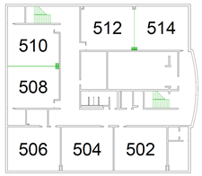


WEST WING
Entrance to East Wing

Slide 26
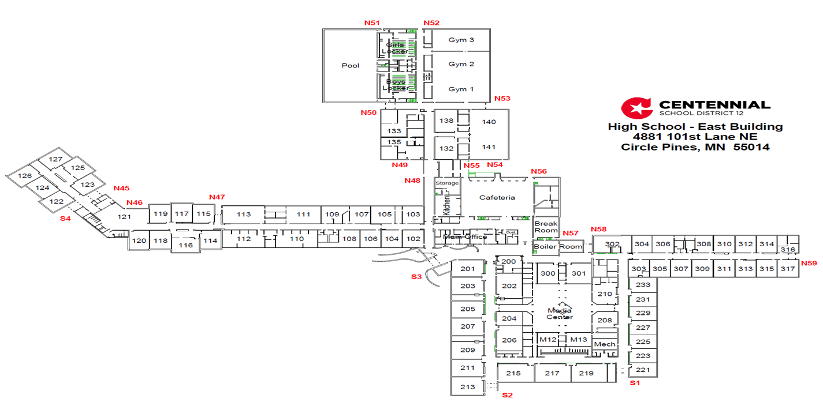

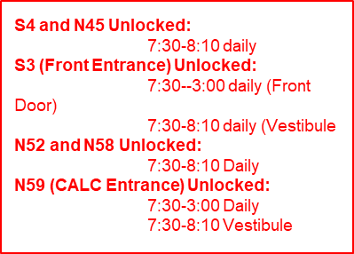
EAST WING

Slide 27


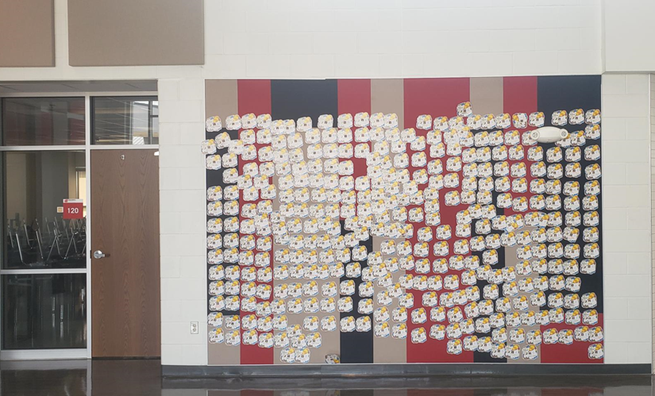
CLASS OF 2026 – SENIOR DECISION DAY
Oh, the places you’ll go!

Slide 28

GENERAL QUESTIONS
PEER LEADER ASSISTANCE AVAILABLE

