Slide 1
O’ Fallon Township High School AFJROTC
1st Year Cadet Orientation

Slide 2
Welcome
Senior Aerospace Science Instructor: Colonel Emily Derry
Aerospace Science Instructor: MSgt (R) Brooke Alf
Top 3- Command Team
  Corps Commander: c/Col Carroll
  Deputy Corps Commander: c/Lt Col Dorfner
  Command Chief: c/CMSgt Warr

Slide 3
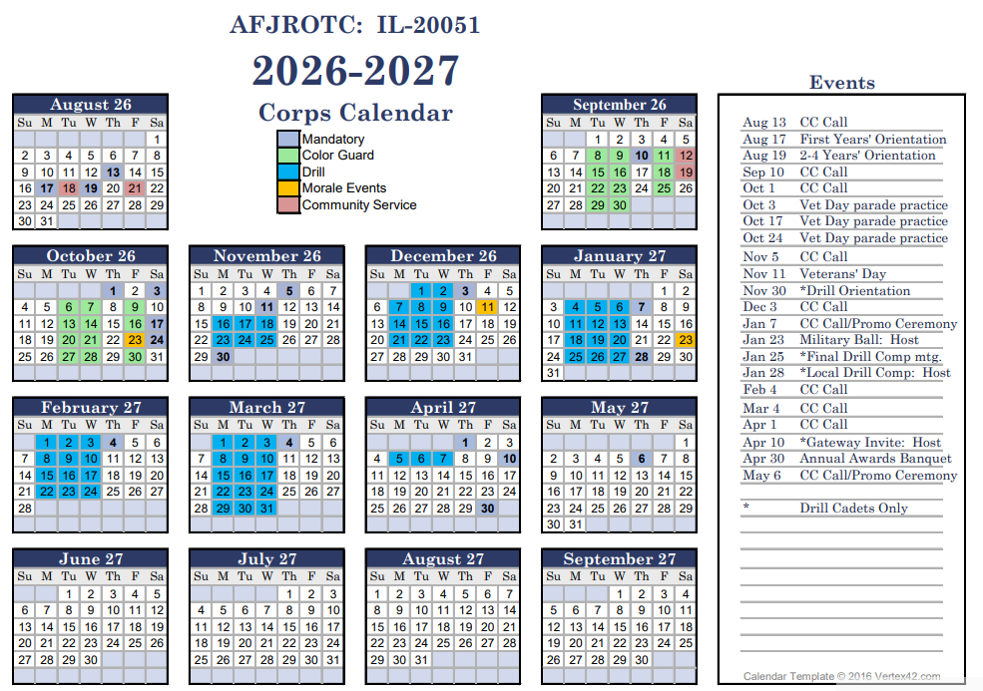

Slide 4
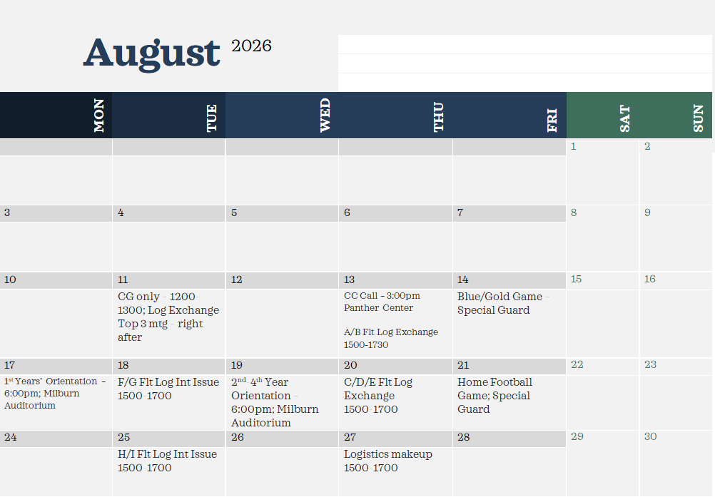

Slide 5
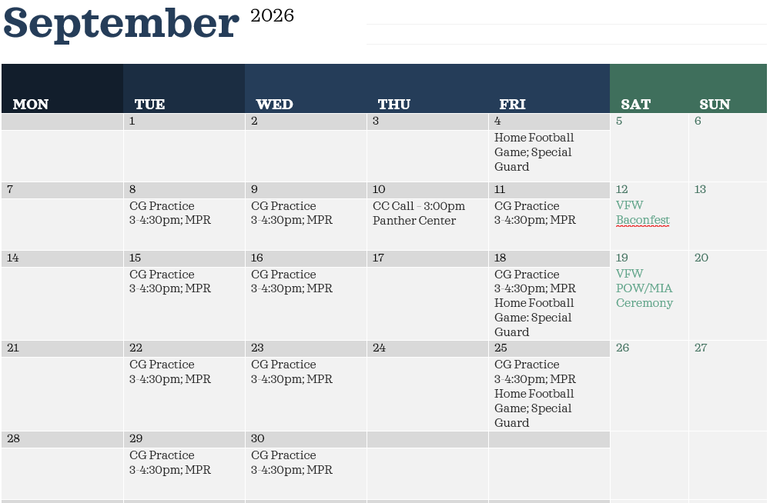

Slide 6
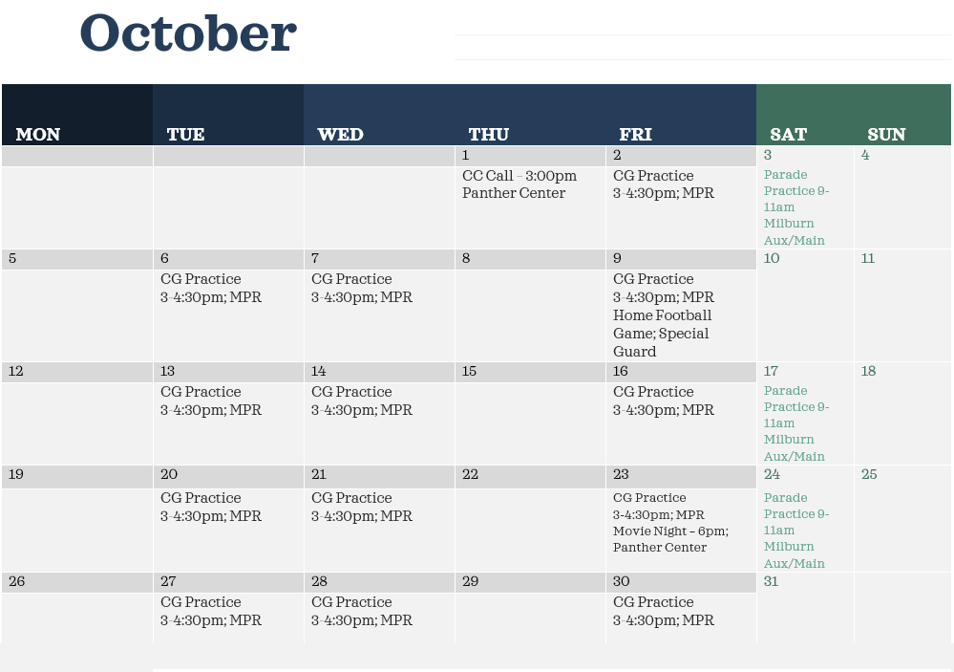

Slide 7
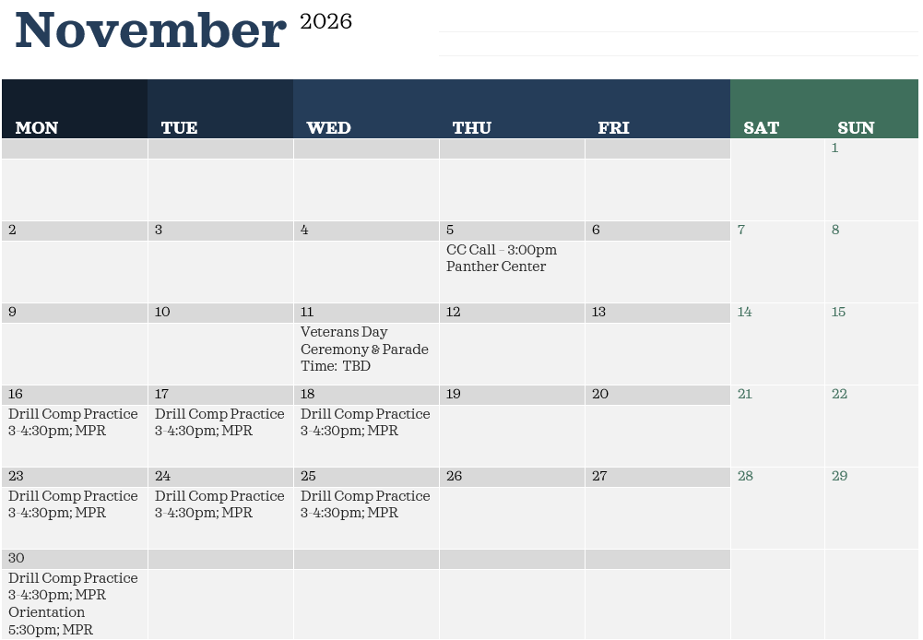

Slide 8
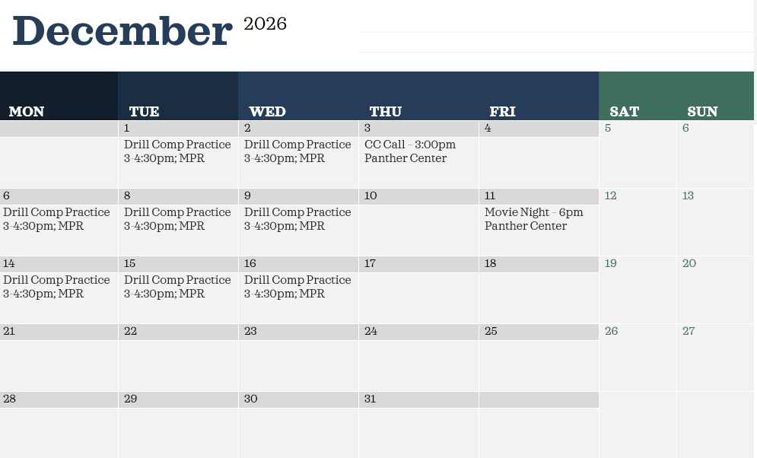

Slide 9
Disenrollment Policy and Mandatory Forms
Cadet Disenrollment Policy Memo Review
DD Form 3203
AFJROTC Supplemental Participation Form/Health Screening Questionnaire
Uniform/Personal Grooming Policy Acknowledgement
  $25.00 Activity Fee; checks made out to OTHS AFJROTC please
Due Tuesday 18 Aug 26

Slide 10
Cadet Assessments
40/40/20 Curriculum
  Leadership Education
  Aerospace Science
  Wellness
Grading Scale
Uniform Requirements/Inspections
Extra Credit
Fitness Assessment

Slide 11
Community Service
Cornerstone Church
VFW BaconFest
POW/MIA service
Veteran’s Day Parade
Canned Food Drive/Homecoming Candy Drive
Smiley Street Clean-up

Slide 12
Extracurricular Activities
Color Guard
Drill Team
Aviation
  Model Rocket
  Drones
Raider/PT Team
Kitty Hawk
APT
Orienteering
Bataan Death March

Slide 13
Booster Club
President: Jeremy Carmichael
Vice President: Vacant
Secretary: Vacant
Treasurer: Joseph Johnston
Activities Coordinator: Amber Dercks

Slide 14
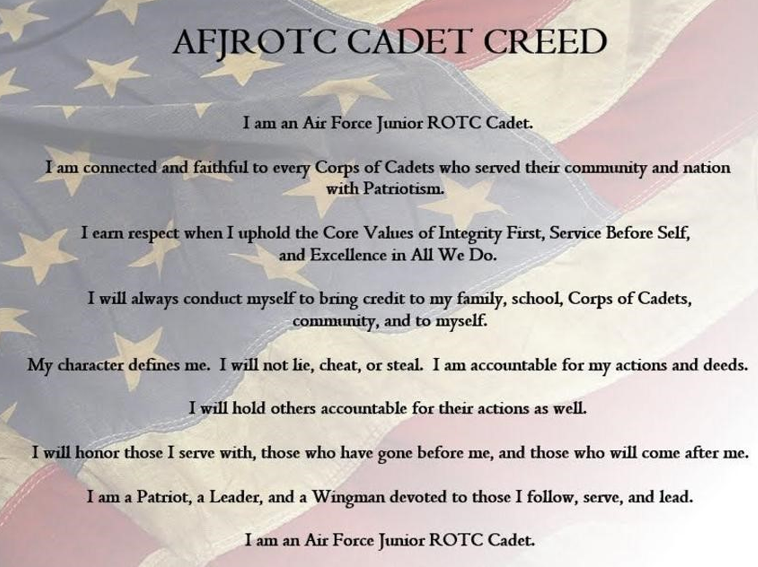

Slide 15
Questions

Slide 16
Flight Commanders, Dismiss Your Flights

