Slide 1



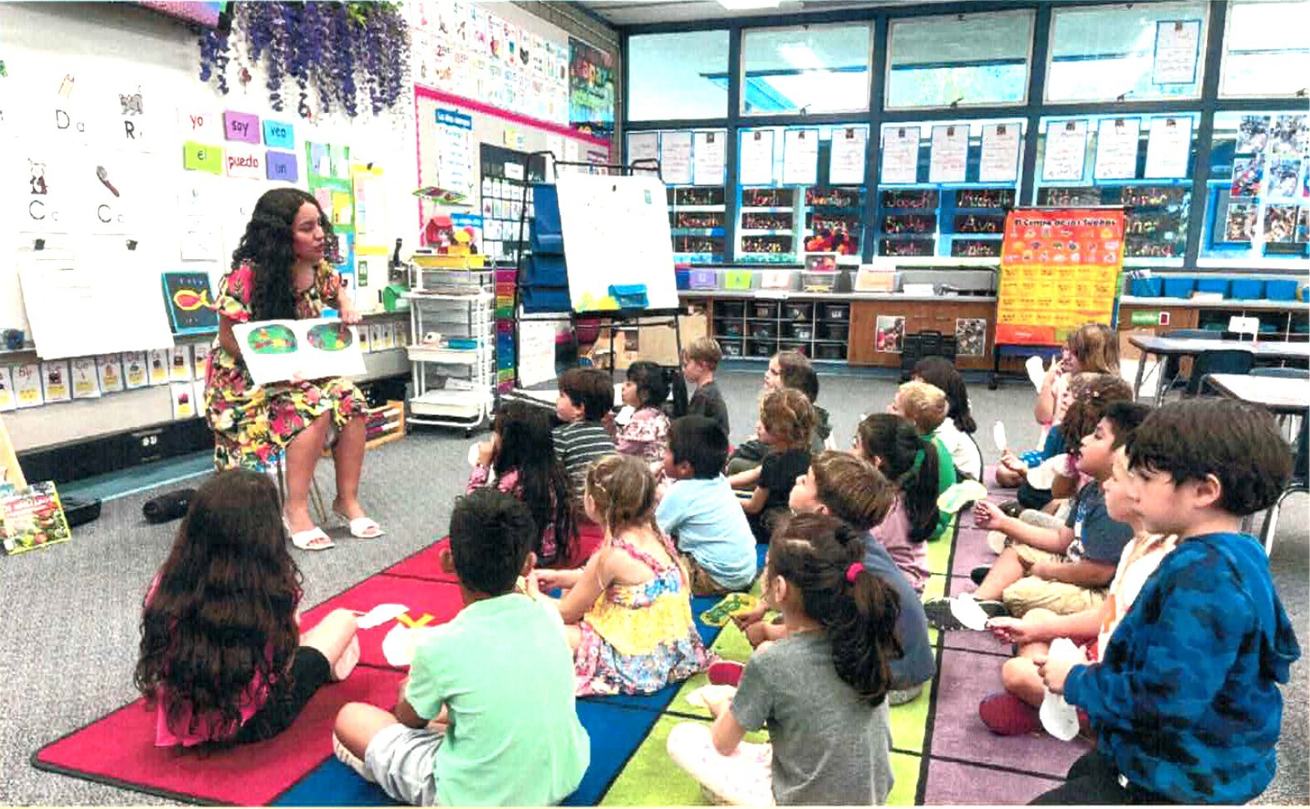

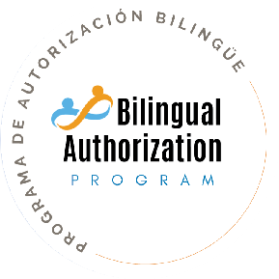
Bilingual Authorization Program (BAP)

Slide 2
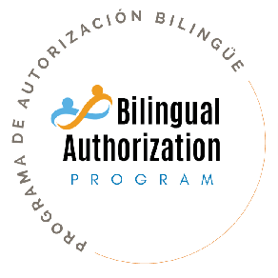
□Program Overview
□Admissions Requirements
□Application Procedures
□Course Schedules

Slide 3
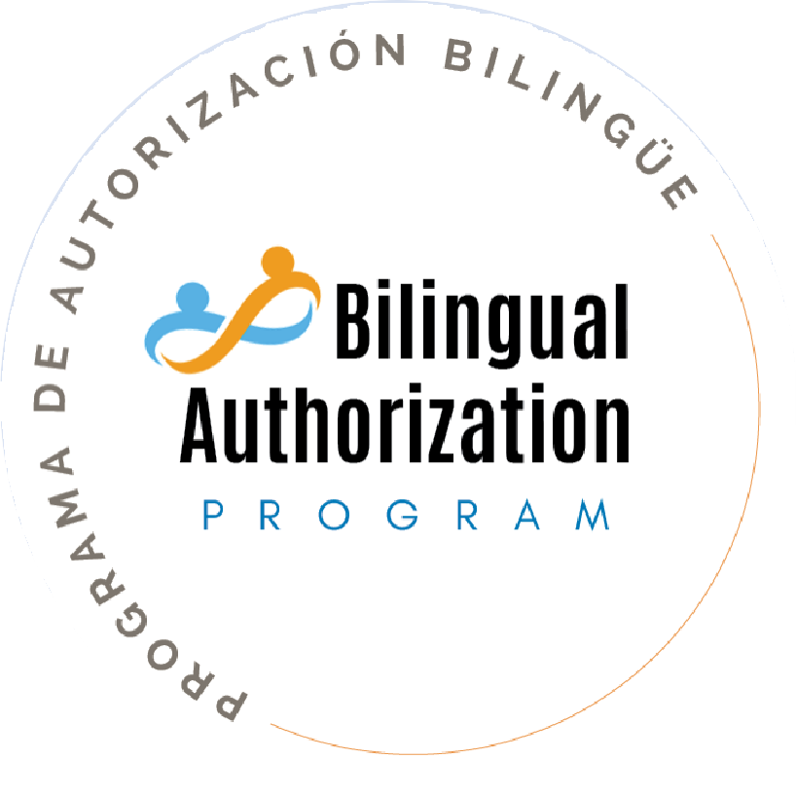
PROGRAM OVERVIEW

Slide 4
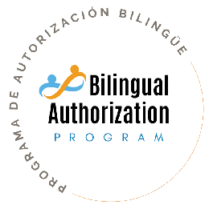
The Bilingual Authorization permits holders to provide students the following:
What is the Bilingual Authorization?
Instruction for English (ELD) and Primary Language Development
Specially Designed Academic Instruction Delivered in English (SDAIE)
Content Instruction Delivered in the Primary Language

Slide 5
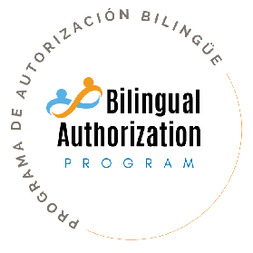
Growing number of English Learners (Newcomers)
High demand for teachers with bilingual authorizations to teach in dual language immersion programs
Why should I pursue the Bilingual Authorization?

Slide 6

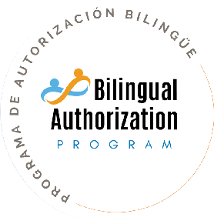
TWO-TERM PROGRAM for post-credential or in-service teachers who are interested in adding a bilingual authorization to their credentials.
BEGINS during the summer with coursework and ends in either fall or spring term with a fieldwork experience.
THREE REQUIRED COURSES address the Bilingual Teaching Performance Expectations (BTPEs).
FIELDWORK EXPERIENCE component of the program, 20 hours minimum, takes place in a bilingual classroom.

Slide 7
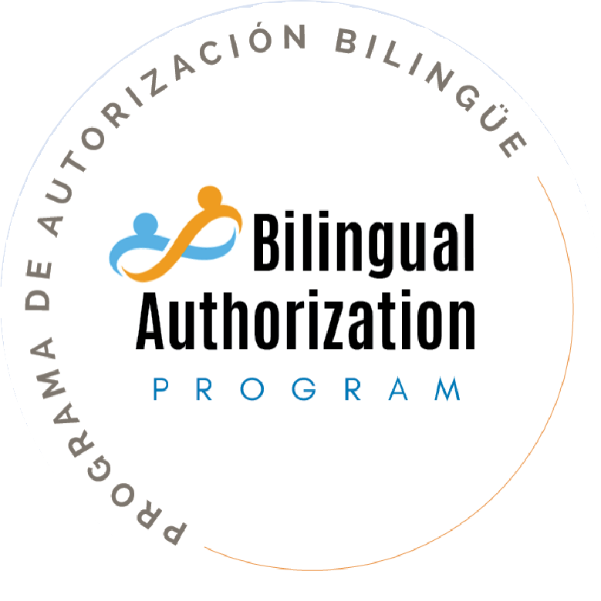
ADMISSION REQUIREMENTS

Slide 8

Prerequisite Credential Candidates must hold or be recommended for a prerequisite
ADMISSIONS REQUIREMENTS
credential. The prerequisite credential must include or be eligible for an English Learner authorization.
Language Proficiency
Additionally, applicants must demonstrate proficiency in Spanish. Language proficiency may be demonstrated with passing scores on the CSET Spanish Subtest III.

Slide 9
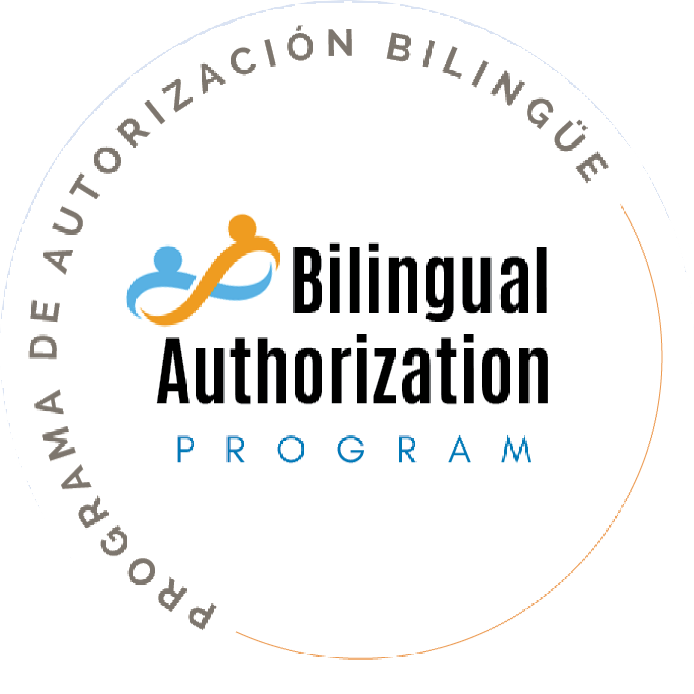
APPLICATION PROCEDURES

Slide 10
Applying for the Bilingual Authorization
Program
STEPS:
Register and complete CSET Assessment
Start Program Application
Submit CSET scores with application
(BAP)

Slide 11
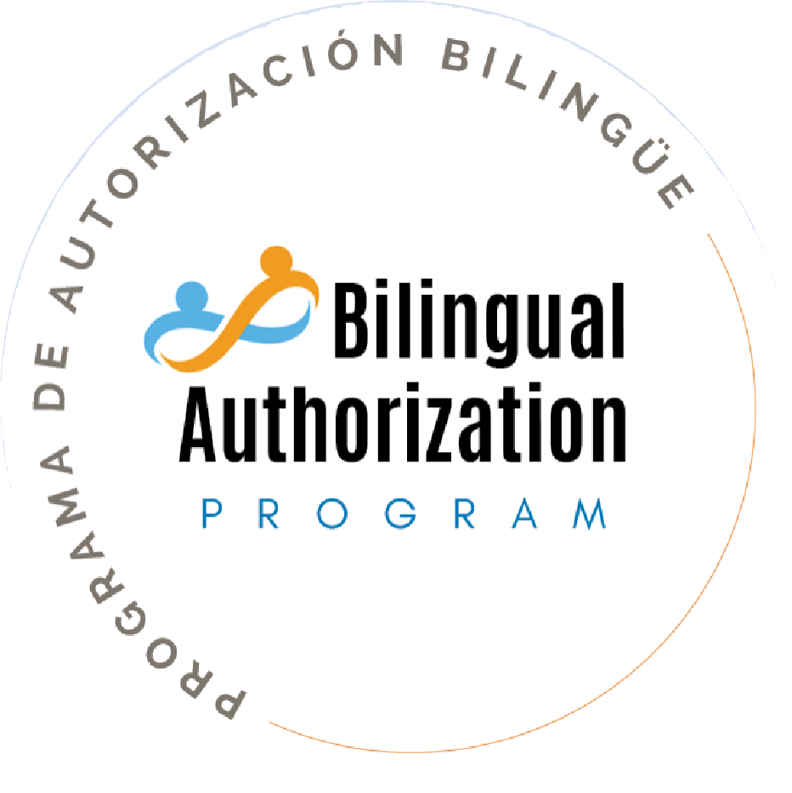
START AND COMPLETION DATES
LOCATION

Slide 12


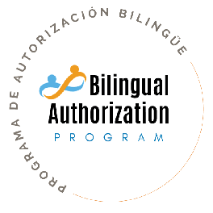
START DATE: Tuesday, July 6, 2027
(9:00 AM – 3:00 PM)
COMPLETION DATE: Fall 2027 or Spring 2028
LOCATION: Santa Barbara County Education Office

Slide 13
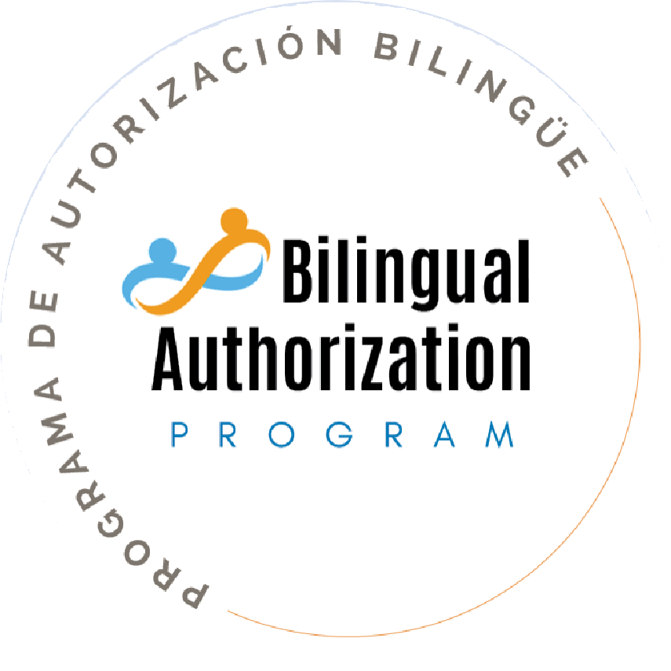
COURSE SCHEDULES

Slide 14


